Slide 1
Short range wakefield of the crab cavity
Toshiyuki OKUGI, KEK
IDT WG2 crab cavity meeting
2021/09/15

Slide 2
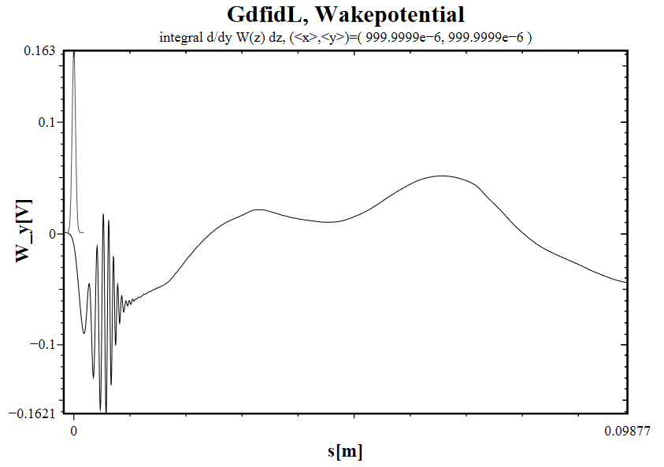
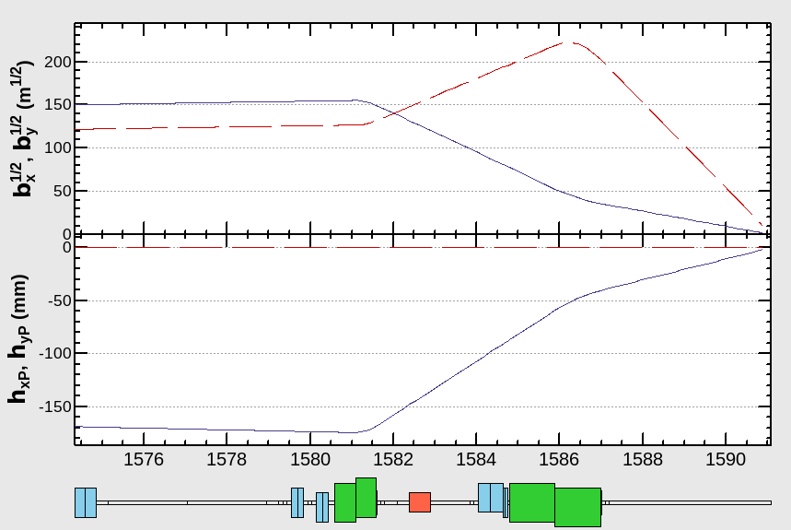
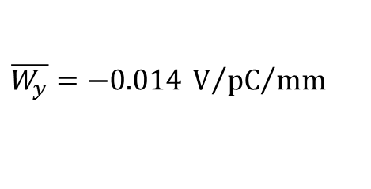
Shot range wakefield of the crav cavity
The short range wakefield was put to the ILC BDS optics deck (Ebeam=125GeV).
$$\overline{W_{y}}=−0.014 {{\text{V}}/{\text{pC}}}/{\text{mm}}$$
Crab cavity
Wakefield calculation by Alexey Lyapin by GdfidL
1pC beam
1mm offset
Put the wakefield here !

Slide 3
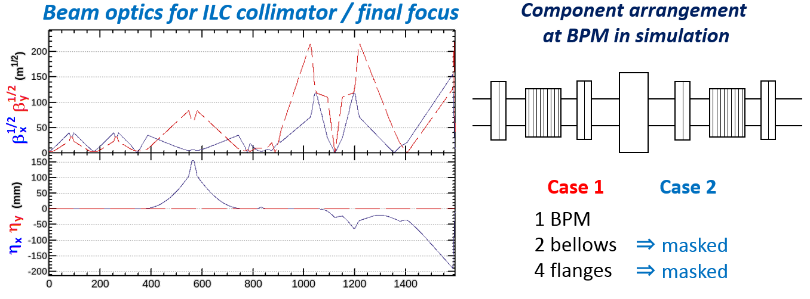
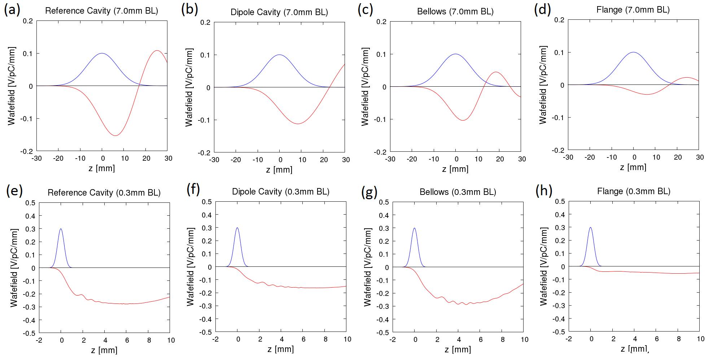
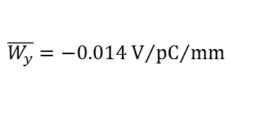
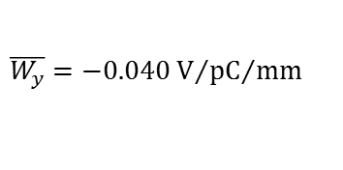
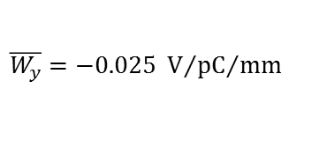
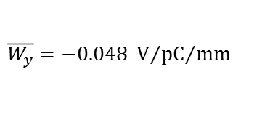
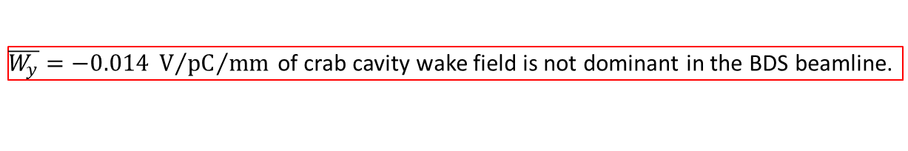
List of the wakefield sources in ILC BDS beamline
Total 107 cavity BPM systems were put into the ILC collimator & final focus beamline as wakefield sources .
Case 1 wakefield condition :
bellows and flange gaps are not masked.
Case 2 wakefield condition :
cavity BPM wake is only put into beamline.
(bellows and flange gaps are masked.)
Crab
cavity
Locations of many wakefield sources are comparable or larger beta-function than crab cavity.
$$\overline{W_{y}}=−0.048 {{\text{V}}/{\text{pC}}}/{\text{mm}}$$
$$\overline{W_{y}}=−0.025 {{\text{V}}/{\text{pC}}}/{\text{mm}}$$
$$\overline{W_{y}}=−0.040{{\text{V}}/{\text{pC}}}/{\text{mm}}$$
$$\overline{W_{y}}=−0.014{{\text{V}}/{\text{pC}}}/{\text{mm}}$$
$\overline{W_{y}}=−0.014 {{\text{V}}/{\text{pC}}}/{\text{mm}}$ of crab cavity wake field is not dominant in the BDS beamline.

Slide 4
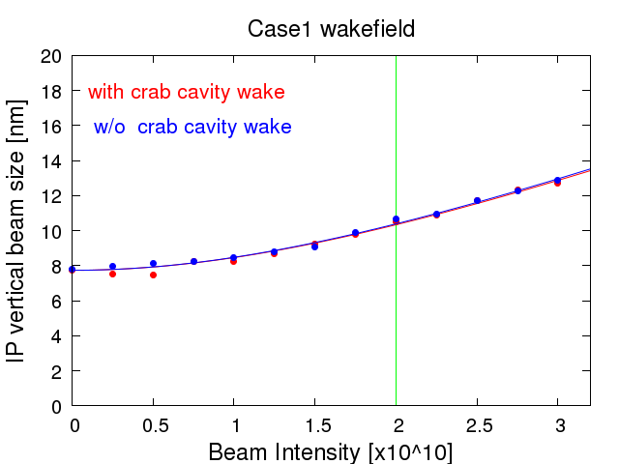
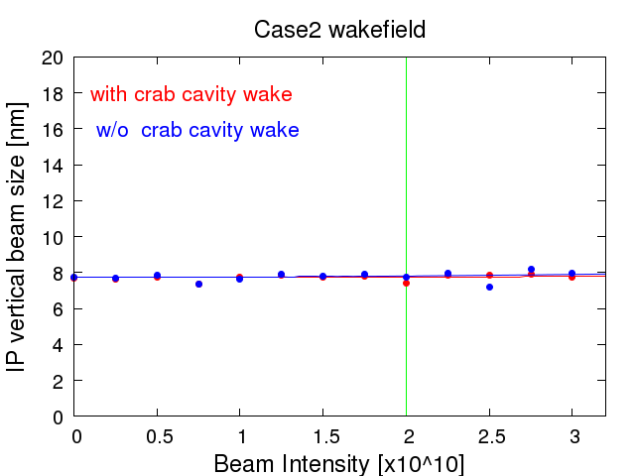
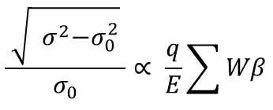
Simulation of dynamic wakefield effect for single bunch beam
Effect of wakefield with orbit distortion (orbit jitter) was evaluated as
q : bunch charge
W : strength of wakefield
E : beam energy
e : emittance
b : beta-function at wake source
$$\frac{ \sqrt{{ σ}^{2}−σ_{0}^{2}} }{σ_{0}}∝ \frac{q}{E}\sum{Wβ}$$
 | W[V/pC/mm]* beta [m]
Crab cavity | -214
ILC Case 1 | -142352
ILC Case 2 (only cavity BPMs in BDS beamline) | -22104
Roughly 1% of
those for cavity BPMs
in ILC BDS beamline
For the dynamic wakefield effect on the single bunch, the simulations did not show any discernible difference with and without the Crab cavity.

Slide 5
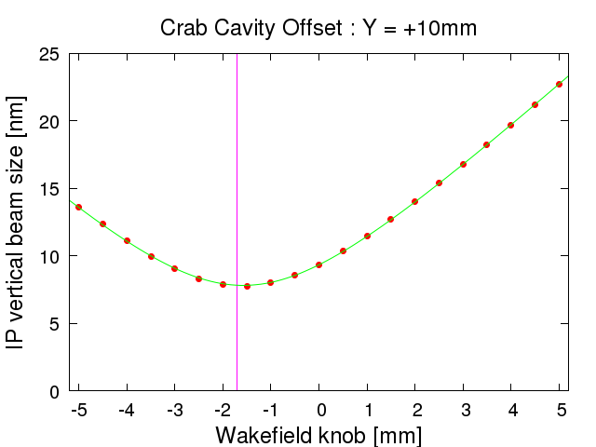
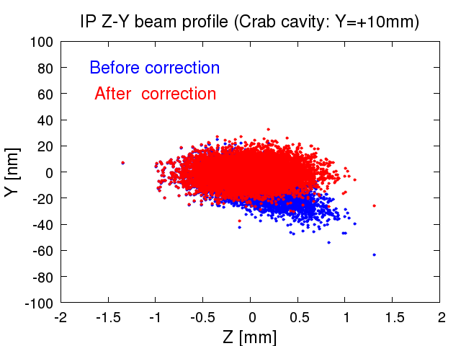
Simulation of static wakefield effect for single bunch beam
Wakefield knob
Crab
cavity
By changing the wakefield source position,
the wakefield of BDS beamline can be cancelled.
Wakefield
Source
Wakefield
source
Wakefield knob was used C-ban reference cavity here.
Put +10mm offset to crab cavity
  - IP vertical beam size was increased 7.7nm => 9.4nm
Apply the wakefield knob by -1.7mm
  - IP vertical beam size was reduced 9.4nm => 7.7nm
The effect of the sigle bunch static wakefield for crab cavity is not significant.
Even if we put 10mm offset, we can correct the effect by using wakefield knob.

Slide 6
Brief summary
The impact of the Crab cavity on the single bunch wakedield is not significantly larger than those of other wakefield sources in the ILC BDS.
Both static and dynamic effects were found to be acceptable in the simulations.
When the short range wakefield is comparable to this sample, we don’t have to consider the short range wakefiel effect.
Considering the large Q-value of superconductivity, I think we need to discuss carefully about the long range wakefield.The amplitude of the beam oscillation shown in the previous meeting, for example, may need to be carefully evaluated.
As for the long range wakefield, it is an issue to investigate in detail the effect of resistive wall impedance in the pre-lab period in addition to the crab cavity.This may be an item to be considered at that time.

