Slide 1
Present ILC FF optics
2021/09/29
Toshiyuki OKUGI, KEK
IDT WG2 DR/BDS/DUMP group meeting

Slide 2
Basic ILC FFS optics design

Slide 3
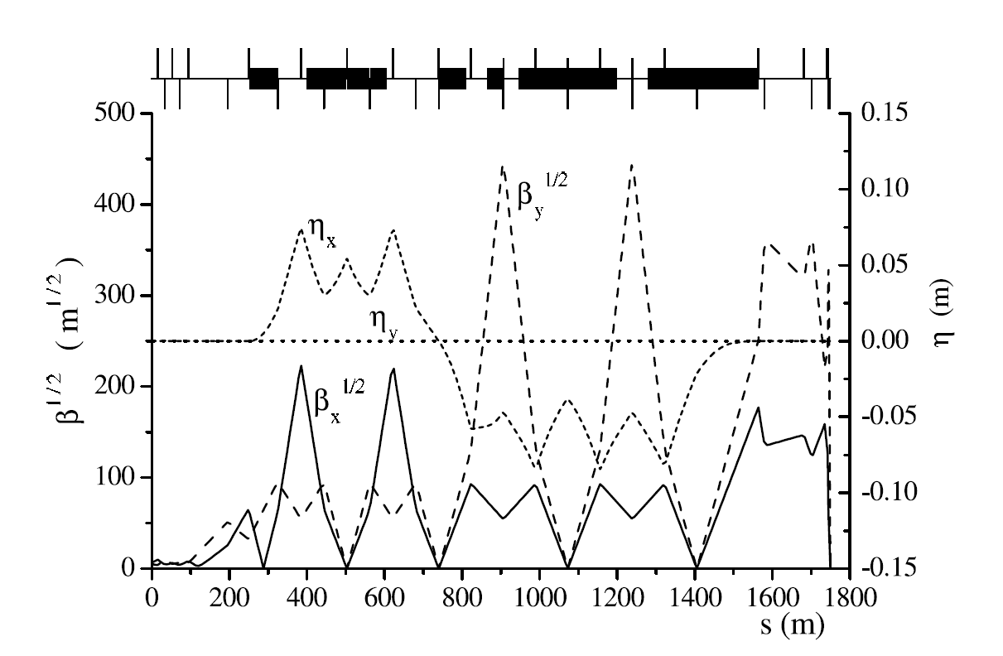
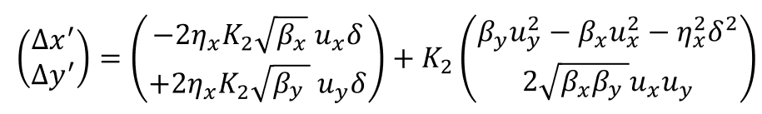
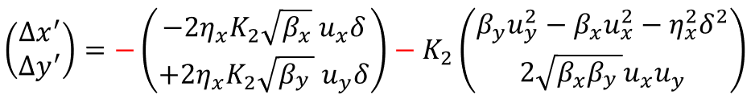
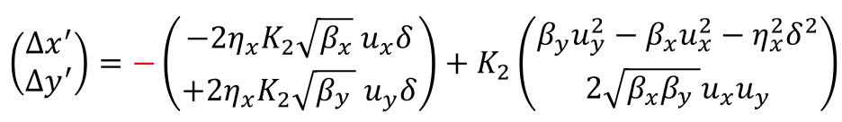
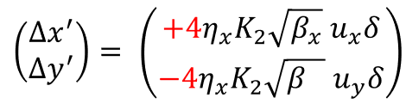



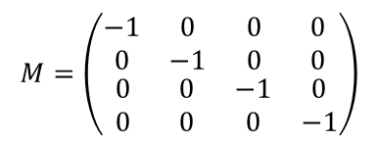



Global Chromaticity Correction System
Linear collider FFS optics in 1990’s
Final Doublet
2 sextupoles are put to the following condition.
Sext-1
Sext-2
$$η_{x}$$
$$\left(\begin{matrix}u_{x} \\ u_{y} \\ δ\end{matrix}\right)⟹\left(\begin{matrix}−u_{x} \\ −u_{y} \\ δ\end{matrix}\right)$$
$$η_{x}$$
$$M=\left(\begin{matrix}\begin{matrix}−1 & 0 \\ 0 & −1\end{matrix} & \begin{matrix}0 & 0 \\ 0 & 0\end{matrix} \\ \begin{matrix}0 & 0 \\ 0 & 0\end{matrix} & \begin{matrix}−1 & 0 \\ 0 & −1\end{matrix}\end{matrix}\right)$$
$$K_{2}$$
$$K_{2}$$
Horizontal
Chromaticity
Correction
Vertical
Chromaticity
Correction
Sext-1
Sext-2
Only chromaticities are generated as total system.
$$⇓$$
Total
Chromaticity

Slide 4
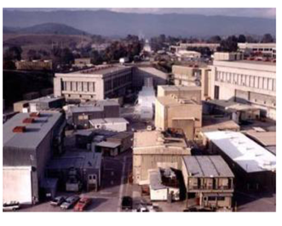
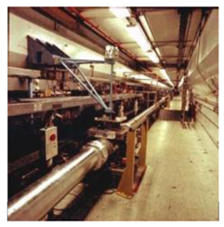
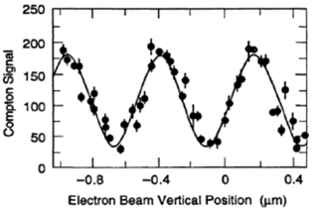
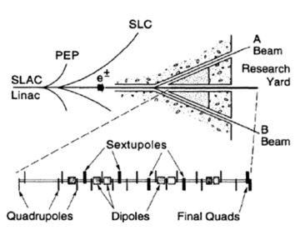
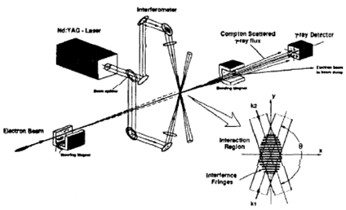
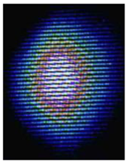
Final Focus Test Beam (FFTB)
FFTB is built in SLC research yard (SLAC) for the LC final focus test
with global chromticity correction system in 1990’s.
 | IP beam size
Design | 45 nm
Achieved | 70 nm
Shintake Monitor

Slide 5
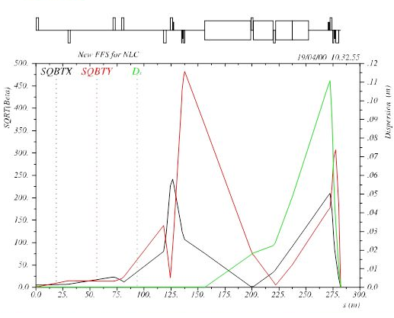
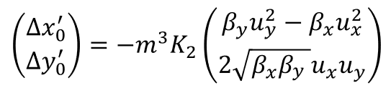
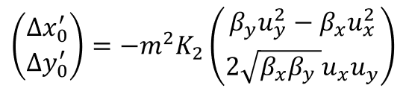
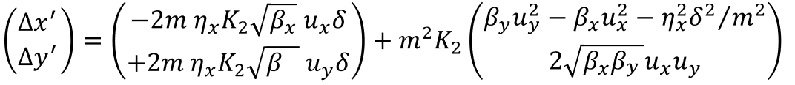
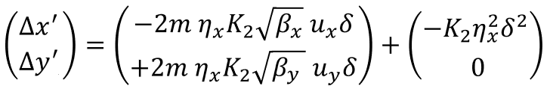

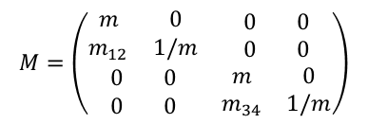




Local Chromaticity Correction System
P. Raimondi and A. Seryi, PRL Vol. 86 3779 (2001)
Sext-1
$$\left(\begin{matrix}u_{x} \\ u_{y} \\ δ\end{matrix}\right)⟹\left(\begin{matrix}mu_{x} \\ mu_{y} \\ δ\end{matrix}\right)$$
$$η_{x}$$
Sext-2
$$M=\left(\begin{matrix}\begin{matrix}m & 0 \\ m_{12} & 1/m\end{matrix} & \begin{matrix}0 & 0 \\ 0 & 0\end{matrix} \\ \begin{matrix}0 & 0 \\ 0 & 0\end{matrix} & \begin{matrix}m & 0 \\ m_{34} & 1/m\end{matrix}\end{matrix}\right)$$
$${−m^{3}K}_{2}$$
$$K_{2}$$
Sext-1
Sext-2
$$⇓$$
 | X chromaticity | Y chrotaticity | 2nd order dispersion
Linear Optics | ○ | ○ | ○
X chromaticity corr. | ○ | △ (small) | ○
Y chromaticity corr. | △ (small) | ○ | ○
Total
Chromaticity
2nd order dispersion
Geonetrical aberration
was cancelled.
When chroticity correction knobs (sextupoles) are changed.
=> 2nd order dispersion is changed. (linear optics and sextupoles are coupled.)
=> Liniear optics must be changed.

Slide 6
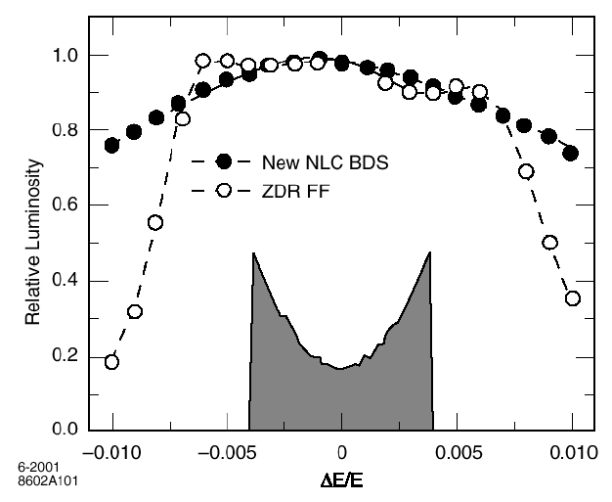
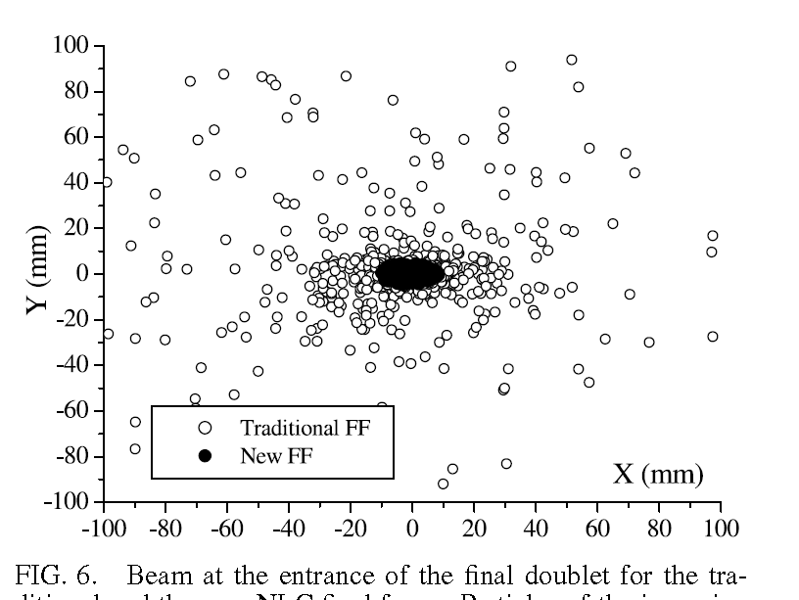
Advantage of local chromaticity correction optics
Global Chromaticity Correction
IP Energy Bandwidth
Horizontal Correction
Vertical Correction
Local Chromaticity Correction
Horizontal Correction
Vertical Correction
Beam Halo at IP
The beamline length is shorter than that for the global chromaticity correction system
Orbit distortion through long beamline of off-momentum particle exists for global chromaticity correction beamline.
  Longer L*
  Smaller background by the halo particles
  Wider energy bandwidth
P. Raimondi and A. Seryi, PRL Vol. 86 3779 (2001)

Slide 7
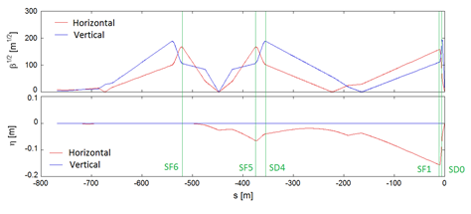
Present ILC Final Focus Optics
We adopted the modified Local Chromaticity Correction Optics.
Chromaticities of quad/sext in ILC FF beamline
Name | X | Y
QD10B | -131.9 | 757.6
QD10A | -168.7 | 673.4
QF9B | 437.4 | -377.5
SF6 | 0.0 | 0.0
QF9A | 460.6 | -295.4
QD8 | -45.0 | 379.0
QF7B | 0.2 | -1.2
QF7A | 0.2 | -1.2
QD6 | -45.0 | 379.0
QF5B | 460.9 | -295.6
SF5 | 155.6 | -112.9
QF5A | 437.6 | -377.8
QD4B | -162.6 | 650.6
SD4 | 1238.1 | -6089.7
QD4A | -126.0 | 736.6
QD2B | 0.0 | -3.9
QF3 | 5.8 | -7.5
QD2A | -13.7 | 0.1
SF1 | -9095.3 | 4954.9
QF1 | 4830.8 | -2934.4
SD0 | 2497.5 | -12835.6
QD0 | -1002.9 | 14564.7
Total | -266.5 | -236.9
The chromaticities are generated not only Final Doublet, but also other quadrupoles.
The chromaticities are corrected by sextupole magnets within the Final Focus Beamline.
The large chromaticities are generated by sextupole near by Final Doublet. ( Not perfect local correction )
Different dispersion
3 parameters to be corrected
- X Chromaticity
- Y Chromaticity
- 2nd order Dispersion
2 sext. pair for correction
- SF6, SF5 (combination) and SF1
- SD4 and SD0
We can correct 2nd order aberration
- only with sextupole magnet.
- without linear optics change.

Slide 8
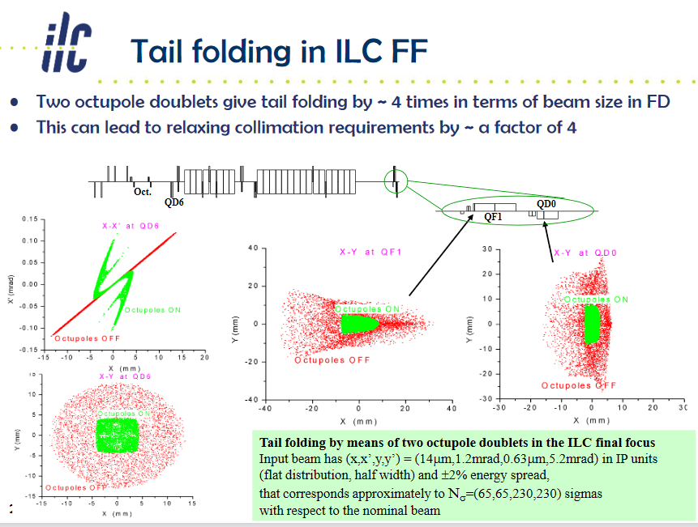
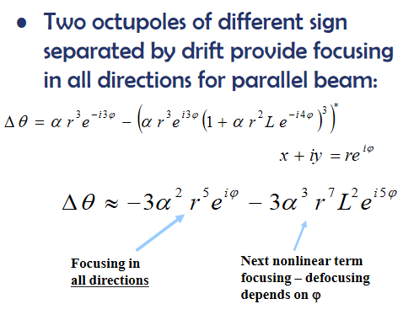
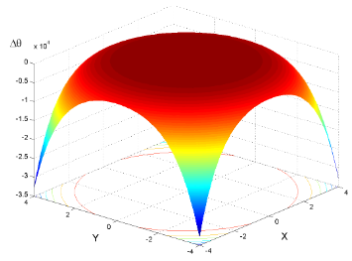
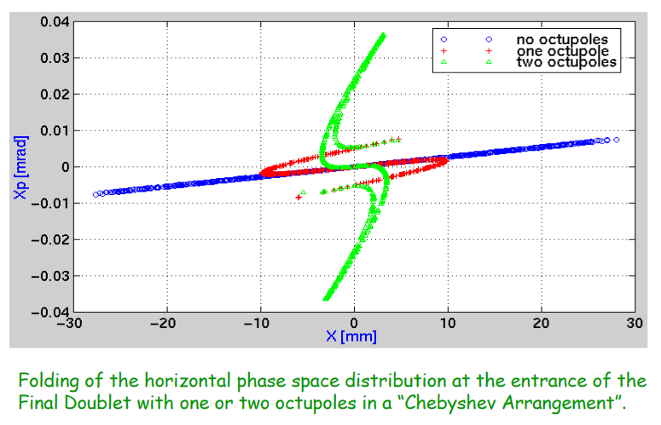
Octupoles were used only for tail folding in the present ILC FFS design.
When the octupoles will be used for the IP beam focusing,
  we should take care of the effect of the collimation depth and the detector background by the halo particles.

Slide 9
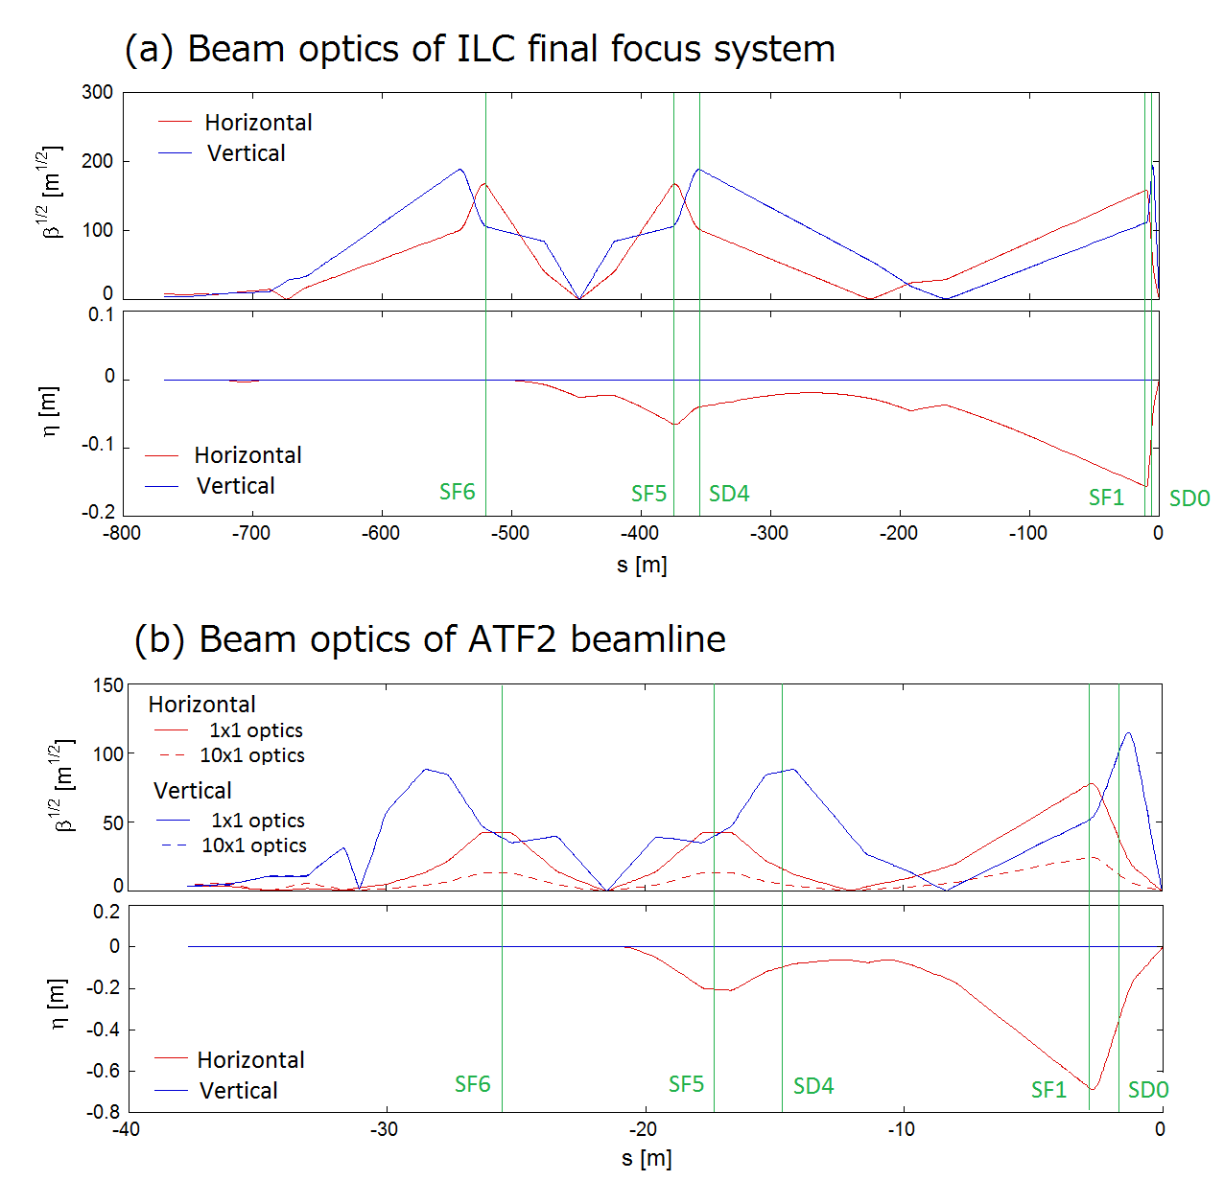
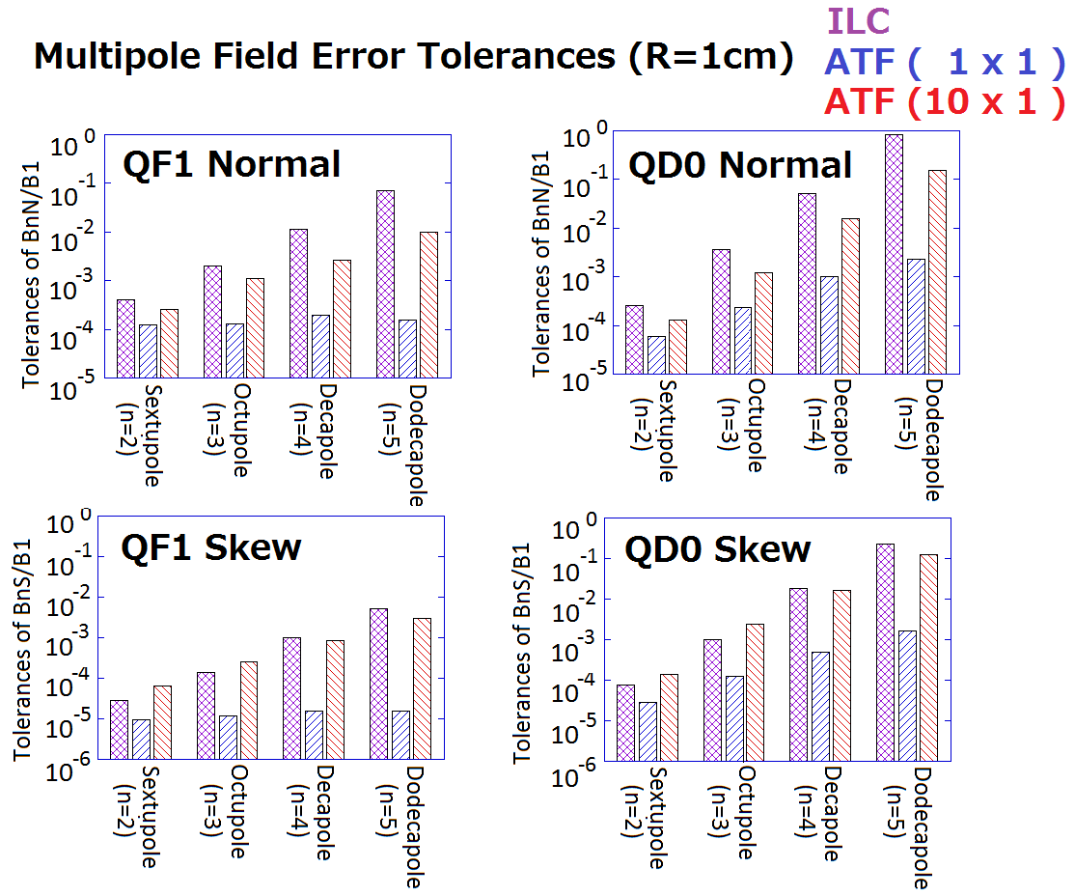
Beam Optics of ILC & ATF2
ILC final Focus System
Tolerances of FD multipole field error
to IP vertical beam size
- ILC final focus systemand ATF2 beamline are both based on the Local Chromaticity Correction.
ATF2 Beam Optics
1x1 optics
X&Y chromaticities are comparable to ILC FF.
10x1 optics
Since betax* is 10 times larger than 1x1 optics, X chromaticity is one order smaller than ILC .
Same magnet arrangement
Same tuning concept
Comparable magnet tolerances

Slide 10
L* of the present ILC FFS

Slide 11
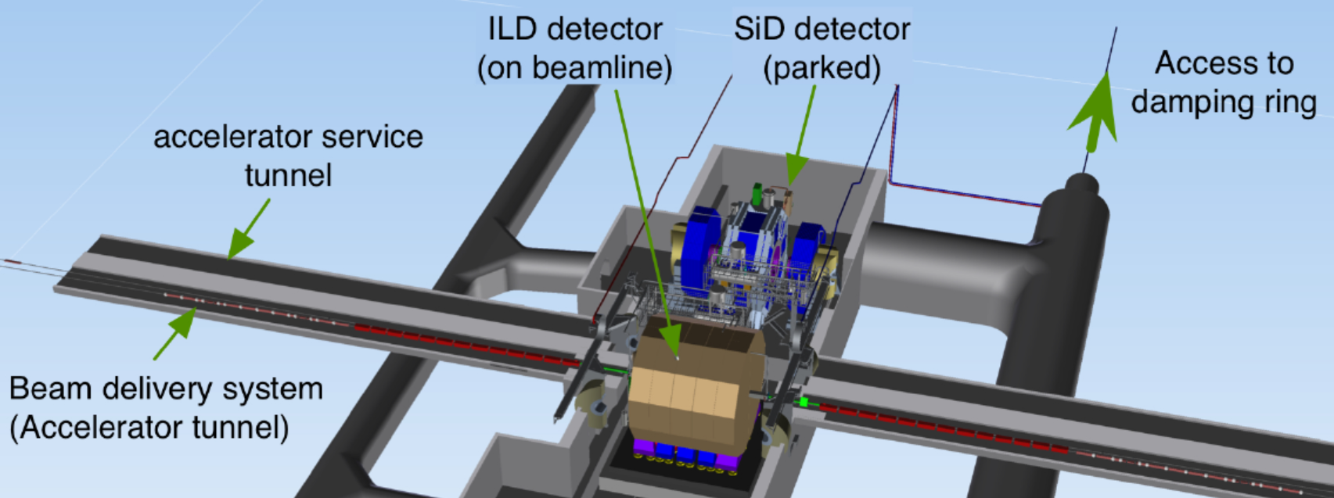
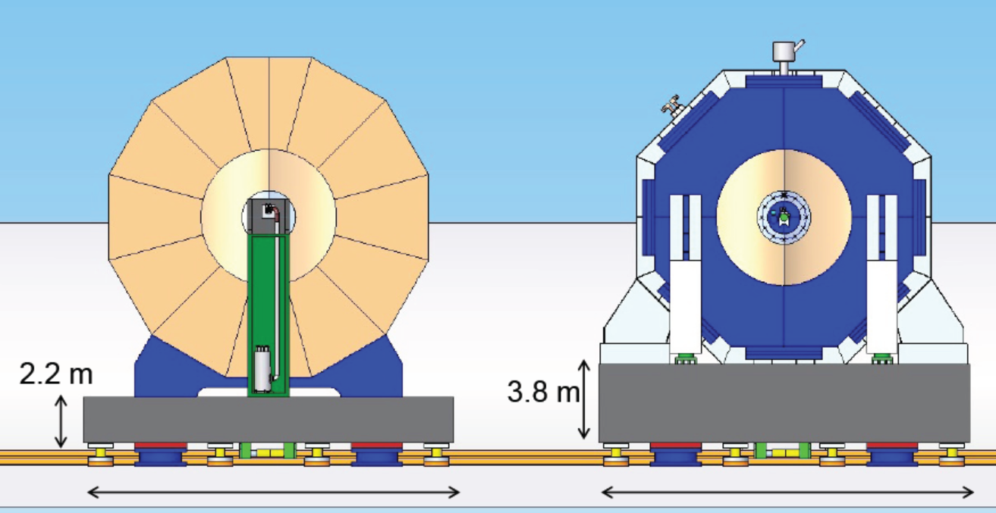
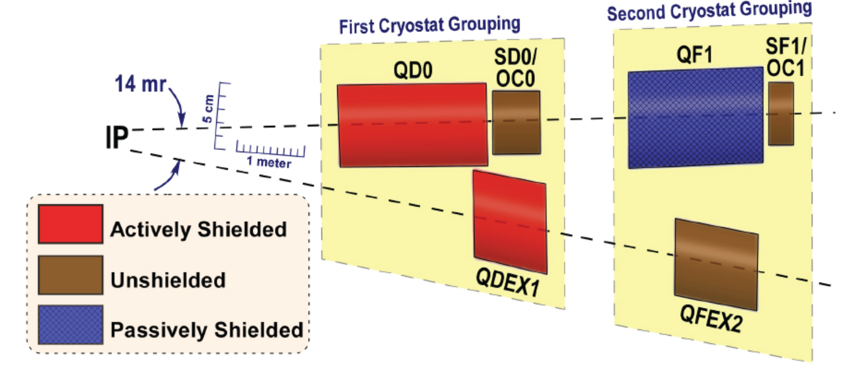
Push-pull scheme of the ILC detectors
QF1 package is common for both detectors, and located in the accelerator tunnel.
QD0 package is independent for each detector.
L* (3.5m and 4.5m) for each detector is different, and the beam optics are not optimized for the L*s in the TDR.

Slide 12
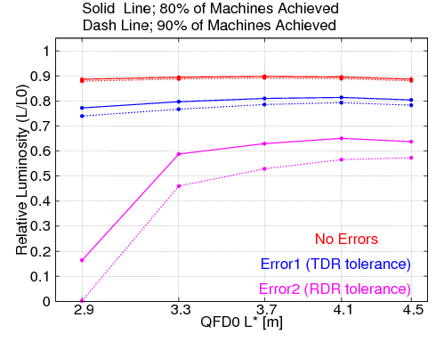
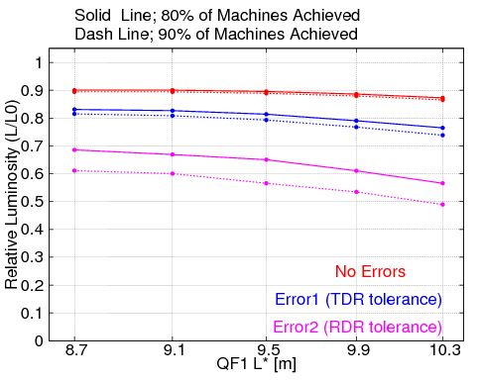
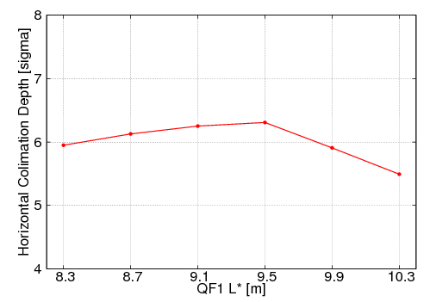
Present ILC L*
Optimum QD0/QF1 L*s were discussed in 2014-2015,
and the present L*s were fixed by taking account of the luminosity and collimation depth.
SiD and ILD use same L* optics.
Since QF1 magnet is common, the optimum of QD0 L* is also same.
Effect of (QD0 L*) to Luminosity
Effect of (QF1 L*) to Luminosity
ECM = 250GeV
beta* (x/y) = 13mm / 0.41mm
(QD0 L*) = variable
(QF1 L*) = 9.5m
ECM = 250GeV
beta* (x/y) = 13mm / 0.41mm
(QD0 L*) = 4.1m
(QF1 L*) = variable
Results of m Tuning Simulation
Results of m Tuning Simulation
Horizontal collimation depth

Slide 13
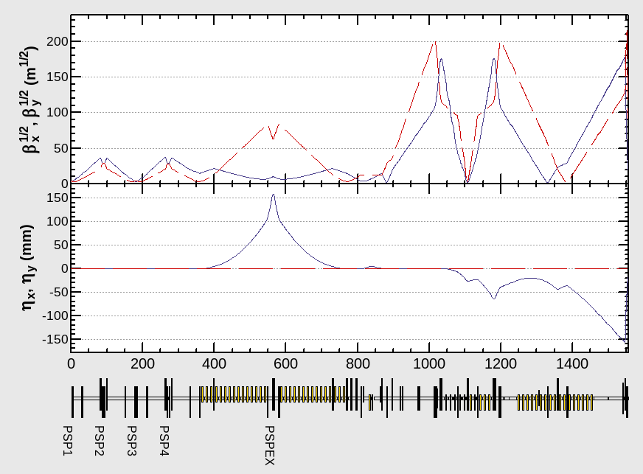
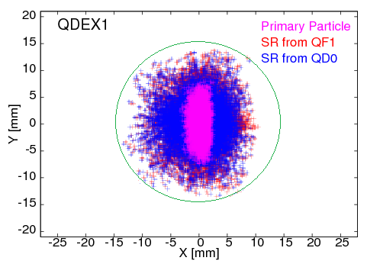
Consideration of collimation depth
Detector apertures
Arrangement of the Collimators
Beta Function at SP2/SP4 = (X; 1000m / Y; 1000m)
Phase Advance (SP2/SP4) = (X; 0.5 pi / Y; 1.5 pi )
Phase Advance (SP4/ IP ) = (X; 5.5 pi / Y; 4.5 pi )
EtaX at SPEX = 0.158m
IP
Source for background
Halo particles
SR form halo particles
QF1
QD0
QDEX1
20 φ
20 φ
28 φ
30 φ
Energy
collimation
IP phase
collimation
FD phase
collimation
When the L* of QD0 is increased, the L* of QDEX1 in the extraction line must also be increased.
Since the collimation depth is limited mainly by the fact that SR from the Final Doublet hits QDEX1, the collimation depth becomes more severe when L* is increased.
SP2/SP4 X ; 0.86mm
SP2/SP4 Y ; 0.98mm
SPEX X ; 1.60mm
( Dp/p = 1% )
30φ

Slide 14
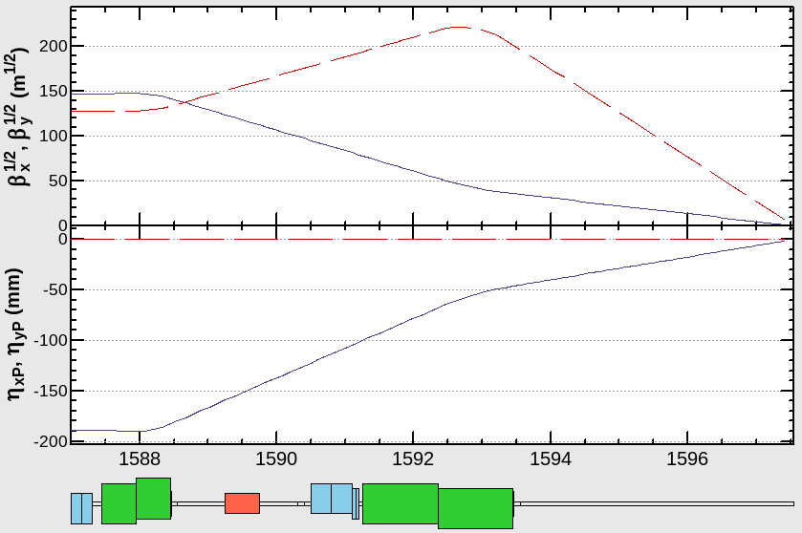
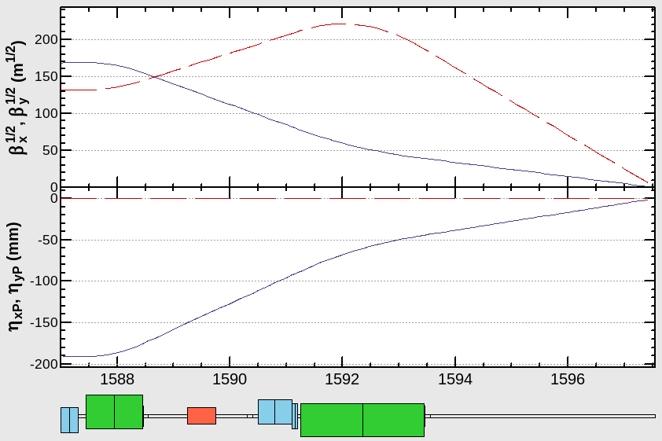
Application to low energy (E_{CM}=250GeV)
ECM=250GeV
The field strength for ECM=250GeV is a half to ECM=500GeV.
When we only use a half of FD magnets,
the beta functions at FD magnets are decreased.
Therefore, the collimation depth can be increased.
Half length of FD was used.
QF1B
QF1A
QD0B
QD0A
ECM=250GeV
0.5
1.1m
IP
ECM=500GeV
0.5
0.5
1.1m
1.1m
ECM=500GeV
Beta
The geometry optimizes the more difficult low-energy optics
and allows the higher-energy optics to deviate slightly from the optimum value.
Full length of FD was used.

Slide 15
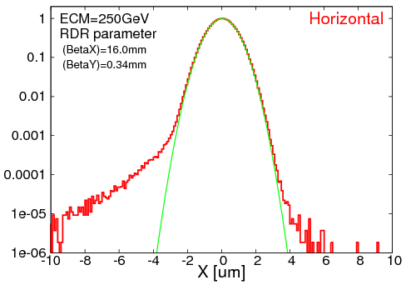
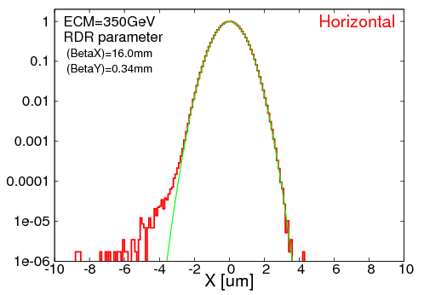
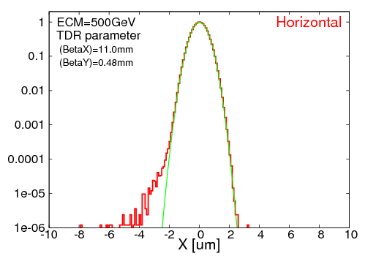
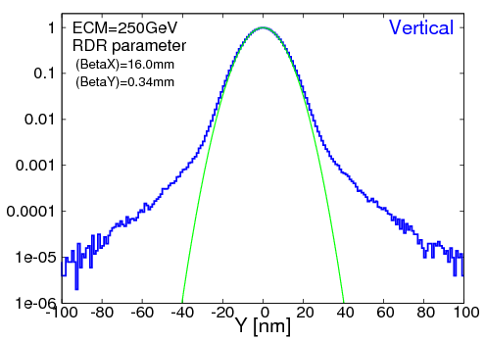
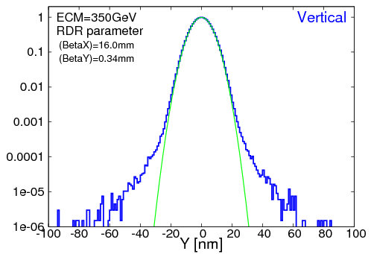
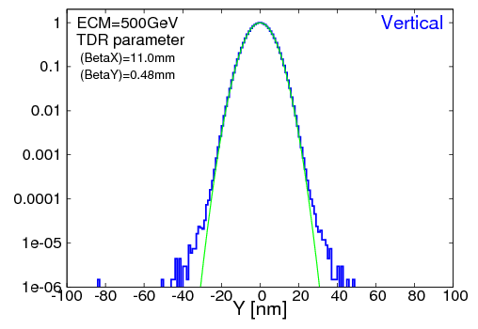
IP beam profile
ECM=250GeV
ECM=350GeV
ECM=500GeV
Horizontal
Profile
ECM=250GeV
ECM=350GeV
ECM=500GeV
Vertical
Profile
Simulation Results for ECM<500GeV optics ( no SR )
ECM | Horizontal |  | Vertical |  | Relative Luminosity
 | design beam size | simulation (core) | design beam size | simulation (core)
250GeV | 0.729um | 0.755um | 7.66nm | 7.81nm | 94.7%
350GeV | 0.683um | 0.690um | 5.89nm | 5.97nm | 97.8%
500GeV | 0.474um | 0.482um | 5.86nm | 5.89nm | 97.8%

Slide 16
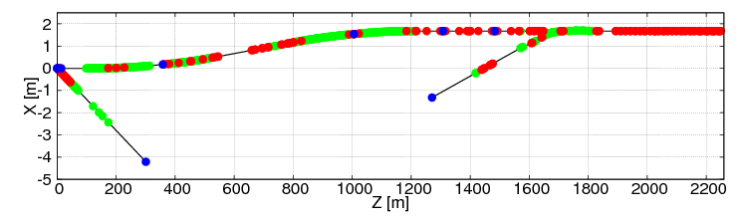
Application to high energy (E_{CM}=1TeV)
The beam optics is designed to be expandable to ECM=1TeV in the same tunnel.
Beam optics up to 500 GeV can be used with electromagnets to support beam optics up to 1 TeV.
Section B
from Energy Collimator
Section A
to betatron collimator
The number of components both for ECM=500GeV and ECM=1TeV
( not include the dumpline )
 | Energy [GeV] | # of BEND | # of QUAD | # of SEXT | # of Steer | # of PS | # of Mover | # of BPM
Section A | 500 | 16 | 64 | 0 | 19 | 73 | 70 | 78
 | 1000 | 43 | 108 | 0 | 19 | 115 | 108 | 116
Section B | 500 | 63 | 33 | 7 | 55 | 46 | 40 | 101
 | 1000 | 176 | 41 | 7 | 55 | 56 | 48 | 112

Slide 17
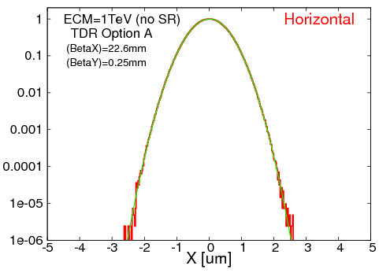
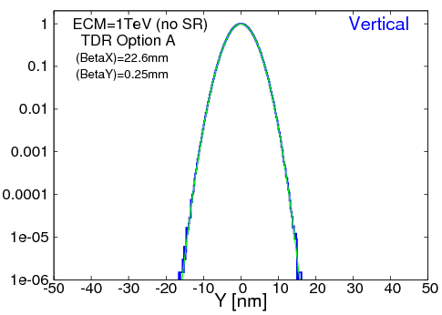
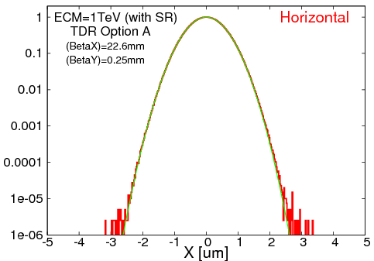
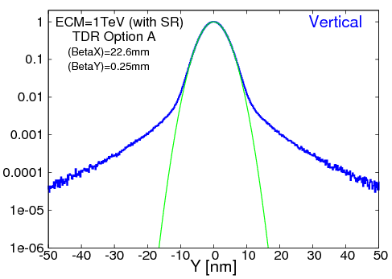
Simulation Results for ECM=1TeV optics
<< no SR >>
<< with SR >>
Aberrations due to synchrotron radiation
 | Horizontal |  |  | Vertical |  |  | Relative Luminosity
 | design | rms | core | design | rms | core
no SR | 0.481um | 0.481um | 0.481um | 2.99nm | 2.99nm | 2.99nm | 99.8%
with SR |  | 0.499um | 0.498um |  | 3.71nm | 3.15nm | 91.7%
Luminosity of more than 90% can be achieved for ECM=1TeV, even with the effect of synchrotron radiation on the beamline.

Slide 18
Longer L*

Slide 19
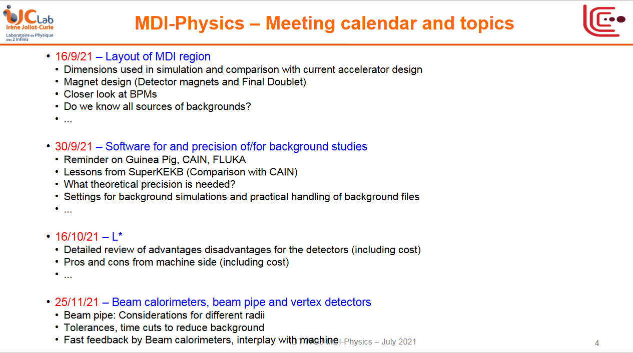
2021/03/16
The longer L* issue was discussed in LCWS2021.
IDT WG3 MDI group meeting
L* issue will be discussed
at WG3 MDI group mtg.

Slide 20
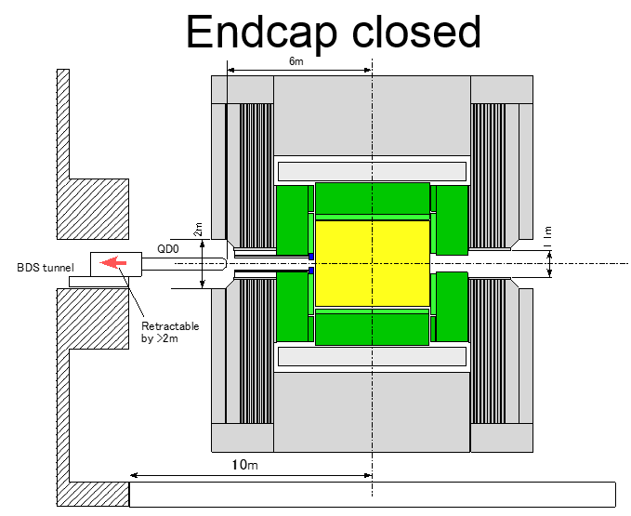

Discussion of the longer L* in WG3 MDI group
Possible benefit of longer L* for detectors
by Y. Sugimoto @IDT-WG3-MDI-Phys kickoff meeting
QD0 can be supported from the BDS tunnel
  We can get rid of QD0 pillar if L*=6m
  QD0 may have to be retractable like QSC of SuperKEKB
  Much more stable than the support from the pillar on the platform
  Much better position repeatability after push-pull
    Pillar on the platform: ~0.5mm
    Support from BDS tunnel: few tens of um (SuperKEKB)
  Much faster machine tuning after push-pull
  Only one pair of QD0 is necessary (2 pairs for ILD and SiD are necessary for TDR design)
ILD needs some modification
  Cut the End-cap iron to make access to flanges at Z~6m possible, and/or remote vacuum connection (RVC) like SuperKEKB
  FCAL support has to be re-considered (telescopic support?)
  No need for split endcap
BeamCAL can be placed far from IP
  Weaker magnetic field at BCAL (and QD0 front surface) causes less back-scattering of pair background
  No need for AntiDID (?)
  Less cost, less construction period, and less risk

Slide 21







Comment; L* and luminosity
L* is not directly related to the design luminosity in linear colliders.
However, it may effectively lead to a decrease the integrated luminosity for ILC
through various tolerances and the associated beam tuning etc.
Luminosity
$$L=fn_{b}\frac{N^{2}}{4πσ_{x}^{∗}σ_{y}^{∗}}$$
In order to increased the luminosity,
Make small vertical emittance
Make beamstrahlung parameter large.
⇒ make the balance of the luminosity
and energy spread for collision beam.
The vertical beta function is roughly optimized to the bunch length
to minimize the hour-glass effect as
$$σ_{y}^{∗2}=β_{y}^{∗}ε_{y}$$
$$β_{y}^{∗}≈σ_{z}$$
The horizontal beam size was defined with beamstrahlung parameter
$$σ_{x}^{∗2}≈\frac{r_{e}^{3}N^{2}γ}{σ_{z}δ_{BS}}$$
Beam energy reduction by beamstrahlung
Then, the luminosity can be expressed as
$$δ_{BS}≡−\frac{{ΔE}_{γ}}{E}≅\frac{0.836 γN^{2}r_{e}^{3}}{σ_{z}{\left(σ_{x}^{∗}+σ_{y}^{∗}\right)}^{2}}\frac{1}{{\left(1+{1.31\left\langle Υ\right\rangle }^{2/3}\right)}^{2}}≈\frac{ γN^{2}r_{e}^{3}}{σ_{z}{\left(σ_{x}^{∗}+σ_{y}^{∗}\right)}^{2}}$$
$$L=\frac{fn_{b}N}{4πr_{e}^{3/2}}\sqrt{\frac{δ_{BS}}{γε_{y}}}$$
For ILC 500GeV, the $δ_{BS}=4.5 \%$

Slide 22
Some issues for large L* optics
In order to change the L*, it is necessary to change not only the arrangement of the magnets near the IP but also the entire FFS optics including the beamline length.
When increasing L*, the acceptable range of the optimum bending angle for the beam energy becomes smaller, which may limit the future energy extendability (see later).
We should reevaluate the effect of the collimation depth and detector background (may be worse than present optics).
We may reevaluate the beam extraction line optics.
However, since the accelerator is a tool for conducting physics experiments, I believe that it is necessary to change the L* if it is required by the consensus of physics.
I have heard that there is no consensus on the physics side that L* should be changed at this time, so the accelerator side is not about to start considering it, and this presentation is nothing more than information sharing.

Slide 23








Synchrotron radiation around IP area
When L* is increased, the effect of SR from the Final doublet on the SC magnet in the extraction line becomes larger and the collimation depth is reduced.
Shorter QD0 L*
Longer QD0 L*
Horizontal limit
Horizontal limit
The situation of QDEX1 limit
will be changed by the parameters
- the location of QDEX1.
- the aperture of QDEX1.
- the vertical aperture of collimator.
QF1
QD0
IP
QDEX1

Slide 24





ILC beam extraction line
Power loss at extraction line (beam-beam effect)
E. Marin and Y. Nosochkov et al., LCWS 2013
Disrupted charged particles
Beamstrahlung photons
The ILC extraction line uses large-diameter quadrupole magnets (maximum bore diameter 170 mm) to transport the beam with large beam spread by the beam-beam effect to the dump with minimal loss.
When the L* of QD0 is lengthened, the L* of the extraction quadrupole magnet QDEX1 is also lengthened, and the diameter of the quadrupole magnet in the entire extraction line may be increased more.
Therefore, the design of the entire extraction line needs to be redesigned.
Quadrupole magnets in extraction line
Y. Nosochkov et al., LCWS/ILC 2007
First two quadrupoles : SC magnets in FD package
Other quadrupoles : Large aperture NC magnets
Apertures for Dumpline

Slide 25
I have considered the ILC final focus optics with long L* in the past.
Large L* optics for ILC
Toshiyuki OKUGI, KEK
2014/ 5/ 15
AWLC2014, Fermilab

Slide 26
Long L* and Chromaticity
Chromaticity correction
The difference in particle trajectory is created by the difference in energy.
The strength of the sextupole magnet depends on the position of the particle passing through it.
The angle at which a particle injects a quadrupole magnet depends on its energy.
In order to squeeze the beam to the same size at the focus, it is necessary to squeeze the beam at the same divergence angle.
The beam size at the final focus magnet becomes larger.
The chromatic aberration at the focal point becomes larger.
This is especially effective in “the low energy region”, because the beam size passing through the magnet is large.
Small difference in position
due to energy in sextupole
Large difference in position
due to energy in sextupole
When the L* is long, the chromatic aberration becomes larger, and a strong chromatic aberration compensation is needed.
Requires strong sextupoles
Spatial aberration becomes large
Enough to use weak sextupoles
Spatial aberrations are small.

Slide 27


L*=7.0m optics based on ILC RDR optics (ECM=500GeV)
Since the (2nd order and higher) geometrical aberration for large L* optics was large
the large L* optics is more difficult than the small L* optics, even if we set same chromaticity.
1st step optimization
2nd step optimization
In order to reduce the beam size at SF6, SF5 and SD4,
the beta function at the section was reduced
(ATF2-like optimization).
The strength of dipole magnet was increased to twice to increase the dispersion and reduce the strength of sextupoles.

Slide 28




Performances for the optics with strong bending magnet
Optics was matched to ILC TDR parameters.
Bandwidth of sigmaX for E=250GeV
Bandwidth of sigmaY for E=250GeV
Effect of SR
Even at ECM=500 GeV,
some effects of synchrotron radiation are appeared.
IP Beam Size at E=250GeV | sigmaX* | sigmaY*
w/o Synchrotron Radiation | 0.50um | 5.81nm
with Synchrotron Radiation | 0.50um | 5.95nm
σp/p = 0.12%
σp/p = 0.12%
Luminosity Bandwidth for E=250GeV
Energy Dependence of Luminosity
At AWLC2014, this proposal was rejected.
The reasons are
Energy extendability
Collimation depth
Aperture of the dumpline .
σp/p = 0.12%
σp/p = 0.12%
The luminosity was increased to almost 97%, and the bandwidth increased.
But, the luminosity reduction for low energy was still large.

Slide 29


Slide 30



L*=6m optics for CLIC 380GeV
The additional sextupoles were put to the original chromaticity correction optics. They also use octupoles for IP focusing.
Since CLIC is designed to have weaker nonlinear effects than ILC, such as smaller horizontal emittance and higher energy, it will be necessary to examine carefully when matching the parameters of ILC.
The effect on the detector background and collimation depth when using octupole magnets for beam adjustment needs to be carefully examined.
The aperture of the inner detector around the IP is assumed to be very wider than ILC.

Slide 31
Other topics

Slide 32

The current ILC FF optics are designed to support energies of ECM=250GeV-1TeV with the same geometry.
However, the FF optics is not optimized for each energy, because the bending angle of the dipole magnet does not have an optimum angle for each energy.
In order to optimize for each energy, we need to choose optimal bending angle of dipole for each beam energy.
A layout to optimize for two energies, ECM=250GeV and 1TeV, was proposed in 2017.

Slide 33





Strong dipole for low energy
IP beam profile at ECM=250GeV
Original beam optics
Synchrotron radiation for BDS at ECM=500GeV
Beam optics with strong bending magnet
Momentum Spread Growth by Synchrotron Radiation
 | Collimator | FF beamline | Total
B = 1.0 x B0 | 0.0058% | 0.0017% | 0.0061%
B = 1.5 x B0 | 0.0059% | 0.0020% | 0.0062%
B = 2.0 x B0 | 0.0060% | 0.0024% | 0.0064%
Horizontal Emittance Growth by Synchrotron Radiation
 | Collimator | FF beamline | Total
B = 1.0 x B0 | 0.45% | 0.07% | 0.52%
B = 1.5 x B0 | 0.67% | 0.49% | 1.16%
B = 2.0 x B0 | 1.49% | 2.06% | 3.55%
Horizontal beamline offset
is shifted by 1m at 2xB0.
Even at ECM=500 GeV, the effect of SR is not so small (1 TeV is impossible).

Slide 34

Design of vertical bead at entrance of BDS
BDS beamline will be longer,
when we put the vertical bend.
BDS tunnel is laser straight.
3.2km
2.3km
PM-8
IP
PM+8
No vertical bend in optics deck
Simple vertical bend (+87.5m)
( 0.432mrad )
The vertical bending section was designed in between MPS and skew quadrupole section.
The optics was designed to smoothly connected to FODO cell of skew quadrupole section.
The vertical emittance growth, generated by the bending system is less than 1%.

Slide 35





New beamline layout to allow ECM=250GeV to 1TeV
ECM=500GeV
Upstream beamline
Entire beamline
Add horizontal bend at BDS entrance.
When we upgrade the energy to ECM=1TeV, we will align the IP position and angle of the two beamlines by adjusting the angle of this horizontal bend and the energy collimator.
This beam optics improves the performance of ECM=250 GeV, and has the expendability up to ECM=1 TeV.
This was proposed in 2017, but was rejected because of the slightly longer beamline (cost).
Upstream beamline
ECM=1TeV
Entire beamline
Small kick angle
for energy collimator
Beam kick
at horizontal bend

Slide 36




Optimization of bending angle for ECM=1TeV
X
Geometrical Aberration
SR Aberration
Optimum
Original
No Errors
$${σ_{p}}/p=0.100\%$$
$${ β}_{x}^{∗} =0.0226 \text{m}$$
$${ β}_{y}^{∗} =0.00025 \text{m}$$
Y
Optimum bending angle is 70% of original.
( balanced geometrical aberration and SR aberration )
No Errors

Slide 37
Summary
The current FF optics of the ILC is designed to cover ECM=250 GeV to 1 TeV with the same geometry. However, they are not optimized for all energies.
The present QD0/QF1 L* was determined by communicating with SiD and ILC groups in 2014-2015.
There are L*=6m optics for CLIC 380GeV. But, we have not yet evaluated the optics is fit to the ILC FF optics.
Long L* optics for ILC was proposed in 2014, but it was rejected for the following reasons.
  Energy extendability
  Collimation depth .
  Aperture of the dumpline
If we will consider for the adoption, a comprehensive design must be developed to meet these conditions (especially for 2 and 3, which have a significant impact on the entire accelerator system).
In order to optimize for each energy, we need to choose optimal bending angle of dipole for each beam energy. A layout to optimize for two energies, ECM=250GeV and 1TeV, was proposed in 2017.
When we prioritize the optimization of FFS at ECM=250GeV, we should consider it again (just my opinion).

Slide 38
Backup

Slide 39





Beam diagnostics for ILC beam extraction line
ILC extraction line beam diagnostics
Cross section of Compton scattering
with different beam polarization

