Slide 1
22nd Meeting of SRF Group in IDT/WG2
Report of tuner expert meeting
Report of meeting with Tom Peterson about heat load/5K thermal shield
Announcement on ILC advisory panel of MEXT
Others (if any)
Attendees: A. Yamamoto, S. Michizono, K. Umemori, E. Cenni, D. Delikaris, S. Posen, M. Liepe, N. Solyak, P. McIntosh, B. List, R. Geng, R. Ruber, Kirk
https://agenda.linearcollider.org/category/256/
You can download every slide from this link
Kirk

Slide 2
Tuner expert meeting @5/Oct
Date: 5/Oct (Tue)
Time zone: 23:00~25:10 @JST
Attendee: Y. Pischalnikov, S. Belomestnykh, C. Pagani, L. Monaco, R. Paparella, D. Kostin, E. Cenni, G. Devanz, R. Ruber, N. Huque, A. Yamamoto, Kirk
Agenda:
GDE & History (Akira Yamamoto, Kirk) [5 min]
Presentation about LCLS-II tuner (Yuriy Pischalnikov) [45 min]
Discussion (Everyone) [80 min]
Conclusion/Opinion
Any design of tuner can work well for imitated LFD compensation at room temperature
No one objected to taking the next step to demonstrate at HTS like CHECHIA
We need some budget to demonstrate at HTS
Attention should also be paid to the attached electronic devices, not only tuner components

Slide 3
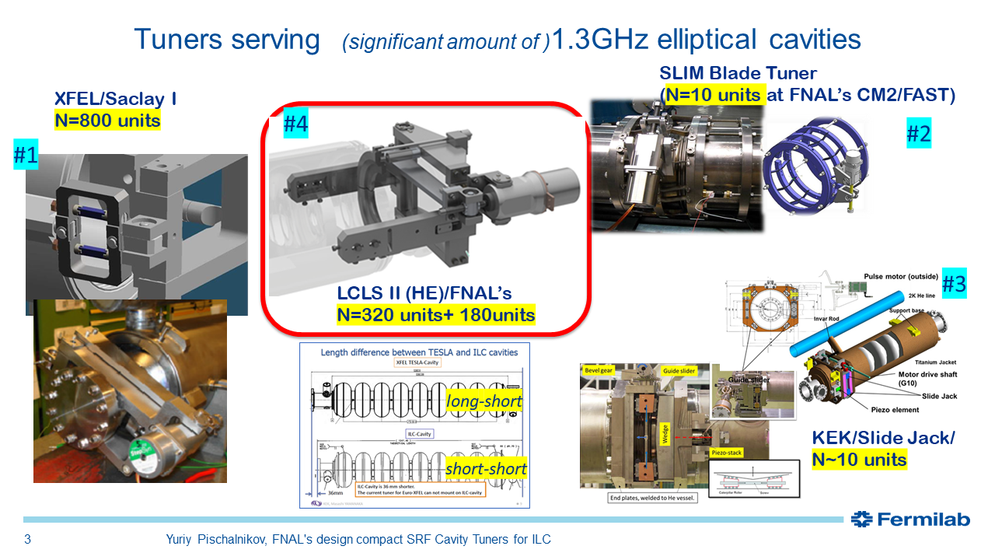

Slide 4
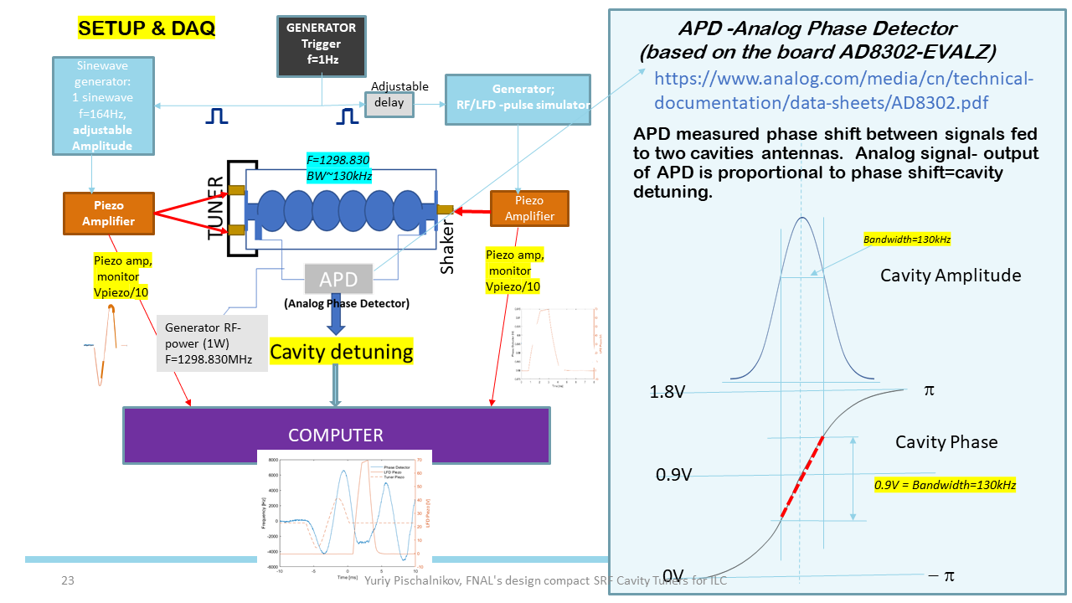

Slide 5
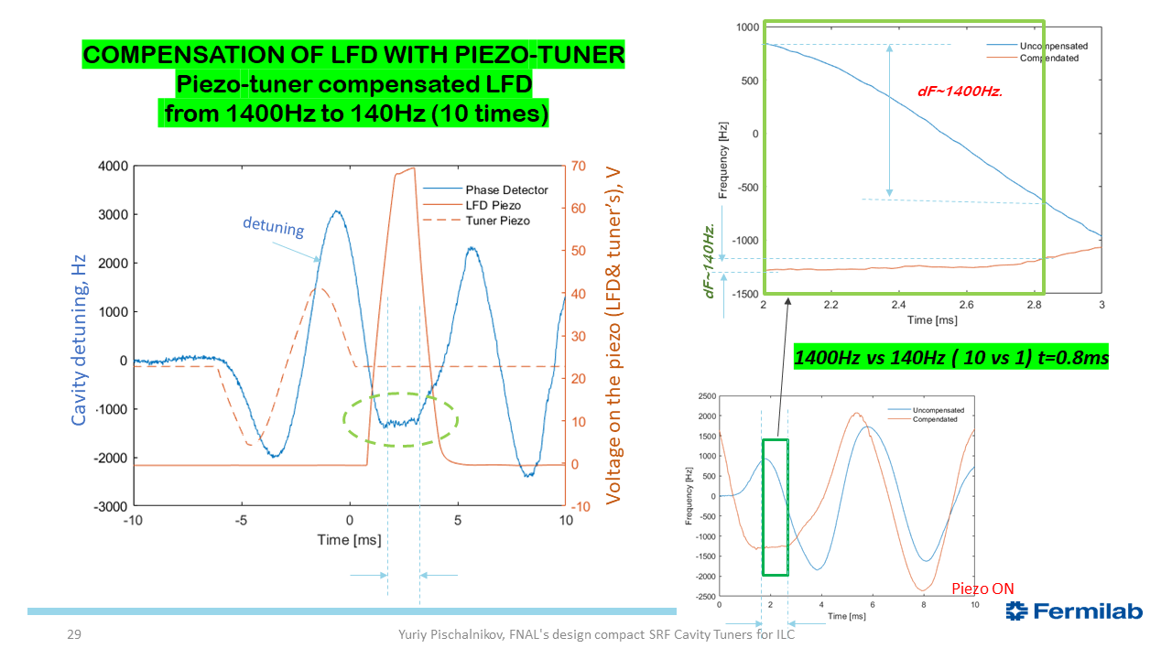

Slide 6
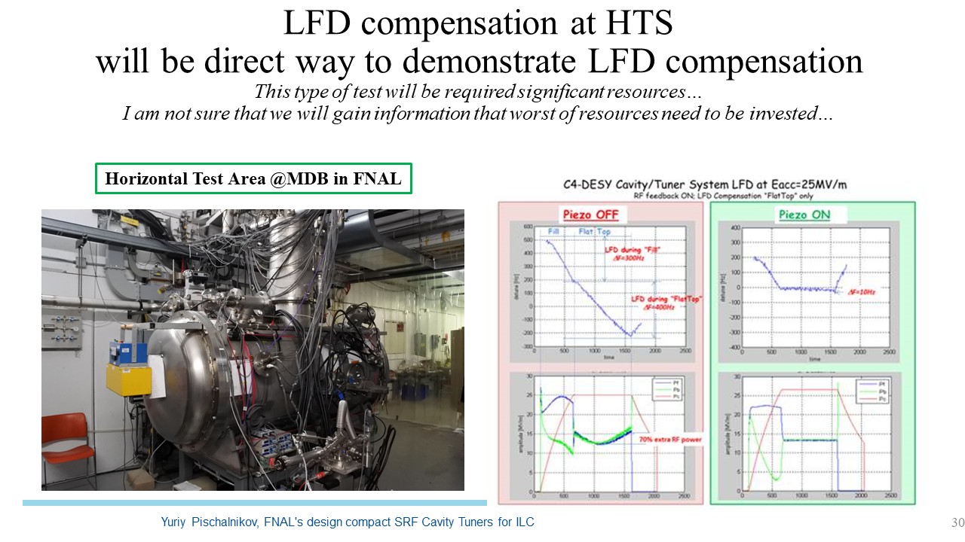

Slide 7
Meeting with T. Peterson @7/Oct
Date: 7/Oct (Thu)
Time zone: 8:00~9:00 @JST
Attendee: T. Peterson, Y. Orlov, A. Yamamoto, T. Konomi, Kirk
Agenda:
CM thermal design (Akira Yamamoto)
Discussion (Everyone)
Conclusion/Opinion/Action
T. Peterson commented about heat load experiment w/ and w/o 5K thermal shield at S1-Global
In LCLS-II, the 5K thermal shield including multi layer insulation (MLI) is completely removed, but the same effect can be achieved if MLI is wrapped around all cooling pipes and cavities instead.
T. Peterson gave us his spreadsheet about heat load in ILC and LCLS-II after this meeting

Slide 8
Study of Thermal Shield for the ILC Cryomodule
N. Ohuchi, T. Arkan, T. Peterson, P. Pierini et al, CEC/ICMC, 2011

Slide 9
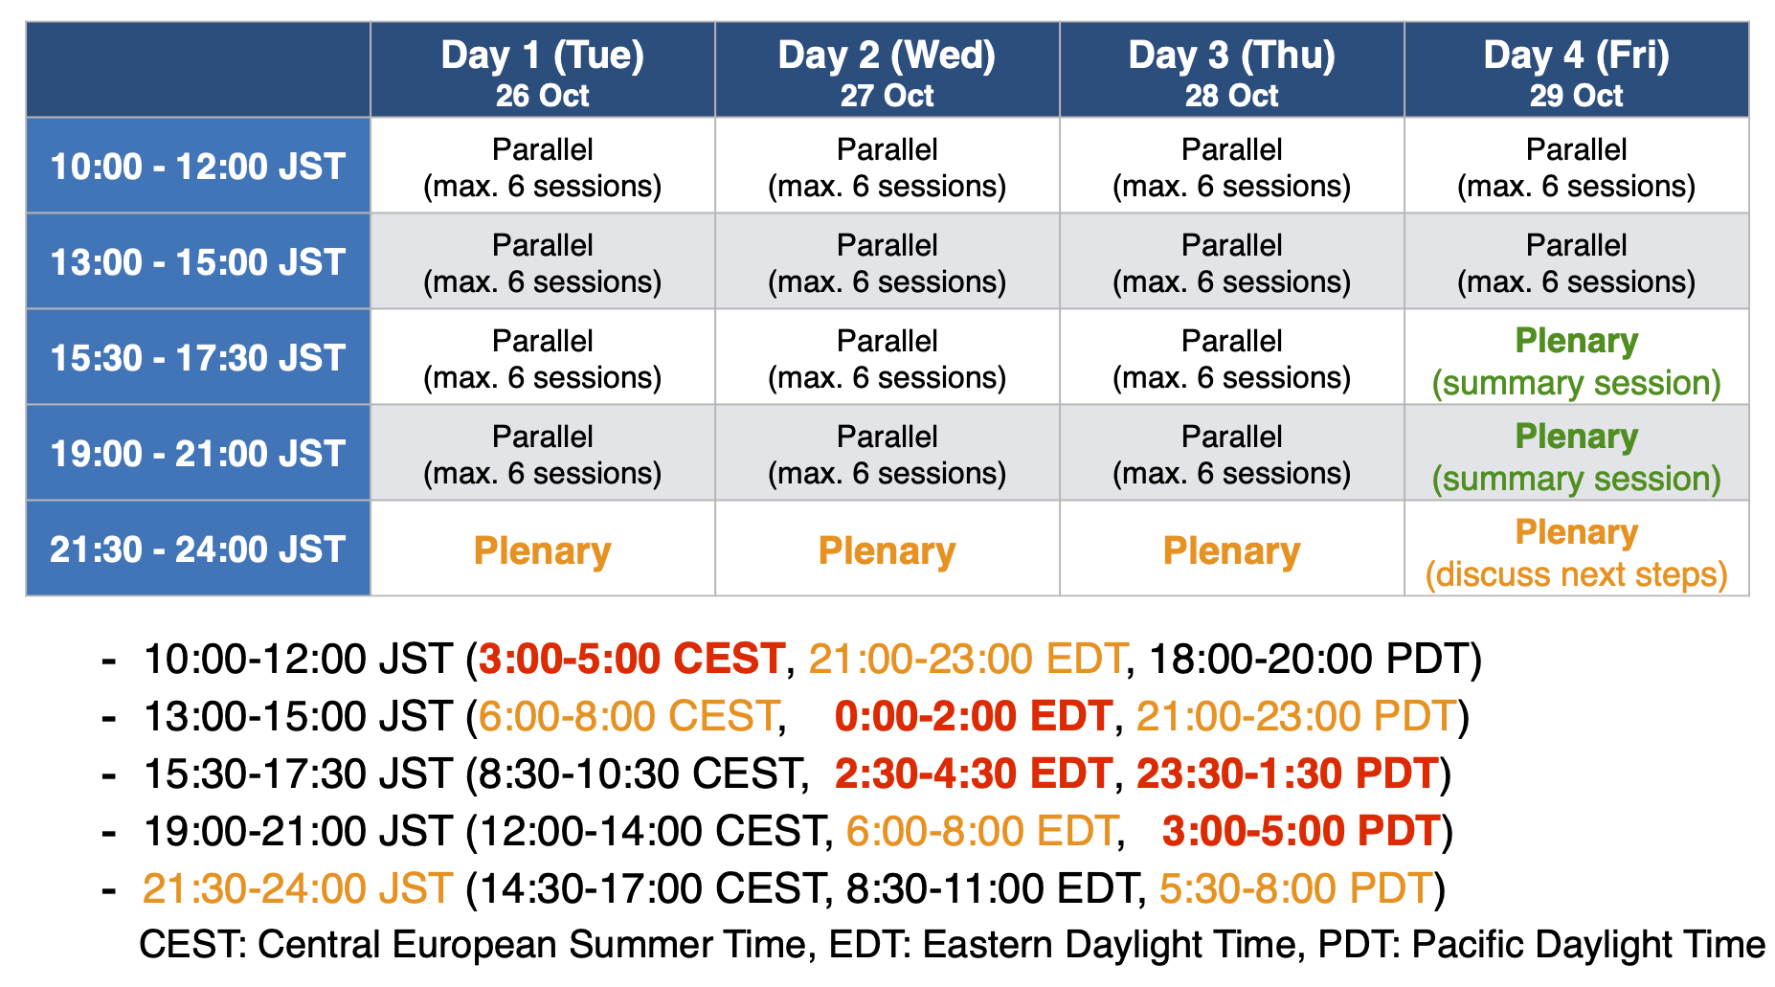

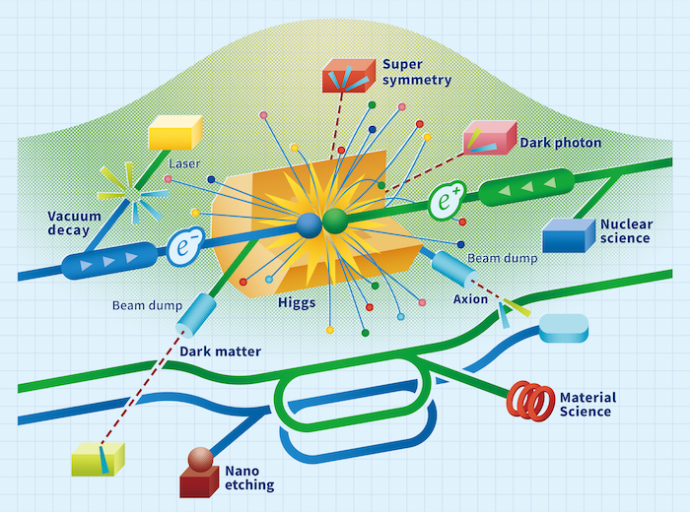
SRF session at ILCX2021
ILCX2021 will be held remotely
https://agenda.linearcollider.org/event/9211/
Hitoshi Murayama-san requested all conveners to provide information of each session
SRF sessions
Crab cavity (organized by Peter) in 27/Oct (Wed) 21:30~23:30 @JST
CM design including HPGS (organized by Kirk) in 28/Oct (Thu) 21:30~23:30 @JST
Timetable is changed a little

Slide 10
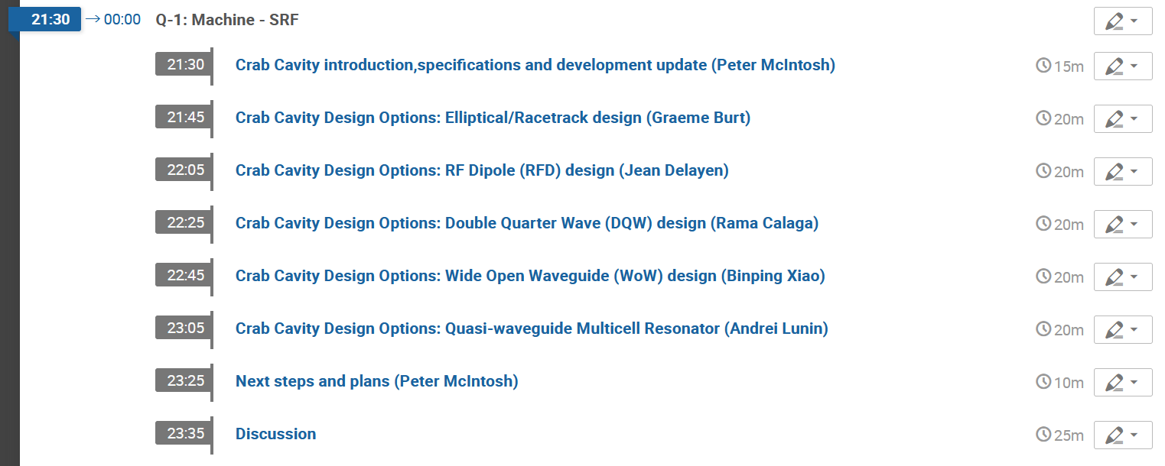
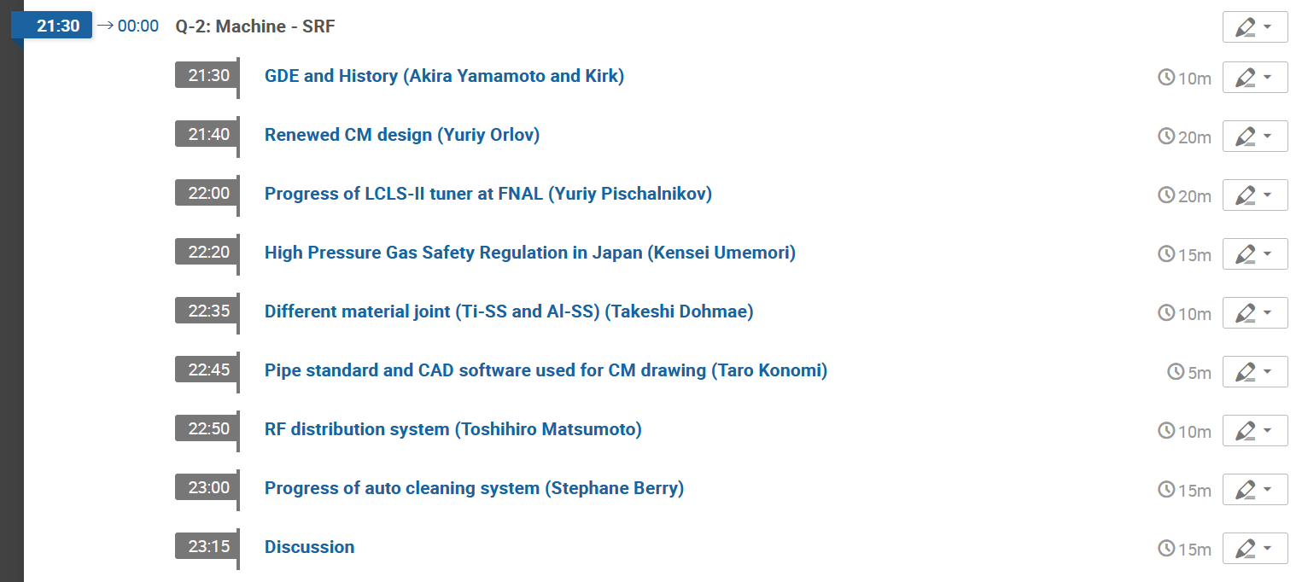
Agenda of SRF sessions
Crab cavity @27/Oct
CM design @28/Oct

Slide 11
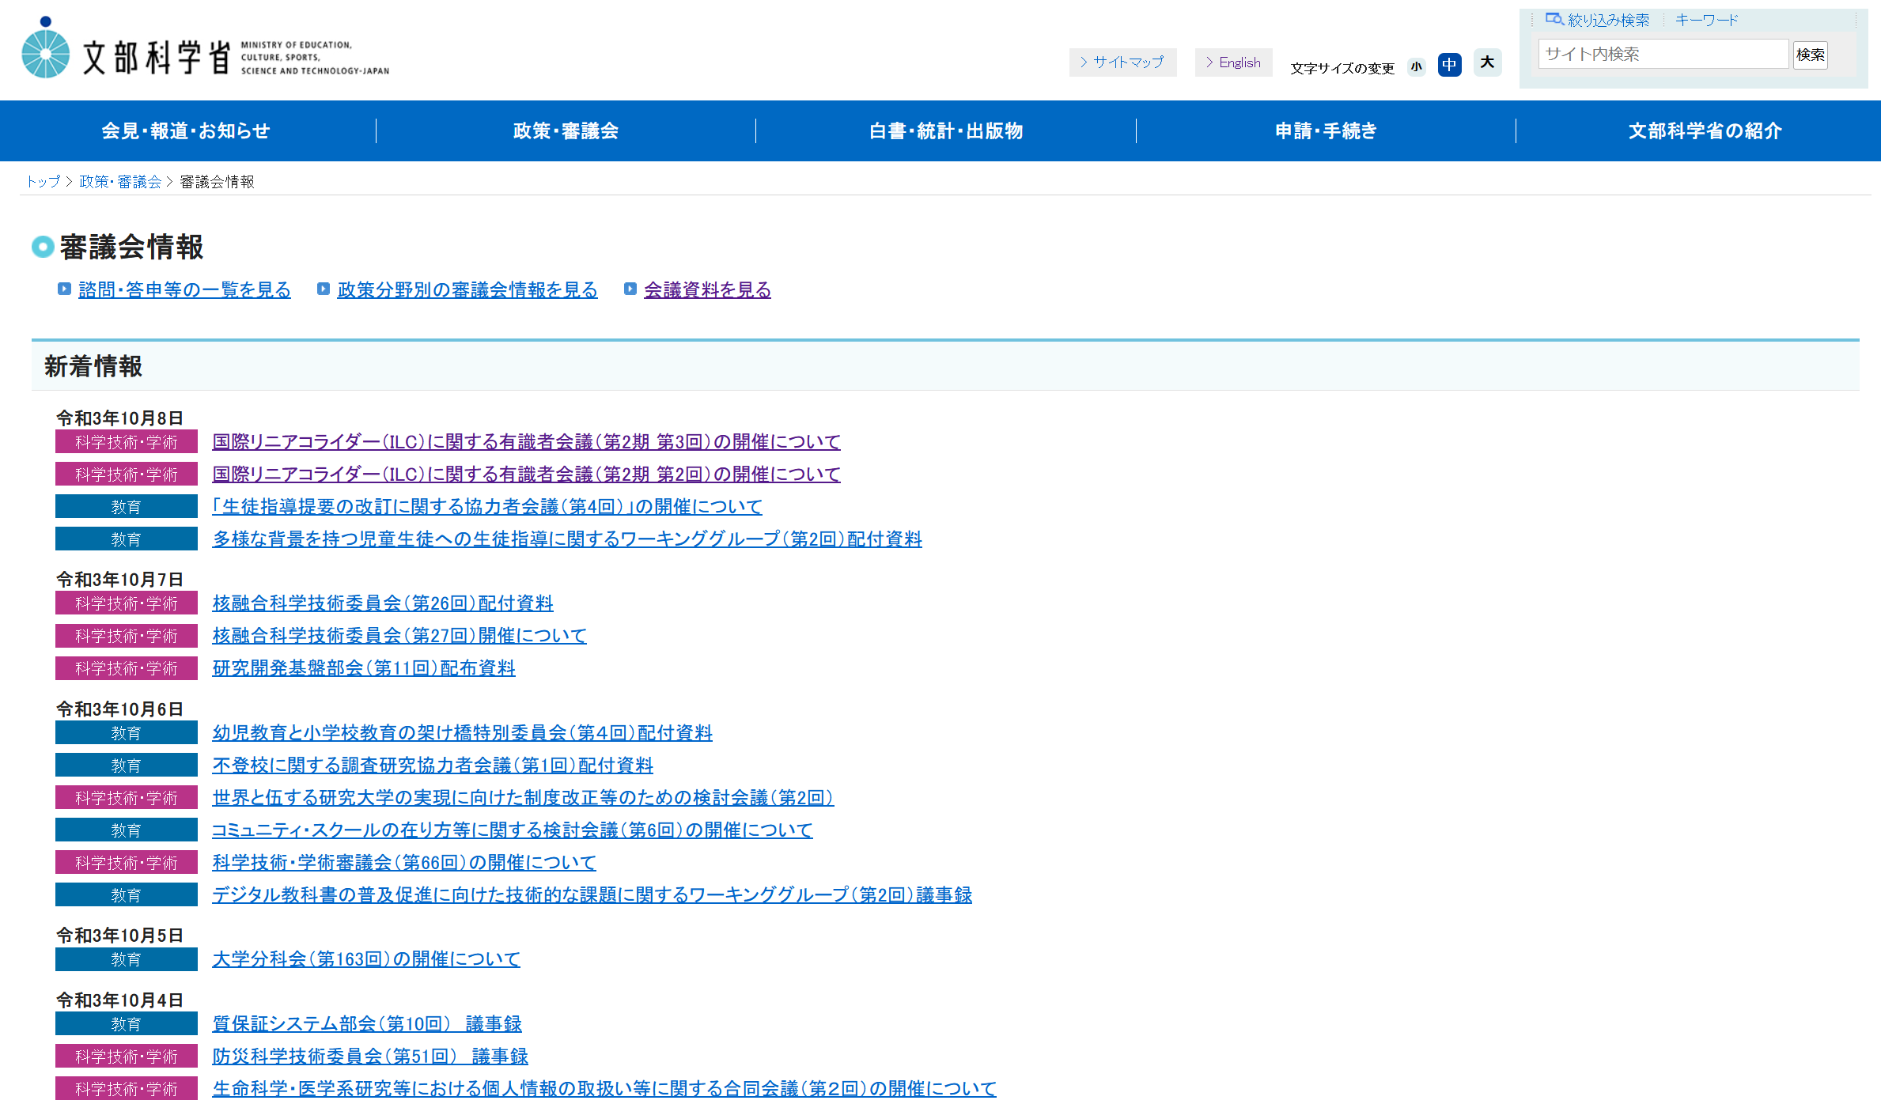
Schedule of SRF (incl. crab cavity sub-) Group Meeting in IDT/WG2
Meeting # | Date | Contents
19 | 31/Aug | Preparation for ILC advisory panel, SRF session at ILCX2021
20 | 14/Sep | Progress of CM design, SRF session at ILCX2021
21 | 28/Sep | Agenda of SRF CM session at ILCX2021 fixed
22 | 12/Oct | Report of tuner exert meeting, Proposal for removal of 5K thermal shield
 | 14/Oct | Second meeting of ILC advisory panel of MEXT
 | 18/Oct | Third meeting of ILC advisory panel of MEXT
 | 26~29/Oct | ILC Workshop on Potential ILC Experiments (ILCX2021) remotely hosted by KEK at Tsukuba/Japan
https://www.mext.go.jp/b_menu/shingi/main_b5.htm
Unfortunately, we speak only Japanese, not English and the other languages!

Slide 12
Questions/Discussions/Comments (memorandum) @22nd meeting
Tuner expert meeting
At ILCX2021, M. Liepe will present the status of blade tuner used at Cornell Injector CM.
Meeting with T. Peterson
Number of bunches used for HOM heat load estimation in TDR should be clear.
It is found from the experiment done at S1-Global that the removal of 5K thermal shield is available for ILC.
We need the result of heat load measurement at LCLS-II.
Sam will ask some experts, maybe Tug Arkan (co-author of the paper for S1-Global).
The dynamic heat load is dominant, and static is negligible at LCLS-II. Then, it maybe difficult to show clearly.
The heat load at CM test has been measured using mass flow meter at FNAL.
If possible, we can have a meeting before ILCX.
SRF session at ILCX2021
Murayama-san requested all conveners to send some information for each session
Peter already sent the agenda of crab cavity. He commented EIC workshop will be held at the same time slot.
Kirk will send the agenda of CM session soon
LOC will have the meeting on 13/Oct (Wed), after that, all programs will be uploaded on INDICO.
ILC advisory panel of MEXT
Second and third meetings will be held on 14/Oct (Thu) and 18/Oct (Mon). It will be done in Japanese!
Translation by Kirk

