Slide 1
Exploration of possible K/π discrimination in SiD
Ch D
Oct 13 2021
This study was triggered by the excellent talk of Valentina Cairo at last week’s SiD optimisation meeting,
titled ‘Strange Tagging and H→s sbar at ILD’. Please study her slides (available in the agenda for that meeting), if you missed it.
Second generation quarks and leptons may open the door to BSM physics, so there’s strong interest in charm and kaon tagging, to identify c- and s-jets.
  Higgs to s sbar will be out of reach, unless strongly enhanced wrt SM expectations
  There also could be measurable BSM decays such as H→cs where the s-tag could be crucial
For Higgs production in ILC, the strange-jet tag should provide K/π discrimination over the momentum range approximately (0.2-0.8)x0.5x125 = 12.5 to 50 GeV (Su Dong, back of envelope, and plots from SLD – Slide 3)
Coverage over only the barrel region gives good acceptance
K/π discrimination can be achieved (at a semi-adequate level) with dE/dx in the ILD TPC (Valentina’s presentation)
Our question, a week ago: Can SiD do as well or indeed much better than this?
Intense exchanges over past week between a ‘dream team’ of Valentina Cairo, Jerry Vavra, Su Dong and me. Wonderful to learn from the wisdom in the heads of Jerry and Su Dong, covering decades of experience with many experiments starting with HRS (1970s) and ending with the ongoing R&D for the Electron Ion Collider at BNL (EIC). Our current thinking:

Slide 2
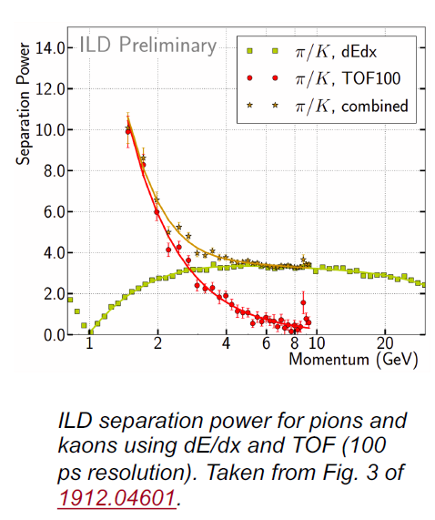
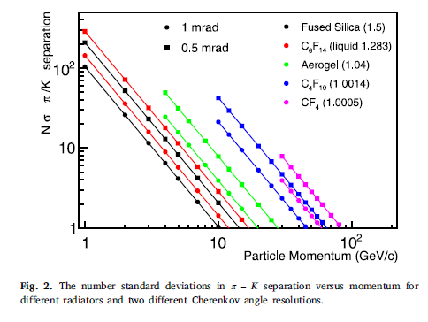
  dE/dx cannot be useful in SiD: it needs ~1 m track length in gas and is disfavoured for solids including silicon due to the density effect, which suppresses the K/π difference in the needed momentum range
  Ring imaging Cerenkov system is the only realistic approach
    Electron Ion Collider (EIC) people are making impressive progress with an aerogel radiator, but for our momentum range, a gaseous radiator is mandatory
Optimal for SiD
….?
Antonis Papanestis NIM,A 952 (2020) 162004

Slide 3
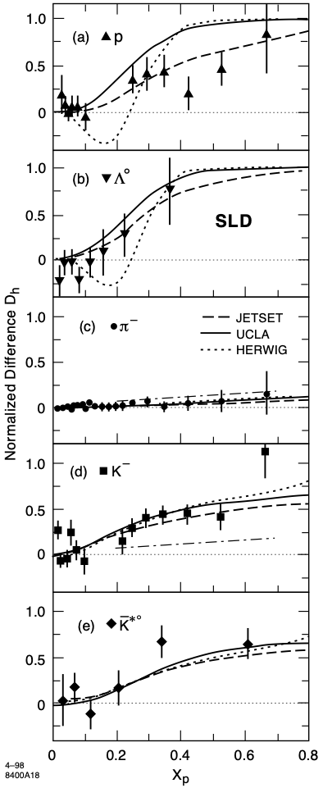
This from Su Dong – he will discuss

Slide 4
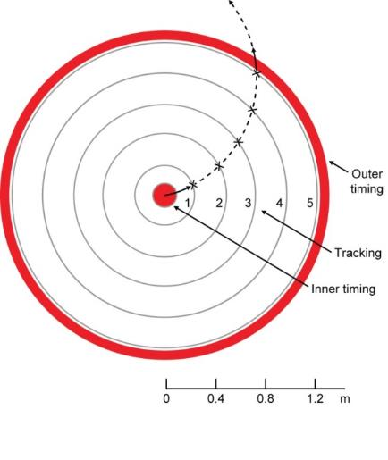
K Stefanov, Pixel tracker for SiD, LCWS2021
(first proposed at LCWS Sendai, 2008)
Tracking layers are ~0.6% X₀ per layer, air cooled
50 μm pixels, 5-bit amplitude digitisation, giving 5 μm precision in rφ and z
28 Gpixels, cf 12.5 Gpixels in ITS2 of ALICE – a modest increase
<100 W dissipation, so air cooled
Timing layers are close to ECAL, so can be thicker (evaporative cooling)
See Konstantin’s LCWS 2021 slides for further details
Dimensions of Barrels 1-5 directly follow the old SiD microstrip tracker. Given the enhanced performance of each layer, the pixel tracker can be significantly compressed, for the same performance (still to be simulated)
See Konstantin’s LCWS 2021 slides for further details

Slide 5
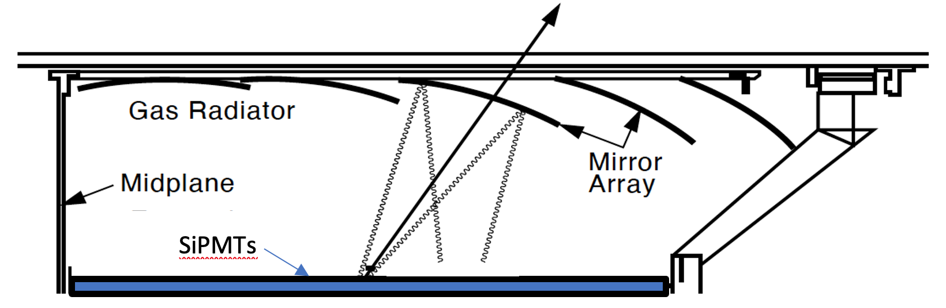
Jerry Vavra Looks at first sight like the SLD CRID, but it’s in another world of performance
**
or MAPMTs (HPK)
or Stacked EM-MAPS (Sony/RIKEN), potentially 10x10 cm²
buttable, very low power, QE close to 100%
Driven by night vision and other commercial applications – see my CERN Courier article:
https://cerncourier.com/wp-content/uploads/2021/07/CERNCourier2021JulAug-digitaledition.pdf
Extremely thin but excellent optical quality mirrors
(Antonis Papanestis)
** Needed radiator thickness will evolve downwards, as QE of photodetectors advances

Slide 6
So an important question is, how much will a ring imaging detector expand the radius of the tracker+PID system, if at all?
This question can not be answered in a rush, and will need a substantial group of keen young people to study it. ILCX may provide the best chance of recruiting participants for this exciting work
[and please be aware of the possible upturn in the prospects for ILC, talks now under way between ILC(Japan) and MEXT]
Over to the real leaders of this adventure, Su Dong and Jerry Vavra ….

