Slide 1
Sources Subgroup Summary, Dec.13. 2021
K. Yokoya, for IDT-WG2 Jan.11.2022
Dec.13 23rd Regular meeting
  Masao Kuriki, Hitoshi Hayano, Gudi Moortgat-Pick, Joe Grames, Kaoru Yokoya, Sabine Riemann, Tsunehiko Omori, Tohru Takahashi (Some may be missing)
  Indico https://agenda.linearcollider.org/event/9507/
Undulator positron source status
  Gudi
  status-undulator-1221rev.pdf
e-Driven positron source status
  Masao
  IDTWG2_EDriven_Summarypub.pptx
Next meeting
  Jan.17 (Mon)
  “Recent development of the target for e-driven source” (Omori)

Slide 2
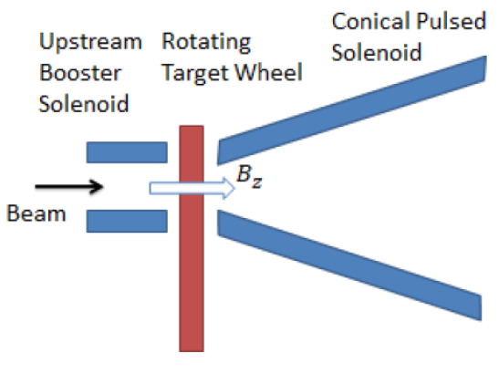
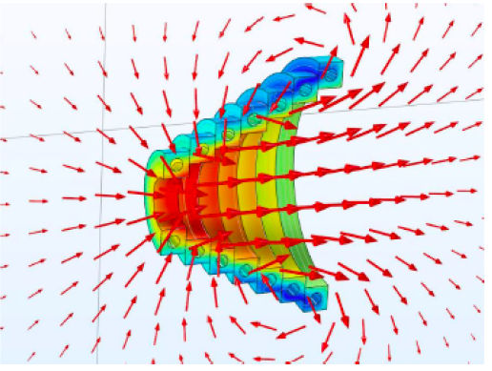
Undulator positron source status
Undulator
  Progress in simulation
    Heating of masks including field errors
Target
  Ti6Al4V, wheel of 1m diameter spinning in vacuum
  Material test using Mainz microtron with high PEDD
  Another heating test at Hamburg
  Magnetic bearings: well-known but negotiation with suppliers needed for ILC-specification
Focusing device
  Best candidate: pulsed solenoid
  Design calculation on-going
  Peak field ~5T
  Max field on target: ~3T
  Ferrite shielding behind coils
    reduce the field and heat on target
    yield decreased only slightly
  Yield simulation results : ~1.74 at DR
  Another choice: plasma lens

Slide 3
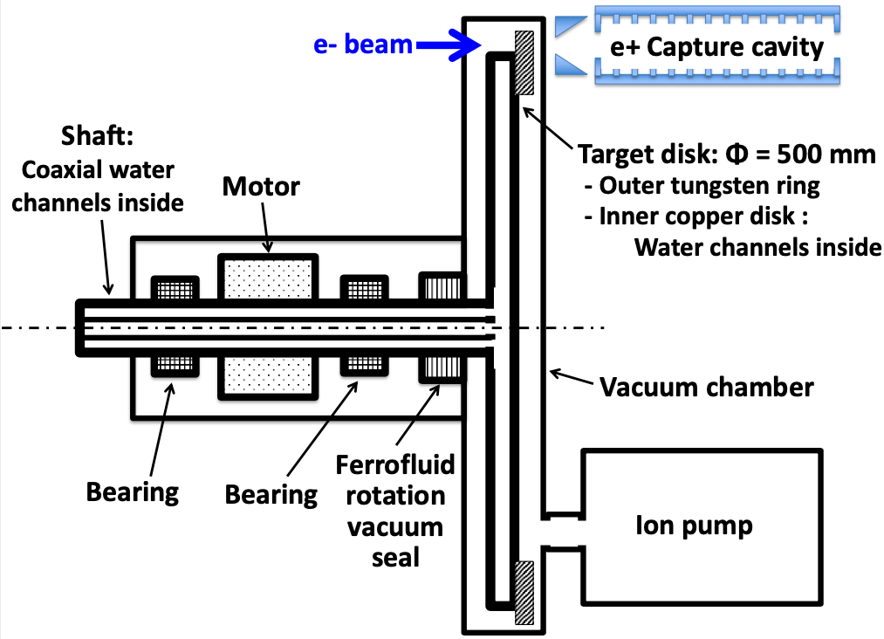
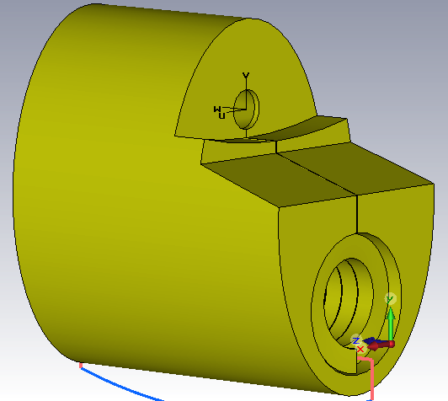
e-Driven positron source status
Electron driver
  S-band (2.6GHz) 3m TW structure, 102 cavities, ~32MV/cavity, 3GeV + 10% margin
  Loading compensation by AM (amplitude modulation)
Target
  W/W-Re , 50cm diameter disk, rotating
  Water cooling, Double ferro-fluid vacuum seal
  Prototype being tested
    ferro-fluid test
    rotation in vacuum
    Fluid evaporation test (analysis of evaporated gas components)
Flux concentrator
  Heat calculation
  Cooling method
Capture cavity
  APS cavity
  Field calculation
  Simulation of loading compensation

