Slide 1




Pixel TPC testbeam results
Yevgen Bilevych, Klaus Desch, Harry van der Graaf, Fred Hartjes, Jochen Kaminski, Peter Kluit, Naomi van der Kolk,
Cornelis Ligtenberg,
Gerhard Raven, and
Jan Timmermans
8 Quad Module
LCTPC January 2022

Slide 2
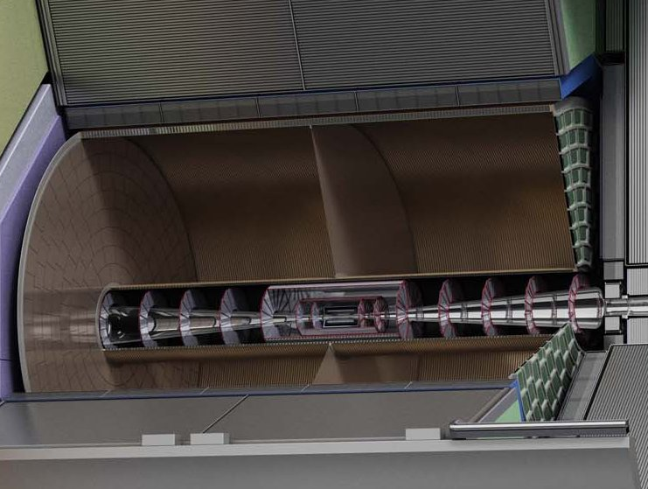
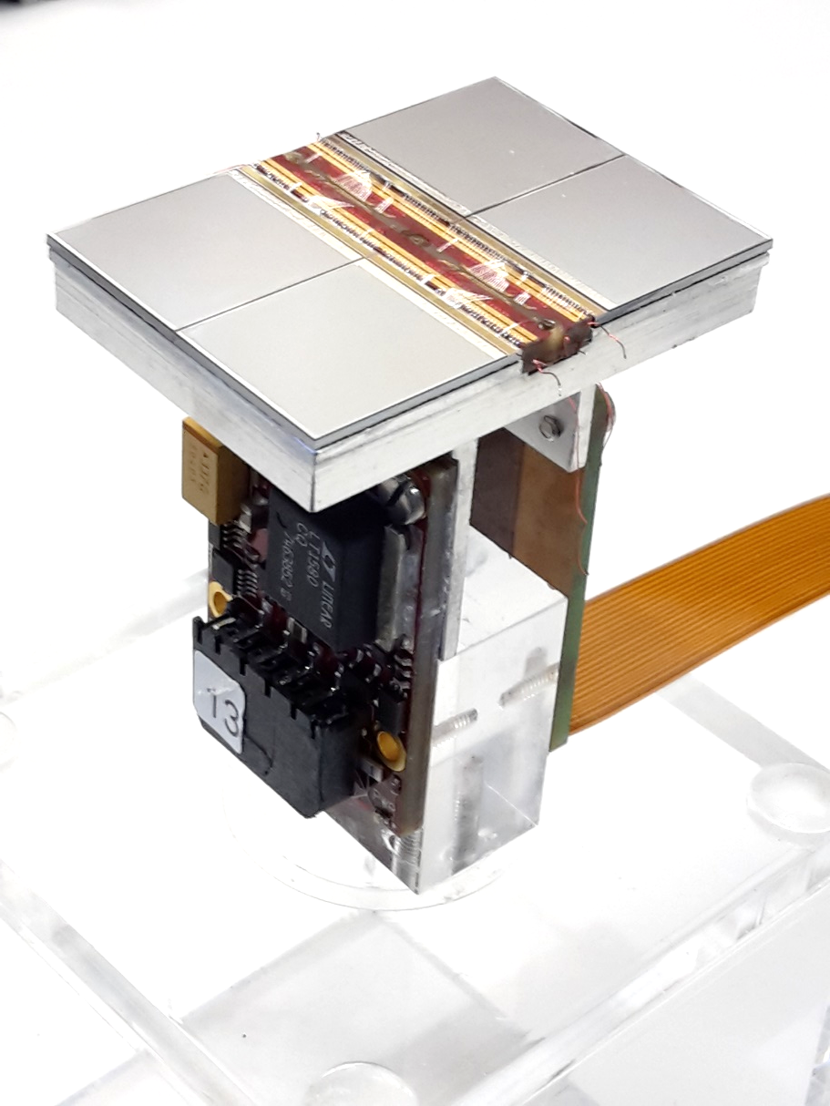
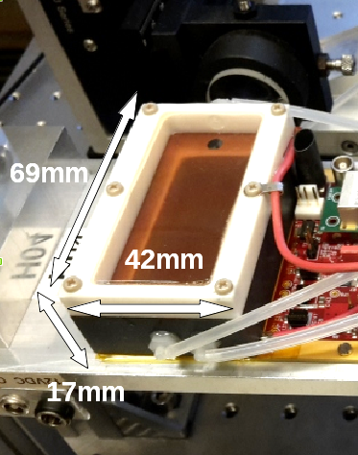
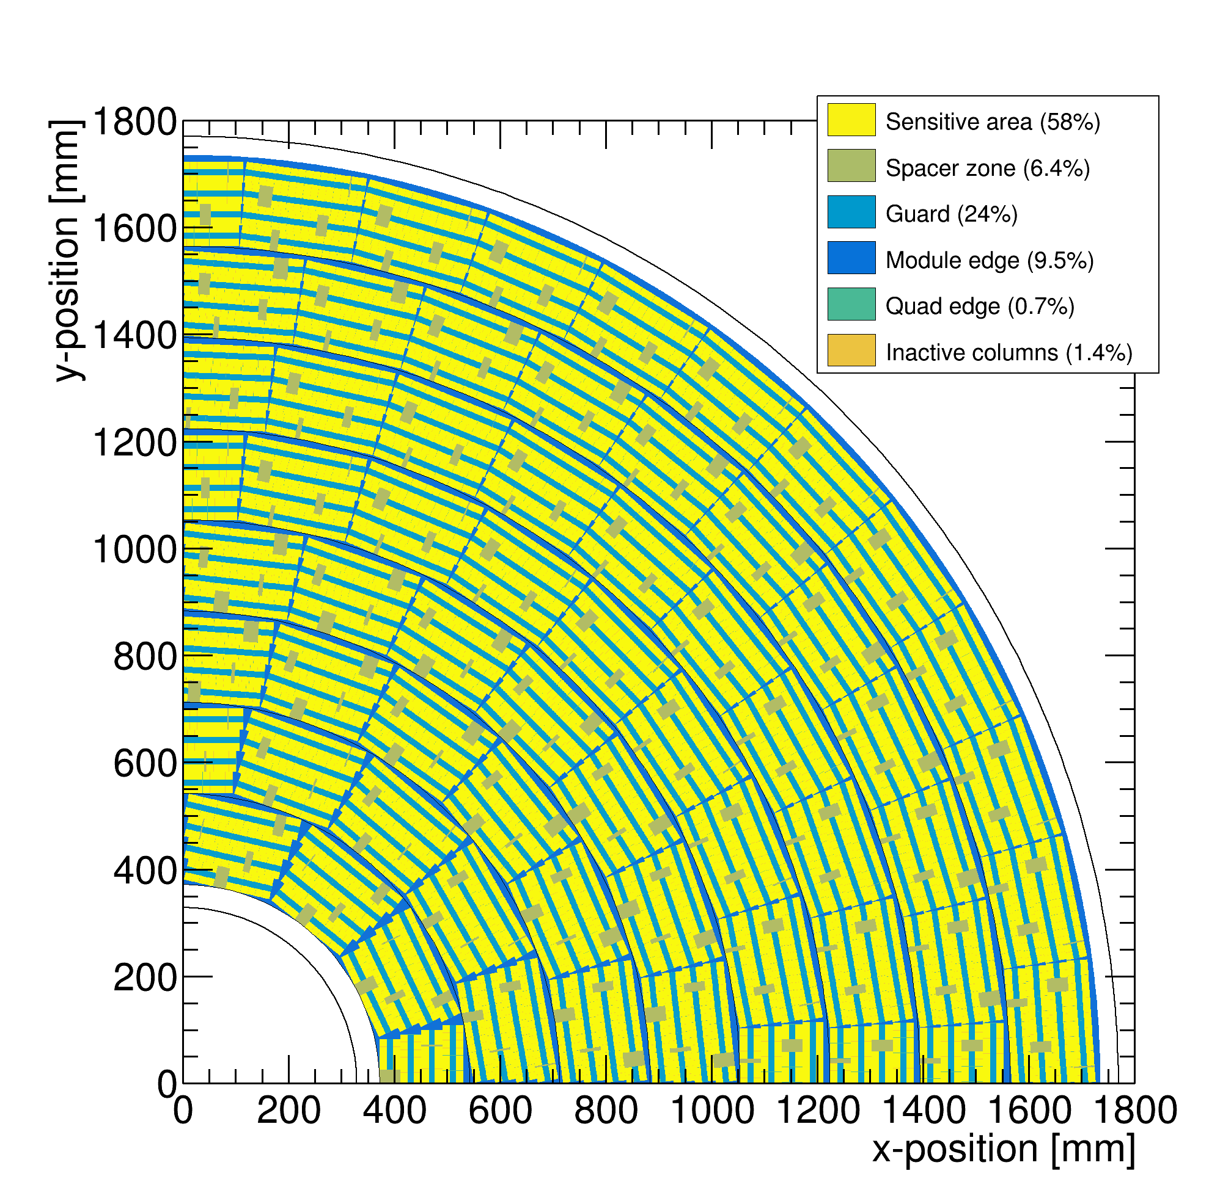
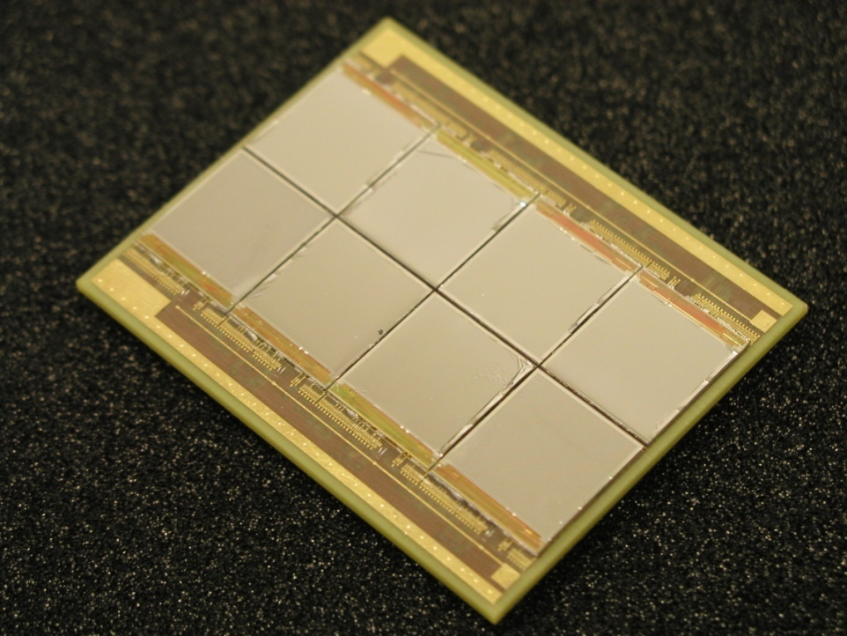
Pixel TPC
(Octopuce)
(TimePix1) TPX3 chip Quad Module TPC plane
(2007-14) 2017 2018 2019

Slide 3
8-QUAD module with field cage
in red guard wires

Slide 4
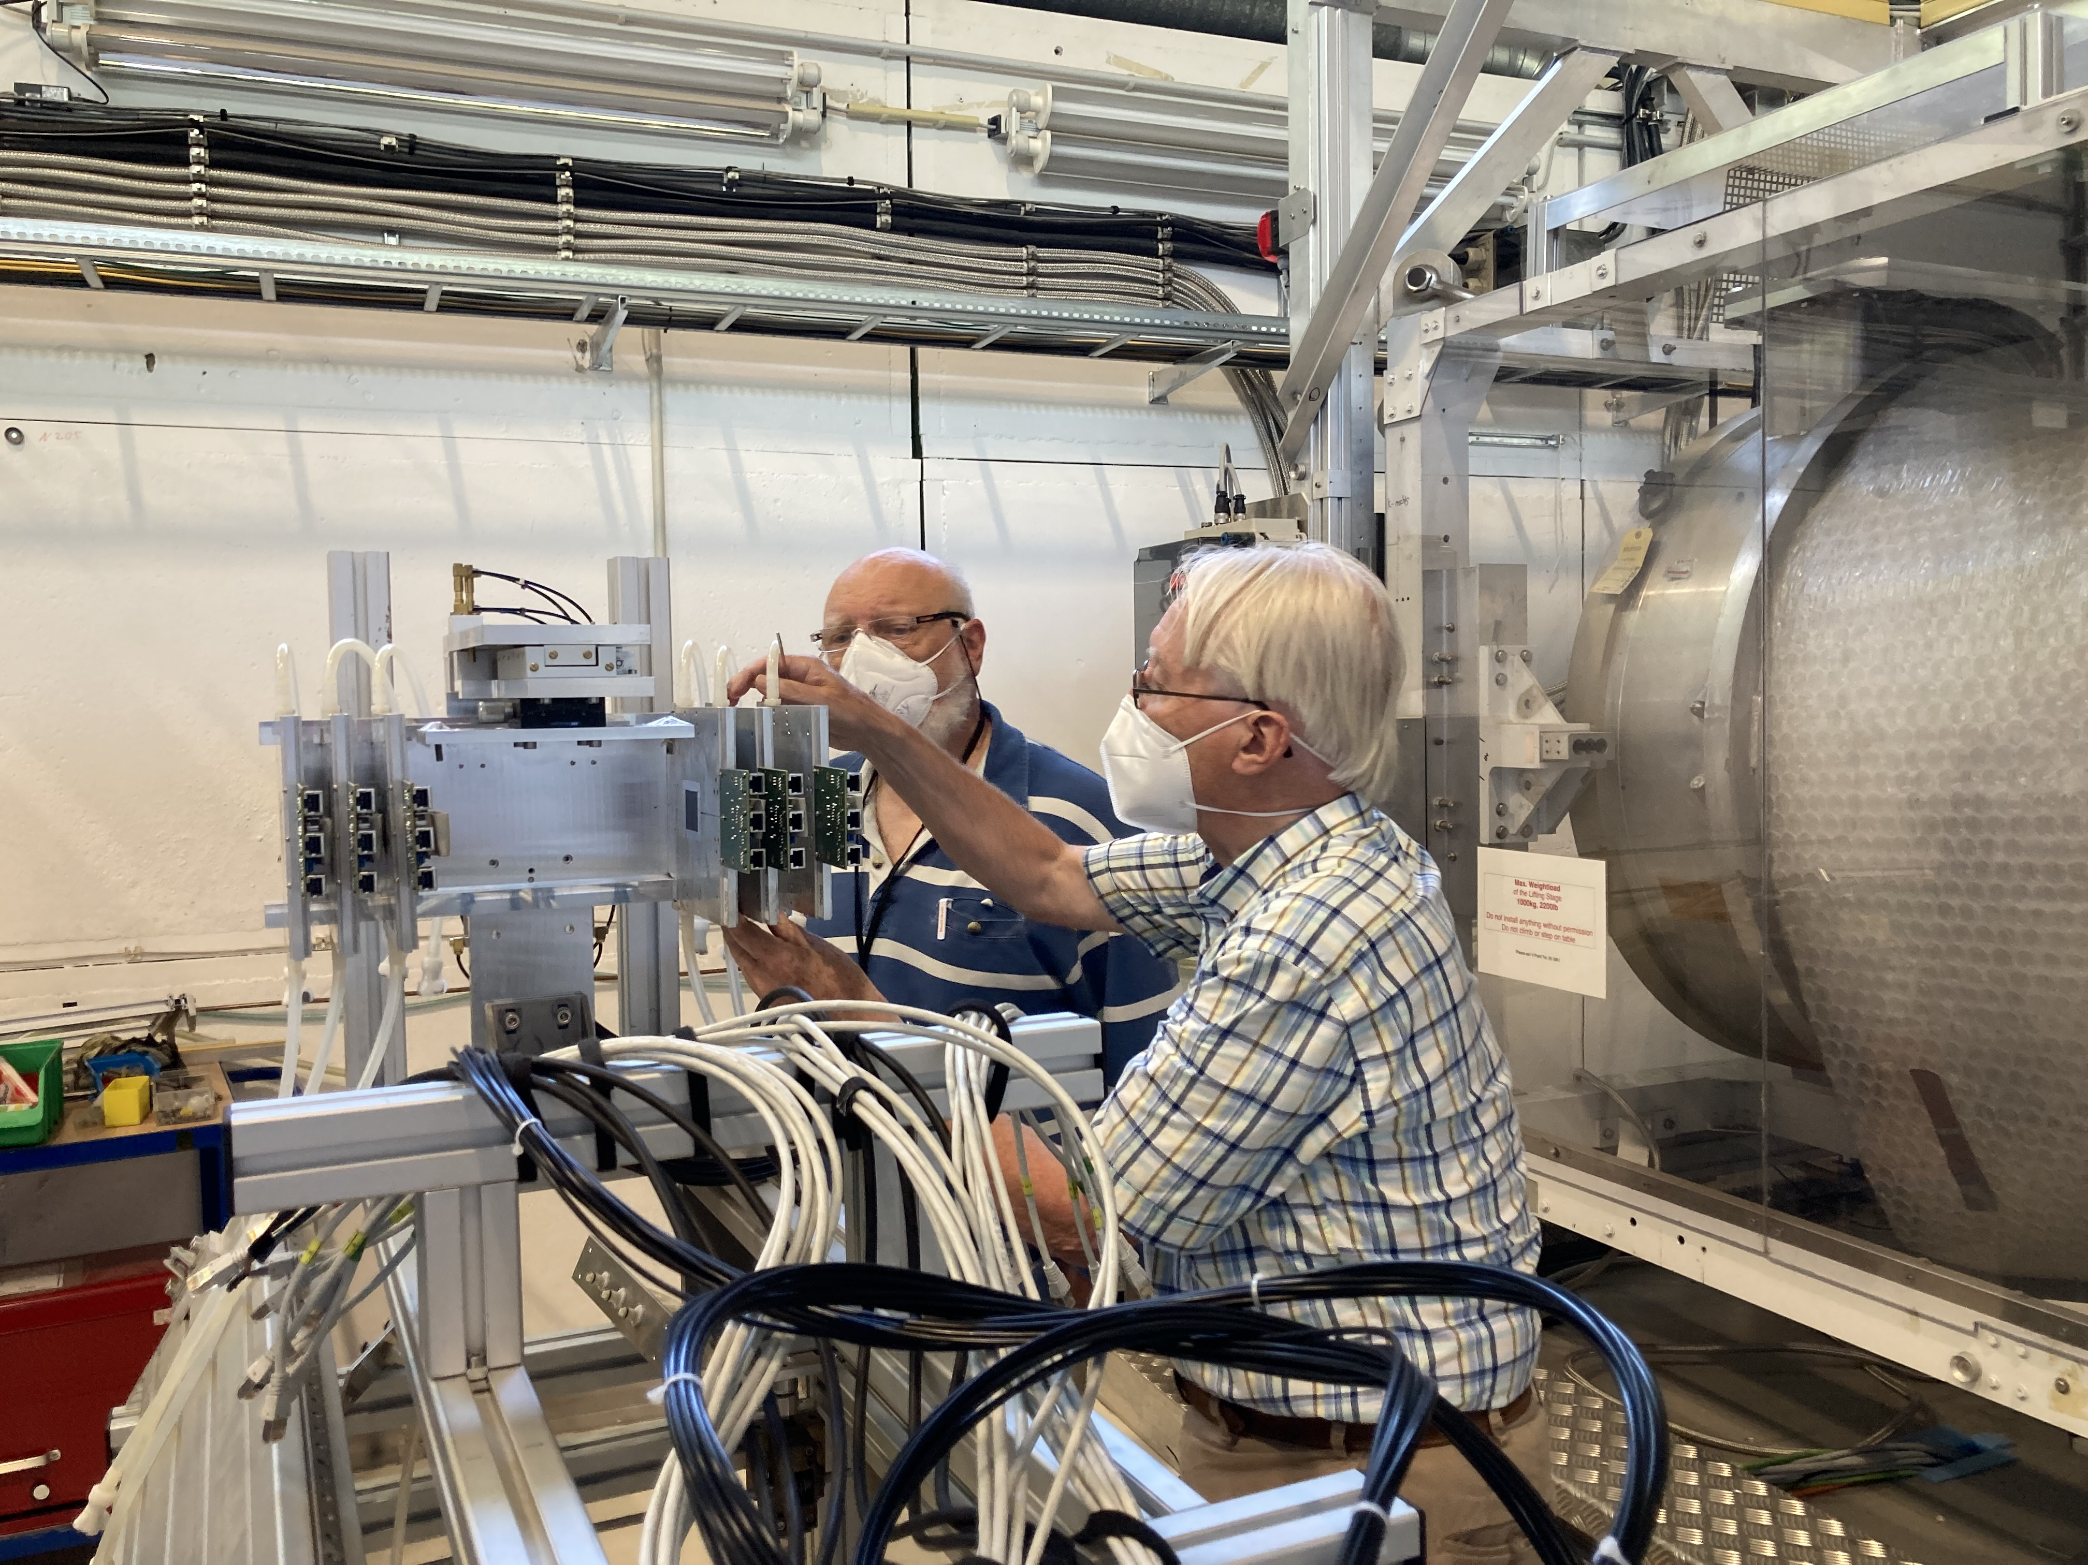
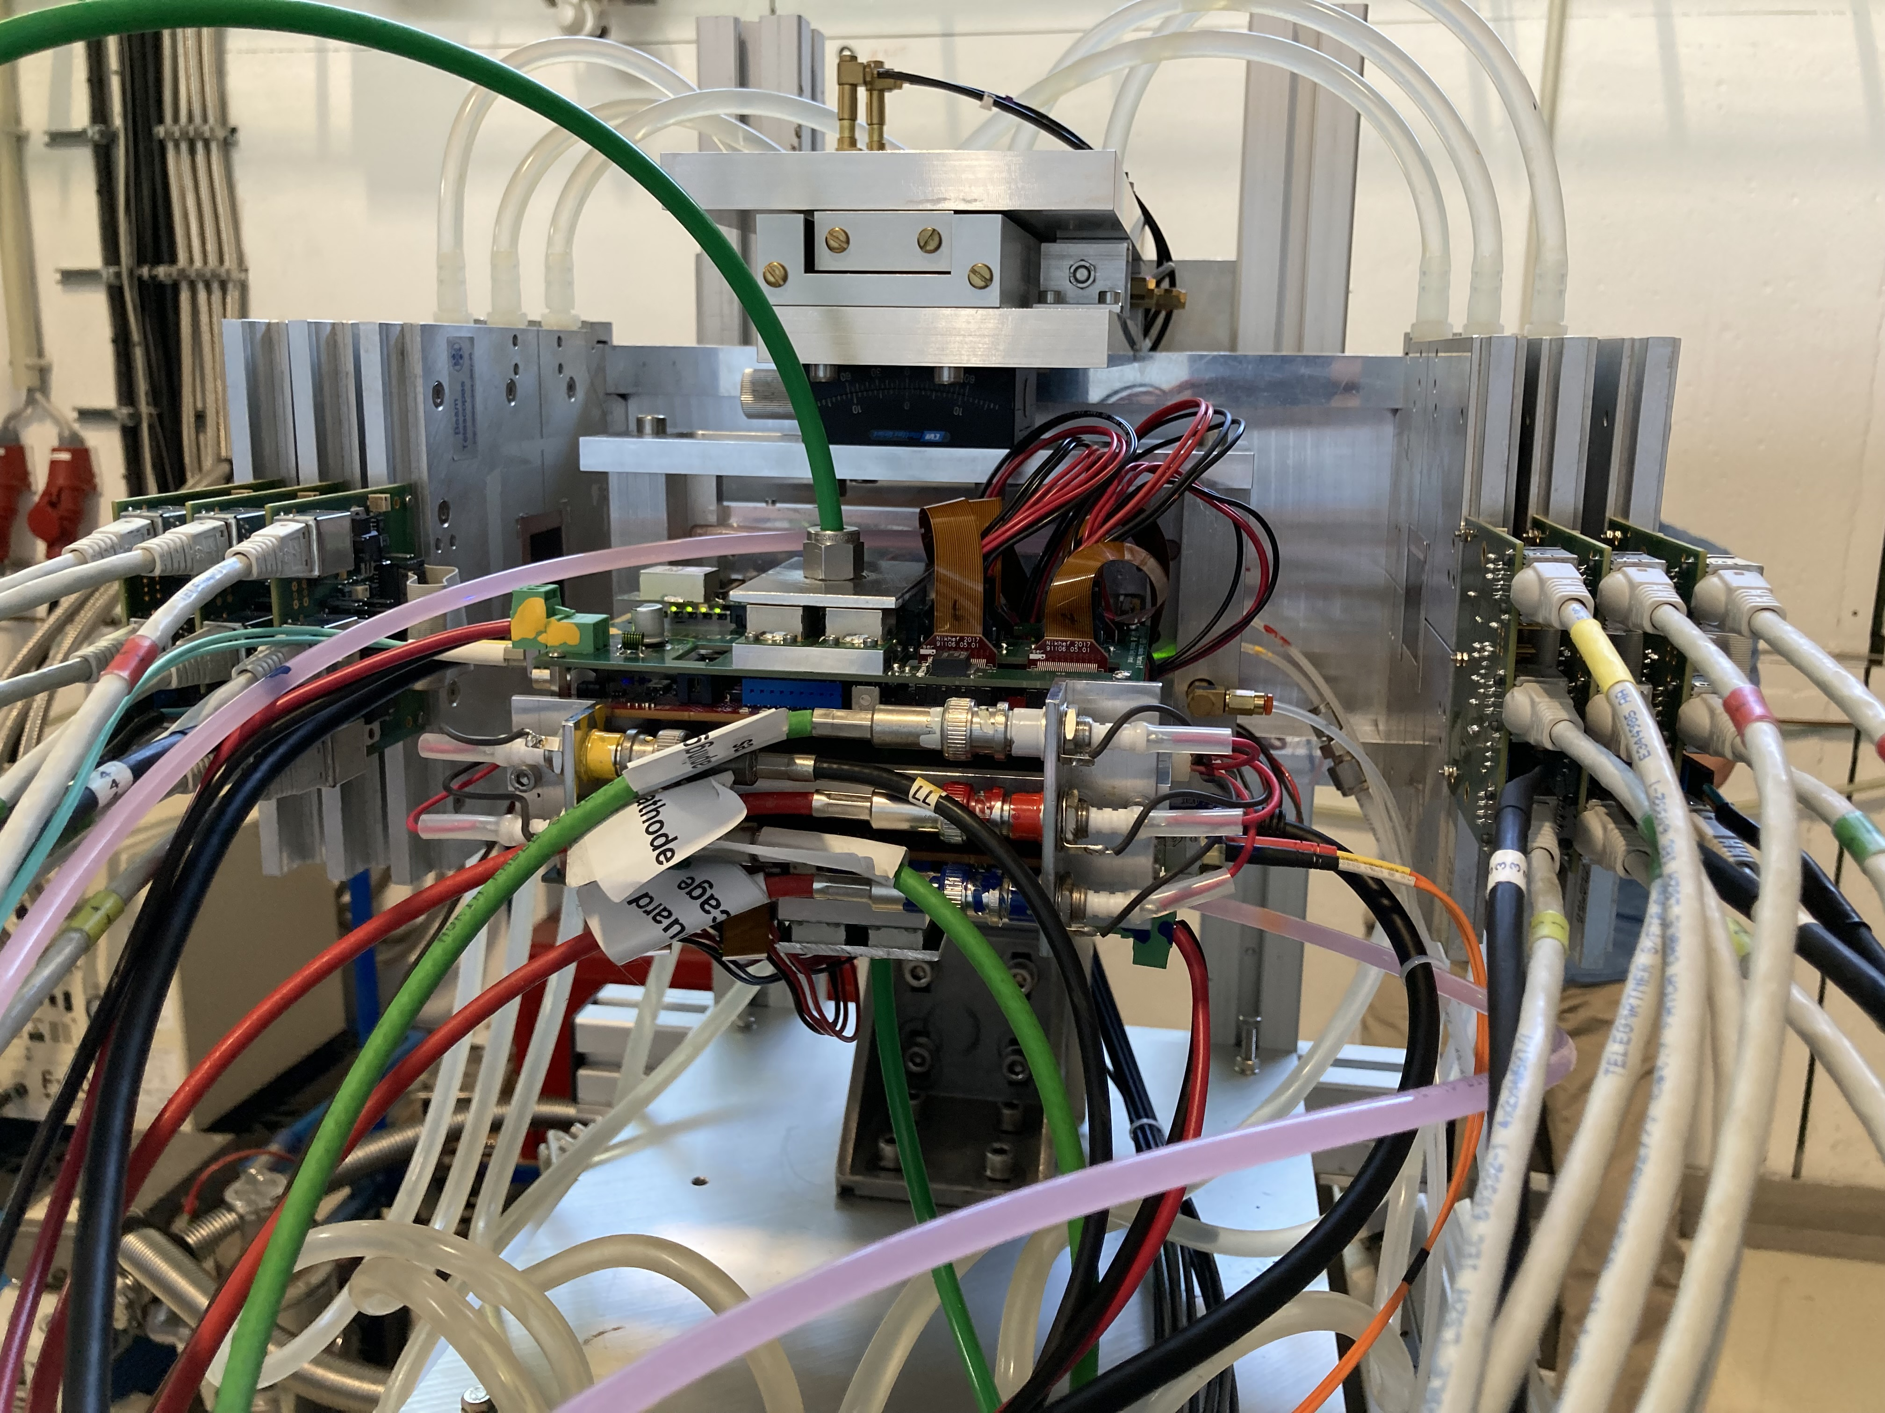
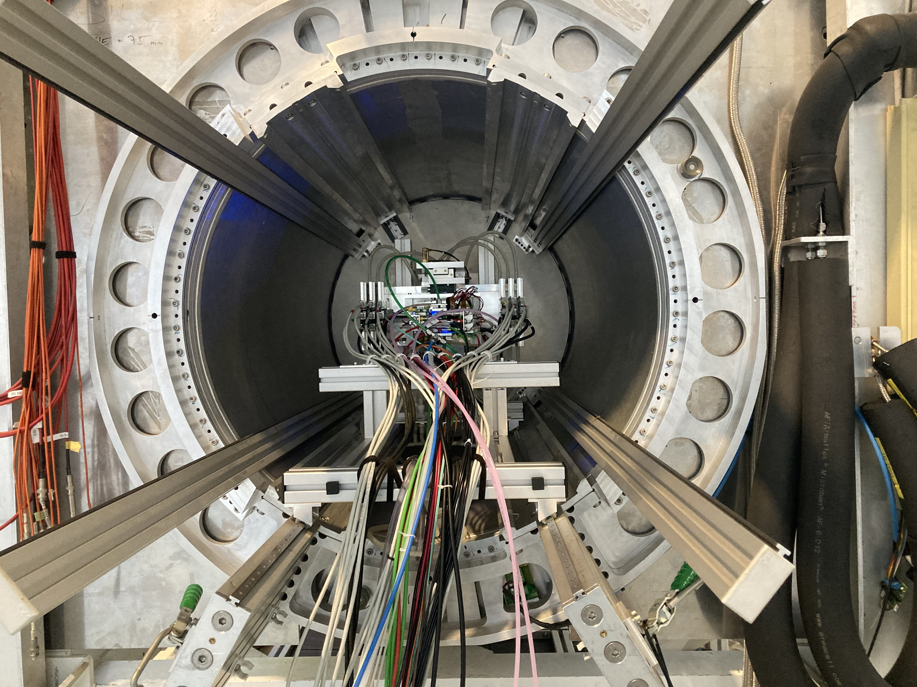
DESY testbeam June 2021
Mounting the 8 quad module between the silicon planes
sliding it into the 1 T PCMAG solenoid

Slide 5
DESY testbeam June 2021

Slide 6
DESY testbeam June 2021

Slide 7
DESY testbeam Analysis
High statistics data taken with B=0, 0.5 and 1 T fields
Electron Beam momenta of 6, 5 and smaller sets with 4,3,1 GeV
The stager allowed to move the 8 Quad Module
  3 positions x and 4 in z (drift)
Some data was taken with a rotated Module to allow studies of e.g. ExB deformations
The Mimosa Silicon telescope was described and aligned using the corryvreckan software with the General Broken Lines (GBL) track model. The ‘corryv’ software was updated to allow for a curved track fit

Slide 8
Setup with Telescope planes
5 4 3
2 1 0
beam exit beam entry
← z axis z=0

Slide 9
DESY Telescope Alignment
B=0 T run 6905
Preliminary

Slide 10
DESY Telescope Alignment
B=0 T run 6905
Preliminary

Slide 11
DESY testbeam Module Analysis
Preliminary results for Run 6916 B=0 T p =6 GeV will be presented
Tracks are preselected using the Mimosa Telescope
Matching between Telescope track and hits local x 2 mm and z 5 mm
Performed an alignment of the 8 quad module:
  local frame xy and z (drift) positions; angles dx/dy and dz/dy
  Adjusted t0 and x per chip
Time slewing applied using ToT:
  δt (ns)= 18.6/ (0.1577+ToT(μs))
Drift velocity (E=280 V/cm) 78 μm/ns
A local fit is performed to the track hits using errors:
  σ_{xy} =250 μm and σ_{z} =425 μm (slight dependence on ToT)

Slide 12
DESY testbeam Module Analysis
Preliminary
x global
x local
Track 1050 hits
χ²_{xy} = 912/1048
χ²_{z} = 1740/1051
(no asymmetric tail or outlier removal applied)
z global
y local
z global
y global
z local drift
y local

Slide 13
DESY testbeam Module Analysis
Run 6916 B=0 T p =6 GeV
σ_{xy} =250 μm and σ_{z} =425 μm 1M hits
Preliminary
<mean> 6.4 mm

Slide 14
DESY testbeam Module Analysis
Run 6916 B=0 T p =6 GeV
Track selection:
more than 100 hits in concentrator 0 and 1
more than 50% of the hits shouldbe on the tracks
Preliminary
1060 selected tracks
Impressive 900 hits / track
module or tracklength 157.96 mm

Slide 15
DESY testbeam Module Analysis
Run 6916 B=0 T p =6 GeV
Tracking precision:
position 9 μm (xy) 13 μm (z)
angle 0.19 mrad (dx/dy) 0.25 mrad
module tracklength = 157.96 mm
Note that in a B field because of the reduced diffusion the tracking precision will improve substantially
Preliminary

Slide 16
Pixel TPC conclusions
First preliminary results of the 8 Quad Module in the DESY test beam in June 2021 have been presented
The run 6916 B=0 T with p=6 GeV has been analysed
The Mimosa telescope has been aligned using the corryvrecan software and tracks fitted with the GBL package
The 8 quad module data is decoded and matched to the tracks
The single electron resolution is:
  σ_{xy} =250 μm and σ_{z} =425 μm (mean drift distance of 6.4 mm)
In total 1060 tracks were selected with 900 hits on track
The tracking precision: position 9 μm (xy) 13 μm (z) in angle 0.19 mrad (dx/dy) 0.25 mrad
Note that the module or tracklength is 157.96 mm
This is very promising: more precise results can be extracted

Slide 17
Backup General Pixel TPC conclusions
A single chip GridPix detector was reliably operated in a test beam in 2017
  Single electron detection => the resolution is primarily limited by diffusion
  Systematic uncertainties are low: < 10 µm in the pixel xy plane
  dE/dx resolution for a 1 m track is 4.1%
  A Quad detector was designed and the results from the 2018 test beam presented
  Small edge deformations at the boundary between two chips are observed
    added guard wires to the module to obtain a homogeneous field
    After correcting the edges, deformations in the transverse plane shown to be < 15 µm
An 8-Quad module has been designed with guard wires
  Deformations in the transverse plane for one quad are shown to be < 15 µm
Test beam data taken at DESY in 2021 are being analysed
A pixel TPC has become a realistic viable option for experiments
  High precision tracking in the transverse and longitudinal planes, dE/dx by electron and cluster counting, excellent two track resolution, digital readout that can deal with high rates
  A double grid will allow to reduce the Ion back flow distortions substantially

