Slide 1




Pixel TPC status and research plans
Yevgen Bilevych, Klaus Desch, Sander van Doesburg, Jean-Paul Fransen, Harry van der Graaf, Markus Gruber, Fred Hartjes, Bas van der Heijden, Kevin Heijhoff, Charles Ietswaard, Dimitri John, Jochen Kaminski, Peter Kluit, Naomi van der Kolk, Auke Korporaal, Cornelis Ligtenberg, Oscar van Petten, Gerhard Raven, Joop Rövekamp, Tobias Schiffer and Jan Timmermans
8 Quad Module

Slide 2
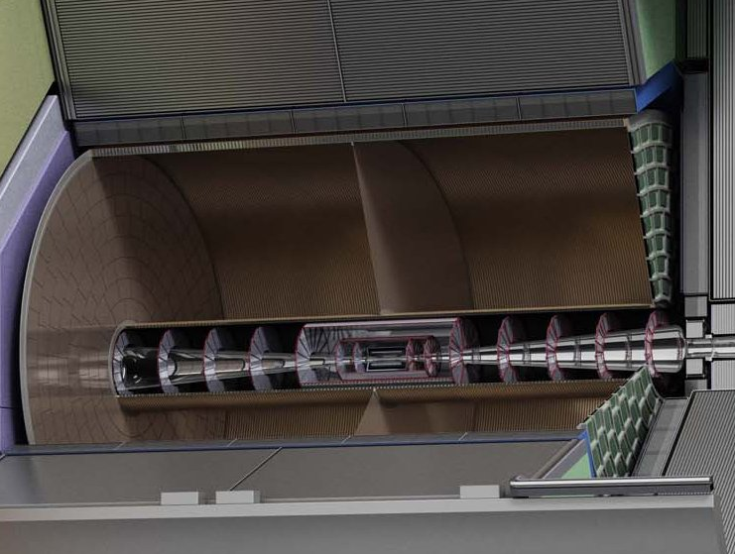
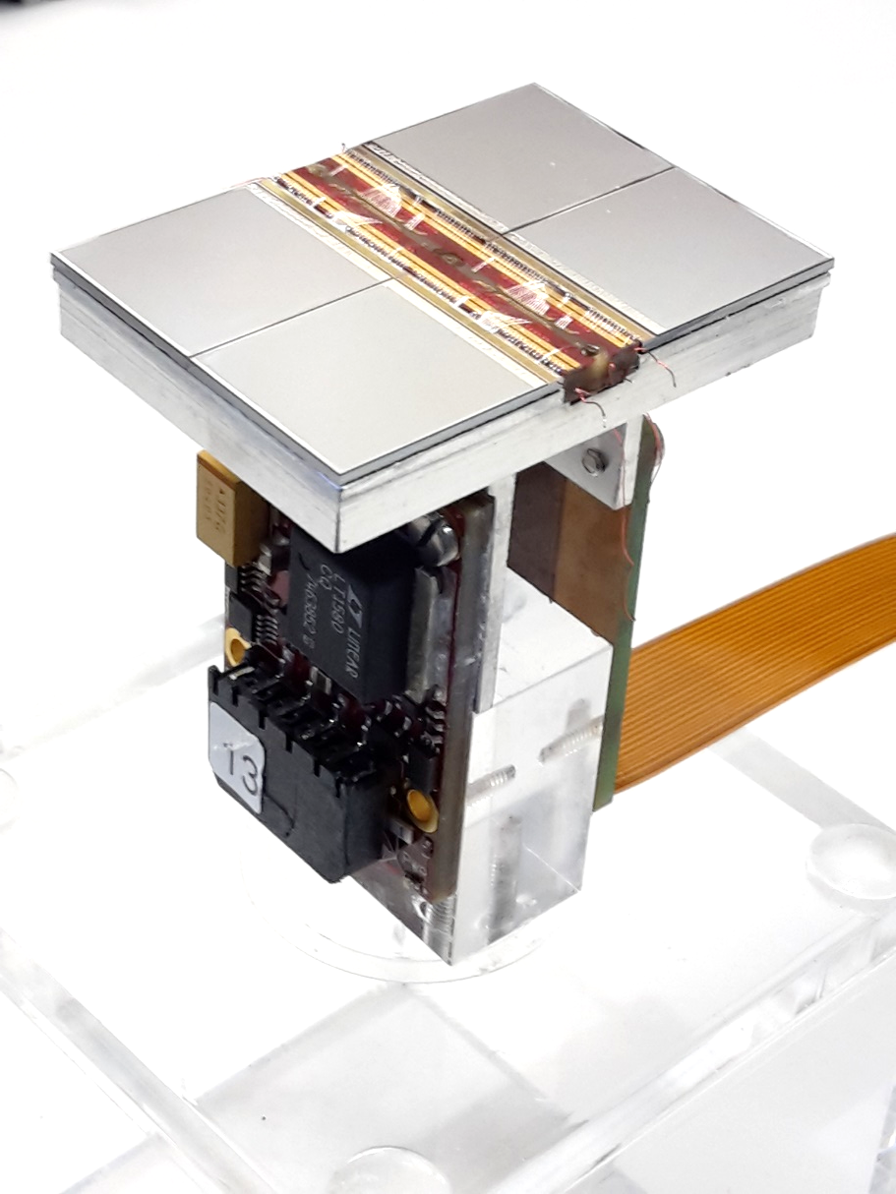
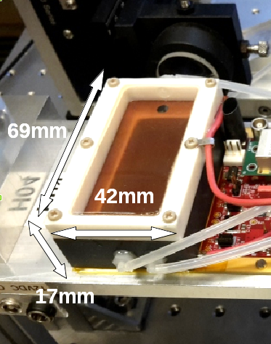
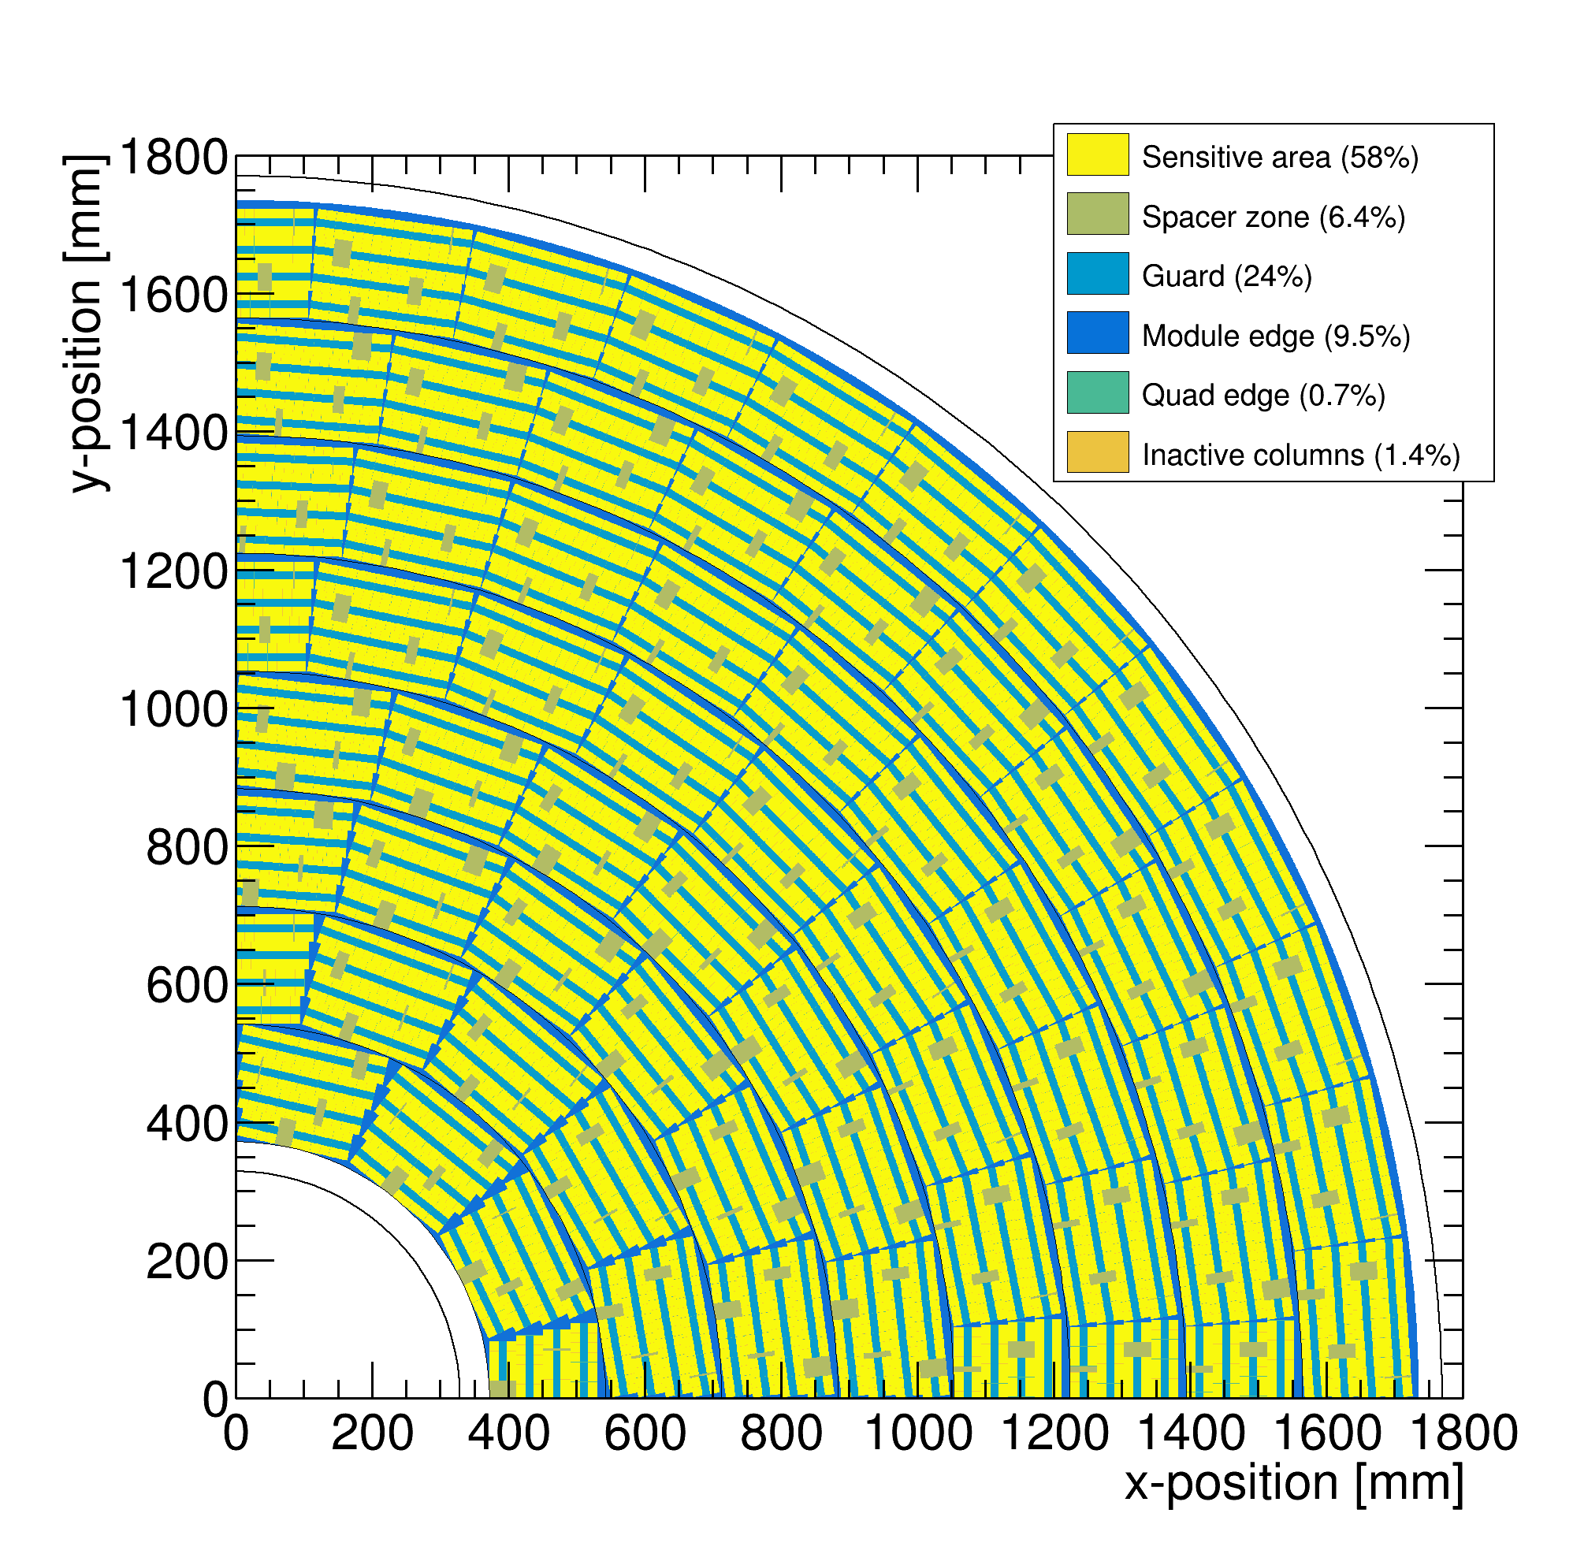
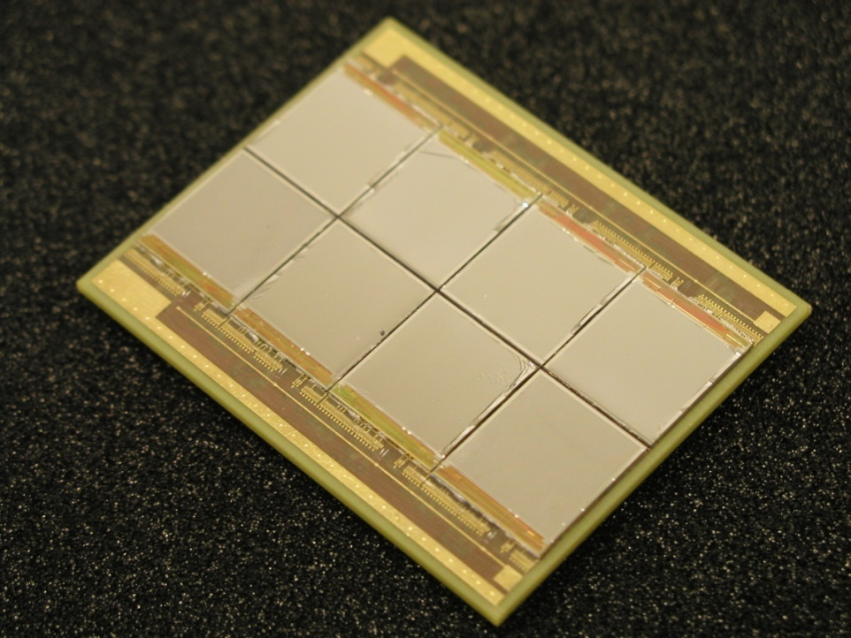
Pixel TPC
(Octopuce)
(TimePix1) TPX3 chip Quad Module TPC plane
(2007-14) 2017 2018 2019

Slide 3
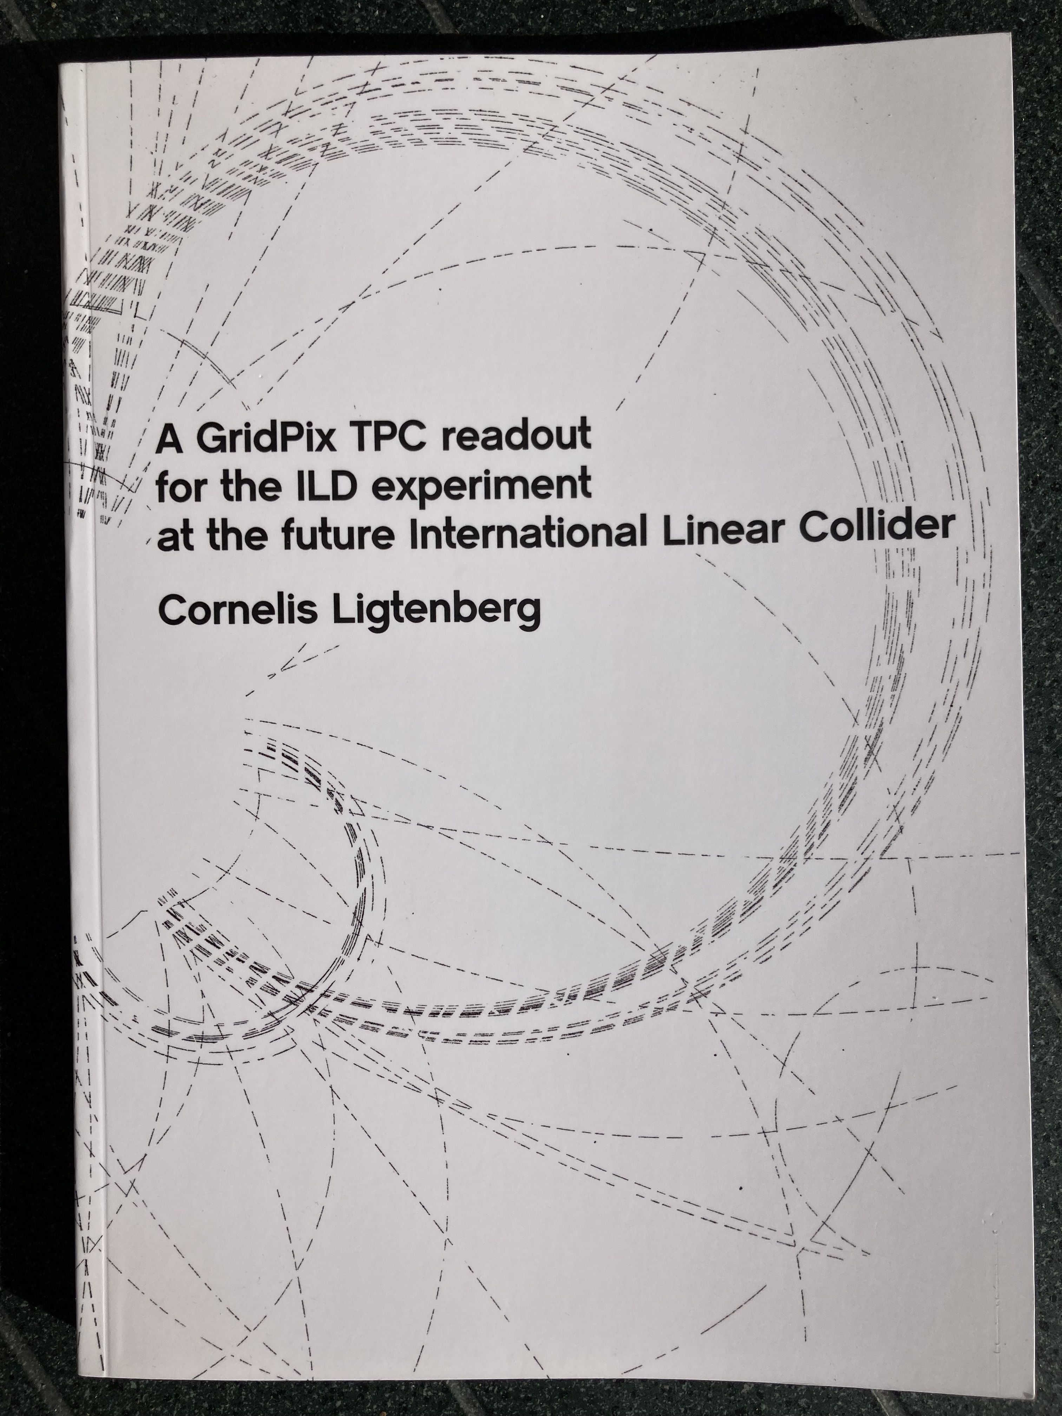
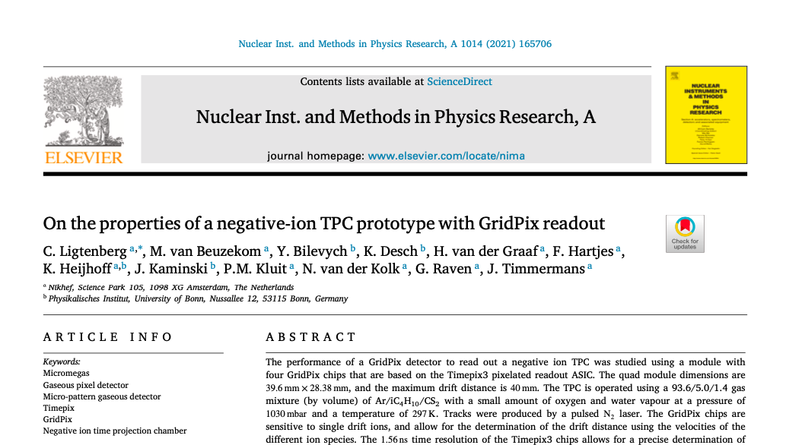
Pixel TPC highlights
    Highlights of 2021:
      Test beam 8-Quad Module at DESY in June 2021
      Publication and defence of thesis Kees Ligtenberg
        “A GridPix TPC readout for the ILD experiment at the future International Linear Collider” https://www.nikhef.nl/pub/services/biblio/theses_pdf/thesis_C_Ligtenberg.pdf
      Publication of the Negative Ion Pixel TPC paper in NIM A
https://www.sciencedirect.com/science/article/pii/S0168900221006914?via%3Dihub
      First preliminary 8-Quad Module testbeam results
      https://agenda.linearcollider.org/event/9533/
      Bonn has a new Detector lab that is commissioned

Slide 4
Pixel TPC status
    Nikhef directorate decided to stop the R&D on gaseous detectors and GridPix detectors
      Active Detector R&D continues on Silicon tracking based on TPX3, VeloPix and TPX4
    The Nikhef building will be renovated and we had to empty the lab room(s) before half November 2020. The gas mixing station was removed.
    The laser setup was transported to Nikhef Nijmegen where it will be used in a setup with quad detectors.
    The equipment and tools for the construction of quads. All testbeam equipment for the quad and 8 quad module including DAQ and gas control systems was transported to Bonn.
      The experimental setup with the 8 quad module and DAQ will be installed in the new Detector Lab in Bonn

Slide 5
Pixel TPC research plans
    TPX3 GridPix production and improvement of resistivity SiN layer
    A Double Grid to reduce the Ion Back Flow
    TimePix4 potential TPC applications
    Analysis of the Pixel TPC and 8-Quad Module data and publication of the results

Slide 6
    TPX3 GridPix production and improvement of resistivity SiN layer
  In the post-processing step a resistive layer is put on the TPX3 chip
  This protects the device from sparks
  In the quad beam tests it was found that the SiN layer charges up at very high rates (> 10 kHz)
  Yevgen is investigating how to reduce significantly the resistivity of the SiN layer; this will reduce the charge up
  Different trial samples were made but can be made easier in the new Lab; The equipment to measure the resistivity is now at Bonn
  Production of TPX3 wafers with InGrids @ IZM Berlin or in Bonn is under discussion

Slide 7
    Reducing the Ion Back Flow in a Pixel TPC
  For TPC applications at a circular collider e.g. CEPC or FCC-ee or for heavy ion experiments it is interesting to reduce the Ion Back Flow IBF
  At the ILC the IBF can be reduced by adding a gating device on top of the readout module
  The basic idea to test is to make a double Grid (see next slide)
  This can be tested in a simple form by adding by hand a grid on top of a single chip
  More involved and challenging is to make a double Grid in post processing. This is possible in the new Detector lab
  Note that a double grid device (called “TwinGrid”) was made by postprocessing using the TimePix chip by Victor Blanco Cavallo https://www.nikhef.nl/pub/services/biblio/theses_pdf/thesis_V_Blanco_Carballo.pdf
TwinGrid
NIMA (2009) 644

Slide 8

    Reducing the Ion Back Flow in a Pixel TPC
  The Ion back flow can be reduced by adding a second grid to the device. It is important that the holes of the grids are aligned. The Ion back Flow is a function of the geometry and electric field ratios in the regions.
  Detailed simulations – validated by data - have been presented in LCTPC in April 2020 WP 326 and shown at the International Workshop on the High Energy Circular Electron Positron Collider Shanghai in October 2020
  With a hole size of 25 μm an IBF of 3 10⁻⁴ can be achieved and the value for IBF*Gain would be 0.6. Simulation is without magnetic field, and assuming equal E field ratios of 16. This is interesting to pursue further.
Plan to test a second
grid and measure IBF

Slide 9
    TimePix 4 potential pixel TPC applications
  In April 2020 we held a brainstorm meeting to discuss the construction of a GridPix detector based on Timepix4 (https://indico.nikhef.nl/event/2243/)
    The TPX4 has the size of a typical Quad (3.5/4)
    The layout Fred Hartjes proposed will have a larger coverage than the Quad. Quad coverage is about 69%. Still there will be an area (˜1+3.5 mm) where the wirebonds are connected to the PCB - with a guard on top of it. Estimated coverage is 73%.
    The layout will not need an expensive flex/PCB. That is a large improvement with respect to TPX3.
    For TPX4 a multiplexer board for a module is not needed
    Lower power consumption (0.55 W/cm²) than TPX3

Slide 10
    TimePix 4 potential TPC applications
    Assembly due to the layout of the TPX4 will be much easier
    The use of Through Silicon Via’s will alllow to improve the coverage substantially: potentially up to 96%. It is interesting to follow the TSV developments
  Several years effort
    It all starts with post-processing of a TPX4 wafer
    At Nikhef there is only support for TPX4 silicon tracking applications and the read out SPDR software for TPX4
    Support will be easier with ILC approved, CEPC, FCCee funding

Slide 11
    Pixel TPC 8-Quad Module performance
  The first prelimary results of the measurements of the 8 quad module using the data taken at the testbeam at DESY have been presented in the LCPTC Collaboration meeting ‘First Results on the pixel testbeam’ https://agenda.linearcollider.org/event/9533/
  The analysis of the data will be further pursued, presented in different LCTPC meeting and conferences before publishing the final results

Slide 12
    Pixel TPC Summary
  Highlights of 2021:
    Test beam 8 quad Module at DESY in June 2021
    Publication and defence of thesis Kees Ligtenberg
    Publication of the Negative Ion Pixel TPC paper in NIM A
    Bonn has a new R&D lab
  Status:
    Nikhef directorate decided to stop the development of gaseous detectors (and focus on silicon)
    Some technical support for the quads will be provided
    Equipment and tools for GridPixes were transferred to Bonn
    Resources are rather limited (post doc Naomi and PhD Kees left)

Slide 13
    Pixel TPC Summary
  Research plans:
    Improvement of SiN layer and production of TPX3 GridPixes
    Ion Back Flow: Testing of a double grid structure
    TPX4: follow the ongoing developments
    Analysis of the Pixel TPC and 8-Quad Module data and publication of the results
  We are contacted by groups that show interest for: X ray polarimetry in space, TPC for Dark Matter searches. Pixel TPC at CEPC and upcoming a Heavy Ion experiment at the Electron Ion Collider (Brookhaven)

