Slide 1
Sources Subgroup Summary, Jan.31. 2022
K. Yokoya, for IDT-WG2 Feb.08.2022
Jan.31 24th Regular meeting
  Masao Kuriki, Gudi Moortgat-Pick, Joe Grames, Kaoru Yokoya, Gregor Loisch, Carmen Tenholt, Sabine Riemann, Tsunehiko Omori, Tohru Takahashi, Peter Sievers, Steffen Doebert, Phil Burrows, Hitoshi Hayano, Jenny List, Andrea Latina, Andy Lankford, (Some may be missing)
  Indico https://agenda.linearcollider.org/event/9556/
Presentation on pulsed solenoid
  Gregor Loisch, Carmen Tenholt
  “A tapered pulsed solenoid as optical matching device for the undulator-based ILC positron source”
  Uploaded in the above indico page
  220128_ILC_Sources_Solenoid_Mk2.pdf
Next meeting
  Not decided yet
  There was steering panel meeting yesterday (Feb.7). Discussed on WP prioritization
  Will continue on next Monday

Slide 2
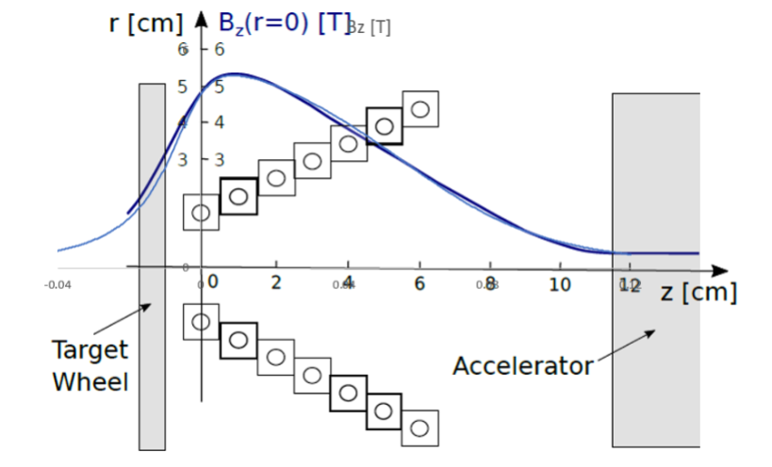
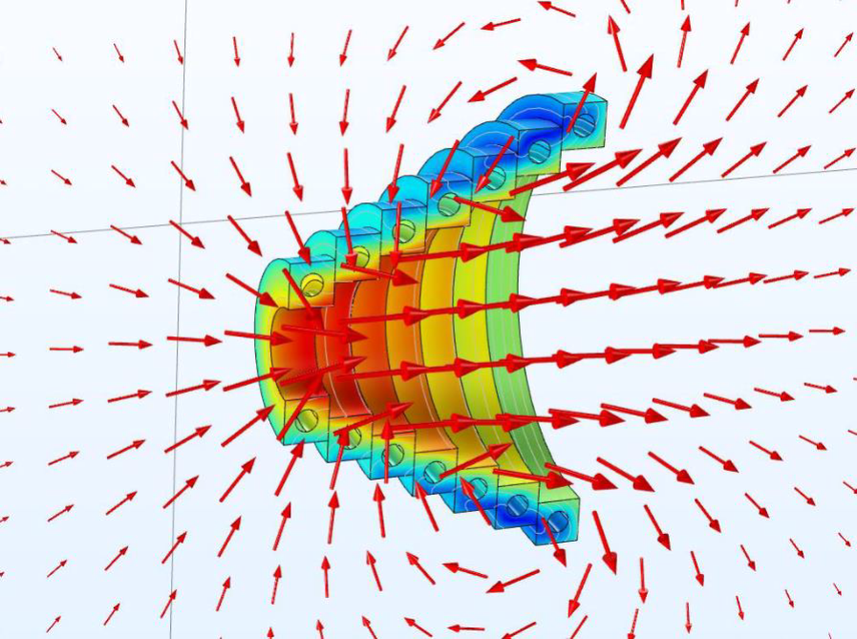
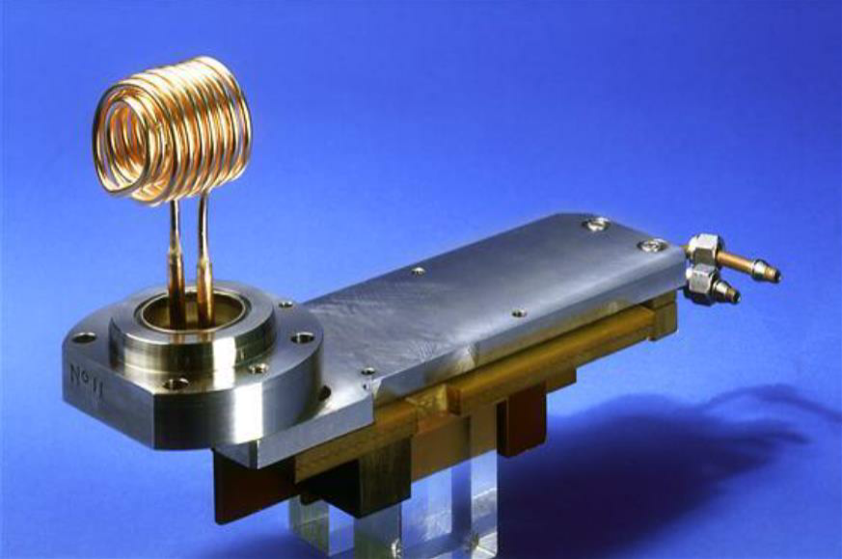
Pulsed Solenoid
Pulsed solenoid being studied as the optical matching device for the undulator scheme
  Flux concentrator: time-dependence problem of the field
  QWT: positron yield is not sufficient
Preliminary parameters
  Peak current ~50kA
  4ms half sine plus 1ms flattop, 5Hz
  Peak field ~5T
  (compare LEP positron source: 2.5kA, 20μs, 100Hz, 0.83T)
  7 turns, linear taper 20mm → 80mm
  With ferrite shielding to reduce the field on target

Slide 3
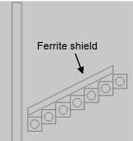
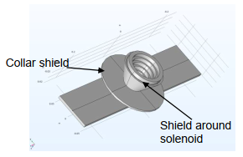
Skin depth effect
  Skin depth at 125Hz ~ 6mm
    Larger than the coil diameter.
    The current is effectively DC
  Field intensity variation less than 1%
Effects of ferrite shielding
  Added to reduce the field and force on target
    Distance target ←→ coil ~4mm right now (to be further optimized)
  Target heat load due to rotation 711W → 298W
  Target head load by time-dependent field 73W → 31W
  Peak force on target 612N → 263N

Slide 4
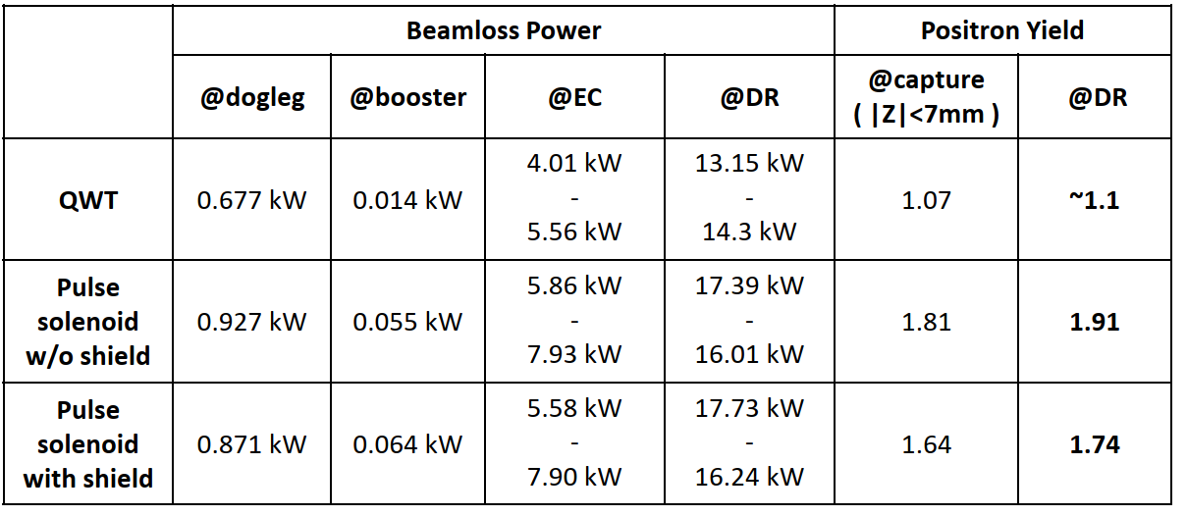

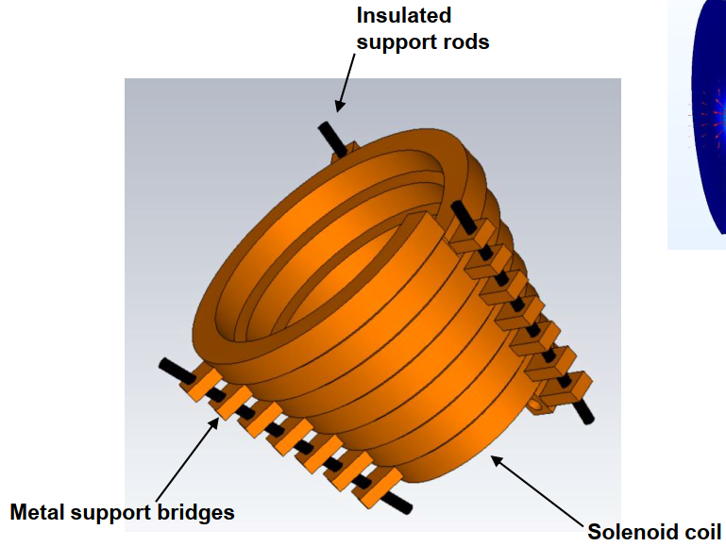
Yield Simulation
  Done by Fukuda and Okugi (KEK)
Coil stress
  Max. peak von-Mises stress ~ 146 Mpa
  Average power dissipation ~11.5kW
  Manageable level
Mechanical design at start

