Slide 1
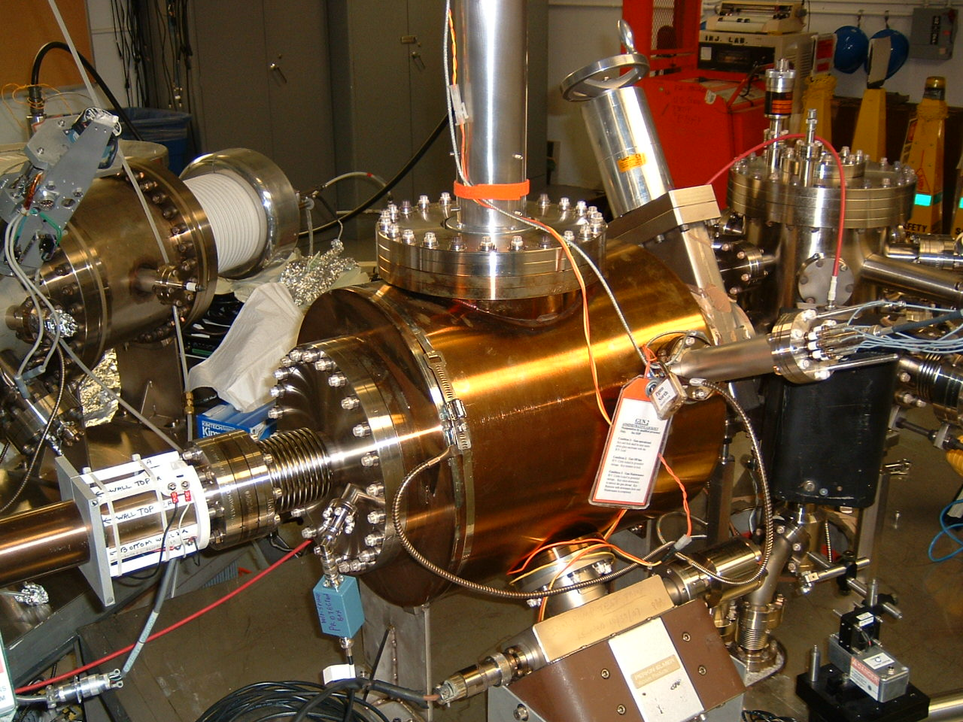
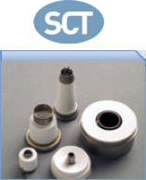
ILC-IDT WG2 Steering Meeting #2 (Feb 14, 2022) – J. Grames (JLab)
Defer to PreLab
Design and build narrow-band gain-switch fiber laser
Collaborate with industry to develop and characterize GaAs/GaAsP SL
Consider for PrePreLab
During GDE, JLab built two XHV inverted 200 KV guns
Now, consider an inverted 350 KV for higher peak current
Child’s Law:
Assume d=3 cm cathode/anode gap
Peak current : GDE (4.8 A), TDR (11 A)
V (kV) | j₀ (A/cm²)
100 | 7
140 | 14
200 | 23
350 | 53
14 A/cm² (10 mm dia. laser)
Jefferson Lab has built two 200 kV DC-HV photo-guns
Large grain Nb tested 225 kV (>18 MV/m)
Stainless steel now at CEBAF 200 kV (no FE)
Both demonstrated <2e-12 Torr (N2 equivalent)
GDE ~ 16 A/cm²
Current density j = 56 A/cm² (5 mm dia. laser)

Slide 2
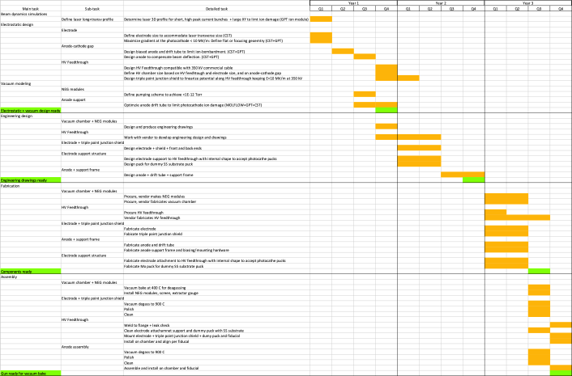
Design (Scientist)
Beam dynamics
Electrostatic
Vacuum
Engineering (Scientist + ½ Eng)
Vacuum chamber/NEGs
HV insulator
Cathode/triple point
Anode/support
PrePreLab (Years 1 and 2) to model, simulate, produce engineering documents for ILC 350 kV gun; requires 2 FTE Sci + 0.5 FTE Eng
Fabrication
Assembly & Testing
PreLab (Year 3) to fabricate, assemble gun; developing cost estimate, est. $250k (no overhead) + 0.5 Sci

