Slide 1
27th Meeting of SRF Group in IDT/WG2
Report on SRF steering panel meeting
Others (if any)
Attendees: A. Yamamoto, S. Michizono, S. Belomestnykh, S. Posen, R. Rimmer, M. Liepe, P. McIntosh, D. Delikaris, S. Stapnes, A. Lankford, E. Cenni, L. Monaco,
P. Burrows, Kirk
https://agenda.linearcollider.org/category/256/
Kirk

Slide 2
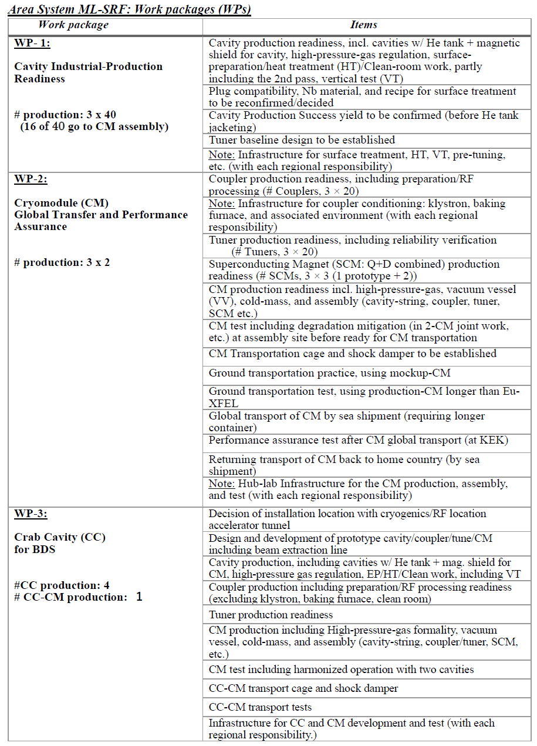
Time-critical Work Packages before Pre-lab
We ranked the following items as the top priority from the TPD.
WP-1
  Eight 9-cell cavity production per region as global
  Some 1-cell cavity production as fundamental research
  Additional 9-cell cavity production as domestic
WP-2
  Finalization of CM design
WP-3
  Prototype crab cavity production for two designs
  Harmonized test with two crab cavities
  Final design of prototype CM

Slide 3
Schedule of SRF (Crab/Steering-Panel) Group Meeting in IDT/WG2
Meeting # | Date | Contents
25 | 18/Jan | Studies of Nb material at KEK
 | 20/Jan | Sixth meeting of ILC advisory panel of MEXT
 | 1/Feb | 1st SRF steering panel meeting
 | 8/Feb | 2nd SRF steering panel meeting
 | 14/Feb | Release of the summary for ILC advisory panel of MEXT
26 | 15/Feb | High pressure gas safety regulation for ILC
 | 16/Feb | 3rd SRF steering panel meeting
 | 16/Feb | Joint meeting of crab cavity and BDS group
 | 23/Feb | 4th SRF steering panel meeting
27 | 1/Mar | Report on SRF steering panel meeting
 | 9/Mar | 5th SRF steering panel meeting
 | 11/Mar | Submission of document related to Time-critical WPs to IDT/EB

Slide 4
Questions/Discussions/Comments (memorandum) @27th meeting
Translation by Kirk
Budget/FTE-yr plan for Time-critical WPs
  These common vendors are located in Europe
  Current plan is 4-year plan including Pre-lab phase. Some items with the top priority will be implemented two years ahead of Pre-lab.

Slide 5
Backup slides including old slides

Slide 6
References
Proposal for ILC Pre-lab
  https://www.interactions.org/press-release/ilc-international-development-team-publishes-proposal-ilc
Technical Preparation and Work Packages
  http://doi.org/10.5281/zenodo.4742018
KEK homepage
  https://www2.kek.jp/ilc/en/
Technical Design Report
  https://ilchome.web.cern.ch/publications/ilc-technical-design-report
  https://www2.kek.jp/ilc/en/docs/
The International Linear Collider Progress Report 2015
  https://www2.kek.jp/ilc/en/docs/
The International Linear Collider – A Global Project
  Submitted to European Particle Physics Strategy Update, 2020.
  https://indico.cern.ch/event/765096/contributions/3295702/
ILC Action Plan
  https://www.kek.jp/ja/newsroom/2016/01/06/1400/
  https://www.kek.jp/ja/newsroom/2018/04/24/1200/
Recommendations on ILC Project Implementation
  https://www.kek.jp/ja/newsroom/attic/20191001_%20ILC%20Project.pdf

Slide 7
CM design session (still under arrangement)
Date: 28/Oct (Thu)
Time zone: 21:30~23:30 @JST, 14:30~16:30 @CEST, 8:30~10:30 @EDT, 7:30~9:30 @CDT, 5:30~7:30 @PDT
Chair: Kirk Yamamoto (KEK)
Agenda:
  GDE & History (Akira Yamamoto, Kirk) [15 min]
  Renewed CM design (Yuriy Orlov) [20 min]
  Progress of tuner (Yuriy Pischalnikov) [20 min]
  HPGS (Umemori-san) [15 min]
  Ti-SS & Al-SS joint (Dohmae-san) [10 min]
  Pipe standard used for CM and CAD software (Konomi-san) [5 min]
  RF distribution (Matsumoto-san) [10 min]
  Progress of auto cleaning system (Stephane Berry) [15 min]
  Discussion (Everyone) [? min]

Slide 8
Items to be discussed in CM design session
5K thermal shield (removal of lower part)
  Asking Tom Peterson
Magnetic shield (installed inside helium tank)
Ti-SS joint for 2-phase pipe including pre-cooling line
SS-Al joint for Al thermal straps of splittable QUAD
Port of current-lead for QUAD
Position of HOM absorber
Availability in 45ft container
RF distribution (how to equip with CM)
Tuner design
Access port to tuner

Slide 9
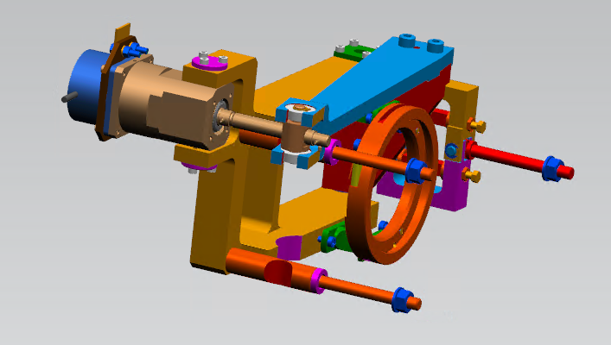
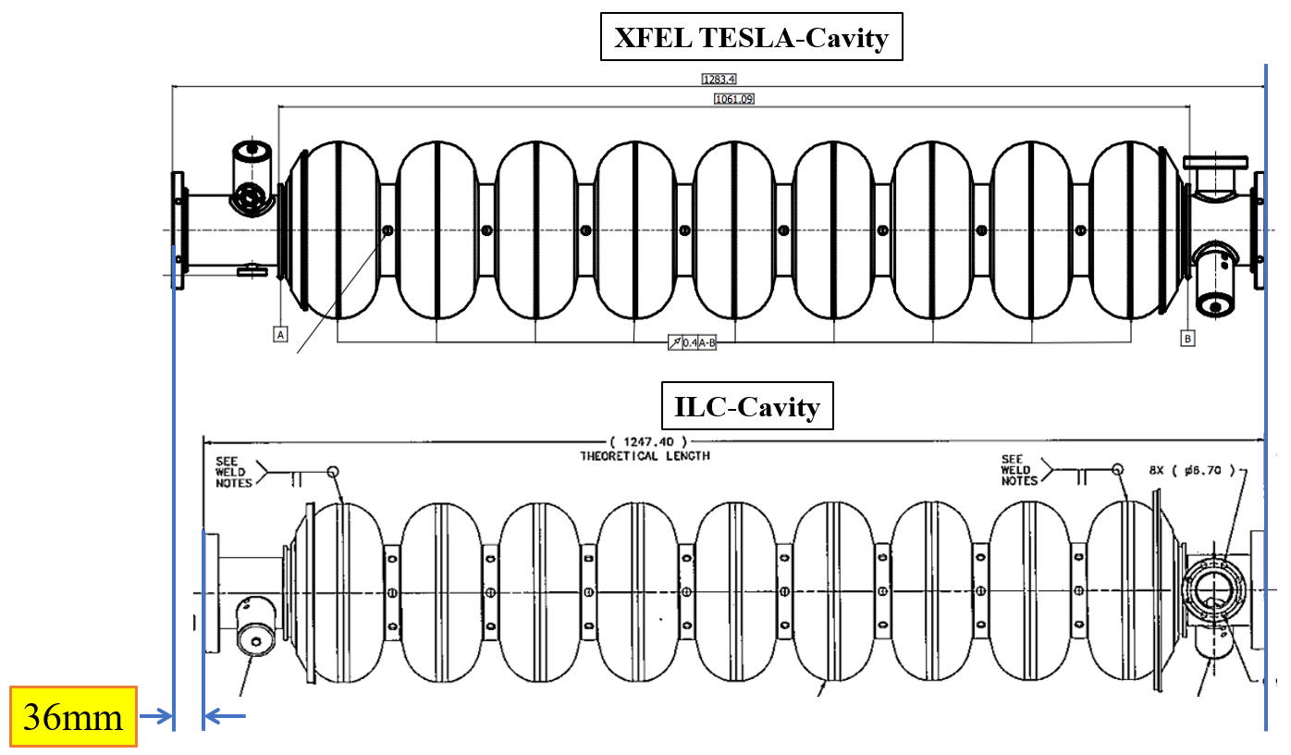
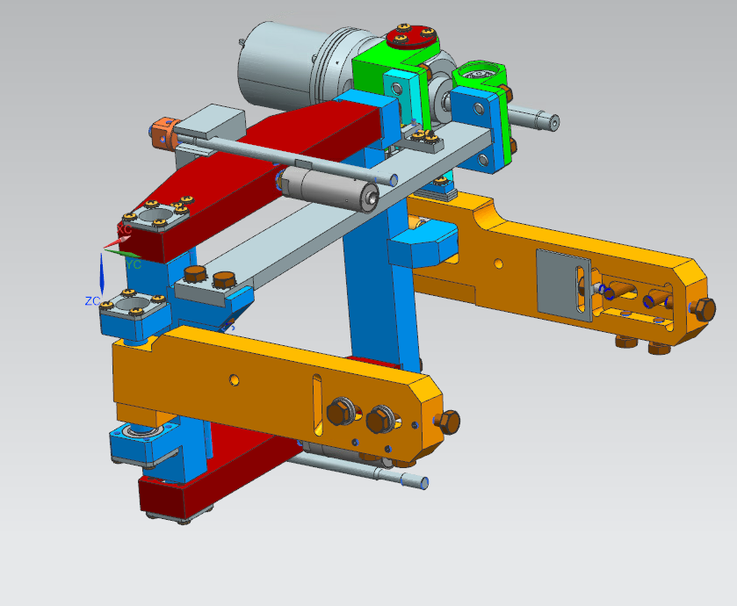
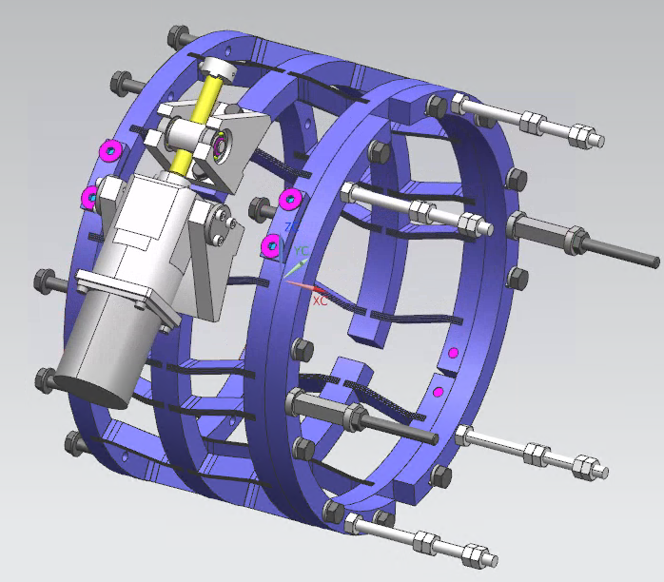
Cavity package and tuner design
Akira Yamamoto-san can comment about
if we change the length of cavity and CM, what happens
E-XFEL
T4CM
LCLS-II

Slide 10
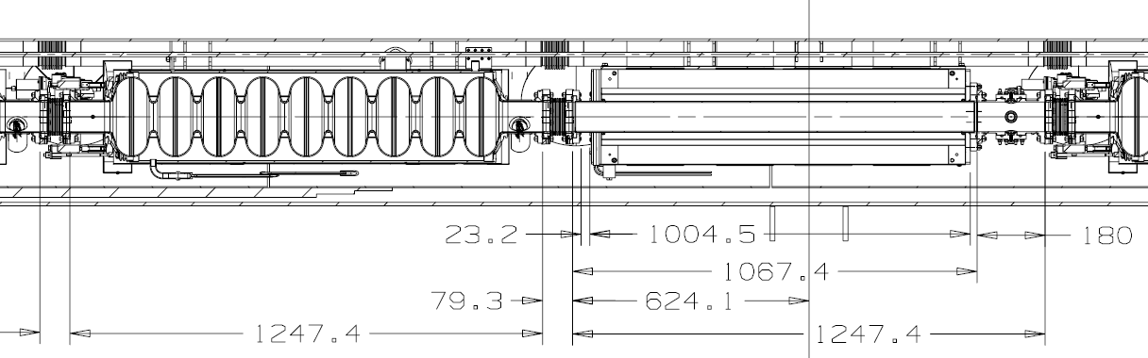
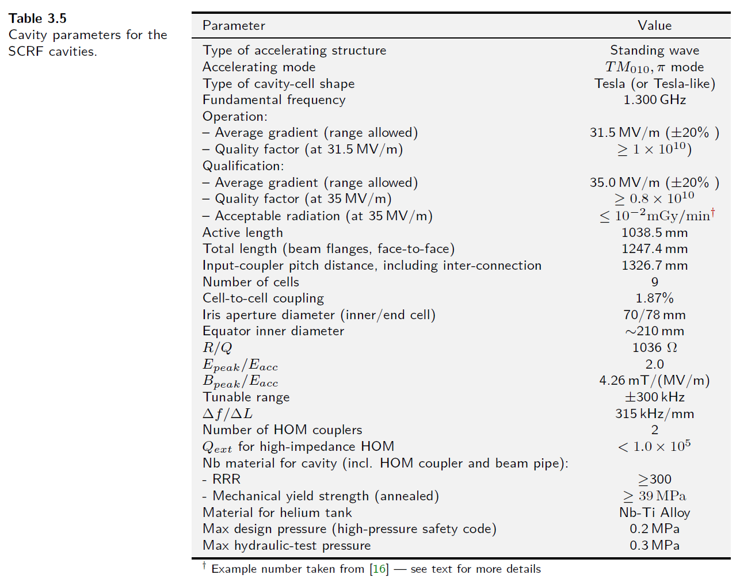
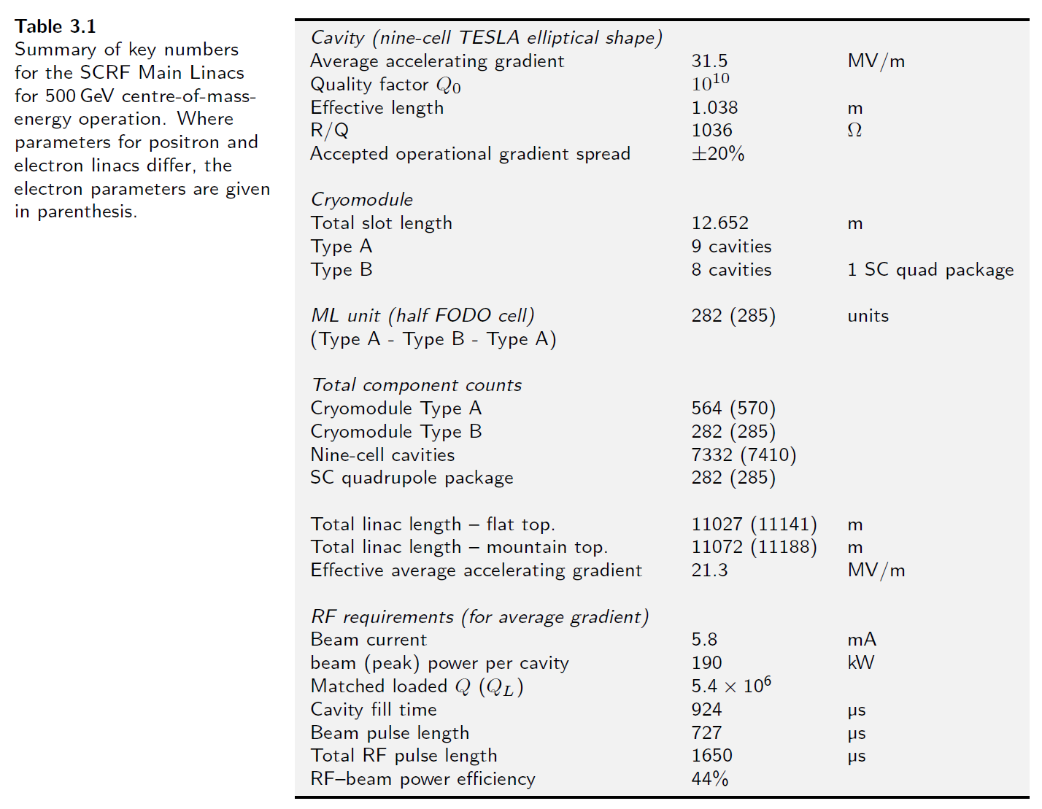
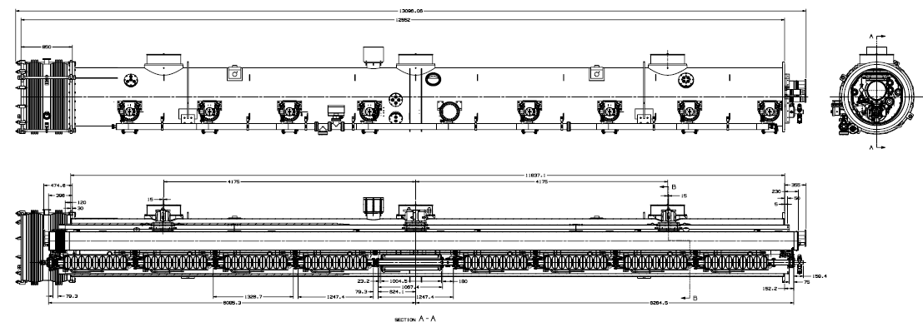
Dimension check for cavity and CM

Slide 11
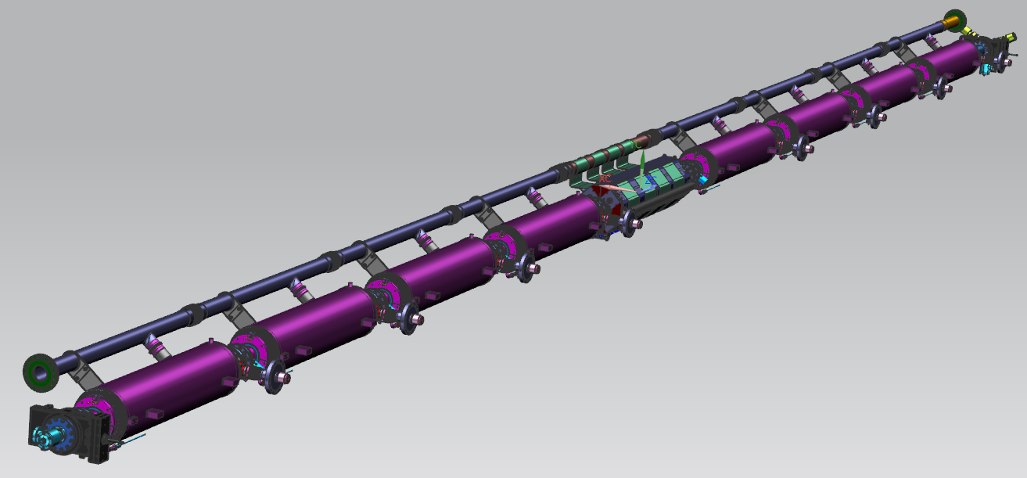
Drawing for Type A and Type B
I already requested Yuriy to develop drawing of Type A CM
Type B

Slide 12
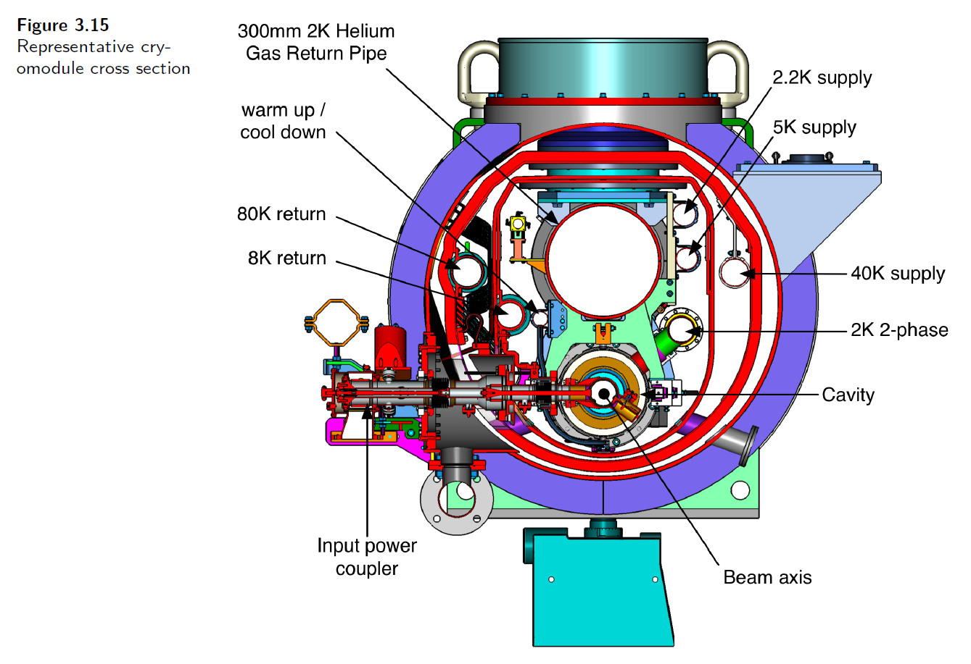
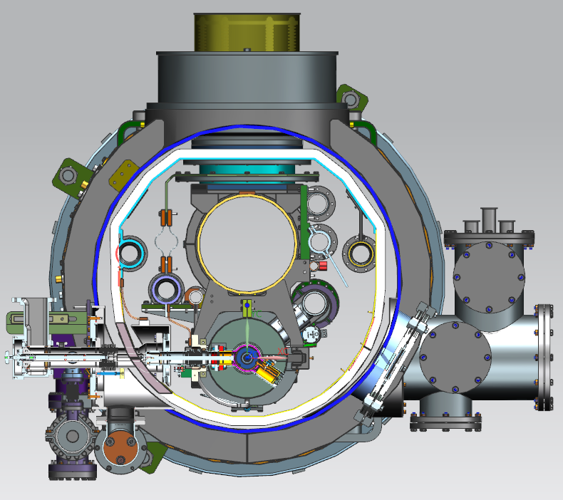
T4CM and renewed ILC CM
Renewed CM
T4CM
Tom Peterson can comment about the impact on the removal of 5K thermal shield (lower part)

Slide 13
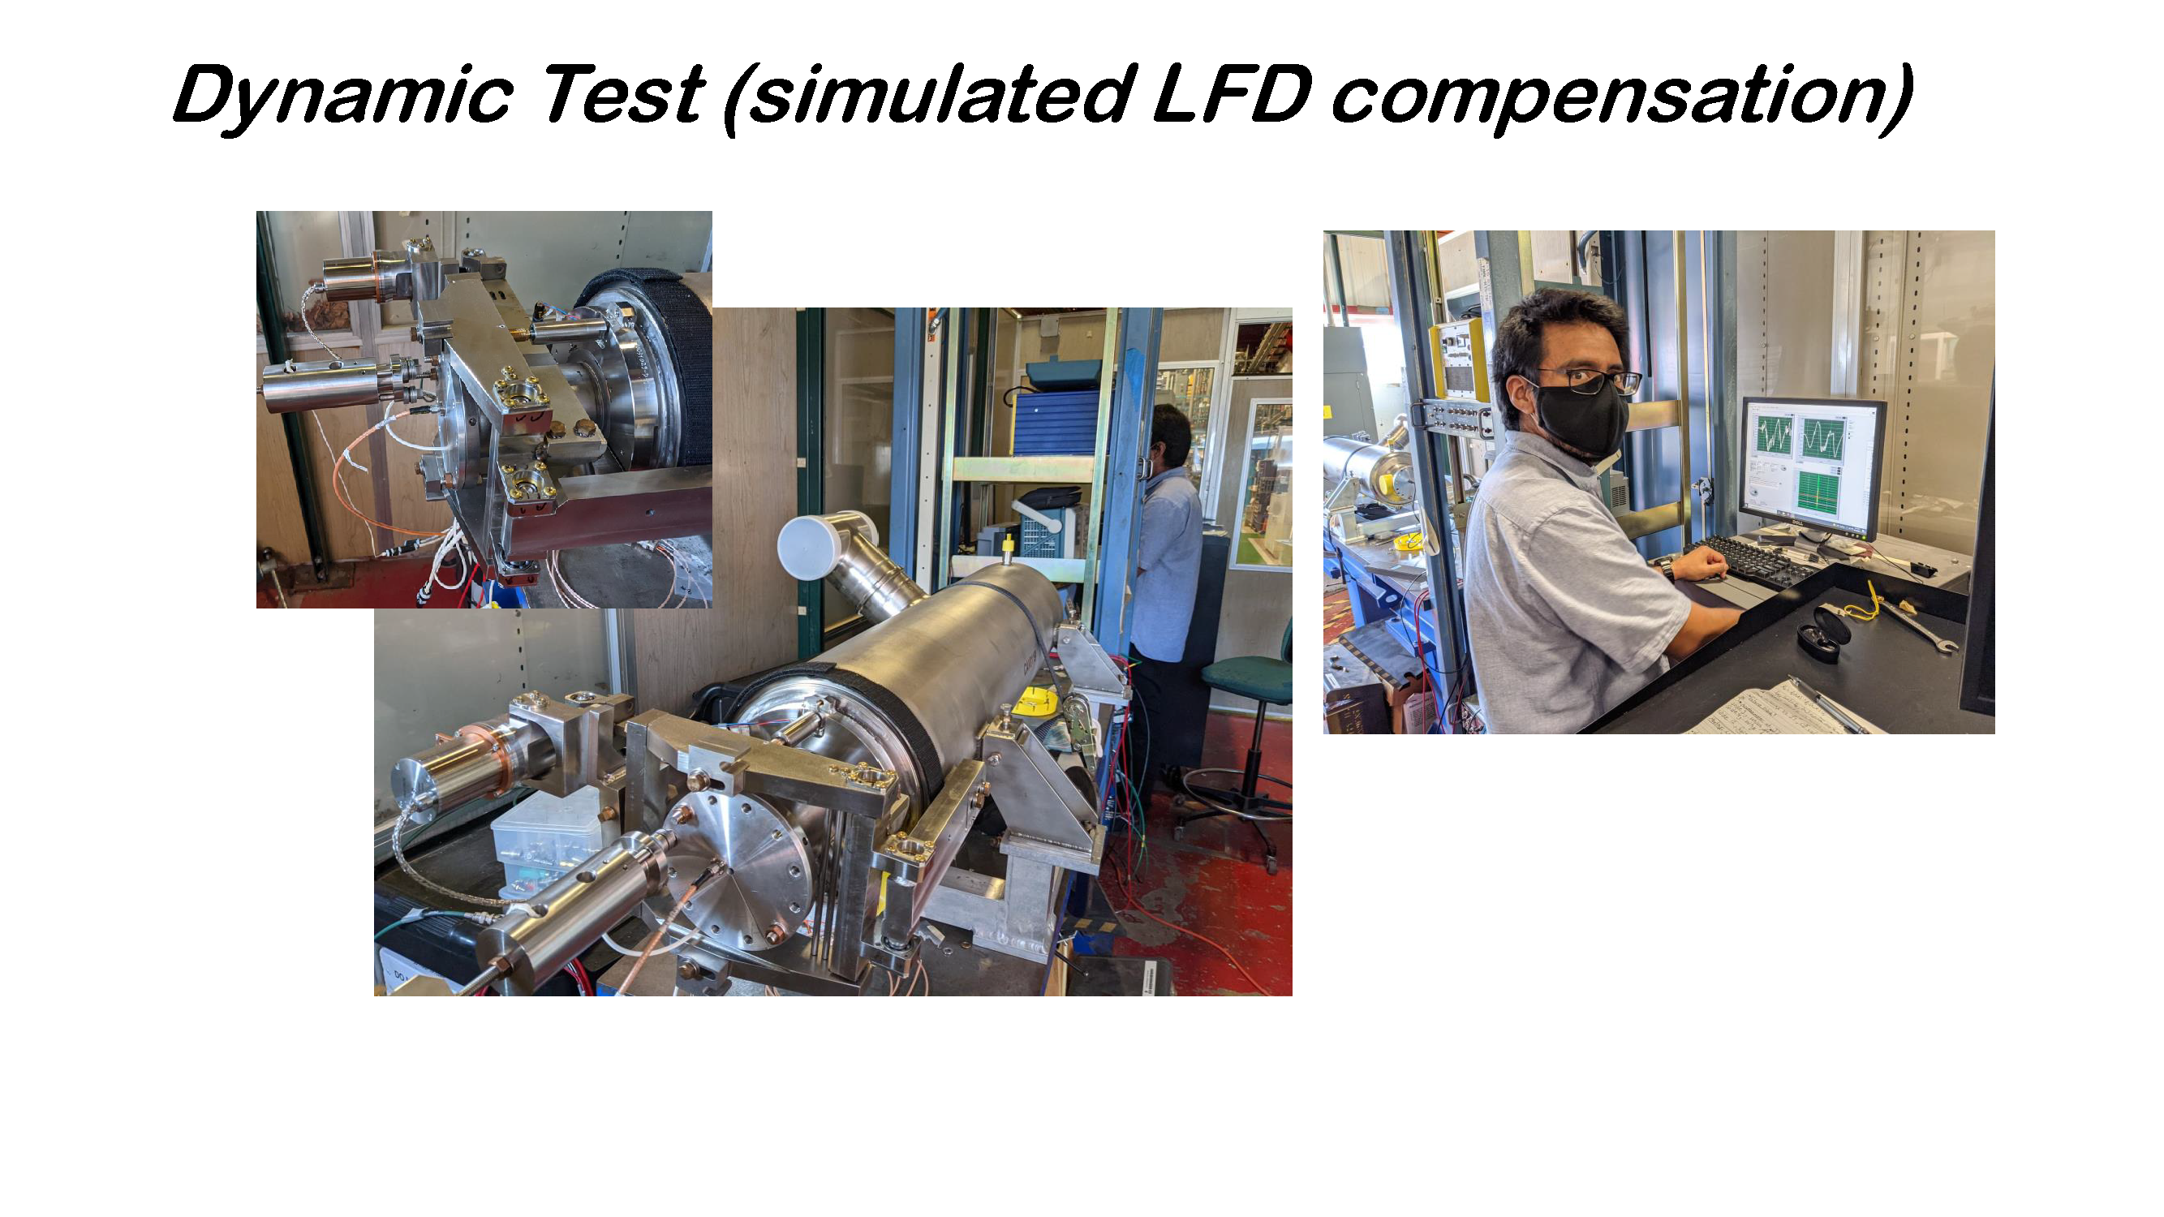
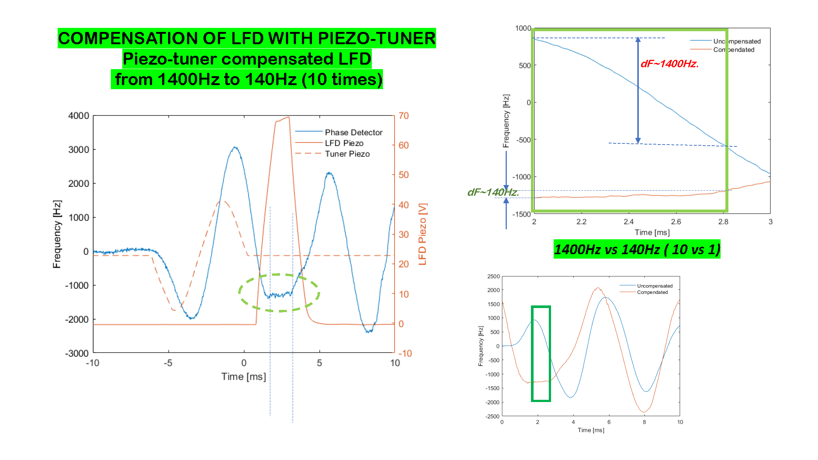
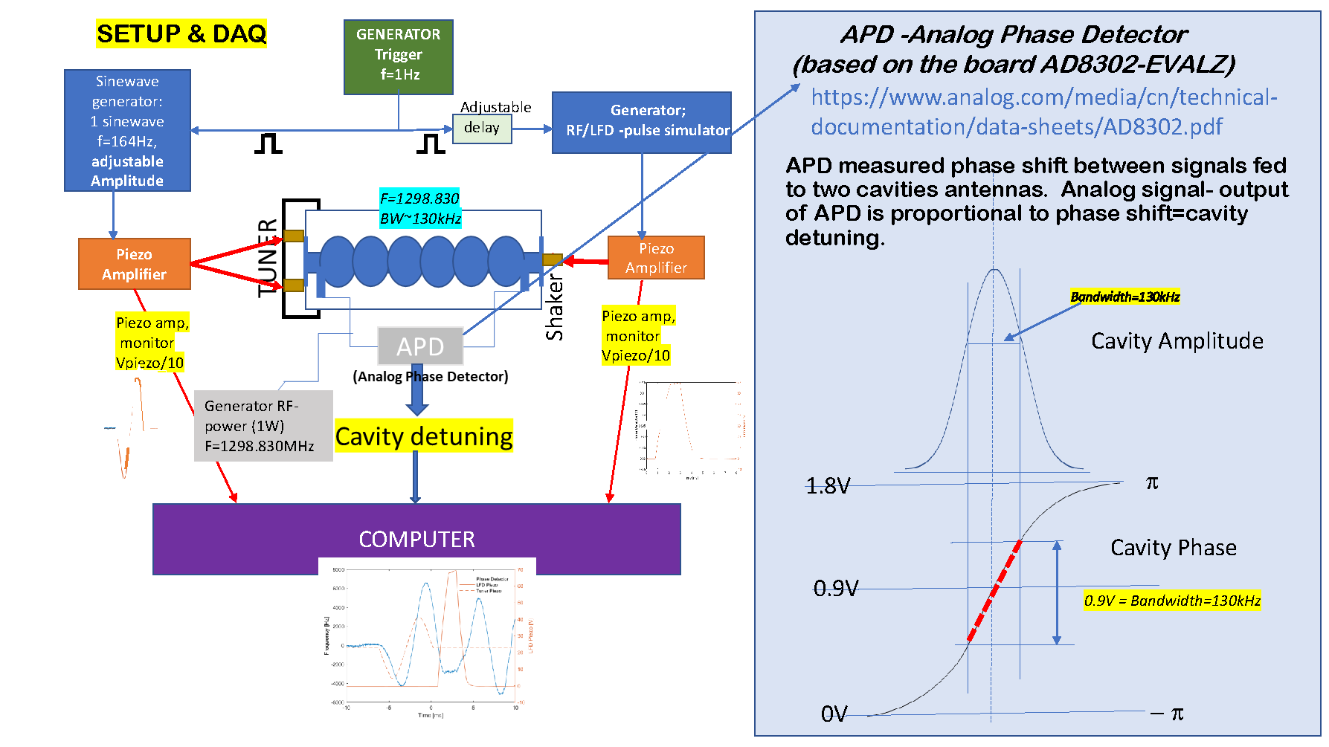
Progress of tuner
Yuriy demonstrated the imitated LFD compensation by piezo at room temperature

Slide 14
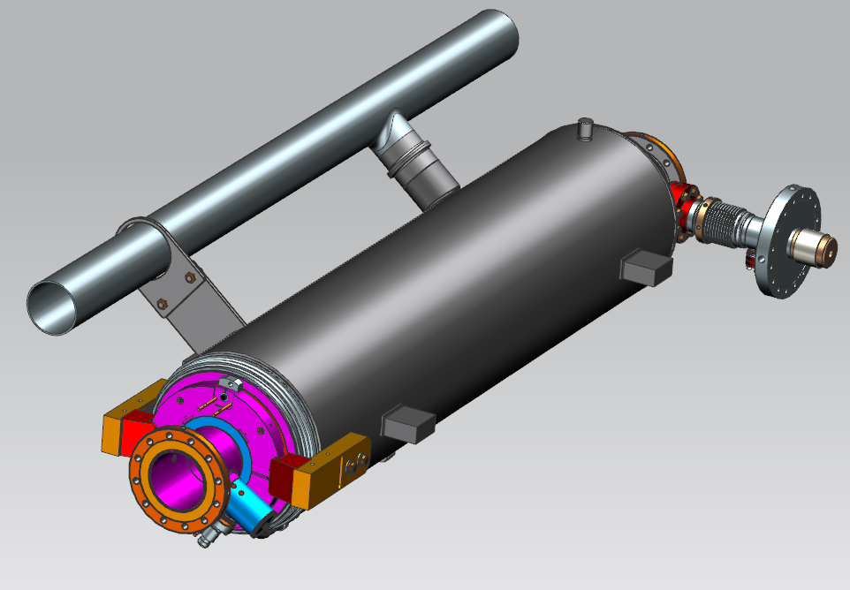
Progress of HPGS in KEK
Discussion with cryogenics group
Negotiation with the local government
Refrigeration safety regulation is preferable for ILC
KEK will visit to KHK as authority of HPGS soon

Slide 15
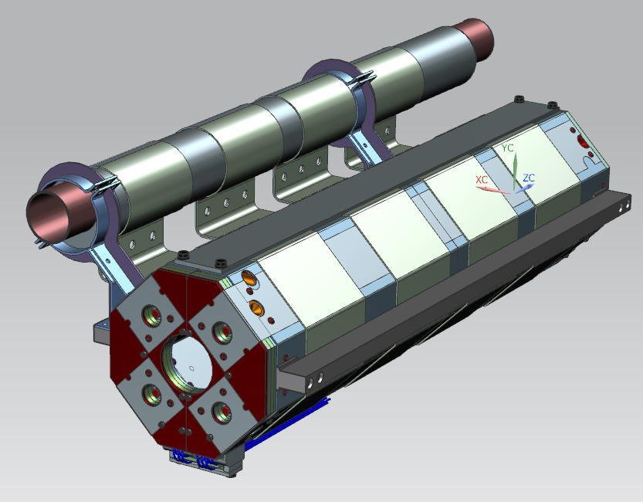
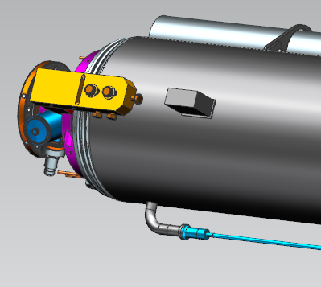
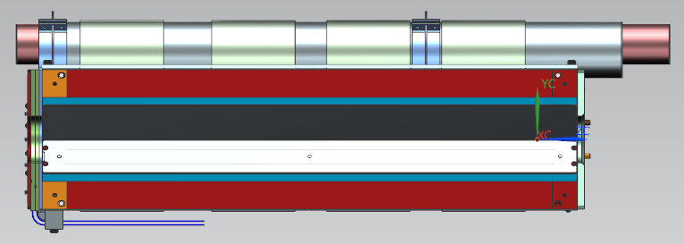
Joint between different metals
Explosive bonding by ASAHI Chemical is available for these two types of joints
SS
Ti-SS transition
Al thermal straps
If we use Aluminum cooling pipe,
we need the joint between Al and SS here
Ti Gr2
Ti-SS transition
1000

Slide 16
Standard of cooling pipes
 |  | Y. Orlov |  |  |  |  |  | By Tom P. Calculation | By Ouchi-san | ASME/ANSI selection | JIS selection
 | Cryigenic Line | OD, mm | ID,mm | Wall. mm | Material |  |  | ID,mm | OD/ID/t | OD/ID/t | OD/ID/t
2.2K Subcooled supply | A | 63.500 | 60.198 | 1.651 | 316L St. Steel | Tube, 2.5"-OD, .065" Wall, 316L SS |  | 60.2 | 63.5/60.2/1.65 | ASME SA249 63.5/60.2/1.65 | JIS G3447 63.5/59.5/2
Gas helium return header, structural support | B | 312.000 | 300.000 | 6.000 | 316L St. Steel | Tube, 300mm-OD, 6mm Wall, 316L SS |  | 300.0 | 312/300/6 | 312/300/6 | 312/300/6
Not used | C | 63.500 | 57.404 | 3.048 | 316L St. Steel | Tube, 2.5"-OD, .120" Wall, 316L SS
5K shield and intercept supply | C | 60.325 | 57.023 | 1.651 | 316L St. Steel | Pipe 2", SCH 5S |  | 56.1 | 60.33/56.11/2.11 | ASME B36.10 60.3/57/1.65 | JIS G3459 60.5/57.2/1.65
8K shield and intercept return | D | 88.900 | 76.200 | 6.350 | Al 6061 | Tube, 3.5"-OD. .25" Wall, Al 6061 |  | 69.9 | 82.55/69.85/6.35 | ASTM B241 88.9/76.2/6.35 | JIS H4080 90/78/6
High temperature shield and intercept supply | E | 76.200 | 71.984 | 2.108 | 316L St. Steel | Tube, 3"-OD, .083" Wall, 316L SS |  | 72.0 | 76.2/71.98/2.11 | ASME SA249 76.2/72/2.1 | JIS G3459 76.3/72.1/2.1
High temperature shield and intercept return | F | 88.900 | 76.200 | 6.350 | Al 6061 | Extrusion |  | 79.4 | 92.08/79.38/6.35 | ASTM B241 88.9/76.2/6.35 | JIS H4080 90/78/6
2-Phase pipe | G, 2-phase | 73.025 | 68.809 | 2.108 | 316L St. Steel | Pipe 2 1/2", SCH 5S |  | 69.0 | 76.1/72.1/2 | ASME B36.10 73.0/68.78/2.11 | JIS G3459 76.3/72.1/2.1
 | "Chimney“ -SS | 60.325 | 57.023 | 1.651 | 316L St. Steel | Pipe 2", SCH 5S |  | 54.9 | 60.33/56.11/2.11 | ASME B36.10 60.3/57/1.65 | JIS G3459 60.5/57.2/1.65
 | "Chimney“ -Ti | 60.325 | 57.023 | 1.651 | Ti | Pipe 2", SCH 5S |  |  | 60.33/56.11/2.11 | ASME B36.10 60.3/57/1.65 | JIS G3459 60.5/57.2/1.65
Warm-up/cool-down line | H | 42.164 | 37.948 | 1.651 | 316L St. Steel | Pipe 1 1/4", SCH 5S |  | 38.9 | 42.16/38.86/1.65 | ASTM A312 42.16/38.9/1.65 | JIS G3459 42.7/39.4/1.65

Slide 17
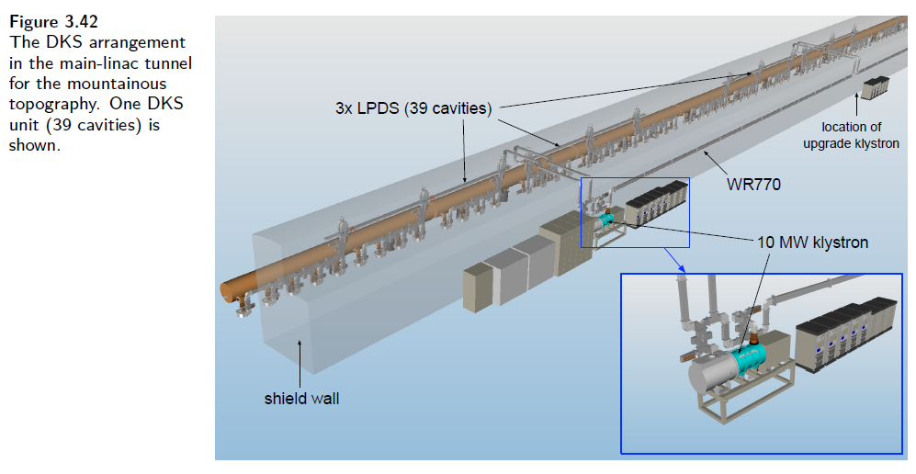
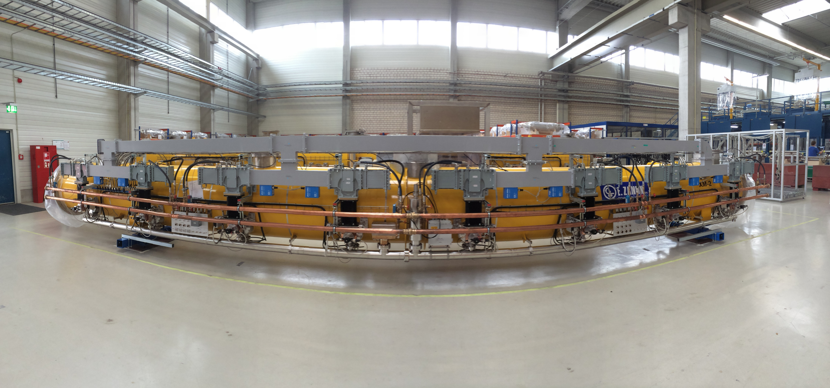
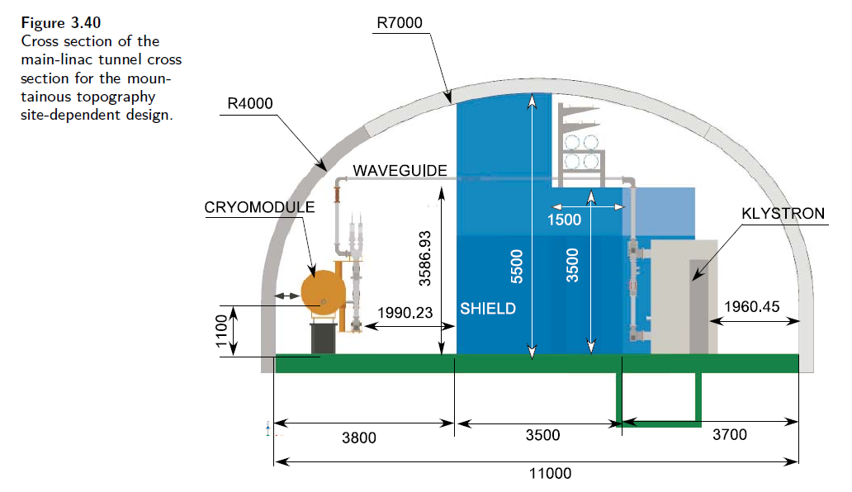
RF distribution system equipped with CM
Matsumoto-san has an idea to equip the waveguide system with CM
E-XFEL

Slide 18
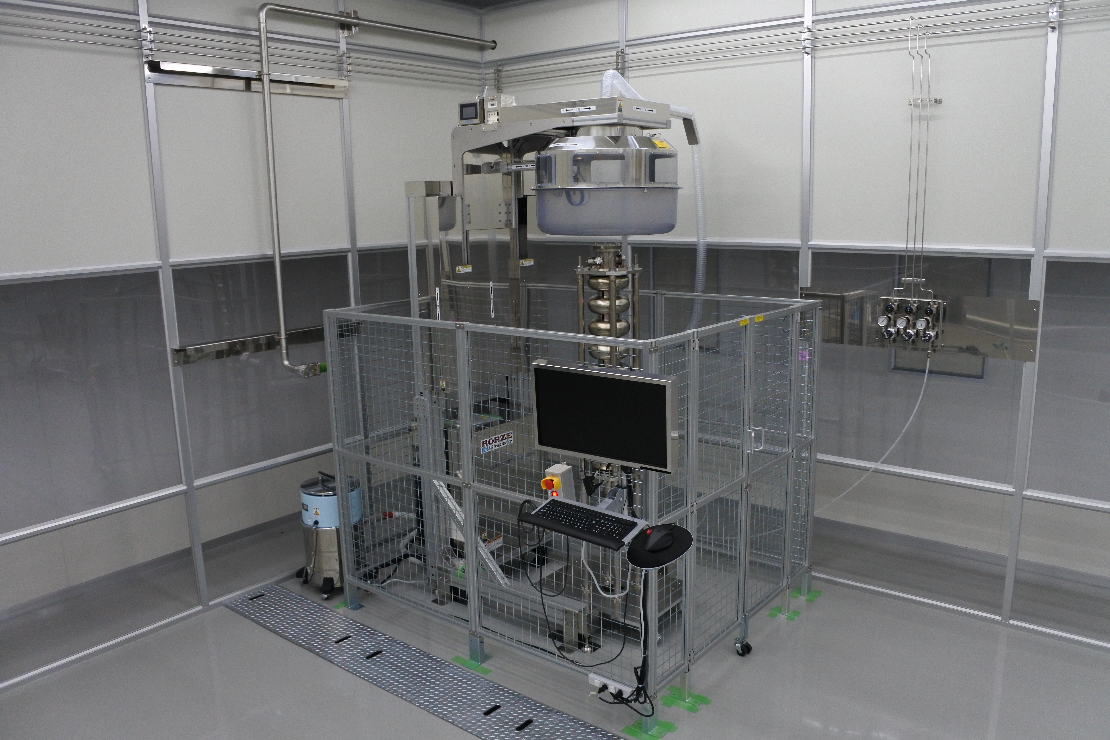
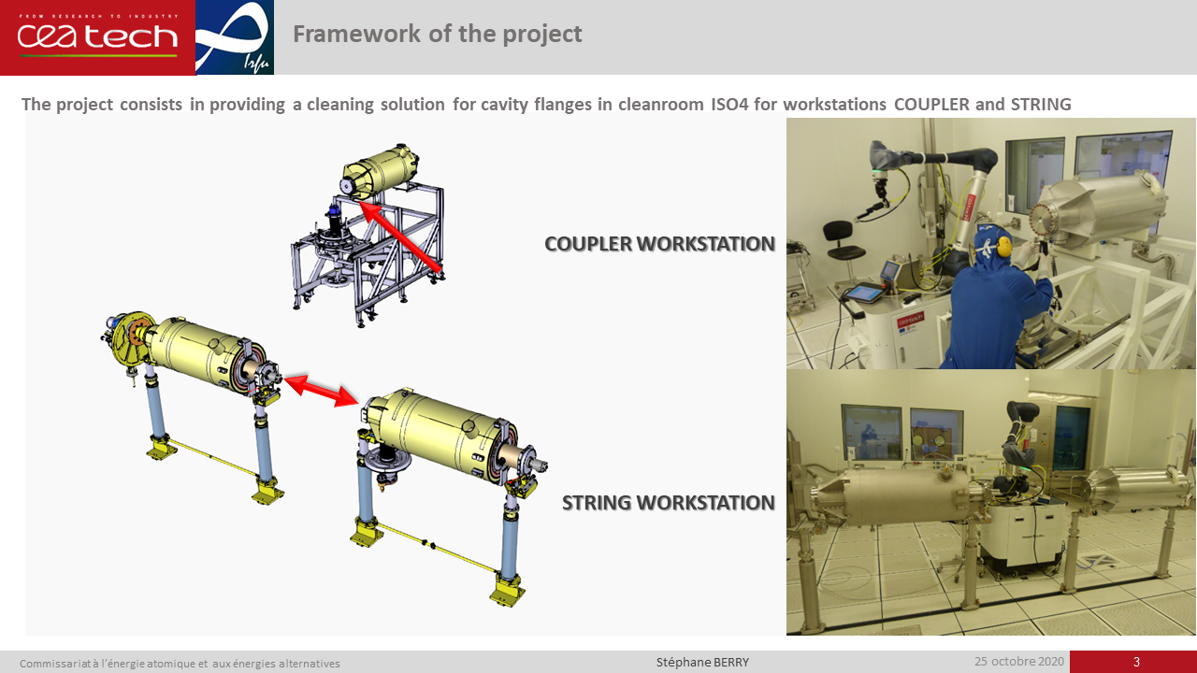
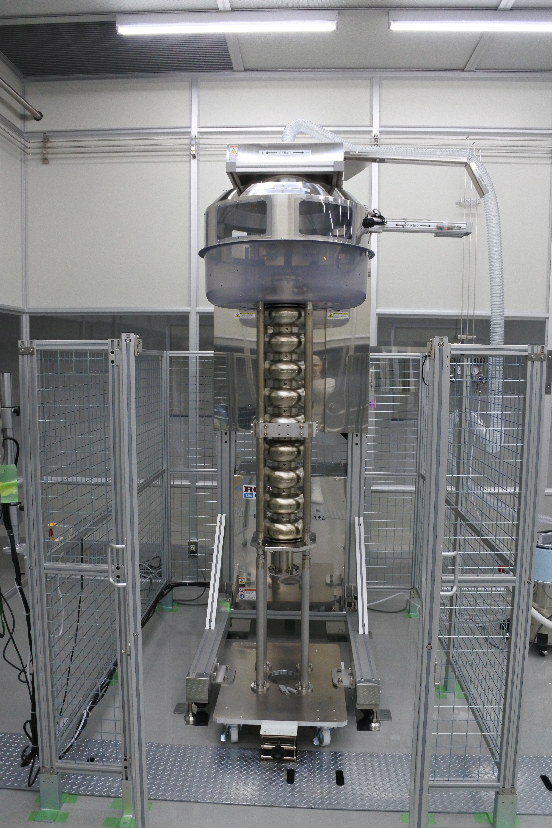
Progress of auto cleaning system
Stephane will summarize the worldwide progress of auto cleaning system

Slide 19
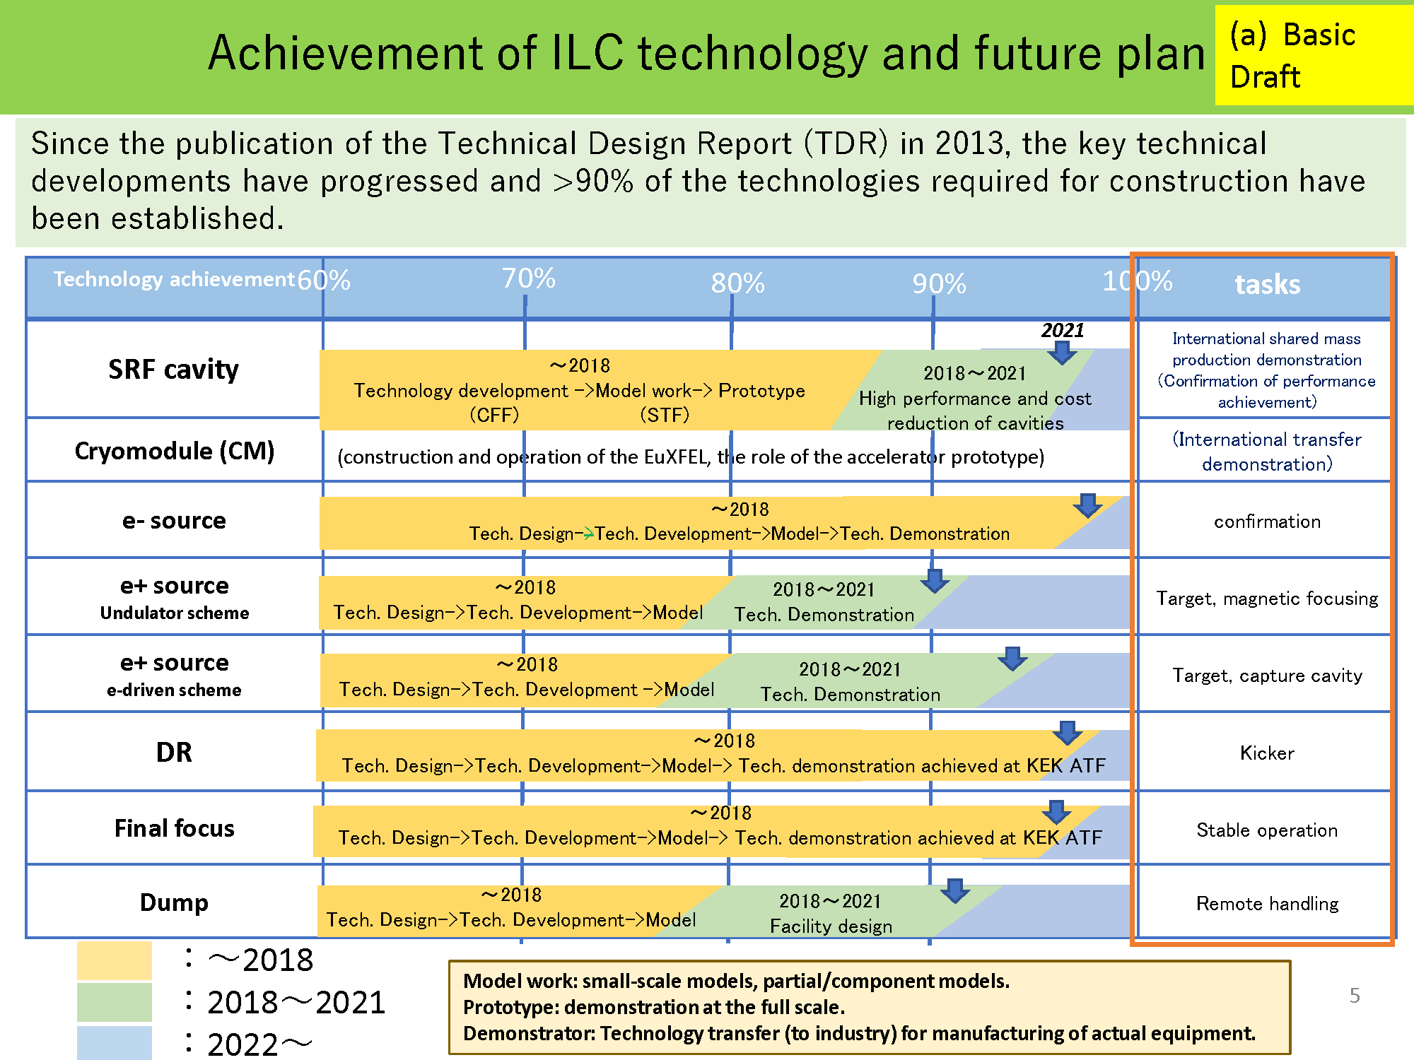
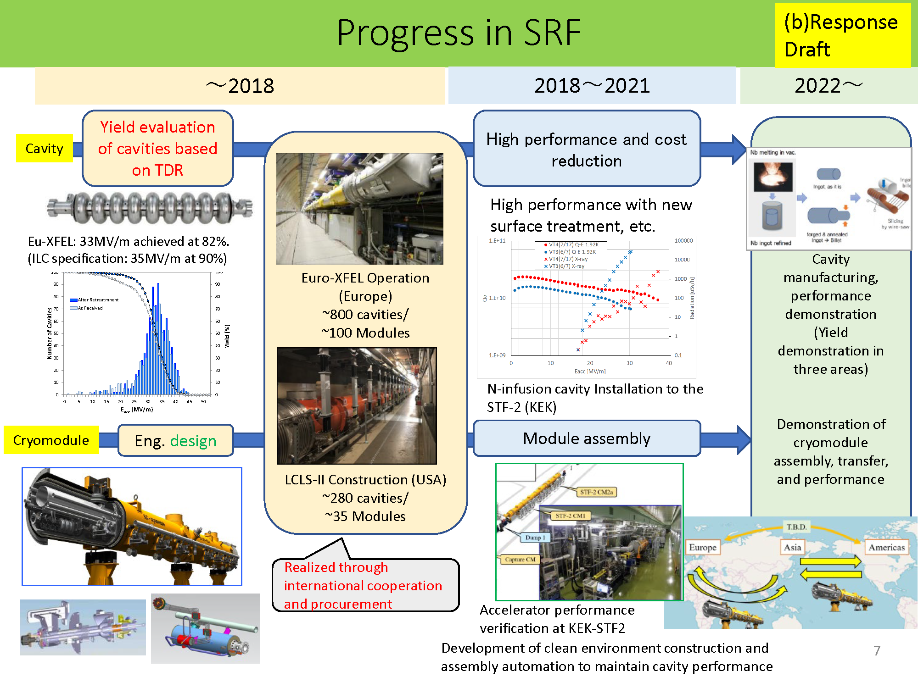
Preparation for ILC advisory panel of MEXT
How accurate are these percentages?
Including items:
Overview
SRF WPs
SRF Infrastructure
Domestic efforts
Worldwide efforts
Slide example for SRF overview
We would like the Japanese side to handle the final preparation of these documents.
If necessary, we will request you all individually.
We already requested some WG2 members and ad-hoc members to prepare for slides.

Slide 20
ILC Cryomodule Design:
History and Advances
A. Yamamoto
ILC CM design, Type 4, established, for the TDR baseline during the GDE phase, in 2010 – 2011, based on Eu-XFEL CM design
  It was updated from XFEL design to adapt to “ILC short-short cavity”, and longer SCQ packages, with global effort and consensus with GDE, mainly in cooperation between Fermilab and KEK, with keeping communication with EU members.
  It has been stored at EDMS’ of Fermilab and DESY (and at KEK), but with old CAD version
We are intending to resume the Type-4 design as our starting point for the ILC-IDT to prepare for ILC Pre-Lab,
  Unfortunately, the CAD system has been updated at Fermilab and KEK, and it is not so convenient for quick re-starting.
It has been proposed by Fermilab, to use the LCLS-II CM CAD drawing for resuming the Type-4 CM design drawing by using the current CAD system, NX, as a quickest and practical approach.
The Type-4 CM design, resumed by using NX, will become the new starting point to be globally discussed again, how we may update it to be the best appropriate design for the ILC CM, used in the ILC PreLab WP1 and WP2.

Slide 21
Starting point of CM drawing for ILC
There were some meetings between KEK and FNAL/SLAC to discuss CM drawing including tuner system
Drawing developed in the GDE era is old
We’d like to start with the CM drawing for LCLS-II
  Still tentative conclusion for JP/US
  Discussion with colleagues in EU is planned
This plan is under progress between Japan and US
Probably, the CAD software will be common in future
  NX is used in FNAL/DESY (from Omet-san)
  INVENTOR/AUTOCAD (AUTODESK) are used in KEK
  Creo (PTC) is used by Ohuchi-san
A. Yamamoto, Konomi-san, Kirk
S. Belomestnykh, Y. Orlov, T. Peterson

Slide 22
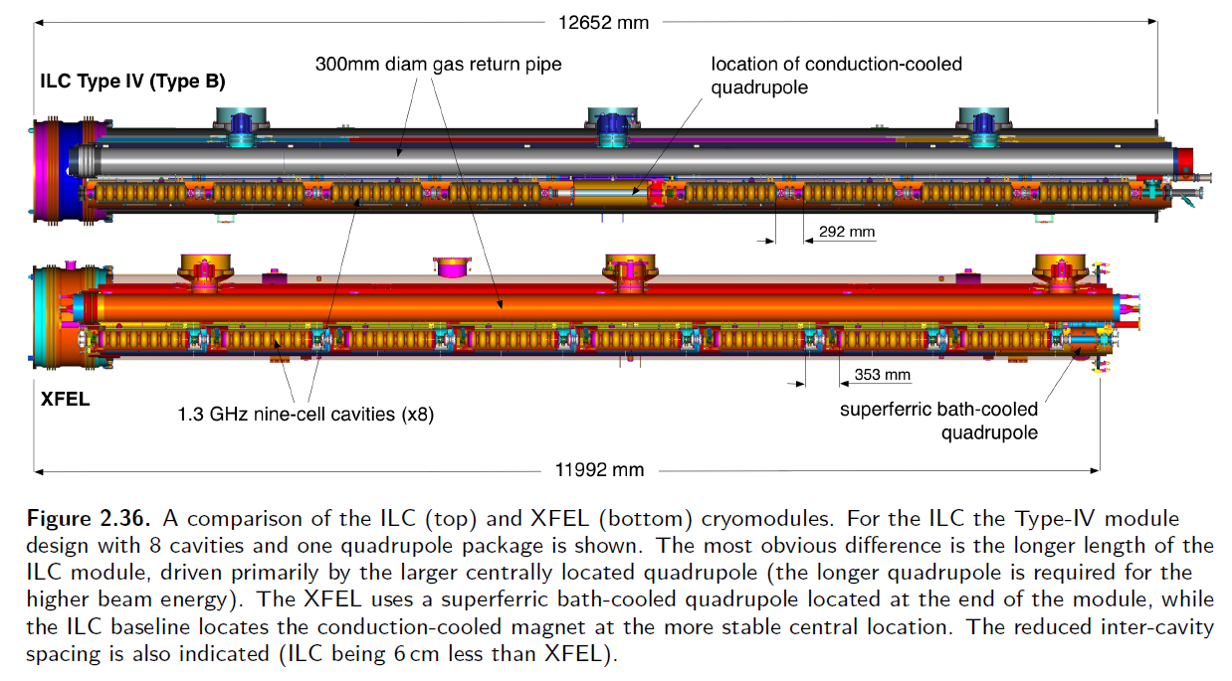
History of CM drawing for ILC (my knowledge)
During the GDE era, CM design was developed among Japan, US and EU
In TDR, Type-IV CM design was presented as follows
In my understanding, Type-IV CM drawing is stored in EDMS at DESY
  In Japan and US, nobody has this drawing, but KEK has the close drawing (not exactly the same!)
Unfortunately, nobody took over this drawing after TDR in Japan and US

Slide 23
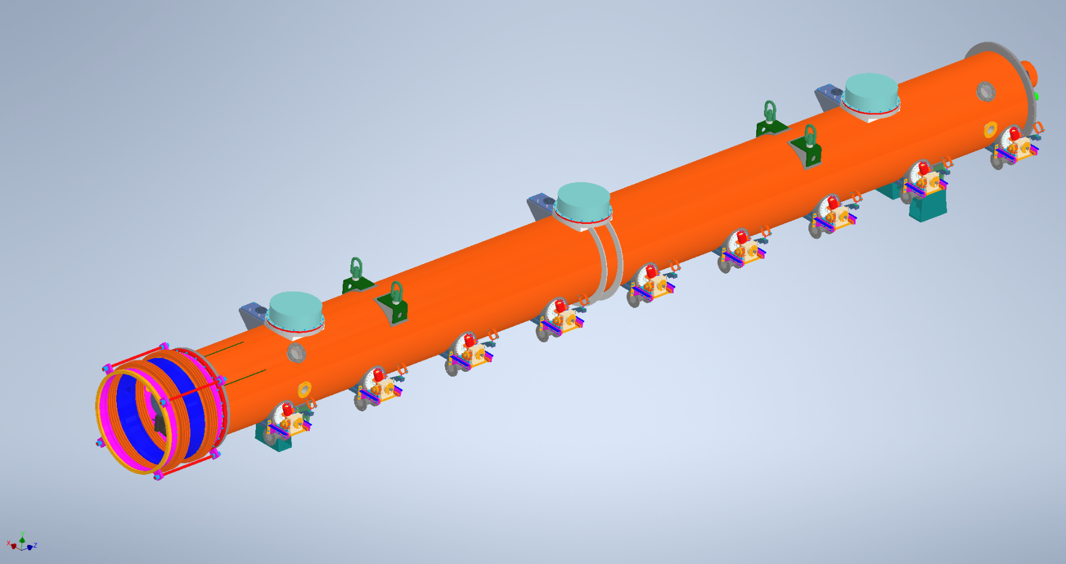
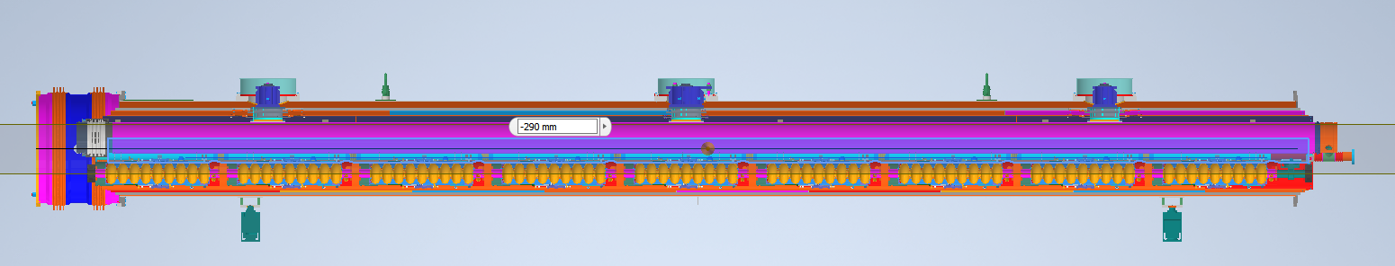
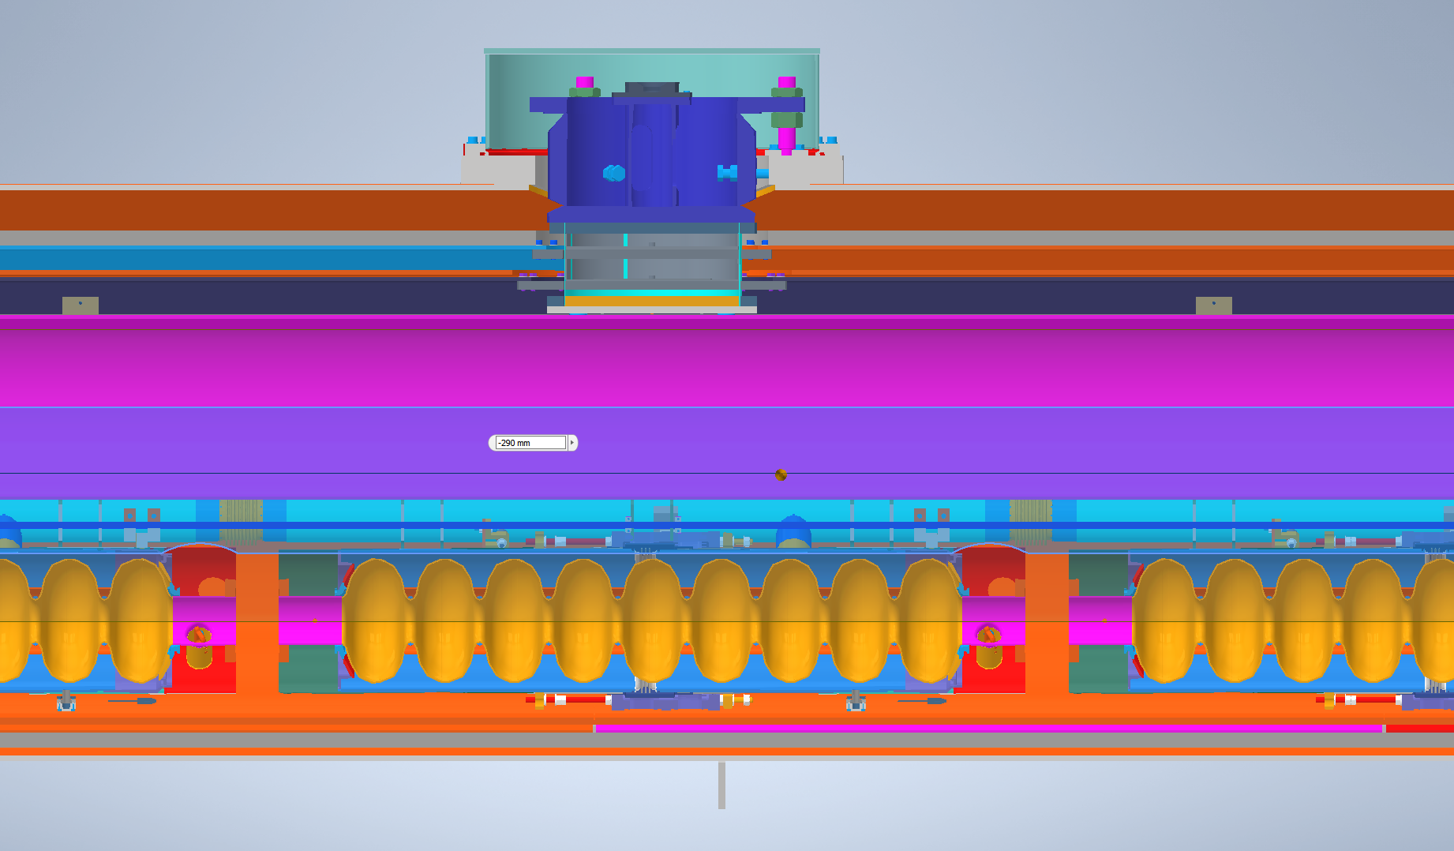
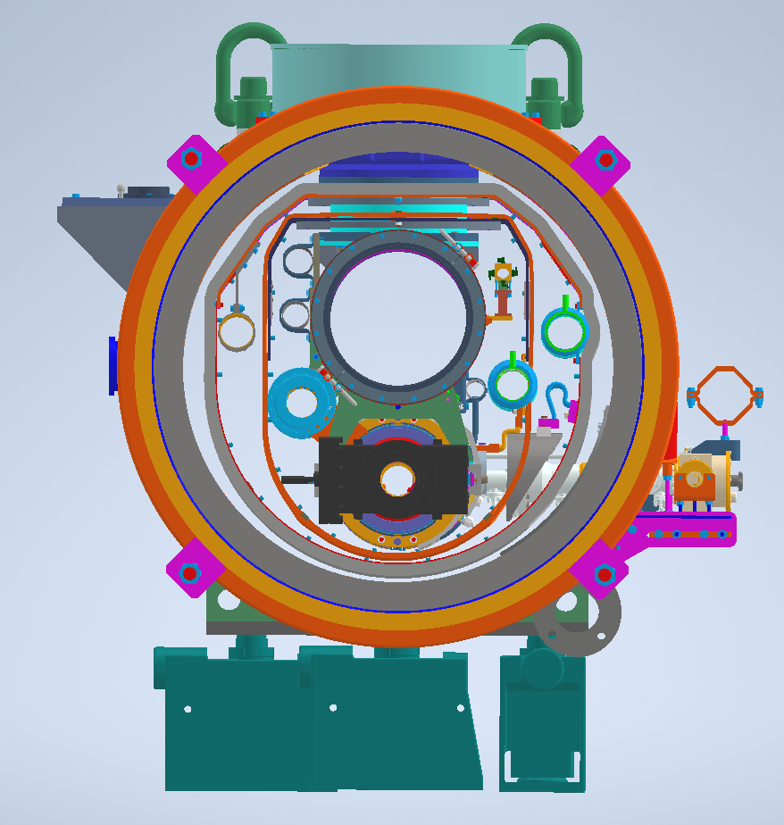
CM Drawing Data (received from Ohuchi-san)
Type-A CM (9 cavities)
No bellows!

Slide 24
TESLA-style cryomodules compared - 1
Slide by T. Peterson (Received from Akira Yamamoto-san)
Peterson - LCLS-II Cryomodule Design - 7 Oct 2014

Slide 25
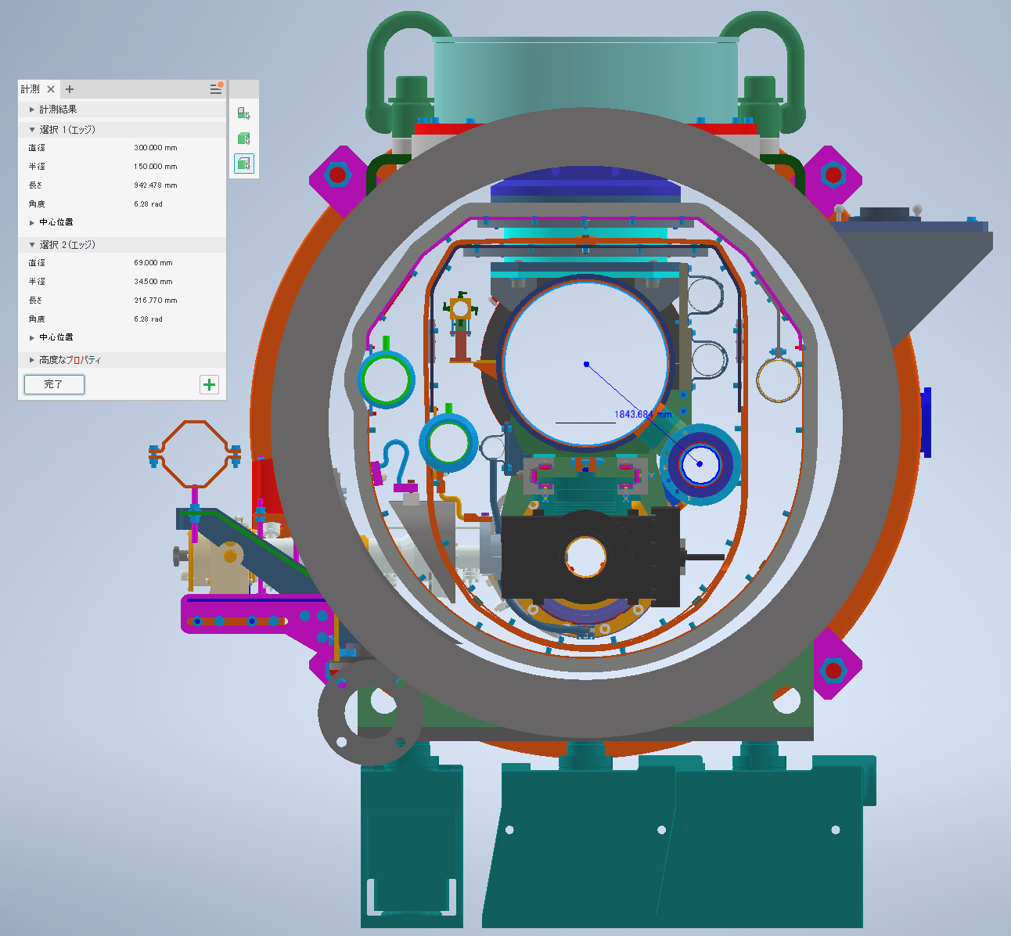
Comparison of CM drawing between TDR and KEK
Diameter of each pipe
Gas Return Pipe | 300.0 mm
2K 2-phase pipe | 69.0 mm
The diameter of every pipe is consistent!
※Only dia. of GRP is shown in TDR

Slide 26
TESLA-style cryomodules compared - 2
Peterson - LCLS-II Cryomodule Design - 7 Oct 2014
Slide by T. Peterson (Received from Akira Yamamoto-san)

Slide 27
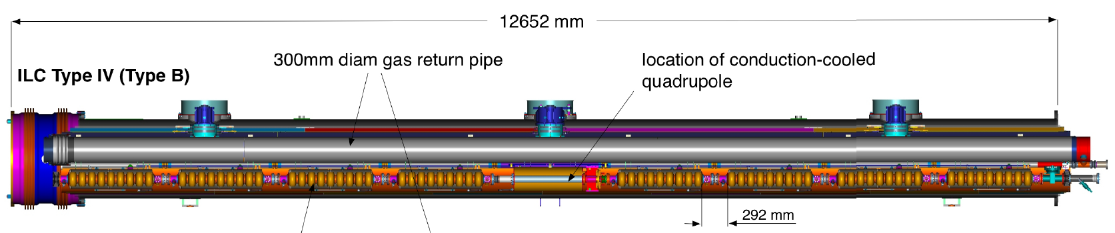
Distance between input couplers
Type-B CM (8 cavities + SCM/BPM)
1326.7 mm
Coupler-to-coupler
1326.7mm – 1247.4mm = 79.3mm (from Table 3.5)
But, from right figure, it’s 82 mm!
Which is correct?
The total length of CM should be checked!

Slide 28
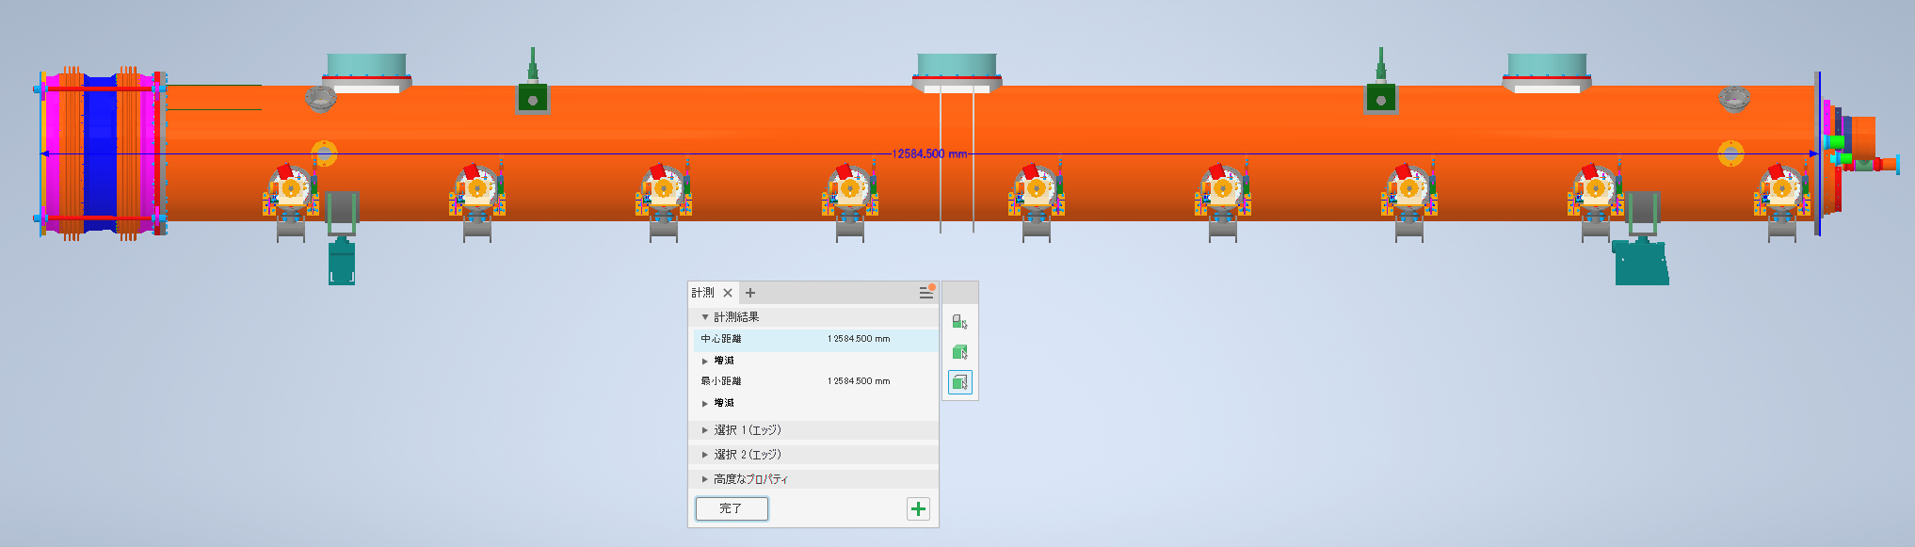
Comparison of CM drawing between TDR and KEK⑤
Length of CM
KEK | 12584.5 mm
TDR | 12652 mm
These drawings look different from each other

Slide 29
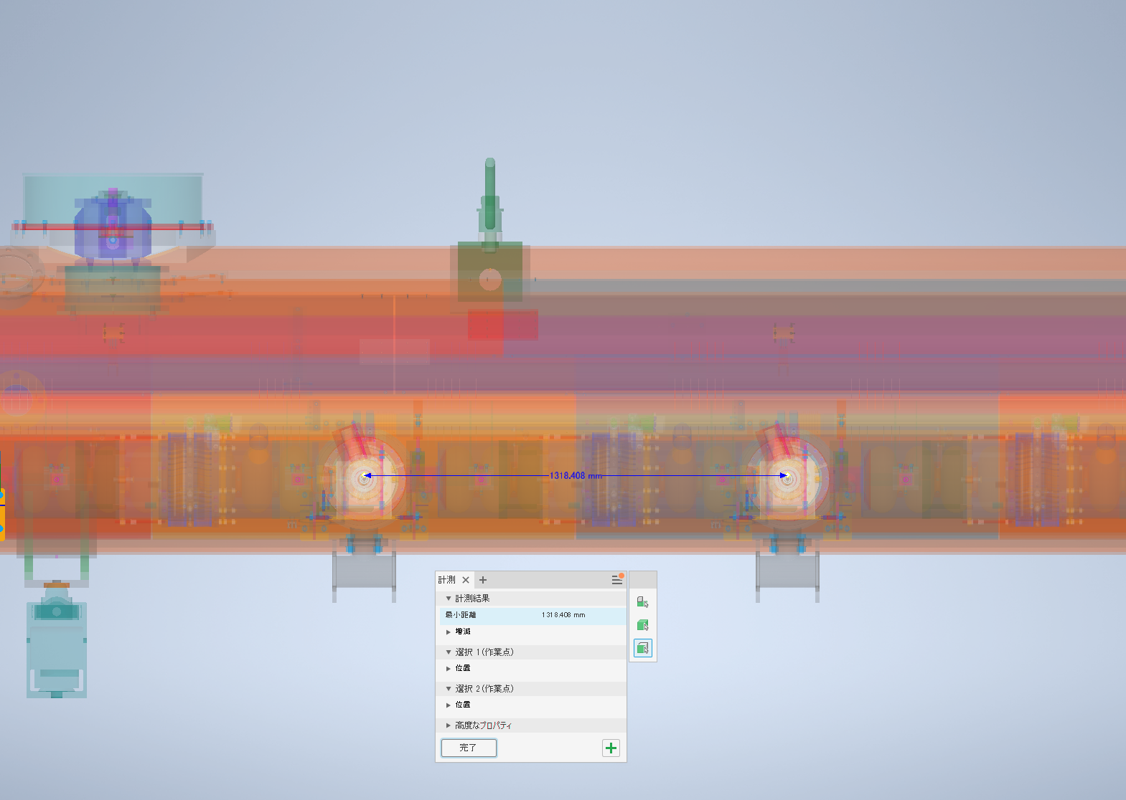
Comparison of CM drawing between TDR and KEK⑥
Distance between coupler-to-coupler
KEK | 1318.4 mm
TDR | 1326.7 mm
The distance of coupler-to-coupler is shorter in KEK!
We don’t understand this reason!

Slide 30
Items to consider regarding CM drawing

Slide 31
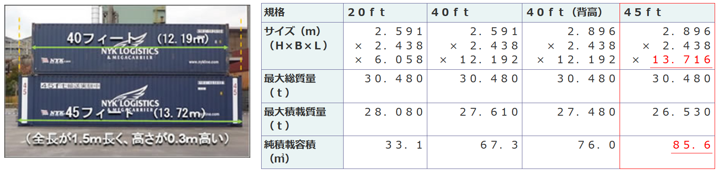
How long CM is available for container?
When starting CM design, we have to take care of the total length to install into container
1.5 m longer, 0.3 m higher
Ministry of Land, Infrastructure, Transport and Tourism of Japan

Slide 32
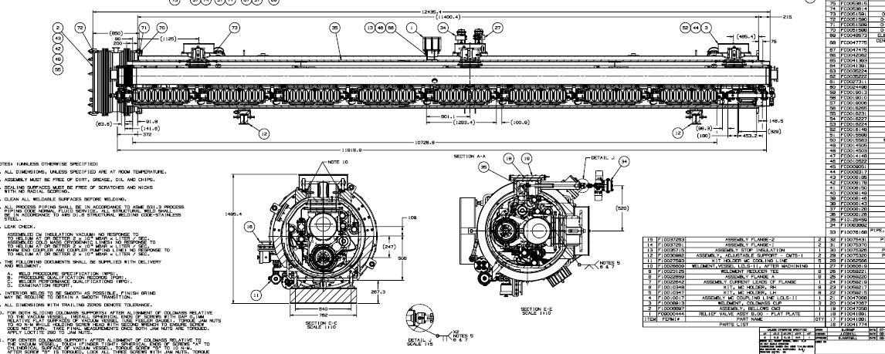
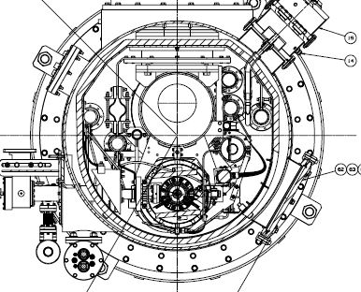
LCLS-II 1.3GHz Cryomodule
JT Valves (Fast Cooling)
50K Thermal
Shield
Magnet With Conducted cooling
Tuner Access Port
Yuriy Orlov

Slide 33
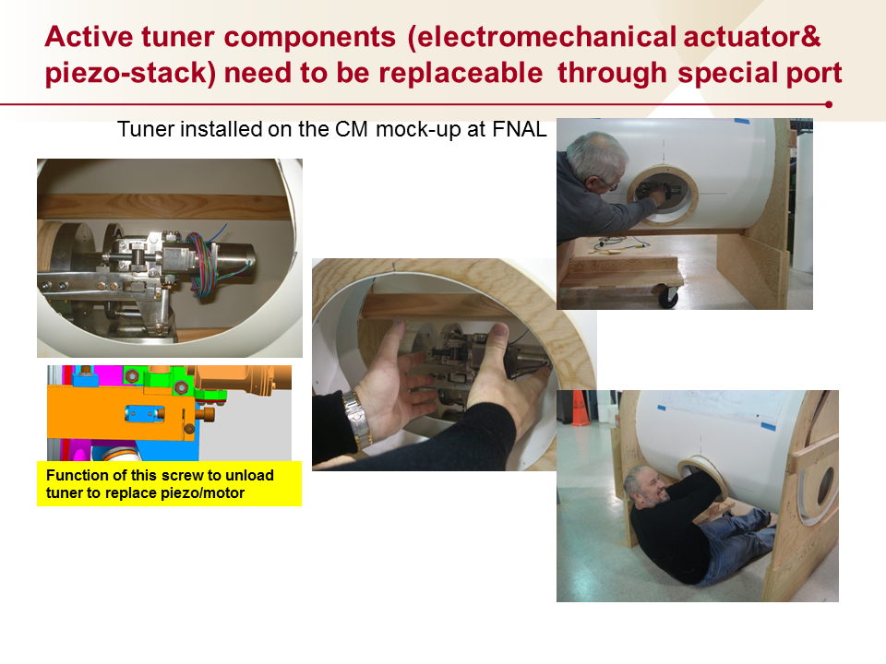
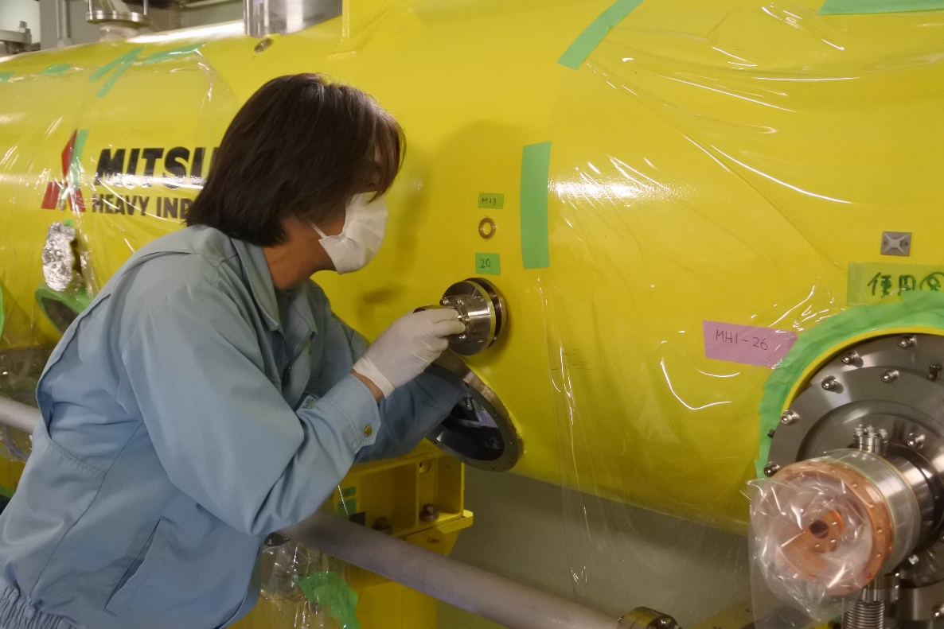
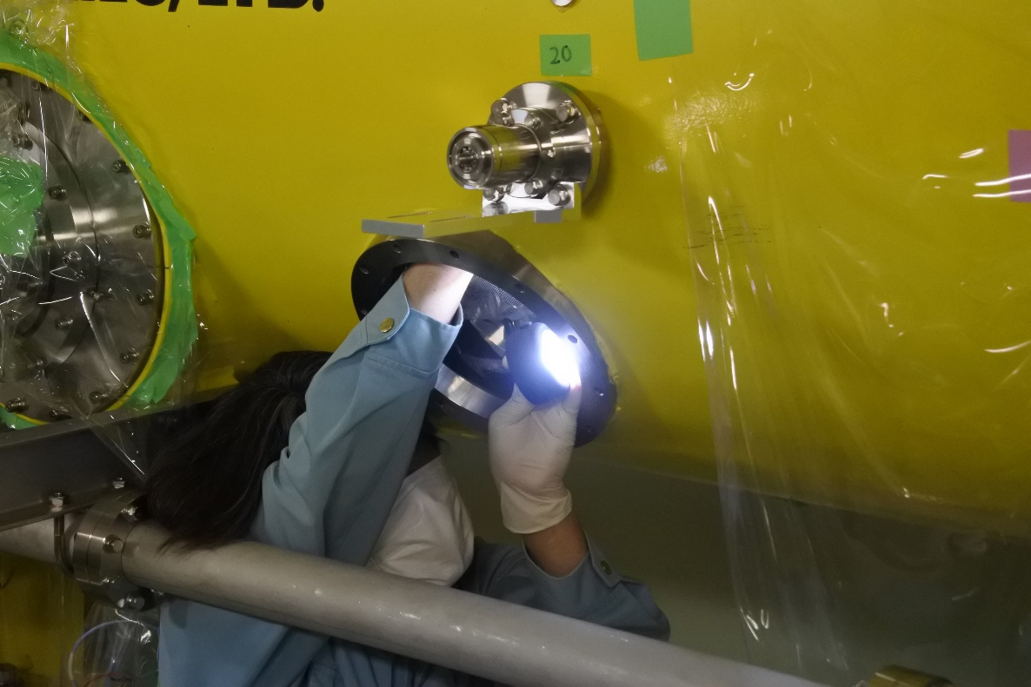
Tuner Access Port
This port is must!

Slide 34
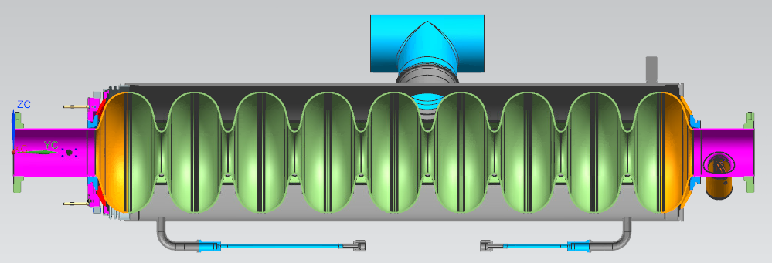
How many pre-cooling lines are necessary?
Where is the chimney position?
ILC needs fast-cooling?
①
②
Yuriy Orlov

Slide 35
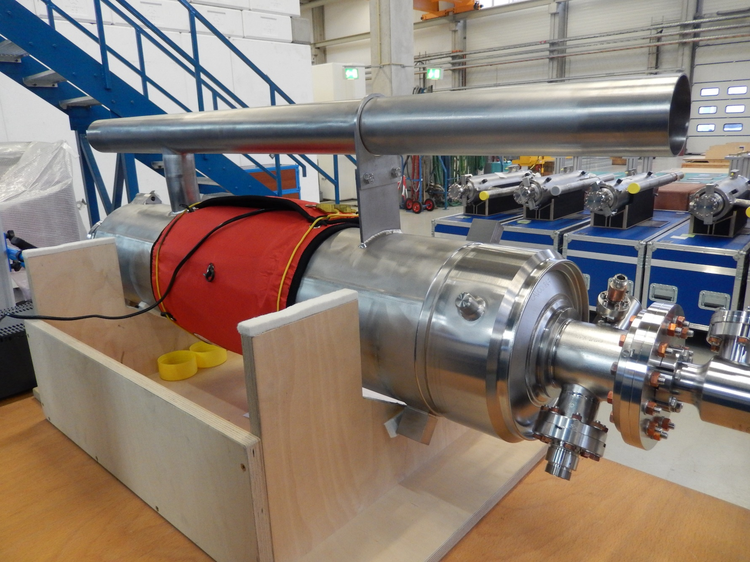
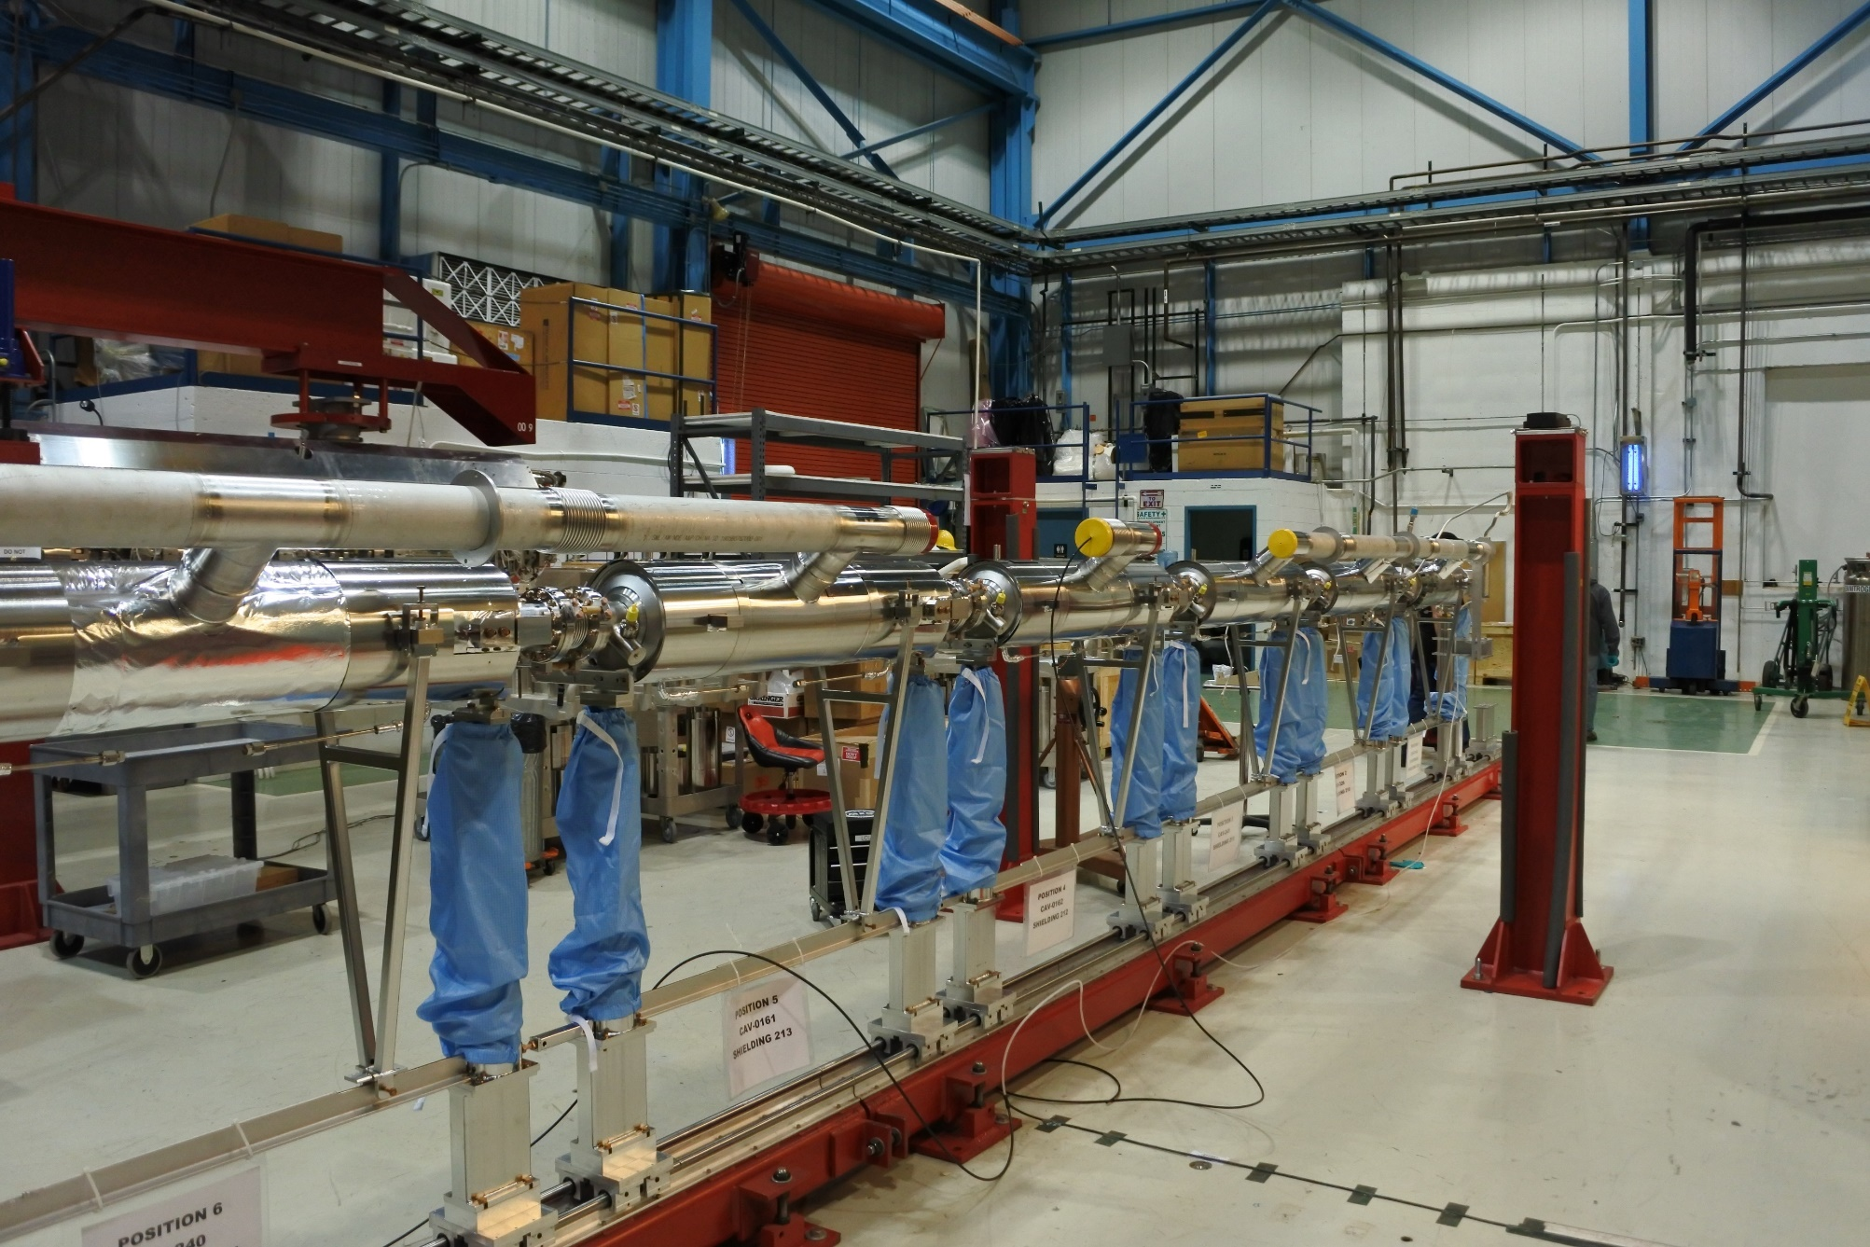
Position of Chimney on Helium Tank
E-XFEL
LCLS-II
E-XFEL cavity needs additional support jig for 2-phase pipe

Slide 36
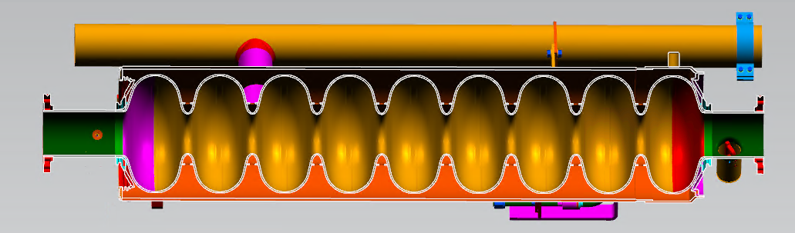
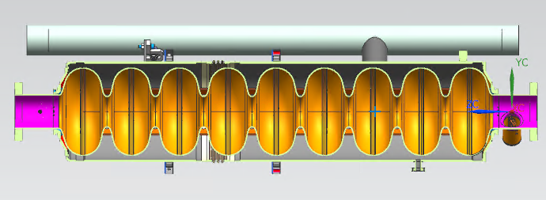
1.3GHz cavities (9 elliptical cells)
(Long-Short)
He Vessel Bellows
XFEL
(Long-Short)
LCLS-II
Ti-SS Transition
(Short-Short)
Yuriy Orlov
T4CM
Ti Mini CF

Slide 37
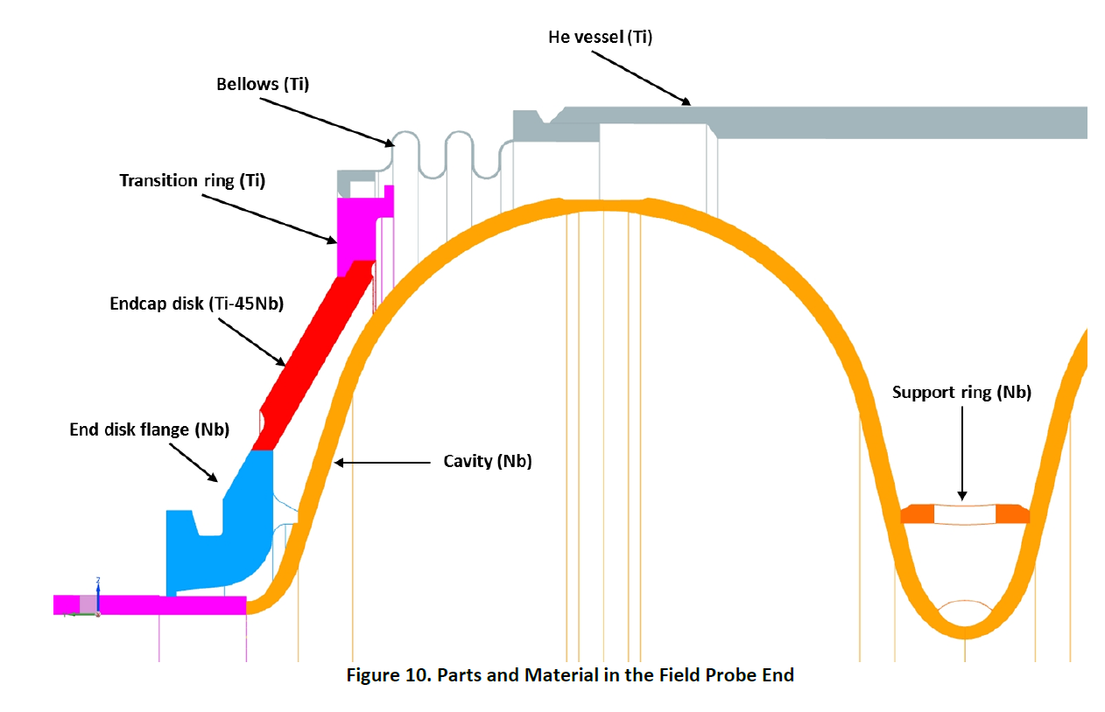
Bellows and Magnetic shield
Bellows on the outside make it vulnerable to damage! Cover is necessary?
Possible to install the magnetic shield inside the helium tank
Yuriy Orlov

Slide 38
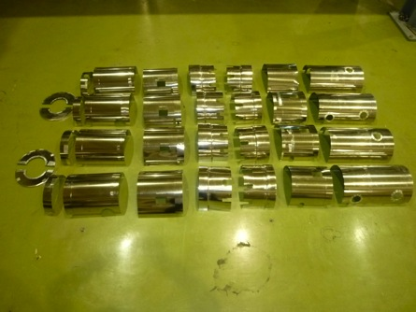
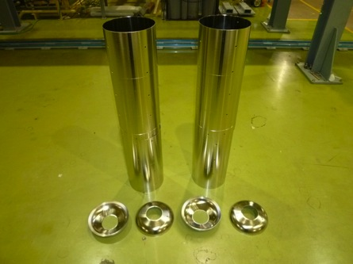



Comparison of Magnetic Shield
16 Components per ca (shield outside
4 Components per Cavity (shield inside)
For 2 FNAL Cavities
For 2 KEK Cavities
N. Ohuchi/A. Yamamoto

Slide 39


Double Magnetic Shields in LCLS-II
Double magnetic shields are obviously expensive!
Contrary to the spirit of cost reduction

Slide 40



5K Thermal Shield
Lower part of 5K shield is necessary?
Vacuum vessel
= φ 965.2mm
If 5K shield removed, position of cooling pipes and diameter are changed
Two shield model
One shield model
N. Ohuchi/A. Yamamoto

Slide 41
Tuners
XFEL
LCLS-II
T4CM
Yuriy Orlov

Slide 42



Proposal to test a WARM dressed cavity with the tuner installed
COLD Transfer Function
WARM
Very strong correlations between measurements of WARM vs. COLD
transfer functions
Y. Pischalnikov

Slide 43



Horizontal Test System for Single Cavity
Horizontal Test Area @AR-E Lab. in KEK
Horizontal Test Area @NML in FNAL
We need the demonstration of tuner drive at horizontal test
Horizontal Test Area @HALLE3 in DESY

Slide 44
Helium inventory in LCLS-II
Each dressed cavity – 27 liquid liters
8 dressed cavities – 214 liquid liters
Pipes – 134 liquid liters equivalent mass
One cryomodule total – 348 liquid liters equivalent
LCLS-II cryomodules – 13,000 liquid liters equivalent
ILC needs the summary table as this, including length, material, operating pressure, maximum allowable working pressure, etc.
T. Peterson - LCLS-II Cryomodule Design - 7 Oct 2014

Slide 45
Progress of HPGS
Visit to local government in Ibaraki-ken prefecture (KEK Tsukuba campus) to discuss HPGS
  Three times: 3/Mar, 23/Apr, 21/May
  Discussion time per meeting: 2~3 hours
Looks like the discussion is going toward good direction
To be checked the max. allowable pressure value (see next page)
Legal handling changes depending on whether it is 160 mm (dia.) or more or less
  How about GRP of 300 mm?
Not discussed yet when testing CM abroad
  Before testing CM performance, inspection by authorized person of HPGS should be done
Need to be inspected separately even if the vendors are different?

Slide 46


Max. allowable pressure described in TDR

Slide 47
4-year-profile of cost for TPP
Recently, 4-year-profilce of cost based on ILC action plan was revised for TPP
 | Year/Date | 8/Jun/2021
 | Items | Japan |  |  |  |  |  | Abroad |  |  |  |  |  | Sum | Japan | Abroad
 |  |  | P1 | P2 | P3 | P4 | Sum |  | P1 | P2 | P3 | P4 | Sum
 |  | (Oku-Y) |  |  |  |  |  | (Oku-Y) |  |  |  |  |  | (Oku-Y) | (FTE-yr) | (FTE-yr)
1 | [WP-1] Cavity Industrial-Production Readiness
 | -Cavity industrial-production readiness to be demonstrated (JP:40, AB: 80)
2 | [WP-2] Cryomodule (CM) Assembly, Global Transfer and Performance Assurance
 | -Ancillaries production (Coupler/Tuner/SCM) (JP:2, AB:4)
 | -CM production (JP:2, AB:4)
 | -CM performance assurance, CM string assembly (2 CMs)
 | -CM Global transfer, Performance assurance after transport
3 | [WP-3] Crab Cavity System
4 | [Infrstructure-A] ]KEK-STF Beam Operation Demonstration (1.5 CM + 0.5 CM)
 | -Tunnel expansion, cryogenics and klystron gallery upgraded
 | -Upgrading STF accelerator (+0.5 CM)
5 | [Infrastructure-B] KEK-STF/COI Hub-lab. Functionality (production, assembly, test)
 | -Cavity fabrication facility (Wire-saw, EBW-renewal, etc)
 | -VT system with four cavities
 | -CM assembly/production incl. cavity string assembly
 | -CM test area (2 CMs available)
 | -Cryogenics system upgraded (separated from STF)
 | -HLRF/LLRF system installed
 | -Horizontal Test Area with single cavity (STF: coupler/tuner)
 | -COI building expansion for CM string
6 | [Infrastructure] Upgrading Abroad hub-lab. Functionality (production, assembly, test)
7 | Electric power, Maintenance work for testing, assmebly work
8 | EDR and Construction/Project Preparation (Documentations)
Sum

Slide 48
Update of scope/deliverable in WBS (Overall/WP-1)
# | Code | Title |  |  | Scoping statement | Deliverables
56 | 2 | SRF Technology |  |  | Design and prototype the SRF and HLRF components and subsystems | Key performance figures; design of SRF and HLRF components and systems; input to cost estimation; CFS requirements; Prototype modules; EDR volume "SRF technology"
57 | 2.1 |  | ML and SRF system design (overall management) |  | Design complete RF units and cryo strings (for Main Linac, Bunch Compressors and 5GeV boosters in Sources) | Layout of RF units and cryo strings; CFS requirements; Chapter for EDR
58 | 2.2 |  | WP01: Cavity production (Incl. ML DR, & others) |  | Demonstrate cavity production readiness | Final cavity design; final surface treatment recipe; testing recipe; cost estimate; performance specification; 120 prototype cavities; Chapter for EDR
59 | 2.2.1 |  |  | SC material | Define SC material standard | Final material definition; standard specification for 120 prototype cavities
 |  |  |  | baseline/cost-down material to be decided (before TPP?) | Decide the baseline before TPP
60 | 2.2.2 |  |  | Cavity production/surface-process | Design cavity; Baseline surface process to be decided. Demonstrate the SRF cavity industrial production readiness with satisfying the plug-compatibility for the cavity-string assembly in the CM. | Drawings of cavity package, Manual for baseline surface process/ Completion of 120 cavity production (40 per region), for the success yield evaluation and for 2 CM assembly (16 per region).
 |  |  |  | baseline/cost-down surface-process to be decided (before TPP?) | Should be decided before TPP Demonstrate the SRF cavity industrial production readiness | Completion of 120 cavity production (40 per region), for the success yield evaluation and for 2 CM assembly (16 per region).
 |  |  |  | high pressure gas safety regulation | Discussion with authority/Sample test/Mechanical simulation/Documentation Establish the guideline to adapt to HPGS regulation in Japan, and globally optimize the cavity fabrication process to be adaptable to the safety regulation in Japan. | Final document to be submitted to authority Receive the safety inspection result (certificate) to be approved by the HPGS authority in Japan.
61 | 2.2.3 |  |  | HOM coupler (measurement and tuning?) | Design and production of HOM coupler / end groups | Tuning range of HOM coupler; Material for use
62 | 2.2.4 |  |  | Helium tank and magnetic shield | Design and production of helium tank and magnetic shield | Final material definition; material for 120 prototype cavities; Drawing of helium tank and magnetic shield
 |  |  |  | tuner design | Design and production of tuner | Drawing of tuner
 |  |  |  | Vertical Test + Success Yield Verification | (Surface treatment and) Vertical test to confirm the SRF cavity performance for the success yield evalution. | Success yield result and to satisfy the success yield fraction of 90 % to reach the ILC SRF cavity performance of E = 35 MV/m (+/-20%) at Q ≥ 0.8E10 with sufficient statistics by using about a half of 40 cavities per region.
 |  |  |  | Infra-structure and Test Facilities: JP | Establish and demonstrate the Hub-Lab function for supervising the SRF cavity production and performance verification. | Realization of the necessary facilities, utilities, and the Hub-Lab functioning.

Slide 49
Update of scope/deliverable in WBS (WP-2)
# | Code | Title |  |  | Scoping statement | Deliverables
63 | 2.3 |  | WP02: Cryomodule asembly, transfer, and performance assurance |  | Demonstrate cryomodule production/asembly readiness, and realize global CM transfer across oceans, and confirm the CM performance assurance. | Final cryomodule design; transportation plan; standards for cryomodule production and operation permit; plug compatibility interface soecification; cost estimate; 6 prototype cryomodules; Chapter for EDR. - 6 CMs completion (2 per each region) with the plug-compatibility to be connected to each other and with satisfying the HPGS regulation in Japan. - 2 CMs (one from Europe and one from Americas) transported to Japan, ant the perforamance assured to satisfy the ILC performance specification of E = 31.5 MV/m (average) and Q ≥ 1 E10 (average).
64 | 2.3.1 |  |  | CM Horizontal Test + Degradation Mitigation (before and after transport) | Provide test facilities Demonstrate the CM performance to satisfy the ILC SRF specification, and to reproduce the perforamce after the connection work for two CMs (including the connection to the test bench). | Test capabilities for cavities and cryomodules in all three regions; Success yield plot in CM test - 2 CMs (one from Europe and one from Americas) transported to Japan, ant the perforamance assured to satisfy the ILC performance specification of E = 31.5 MV/m (average) and Q ≥ 1 E10 (average). - Confirmation of the CM performance maintained after the CM string (actually two CMs in Pre-Lab phase) connection work.
 |  |  |  | CM Transport (categorized into 4 items as follows)
 |  |  |  | Transport design | Design cage/shock damper Establish the safe CM tranport technology and process, with ship-tranport acress the oceans. | Final design of cage/shock damper; cost estimate Production of the tranport cage.
 |  |  |  | Mock-up CM transport twice | Trailer size should be checked Confirm the tranport scheme including physical size and tranportation by using the transport cage adaptable for both ground tranportation and sea shipment. | Demonstration of the safe tranport at first on the ground
 |  |  |  | Global transport | Container size should be checked Demonstrate the safe CM tranport across the oceans. | Final container size; cost estimate Successful global transer of the CM across the oceans.
 |  |  |  | Returning transport | if necessary, Confirm capability of the CM transport, even after the CM test in Japan, for reconfirmation of the performance reproducibility after transport repeated. | Confirmation of the CM performance after transport back to Europe and Americas, just in case.
65 | 2.3.2 |  |  | Tuners | Establish the design and fabricate tuners in cooperation with WP1. | Final tuner design and drawings; cost estimate; Complete 60 prototype tuner production to be assembled into the 6 CMs (2 CMs per region).
66 | 2.3.3 |  |  | Couplers | Establish the design and fabricate couplers in cooperation with WP1. | Final coupler design and drawings; cost estimate; Complete 60 prototype coupler production to be assembled into the 6 CMs (2 CMs per region).
67 | 2.3.4 |  |  | Quad/BPM Package | Establish the design and fabricate cryomodule quad/BPM/corrector packages | Final quad/BPM package design and drawings; cost estimate; Complete 6 prototype packages to be assembled into the 6 CMs (2 Cms per region).
68 | 2.3.5 |  |  | Cold mass and V. Vessel (CM design/fabrication/assembly + Inter-connect) | Establish the design and fabricate cryomodule cold mass | Drawing of CM; cost estimate; Complete 6 Type-B CM cold-mass.
 |  |  |  | high pressure gas safety regulation | Discussion with authority/Sample test/Mechanical simulation/Documentation Establish the guideline to adapt to HPGS regulation in Japan, and globally optimize the CM fabrication process to be adaptable to the safety regulation in Japan. | Final document to be submitted to authority and local government Receive the safety inspection result (certificate) to be approved by the HPGS authority in Japan.
 |  |  |  | Hub-Lab, CM H. Test Facilities, coupler process (Infra: JP) | Establish and demonstrate the Hub-Lab function for supervising the SRF CM production and performance verification. | Realization of the necessary facilities, utilities, and the Hub-Lab functioning.

Slide 50
Update of scope/deliverable in WBS (WP-3)
# | Code | Title |  |  | Scoping statement | Deliverables
69 | 2.4 |  | WP03: Crab cavity |  | Design crab cavity system | Final crab cavity design; cost estimate; Chapter for EDR
 |  |  |  | CC design including coupler, tuner etc. | Establish the baseline design with downselection to two crab cavity pacakges, Design crab cavity, coupler, tuner | Design prototype crab cavity with two designs Complete the design document and drawings for the protytpe fabrication.
 |  |  |  | CC model and prototype production | Fabricate the prototype crab cavities and evaluate the perforamnce. | Complete 2 x 2 prototype (one is for model work) crab cavities and their performance tests with confirmation of the CC performance required for the ILC.
 |  |  |  | Vertical test including hamonized operation | Downselect one crab cavtiy design based on the evaluation of the two prototypes. | Test result from VT with two crab cavities Complete the downselect process and the documentation for the process.
 |  |  |  | CC-CM design | Establish the CC-CM design | Final design CC-CM Complete the engineering design work and the final design documentation
 |  |  |  | WP3: CC Infra-structure (TBC))

Slide 51
Tentative summary of WBS related to SRF
We need to consider the other materials than TPD for WBS
WBS for PreLab Phase
TPD:
WP-1
WP-2
WP-3
Detailed system design for real construction
Cryogenics design for real construction
HLRF (klystron/modulator/power distribution) system design for real construction
Engineering Design Report (EDR)
Already done!
Additional item:
650 MHz SRF system for DR?
Additional item:
5 GeV SC Booster Linac?
We may not need any cost, but HR is necessary

Slide 52


Additional items (e± booster linac) in WBS-SRF

Slide 53

Additional items (650 MHz @DR) in WBS-SRF

Slide 54
(modified) Table 2.12 in TDR Vol.3 Part I
Revised Table 2.12 "Various tuners investigated in the Technical Design Phase." |  |  |  | 12/Apr/2021 Revised by Yuriy + Kirk
 | (SLIM) Blade tuner [1] | Saclay/DESY tuner [2] | Slide-jack tuner [3] | Double-lever tuner [4]
Type | Coaxial | Lateral-Pick-up side | Coaxial and lateral coupler side | Lateral-Pick-up side
(fit to) Beampipes of TESLA Cavity | short-short, short-long | short-long | short-short, short-long | short-short, short-long
Cavity/Tuner system stiffness | 30 kN/mm | 30 kN/mm | 290 70 kN/mm | 40 kN/mm
Drive unit | Inside vessel | Inside vessel | Outside vessel | Inside vessel
 | Stepper motor | Stepper motor | Stepper motor | Stepper motor
 | Harmonic Drive | Harmonic Drive | both manual or stepper motor actuation | Planetary Gear Drive
Nominal frequency | 1.3 GHz | 1.3 GHz | 1.3 GHz | 1.3 GHz
Nominal tunable range | 600 kHz | 500 kHz | 900 kHz | 800 kHz
Nominal sensitivity | 1.5 Hz/step | 1 Hz/step | 3 Hz/step | 1.4 Hz/step
Coarse tuner hystersis | 100Hz | 100Hz |  | 45Hz
Piezo | 2, thin-layer | 2, thin-layer | 1, thick-layer | 2 , thin-layer
 | (0.1 mm), dim. | (0.1 mm), dim. | (2 mm), dim. | (0.1 mm), dim.
 | 10 x 10 x 40 mm³ | 10 x 10 x 36 mm³ | diameter 35 x 78 mm² | 10x 10 x 36 mm³
Piezo Voltage | 200 V | 120 V | 1000 V, operated at 500 V | 120 V
Nominal piezo stroke at R.T. | 55 μm | 40 μm | 40 μm | 40um
Nominal piezo capacitance at R.T. | 8 μF | 13 μF | 0.9 μF | 13 μF
Nominal tunable range (tested at 2K) | 2,000 Hz | 800 Hz | ~600 Hz @500 V | 3,000 Hz
Capability to repair (motor + piezo) | No | No | OK | OK
# of tuner operated in accelerators | 8 @FNAL/FAST | 800 @E-XFEL | 14 @STF-2, Quantum Beam | 320+180 @LCLS-II (HE)
# of tuner operated in S1-Global | 2 | 2 | 4
[1] https://lss.fnal.gov/archive/2011/conf/fermilab-conf-11-101-td.pdf
[2] LLRF Tests of XFEL Cryomodules at AMTF: First Experimental Results (cern.ch)
[3] Cryomodule Tests of Four Tesla-Like Cavities in the STF Phass-1.0 for ILC (cern.ch)
[4] https://accelconf.web.cern.ch/IPAC2015/papers/wepty035.pdf

Slide 55
Minor changes in task list for technical preparation
SRF
Main linac and SRF
※Based on TDR
Cavity Industrial-production Readiness
Cryomodule transport and Performance assurance
Crab Cavity
Bunch compressor and others (not only SRF)
Engineering design report
Cavity and cryomodule production
Cryomodule transport (“Global CM transfer”)
※Hub-lab. Infrastructure added in CM and crab

Slide 56

Reconfirmation of cost unit in ILC
ILCU (ILC unit) has been used as the cost unit for ILC since GDE era
Based on US dollars as of January 2012 (1 ILCU = $1)
TDR Vol.3 II

Slide 57

FTE-yr estimated in ILC Action Plan 2016
ML and SCRF has 224 (Japan) and 74 (abroad)
KEK ILC Action Plan 2016

Slide 58
IDT-WG2 organization
Bi-weekly Tuesday meeting: Sep.22, Oct. 6, 20,…
Charges of Sub-groups
Discuss and coordinate the topics for
- technical preparation (remaining topics) at Pre-lab
- preparation for mass production at Pre-lab
- possible schedule at Pre-lab
- international sharing candidates of these activities
Report to the IDT-WG2
IDT WG2
Shin Michizono (Chair)
Benno List (Deputy)
https://agenda.linearcollider.org/category/256/
SRF
Bi-weekly Tuesday
Oct.13,27,…
DR/BDS/Dump
Bi-weekly Tuesday
Oct.13,27,…
Yasuchika Yamamoto | KEK
Nuria Catalan | CERN
Enrico Cenni | CEA
Dimitri Delikaris | CERN
Rongli Geng | JLAB
Hitoshi Hayano | KEK
Bob Laxdal | Triumf
Matthias Liepe | Cornell
Peter McIntosh | STFC
Laura Monaco | INFN Milano
Olivier Napoly | CEA
Sam Posen | FNAL
Robert Rimmer | JLAB
Marc C. Ross | SLAC
Luis Garcia Tabares | CIEMAT
Hans Weise | DESY
Akira Yamamoto | KEK
Toshiyuki Okugi | KEK
Karsten Buesser | DESY
Philip Burrows | U. Oxford
Angeles Faus-Golfe | LAL
Jenny List | DESY
Thomas Markiewicz | SLAC
Brett Parker | BNL
David L. Rubin | Cornell
Nikolay Solyak | FANL
Nobuhiro Terunuma | KEK
Glen White | SLAC
Kaoru Yokoya | KEK
Mikhail Zobov | INFN LNF
All members belong to some sub-group(s).
Sources
Bi-weekly Monday
Oct.12,26,..
Kaoru Yokoya | KEK
Jim Clarke | STFC
Steffen Doebert | CERN
Joe Grames | JLAB
Hitoshi Hayano | KEK
Masao Kuriki | U. Hiroshima
Benno List | DESY
Gudrid Moortgat-Pick | U. Hamburg
Civil engineering
Nobuhiro Terunuma | KEK
John Andrew Osborne | CERN
Tomoyuki Sanuki | U. Tohoku
Ivan Podadera ivan.podadera@ciemat.es
Peter Sievers Peter.Sievers@cern.ch
Sabine Riemann<sabine.riemann@desy.de>
2pm UTC (6am US Pacific, 8am US Central, 2pm U.K., 3pm Geneva, 11pm Japan)

Slide 59
Main tasks in technical preparation period
based on “Recommendations on ILC Project Implementation”
Cavity and cryomodule production
  100 cavities produced in preparation for mass production
    ~1% of full production
    Japan: 50 cavities, other regions/countries: 50 cavities
  By new cost-effective production method
  Plug-compatibility re-confirmed/re-established
  Surface preparation recipe baseline/guideline to be re-established
  To be checked RF performance/success yield
  High pressure gas regulation in Japan (cavity/cryomodule production)
  Coupler/Tuner improved/produced/assembled/tested
  Superconducting magnet (quad.+dipole combined) in CM to sustain under dark current irradiation from high-gradient SRF linac
  Cryomodule (CM) production/test
Cryomodule transport (“Global Cryomodule transfer”)
  Shipment/transport incl. inspection
  RF performance rechecked after transport
Crab cavity is listed additionally as third issue

Slide 60




Update of # of cavity/cryomodule produced in technical preparation period
Before this production starts, tuner design should be fixed!!
Done by Japan-U.S. collaboration
Europe
Japan
Americas
x ?
30 + 30
50
From Matthias’s report
x ?
16 + 16?
>16
x ?
2 + 2
>2
We think the first CM should be satisfied with HPG
In the both plans of Japan and Americas, upgrade of infrastructure as function of hub-laboratory is also included!

Slide 61


Plug-compatible Conditions in TDR
SRF-Report at ILC-PAC
12/05/14, 12/12/13
Interface and Process established, in TDR, 2013
Item | TDR Baseline
Cavity shape | TESLA
Length | Fixed, L = 1,247 mm (61 mm shorter than XFEL)
Beam pipe flange | Fixed
Suspension pitch | Fixed
Tuner | Blade
Coupler flange (cold end) | 40 mm
Coupler pitch | Fixed
He –in-line joint | Fixed

Slide 62

Global cryomodule transfer in technical preparation period
T.B.D.
Europe
Japan
Americas
conforming to high-pressure gas regulation
Multi-beam klystron transportation from Japan to EU
New CM production/test
@America/EU
Transportation
(Surface shipment)
CM inspection/test @Japan
Note: Returning the CMs to Europe/Americas for redundant confirmations, to be discussed.

Slide 63

Preparation for task list/budget request
Michizono-san and Kirk are preparing for document and task list including budget request for the technical preparation period.
We will submit the preliminary version to EB early December.
Then, the SRF subgroup has to fix the task list until the end of this month.
Budget request will be added
Name of laboratories will be added
Component | Issue | Task | Candidates
CM SCQ(+D) | Sustainability against SRF dark current | Absorb heating and not causing quench | US and Spain
Tuner | Design not fixed | Reconfirmation Wider range piezo | Japan and US
Crab cavity is listed additionally as third issue
If you don’t have any other input, we can fix these two (plus one) tasks as the list of SRF

Slide 64


High pressure gas regulation and schedule of cavity/CM production
Regarding high pressure gas (HPG) regulation, KEK is currently trying to launch a task force.
Recently, cavities and cryomodule components produced in Europe have been delivered to Rokkasho for IFMIF project.
After the delivery, every part including cavity string is assembled at Rokkasho (under prgress).
I think we can learn a lot from this experience.
Mr. Kasugai replied that he may provide his presentation reviewing his effort for IFMIF, and possibly at LCWS2021.
We will have a first meeting about HPG between KEK and QST on 25/Nov.
As a proposal, since it is impossible to manufacture cavities compatible with HPG in the first year of the technical preparation period, we will manufacture 10 cavities that are not compatible only in the first year. If we decide to manufacture a cavity compatible with HPG from the next fiscal year and later, it will open the way for the ILC to be used as spare cavities, which will be an effective utilization measure.
For construction of CM, we think that the "global transfer" cryomodule program shall start from the beginning of the technical preparation period, in order to properly satisfy the HPG regulation process in Japan.
There are two different types of rules (general rule and cryoplant rule (cryo-plant in refrigeration mode with closed gas-flow circuit)) in HPG in Japan. We think cryoplant rule is preferable for ILC.
It is necessary to discuss/consider this matter more with many experts.
Linac and CM in IFMIF
(courtesy of Kasugai-san)

Slide 65
Brief view of High-Pressure Gas Regulation
Step 1 (discussion)
  Before cavity/CM production, we need to discuss with KHK (authority of HPG in Japan)
  KHK requests to submit necessary documentations (material certificate, EBW method, simulation results related to mainly mechanical crush, etc.)
  KHK may request Charpy impact test for Nb material
  KHK may request TIG welding test between cavity and helium tank
Step 2 (production)
  Cavity/Cryomodule production satisfying high pressure gas regulation
  KHK may stand by during production
Step 3 (inspection)
  Must undergo completion inspection for cavity
These issues will be drastically changed in case of RS ordinance!

Slide 66
Required number of cavities, and performance improvement by recent surface treatment for ILC
Recently, some ideas for improving cavity performance (mainly Q₀ value) have been tested.
Even if these attempts of cost down R&D are successful, we will not reduce the number of cavities required for the ILC-250 presented after TDR.
The performance improvement achieved after TDR is considered as an additional margin (insurance).
And, it will be positioned as a technology for more efficient and appropriate upgrades in the future.
The performance of the cavities manufactured during the preparation period shall also satisfy the specifications of TDR.
Further, for the purpose of improving the cavity performance, the number of recent surface treatments has been increasing, but it is also a factor of cost increase.
In the first place, it is necessary to consider cost effective improvement while maintaining the spirit of cost reduction.
The selection of niobium material and surface treatment method can be finally selected in each country or each laboratory.
Similarly, it is necessary to agree that each country or each laboratory is responsible for the cost increase associated with it.
We plan to hold a session at LCWS2021 (around spring in 2021) to discuss cost reduction R&D, and which is the best method. Probably also in TTC meeting 2021.

Slide 67
Accelerator activities at ILC Pre-lab phase
Presented by S. Michizono in IDT-EB meeting
Technical preparations /performance & cost R&D [shared across regions]
  SRF performance R&D, quality testing of a large number of cavities (~100), fabrication and shipping of cryomodules from North America and Europe (for validating shipping)
  Positron source final design and verification
  Nanobeams (ATF3 and related): Interaction region: beam focus, control; and Damping ring: fast kicker, feedback
  Beam dump: system design, beam window, cooling water circulation
  Other technical developments considered performance critical
Final technical design and documentation [central project office in Japan and possibly regional project offices ]
Engineering design and documentation, WBS
Cost confirmation/estimates, tender and purchase preparation, transport planning, mass-production planning and QA plans, schedule follow up and construction schedule preparation
Site planning including environmental studies, CE, safety and infrastructure (see below for details)
Review office
Resource follow up and planning (including human resources)
Preparation and planning of deliverables [distributed across regions, liaising with the central project office and/or its satellites]
Prototyping and qualification in local industries and laboratories, from SRF production Iines to individual WBS items
Local infrastructure development including preparation for the construction phase (including Hub.Lab)
Financial follow up, planning and strategies for these activities
Civil engineering, local infrastructure and site [host country assisted by selected partners]
Engineering design including cost confirmation/estimate
Environmental impact assessment and land access
Specification update of the underground areas including the experimental hall
Specification update for the surface building for technical scientific and administrative needs
Technical preparation
Engineering Design Report (EDR)
Planning and preparation of Hub lab.
Civil engineering

Slide 68
Assumed Pre-lab timeline
Presented by S. Michizono in IDT-EB meeting
For Engineering design
1st year: Work on TDR-based cost-estimate confirmation, started by an international team centered on the Pre-lab.
2nd year: Complete the cost-estimate confirmation, and an internal review in the latter half of the 2nd year.
The review also reports on the progress of technical issues during the preparation period.
3rd year: Conduct an external review and completed scrutiny of costs and risks.
Complete the draft of Engineering Design Report (EDR).
4th year: Publish EDR (in first half yr), report progress on technical issues,and prepare each large bid.
For technical preparation (example of SCRF and positron)
1st year: Extend SCRF cost reduction R&D, Start a pre-series SCRF cavities production preparing for industrialization
Continue positron survey
2nd year: Complete SCRF cost-reduction R&D, and extend the work to assemble the cavities with cryomodule (CM),
Select positron scheme
3rd year: Demonstrate “Global CM transfer, aiming at HPG legal-process, shipment, and SRF QA test after transport
Mature Lab. planning and preparation
Prototyping of critical items (such as positron target)
4th year: Evaluate CM performance based on CM shipment, and prepare for Hub Lab. functioning
Progress prototyping of critical items (such as positron target)

Slide 69


Kick-off meeting for crab cavity
Crab cavity system is essential for ILC
No progress after TDR
Prototype CM is necessary (Nomura Research Institute, Ltd. considered not-matured technology)
Kick-off meeting will be held 30 min earlier before next SRF subgroup meeting on 24/Nov
Expected attendees: SRF subgroup, BDS subgroup, UK members related to crab cavity R&D in TDR, Crab cavity members for HL-LHC (?)
Discussion items: Work list in technical preparation period, Cavity design, Responsible laboratories, etc.
For higher luminosity
ILC RDR parameter, by CAIN simulation
Cavity design presented in TDR
Not using crab cavities reduces luminosity by 80%!

Slide 70
Pre-Lab schedule (translated into table)
 | Technical preparation period (Fiscal year)
Items | 1 |  | 2 |  | 3 |  | 4
Cost down R&D
Cost estimation based on TDR
Review |  |  |  | Internal | External
Engineering design report |  |  |  |  |  | Draft | Publish
Prototyping of critical items
Preparation for mass-production technology
These schedules are under discussions!
Writing
We have to fit the SRF schedule to this overall schedule!

Slide 71
Brief view of cavity production by cost-effective method, and the best recipe
Step 1 (production)
  Cavity production by cost-effective method incl. selection of Nb material
  Reconfirmation of plug-compatibility (only flanges)
  Not necessary for satisfying high pressure gas regulation of Japan
  Not necessary for helium tank
Step 2 (decision of surface/heat treatment methods)
  Cold temp. EP or standard EP?
  N-dope, N-inf, Low temp. baking, Mid temp. baking, etc.?
Step 3 (RF performance check)
  VT1, but if not successful, VT2 done (after VT3, to be discussed)
Step 4 (success yield)
  Estimate success yield for 1st pass and 2nd pass (after 3rd pass, to be discussed)
Technical workshop is necessary
Technical workshop is necessary

Slide 72


How many cavities are produced for mass production?
We can refer Volume 3 Part 1 in TDR.
At that time, 16 9-cell cavities (out of > 50 cavities, recognized as identical in fabrication and surface process) were used to evaluate cavity performance.
In the preparation phase, at least ~ 20 or much more cavities are necessary to evaluate recent surface treatment method including fabrication method much advanced since TDR.
Not only surface treatment method but also what type of Nb material/fabrication method is used has to be discussed.
Discussion item
Treatment method in TDR
History of cavity performance
When we evaluate success yield of cavity performance,
each region/lab. has to select one method of fabrication and surface process.
But, we don’t need world-unified method of fabrication and surface process.
Helium tank/tuner are not necessary for this evaluation
# of cavities | Japan (/Asia) | Americas | Europe
w/o helium tank/tuner | 20 | 20 | 20
w/ helium tank/tuner
At least 20 cavities are produced

Slide 73
Brief view of “Global CM transfer”
Step 1 (production)
  Cavity/Cryomodule production satisfying high pressure gas regulation
Step 2 (performance check)
  Checking RF performance and success yield in each region
Step 3 (transport)
  Designing/developing cage and shock damper
  Inspecting vacuum pressure and mechanical damage after transport
Step 4 (performance re-check)
  Re-checking RF performance and success yield in Japan (maybe in others)

Slide 74
How many cryomodules are produced for mass production?
ILC needs two types of cryomodules; Type A and Type B.
Any laboratory has never produced same types of CM as ILC.
High pressure gas regulation of Japan should be also satisfied for ILC.
As first step, each region produces one prototype CM (not necessary for conforming high pressure gas regulation).
Type B is preferred, as it includes systems of SC-Q magnet/cold BPM.
Prototype CM is produced and tested in each region.
As second step, each region produces at least one CM conforming high pressure gas regulation of Japan.
That CM (Type B is preferred) is produced and tested in each region.
If possible, Type A can be also produced.
As final step, each region carries out global CM transfer to Japan.
CM produced in second step is available.
Discussion item
# of cavities/couplers/CMs | Japan (/Asia) | Americas | Europe
Cavity | 16 + spare | 16 + spare | 16 + spare
Power coupler | 16 + spare | 16 + spare | 16 + spare
Cryomodule | 2 | 2 | 2

Slide 75
Brief report of KEK-DOE meeting
The meeting done at 7:00~8:22 on 27/Oct (JST)
Organized by A. Lankford
35 people attended
  Japan: S. Michizono, A. Yamamoto, K. Yokoya, N. Terunuma, Kirk
  Members of SRF subgroup in Americas: R. Rimmer, M. Liepe, R. Laxdal, R. Geng, S. Posen
Michizono-san presented ILC overview, IDT, technical preparation, budget request from KEK, Recommendations on ILC Project Implementation, SCRF, positron source, damping ring, final focus system, beam dump, potential US accelerator contribution, and so on.
A lot of discussions/questions/comments

Slide 76
Brief report of SRF session in AWLC2020
20 impressive presentations incl. three large-scale operating/on-going projects
Presentation time was too short! Necessary to be considered in next LCWS
Each topic:
  E-XFEL by Nick; Four degraded cavities during operation, Stable RF availability, Piezo has impact on beam dynamics
  LCLS-II-HE by Mattia; 2/0 doping was chosen as standard recipe, Cold temperature (<13℃) EP used, Higher Q₀/E_{acc} than LCLS-II was already achieved in CM test
  PIP-II by Genfa; Two CMs (HWR and SSR1) constructed/tested and testing, common design of 325/650 MHz CMs
  Tuner by Yuriy; LCLS-II tuner is strong candidate for to ILC (no design changes required), piezo study is necessary
  Power coupler by Denis; 776 couplers operated stably, 4 couplers had no conditioning and overheating, Much higher power operation is necessary for ILC
  Robotics by Stephane; Robotics study is under progress using ESS cavities, Goes to assembly of flange/coupler in future

Slide 77
Mission of SRF subgroup in IDT/WG2
List work items in ILC preparation period
  Plug-compatibility of design to be re-confirmed/re-established
  Mass production
  Global CM transfer
  Any other?
List technical concerns (if any)
  Although E-XFEL has been successfully constructed and operated (and LCLS-II also in progress), are there any concerns for ILC to be constructed in Japan?
  High pressure gas (HPG) regulation to be globally handled
    In Japan, IFMIF (@Rokkasho) requested CM construction to EU (satisfied with HPG regulation)
  Contents specialized in Japan?
List human resources/budget/schedule for each work item and in each region/lab.
  Necessary to discuss how to share each work item for each region/lab.

Slide 78


Slide 79

2021, Submission of budget request in each region/lab,
(2021, early Summer: Submission of budget request to MEXT, in case of Japan)

Slide 80
Progress of High-Pressure Gas Safety Act in Japan
Two categories in Japan (see next slide by Nakai-san)
  General High-Pressure Gas Safety (General HPGS) Ordinance (Regulations)
  Refrigeration Safety (RS) Ordinance
Current status of KEK as follows (due to historical reason since 1970’s)
  SC Magnet systems have (mostly) moved to the RS Ordinance
  SC Cavity (SRF) systems have (mostly) stayed at the General HPGS Ordinance
Recent advances in new SRF cavity/CM projects in Japan, as follows
  RILAC SRF cavities @RIKEN with the RS Ordinance → in operation since 2020
  IFMIF SRF cavities @QST with RS Ordinance → under construction
We are considering “Refrigeration Safety Ordinance” is suitable for ILC, instead of “General High Pressure Gas Safety Ordinance”!
(See more explanation following)

Slide 81


Slide 82



Schematic view of STF/COI in KEK (Current Status/Plan)
STF
(ground level)
COI
CM test cave
(for WP-2 “CM transport”)
General High Pressure Gas Safety Ordinance
General High Pressure Gas Safety Ordinance, currently, and a possibility to convert to Refrigeration Safety Ordinance to be investigated.
STF
(tunnel)

Slide 83



In case of Japan (KEK)…
Demonstration of beam acceleration satisfied with ILC spec.
STF
Infrastructure upgrade for hub-lab. is mandatory!
COI
CFF
Mass production of CM
Mass production of cavity

Slide 84




Contribution from each lab. (case of E-JADE)
Kirk will make template table after discussion with Michizono-san and Akira Yamamoto-sensei. Please wait a minute!
SRF sub-groups need to make similar table for each region (Asia, America).
Addition to these items, some new contents need to be added to the table.
  CM transportation, automation, etc.
And, budget, human resources…
KEK starts development of automation technique

Slide 85
Length difference between TESLA and ILC cavities
XFEL TESLA-Cavity
ILC-Cavity
36mm
H. Hayano

Slide 86



Table 3.8 in TDR Vol.3 Part II
Results in STF-2

Slide 87

Table 2.12 in TDR Vol.3 Part I
Based on S1-Global

Slide 88


Overall layout for cryogenic system and cooling scheme
7 cryogenic stations for 30 km for 500 GeV
5 cryogenic stations for 20 km for 250 GeV
Each CM string is cooled down from upstream to downstream

Slide 89
Work packages of SRF at ILC (it’s too early!)
Item | Brief description
1.3 GHz Cavities | Order/fabrication, preparation , surface treatment, VT
1.3 GHz cavities for positron beam booster | T.B.D., 3 types of CM, Not necessary for many cavities, Order/fabrication, preparation , surface treatment, VT
1.3 GHz cavities for electron beam booster | T.B.D., Not necessary for many cavities, Order/fabrication, preparation , surface treatment, VT
Power couplers | Order/fabrication, preparation, assembly, high power test
HOM couplers | Order/fabrication, tuning
Frequency tuners incl. piezo | Order/fabrication,
Cavity string assembly | Overall works in clean room
Cryomodules | Order/fabrication, assembly incl. waveguide system (preparation by HLRF), cold test
Cold vacuum incl. HOM damper | Beamline connection of CM-to-CM, Pumping systems, Open/close gate valves
SC Q/D-magnet + BPM Systems | Order/fabrication, test
Alignment | Cavity-to-cavity, Cavity-to-CM, CM-to-CM
650 MHz Cavity System | For damping ring, KEKB type?
Crab Cavity System | For head-on collision, Design not fixed, Discussion is necessary with BDS group
High Level RF System | Klystron, modulator, waveguide, dummy load, variable hybrid, phase shifter, circulator?
Low Level RF System | Construction of control systems incl. feed-forward/feed-back (closed-loop operation)
Cryogenics | For VT and module test, He/N₂ line connection in tunnel
Global CM transfer | CM transfer to Japan by ship
High pressure gas regulation | To satisfy Japanese law
Installation | CM installed into accelerator tunnel
Machine protection (?) | Performance degradation, dark current, radiation security, possible quench of SCQ-magnet, etc.

Slide 90
Questions/Discussions/Comments (memorandum) @26th meeting
Translation by Kirk
HPGS for ILC
  Safety valve and burst valve are necessary for “Refrigerator Safety Regulation”? → Yes. But, it depends on the discussion with local government where we should install them.
  How many rate of inspection for HPGS system? Usually, once every year. But, this also depends on the discussion.
  Cryo-vessel is included for HPGS? → No. Only helium lines including 2-phase pipe and tank.
  Each CM should have one safety valve? Actually, one safety valve is necessary at the interconnection region between CMs.
  What means “unannounced inspection”? → Local government people may suddenly come to the HPGS facility to inspect. But, actually, it’s difficult to do that for operating system.
  Refrigerator safety regulation has no time limit before operation, but we have to monitor carefully and keep the condition of CM/cavity safely.
  We will have a discussion with Arkadiy at FNAL again

Slide 91
Questions/Discussions/Comments (memorandum) @25th meeting
Experimental studies of Nb material at KEK
  Did you carry out mechanical polishing for MG cavity?
  After EBW, we did mechanical polishing for one cavity due to many pits and bumps, but did not another cavity. These defects may generate after elongation.
  Tantalum content dose not depend on cavity performance
  MG Nb material may become good cost effective material
Translation by Kirk

Slide 92
Questions/Discussions/Comments (memorandum) @24th meeting
High-G CM project
  900 deg HT was done before cold EP
  40 μm EP was used for refreshing surface, done many times
  Information on residual magnetic field during VT is useful
  Magnetic shield is installed between blade tuner and helium tank for four cavities
  Field flatness was checked before VT. After VT, it may be checked again like E-XFEL.
  Cost estimation should be taken very carefully. Assumption may be different in each estimation.
WGs in TTC meeting 2022
  LCLS-II, MYRRHA should be included in WG-1
  Industry effort is also included, because of many experiences
  We can focus on some main topics, that is, HPGS, quality control, etc.
Translation by Kirk

Slide 93
Questions/Discussions/Comments (memorandum) @23rd meeting
ILCX
  Crab cavity
    Q_{L} is same between pulsed and CW operation? → it’s same
    Dynamic aperture for extraction beamline was checked
    Do we need expert meeting to discuss possibility of CW operation?
    If we use CW mode, we need to check available cryogenic power and RF system at IP region
  CM design
    If we change something from TDR, we need to consider the impact on cost
      For example, we added tuner access port, but we removed the 5K thermal shield. We need to estimate the cost is higher or lower after these changes.
      Before real production, we will need some reviews on cavity/CM design by the other experts, not only WG2 members.
Translation by Kirk

Slide 94
Questions/Discussions/Comments (memorandum) @22nd meeting
Tuner expert meeting
  At ILCX2021, M. Liepe will present the status of blade tuner used at Cornell Injector CM.
Meeting with T. Peterson
  Number of bunches used for HOM heat load estimation in TDR should be clear.
  It is found from the experiment done at S1-Global that the removal of 5K thermal shield is available for ILC.
  We need the result of heat load measurement at LCLS-II.
    Sam will ask some experts, maybe Tug Arkan (co-author of the paper for S1-Global).
    The dynamic heat load is dominant, and static is negligible at LCLS-II. Then, it maybe difficult to show clearly.
    The heat load at CM test has been measured using mass flow meter at FNAL.
    If possible, we can have a meeting before ILCX.
SRF session at ILCX2021
  Murayama-san requested all conveners to send some information for each session
    Peter already sent the agenda of crab cavity. He commented EIC workshop will be held at the same time slot.
    Kirk will send the agenda of CM session soon
  LOC will have the meeting on 13/Oct (Wed), after that, all programs will be uploaded on INDICO.
ILC advisory panel of MEXT
  Second and third meetings will be held on 14/Oct (Thu) and 18/Oct (Mon). It will be done in Japanese!
Translation by Kirk

Slide 95
Questions/Discussions/Comments (memorandum) @20th meeting
Translation by Kirk
Progress of CM design
  Magnetic shield is installed inside helium tank?
    This is one discussion item. We can decide which (inside or outside) is better at ILCX.
SRF session at ILCX2021
  Kirk showed the preliminary agenda of crab cavity session prepared by Peter
  If you have any request for this session, please join the 5th crab cavity meeting in 15/Sep

Slide 96
Questions/Discussions/Comments (memorandum) @19th meeting
Translation by Kirk
Preparation for ILC advisory panel
  TRL is not necessary, also percentages as technology progress
  Pre-Lab should be 100% as our goal, not construction phase
  50% should be put between RDR and TDR
  Crab cavity for ILC is not mature now, quite different situation from WP-1 and WP-2
    SC-solenoid at IP has also same situation
SRF session at ILCX2021
  23:30~25:30 @JST is the best solution for all members
  We will request this extra time table for SRF session after the plenary
  All conveners for all sessions will be temporarily assigned this week

Slide 97
Questions/Discussions/Comments (memorandum) @18th meeting
Translation by Kirk
Another purpose in ILC
  ERL option is under consideration

Slide 98
Questions/Discussions/Comments (memorandum) @17th meeting
Translation by Kirk
Explanation on the message from the EB by T. Nakada
CM drawing
  Fast-cooling may not need for ILC
    Double magnetic shields may not be also necessary
    One pipe for pre-cooling is enough
  Typical static heat load is around 6 W in LCLS-II, same as E-XFEL
    Lower part of 5K thermal shield is not necessary for ILC, as suggested in TDR
Crab Cavity
  Kirk presented the current situation on behalf of Peter
  Down-selection to final design of crab cavity will be done in two stages
European workshop for higher gradient technology
  On 7/Jul, SRF session will be assigned, and KEK can present about the SRF technology for ILC, and the recent situation of ILC
  Michizono-san and Kirk will join to present

Slide 99
Questions/Discussions/Comments (memorandum) @16th meeting
Translation by Kirk
WBS
  Looks WBS of EIC (Joe presented in the sources meeting on this Monday) is quite different from ILC
  Currently, “Area Systems” is positioned at the top category, and “Technical Systems” is the next
  Looking for a better solution to summarize
  If you have new inputs, please tell us
CM drawing
  Better to start from the drawing based on LCLS-II than that developed in GDE
  Sending the drawing of LCLS-II is currently in progress, but will be a little late
    This includes SC-magnet, coupler, cavity, tuner, HOM damper, etc
HPGS
  Before testing CM abroad as the first performance test, you need to get the approval from the authorized person of HPGS from Japan (probably)
    Production of CM → Inspection for HPGS → Cold test at each lab. → CM transfer → Inspection for HPGS at KEK → Cold test at KEK
  IFMIF project in QST/Japan is different from ILC
    Their CM is never constructed in CEA, all components including resonators are delivered to Japan, then constructed there
    QST dose not need to get the approval of HPGS at CEA
Tuner
  Take care of this issue
  Some experts can give advice/comment

Slide 100
Questions/Discussions/Comments (memorandum) @15th meeting
Translation by Kirk
WBS
  Conceptual design for CMs in SC booster linac and DR is sufficient during the Technical Preparation Period, not necessary for the detailed design
  In FCC and EIC projects, 650 MHz CM will be used, as synergy effect, then some R&D may be necessary in HOM damping and others even for ILC
  Special type of CM may be not necessary, standard type of CM as modified version can be used for booster linac
    CM package standardization may be necessary
  Cost estimation on these CMs is needed during TPP
  The ratio of FTE-yr between Japan and abroad will be adjusted for WBS
Tuner
  Re-baseline design for tuner system is necessary
    Slow tuner in LCLS-II looks no problem, but fast tuner should be demonstrated in pulsed operation
    Following the LCC policy, we need to submit “Change Request (CR)” to EB in the end
  In HTS at FNAL, Double-lever tuner can/may be tested in the pulsed operation after the test for LCLS-II-HE?
    The test items including setup should be discussed, and some additional components are necessary
    This is very important demonstration before TPP starts
    Q_{ext} in LCLS-II is different from ILC, but variable?
    E_{acc} is around 20 MV/m, not 31.5 MV/m (is it o.k.?)
    LLRF/HLRF systems need to be prepared
  Availability and cost estimation should be considered for tuner selection
    In GDE, one important factor was cost, and currently it’s still same

Slide 101
Questions/Discussions/Comments (memorandum) @14th meeting
WBS
  Scope and Deliverables for each item should be well-considered
  SRF Group is responsible for 650 MHz SRF system in DR?
    We can think of the both directions, Area System and Technical Items
    Probably, complicated matrix for HR is necessary for the both directions
    Some people join the ML and SRF, and also DR
    J-LAB was responsible for 650 MHz SRF system in RDR and TDR
  Tuner design is categorized in WP-1, and tuner production in WP-2
  The deadline of WBS is around one month later
    Americas and Europe will start to negotiate with their governments from the end of this month
    WBS is the useful item for this
  In WP-3, WBS will be discussed in the next meeting
  In the next SRF Group meeting, we can discuss more
Tuner
  Yuriy presented the tuner review as one good candidate for ILC
  Bias voltage is necessary for piezo drive?
    Change of LFD is one direction, then it is not necessary
  When we change the design of tuner from TDR, we need to submit the change request by convention
    Expert meeting should be organized to be discussed soon
    This organization is Kirk’s homework
  In pulsed mode, LFD compensation is not too difficult as there are only linear changes
  It is important to suppress ringing of cavity as much as possible
Translation by Kirk

Slide 102
Questions/Discussions/Comments (memorandum) @13th meeting
Update of TPD
  Presented the changed part in WP-1, 2, 3
  Akira Yamamoto-san presented WP-3 on behalf of Peter , and discussed with Sergey and Bob Rimmer to modify the sentences
  Updated TPD should be finalized in this week
    After the response from Peter about WP-3, Kirk will upload the SRF part as the final version on INDICO
    Any question/comment by the end of this week
Recent progress in KEK
  KEK already started to negotiate with the local government in Ibaraki prefecture, and will visit to the main office on April
Next meeting
  All parts (not only SRF, but Sources, BDS/DR/Dump) of TPD should be finalized
  EDR preparation will start
Translation by Kirk

Slide 103
Questions/Discussions/Comments (memorandum) @10th meeting
International review
  The chair person is Dr. Tor Raubenheimer at SLAC
  All presenters were fixed in this meeting, because we don’t have enough time to prepare for the review
  Peter will present WP-3 including the proposals from the other institutes
  Dates not fixed yet, but at the end of Feb. or early Mar. (under progress)
  Each presentation has 30 min including questions
Crab cavity workshop
  What is the criteria for technical items?
    Kirk will explain again at the introduction of the workshop
  SLAC/BNL/LBNL will join
  Anyone will be assigned as a coordinator, or co-organizers after this workshop?
  Focus on technical issues, not decisions
  Final circular including the zoom link will be delivered soon
Technical preparation document
  Version 4 was released just before this meeting
  Authors and participating laboratories list were checked by the SRF subgroup members
High pressure gas safety act for ILC
  Akira Yamamoto-san explained the recent progress about HPG safety act
  Recent SRF applications were presented, IFMIF, RILAC, LCLS-II, HL-LHC crab cavity
  Communication with QST, CERN, FNAL, JLAB, SLAC has been done
Translation by Kirk

Slide 104
Questions/Discussions/Comments (memorandum) @9th meeting
Crab cavity workshop
  The workshop date is fixed on 18/Feb
  All speakers agreed to join and present their proposals
Technical preparation document
  The document is separated into public part and confidential part
  Cost/FTE-yr/Participating labs. are included in the confidential as appendix
  Cost estimation is committed? Authorized by DG?
  At international review, cost estimation will be reviewed. First of all, this has to be done by bottom-up scheme.
  In Europe, the situation to get budget is too complicated. Negotiation should be done each by each country.
  In this document, general cost/FTE-yr are shown regardless of individual circumstances, but local cost is different at each region.
International review
  The date is not fixed
  Presenter for WP-3 will be decided in the crab cavity workshop
High pressure gas safety act in Japan
  Detailed presentation was given by Akira Yamamoto-san (Nakai-san’s slide is also useful to understand)
  When cavity/CM to transport to Japan is manufactured abroad, we (KEK/Abroad Labs or Company) need to visit to KHK (High-pressure gas authority of Japan) and local government (Ibaraki-ken, Iwate-ken and etc.) to discuss something “before production”. After their agreement to produce cavity/CM or construct SRF accelerator, we can start the production. We have to submit a lot of documents, drawings, inspection sheets, and etc. We need to get High-pressure gas safety act diploma (KEK can support instead of abroad labs.).
Translation by Kirk

Slide 105
Questions/Discussions/Comments (memorandum) @8th meeting
International review
  Global situation and proposal can be presented, not status of each region and R&D
  Technology topics are included?
    The background can be presented
      Recipe for surface treatment, Nb material, design of tuner/coupler/SCQ-Mag
  FNAL can present about WP-1
  After the crab cavity workshop, this review will be held, and someone will present about WP-3 (to be discussed in the workshop)
Detailed explanation on cost estimation based on TDR
  MILCU is used up to when?
  Translation table should be added in the table
  How much is MILCU expectedly increased in 2022-2025?
    20-30%, or 10-15%?
Crab cavity workshop
  Should be held before the international review
  At 17/Feb, Snowmass will be held in US, 18/Feb is much better
  Kirk is the chair person for this workshop, but after this, we have to discuss who leads the activity of crab cavity?
  And, also who will present in the international review?
  Other technical items should be discussed
LCWS2021
  Not fixed yet, but there are four parallel sessions incl. CLIC
  Until the end of Jan, it will be fixed
Translation by Kirk

Slide 106
Questions/Discussions/Comments (memorandum) @7th meeting
Transport of crab cavity CM
  Cost estimation of crab cavity CM transport looks reasonable
  TRIUMF has a plan to transport the CMs of crab cavity for HL-LHC, on the ground and by plane
    Cage and shock damper will be designed and developed
Infrastructure of hub-lab
  In Europe, request from each lab. will be summarized, very complicated
  In US, FNAL/JLAB have some new ideas for CM production at the double rate
Coupler cost/# of SC-Q
  Additional explanation for the changed items
  Coupler cost includes mainly mechanical production, quite different from cavity production (incl. surface treatment, He-tank, magnetic shield, VT, etc.)
# of CM in US may be doubled
  In this draft, necessary to consider well-balance among three regions or more
  In the ideal case, 1/3 at Asia, 1/3 at Americas, 1/3 at Europe
  Baseline (Maximum/minimum success?) can be presented in the draft
Success yield
  90% means the success yield after 2nd pass in TDR
  90% should be hold, even if the cost reduction will be successful
    If we find revolutionary idea/method, how to proceed to be discussed
  After 3rd pass, to be discussed, but those cavities can/should be used for ILC because of lower cost dissipation
Crab cavity
  Special workshop is necessary early 2021, LCWS2021?
  Mid. of February can be good candidate
  UK, CERN, FNAL, JLAB and TRIUMF will join
FTE-yr of Japan is three times higher than abroad?
  Original number was decided in the ILC action plan
  In this draft, FTE-yr is based on the ILC action plan, but we changed a little from that
Translation by Kirk

Slide 107
Questions/Discussions/Comments (memorandum) @6th meeting
Budget request
  Cost of cavity production includes everything from production to cavity string excluding infrastructure as hub-laboratory
    Helium tank, magnetic shield, surface treatment, clean room work, high pressure gas regulation, VT (after 2nd pass)
      Additional lecture/meeting is necessary for high pressure gas regulation of Japan (not this year, but needs to be hurried)
    Unit cost is preferable?
      Cavity and coupler cost looks valid
  Coupler production includes preparation work, waveguide system to connect between two couplers for RF processing at test bench excluding klystron/modulator
  Number of CM in abroad
    In US, as we already presented in the previous subgroup meeting, totally four CMs will be produced (FNAL/J-LAB), the number is increased
    The number of abroad production needs to be discussed well in Europe
  Remaining cavities (not used for CM production) and bad performance cavities
    If the performance is good and HPG is satisfied, those cavities can be in stock for ILC (may be not used in technical preparation period)
    If the performance is bad and HPG is satisfied, those cavities can be repeatedly surface-treated and tested to achieve the good performance
    If the performance is bad and HPG is not satisfied, those cavities can be used for the other purpose
    If a cavity with poor performance appears, it is necessary to discuss in advance whether or not the cavity equips a helium tank in production
  Additional infrastructure
    If you need some additional items, you can put them into hub-lab. infrastructure in ML-SRF-2
      ex) klystron/modulator, CM test cave, coupler test area, clean room, pre-tuning machine, EP facility, vacuum furnace for heat treatment, etc.
    UK team needs the CM test area (cave?) as the additionally necessary infrastructure for crab cavity
  Crab cavity
    Japan may/can not control the management for this, because too many labs. have strong interest
      Candidate labs: UK, FNAL, J-LAB, TRIUMF, CERN?
    In the current budget request, only abroad has some number in budget/FTE-yr
  CM transportation
    Simulation and support from DESY are necessary
    Cost of cage/shock damper looks reasonable
    Cost of ground transportation to be checked
    Cost of sea shipment may be increased, if a special container is necessary (because CM length for ILC is longer than E-XFEL)
      KEK will have the meeting with a transportation company this month
  Breakdown is necessary for each quantity and FTE-yr for abroad
  FTE-yr
    EDR needs some people, then we put 10 FTE-yr for each
  Release
    If you keep this sheet confidentially, we can release → already done
Translation by Kirk

Slide 108
Questions/Discussions/Comments (memorandum) @5th meeting
Plug-compatibility
  One design should be selected. More than two types, we need two jigs, and will experience complicated situation.
  We can decide only flanges of cavity and CM, it dose not mean two types are used
Relation between surface treatment and cost increase
  We think selection of surface treatment is flexible, but we also need to think about the cost increase related to the selected method
The words of “mass production” may be misunderstood, it’s much better to use the other ones
SCQ is included in CM production?
  Yes, Spain is added as the new contributor
Steiner will organize the meeting in Europe to discuss cavity/CM production and test, how shared, how proceeding
  Crab cavity is unknown to discuss
Budget request
  Local or global to be submitted?
  How much precise is the draft?
  In Japanese case, we need to submit by August of the previous fiscal year. We need to complete the draft by the end of this year, discuss it with EB, and go to each lab. for consultation.
  In Americas and Europe, it will be a different process. At least, the process will be slower than in Japan.
  In Europe, we need to hold a meeting because we have to discuss the proposal first
  The SRF budget request does not include the cost of infrastructure as function of hub-lab, but FNAL and J-LAB plan to construct new experimental facilities. If it is built during the technical preparation period, the new experimental facility will be available only around the final fiscal year, and there will not be enough time to demonstrate its function as a facility.
    There are various approaches in each lab and each region, and it is difficult to unify all of them. Of course, it may be behind the expected plan, so you don't have to think so seriously.
The SRF subgroup concluded that there are three main tasks (cavity/CM production, global CM transfer, crab cavity) during the technical preparation period
  If there is more input from Europe and Americas, we think it can be added later
How about the SRF subgroup meeting on 22/Dec?
  CERN and Spain are on Christmas holidays
  Americas has no problem
Translation by Kirk

Slide 109
Questions/Discussions/Comments (memorandum) @4th meeting
Reports from U.S.
  M. Liepe presented the schedule/task list
    There are two stages of cavity production; yield study (1) and yield study (2), totally 60 new 9-cell cavities produced
      To be discussed yield study (2)
        Really necessary? By new vendor in US? By new recipe?
    Global CM transfer done in 4th year of technical preparation period. It’s also to be discussed.
  S. Posen presented the infrastructure of CM assembly in FNAL
    Two lines of cavity string assembly available in clean room enlarged for PIP-II
    In CM test area, one CM test available. For second, space of klystron to be checked
    Test stand of power coupler to be discussed/checked
  B. Rimmer presented the present infrastructure of CM assembly/test, and upgraded plan for ILC in J-LAB
    Three assembly lines of CM and one cave for CM test at present for CEBAF, LCLS-II-HE, and SNS
    Possibly additional clean room, and test cave to be constructed in the same building
  Requests from Akira and Kirk
    Tuner should be put to the list, and we need to discuss the final design between Japan and U.S. before the technical preparation period
    Please consider the preparation area/test stand of power coupler in U.S. labs. (one klystron maybe available for both CM test and power coupler test)
Task list to be fixed in the next SRF subgroup meeting on 24/Nov
  Any other than cavity/cryomodule production, and cryomodule transport recommended in ILC project implementation?
Cost down R&D
  Think about the balance between cost increase and performance improvement
  In LCLS-II-HE, EP x 3 and HT x 2 (In TDR, EP x 2 and HT x 1), but may be reduced the number in future
  In TDR, the number of final EP was limited to up to twice to evaluate the success yield
  In TDR, 10 % margin in RF power
  For higher gradient operation than TDR (above 35 MV/m @CM operation), piezo should be improved for wider frequency range
  We should not change number of cavity/CM/klystron from TDR
  To be discussed in the next LCWS, and TTC meeting 2021, and to be reconfirmed
Crab cavity
  Kick-off meeting held on 24/Nov 30 min earlier the SRF subgroup meeting, organized by Okugi-san (as the leader of BDS Gr.) and Kirk
  Design of cavity, coupler, tuner, CM to be discussed, establishment of collaborators, possible schedule, what we can do before technical preparation period
  Every member of SRF and BDS subgroup can join, and Kirk will send the invitation to G. Burt and R. Calaga
  If you know any other candidate person, please tell me before the next meeting
High pressure gas regulation
  Kirk explained very shortly (the time is over)
  Necessary for longer time to discuss in the future meetings
  Before cavity/CM production in Japan, we have to visit to KHK (authority) and discuss with them; need to pass each by each step (too complicated processes)
  CEA has the experiences for HPG of Japan, and U.S. labs. have different situation (DG in each lab. can make a decision for HPG)
Translation by Kirk

Slide 110
Questions/Discussions/Comments (memorandum) @3rd meeting
Translation by Kirk
50 cavities satisfied with HPG? Or not? Cost should be effectively used. Cavities w/o helium tank is used for only estimation of success yield
  10 cavities w/o tank in 1st year, 10 cavities w/ tank satisfying with HPG in 2nd year…
Necessary for learning impact on high pressure gas regulation of Japan
How much is one cavity estimated?
Flexibility in surface treatment is necessary, to be discussed
  To be decided in technical workshop
International workshop is necessary to review material/fabrication/surface treatment methods
  plug-compatibility reconfirmed
  To be held after TTC meeting 2021 or next LCWS2021?
New vendors in US
  Important to find cavity fabrication vendor, in not only US but the other countries
  To be checked qualification, learning curve expected, capability of large number production, etc.
In GDE, cost estimation has been done by some vendors, but one vendor was dominant
Reexamine lesson/learned from what GDE have done
After E-XFEL construction, cavity fabrication cost is not changed, or a little changed
  Cost of power coupler increased
Laboratory-vendor collaboration in cavity fabrication is also necessary
  KEK has already done
Year and year plan is necessary in each region for technical preparation period
Americas laboratory proposals in next meeting
  Kirk requests responsible persons in each lab.

Slide 111
Questions/Discussions/Comments (memorandum) @2nd meeting
CM production
  Existing CM or New CM?
  In Japan, before production, we have to discuss with KHK (authority of high pressure gas in Japan)
    During production, inspection by KHK is necessary
CM transfer
  Shipping/High pressure gas regulation can be separated
  Also rechecking cavity performance after shipping
No cavity vendor in U.S., but same process as LCLS-II can be used
How many cavities are produced? 20 at minimum. It depends on budget.
Fabrication (incl. Nb material)/surface treatment to be discussed
In TDR, second pass was available. How many times in surface treatment is available? It also depends on cost, and to be discussed.
  Reliability
  Cost-effectiveness
Same method of fabrication and surface treatment as technical preparation period has to be used in construction of ILC
Global CM transfer among Japan/U.S./EU to be discussed (Japan → U.S./EU?)
  For fair international collaboration
There are strict rules in high pressure gas regulation of Japan
  It may take longer time to solve this
How many prototypes do we need?
  No prototype CM in LCLS-II → The construction started immediately (some of existing cavities are used)
  Three prototype CMs in E-XFEL (PXFEL series)
Translation by Kirk

Slide 112
Questions/Discussions/Comments (memorandum) @1st meeting
Surface treatment
  Which surface treatment method (EP, HT) is selected in mass production?
    Surface treatment method is flexible, rather, plug-compatible design of cavity package should be fixed
    To investigate yield rate, same method should be used. One method in each region (Japan, US, EU)?
    Always think about which method is used in mass production (performance, cost effective)
    Choice as advanced technology should be left, even though new method does not work well at present
Power coupler
  Power coupler needs a lot of improvements for ILC
  D. Kostin will present those issues and some suggestions in AWLC2020
CM transportation
  13 CMs will be transferred from EU to US by plane in PIP-II (2023-2024?)
  CM of ILC needs very large cage for marine transportation. After arrival at Japan, the cage may be sent back.
  Cost of aerial transportation is much higher than marine
  Cost of marine transportation is included into budget of each region
  Design of cage and supporting jigs is necessary
  “CM transportation” is not appropriate, then ”Global CM transfer” is better?
Necessary to fix design of tuner/coupler until second year of technical preparation phase when technical review is done
Additional membership (Michizono-san discussed with Andy and Steiner)
Budget request of SRF including technical preparation
  Budget request of subgroup → WG1 → each laboratory → Conclusion of MOU
  Mass production and Global CM transfer should be summarized to one page for each until end of this year
  Preparation for conclusion of MOU after Feb/2021
Introduction of activity of SRF subgroup will be presented in AWLC2020
Request to upload meeting slide on INDICO
Translation by Kirk

