Slide 1
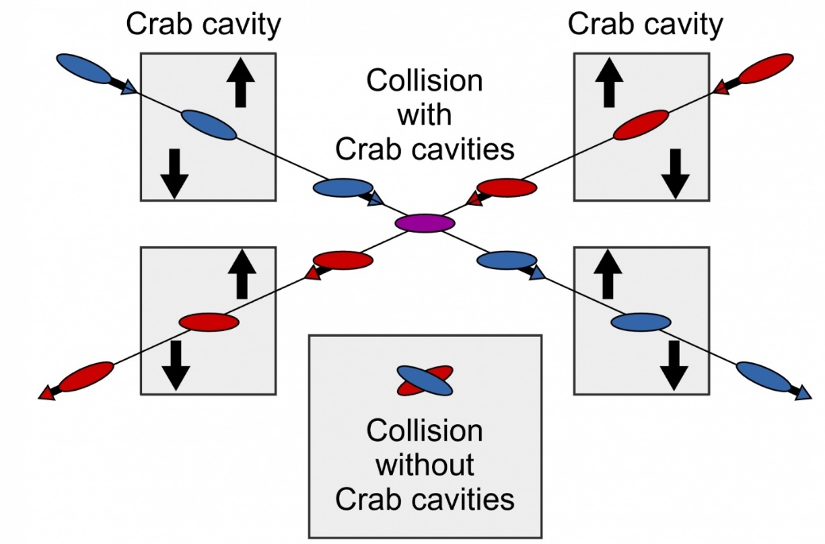

WP3: 6th Crab Cavity Preparation Meeting
Peter McIntosh,
UKRI-STFC Daresbury Laboratory
18th March 2022

Slide 2
Agenda for Today
1. Specifications Review P McIntosh
  Updates from Design Review Workshop #1 on 8/12 (https://agenda.linearcollider.org/event/9515/)
  Updates from Joint-BDS meeting on 16/2 (https://agenda.linearcollider.org/event/9589/)
2. Cavity Design Parameters P McIntosh
  Agree a basis for comparison
3. WG2 Steering Panel Pre-lab Update P McIntosh
  Provide indication of proposed 4-yr programme and priority WP3 objectives
4. Prep for next Design Review Meeting in June P McIntosh

Slide 3
Actions from Design Review Workshop #1 (8/12/21)
BDS team requested to perform a 10sigma simulation, as this is expected to be more representative of beamline effects and likely to need a larger aperture, but how much larger? Action: Okugi-san
Analysis performed reinforcing requirement for larger aperture.
It was noted that the beam-size at the CC location will vary with energy and so parameters should be provided for 1TeV. Action: Okugi-san
Similarly identified for larger energy.
Important that the WP3 team have a clear specification for the interfacing beam-line components, which need to be confirmed. Action: Akira
This requires more detailed development of BDS interfacing of SC magnet systems, which is not likely to happen quickly.
It was noted that the Ep and Bp figures should be scaled for the various frequency options proposed. Action: Andrei
Agreed parameters for 1.3GHz, but need equivalent for 2.6 and 3.9GHz options.
Multipole components require further clarification, suggestion to use the parameters set for HL-LHC as a starting point. Action: Rama
Parameters added to Specification spreadsheet for collective WP3 review.
For all specification updates identified, a revised specification list would be distributed (v11). Action: Peter
Revision issued on 31/1.
How much do need to detune CC if it is to be parked, suggestion of >1000 x BW proposed, seems too high. Can BDS team provide some indication of scaling for linac vs circular machine. Action: Okugi-san
Slava provided an extensive analysis paper for evaluating CC detuning requirements, needs translating for 1.3GHz and 3.9GHz options and higher energy.
A proposed list of cavity design parameters were highlighted and posted into the V10 specification file. All WP3 collaborators requested to send updates for this list (to Peter M) identifying all needed parameters and also clarifying (where necessary) the nomenclature/definition used (i.e. circuit vs accelerator), along with the equation if necessary. Action: All WP3
No feedback received, propose to agree parameters today.
It is anticipated that further update meetings will also be scheduled, to deal with specific specification issues and information dissemination, which will be announced accordingly. Action: Peter
Conducted with today’s meeting.
Note: Underlined actions, also reviewed at Joint-BDS meeting on 16/2

Slide 4
Actions from Joint-BDS meeting
CC detuning – Not a defining criteria for the cavity itself, WP3 to determine tolerable voltage wrt beam offset without impacting luminosity. WP3
Longitudinal space constraint – for 3.25m revised installation constraint, further discussions required with the BDS Engineering team with B Parker to clarify risk for increasing the 300mm cryostat interface, thereby reducing the 3.25m for the CC even further. B Parker
Longitudinal space constraint – a dimensioned schematic is required showing the upstream and downstream interfacing cryostats, along with the warm section components with then are expected to directly interface with the CC cryomodule. T Okugi
Horizontal aperture @ 250GeV – specific concerns regarding the QmiR cavity aperture changes to be reviewed with BDS team for any associated issues to be identified. A Lunin
Horizontal aperture @ 1TeV – indications that aperture restrictions are more favourable at higher energies, a technology solution that works at 250GeV which can also work at 1TeV would be more favourable, however this is not a fundamental requirement. The WP3 team will identify a collectively agreed approach for the first down-selection process. WP3
Operational contingency – The WP3 team will also collectively agree the level of operational contingency or otherwise required redundancy for the solutions proposed. From this, the necessary criteria will be used for the first down-selection process. WP3

Slide 5
ILC CC Specifications (v11)
Parameter | Recent Spec (After TDR) |  | 10Hz Upgrade^{1,2} | 1 TeV CoM Spec ²
Beam Energy (GeV) e- | 125 |  |  | 500
Crossing Angle (mrad) | 14
Installation site (m from IP) | 14
RF Repetition Rate (Hz) | 5 |  | 10 | 4
number of bunches | 1312 |  | 2625 | 2450
Bunch Train Length (ms) | 727 |  | 961 | 897
Bunch Spacing (ns) | 554 |  | 366
Beam current (mA) | 5.8 |  | 8.75 | 7.6
Operating Temp (K) | 2
Cryomodule installation length (m) | 3.8 – reduced to 3.25m
Horizontal beam-pipe separation (m) | 0.1967 (centre) ±0.0266 (each end of installation length)
Cavity Frequency (GHz) | 3.9 | 2.6 | 1.3 | 3.9 | 2.6 | 1.3
Total Kick Voltage (MV) | 0.615 | 0.923 | 1.845 | 2.5 | 3.7 | 7.4
Max Ep (MV/m) |  |  | 45 |  |  | 45
Max Bp (mT) |  |  | 80 |  |  | 80
Amplitude regulation/cavity (% rms) | 3.5 (for 2% luminosity drop)
Relative RF Phase Jitter (deg rms) | 0.069
Timing Jitter (fs rms) | 49 (for 2% luminosity drop)
Max Detuning (kHz) |  | 200
Longitudinal impedance threshold (MOhm)
Trasverse impedance threshold (MOhm/m) (X,Y) | 48.8, 61.7 (from TDR)
Cavity field rotation tolerance/cavity (mrad rms) | 5.2 (for 2% luminosity drop)
Beam tilt tolerance (H and V) (mrad rms and urad rms) | 0.35, 7.4 (for 2% luminosity drop)
Minimum CC beam-pipe aperture size (mm) | ≥20 (same as FD magnets)
Minimum Exraction beam-pipe aperture size (mm) | 20
Beam size at CC location (X, Y,Z) (mm,um,um) | 0.97, 66, 300
Beta function at CC location (X, Y) (m,m) | 23200, 15400
CC System operation | assume CW-mode operation
Interface apertures – BDS team reduction
Conservative levels to adopt – TBC
Scaling with frequency – S Yakovlev analysis
Cavity wakefields (GdfidL sims) – Update from teams?
Collimation studies – ideally ≥20mm!

Slide 6
CC Design Parameters
Parameter | Value | Units | Nomenclature
Operating frequency [GHz] |  | GHz
SOM [GHz] |  | GHz
1st Longitudinal HOM [GHz] |  | GHz
1st Transverse HOM (GHz) |  | GHz
E_{p}/E_{t}*
B_{p}/E_{t}* [mT/(MV/m)] |  | mT/(MV/m)
B_{p}/E_{p} [mT/(MV/m)] |  | mT/(MV/m)
G [Ω] |  | Ω
R/Q [Ω] |  | Ω
R_{t}R_{s} [Ω²] |  | Ω²
V_{t} per cavity [MV] |  | MV
E_{p} [MV/m] |  | MV/m
B_{p} [mT] |  | mT
Total V_{t} [MV] |  | MV
Total No. of cavities
Cavity Length [mm] |  | mm
Cavity Diameter [mm] |  | mm
Minimum Aperture [mm] |  | mm
R_{t}/Q [Ω] |  | Ω
FPC Q_{L}
Bandwidth [kHz] |  | kHz
Cavity Input Power [kW] |  | kW
Horizontal Kick Factor k_{x} |  | V/pC/m
Vertical Kick Factor k_{y} |  | V/pC/m
Stored Energy W [J] |  | J
HOM impedance (Longitudinal) |  | MΩ
HOM impedance (Transverse) |  | MΩ/m
Anything else?
Clarify/Agree?!?

Slide 7
WG2 Steering Panel Update – Pre-Lab Preparations
2023
Priority | Items | Y1 | Y2 | Y3 | Y4 | Japan |  | Europe |  | Americas
 |  |  |  |  |  | $M | FTE | $M | FTE | $M | FTE
A | Decision of installation location with cryogenics/RF location accelerator tunnel | All
A | Confirm the complete CC system specifications | All
A | Development of CC cavity/coupler/tuner integrated design (ahead of Preliminary CC technology Down-selection) | EU/AM
A | Preliminary CC technology down-selection (2 cavity options) | All
A/B | CC Model-work and Prototype production and high-power validation of CC cavity/coupler/tuner integrated system (incl HPGS provision) for two primary candidates (ahead of Final CC technology Down-selection) | EU/AM | EU/AM |  |  | 0.5 |  | 0.35 | 5.5 | 0.35 | 5.5
B | Perform harmonized operation of the two prototype cavities in a vertical test to verify ILC synchronization performance (cryo insert development and commercial optical RF synchronization system). |  | EU/AM | EU/AM |  |  |  |  |  | 0.05 | 1
A/B | Final CC technology down-selection |  |  | All
B | Preliminary Crab Prototype CM (pCM) design – confirming dressed cavity integration and compliance with beam-line specification (incl HPGS provision) |  |  | EU/AM | EU/AM |  |  |  | 3.5 |  | 3.5
B | Final pCM engineering design prior to production |  |  | EU/AM | EU/AM |  |  |  | 0.5 |  | 0.5
 | Totals (Dependent on prioritised funding) |  |  |  |  | 0.5 |  | 0.35 | 9.5 | 0.4 | 10.5
Already set for 27/9/22
Provisionally set for Q1 2024

Slide 8
WG2 Steering Panel Update – Pre-Lab Preparations
Post Pre-Lab
Timescales TBD

Slide 9
Prep for next Design Review Meeting in June
Meeting scheduled for 22nd June 2022, 13:30 – 16:00 (UK Time)
Expectations to have updates for:
  Cavity optimisation
  Coupler developments (Input and mode extraction)
  Pressure/Tuning analysis
  Multipacting
  Anything else?
Criteria for down-selection scheduled for 27th Sept 2022, 13:00 – 18:00 (UK Time):
  Compliance with specification
  Technology compliance for 1TeV – identical technology would be preferred
  Operational contingency – overhead capability, redundancy etc
  Anything else?

