Slide 1
Ion backflow in TPC
FCC France workshop
January 21, 2021
P. Colas

Slide 2
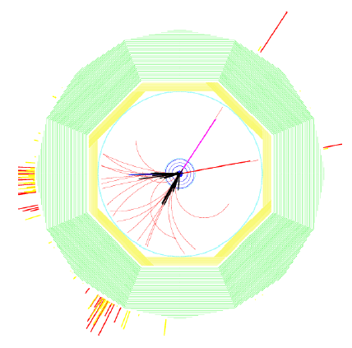
Motivation for the tracking at e+e- colliders as Higgs factories
e+e- -> HZ, Z->µµ
Need to reconstruct complex multi-track events (jets) in a noisy environment : calls for high segmentation
Also need to reconstruct very accurately high energy tracks from Z recoil to Higgs. This translates into O(10 µm) control of the systematics on sagitta and Δ(1/P)=10⁻⁴ GeV ⁻¹ for TPC only (2.10⁻⁵ GeV ⁻¹ for the whole tracking system).
Silicon detectors give point measurement accuracy, but also introduce multiple scattering, while a TPC provides a continuous 3D track reconstruction with minimal matter : useful for V0, kinks, connecting to vertex tracker, other silicon trackers, and to calorimeter.
Also a TPC has dE/dx capability, for K/π separation, essential for Heavy Flavour physics at the Z pole.

Slide 3
Motivation for the tracking at e+e- colliders as Higgs factories
e+e- -> HZ, Z->µµ
Need to reconstruct complex multi-track events (jets) in a noisy environment : calls for high segmentation
Also need to reconstruct very accurately high energy tracks from Z recoil to Higgs. This translates into O(10 µm) control of the systematics on sagitta and Δ(1/P)=10⁻⁴ GeV ⁻¹ for TPC only (2.10⁻⁵ GeV ⁻¹ for the whole tracking system).
Silicon detectors give point measurement accuracy, but also introduce multiple scattering, while a TPC provides a continuous 3D track reconstruction with minimal matter : useful for V0, kinks, connecting to vertex tracker, other silicon trackers, and to calorimeter.
Also a TPC has dE/dx capability, for K/π separation, essential for Heavy Flavour physics at the Z pole.

Slide 4
The Ion Problem
Ions are copiously produced in the amplification device. A fraction of them will flow back in the drift space and add to the primary ions produced by the charged tracks and converted X-rays from the machine background.
Ions drifting in the electric field of the TPC are very slow, of the order of a m/s
As a consequence, this positive charge accumulates and gives rise to a space charge. The region where this space charge builds up being limited, and the density being non-uniform, this produces transverse E field components which produce distortions (enhanced by ExB effects)
At the TeraZ, there is one Z produced in every drift time of the TPC. Even primary ionization produces enough space charge to distort the tracks.

Slide 5
The ion backflow problem impacts TPCs at colliders (LEP, RHIC, LHC/Alice). It is usually escaped by stopping and neutralizing the ions with a gating grid of wires between collisions.
OPEN
CLOSED
Parallel wires are set at alternating potentials to close the gate by producing a transverse field.
The gate is open only during electron drift (50 µs at LEP)

Slide 6
C. Garabatos in workshop
«New Horizons for TPCs», October 7, 2020

Slide 7
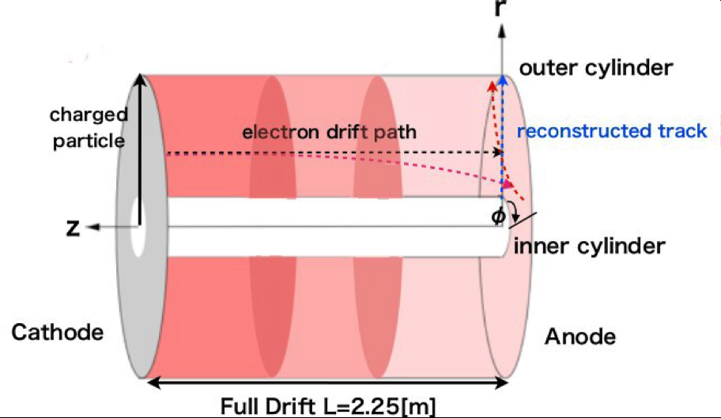
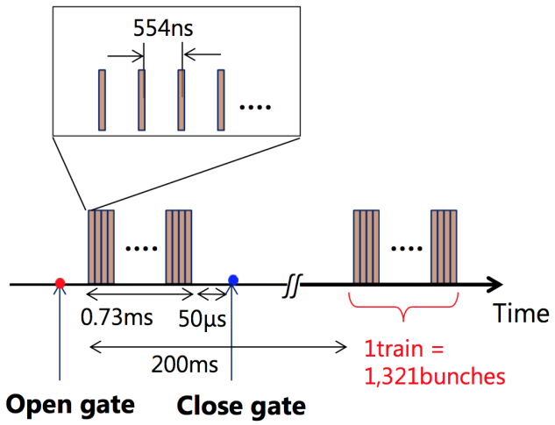
Need for gating
In TPCs, ions are produced and migrate very slowly (1 m/s) . They produce a charge density which can be one or two orders of magnitude above the primary ionization (IBF*Gain). Present-day electronics allows running at a gas gain of 2000 or a bit less. 500 could be in reach. Thus backflow fractions of 0.5% to 2% would not add to the primary ionization.
The resulting electric field can be the origin of distortions.
At the ILC, the bunch trains last about 1ms every 200 ms, giving rise to ion disks slowly drifting to the cathode

Slide 8
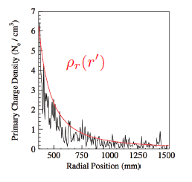
Need for gating
In TPCs, ions are produced and migrate very slowly (1 m/s) . They produce a charge density which can be one or two orders of magnitude above the primary ionization (IBF*Gain). Present-day electronics allows running at a gas gain of 2000 or a bit less. 500 could be in reach. Thus backflow fractions of 0.5% to 2% would not add to the primary ionization.
The resulting electric field can be the origin of distortions.
A. Vogel
At the ILC, the bunch trains last about 1ms every 200 ms, giving rise to ion disks slowly drifting to the cathode
Charge density for 100 bunches

Slide 9
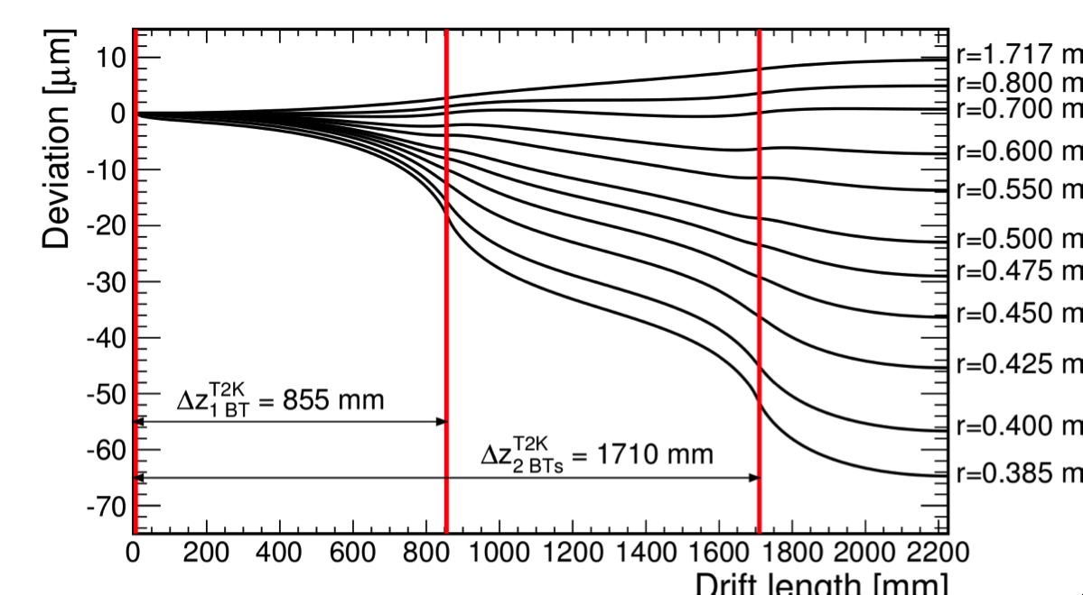
Need for gating
In TPCs, ions are produced and migrate very slowly (1 m/s) . They produce a charge density which can be one or two orders of magnitude above the primary ionization (IBF*Gain). Present-day electronics allows running at a gas gain of 2000 or a bit less. 500 could be in reach. Thus backflow fractions of 0.5% to 2% would not add to the primary ionization.
The resulting electric field can be the origin of distortions.
Calculation by Daisuke Arai
At the ILC, the bunch trains last about 1ms every 200 ms, giving rise to ion disks slowly drifting to the cathode

Slide 10
One gating solution: the gating GEM
A. Sugiyama et al.
86 % transparency for electrons demonstrated for Delta V = 4 V over 50 µm
Preservation of the resolution demonstrated in a beam test
Ion blocking expected for DeltaV =-40V
Other solution : equipotential wire grids (was not possible at LEP as there was no time to switch it on and off)

Slide 11
Summary on gating
Gating is a solution for ILC @ nominal luminosity, for instance with a gating grid, thanks to the beam time structure at 5 or 10 Hz.
However mechanically very difficult.
In many other applications (sPhenix@EIC, ALICE@LHC, FCCee, CEPC), gating is not possible because of continuous beam.
Note that at the TeraZ, even primary ionization rules out the use of TPC
ONE MUST FIND WAYS OF MITIGATING THE BACK-FLOW WHILE KEEPING GOOD ELECTRON EFFICIENCY

Slide 12
Philippe Schwemling
The higher the magnetic field, the more curlers, increasing ionization

Slide 13
S. Ganjour

Slide 14
This estimate is probably a lower limit, if not an underestimate.
No background is included.
Assumes 20 kHz Z rate (should be up to 40 kHz)
and 40 ions per cm (should be 100)
Assumes IBF*gain=1
Possible handles : lower magnetic field, inner radius increased to 50cm?
Still OK for CEPC parameters (1 to 2 orders of magnitude less in luminosity)
(Huirong Qi assuming Gain*IBF=5 with a Micromegas + GEM)
Philippe Schwemling

Slide 15
Ion backflow mitigation/suppression
Several ideas have been proposed to suppress ion backflow
4-GEMS, 2 or 3 GEMs + Micromegas, double or triple meshes, staggered, crossed…
The situation is rather confused : impressive results like 10⁻⁴ or even 10⁻⁵ ion backflows are suspected to be due to screening by space charge . The measurement is extremely difficult.
The suppression is often obtained at the cost of resolution
(in energy/dE/dx and position)

Slide 16
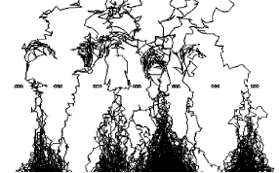
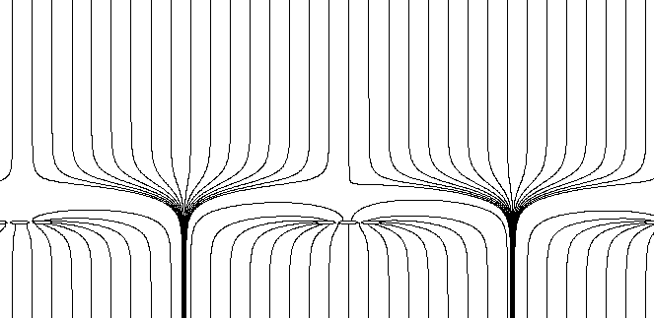
Ion backflow natural suppression in Micromegas
S1
σ
Electrons from the avalanche undergo transverse diffusion.
The ions created follow field lines with negligible diffusion.
Thus most of them (outside the funnel) go back to the mesh where they are neutralized.
The maximum backflow is thus proportional to the field ratio
(0.3% in the ILC TPC case).
S2
S2/S1 = E_{drift}/E_{amplif} ~ 200/60000= 1/300

Slide 17
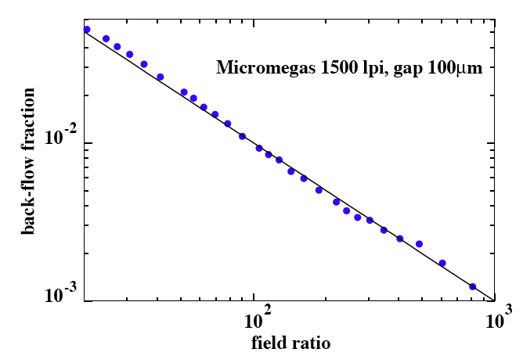
The inverse field ratio law is well verified experimentally
P. Colas et al., NIMA535(2004)226
1%
More detailed measurements have been carried out with Ingrid detectors.
(M. Chefdeville’s thesis)
Ar-CH₄ 97-3
E_{A}/E_{D}

Slide 18
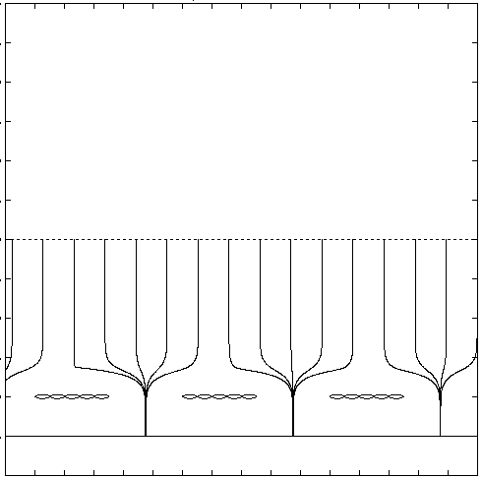
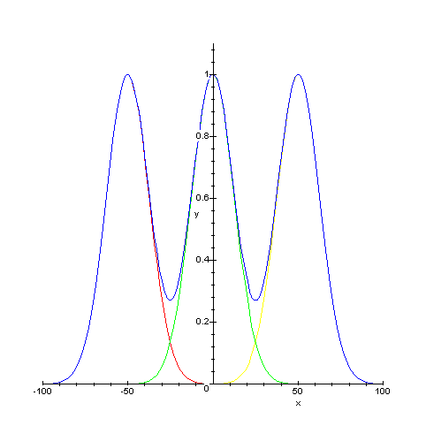
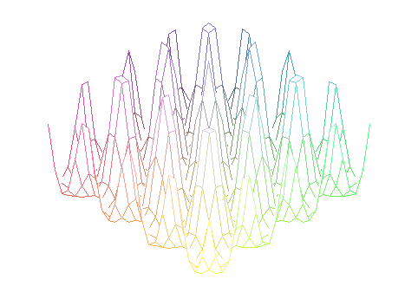
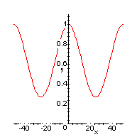
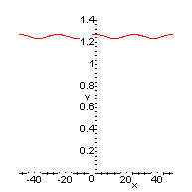
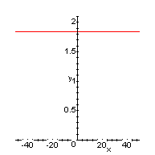




Sum of gaussian diffusions
Periodic structure
2D
3D
p
Mesh
500 LPI
1000 LPI
1500 LPI
σ_{t}/p
0.25
0.5
0.75
Theoretical model
$$\frac{IBF}{FR}$$
$$2.5$$
$$1.03$$
$$1$$
J. Martin (2003)
When the avalanche extends to neighbouring holes, the minimum backflow is attained

Slide 19
4 GEMs
ALICE with 4 GEMs
Also adopted by SPhenix
Piotr Gasik
Klaus Dehmelt

Slide 20
4 GEMs
ALICE with 4 GEMs
Distortions up to 20 cm
Energy resolution (%)
See also : M Ball et al 2014 JINST 9 C04025
Ion Backflow (%)

Slide 21
Double Micromegas
DMM (Jianbei Liu et al., USTC)
Claim that misaligning the meshes reduces the backflow.
But resolution also degrades.
Also studied in F. Jeanneau et al. NIMA623(2010)94, but very difficult measurement
Caveats : Moiré modulation of the gain, effect of magnetic field
It is also possible to make use of a magnetic field in a high ωτ gas (E. Shulga, Weizmann)

Slide 22
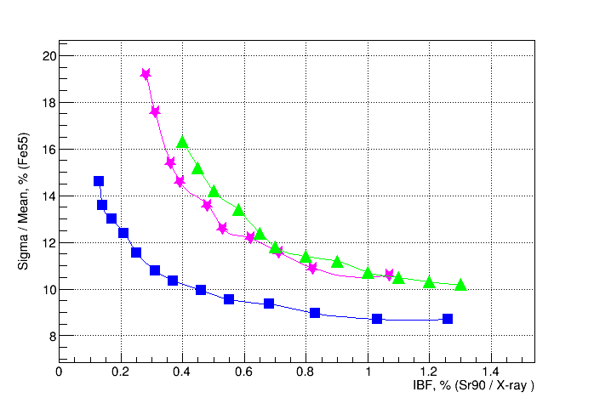
Micromegas + nGEMs
Also measurements have been done with Micromegas + 1, 2 or 3 GEMs
At the end marginally better than Micromegas alone
Hugo Peireira
Nikolai Smirnov
F. Bossu
S. Aune
et al.
More results can be found. NIM A 834 (2016) 149

Slide 23
One direction of research is to use Graphene, but this looks very difficult
Patrick Thuiner

Slide 24
Possible solution : shape the field so that they converge to a small region, from which electrons escape
by diffusion. Necessitates to shape the anode at the hole scale level.
This can be done using micro-additive fabrication at the sub-micronic level (example from Tiago Silva, Sao Paulo)

Slide 25
Peter Kluit, Nikhef, CEPC workshop, Shanghai, Oct. 2020

Slide 26
Conclusions
Ion backflow has to be suppressed if one is to select Higgs recoils.
If gating is not possible (case of FCC and CEPC) one needs to find a new structure to suppress the ion backflow without degrading the space resolution or dE/dx resolution.
So far many trials with multiple GEMs or Micromegas or combinations have been done, but still IBF limited to 1 permil or a few.
Micro-additive fabrication of the anode might provide a technical solution.

Slide 27
Peter Kluit : ‘there is no need for a gating device (a double grid suffices)

Slide 28
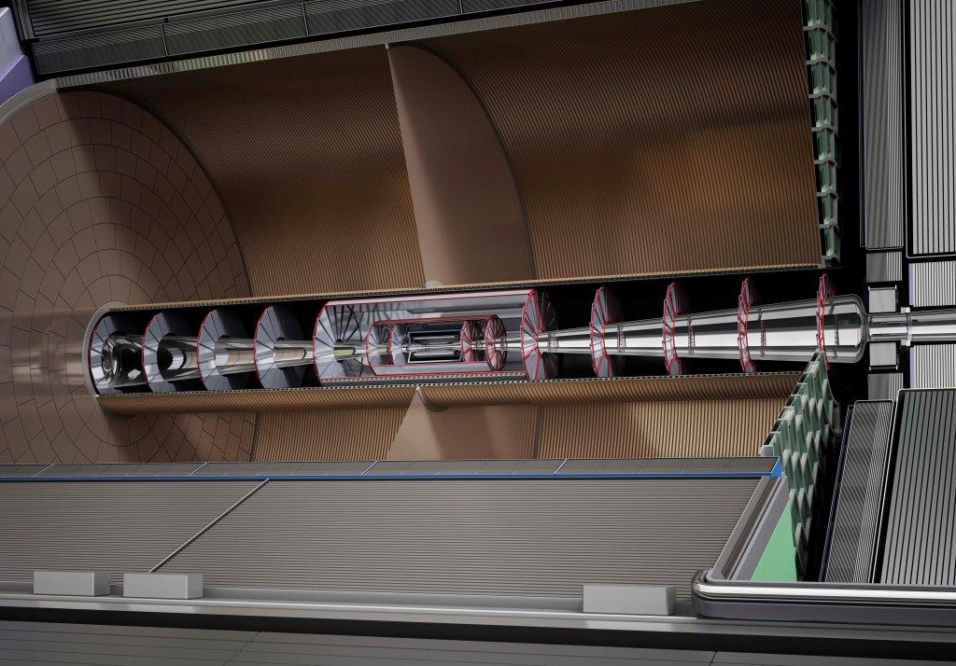
A TPC for ILC
Options : GEM and Micromegas with pads or pixels
R&D lead to a design of a Micromegas module with fully integrated readout and 2-phase CO2 cooling.
The ERAM concept (Encapsultated Resistive Anode Micromegas) proved to ‘do the job’ : 200 points with 60 µm resolution
This ERAM concept is adopted by T2K/ND280 for its upgrade. If successful, it might be used at DUNE/SAND

