Slide 1
SDHCAL
Status and future
I. Laktineh
For
Gent, CIEMAT,GWNU, IP2I, LPC, OMEGA, SJTU, Tunis. U.

Slide 2
Outline
Status:
SDHCAL technological prototype
Short description
Energy reconstruction method
Improvement with PID techniques
Further improvements on energy reconstruction
Future:
SDHCAL for ILD@ILC
SDHCAL for ILD@CEPC
Summary

Slide 3
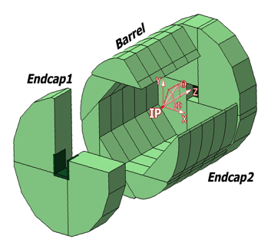
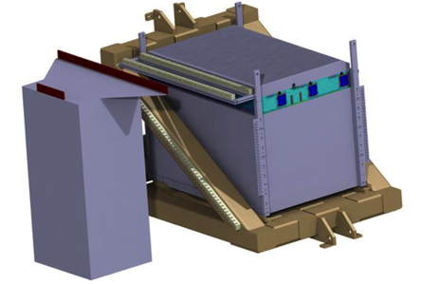
SDHCAL
The SDHCAL concept is based on exploiting Gaseous Detectors high granularity potential
G.D are equippedwith semi-digital, power-pulsed electronics readout and placed
in self-supporting mechanical structure to serve as absorber as well.
The structure proposed for the SDHCAL :
is very compact with negligible dead zones
Eliminates projective cracks
Minimizes barrel / endcap separation
(services leaving from the outer radius)
SDHCAL Technological Prototype should
be as much as possible similar to the ILD module
and able to study hadronic showers
Challenges
-Homogeneity for large surfaces
-Thickness of only few mms
-Lateral segmentation of 1 cm X 1 cm
-Services from one side
-Embedded power-cycled electronics
-Self-supporting mechanical structure

Slide 4
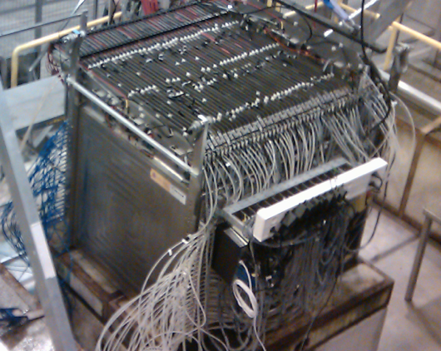
Completed in 2011 and tested in 2012
48 layers (-6λ_{I})
1 cm X 1 cm granularity
3-threshold, 500000 channels
Power-Pulsed
Triggerless DAQ system
Self-supporting mechanical structure
Published: JINST 10 (2015) P10039

Slide 5
SDHCAL prototype was exposed to beam particles
at CERN PS, SPS in 2012, 2015, 2017 and 2018
Electron rejection: shower starting after the fourth layer (6 radiation length)

Slide 6
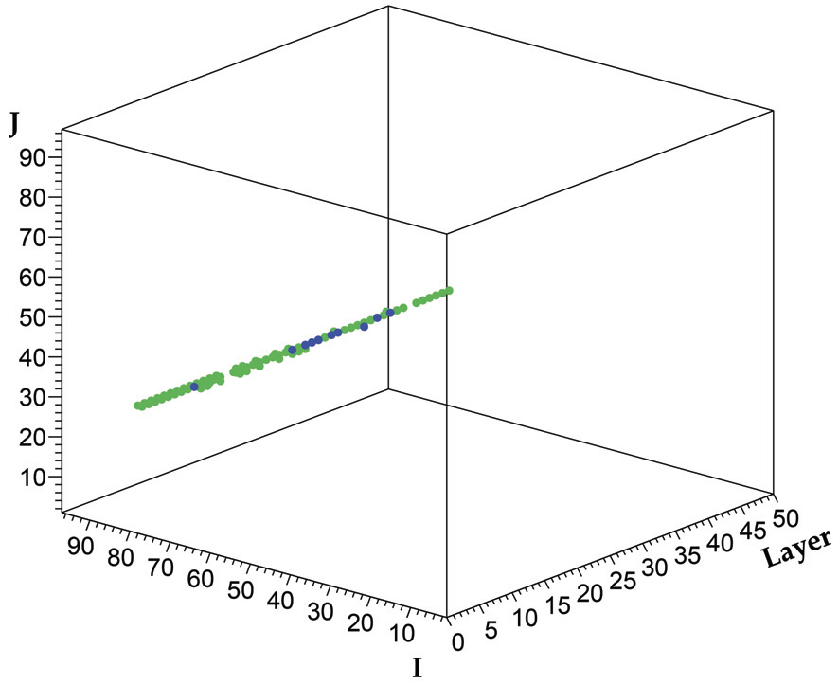
SDHCAL prototype was exposed to beam particles
at CERN PS, SPS in 2012, 2015, 2017 and 2018
Muon rejection: average number of hits/layer < 2

Slide 7
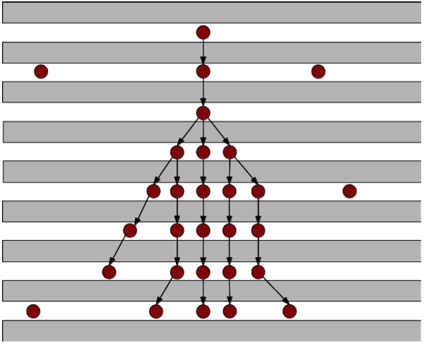
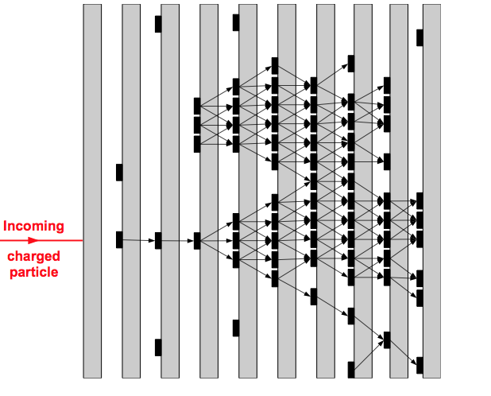
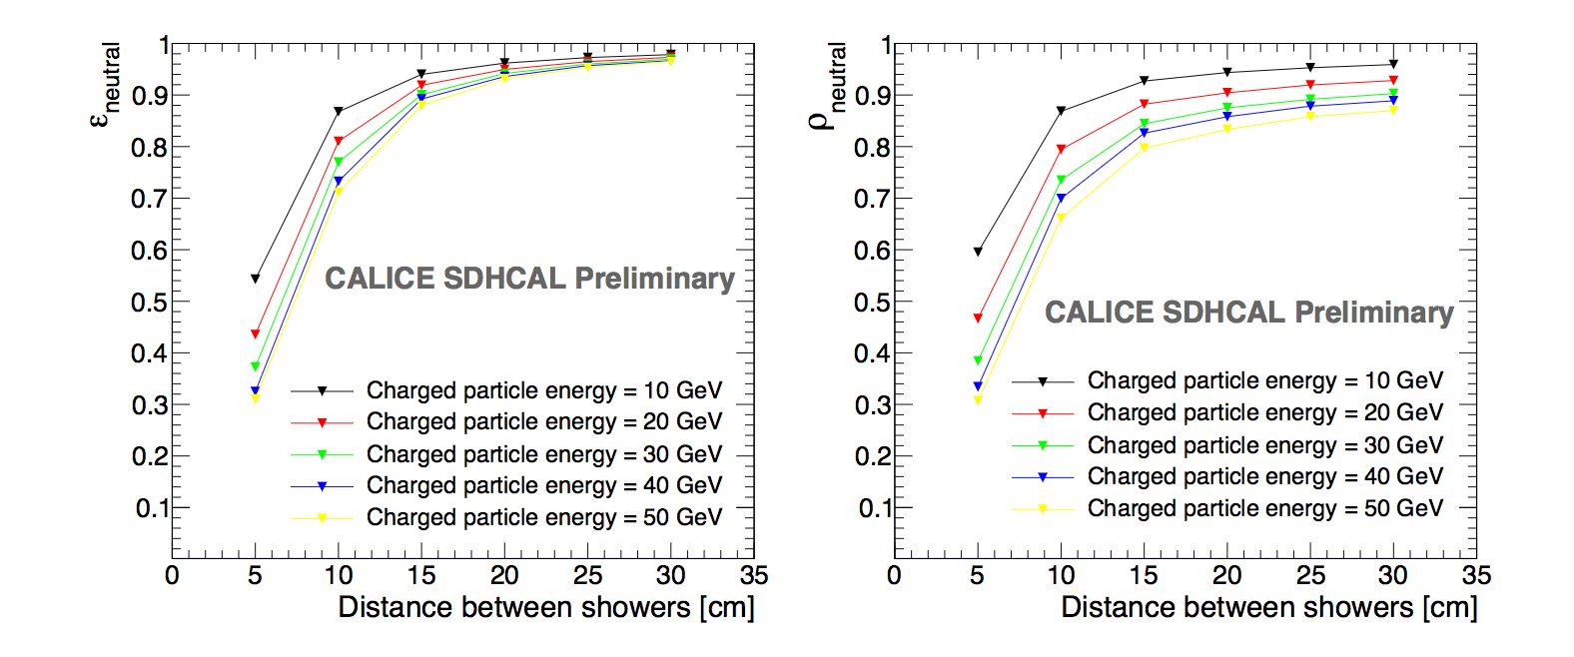
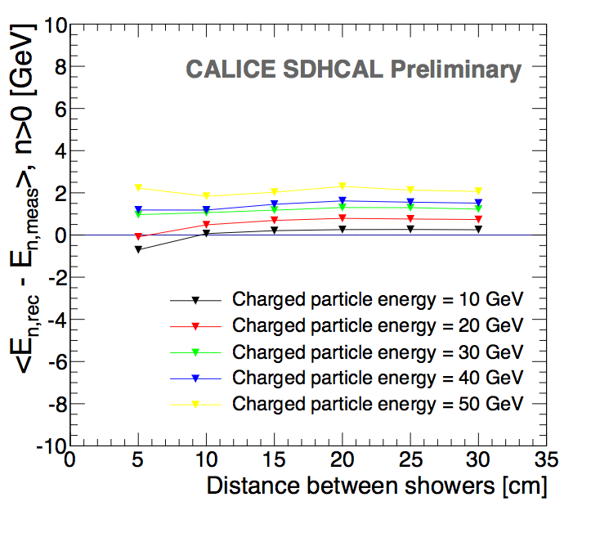
SDHCAL high granularity is conceived for PFA
It helps to optimize the connection of hits belonging to the same shower by using first the topology and then the energy information
ArborPFA, April algorithms:
It connect hits and then their clusters using distance and orientation information
then correct using tracker information (momentum)
Efficiency
ΔE
Purity
1 neutral of 10 GeV
1 neutral of 10 GeV
1 neutral of 10 GeV
CALICE note CAN054

Slide 8
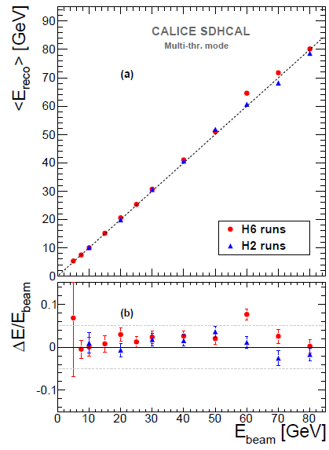
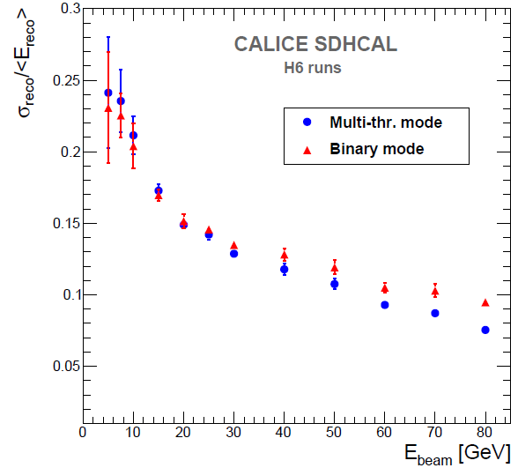
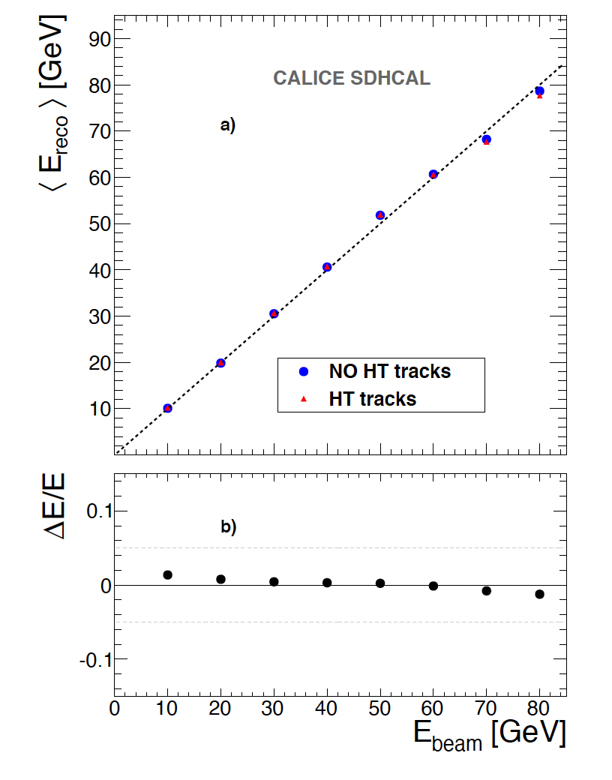
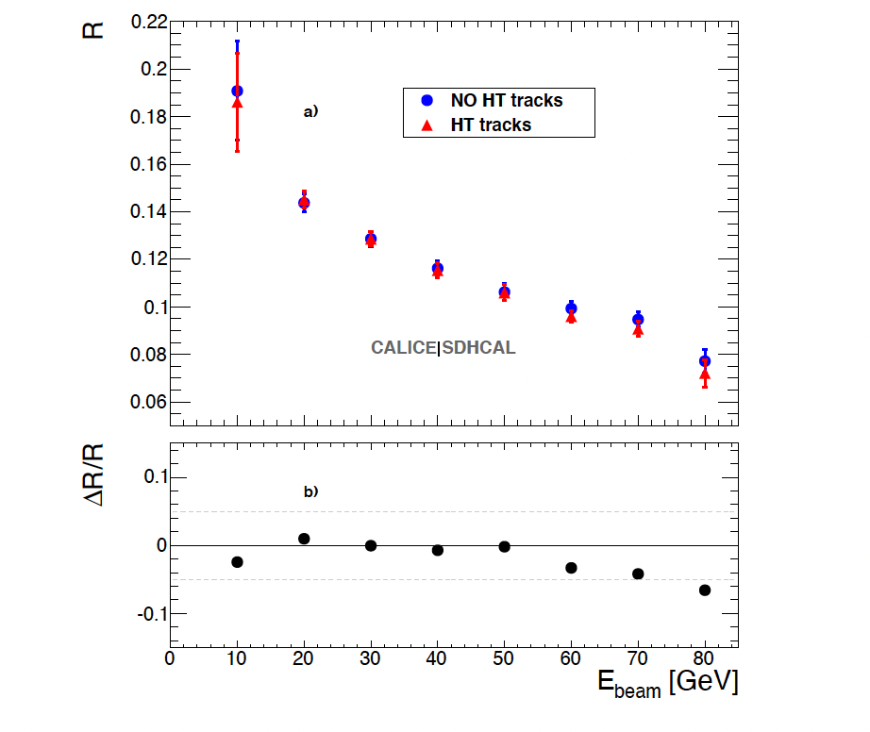
Energy reconstruction
N₁= Nb. of pads with first threshold <signal < second threshold
N₂ = Nb. of pads with second threshold <signal < third threshold
N₃ = Nb. of pads with signal> third threshold
E_{rec =} α (N_{tot}) N₁ + β (N_{tot}) N₂ + γ (N_{tot}) N₃
α , β , γ are quadratic functions of
They are computed by minimizing :
N_{tot} = N₁ + N₂ + N₃
χ²= (E_{beam}-E_{rec})²/E_{beam}
Hough-Transform
Track segments reconstruction using 3D-Hough Transform helps to apply different treatment to the hits of these segments.
JINST 11 (2016) P04001
E_{rec =} α (N_{tot}) N’₁ + β (N_{tot}) N’₂ + γ (N_{tot}) N’₃ + c N_{HT}
N_{tot} = N’₁ + N’₂ + N’₃+ N_{HT}
JINST 12 (2017) P05009

Slide 9
Particle Identification
Due to the absence of Cerenkov detectors in front of the SDHCAL, the use of an electron selection (shower starting > d= 6 X_{I}) was rather powerful but led to an important loss of hadrons (d= 1 λ_{l}).
To reject electrons and muons without losing hadrons we use the excellent granularity of SDHCAL to discriminate the three species. Several discriminatory variables were selected:
1- First layer of the shower (begin)
2- Number of tracks in the shower (trackMultiplicity)
3- Ratio of shower layers over total fired layers (nSHowerLayer/Nlayers)
4- Shower density (density)
5- Shower radius (radius)
6- Maximum shower position (length)
7- Ratio of N₃/N_{tot}
8- Average number of clusters
….
BDT technique was used.
Simulated events of electrons, muons and pions were used for training/validation before to apply to data.
To avoid a possible bias due to discrepancy between data/simulation of electrons showers in the SDHCAL, pure electrons and muons data events were also used

Slide 10
JINST 15 (2020) P10009

Slide 11
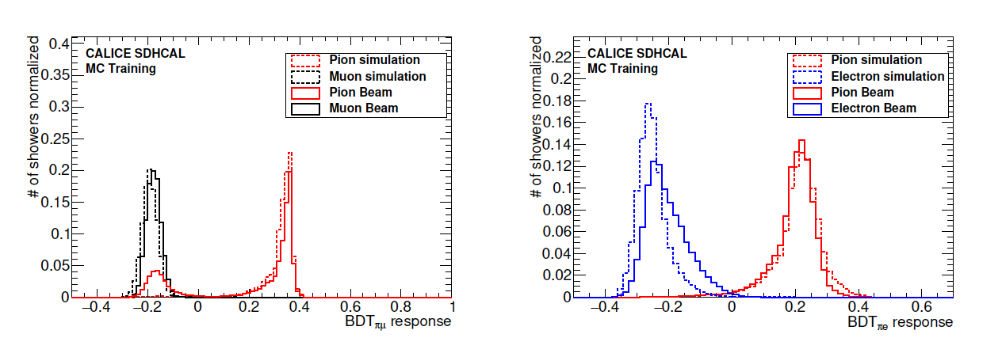
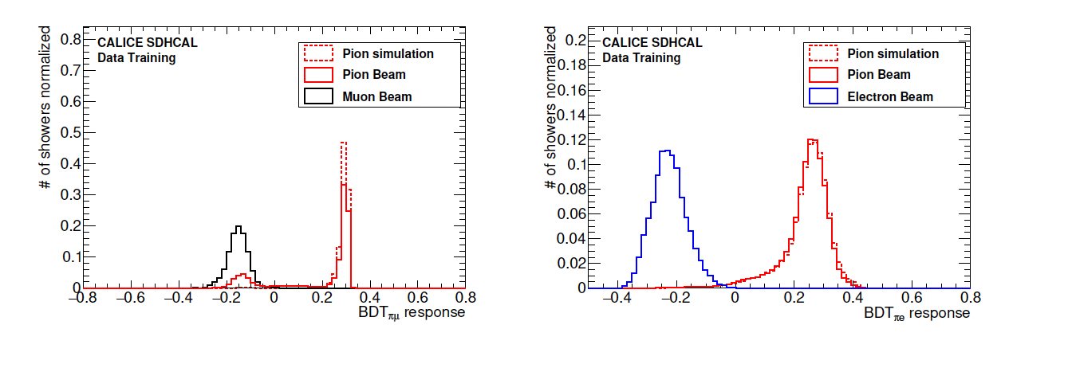
JINST 15 (2020) P10009
Electron and muon rejection > 99%

Slide 12
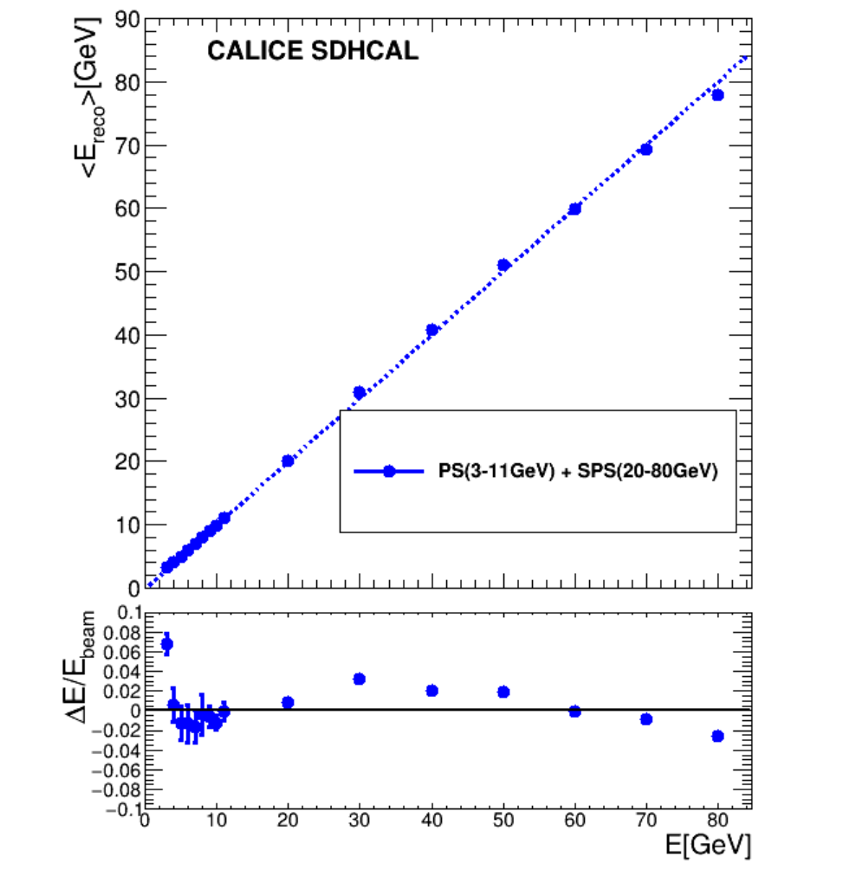
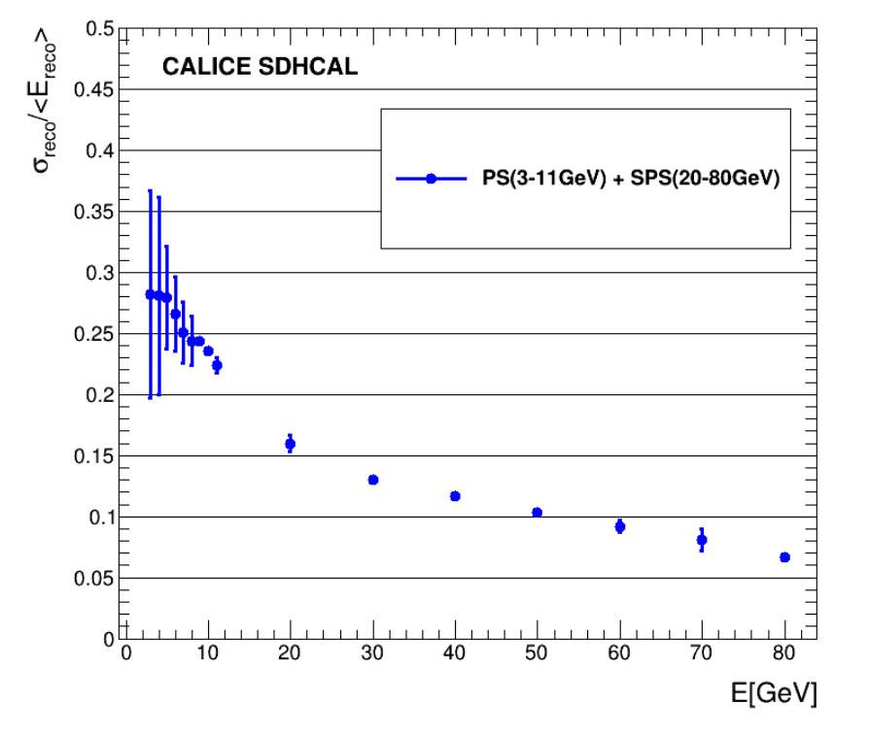
Particle Identification & Energy reconstruction
The BDT-based PID technique was also applied to the PS (3-80 GeV) samples
Linearity
Resolution
arXiv:2202.09684
Accepted to be published in JINST

Slide 13
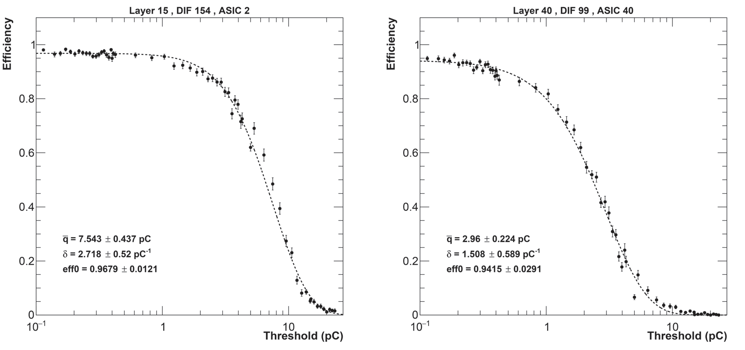
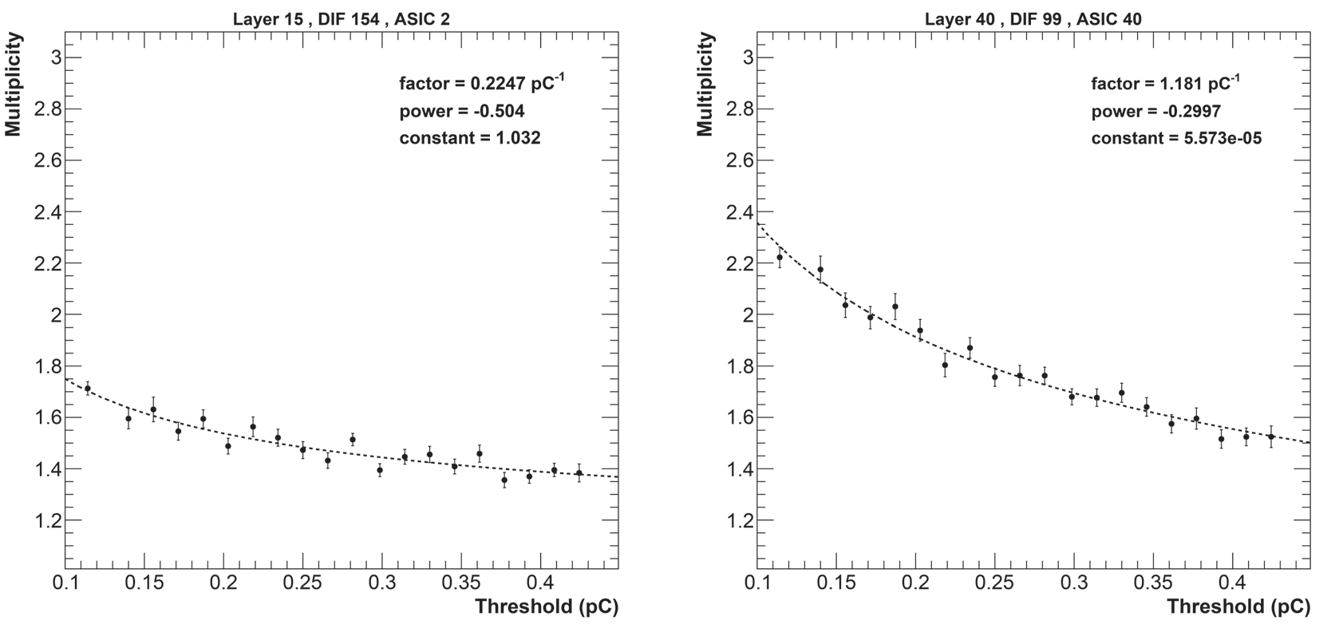
Further improvements on the energy reconstruction
Detector homogeneity
The homogeneity of the detector response is important to achieve better energy reconstruction
CALICE SDHCAL Preliminary
H2/2018
A new calibration method based on varying the thresholds rather than the electronic gain was found to be powerful. Muon runs with different thresholds Thr1: 0.1-0.42 pC, Thr2: 0.4-5, Thr3:4.7-24) and efficiency and multiplicity were measured for each value. The values of the three thresholds of each ASIC were fixed to obtain same multiplicity (first threshold) and the same efficiency for thr2 and thr3.
CALICE SDHCAL Preliminary
CALICE SDHCAL Preliminary
CALICE SDHCAL Preliminary
CALICE SDHCAL Preliminary

Slide 14
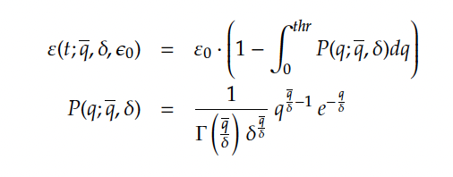

Further improvements on the energy reconstruction
Detector homogeneity
The homogeneity of the detector response is important to achieve better energy reconstruction
CALICE SDHCAL Preliminary
H2/2018
A new calibration method based on varying the thresholds rather than the electronic gain was found to be powerful. Muon runs with different thresholds Thr1: 0.1-0.42 pC, Thr2: 0.4-5, Thr3:4.7-24) and efficiency and multiplicity were measured for each value. The values of the three thresholds of each ASIC were fixed to obtain same multiplicity (first threshold) and the same efficiency for thr2 and thr3.

Slide 15
Further improvements on the energy reconstruction
Detector homogeneity
The homogeneity of the detector response is important to achieve better energy reconstruction
CALICE SDHCAL Preliminary
H2/2018
CALICE SDHCAL Preliminary
H2/2018

Slide 16
Further improvements on the energy reconstruction
Detector homogeneity
The homogeneity of the detector response is important to achieve better energy reconstruction
CALICE SDHCAL Preliminary
H2/2018
Before
After
1.4%
3.9%
We will apply the new method to the data to be collected in 2022

Slide 17
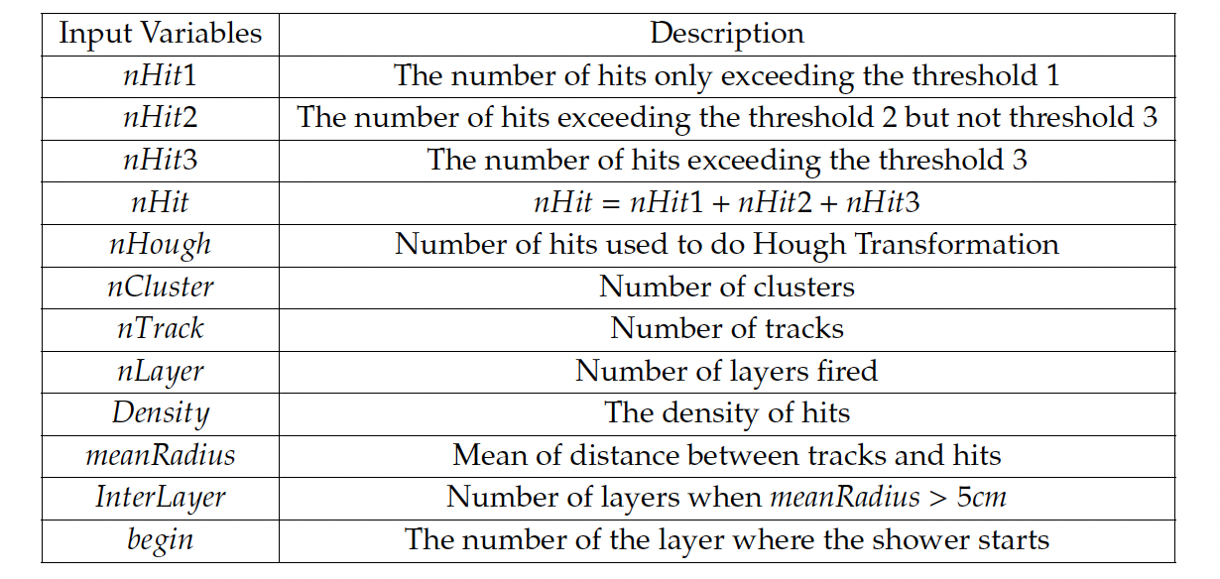
Further improvements on the energy reconstruction
Multi-Variate Techniques
Several MVT methods (NN and BDT) were used to exploit, in addition to N₁, N₂ and N₃, the hadronic shower shape information related to its energy thanks to the high granularity of the SDHCAL

Slide 18
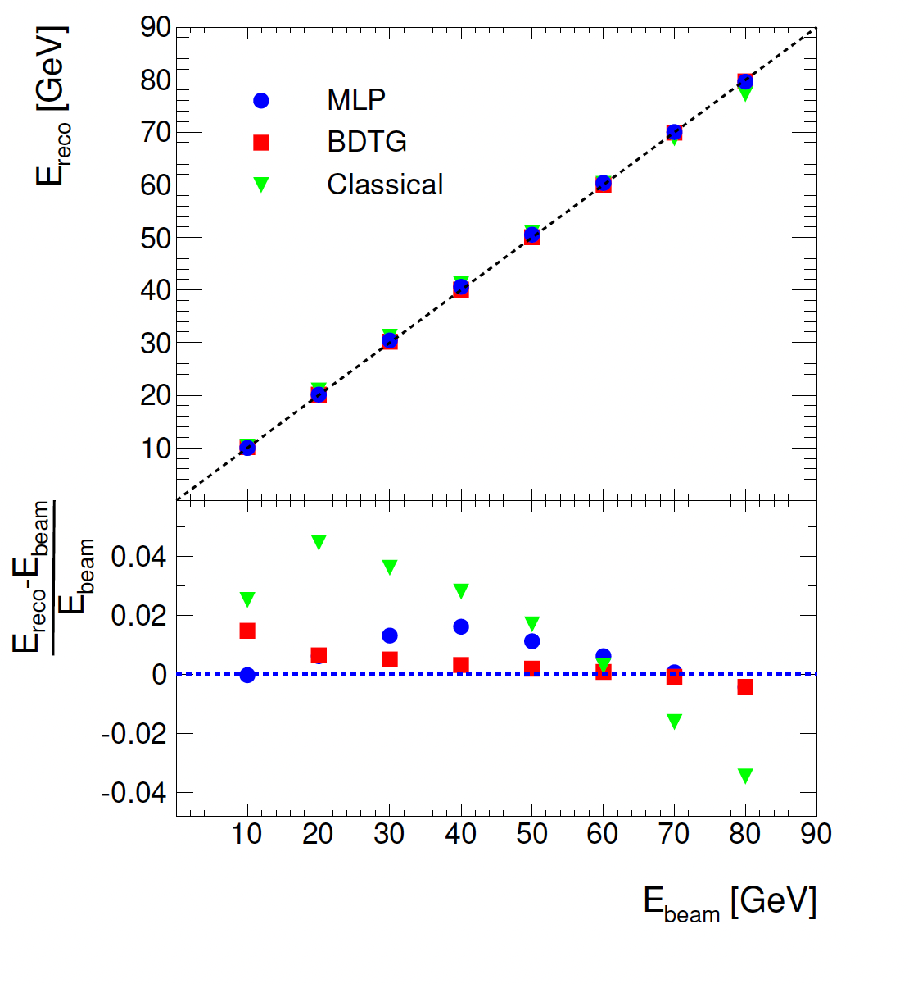
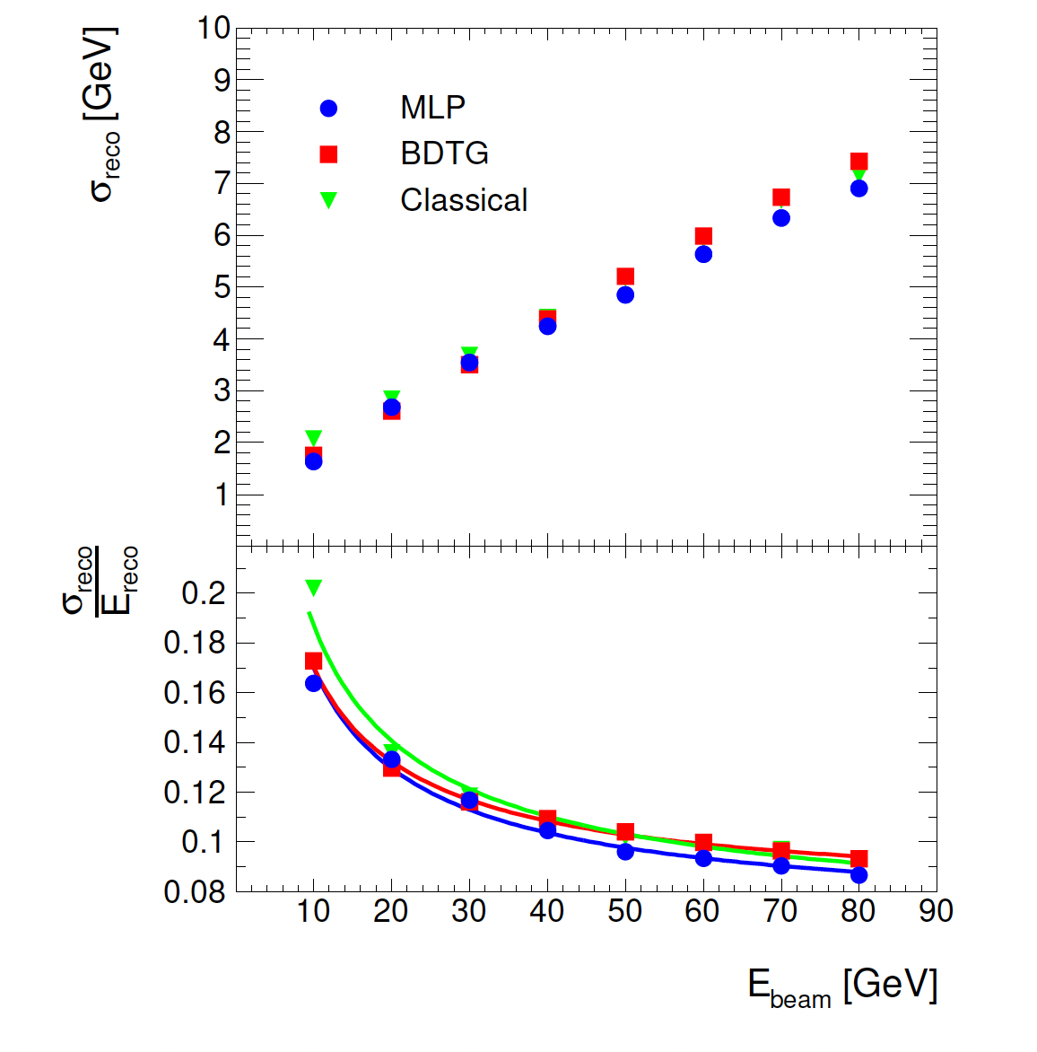
Further improvements on the energy reconstruction
Several MVT methods were used to exploit in addition to N₁, N₂ and N₃ the shape information that is related to the shower energy thanks to yhe high granularity of SDHCAL. Simulated pion events within SDHCAL were used for this study.
Simulation
Simulation
MLP seems to perform better
JINST 14, 2019, P10033

Slide 19
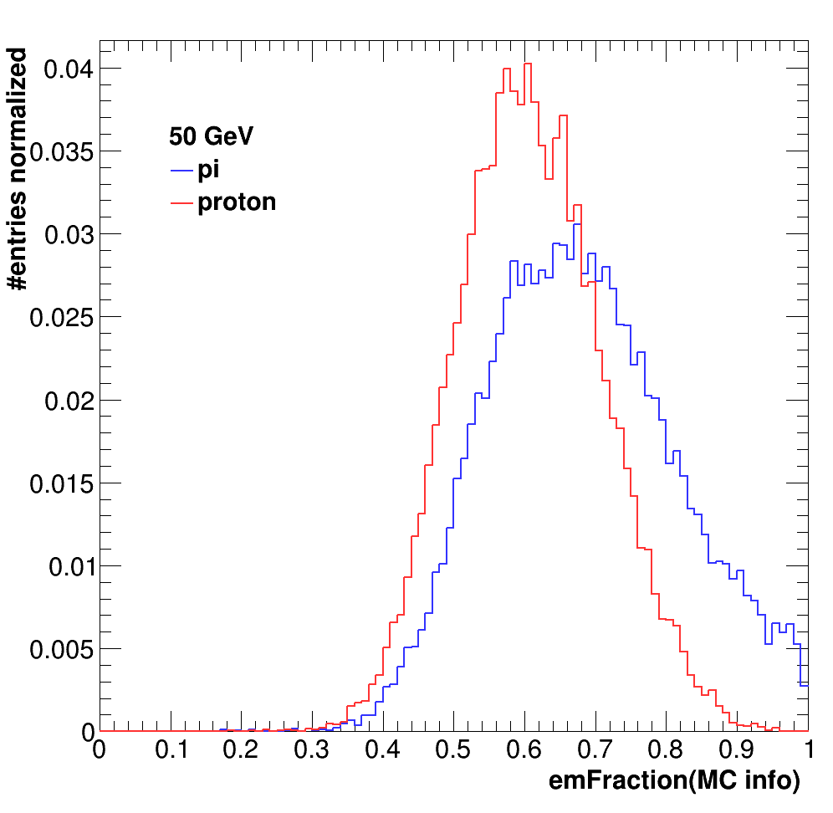
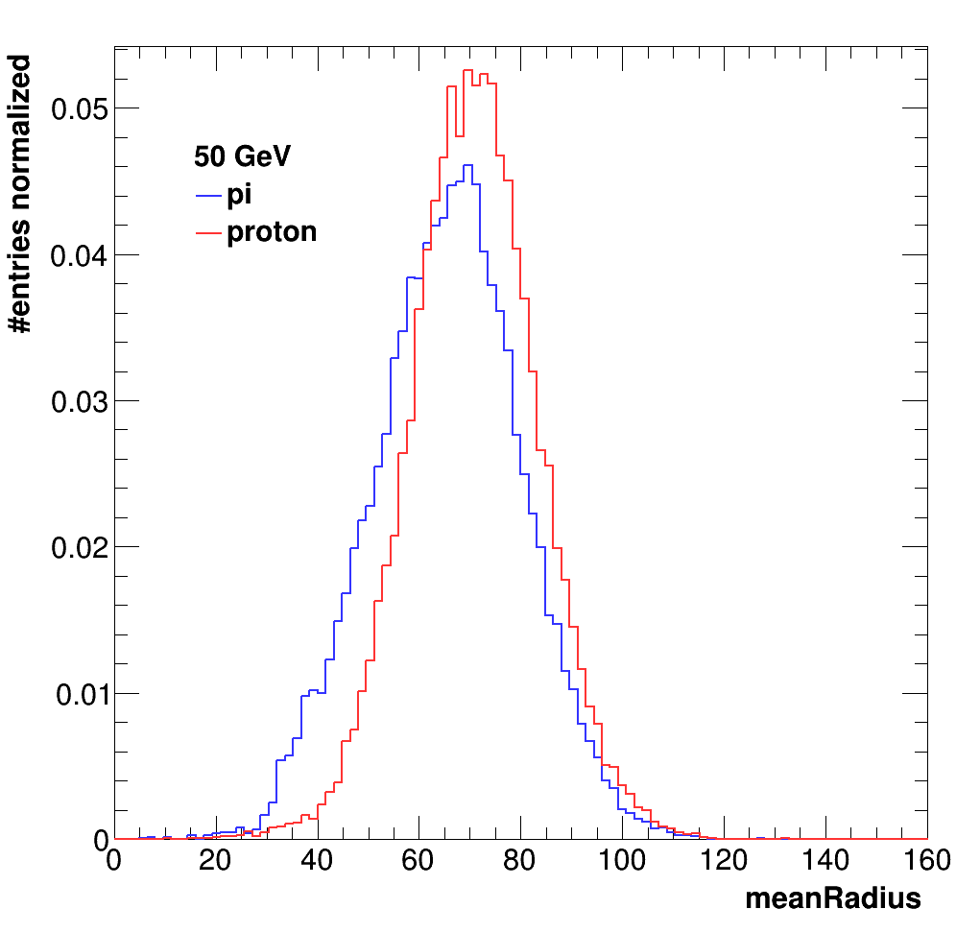
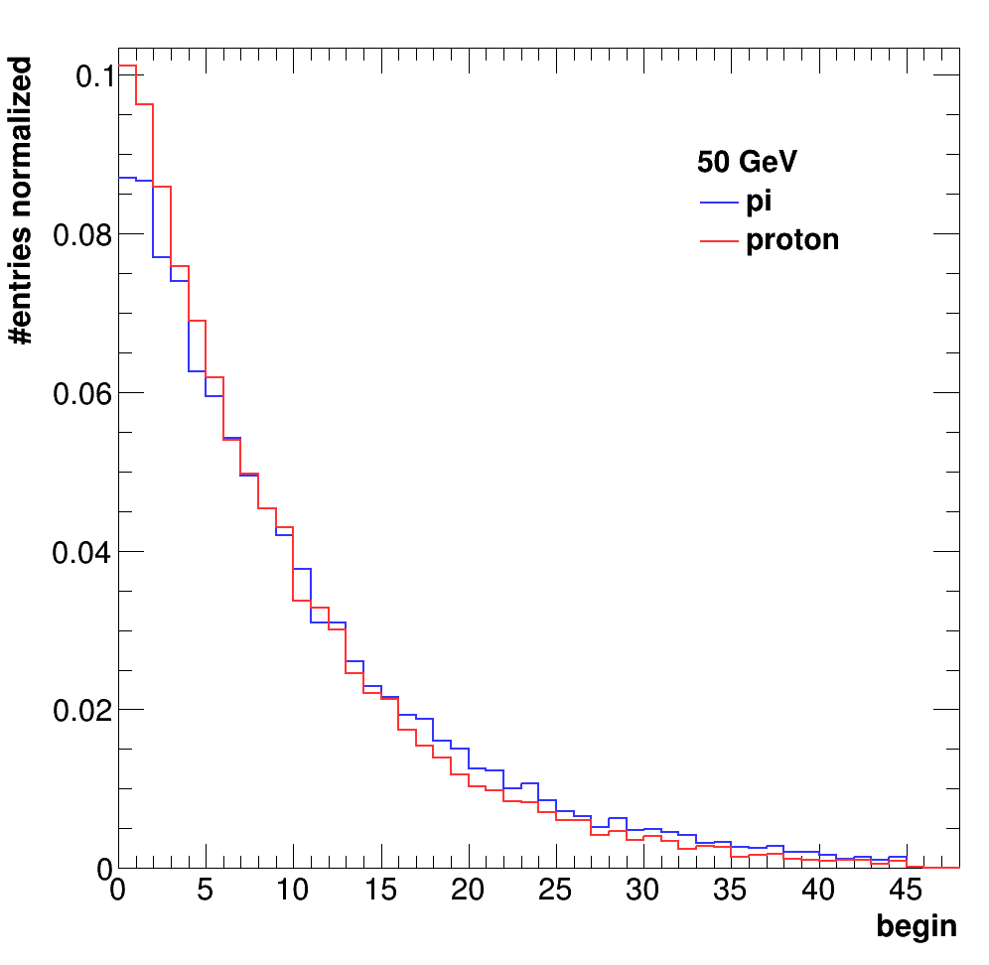
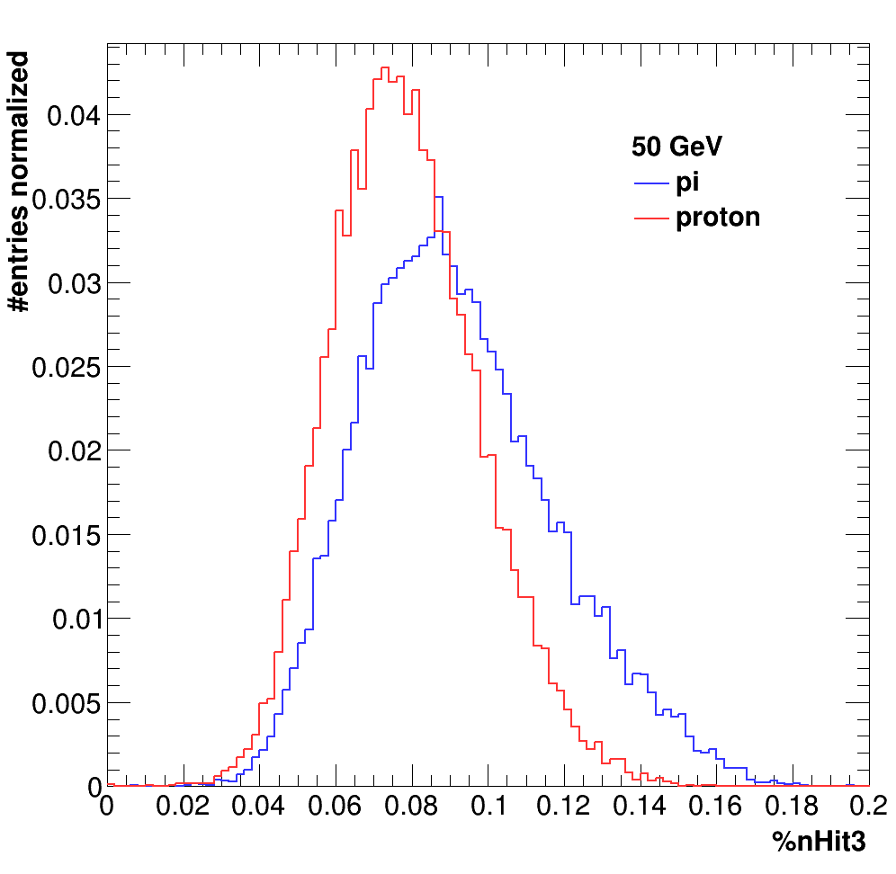
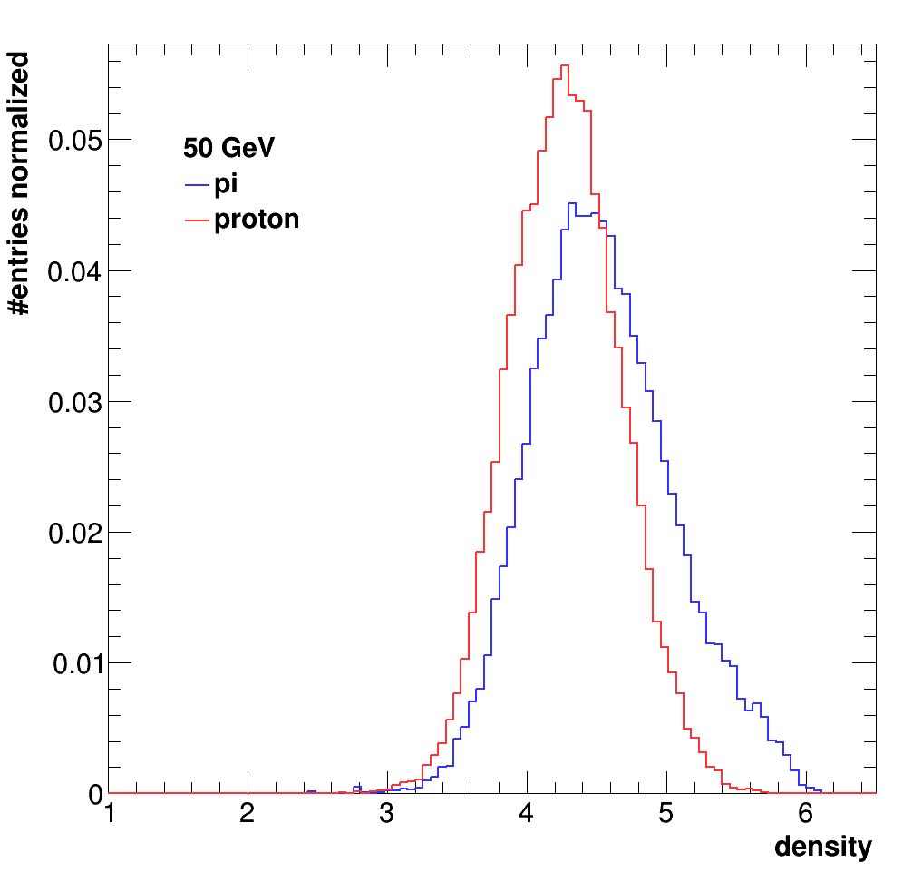
Further improvements on PID energy reconstruction
Hadron identification
The energy reconstruction method was applied to hadron events.
No distinction was made between pions and protons or others.
Hadronic showers of pions and protons are not identical.
Simulation
This is one of the goals of the next TB at CERN in September 2022
Better construction can be made if one can identify the nature f the hadron.
Simulation
Simulation
Simulation
Simulation
2022 beam test will be dedicated to study pion vs proton and kaon showers using Cerenkov detectors. Then BDT technique will be used to develop hadron PID and then energy construction algorithm with different (α, β, γ) parameters could be used.

Slide 20
SDHCAL-ILD@ILC

Slide 21
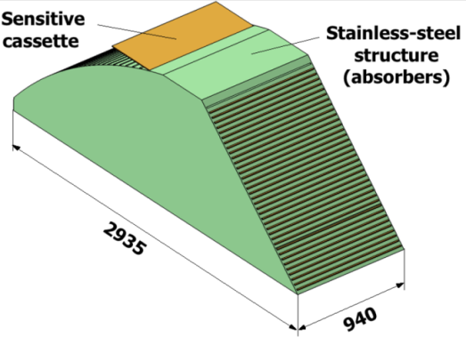
SDHCAL R&D towards ILD
GRPC
Glass Resistive Plate Chambers
Detectors as large as 3m X 1m need to be built
Electronic readout should be the most robust with
minimal intervention during operation.
DAQ system should be robust and efficient
Mechanical structure to be similar to the final one
Envisage new features such timing, etc..
SDHCAL
ILD Module
Goal: to build new prototype with few but large GRPC with the new components
→ ILD Module0

Slide 22
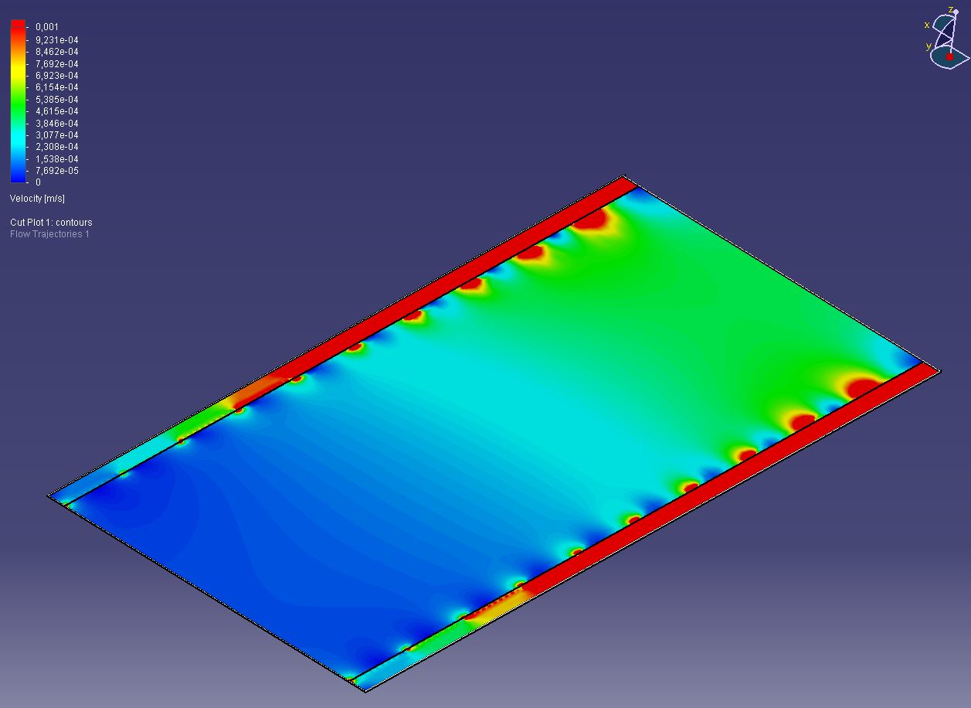
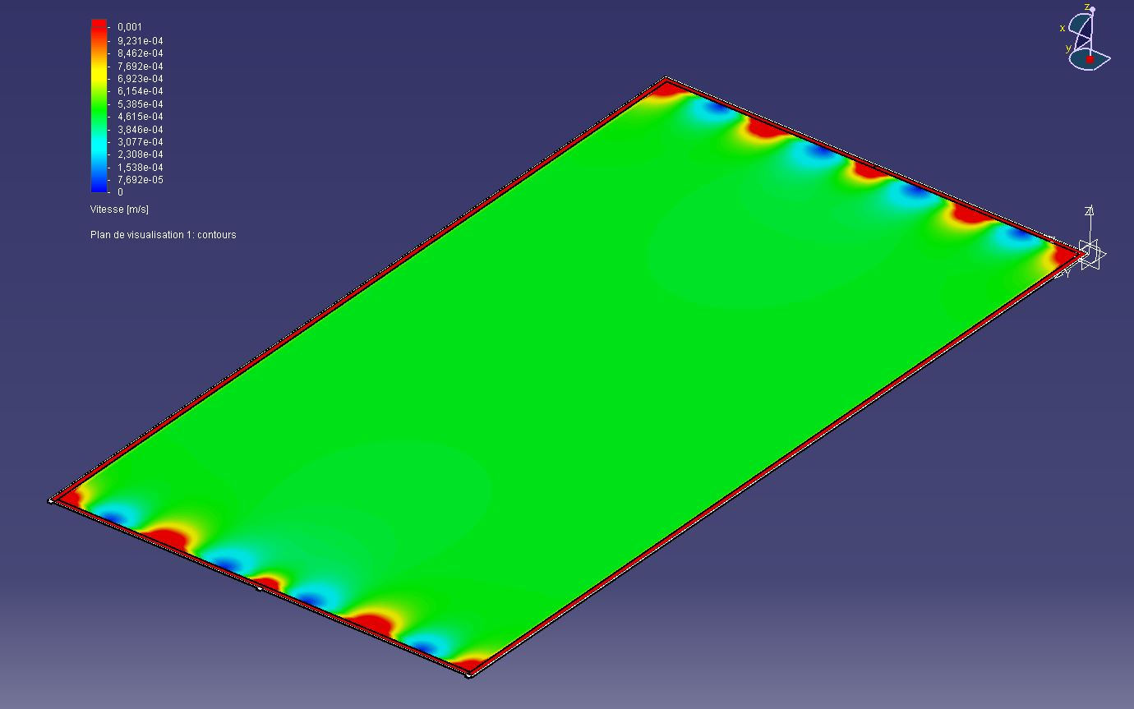
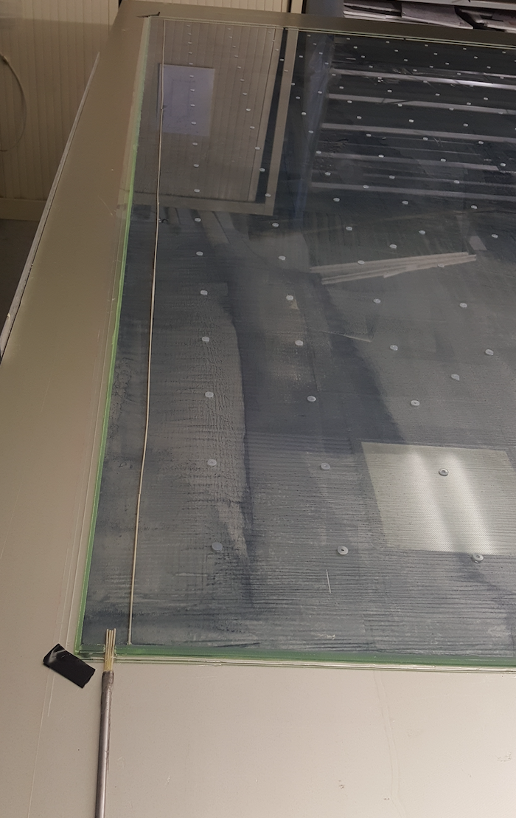
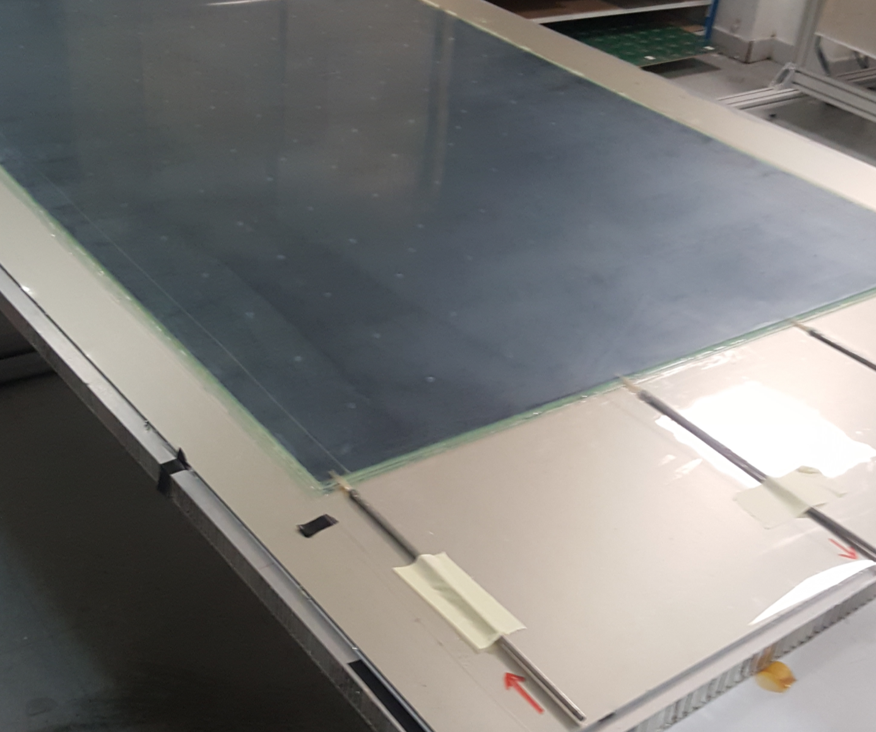
Detector conception
Construction and operation of large GRPC necessitate some improvements with respect to the present scenario.
Gas distribution : new scheme is proposed
Prototype circulation system
New circulation system
inlet
outlet
1 m
2 m
Cassette conception to ensure good contact between the detector and electronics is to be improved

Slide 23
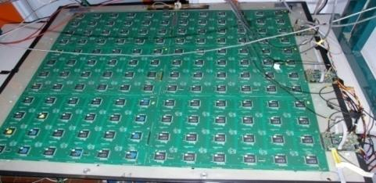
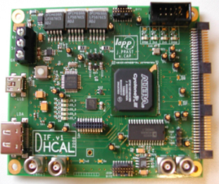
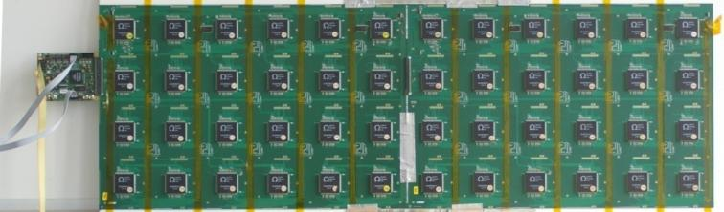
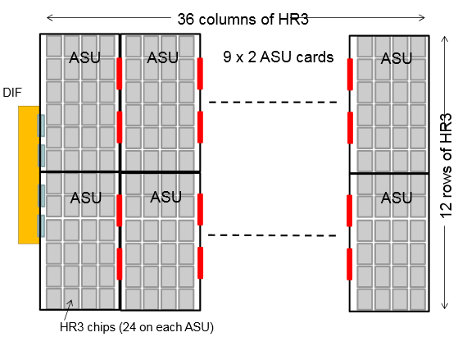
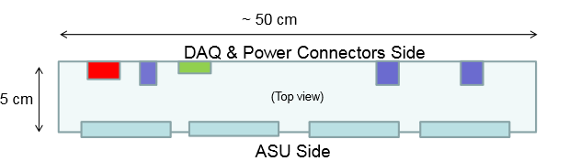

New electronics
Electronics readout for the 1m³ prototipo
HADROC chip
(ASIC)
1m² board ➔ 6 ASUs hosting 24 ASICs
3072 ch
DIF #1
144 ASICs= 9216 channels/1m²
USB
ASU1
ASU2
33 cm
DIF #2
HDMI
DIF
100 cm
DIF #3
1 DIF (detector InterFace) for 2 ASU (Active Sensor Unit.- PCB+ASICs) ➔ 3 DIFs for ONE 1m2 GRPC detector
Electronics readout for the final detector
Only 1 DIF per GRPC (any size) with small dimensions to fit in the small space available at the ILD detector
Uo to 9
DIF dimensions

Slide 24
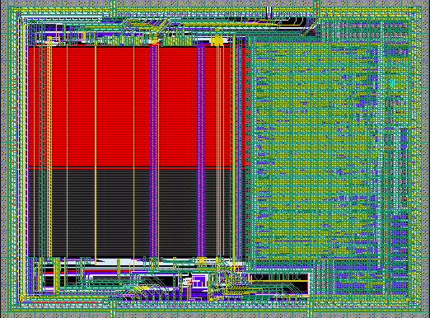
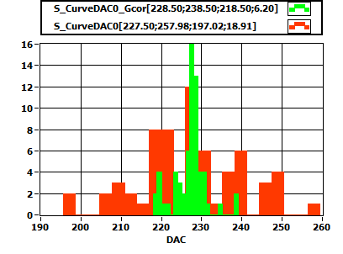
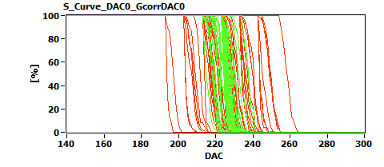
6,3 mm
New electronics: ASIC
HARDROCR3 main features:
  Independent channels
  Zero suppress
  Extended dynamic range (up to 50 pC)
  I2C link with triple voting for slow control parameters
  packaging in QFP208, die size ~30 mm²
  Consumption increase (internal PLL, I2C)
4,7 mm
H3B TESTED : 786, Yield : 83.3 %

Slide 25
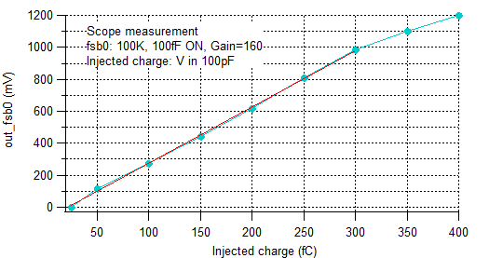
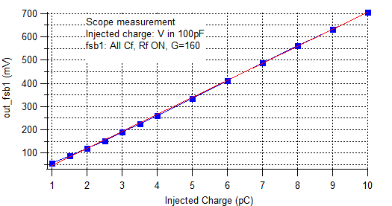
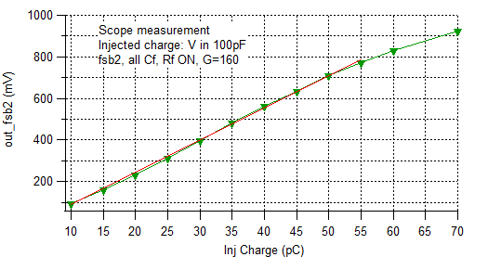
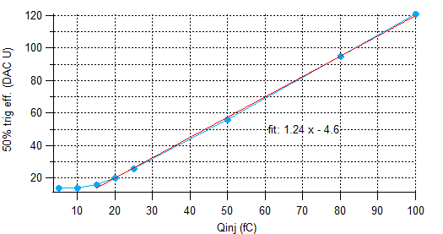
HARDROC3: Analog linearity
Fast shaper outputs (mV) vs Qinj (fC)
FSB0
FSB1
Up to 10 pC
50% trig. Eff. (DAC units) vs Qinj (fC)
FSB0: 5σ noise limit= 15 fC
FSB2
Up to 50 pC
Dynamic range: 15fC - 50 pC

Slide 26
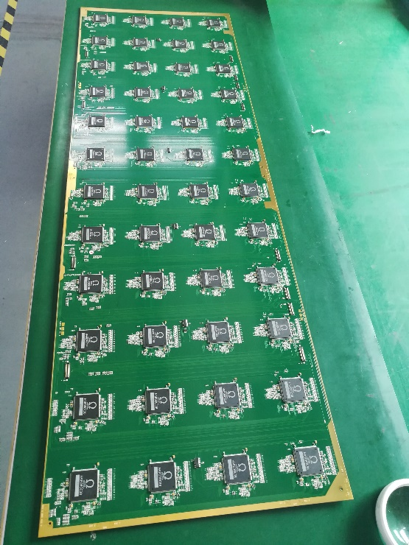
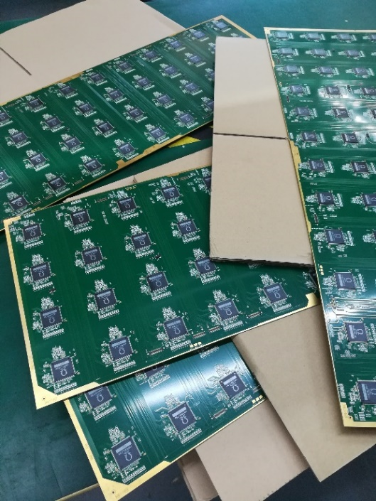
ASU (Active Sensor Unit)
An important challenge is to build a PCB up to 1m length with good planarity to have a homogeneous contact of pads with RPCs in order to guarantee an uniform response along all the detector.
A company was found and 1x0.33 m2 with 13 layer ASUs have been built.
ASU
HR3
ASICs
PCB
The ASU-ASU (= ASU-DIF) connections also produced

Slide 27
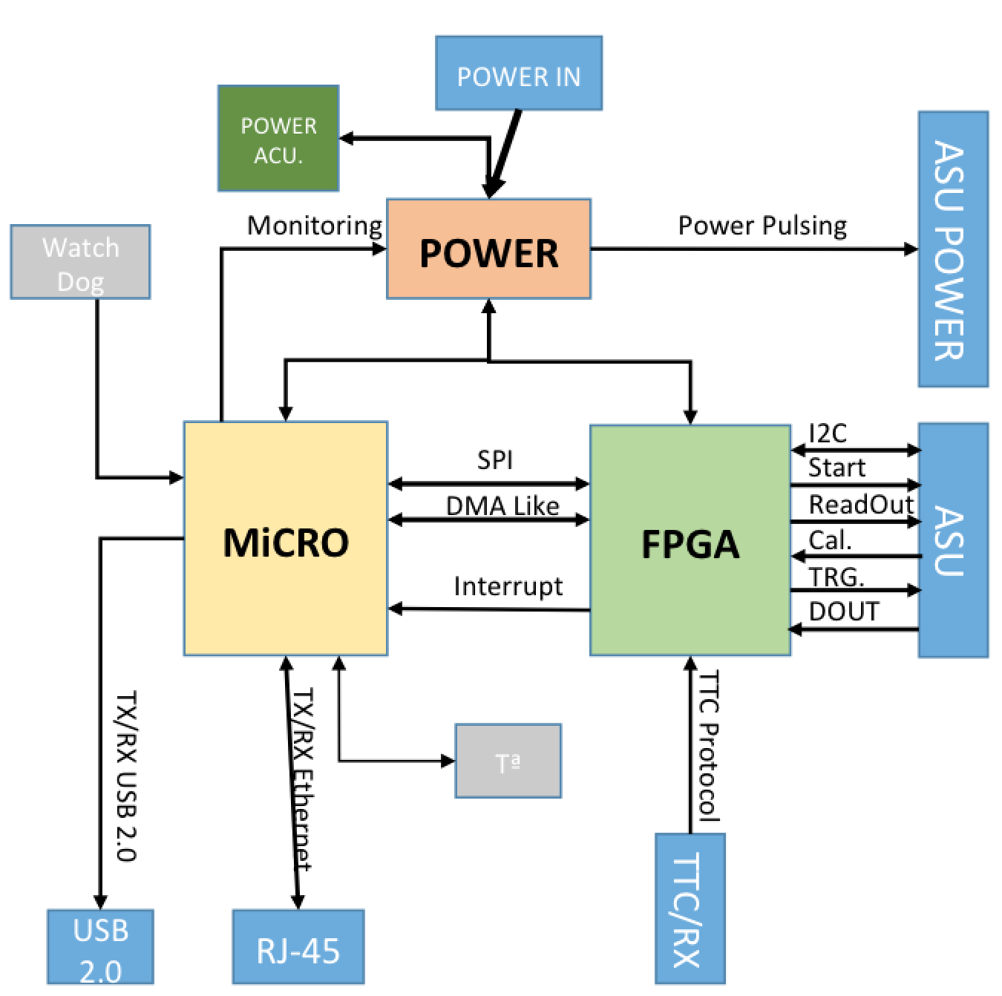
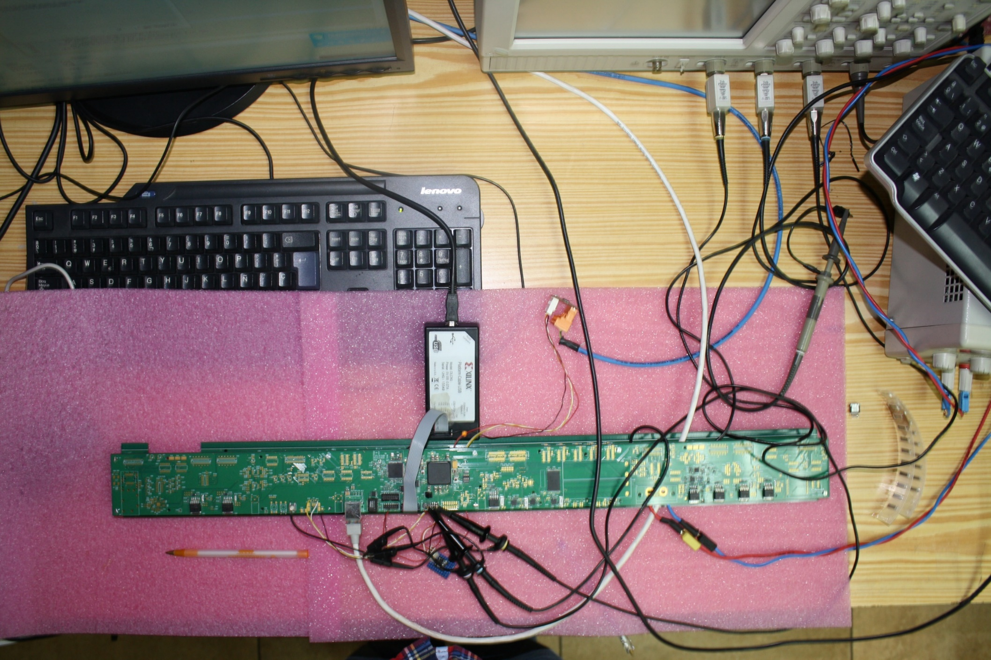
New electronics : DIF
DIF sends DAQ commands (config, clock, trigger) to front-end and transfer their signal data to DAQ. It controls also the ASIC power pulsing
• Only one DIF per plane (instead of three)
• DIF handle up to 432 HR3 chips (vs 48 HR2 in previous DIF)
• HR3 slow control through I2C bus (12 IC2 buses).
Keeps also 2 of the old slow control buses as backup &
redundancy.
• Data transmission to/from DAQ by Ethernet
• Clock and synchronization by TTC (already used in LHC)
• 93W Peak power supply with super-capacitors
(vs 8.6 W in previous DIF)
• Spare I/O connectors to the FPGA (i.e. for GBT links)
• Upgrade USB 1.1 to USB 2.0
TEXAS TM4C1294U
FPGA XC7A35TFGG484
POWER
POWER
POWER

Slide 28
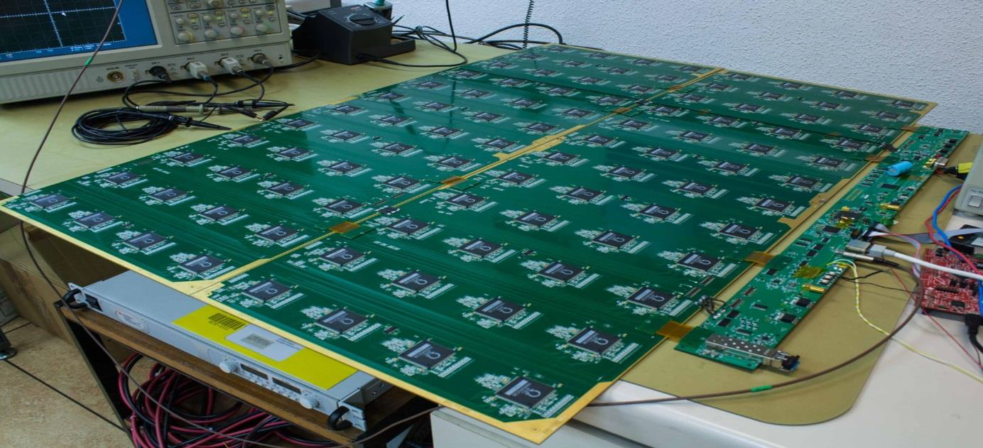
New readout electronics is being tested
All functionalities seem ok
100 cm
33 cm

Slide 29
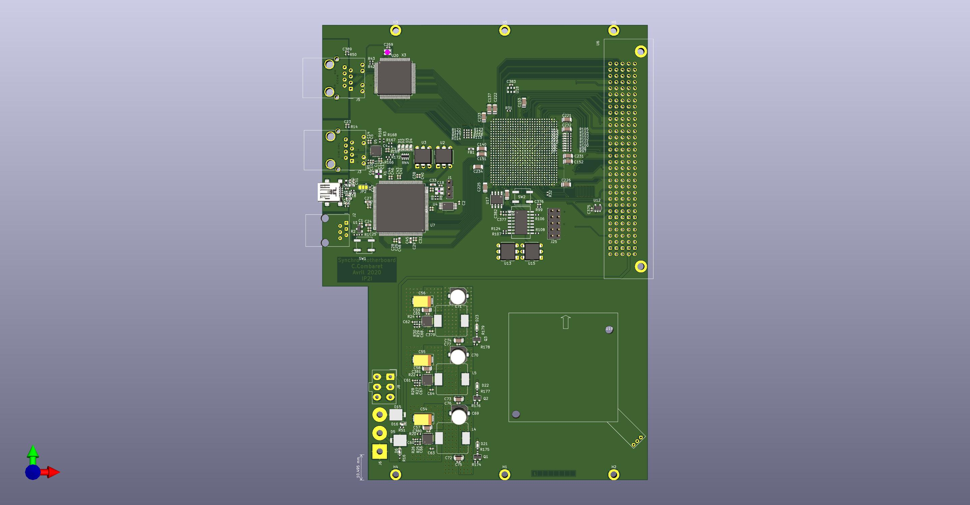
New electronics : DCC
To synchronize several DIFs, a new DAQ board was developed. It contains:
-1 FPGA (cyclone10LP) with 12x5 LVDS links
-Microprocessor (PIC32MZ) interfaced with TCP/IP and with the FPGA for
high level operations ( calibrations..etc)

Slide 30
Summary of activities related to ILC
SDHCAL is a powerful PFA tool that fulfills all the requirements for ILD@ILC.
All the pieces of a module0 have been developed and successfully tested. If a decision to go for ILC, the construction of module0 is straightforward and will take a short time to be built.
Full construction of SDHCAL for ILC could be achieved easily with the help of industry.

Slide 31
SDHCAL-ILD@CEPC

Slide 32
Strategy followed by the SDHCAL groups
From the beginning the SDHCAL groups were part of the ILD@CEPC proposal.
SDHCAL is one of the HCAL baselines and the simulation of physics performance of CEPC is based on SDHCAL performance.
Three important aspects were studied to cope with the constraint of CEPC:
SDHCAL depth
SDHCAL power consumption and active cooling
SDHCAL timing
Rate capabilities

Slide 33


SDHCAL depth
Due to L* constraint from CEPC the detector radius is smaller than the one for ILC. This leads to that fact that the depth of the HCAL is smaller than that of ILD@ILC.
The option to reduce the number of SDHCAL layers by 4 and 8 and 12 layers was studied on the simulation and on the data collected at TB@CERN.
Reducing by 4 layers seem to have small effects but one can still be efficient with
40 layers

Slide 34

SDHCAL power consumption and cooling
The duty cycle of CEPC is different from that of ILC and no power pulsing is possible.
The power consumption is therefore increased by a factor of 100-200 with respect to ILC and active cooling is needed.
Lyon and Shanghai groups worked on a simple cooling system for SDHCAL based on using water circulating into copper pipes
0.8 mW/chips with power pulsing, 80 mW/chips without power pulsing
0.5 m
108 chips
Rectangular section tubes : 2x1 mm
1.5 m
Copper plate over: 1.5 mm
Flow out
symmetry
PCB plate under: 1.4 mm
Flow in

Slide 35

SDHCAL power consumption and cooling
The duty cycle of CEPC is different from that of ILC and no power pulsing is possible.
The power consumption is therefore increased by a factor of 100-200 with respect to ILC and active cooling is needed.
Lyon and Shanghai groups worked on a simple cooling system for SDHCAL based on using water circulating into copper pipes
0.8 mW/chips with power pulsing, 80 mW/chips without power pulsing

Slide 36
SDHCAL power consumption and cooling
Other solution is to use the new scheme developed by Lyon group (woven strips) to read out RPC for which a reduction of a factor higher than 30 can be obtained.
Caveat: This is ok for muon detectors and tail catchers. For SDHCAL a simulation is needed to validate

Slide 37



SDHCAL power consumption and cooling
Other solution is to use the new scheme developed by Lyon group (woven strips) to read out RPC for which a reduction of a factor higher than 30 can be obtained.
Caveat: This is ok for muon detectors and tail catchers. However to be used in SDHCAL
a simulation is needed to validate the concept.
With four PCBs
With 10 PCBs
Preliminary results: Efficiency > 85%

Slide 38






SDHCAL power consumption and cooling
Timing is an important factor to identify delayed neutrons and better reconstruct their energy
Timing can help to separate close-by showers and reduce the confusion for a better PFA application. Example: pi-(20 GeV), K-(10 GeV) separated by 15 cm.
1 ns resolution
Y
Y
Z
X
100 ps resolution
Y
X
X

Slide 39





SDHCAL power consumption and cooling
How to achieve an excellent time resolution:
An ASIC with a fast preamplifier, precise discriminator and excellent TDC
is needed
→PETIROC 32-channel, high bandwidth preamp (GBWP> 10 GHz), <3 mW/ch, dual time and charge measurement (Q>50 fC)
jitter < 20 ps rms @ Q>0.3 pC
TDC either internal or external (delay-line, Vernier,.etc on FPGA as for iRPC CMS upgrade project)
A fast-time DETECTOR
MultiGAP RPC is an excellent candidate.
4-5 gaps of 250 µm each can provide 100 ps tim resolution

Slide 40
First step towards transforming SDHCAL into T-SDHCAL
Front-End Electronics for MRPC readout with high timing resolution
The system includes a front-end board (FEB), a detector interface card (DIF) and a data acquisition system(DAQ) based on ZCU102.
Test System and Setup

Slide 41





First step towards transforming SDHCAL into T-SDHCAL
New and easy way of construction MRPC
Using thin spacers made of mylar+double face
Large timing PCB
Board with 8 (could be extended to 12) Petircoc2B ASICs
Pads 2cm x 2cm, 256 channels
Local FPGA (Xilinx Spartan-6 TQFP) embedded on board
Top view
Bttom view

Slide 42


SDHCAL rate capability
GRPC have low rate detection capability (a few hundreds of Hz/cm2)
This is ok for ILC.
For CEPC with 1.5 MHz cycle duty (Higgs factory) this is still ok since the probability to have the same pad fired in one BC (0.7 µs) is about 10⁻⁵ and the probability to be fired once again before the electric field of the GRPC has reached its full value after a depletion is still small.
In case of Z-run the rate may be a problem, in particular at high eta.
Several scenarios are proposed:
Replace glass by other low resistivity electrodes leading to higher rate
(a factor of 100-1000 higer)→ PEEK doped with nanoparticle

Slide 43
SDHCAL rate capability
GRPC have low rate detection capability (a few hundreds of Hz/cm2)
This is ok for ILC.
For CEPC with 1.5 MHz cycle duty (Higgs factory) this is still ok since the probability to have the same pad fired in one BC (0.7 µs) is about 10⁻⁵ and the probability to be fired once again before the electric field of the GRPC has reached its full value after a depletion is still small.
In case of Z-run the rate may be a problem, in particular at high eta.
Another possible scenario is to use resistive MPGD such as GEM, MICROMEGAS or µWell in the forward region and RPC in the barrel region.
Tests using MM in the SDHCAL along the RPC has already been successfully done.

Slide 44



4 units of SDHCAL-MM
1m x 1m each were produced, tested in a
muon beam
CNRS-LAPP

Slide 45
The 4 units of SDHCAL-MM were then inserted in the SDHCAL-RPC prototype replacing the RPC units #10, 20, 35 and 50
Additional development with Resistive Micromegas has started to render the SDHCAL-Micromegas more robust against discharges that may happen in the core of the shower.
Similar activities with Thick GEM replacing MM were also initiated.

Slide 46
SDHCAL rate capability
GRPC have low rate detection capability (a few hundreds of Hz/cm2)
This is ok for ILC.
For CEPC with 1.5 MHz cycle duty (Higgs factory) this is still ok since the probability to have the same pad fired in one BC (0.7 µs) is about 10⁻⁵ and the probability to be fired once again before the electric field of the GRPC has reached its full value after a depletion is still small.
In case of Z-run the rate may be a problem, in particular at high eta.
Another possible scenario is to use resistive MPGD such as GEM, MICROMEGAS or µWell in the forward region and RPC in the barrel region.
Tests using MM in the SDHCAL along the RPC has already been successfully done. Similar tests with µWell is being discussed with colleagues from Wiseman Institute.
Still the use of MPGD will not allow to reach excellent time resolution as in the case of MRPC.

Slide 47
Summary of activities related to CEPC
SDHCAL fulfills also the requirements for ILD@CEPC as a Higgs factory but necessitates probably some accommodations for Z factory

Slide 48
SDHCAL-ILD@FCCee
The same logic as the one of CEPC and what can be achieved for CEPC could be for FCCee in principle.
Personal opinion:
When the construction of FCCee (> 2035) there will certainly be many new technologies that are much better than all the existing technologies including SDHCAL.

Slide 49
Summary
SDHCAL concept with its high granularity provides an excellent tool not only to apply PFA by separating nearby showers but also to measure their energy.
Different techniques were used to measure hadronic shower energy
excellent linearity and very good resolution are obtained
The exploitation of the hadronic shower shape thanks to the high granularity is an excellent asset to identify particles and then better measure their energy.
In the future SDHCAL will exploit precise time information using MRPC. The time information will improve on energy reconstruction by separating delayed neutrons contribution and better estimating it.

Slide 50


Slide 51

Time correction

Slide 52



SDHCAL High-granularity impact
Hough Transform is an example to extract tracks within hadronic showers and to use them to control the calorimeter in situ
ρ_{xz} = z sin(θ) + x cos(θ)
Excellent agreement with efficiency/multiplicity results obtained with cosmic and beam-muons. Excellent agreement data/MC

Slide 53


Timing could be an important factor to identify delayed neutrons and better reconstruct their energy

Slide 54

Gas system
Gas recycling is necessary to reduce cost :
-Goal: reduce the gas consumption to reduce the cost.
-Gas renewal of 5-10% rather than 100%
-Conceived by the CERN gas group

