Slide 1
29th Meeting of SRF Group in IDT/WG2
Proposal for SRF Time-critical WPs
Others (if any)
Attendees: A. Yamamoto, K. Umemori, S. Belomestnykh, M. Liepe, R.Geng, R. Rimmer, D. Delikaris, E. Cenni, L. Monaco, P. Burrows, S. Stapnes, Kirk
https://agenda.linearcollider.org/category/256/
Kirk

Slide 2
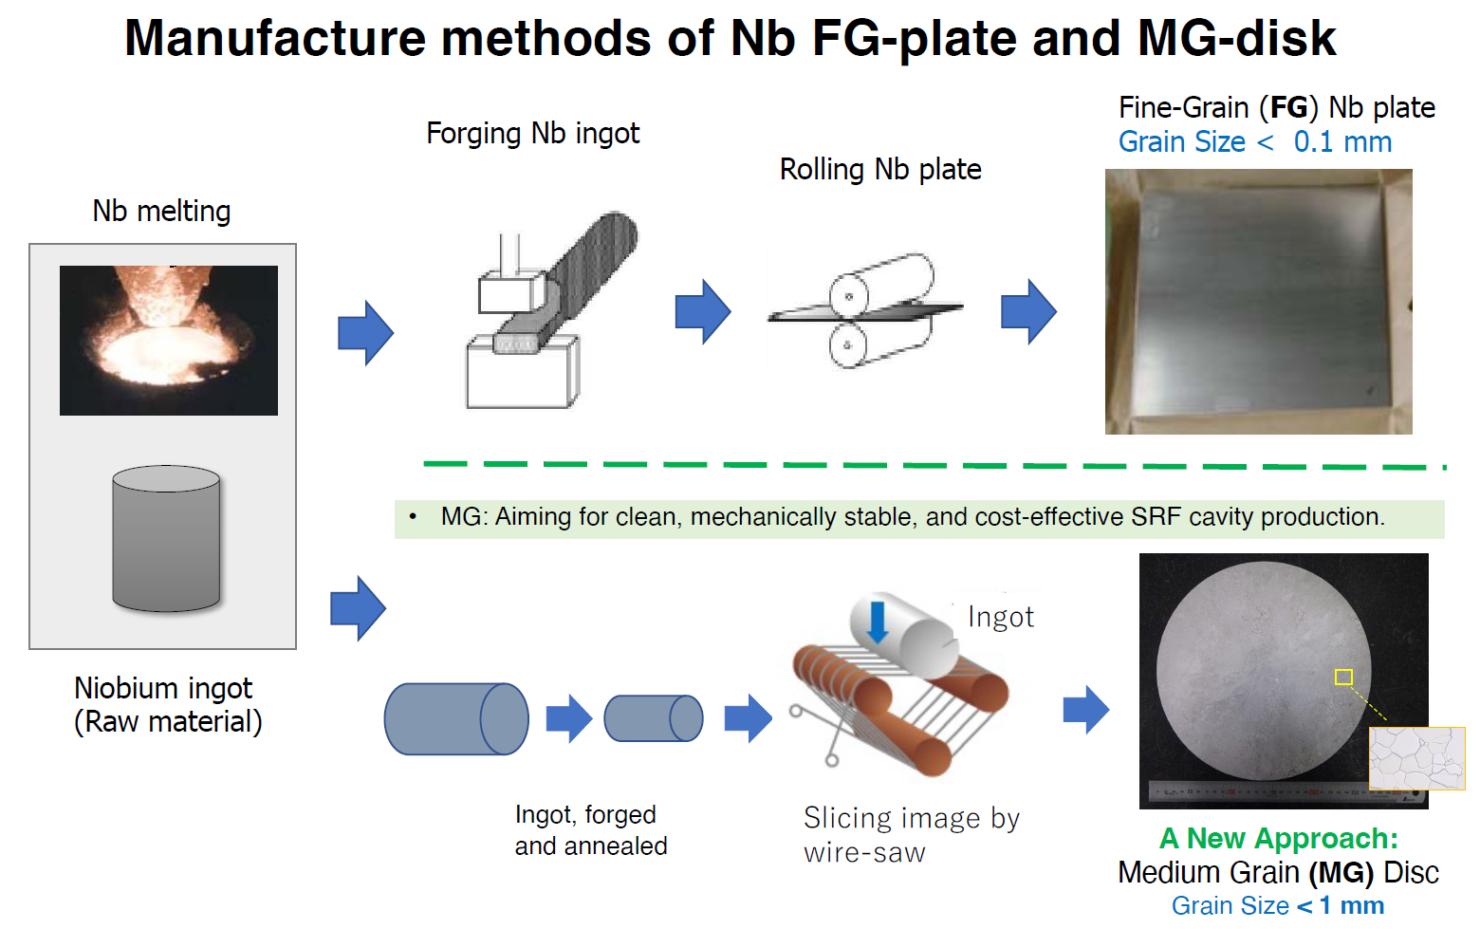


WP-prime 1: SRF Cavity
(Scoping the Industrial-Production Readiness)
Research with single-cell cavities to establish the best production process
  Advanced Nb sheet production method
  Advanced surface treatment recipe
Globally common design compatible with High Pressure Gas Safety (HPGS) regulation
24 nine-cell cavities are to be developed for industrial-production readiness
  8 cavities (4 / batch) in each region
  Production process optimized in each region encouraged
RF performance/success yield to be examined (at least including 2nd pass)
  3rd pass to be examined if effective
 | # of cavities to be produced
 | Americas | Europe | JP/Asia
single-cell | 2 | 2 | 2
nine-cell | 8 | 8 | 8 (+ 12)
Material/Sub-component
QA of Material/Sub-C
Cavity Production
Surface Process
Vertical Test =
Cavity RF Test
Production process
2

Slide 3
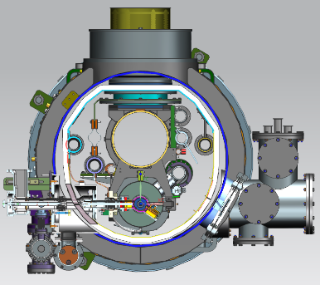
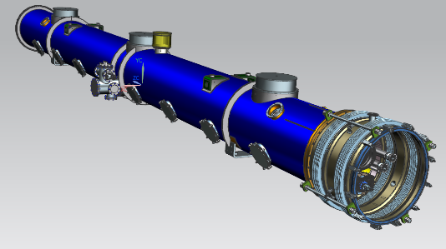
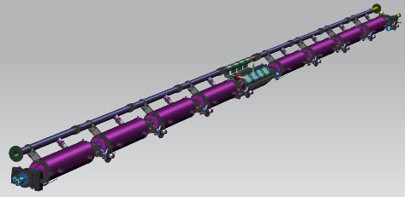
WP-prime 2: Cryomodule (CM) design
(Scoping the CM Global Transfer and Performance Assurance)
Unify cryomodule (CM) design with ancillaries, based on globally common drawings and data-base
Establish globally compatible safety design to be approved by HPGS regulations individually authorized in each region.
Cavity string
Ancillaries:
SC mag., tuners, couplers
CM outlook with vacuum vessel
 | Americas | Europe | Japan/Asia
CM tech. design base | LELS-II | Euro-XFEL | ILC-TDR
HPGS regulation base | ASME | TÜV and EN | JP-HPGS act
ILC CM design | Common CM design globally adaptable to HPGS regulation in any regions
3

Slide 4
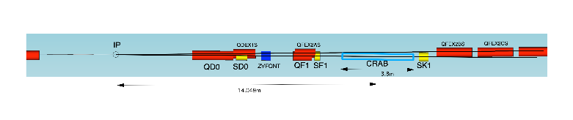
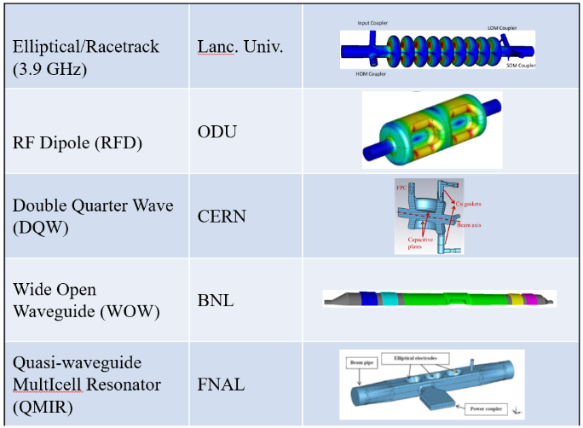
WP-prime 3: Crab Cavity Development with down-selection
RF property simulation to optimize cavity design
Pre-down-selection to choose two primary candidates
Development and evaluation of two prototype cavities
Demonstration of synchronized operation with two prototypes
Down-selection to choose final cavity design
Cryomodule design based on final cavity design
two beamline distance
14.049m x 0.014rad = 197mm
Item | Recent specification (after TDR)
Beam energy | 125 GeV (e⁻)
Crossing angle | 14 mrad
Installation site | 14 m from IP
RF repetition rate | 5 Hz
Bunch train length | 727 μsec
Bunch spacing | 554 nsec
Operational temperature | 2.0 K (?)
Cavity frequency | 1.3/3.9 GHz
Total kick voltage | 1.845/0.615 MV
Relative RF phase jitter | 0.023/0.069 deg rms (49 fs rms)
4

Slide 5
Schedule of SRF (Crab/Steering-Panel) Group Meeting in IDT/WG2
Meeting # | Date | Contents
29 | 24/May | Proposal for SRF Time-critical WPs

Slide 6
Questions/Discussions/Comments (memorandum) @29th meeting
Translation by Kirk
Proposal for Time-critical WPs
  SC-magnet port can be changed to the coupler side (originally tuner port side).
  KEK needs a lot of cavity drawings for HPGS, especially interfaces between different materials.
  KEK and FNAL will have a meeting for this activity on June.

