Slide 1
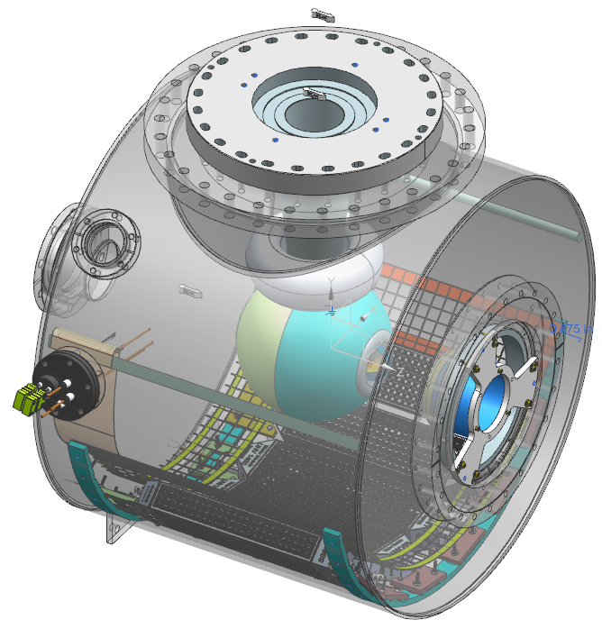
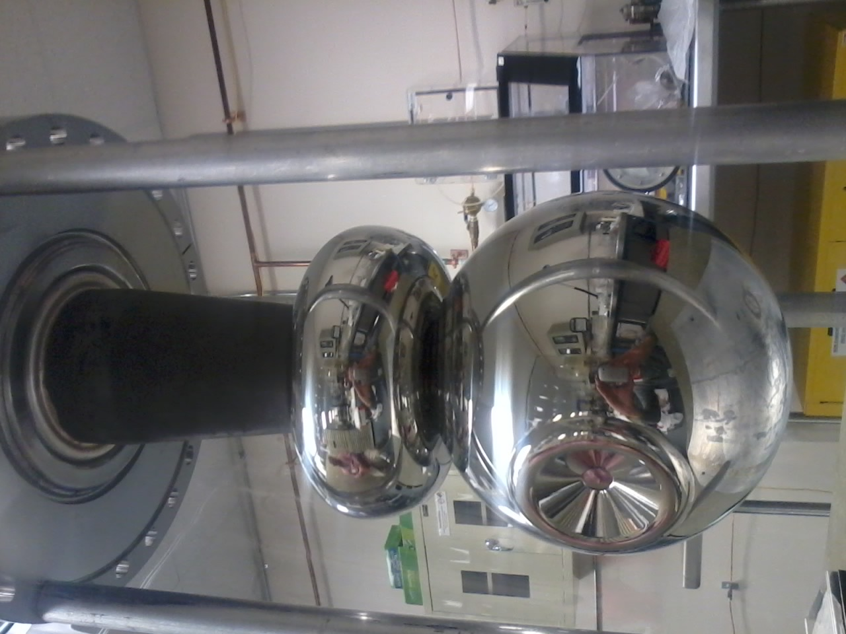
WPP-4: Electron Gun
The electron gun consists of
  High-voltage photo gun
  Drive laser system
  GaAs/GaAsP Photocathode
High-voltage gun is the most urgent item
  The gun voltage in TDR is 200 kV. A higher voltage desirable.
  Meaningful technical progresses since TDR would be reflected in a new design
  New GaAs gun based on lessons learned from 350 kV CsKSb magnetized dc photogun
350 kV alumina insulator
Triple-junction shield
NEG pumps
Cathode electrode
Photocathode
Biased and Tilted Anode
1

Slide 2
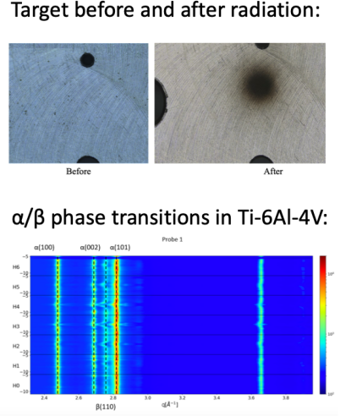
WPP-6: Rotating Target for Undulator Scheme
Target specification
  Titanium alloy, 7mm thick (0.2 X₀), diameter 1m
  Rotating at 2000 rpm (100 m/s) in vacuum
  Photon power ~60 kW, deposited power ~2 kW
  Radiation cooling
  Magnetic bearings
R&D to be done as WP-prime
  Design finalization, partial laboratory test, mock-up design (in the first 2 years)
  Magnetic bearings: performance, speciﬁcation, test (in the remaining years)
Target material test
Target material test

Slide 3
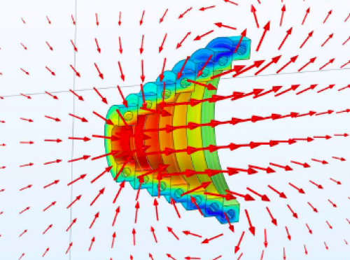
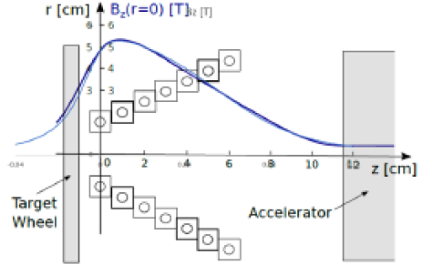
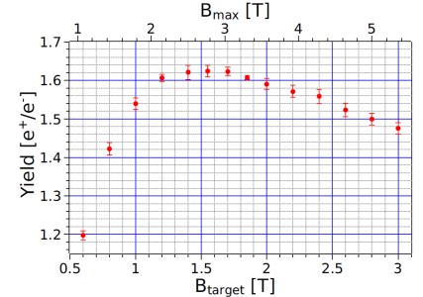
WPP-7: Focusing System for Undulator Scheme
The critical item for the undulator scheme is the magnetic focusing system right after the target
Possible candidates are: (a) Pulsed solenoid, (b) Plasma lens
The strongest candidate is (a) pulsed solenoid.
R&D items to be done as WP-prime
  Detailed simulations for (a) (already on-going)
  Principal design for a prototype pulsed solenoid
  Field measurements with 1kA (pulsed and DC) and with 50kA both in a single pulse mode and finally in a 5ms pulsed mode
  Prototype of (b) plasma lens (funded study on-going)
Yield versus field on the target

Slide 4
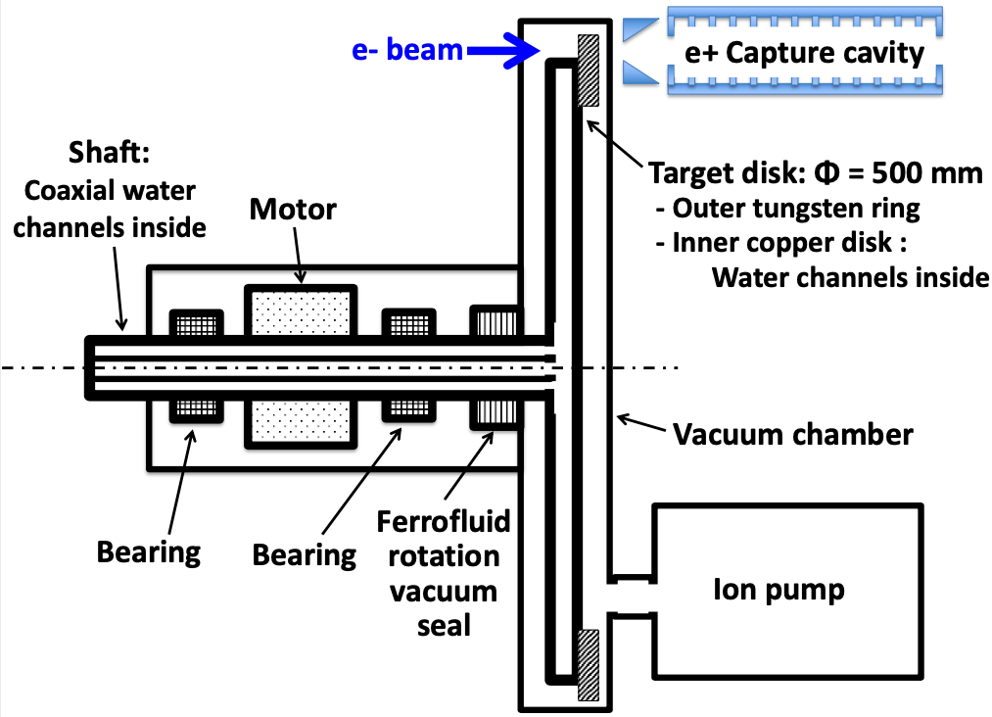
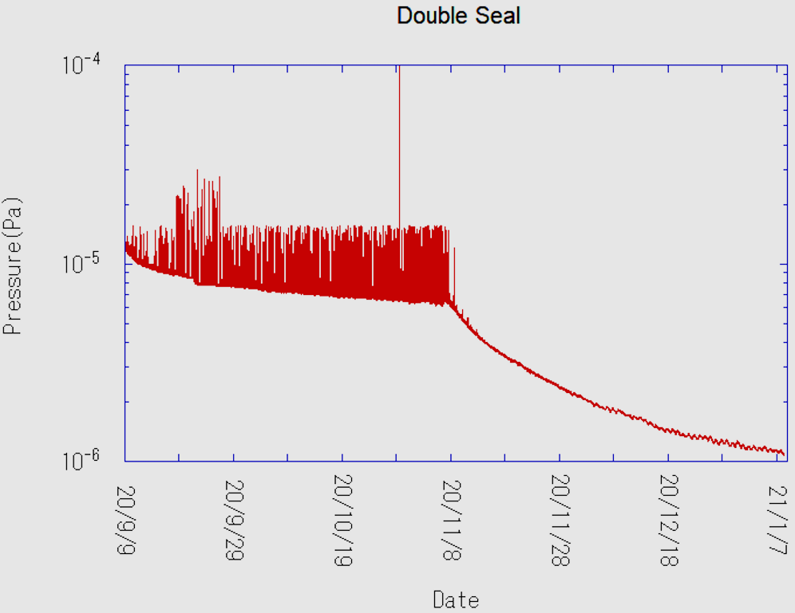
WPP-8: Rotating Target for e-Driven Scheme
Target specification
  W or W-Re, 16 mm (5 X₀) thick, diameter 50cm
  Rotating at 5 m/s in vacuum
  Water cooled.
  Vacuum seal by ferromagnetic seal
R&D items to be done in 2 years
  Target stress calculation with FEM
  Vacuum seal
  Target module design
Target module prototyping can be done in the remaining years
Vacuum test with double seal

Slide 5
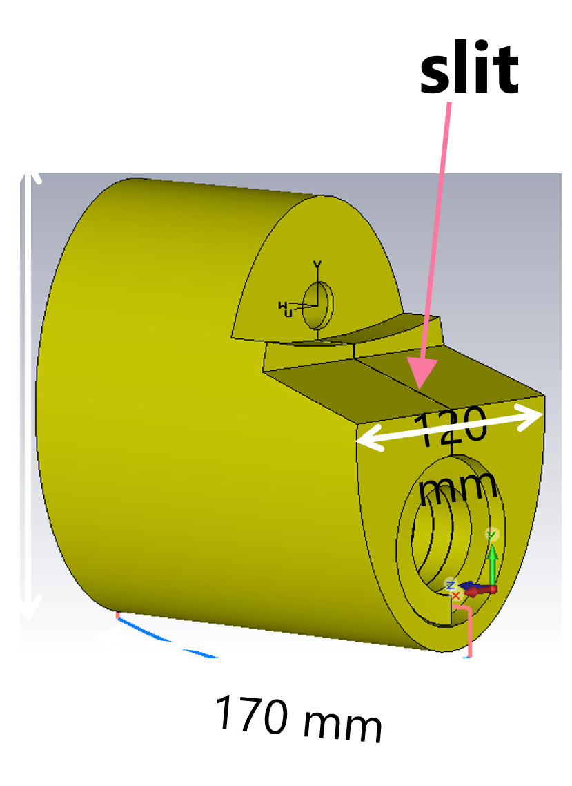
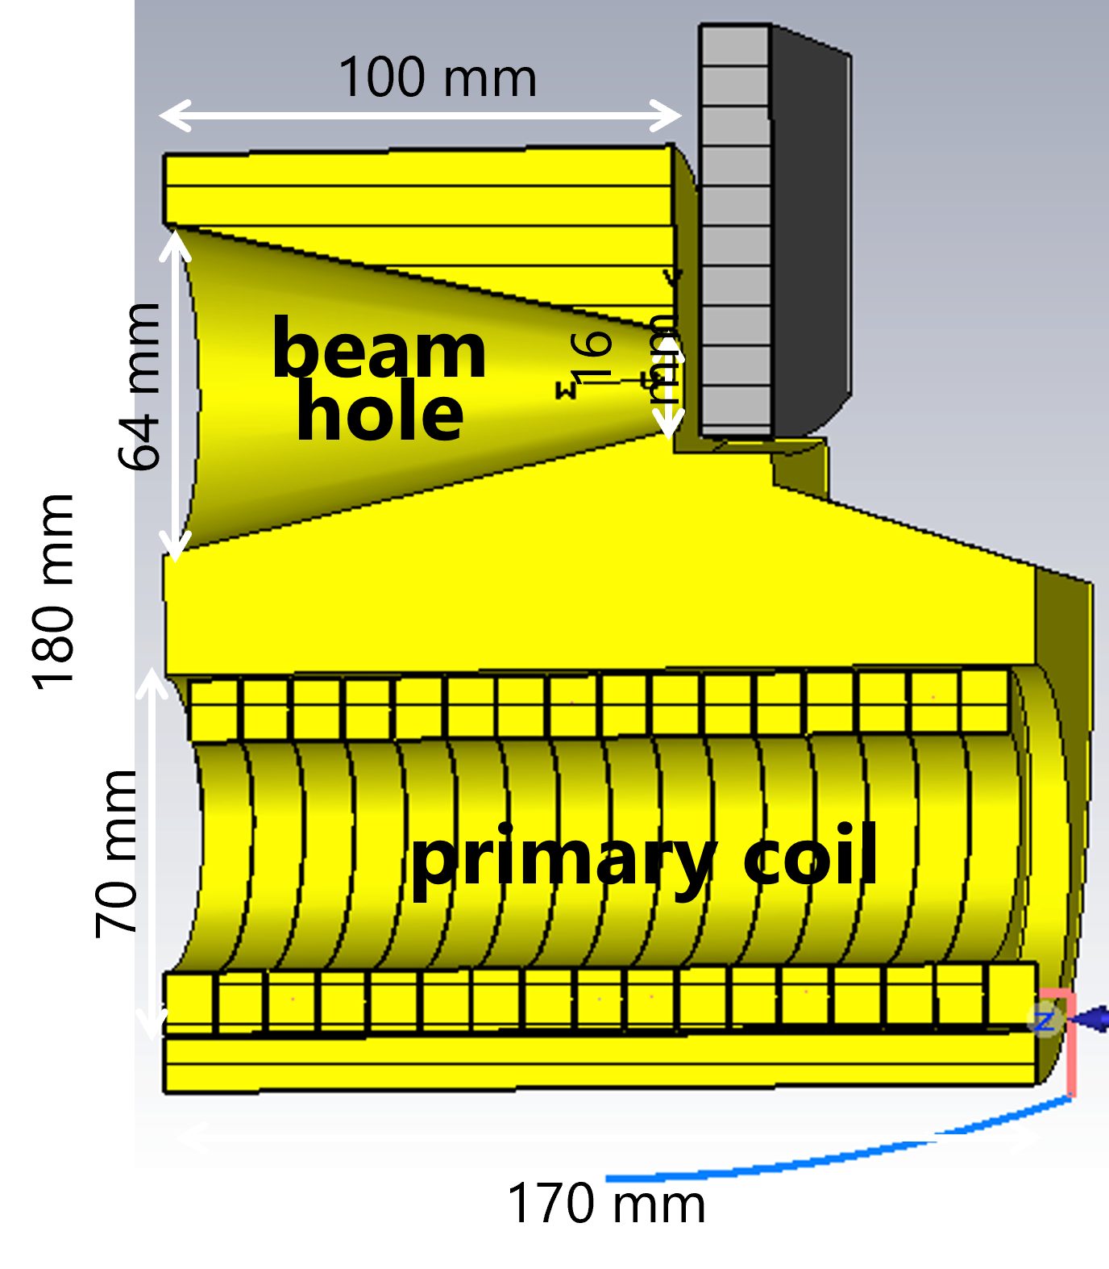
WPP-9: Focusing System for e-Driven Scheme
Flux Concentrator (FC) is chosen as the focusing device after the target
The specification parameters such as max field, electric current and the dynamic force are satisfied in existing target, but the pulse energy and the heat load are higher.
A prototype necessary after detailed design study
R&D items as WP-prime
  Flux concentrator conductor design (in first 2 years)
  Conductor prototyping (in the remaining years)
Parameter | ILC FC | Unit
Max. B field | 5 | T
Max. surf. current | 25 | KA
Dynamic force | 125 | kA.T
Pulse energy | 140 | J
Average Power | 13.7 | kW

Slide 6
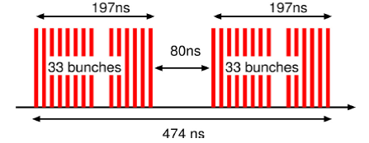
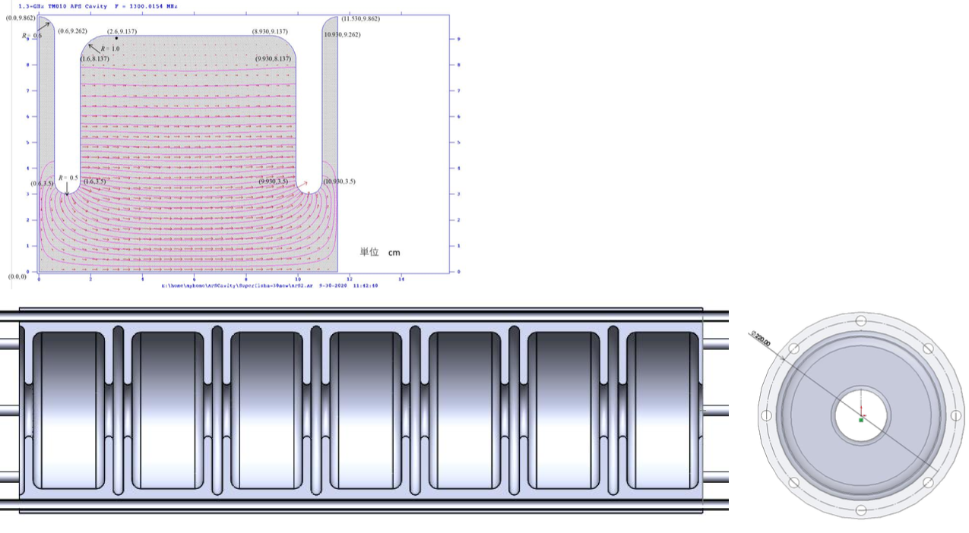
WPP-10: Capture Cavity and Linac for e-Driven Scheme
The positrons after the magnetic focusing system are accelerated to 5GeV through various linacs (Standing wave, travelling wave, S-band, L-band) and injected into the damping ring.
Technically the most critical element is the L-band, standing-wave structure right after the target and FC.
  High beamloading (up to ~1A)
  Special bunch pattern →
  Changing beam current (mixed electron-positron, capture process in RF buckets)
The technologies of the power unit is known well but it is needed for the test.
R&D items as WPP-10 for the first 2 years
  APS (Alternating Periodic Structure) cavity design and cold model
  Beam-loading compensation and tuning method
  L-band klystron design
  Power unit prototype design
  solenoid design
Prototyping of these components in later years
APS cavity →

Slide 7
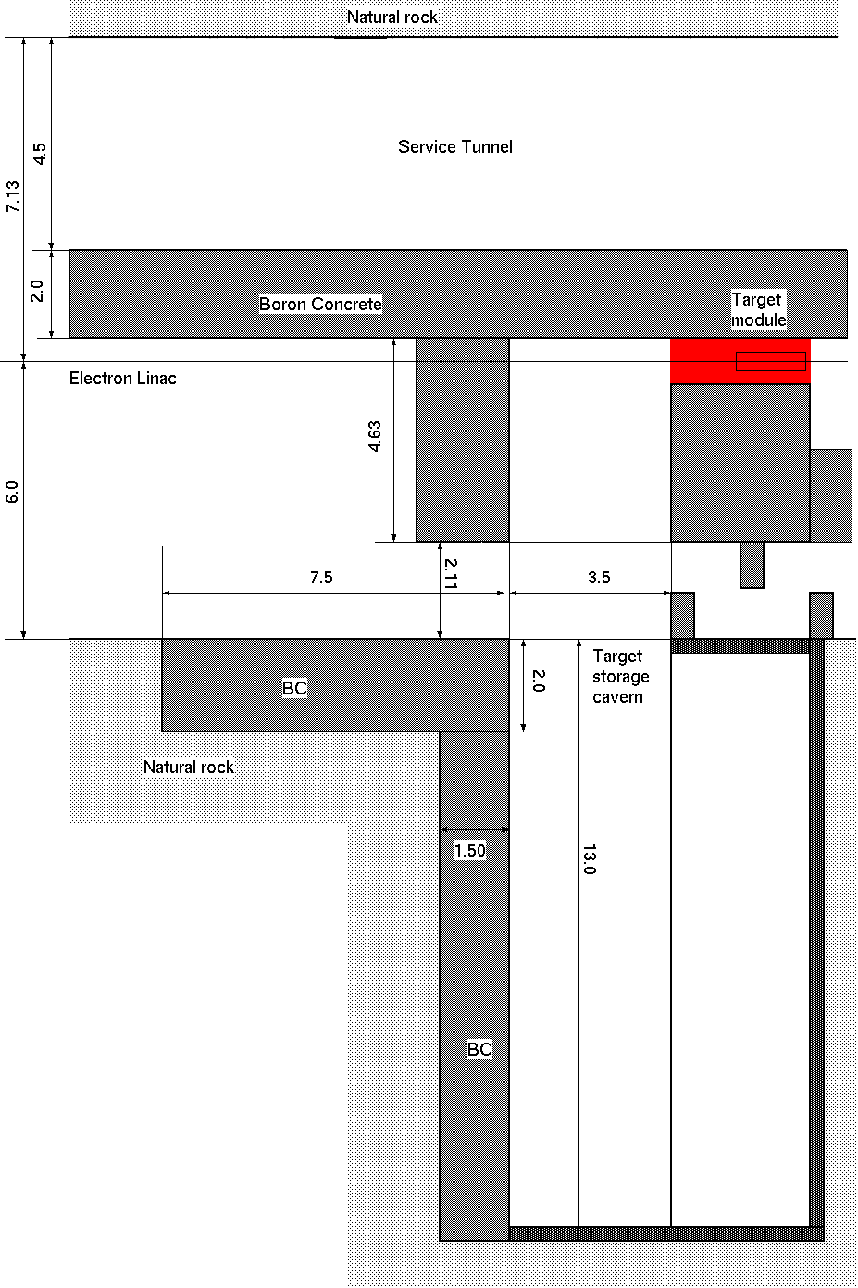
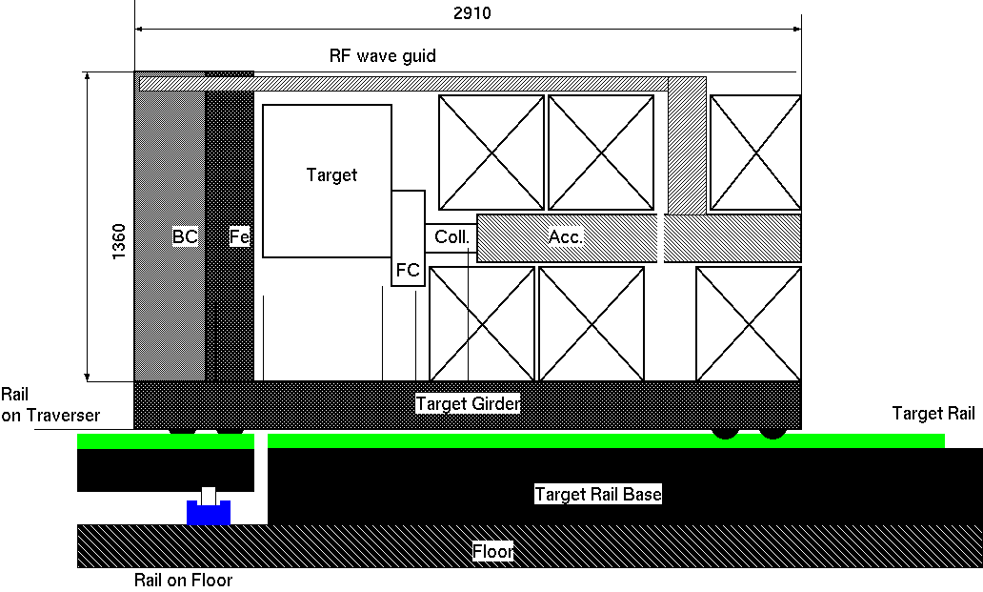
WPP-11:
Special attention is needed due to the high radiation of the target area. This is a common issue for E-Driven and Undulator positron source.
Careful design of shielding is required.
The components near the target (target, flux concentrator, first cavity with solenoid) require replacement in every few years. The work must be done by remotely.
The works to be done as WP-prime
  Conceptual design
  Fabricate Mockup
  Prototyping of critical components
Floor layout of the target section.
← Side view of the target module
Electron beam
Animation to show the target module movement

