Slide 1
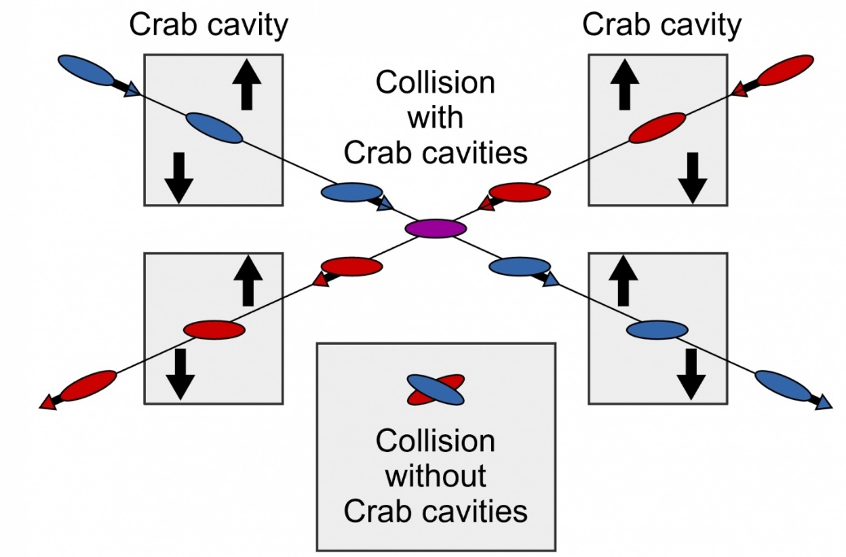

WG2 SRF: WP3 Crab Cavities
Design Review Workshop #2
Peter McIntosh
UKRI-STFC Daresbury Laboratory
22nd June 2022

Slide 2
Agenda for Today (GMT)
13:30 | Introduction and Remit for the Workshop | Peter McIntosh (STFC) | 5 min
13:35 | Specification Review | Peter McIntosh (STFC) | 5 min
Cavity Design Updates
13:40 | Elliptical/Racetrack | Graeme Burt (Lancaster University) | 15 + 5 min
14:00 | RF Dipole (RFD) | Suba De Silva/Jean Delayen (ODU/JLab) | 15 + 5 min
14:20 | Double Quarter Wave (DQW) | Silvia Verdu Andres (CERN) | 15 + 5 min
14:40 | Wide Open Waveguide (WOW) | Binping Xiao (BNL) | 15 + 5 min
15:00 | Quasi-waveguide Multicell Resonator (QMiR) | Andrei Lunin (FNAL) | 15 + 5 min
15:20 | Preparations for Down-selection review (Sept 27th 2022) | Peter McIntosh (STFC) | 10 min
15:30 | Meeting close

Slide 3
Preparations for 2nd Design Workshop (22nd June 2022)
Assess and compare CC EM designs, not likely finally optimised:
  Cavity,
  HOMs,
  Couplers,
  Multipacting,
  Tuning.
Clarifying then next steps to perform first CC down-selection on 27th Sept 2022:
  All EM design aspects complete, including pressure stability and fabrication assessment.
  Down-select 2 optimum CC designs for future prototype development (external review).
Final CC down-selection, post-prototype validation at ~18-months later (Mar 2024).

Slide 4
Workshop Remit
For WP3 teams to identify progress made with CC designs.
Identify outstanding issues which may exist regarding specifications as defined (v13).
Agree the cavity parameters to define for down-selection review – finalise process today.

Slide 5
CC Design Updates
Elliptical/Racetrack G Burt (Lancaster U)
RF Dipole (RFD) S De Silva/J Delayen (ODU/Jlab)
Double Quarter Wave (DQW) S Verdu Andres (CERN)
Wide Open Waveguide (WOW) B Xiao (BNL)
Quasi-waveguide Multicell Resonator (QMiR) A Lunin (FNAL)

Slide 6
Specifications Update (v13)

Slide 7
Break Here

Slide 8
Preparations for Down-Selection Review
Sept 27th 2022
Terms of Reference for the review to be developed (Myself, Akira and Kirk).
Review panel membership to be determined and invitations solicited (Myself, Akira and Kirk):
  Suggestions welcome from WP3 collaborators.
Discussion of remaining requirements for all WP3 collaborators.

Slide 9
CC Design Parameters
Parameter | Value | Units
Operating frequency |  | GHz
SOM |  | GHz
1st Longitudinal HOM |  | GHz
1st Transverse HOM |  | GHz
E_{p}/E_{t}*
B_{p}/E_{t}* |  | mT/(MV/m)
B_{p}/E_{p} |  | mT/(MV/m)
G |  | Ω
R/Q |  | Ω
R_{t}R_{s} |  | Ω²
V_{t} per cavity |  | MV
E_{p} |  | MV/m
B_{p} |  | mT
Total V_{t} |  | MV
Total No. of cavities
Active Cavity Length |  | mm
Flange-flange Cavity Length
Number of cells
Cavity Diameter |  | mm
Minimum Aperture |  | mm
FPC Q_{L}
Bandwidth |  | kHz
Cavity Input Power |  | kW
Horizontal Kick Factor k_{x} |  | V/pC
Vertical Kick Factor k_{y} |  | V/pC/m
Stored Energy W |  | J
HOM impedance (Longitudinal) |  | MΩ
HOM impedance (Transverse) |  | MΩ/m
First 3 multipole pararameters
Propose standardised set of CC parameters for each design.
This will become the basis for comparison at the Sept Down-selection review.
No further feedback since Design Review meeting #1.

Slide 10
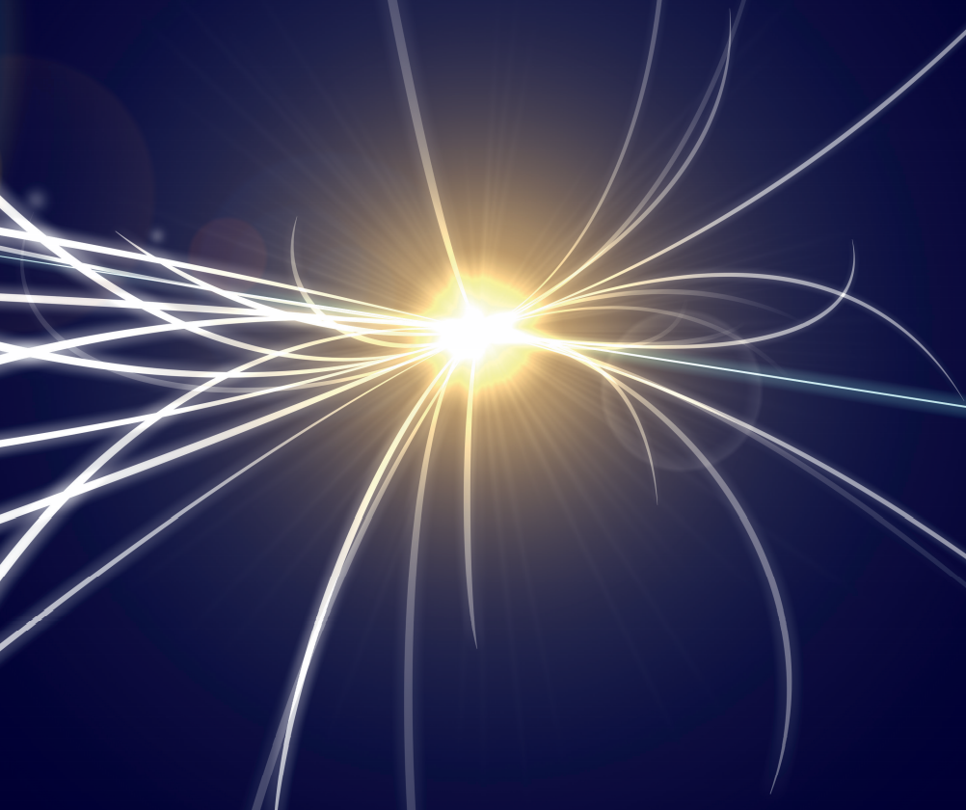

MANY THANKS
Questions?

