Slide 1
ILC Racetrack Crab Design
Prof Graeme Burt, Lancaster University / Cockcroft Institute
On behalf of the UK team at Lancaster and STFC

Slide 2
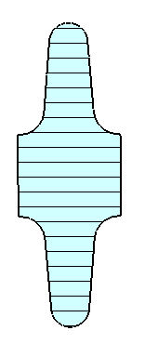
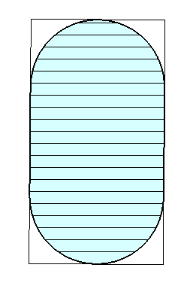
Re-optimizing the ILC crab
Minor radius
Decided to re-optimise the ILC crab cavity to increase the gradient and separate the SOM
Kept frequency at 3.9 GHz as its compact and required gradient decreases linearly with frequency
250 GeV ILC requires a 3-cell cavity @ 5 MV/m, or 2 cells at @8 MV/m
3 x 3 cells or a single 9 cell @7.5 MV/m at 1 TeV
Equator rounding radius
Iris rounding radius
Major radius

Slide 3
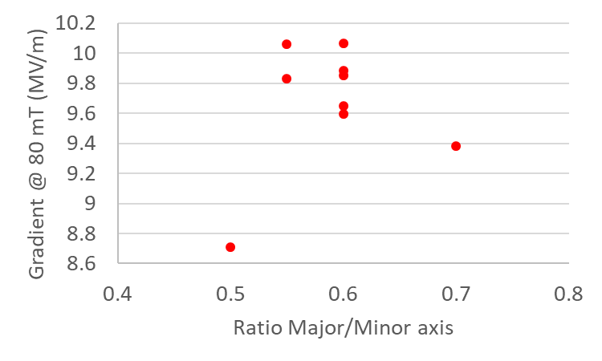
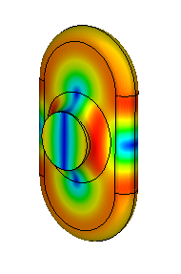
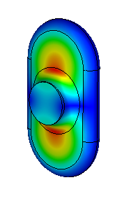
Improved geometry
The surface magnetic field decreases as the ratio of minor to major axis decreases (below 0.5 its starts to increase but with our aperture this is not an allowed geometry anyway)
The surface electric field is too low to worry about
25 mm aperture
It appears we want a small equator radius and a large equator radius (ie short cavity with a thick iris)
Since last time reoptimized for a 25 mm iris
Magnetic
Electric

Slide 4
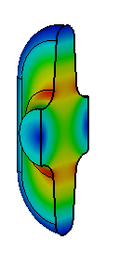
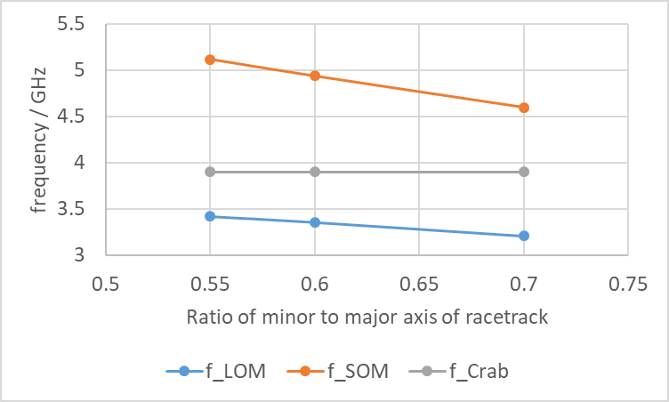
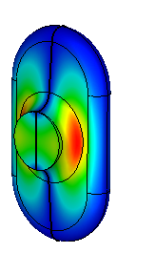
Varying the ellipticity to tune the LOM/SOM
Lower order mode (LOM)
Making the cavity elliptical pushes the other polarization of the dipole mode to higher frequencies
One issue with making the cavity highly elliptical is the lower order mode moves closer to the crabbing mode
Ideally LOM and SOM spacing equal
Making more elliptical also drops Bpk until it gets close to the aperture
Same order mode (SOM)

Slide 5
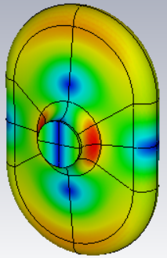
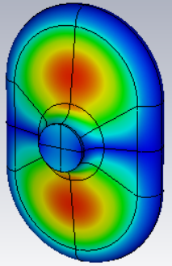
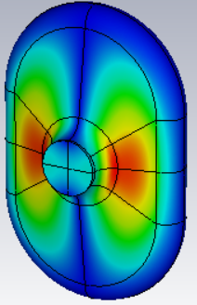
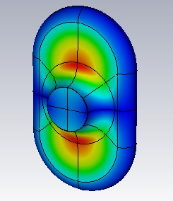
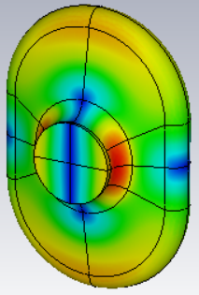
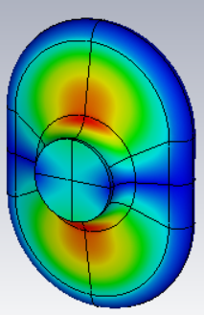
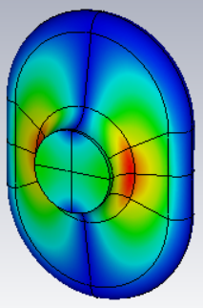
20mm - 30mm single cell final results
20mm
Rt/Q =53.47 Ohms/m
B_{pk} = 65.43565 mT @ grad=8MV/m
E_{pk} = 22.62528 MV/m @ grad=8MV/m
LOM = 3.073 GHz
SOM = 4.74718 GHz
Rt/Q_{SOM} =52.86581 Ohms/m
25mm
Rt/Q = 47 Ohms/m
B_{pk} = 64 mT @ grad=8MV/m
E_{pk} = 33.2 MV/m @ grad=8MV/m
LOM = 3.3 GHz
SOM = 5.08 GHz
Rt/Q_{SOM} =37.3 Ohms/m
30mm
Rt/Q = 44.03 Ohms/m
B_{pk} = 79.706 mT @ grad=8MV/m
E_{pk} = 27.230 MV/m @ grad=8MV/m
LOM = 3.21817 GHz
SOM = 4.57387 GHz
Rt/Q_{SOM} =40.77031 Ohms/m

Slide 6
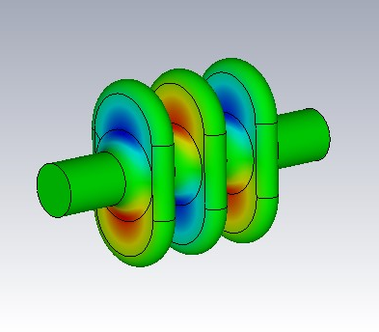
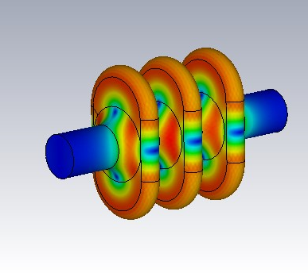
3 cell cavity
End cells initially had lower peak magnetic field
Larger beampipes were used on the end cells to aid damping (30 mm)
Slightly higher B field means that gradient is limited to 9.7 MV/m at 80 mT
R_{t}/Q=132 Ohms
E field
B field

Slide 7
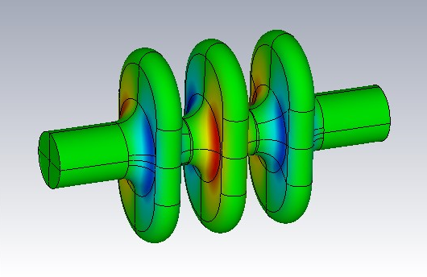
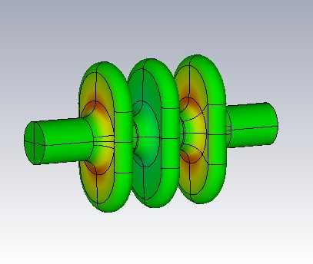
Same order and lower order modes
Highest impedance SOM is the pi mode at 5.07 GHz, Rt/Q is only 50 Ohms due to frequency not being synchronous.
Highest impedance LOM is the pi/2 mode at 3.32 GHz, Rt/Q is only 134 Ohms

Slide 8
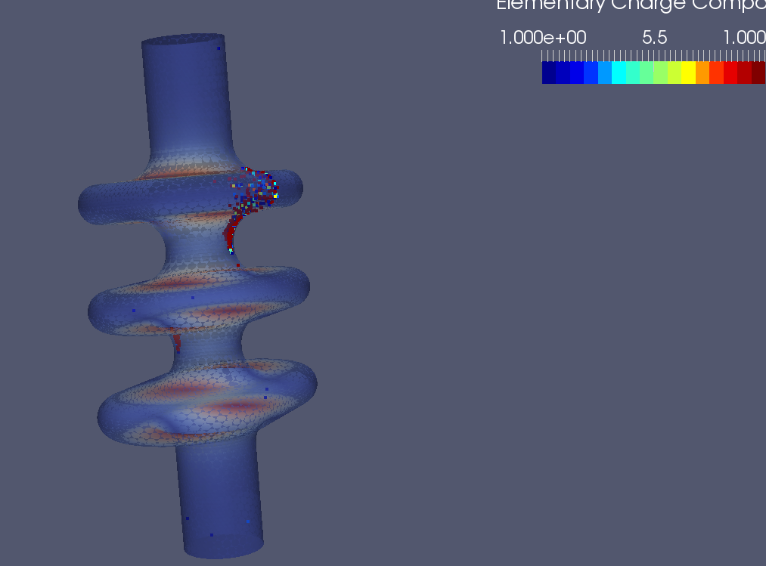
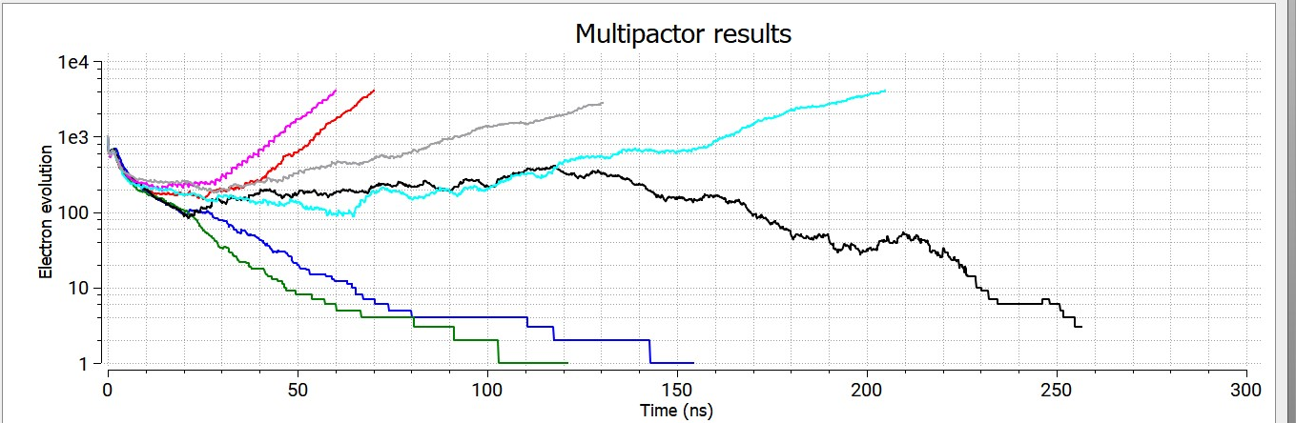
Multipactor
Multipactor band found at 7.15 MV/m on minor axis iris.
Either need to modify iris or limit gradient to 7 MV/m
Appears very narrow band (not at 7 or 7.3 MV/m)
ILC spec need 7.5 MV/m for 1 TeV with only 3 cavities or a single 9 cell.

Slide 9
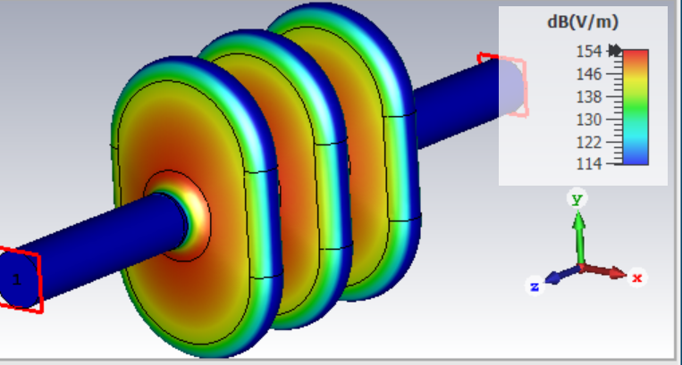
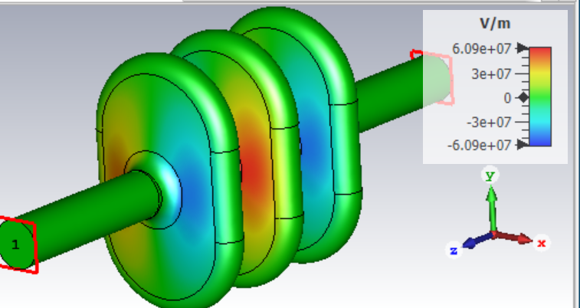
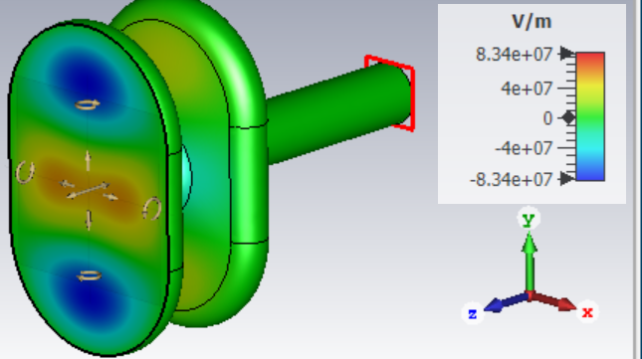
Mode spectrum

Slide 10
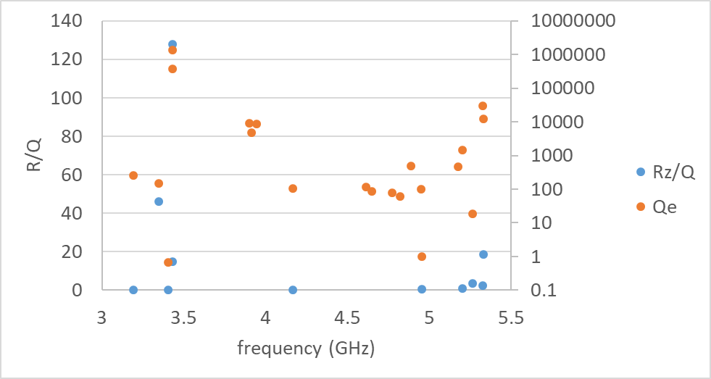
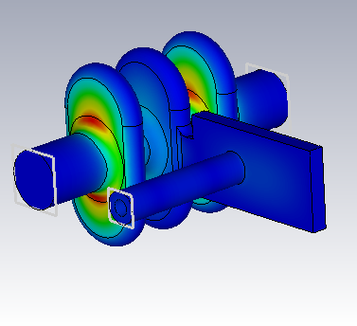
Waveguide damping
Considering a waveguide section with a coax coupled to it to minimize size and heat leak.
Coax can be positioned to prevent coupling to the crabbing mode.
Good damping overall except one mode, unfortunately the highest impedance mode.
Waveguide damper does damp the pi and 0 modes well but doesn’t damp the pi/2 modes but these will be damped strongly by a coax damper in the beampipes.
Also investigating putting the waveguide in an end cell.

Slide 11
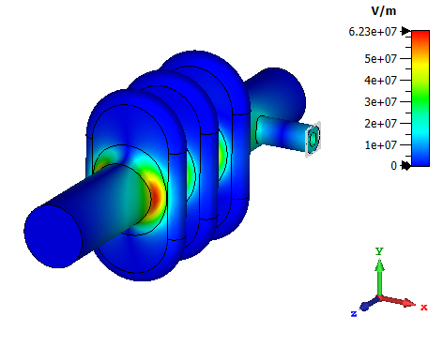
Coaxial damper (30 mm aperture)
Specification is Rt/Q*Qe = 60 MOhm/m
Rt/Q_SOM=40 hence Qe= 1.5e6
Initial trials suggest this is simple to achieve
Q_crabbing mode=2e8 - 1e9
Q_SOM=1500 – 6000
Q_LOM=1e6 – 1e7

Slide 12
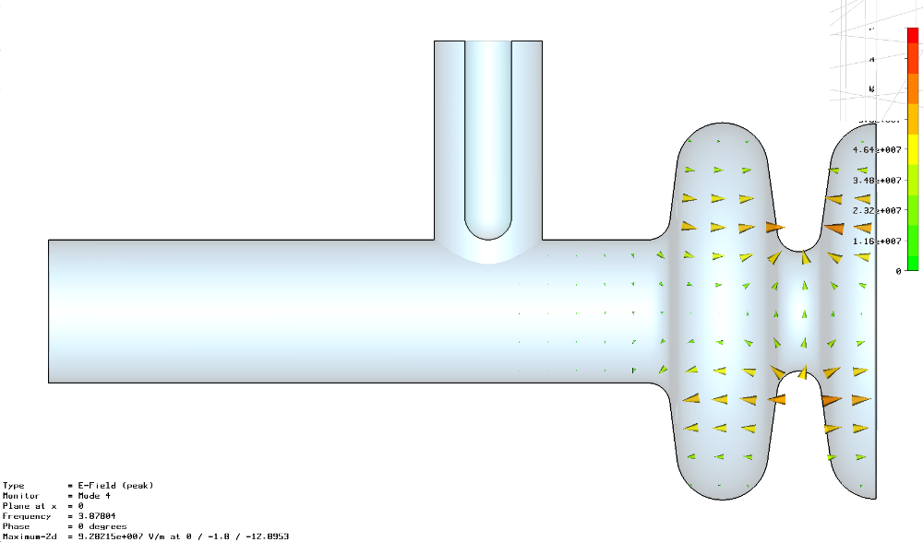
Cockcroft SOM Coupler design
The SOM coupler is currently a simple coaxial structure.
The problem is that as we decrease the SOM external Q we make the coupler susceptible to damping the operating mode.
Assuming 10 Watts mean power flow in the coupler, and we meet the SOM damping spec then we need to align the coupler to within 1.4 degrees.
May be better to use a racetrack cell shape to separate the vertical and horizontal mode in frequency and use a filter

Slide 13
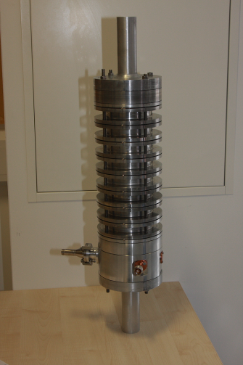
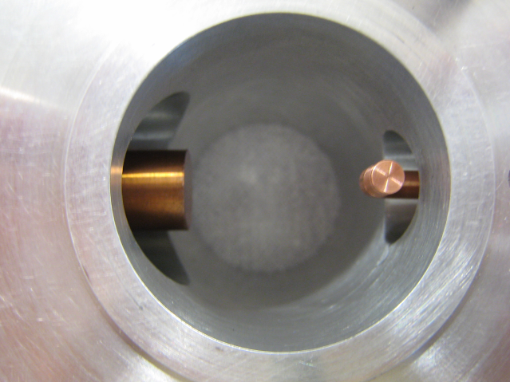
Lower Order Mode Coupler
Hook type LOM coupler designed by FNAL/Lancaster and improved by SLAC
No filter, uses polarisation to avoid coupling to the crabbing mode
The LOM coupler prototype was found to give good agreement with both MWS and Omega3P simulations.

Slide 14
Conclusions
We believe 3.9 GHz elliptical is still optimal as can achieve same gradient as a 1.3 GHz compact crab but needs a 3rd of the length and could use a single cavity per IP at 1 TeV so simpler than 9 single cells.
Investigating a racetrack cell shape which allows a higher gradient and better mode speration to LOM and HOM.
Based on fields can reach 9.7 MV/m but MP limited to 7 MV/m.
LOM/SOM/HOM couplers needs some redesign
Coax, & WG damping being considered.

