Slide 1
Sources Subgroup Summary IDT-WG2, Jul.26. 2022, K. Yokoya
Jul.18 29th Regular meeting
Masao Kuriki, Kaoru Yokoya, Peter Sievers, Sabine Riemann,
Indico https://agenda.linearcollider.org/event/9763/
Talk by Joe Grames “Status of Polarized Electron & Positron Source R&D at Jefferson Lab”
Uploaded in the above indico page
Introduction of many works at JLab in 2021-2022
I cannot describe individual research
Just give the table of contents

Slide 2
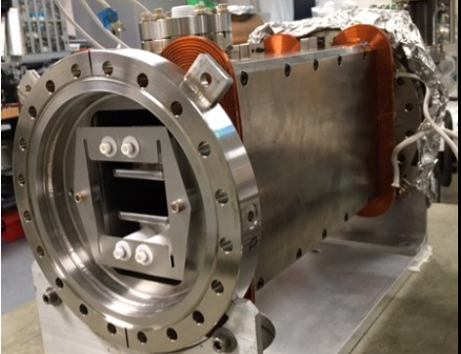
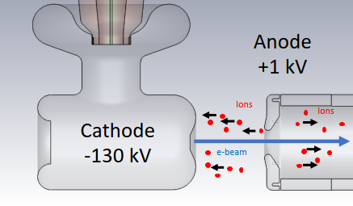
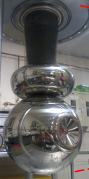
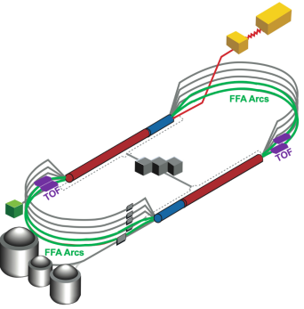
Jefferson Lab Polarized Source R&D Topics (2021 – 2022)
Polarized e-
High Polarization Photocathodes
Molecular Beam Epitaxy (MBE)
Molecular Organic Vapor Deposition (MOCVD)
Chemical Beam Epitaxy (CBE)
High Voltage Devices
200 – 300 kV Wien filters
500 kV inverted insulator
300 kV polarized 1 mA photogun (proposal, driver for pol. e+ production)
Ion Damage Experiments
Biased anode mitigation
Robust chemistry
Gun voltage dependence
Simulation & Modeling
GPT ion generation & spin tracking
Lifetime evolution model
Spot size evolution model
Polarized e+
Polarized positrons beams for CEBAF
Positron physics scope (today)
CEBAF upgrades beyond 12 GeV e-
Polarized positron improvement
Energy upgrade 22 GeV
Positron injector
Technical workshop

