Slide 1
Gamma Resolution vs Angle From Jet Axis
Bayley Burke (University of Oregon)

Slide 2
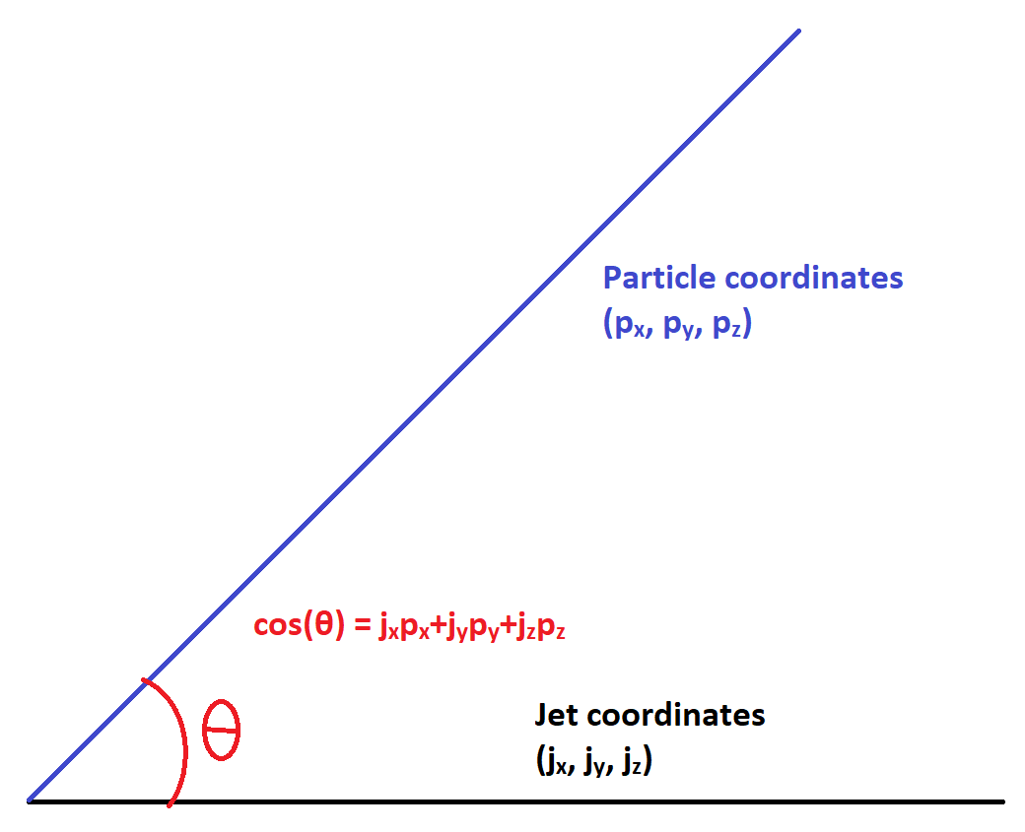
R, Resolution definition
Particles are clustered into jets
The jet itself and each constituent particle has a (unit) momentum 3-vector
R is the angular distance of a particle from the jet axis, defined as:
R = 1 - cos(θ) = 1 - (p_{x}j_{x} + p_{y}j_{y} + p_{z}j_{z})
Close to the jet axis cos(θ) ~ 1, R ~ 0; likewise far from it R ~ 1
Resolution is a measure of how well the detector (pfo) determines energy vs truth (mct)
Using energy scaled resolution to treat high and low energy jets equally (ideally)
Resol = (E_{mct} - E_{pfo}) / E_{mct}^{1/2}

Slide 3
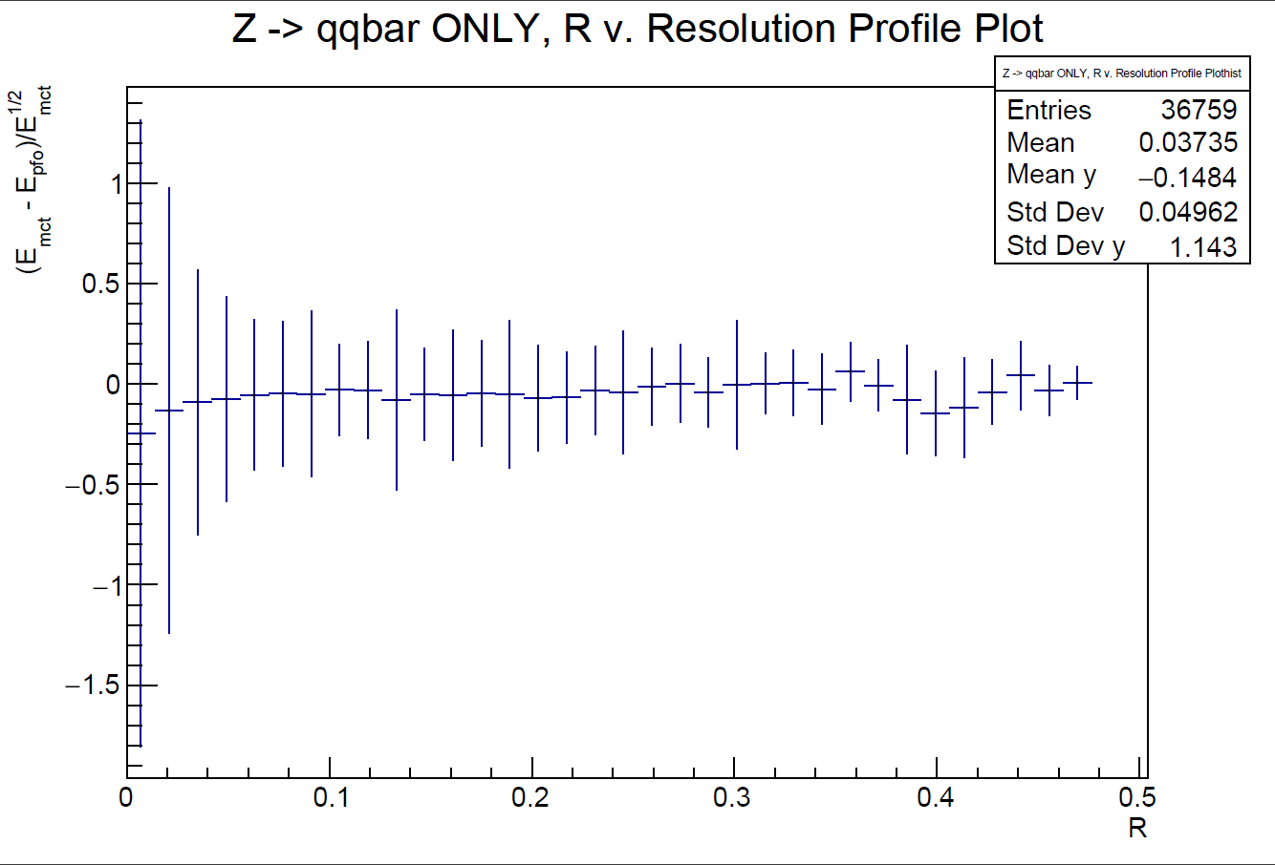

Slide 4
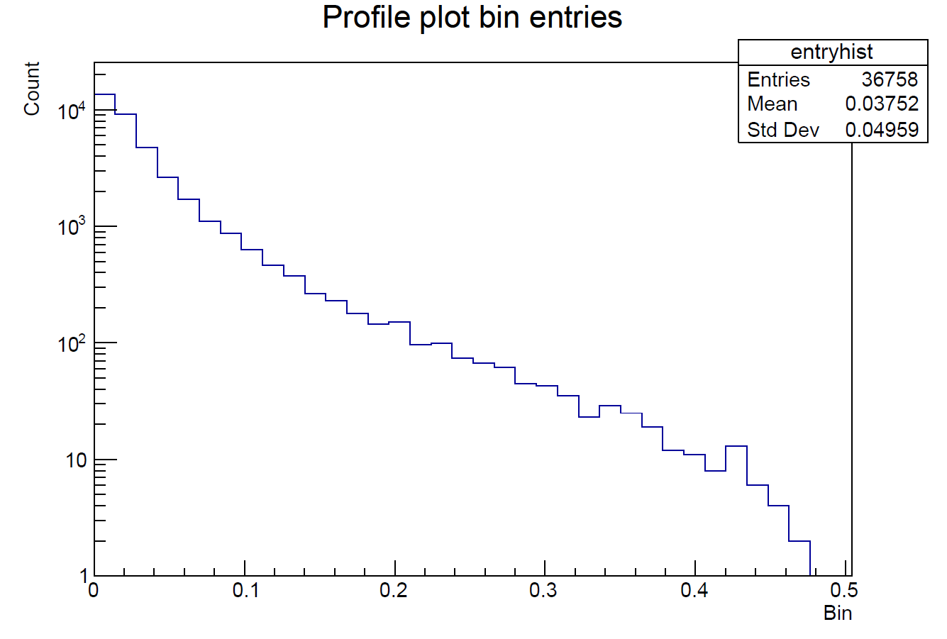

Slide 5
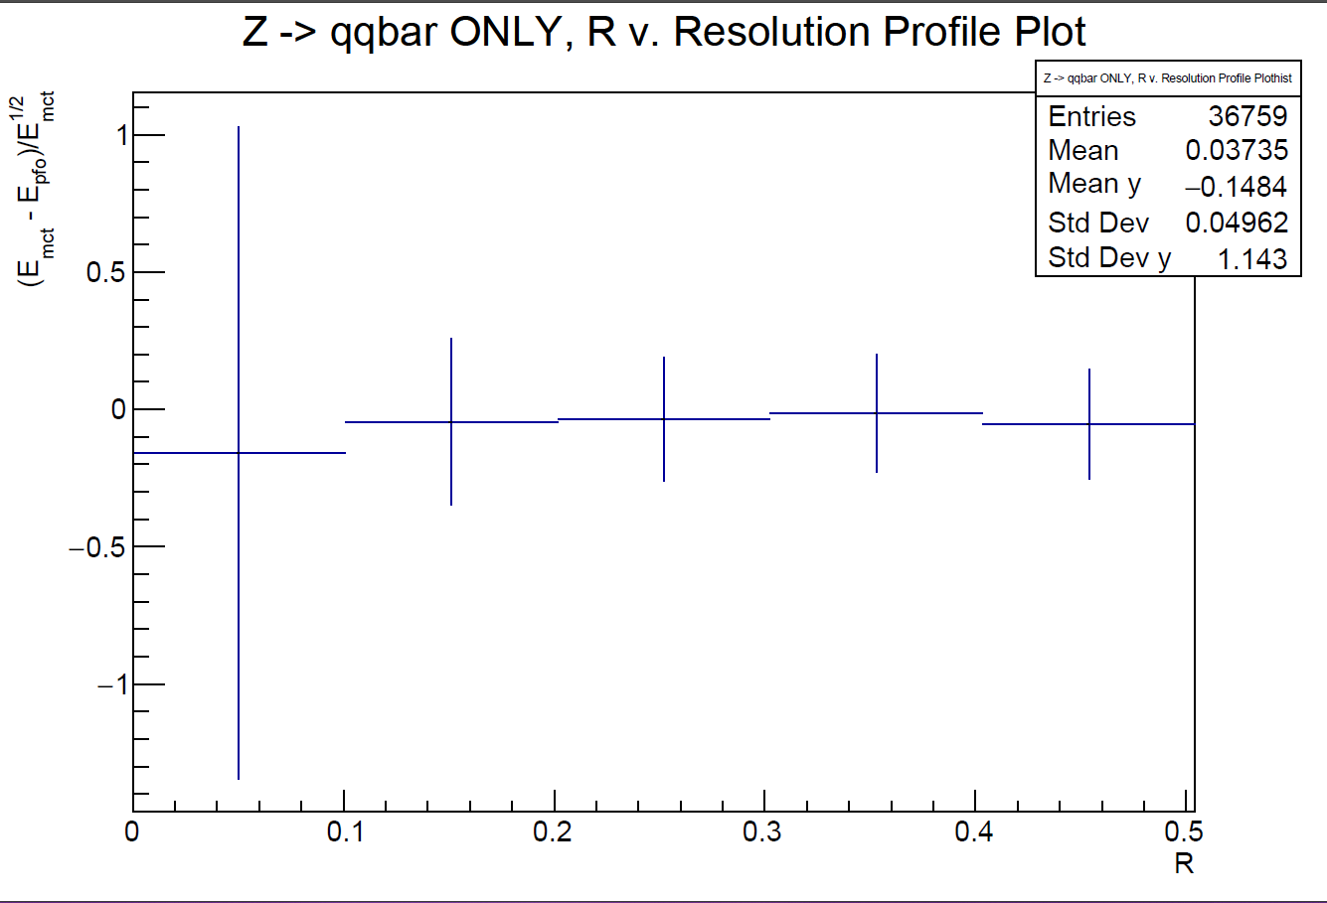

Slide 6
