Slide 1
ISO Standards for Sustainability
Benno List, DESY
Sustainability Meeting
1.6.2022

Slide 2
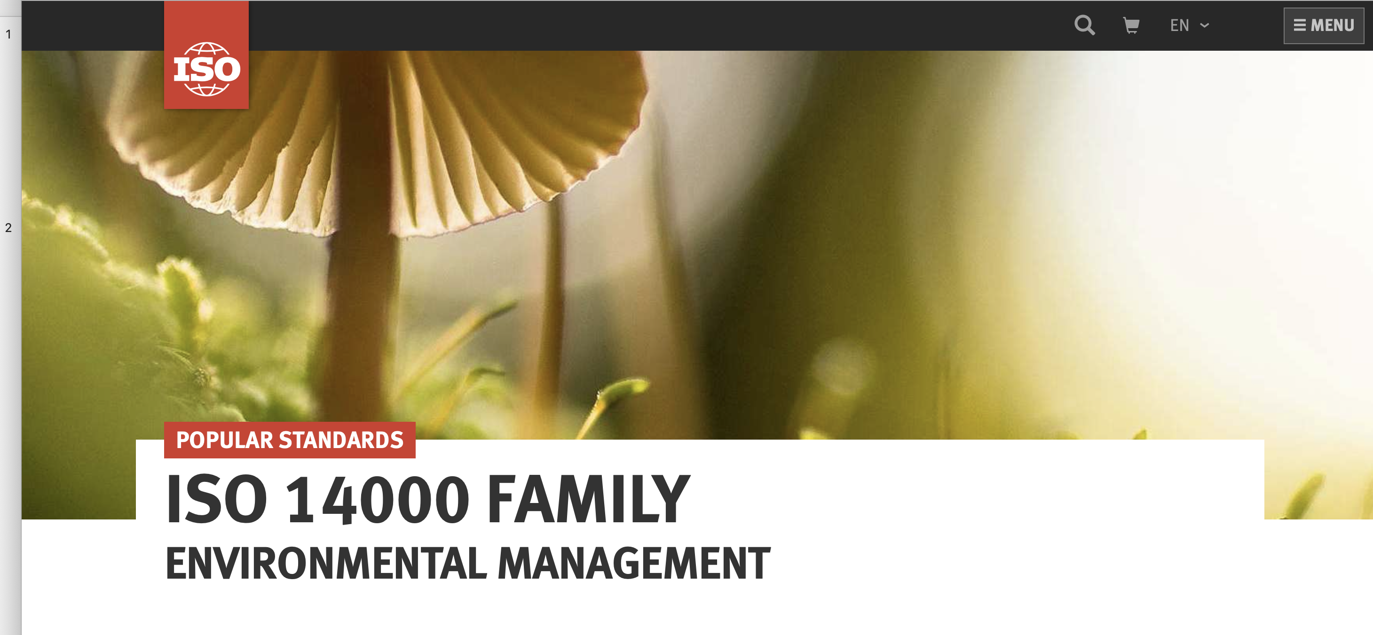
ISO 14000 Family
https://www.iso.org/iso-14001-environmental-management.html

Slide 3
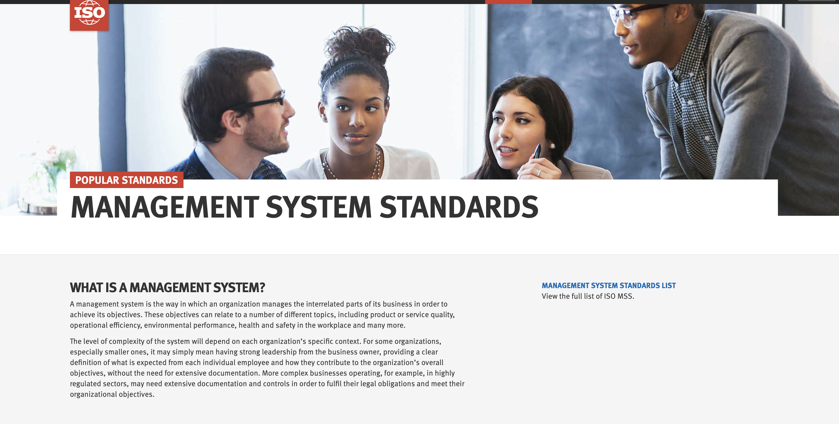
https://www.iso.org/management-system-standards.html

Slide 4
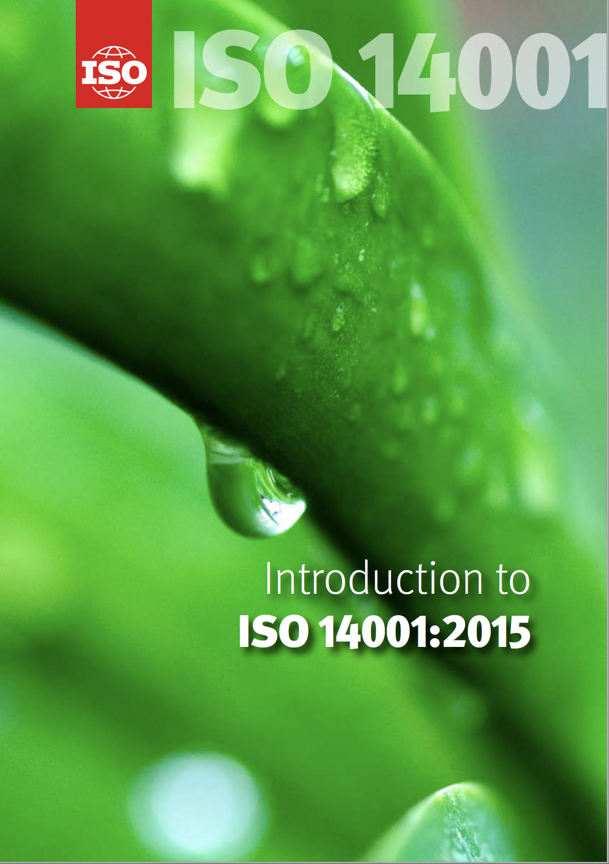
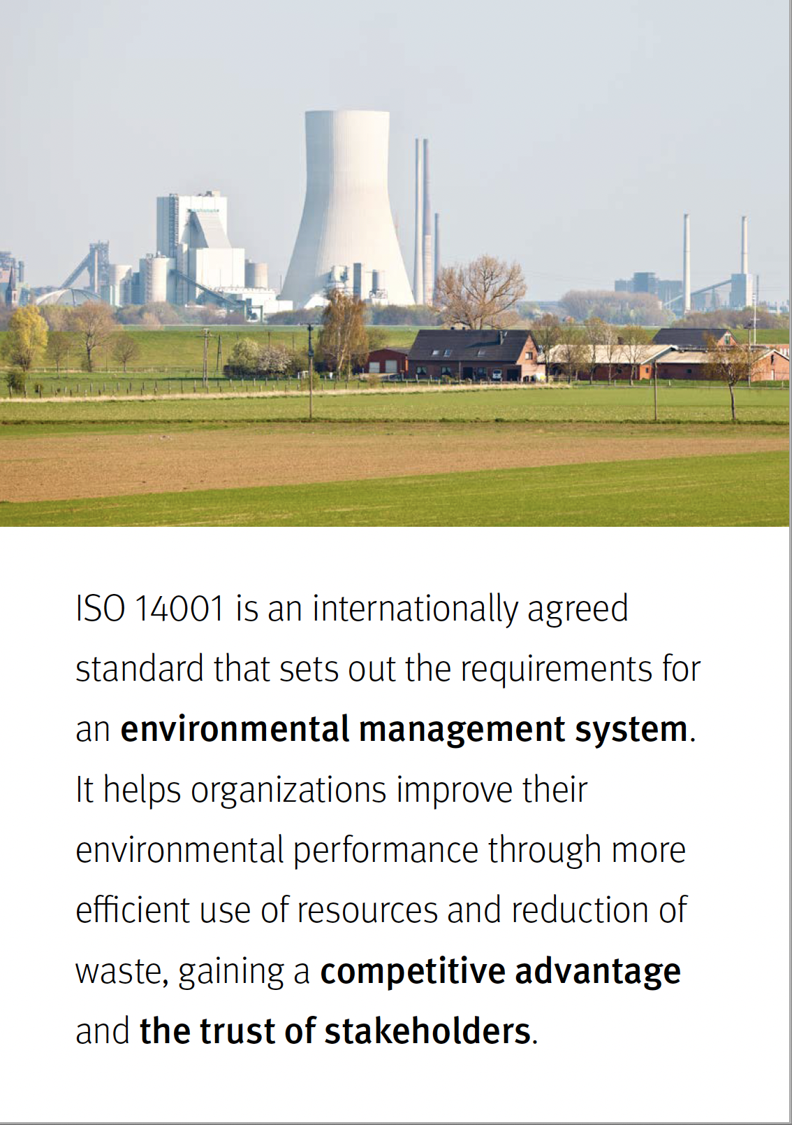
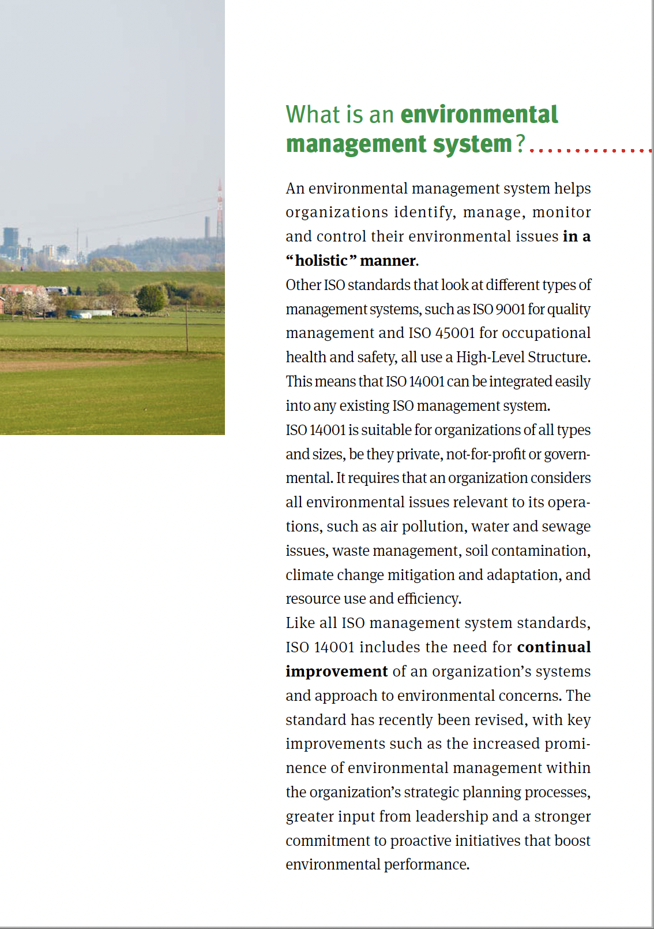
Overview
https://www.iso.org/publication/PUB100371.html

Slide 5
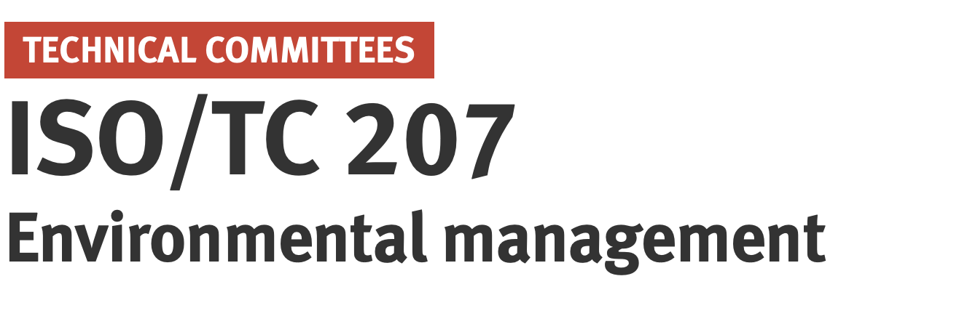
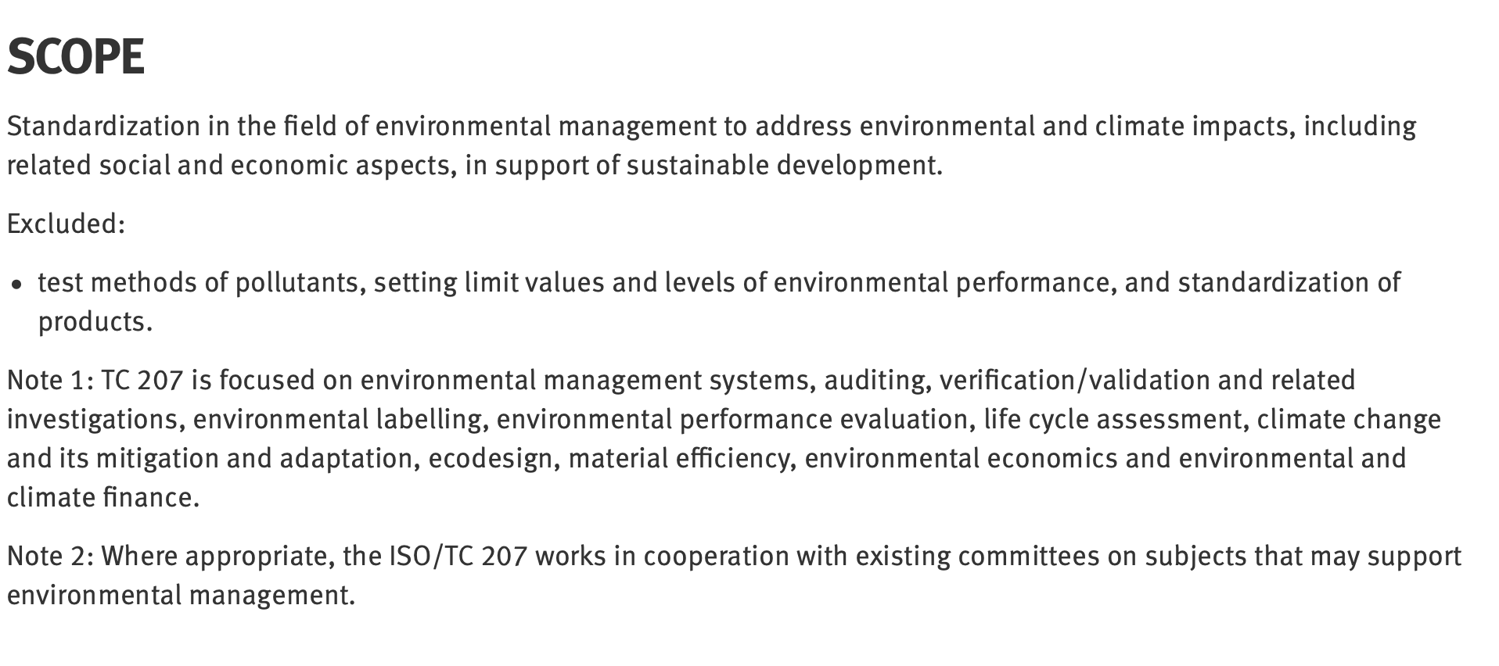
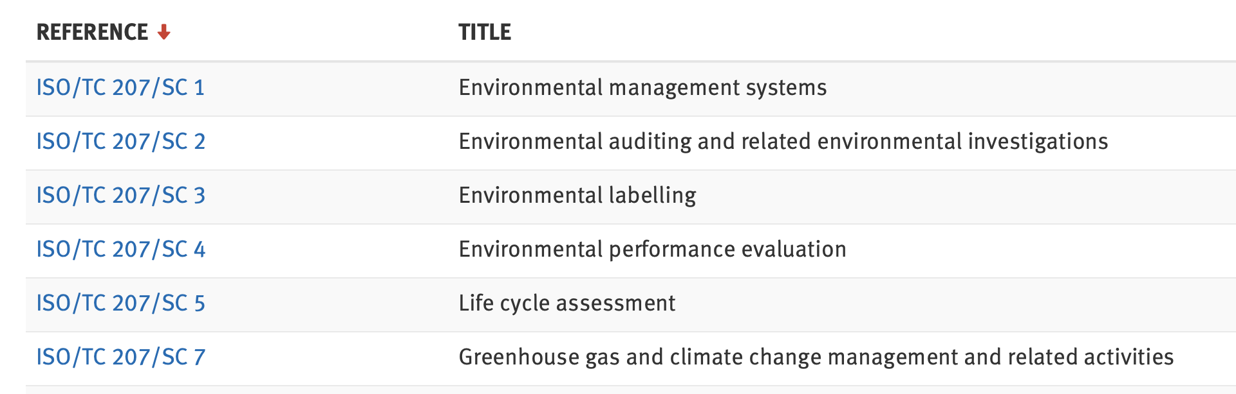
Committee ISO/TC207
https://www.iso.org/committee/54808.html
-> ISO 14001
-> ISO 14040
-> ISO 14064

Slide 6
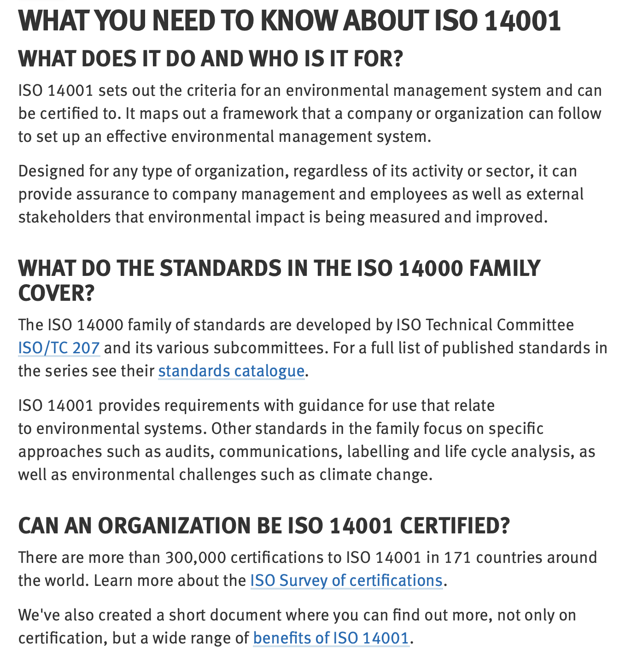
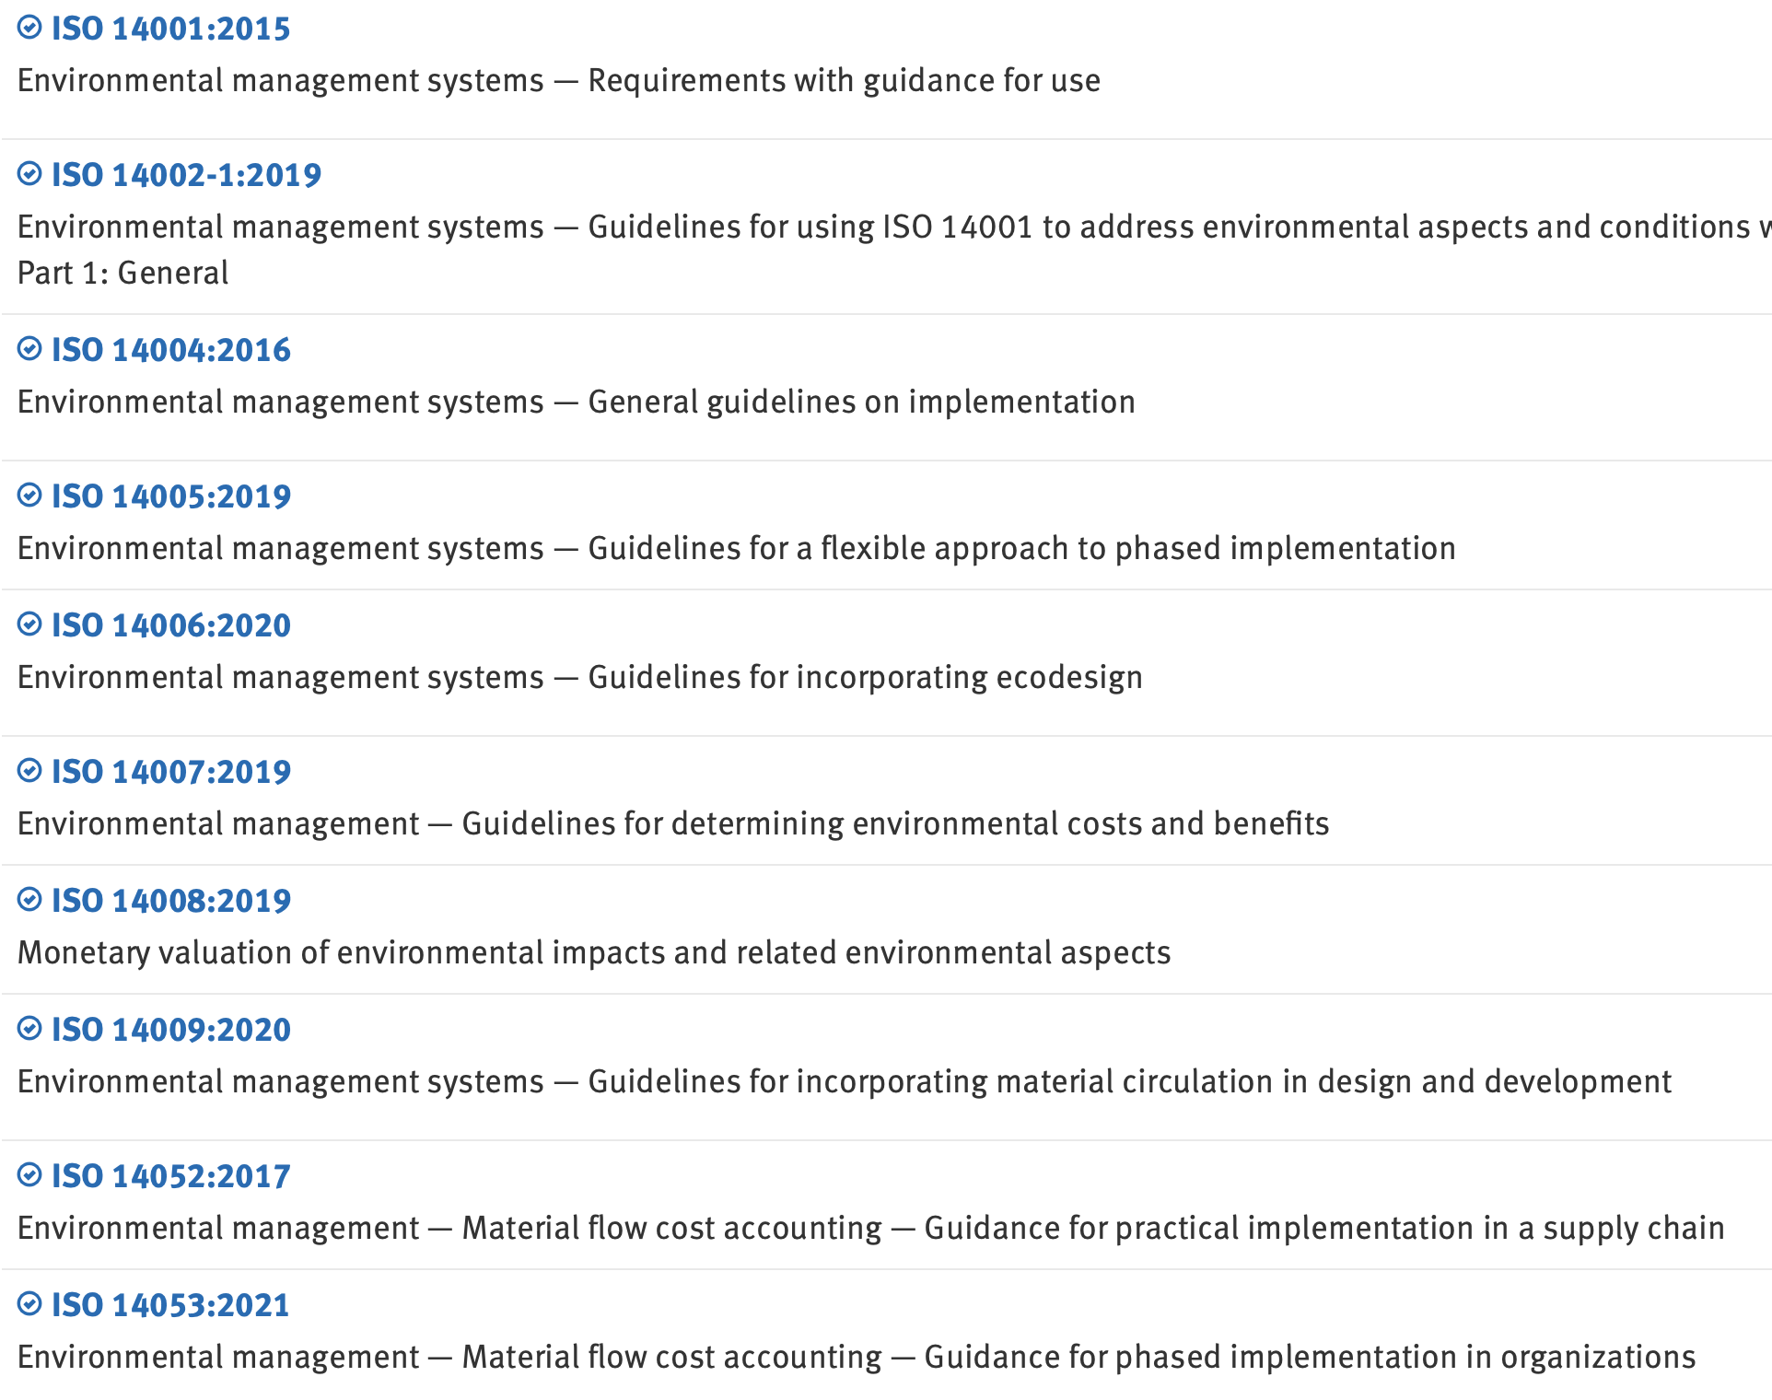
ISO 14000 Family (ISO/TC 207/SC1)
https://www.iso.org/iso-14001-environmental-management.html
https://www.iso.org/committee/54818/x/catalogue/p/1/u/0/w/0/d/0

Slide 7
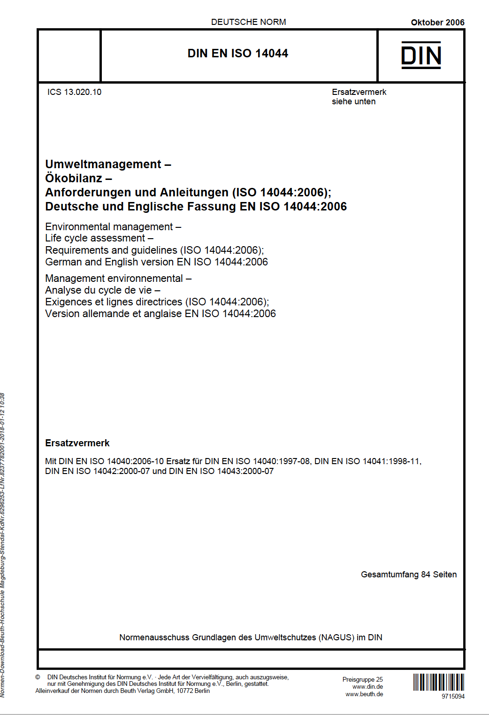
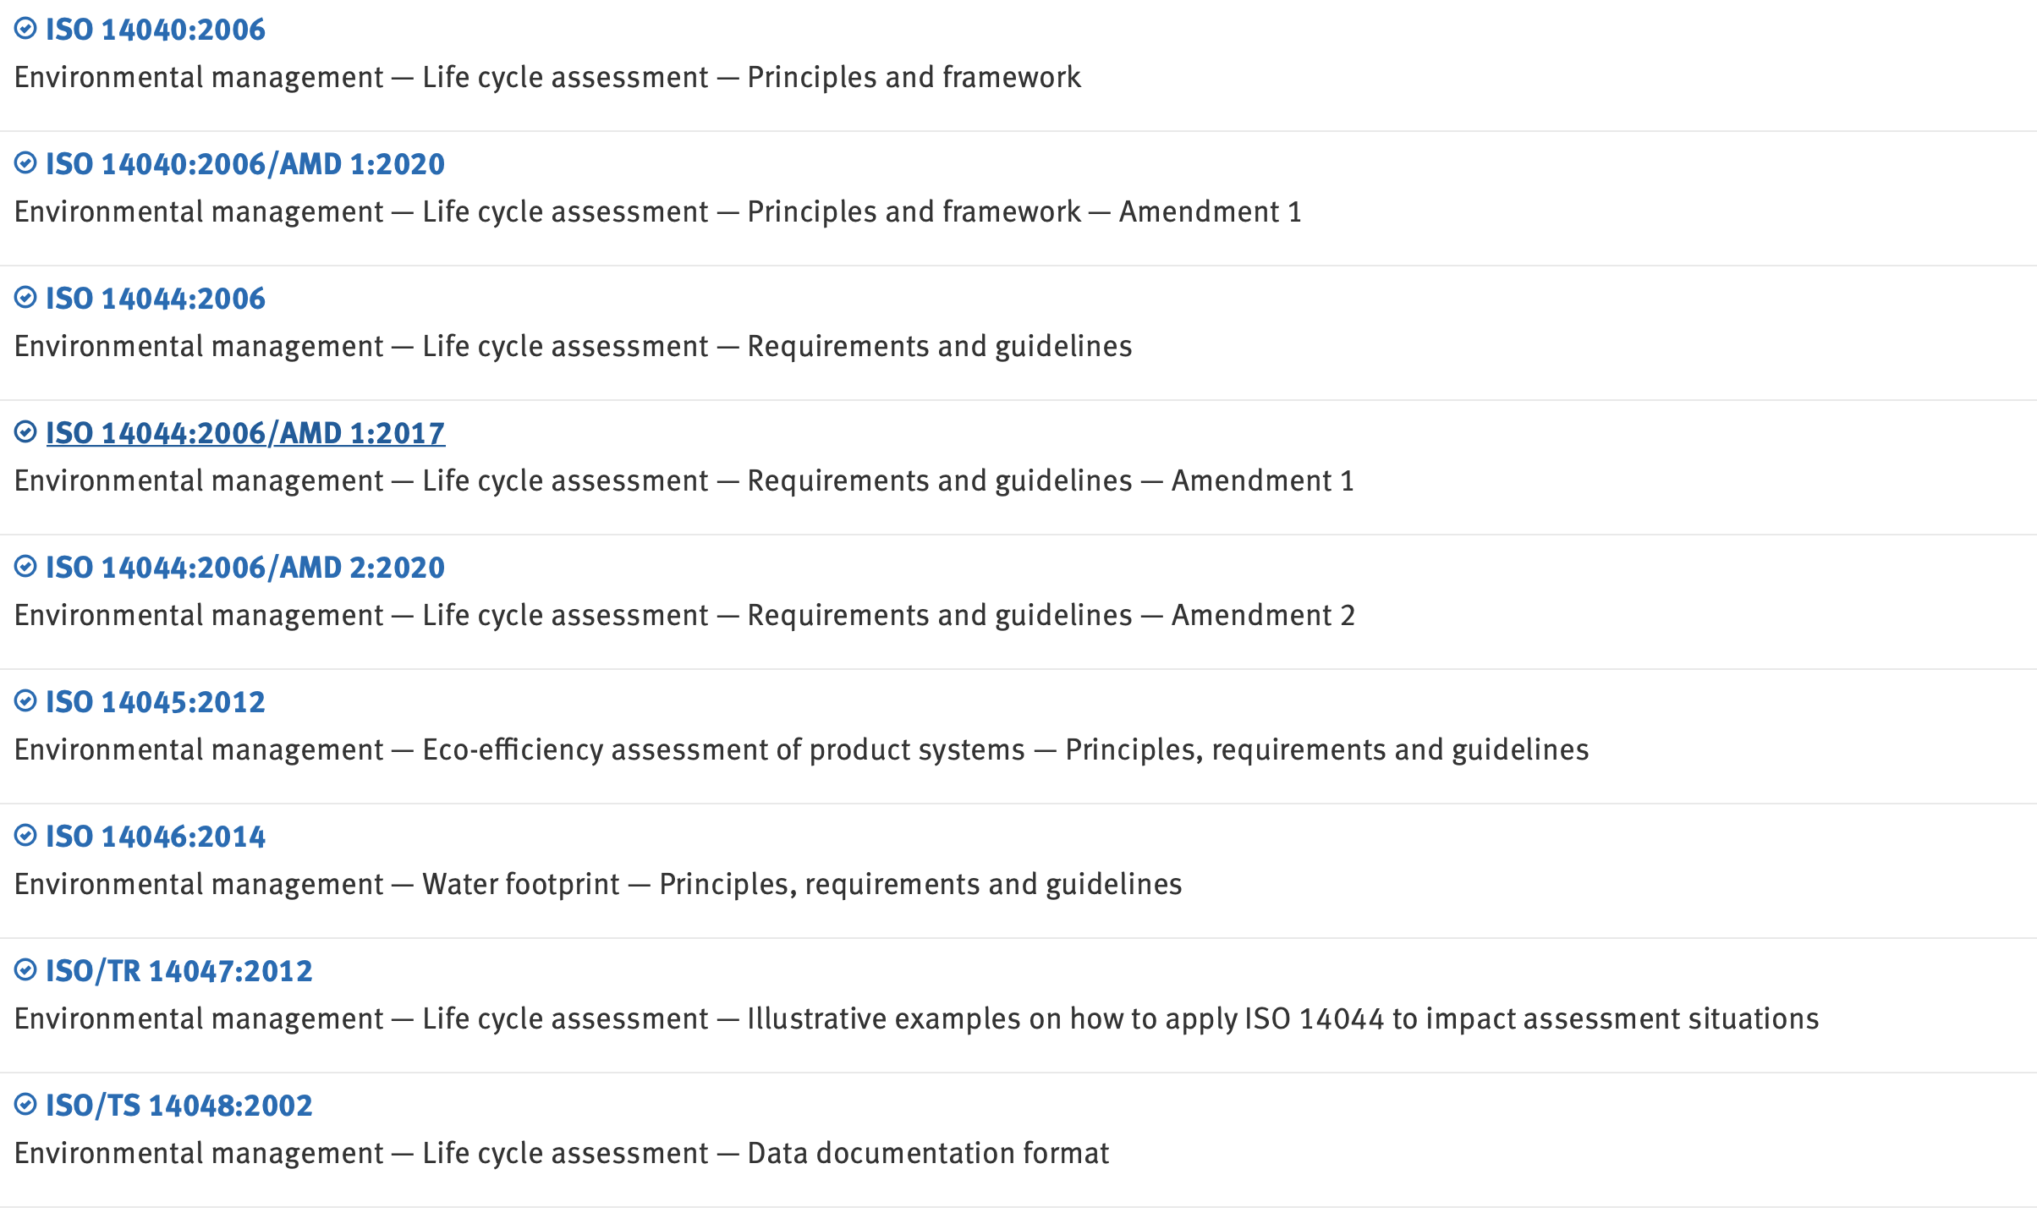
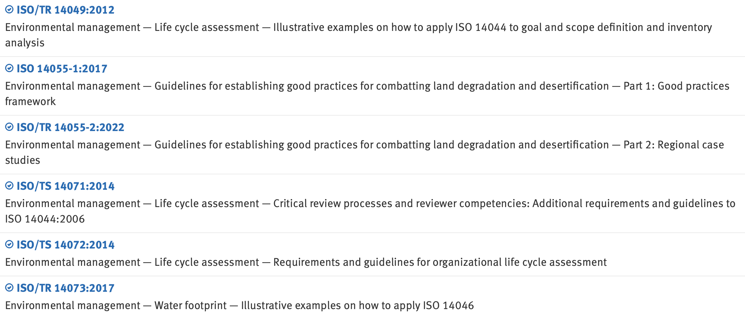
14040 Family Family (ISO/TC 207/SC5)
https://www.iso.org/committee/54854/x/catalogue/p/1/u/0/w/0/d/0

Slide 8
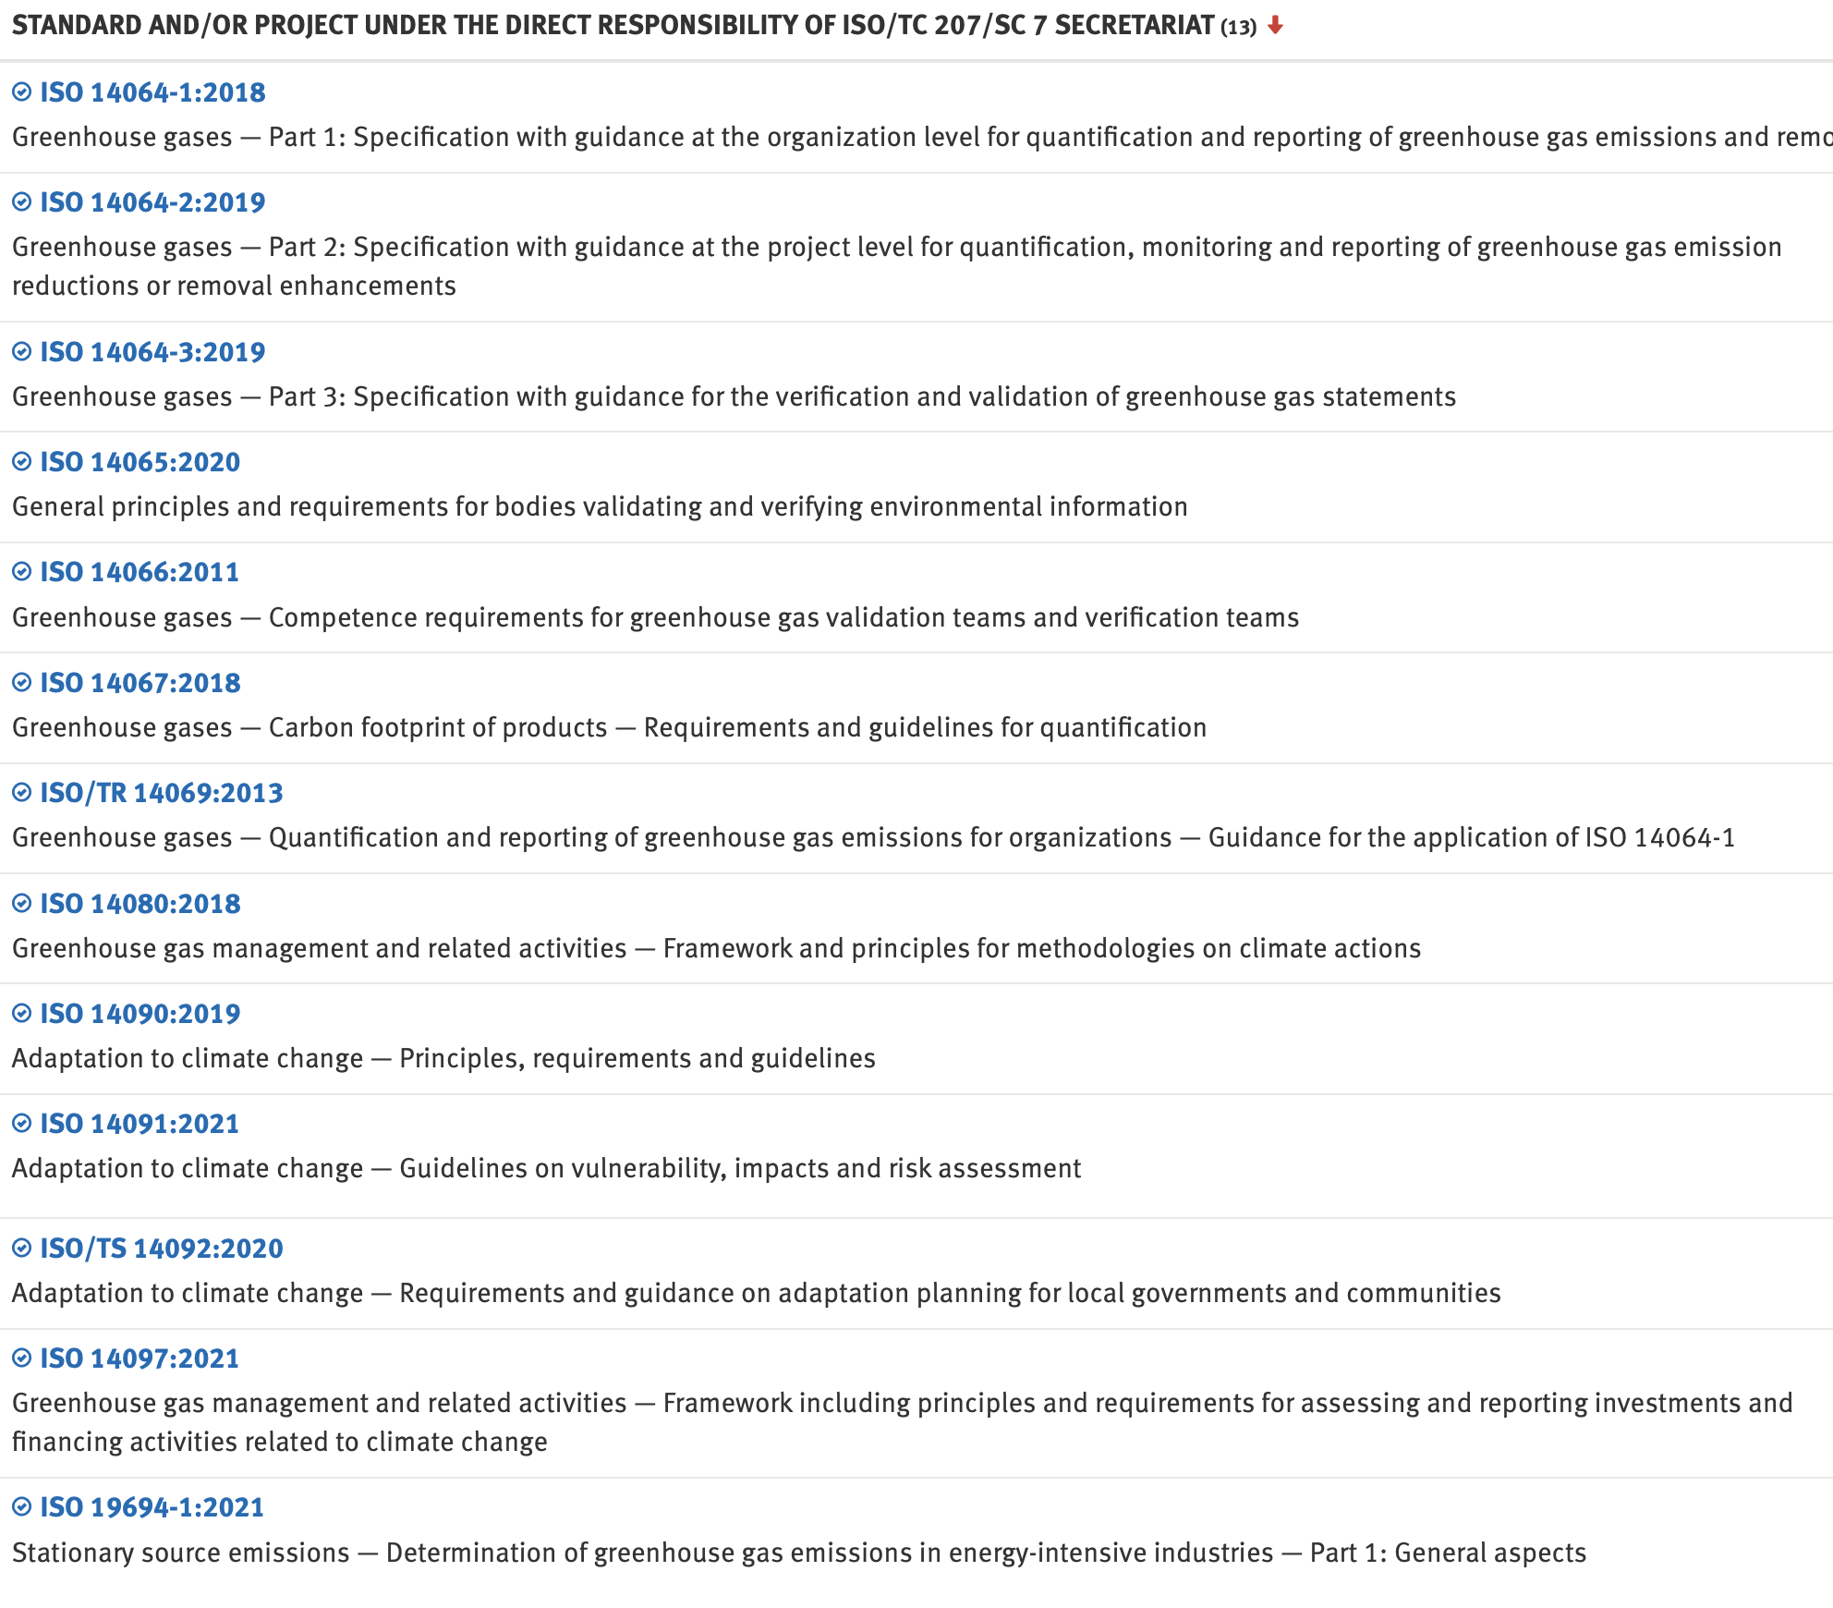
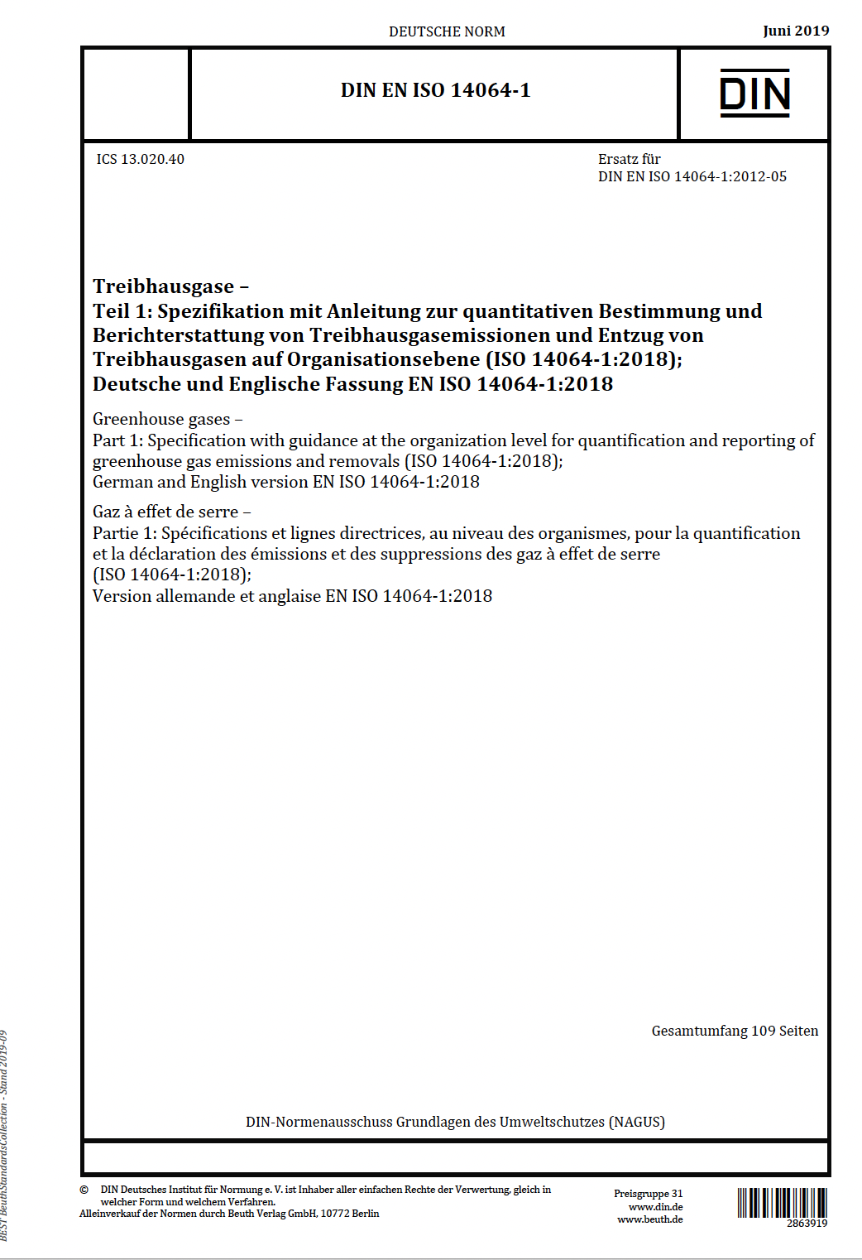
14064 Family Family (ISO/TC 207/SC7)
https://www.iso.org/committee/546318/x/catalogue/p/1/u/0/w/0/d/0

Slide 9
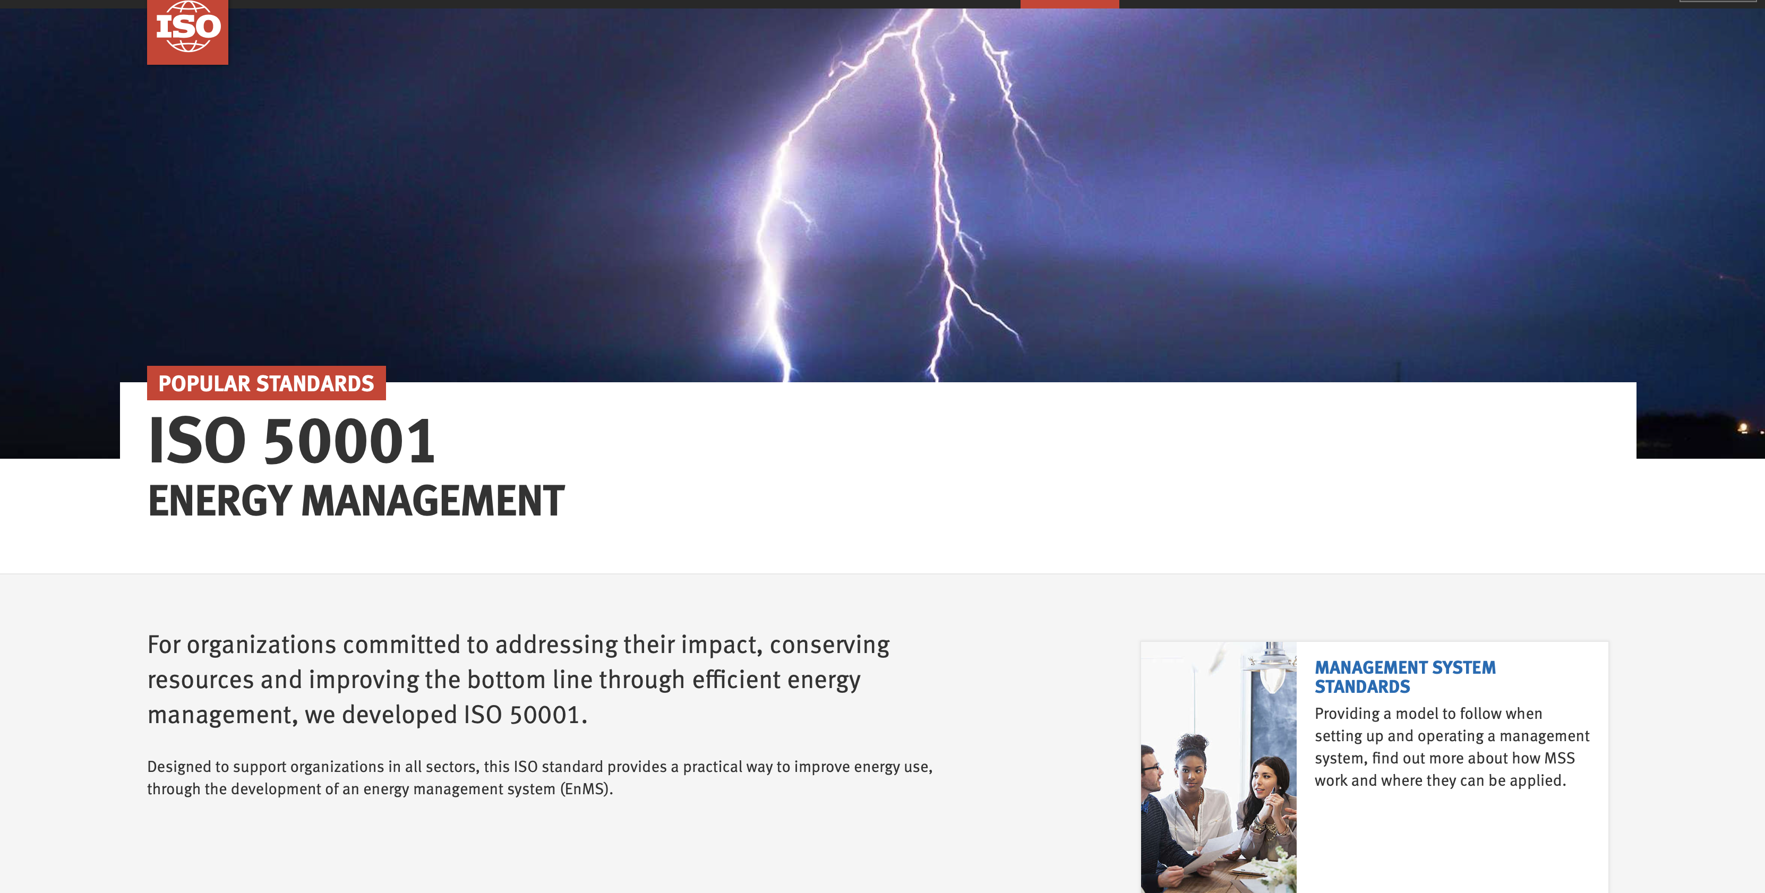
https://www.iso.org/iso-50001-energy-management.html

Slide 10

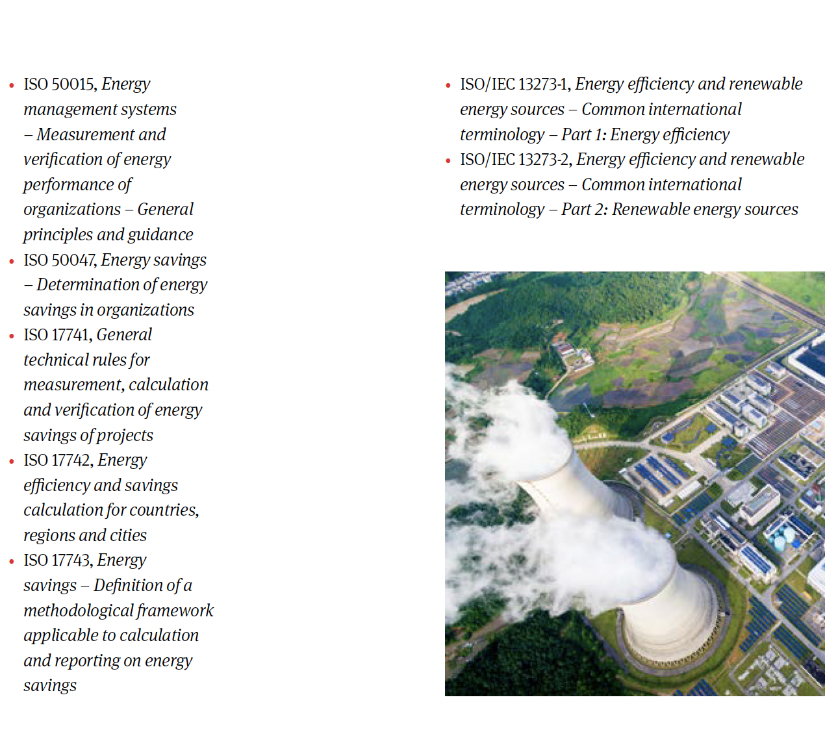
ISO 50001
https://www.iso.org/publication/PUB100400.html

