Slide 1
Project Proposal:
Comparative Carbon Footprint of Underground Civil Engineering Facilities for Future Colliders
Benno List
LC Sustainability Meeting 21.9.2022

Slide 2
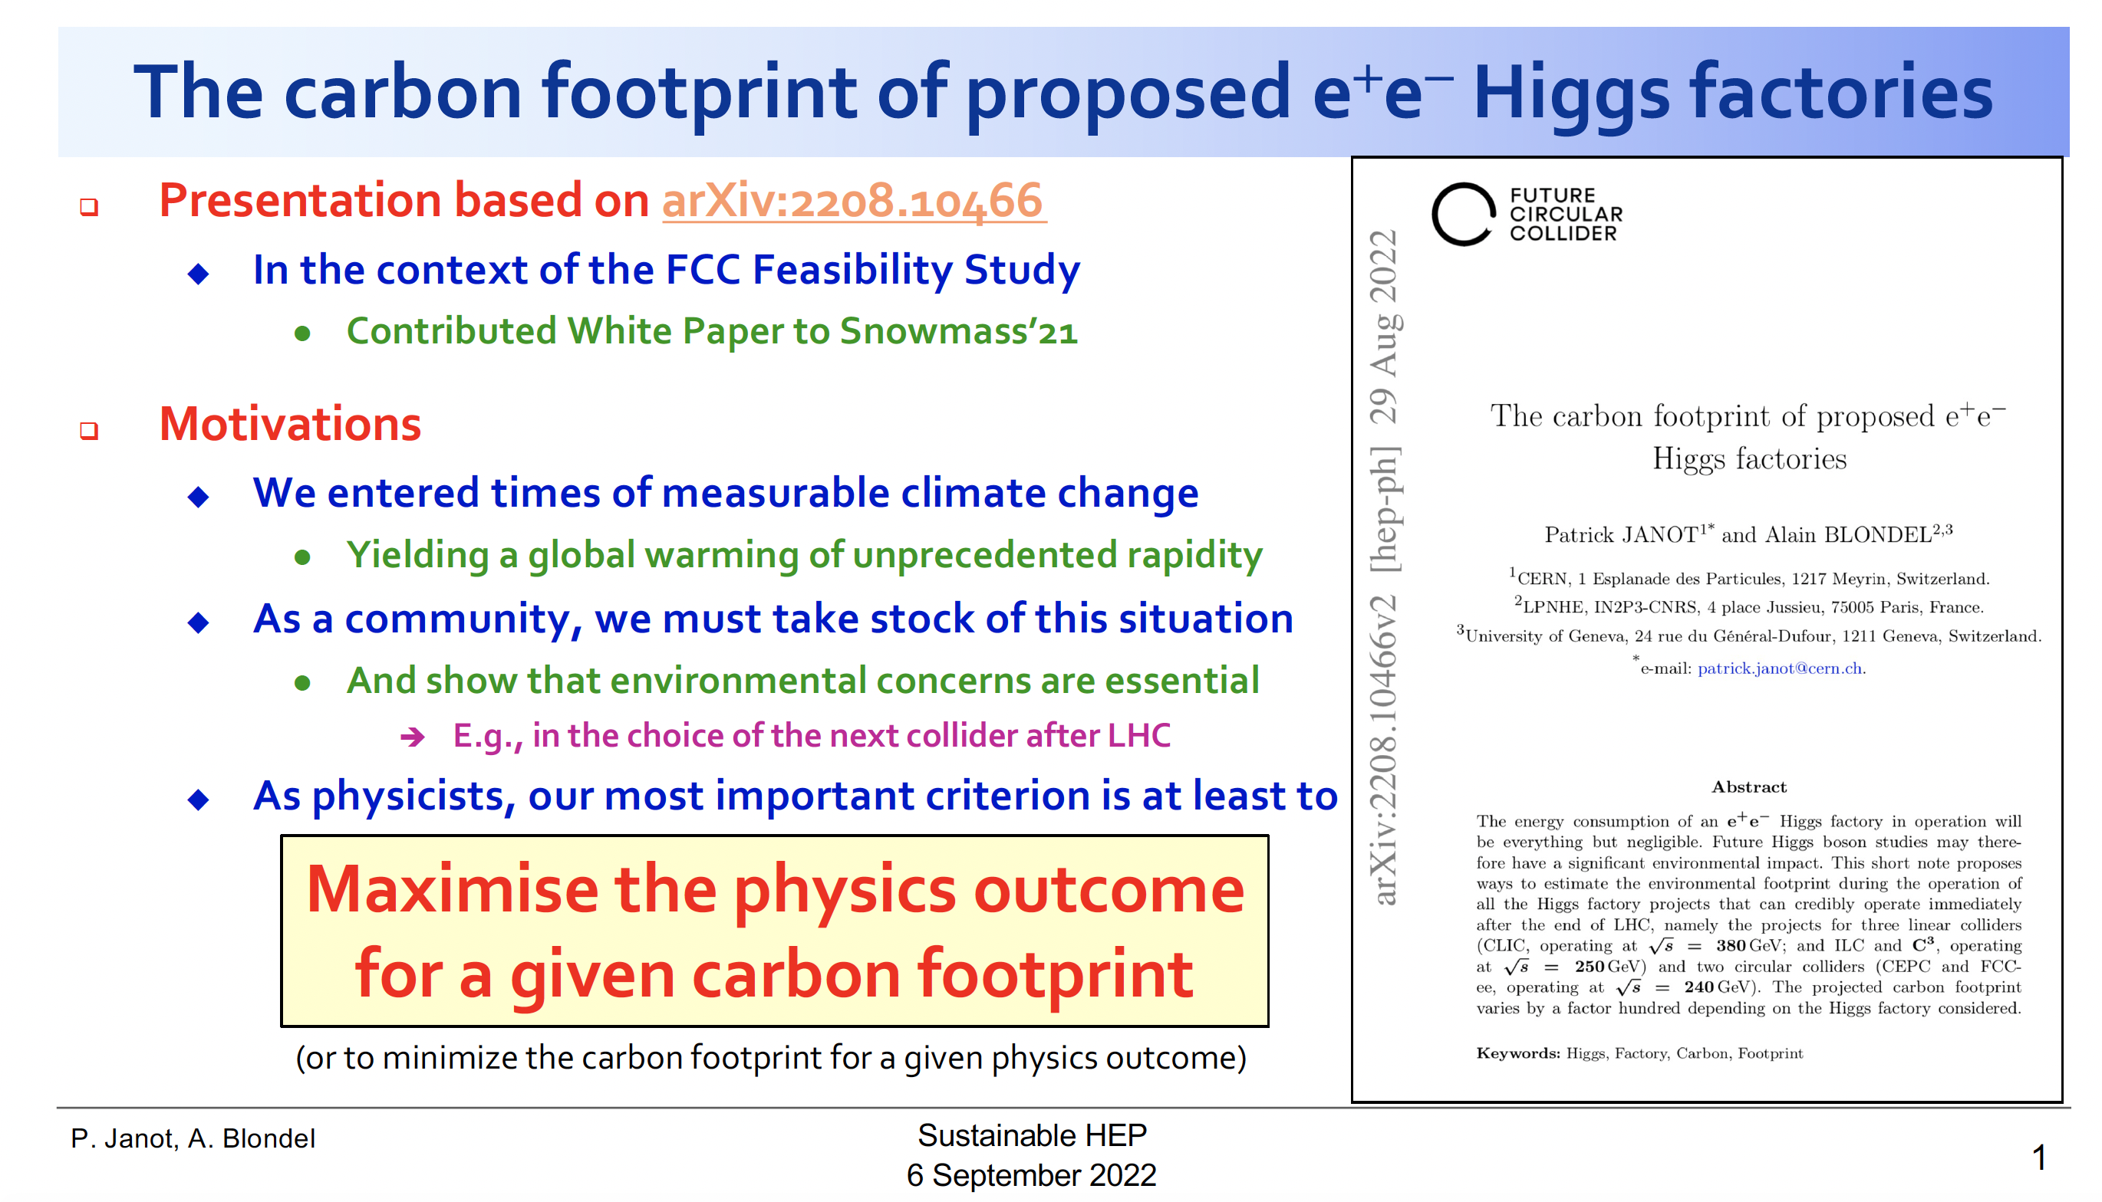
FCC-ee Study by Janot & Blondel
https://indico.cern.ch/event/1160140/contributions/5025092
arXiv:2208.10466

Slide 3
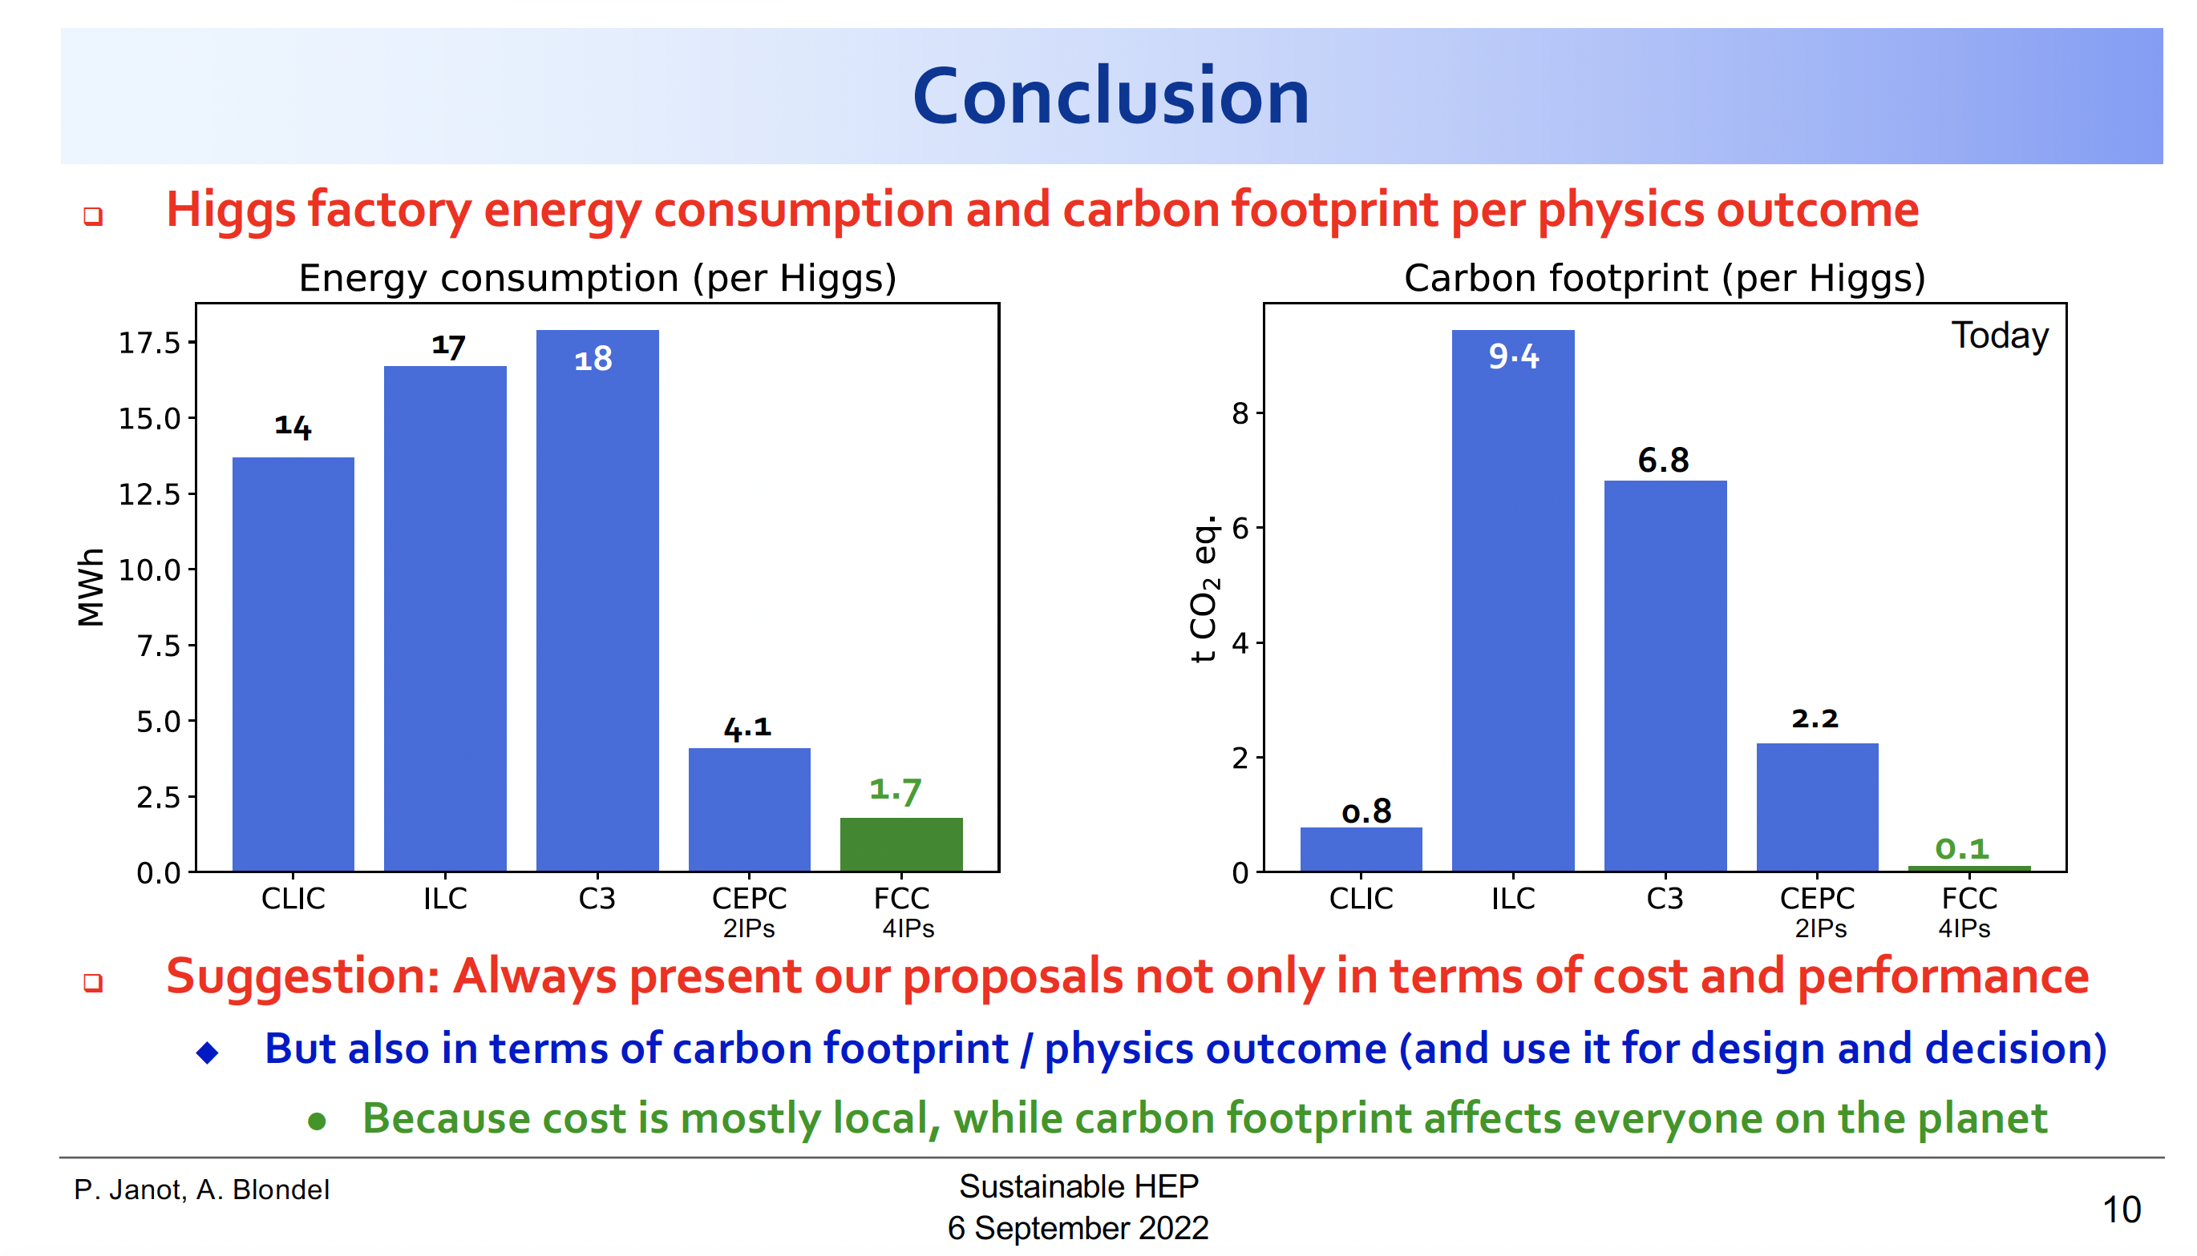
… their conclusion

Slide 4
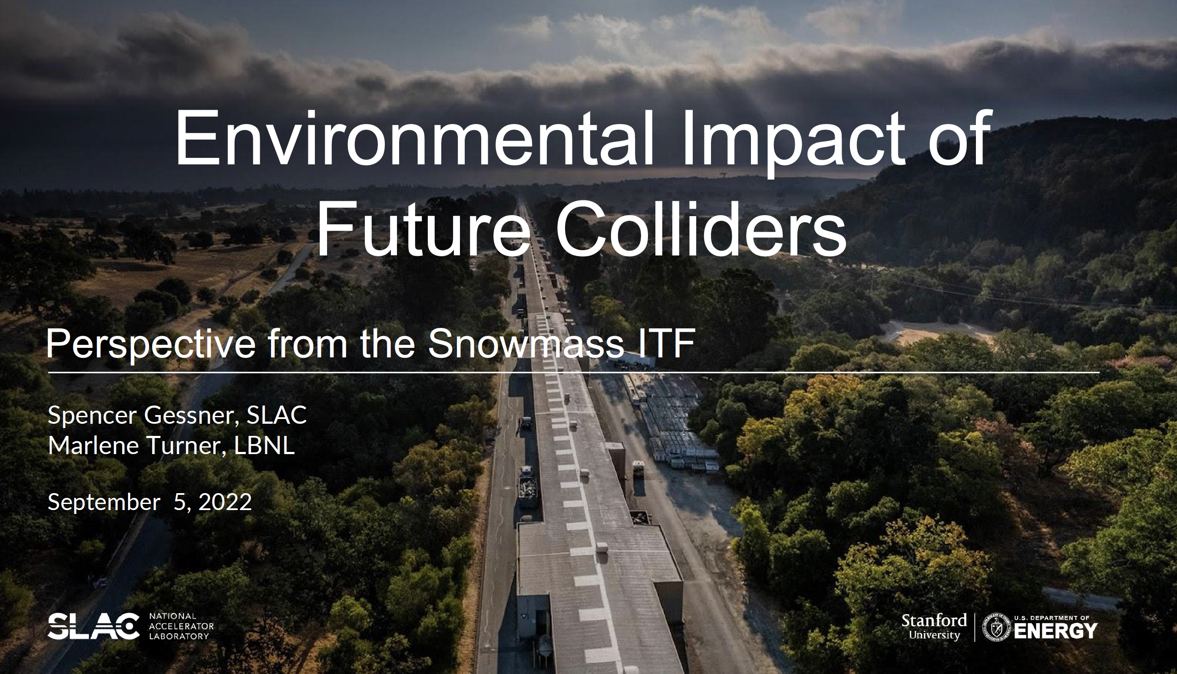
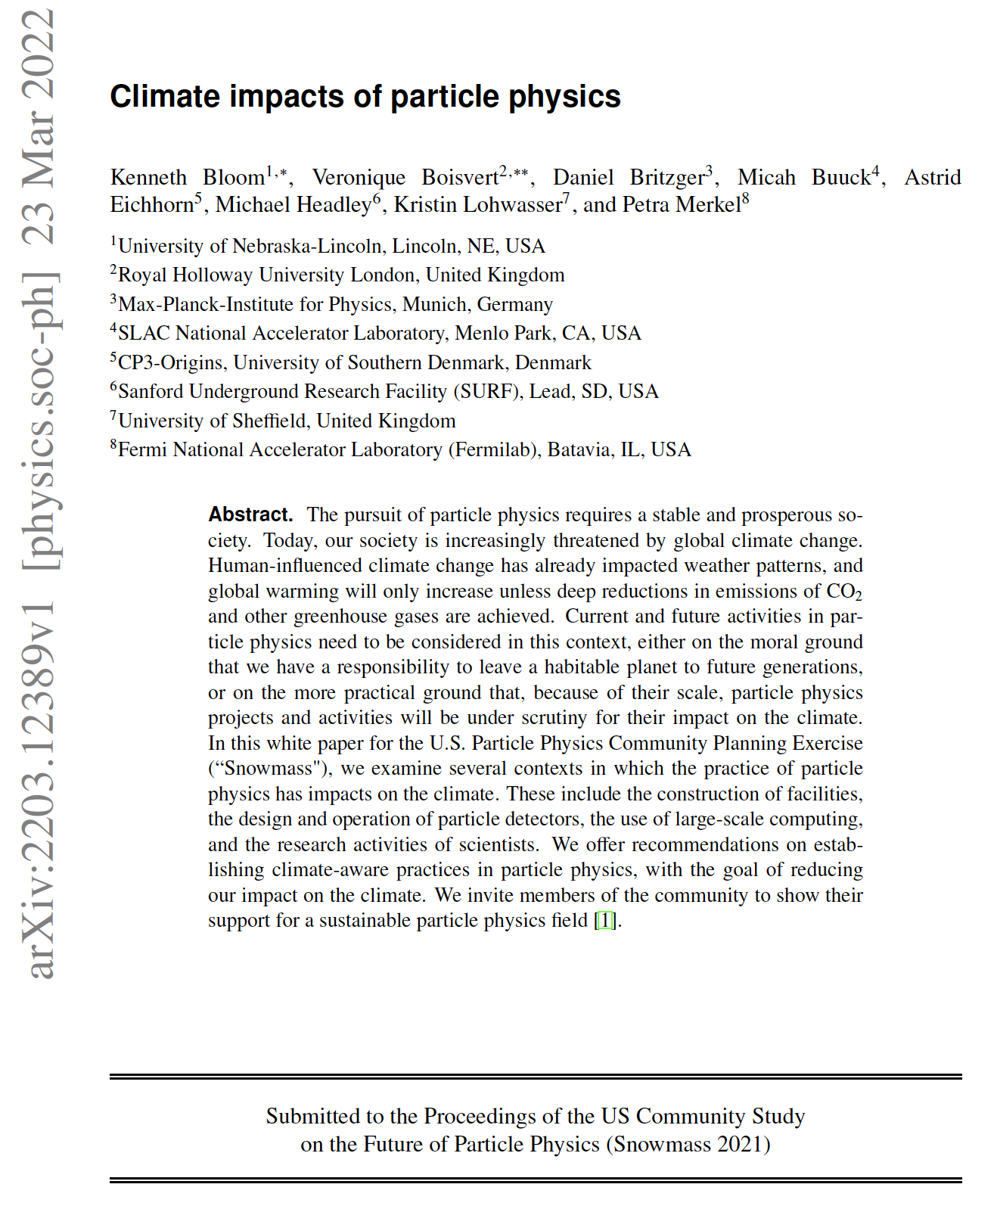
Starting Point: Snowmass Study
Presentation at Workshop
“Sustainable HEP - 2nd edition”
https://indico.cern.ch/event/1160140
https://indico.cern.ch/event/1160140/contributions/5014540

Slide 5
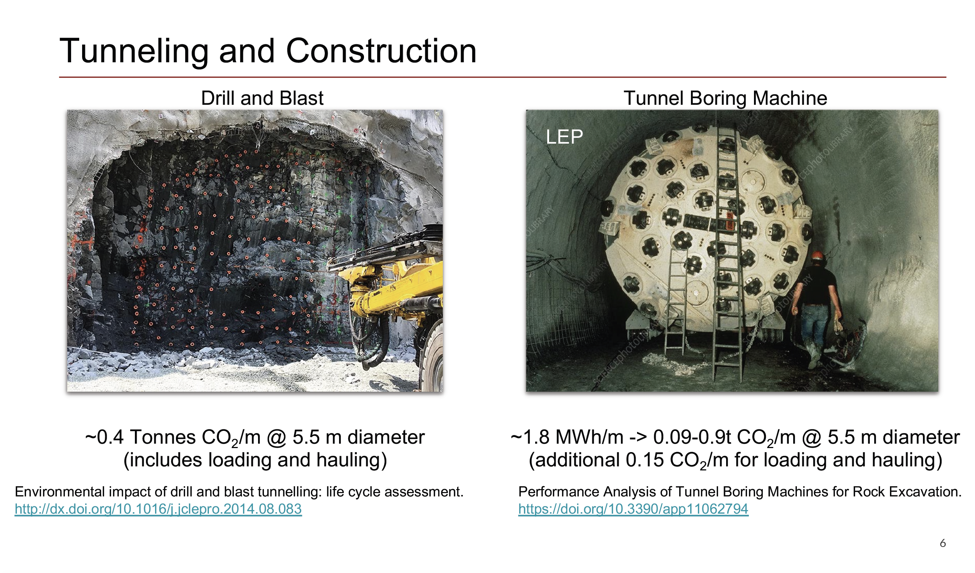
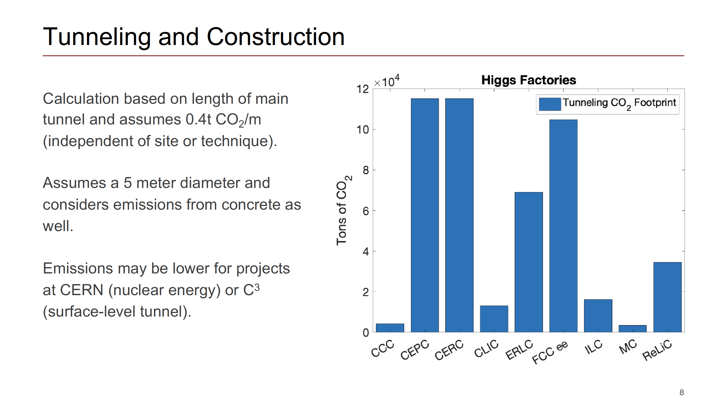
Snowmass Study: Tunneling

Slide 6
Proposal: A serious study of environmental impact of building civil infrastructure of new accelerator
Conduct a Life Cycle Assessment (LCA) that will evaluate the environmental impact of the construction of underground facilities
  tunnels, caverns and access shafts
  taking into account the present state of design and the specifics of the proposed location
  cover the construction period up to the point where the technical equipment (water and electrical supplies, heating and ventilation, lighting etc.) can be installed.
Impact categories:
Greenhouse gas emissions, quantified by the 100-year global warming potential (GWP100), measured in kg CO2-eq
Ecotoxicity (terrestrial and aquatic), quantified by Ecotoxicity Potential (ETP), measured kg 1,4
Acidification, quantified by Acidification Potential (AP), measured in kg SO2-eq
Eutrophication, quantified by Eutrophication Potential (EP), measured in kg PO4-eq (phosphate equivalent)
Ozone depletion, quantified by Ozone Depletion Potential (ODP), measured in kg CFC11-eq
Sommer smog, quantified by Photochemical Ozone Creation Potential (POCP), measured in kg C2H4-eq (ethene equivalent)
Particulate Matter emissions below 2.5µm (PM2.5)

Slide 7
Methodology
Start with paper by Rodríguz and Pérez [1]
extended to the use of Tunnel Boring Machines (TBM).
And extend to caverns and shafts!
Specific assumptions will need to be checked and possibly adapted to the situation and construction codes in the Geneva or Japan regions.
To formulate the estimate, the current civil engineering proposals shall be provided by the respective design teams, with a list of tunnel segments (portions of tunnels with roughly uniform cross section and geological conditions) giving length, cross section dimensions, planned lining, excavation method, access routes etc., and appropriate figures for underground caverns and access shafts.
[1] R. Rodriguez and F. Pérez: Carbon footprint evaluation in tunneling construction using conventional methods,
Tunn. Undergr. Space Tech. 108 (2021) 103704. doi:10.1016/j.tust.2020.103704

Slide 8
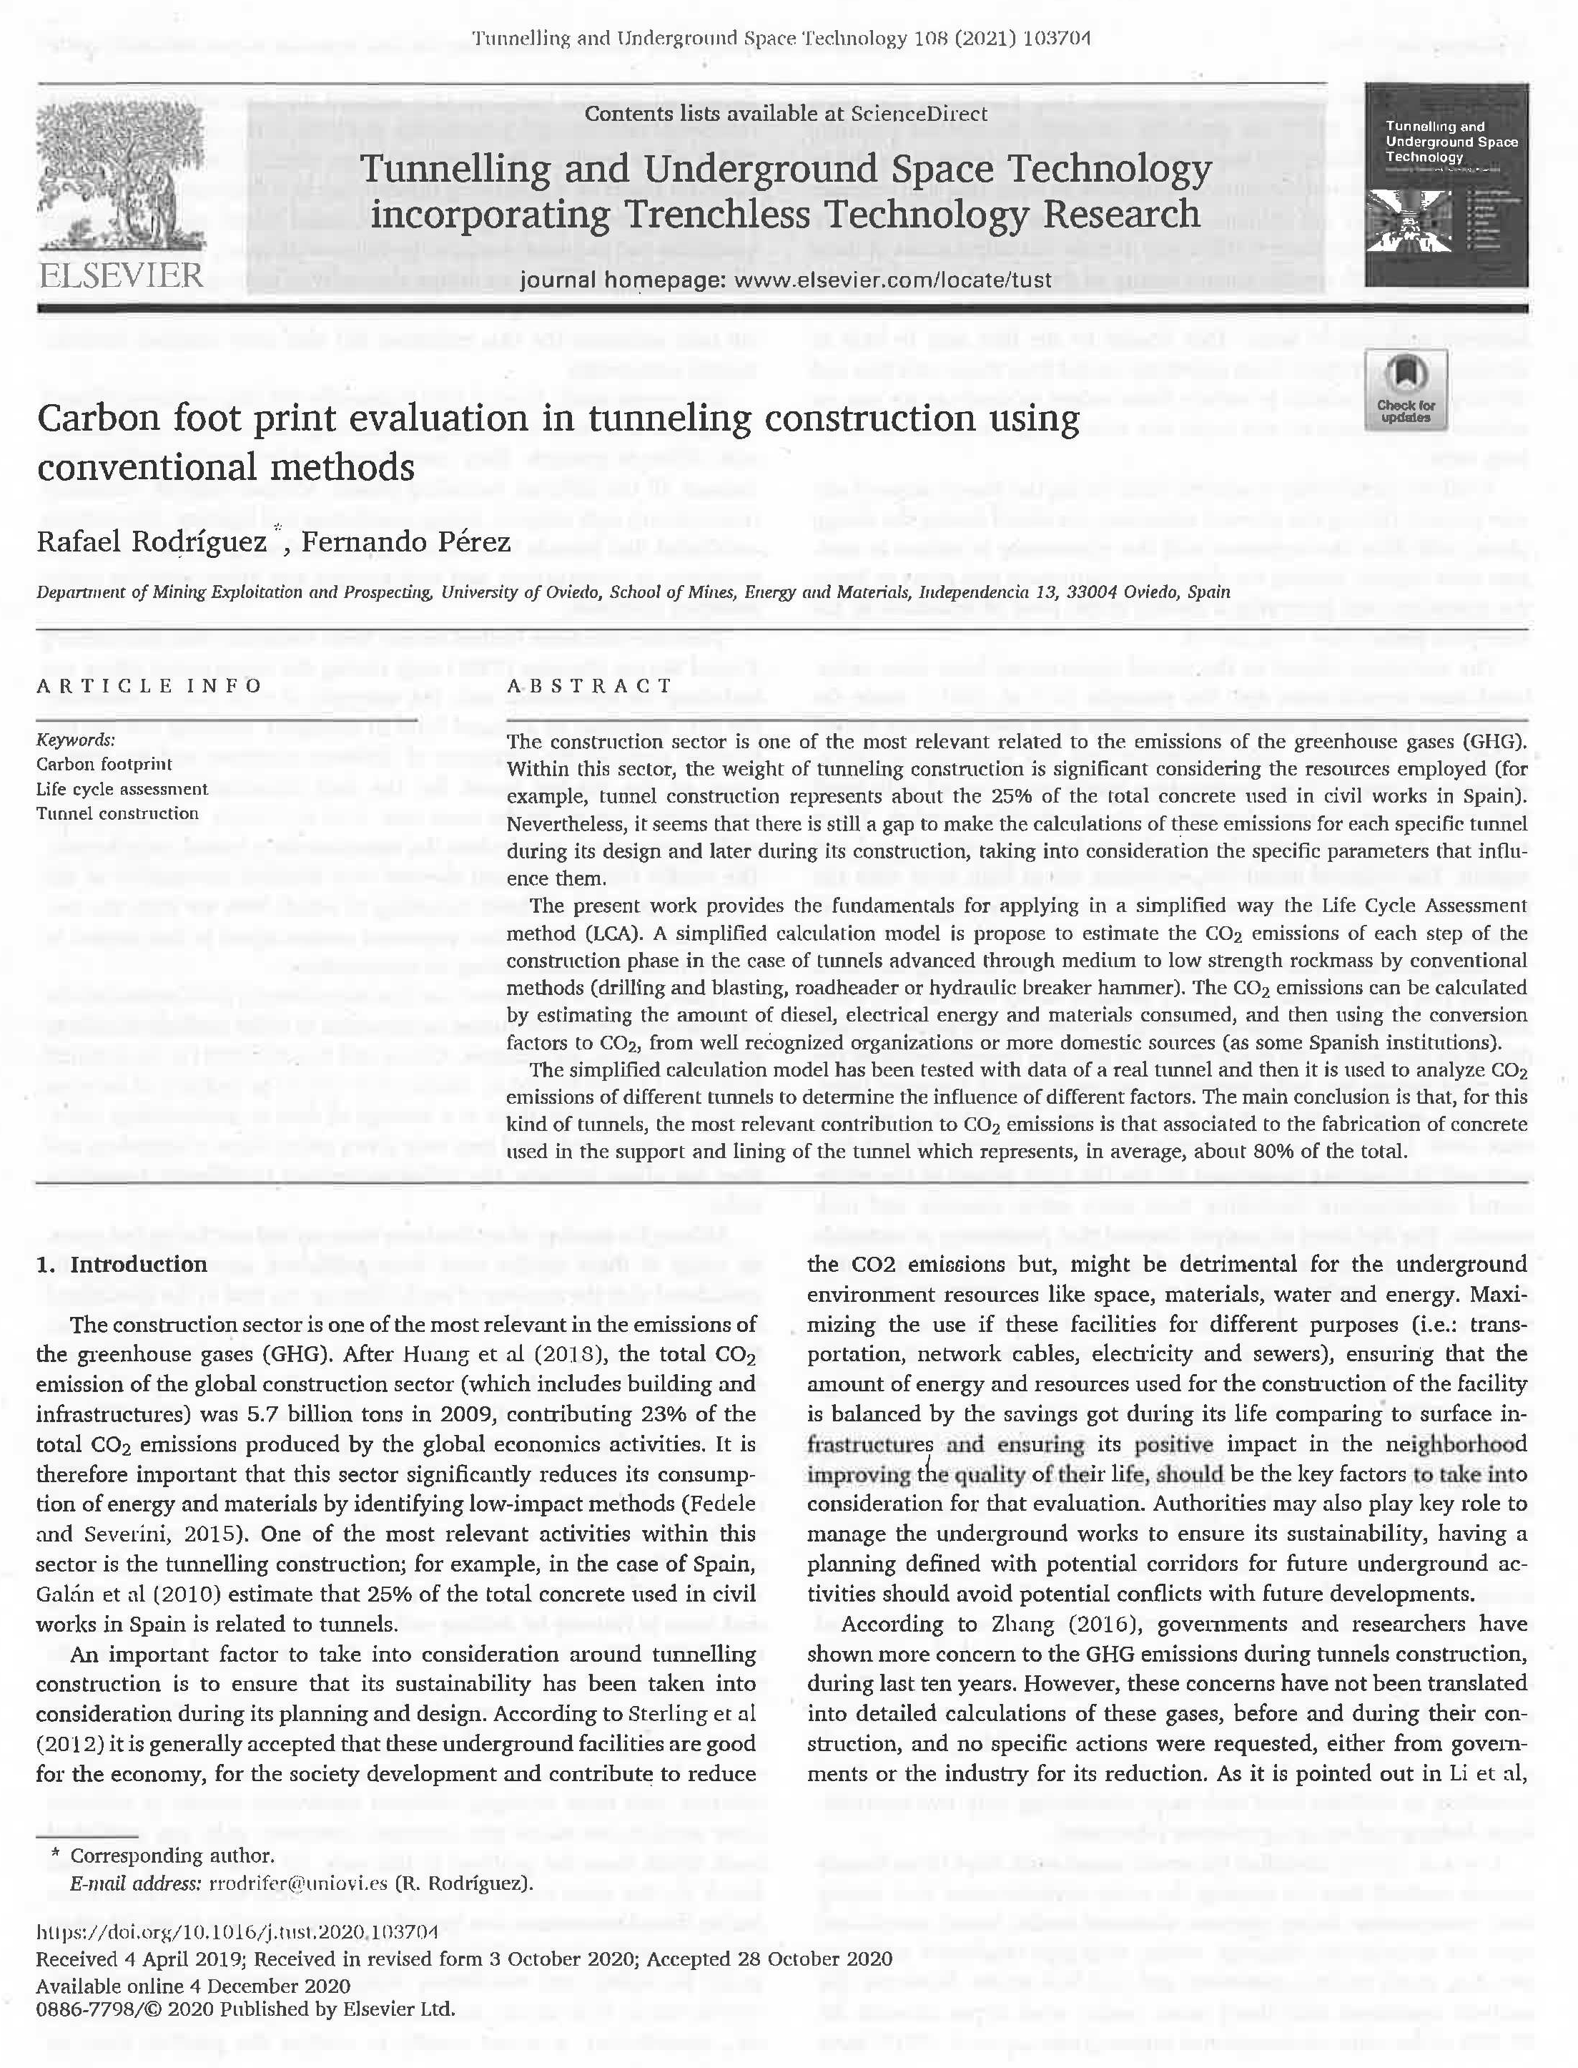
Carbon Foot Print for D&B Tunneling
Study made for drill&blast or Roadheader tunnels in Spain
Considers CO2 emissions from
  Excavation (”Jumbo” operation needs diesel fuel and electricity, Roadheader needs electricity)
  Mucking and waste transport: diesel fuel (grows quadratically with segment length)
  Heating and ventilation (electricity)
  Indirect emissions from materials: Concrete (cement) and steel
Main result: steel and cement are dominant factors (~90%)

Slide 9
Deliverables and Schedule
Deliverables
The results of the LCA shall be delivered in a technical report, including all relevant assumptions, calculations, results, and appendices. An interim note/report will be required by the end of 2022 to evaluate progress.
Programme
4 to 5 online progress meetings with CERN during the study period.
Face to face meeting to present study findings during Linear Collider workshop at SLAC, San Francisco.
Interim technical note/report by the end of 2022 to evaluate progress.
Final technical report by end of March 2023.
Thanks to Liam Bromiley

Slide 10
Scope?
CLIC at CERN
ILC in Kitakami
Include FCC or apply methodology later?
For comparison: ILC in European design (one tunnel, no shield wall, TBM)
-> separate
  impact of accelerator design differences between ILC and CLIC (ML length, drive beam complex, damping rings)
  from site specific impacts (Geology, tunnelling method)

Slide 11
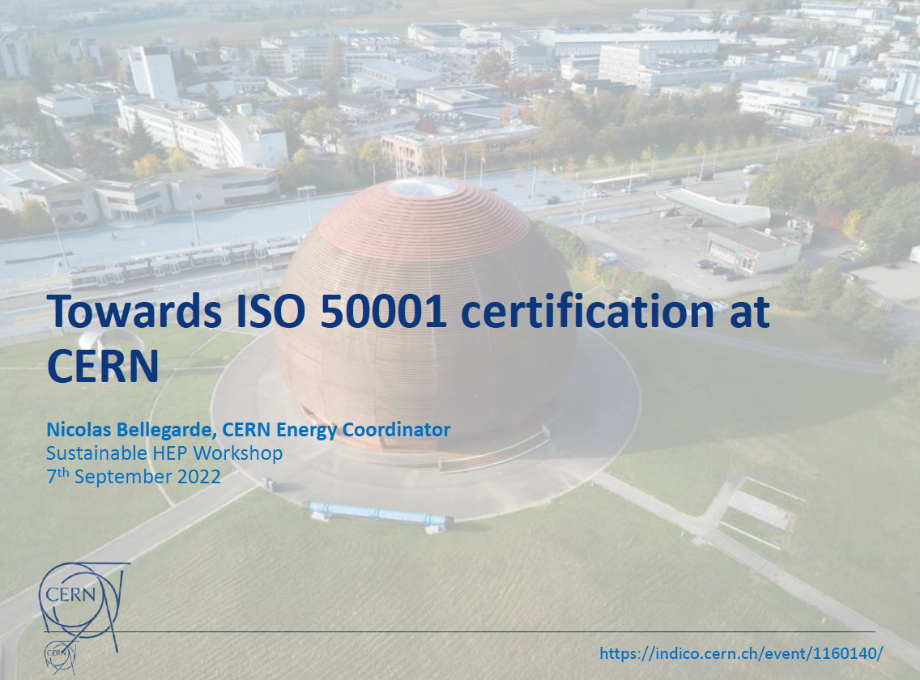

Presentations on “Sustainable HEP – 2nd edition”
https://indico.cern.ch/event/1160140/
Ayan Paul
https://indico.cern.ch/event/1160140/contributions/5031660/
https://indico.cern.ch/event/1160140/contributions/5008180/

Slide 12
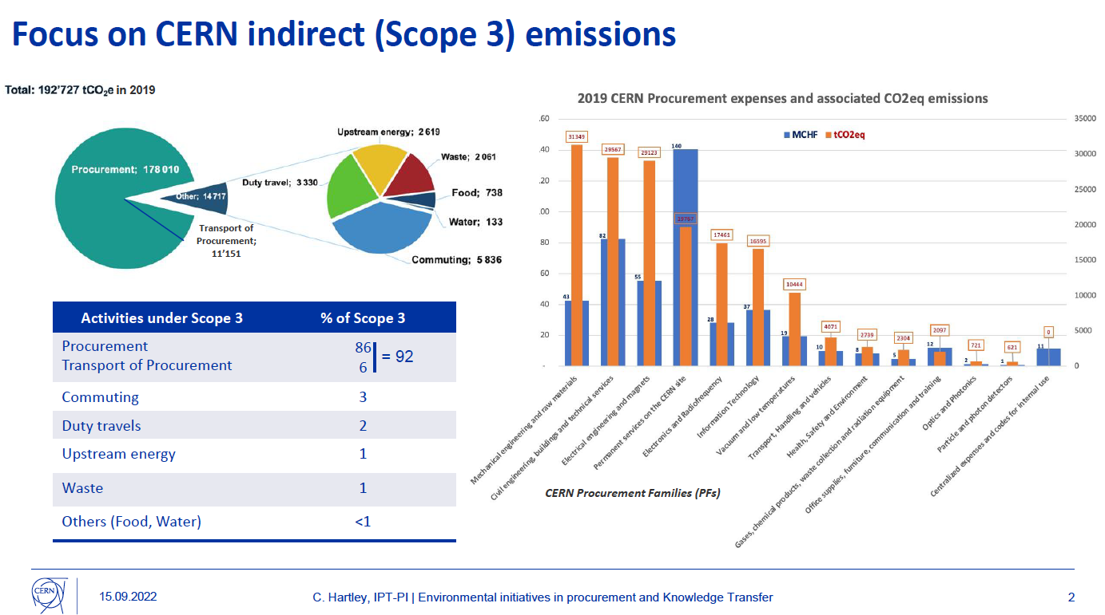
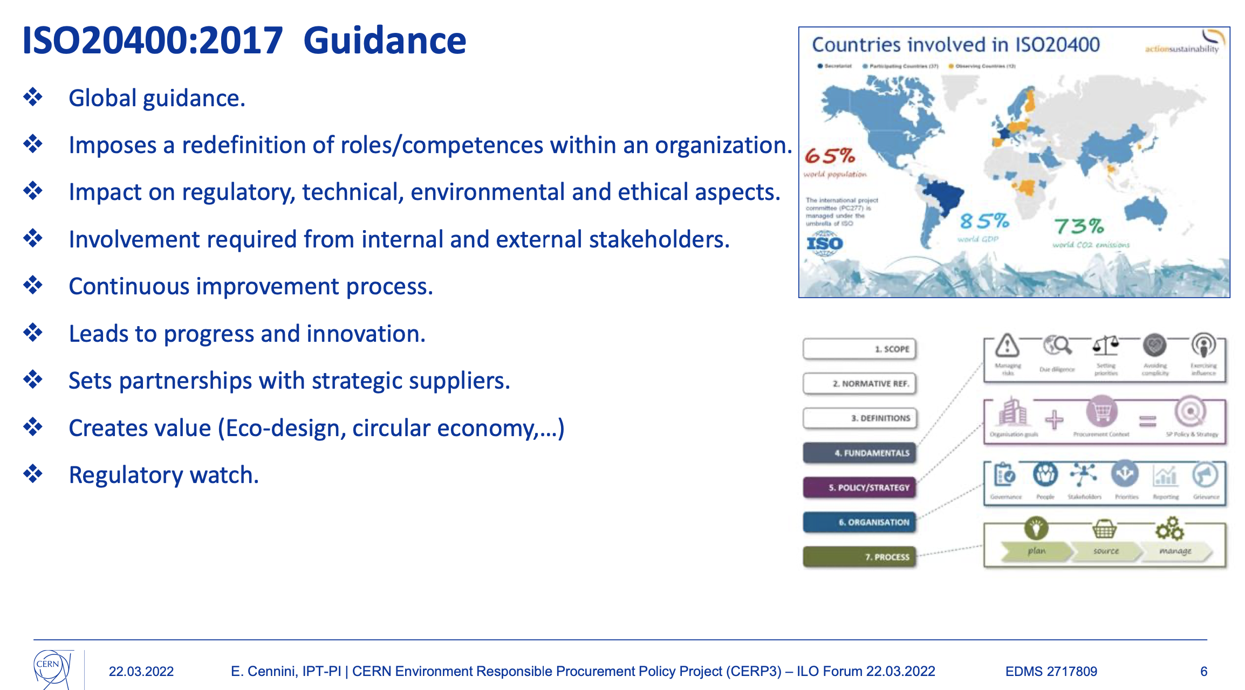
CERN: Procurement Policy
https://indico.cern.ch/event/1166618/contributions/4899637/
https://indico.cern.ch/event/1135394/contributions/4763978/

