Slide 1
31st Meeting of SRF Group in IDT/WG2
Summary report of SRF session at Snowmass2022 (S. Belomestnykh)
Meeting schedule and recent progress (Kirk)
Others (if any)
Attendees: K. Umemori, S. Belomestnykh, E. Cenni, R.Geng, R. Ruber, D. Delikaris, S. Stapnes, Kirk
https://agenda.linearcollider.org/category/256/
Kirk

Slide 2
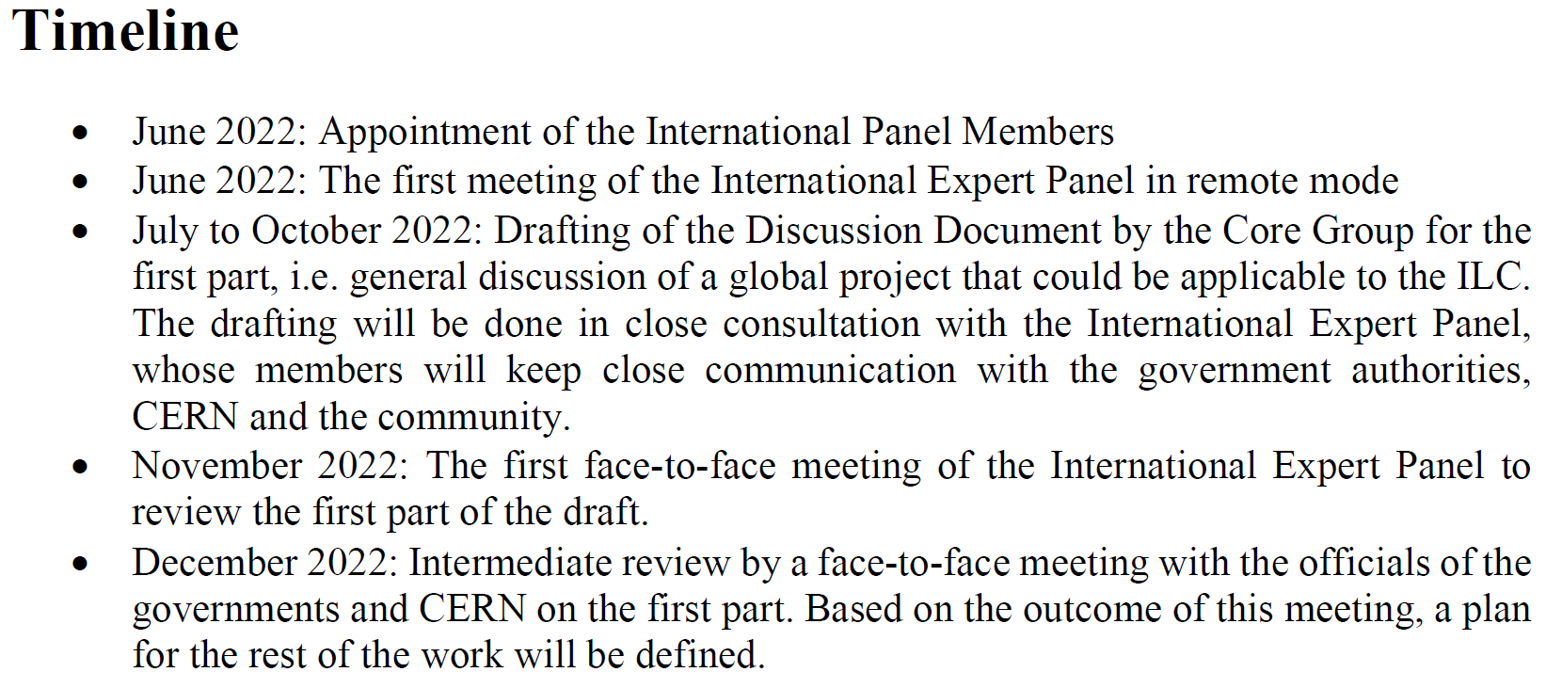
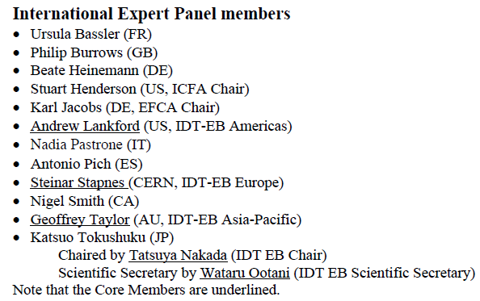
Meeting schedule and recent progress
Meeting # | Date | Contents
 | 11/Jul | Foundation of international expert panel (ICFA endorsed)
 | 31/Aug | Budget plan of FY2023 was submitted from MEXT to MOF at Japan (reported by Iwate-Nippou (local newspaper at Iwate-ken prefecture))
31 | 13/Sep | Summary report at Snowmass2022
 | 11~14/Oct | TTC Meeting 2022 @Aomori
 | 21, 24, 25/Oct | Crab Cavity Design Review #3 (the date is under discussion)
 | End of Dec | Budget plan will be fixed
 | Early 2023 | LCWS2023 @SLAC (Nakada-san already announced)

