Slide 1
Sources Subgroup Summary
IDT-WG2, Sep.20. 2022, K. Yokoya
Sep.12 31st Regular meeting
  Masao Kuriki, Kaoru Yokoya, Gudi Moortgat, Sabine Riemann, Gregor Loisch, Tsunehiko Omori, Steffen Doebert, Andrew Lankford
  Indico https://agenda.linearcollider.org/event/9813/
Talks
  “Status of undulator-related R&D topics”
    Gudi Moortgat
    Uploaded as undulator-RD-922.pdf
    Summary of the progresses in the undulator scheme
  “Tapered pulsed solenoid as optical matching device for the undulator-based ILC positron source – update”
    Gregor Loisch
    Uploaded as 220912_ILC_Sources_Solenoid_Mk2.pdf
    Recent progress on the pulsed solenoid

Slide 2
Status of undulator-related R&D topics (Gudi)
Ongoing work:
  Undulator Simulations
    Field & alignment errors, undulator wall heating, finalize undulator line
    Alharbi, thesis April 2023
  Target Material Analyses
    Mainz Microtron,
    Comparison of radiated vs heat loaded targets
    Targets under high temperator within dilatometer, fast and cyclic stress , etc
  Rotating Wheel Design
    New shape to minimize the max stress, use pulsed beam, 31 slices,
    Examine variations in target thickness, rotation velocity,…
    Highest stress at the free edge, but still acceptable
  Plasma Lense
    design finalization for small prototype

Slide 3
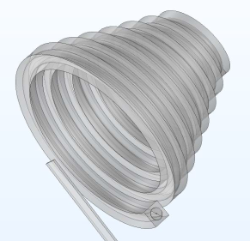
Tapered pulsed solenoid – update (Gregor)
Summary
  Simulations now moving to answering mechanical design questions
    Coil shape refinement (helical, tapered coil)
    → Optimise input/connection for symmetric field
    → Iteration w/ yield simulations
    Soon able to finalise coil design
  Possible collaboration with HZDR (Hermholtz Zentrum Dresden Rossendorf)
    laser-ion acceleration at HZDR
    Using pulsed solenoids to capture accelerated ions
    Could use ~ms/~20kA pulser for prototype tests
    Could maybe manufacture prototype coil

