Slide 1

  ESSRI Impressions
  Benno List, DESY and CERN
  IDT WG2 Meeting
  4.10.2022

Slide 2
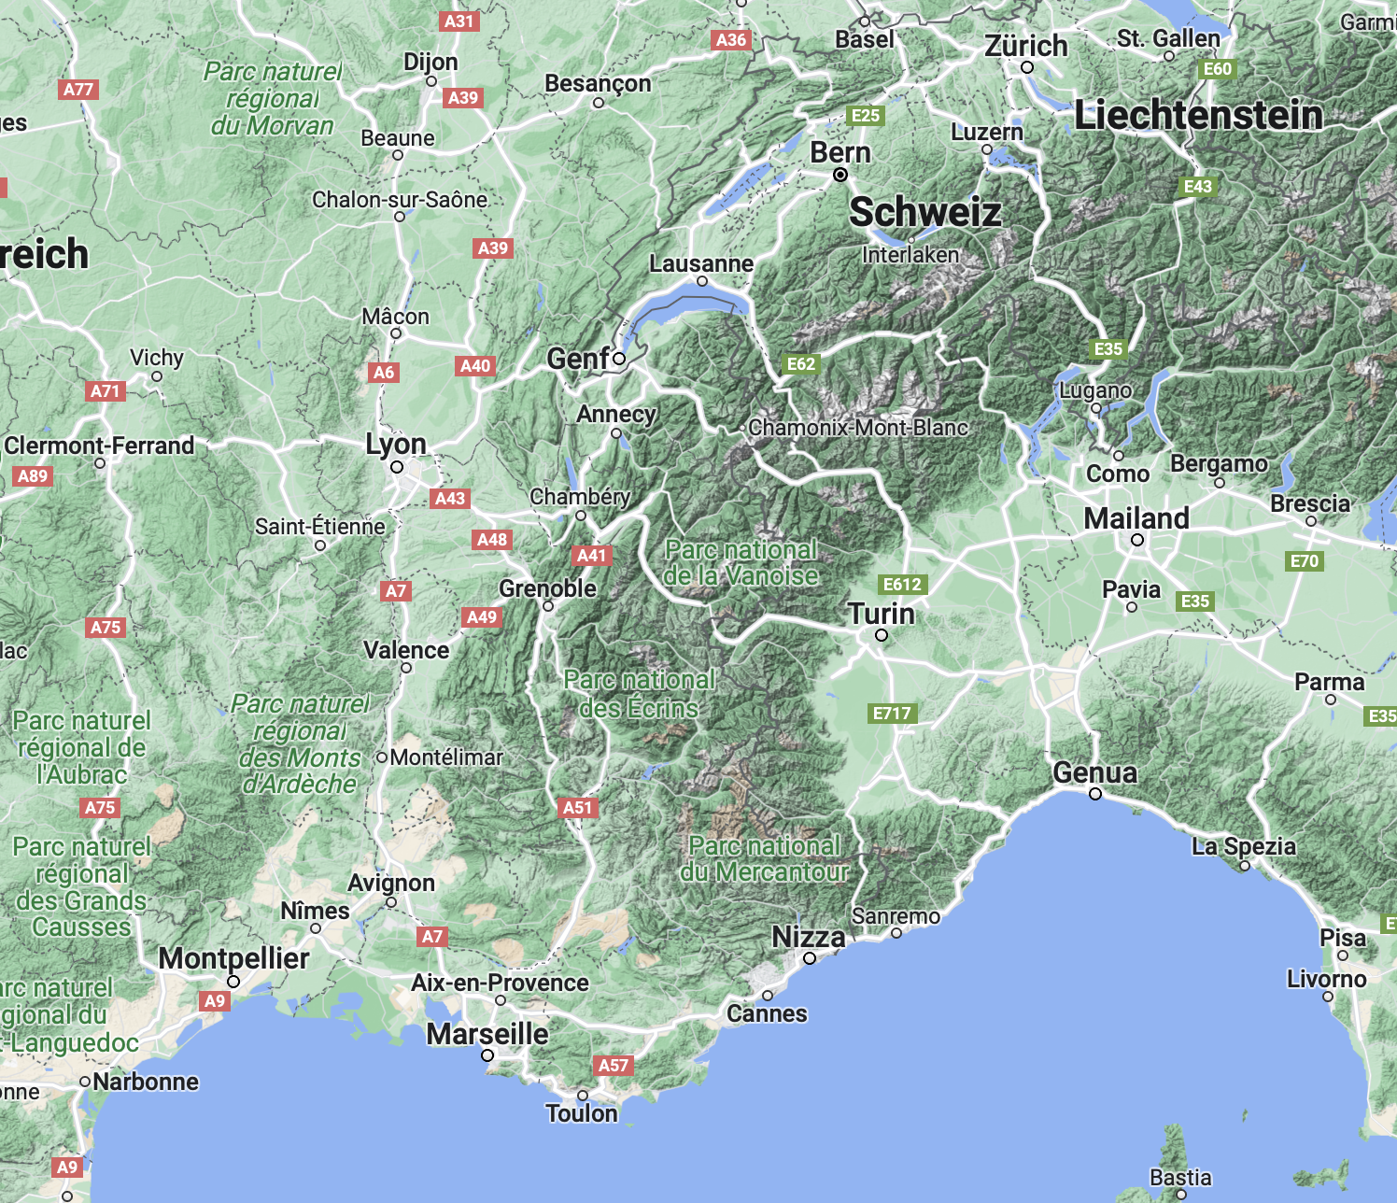
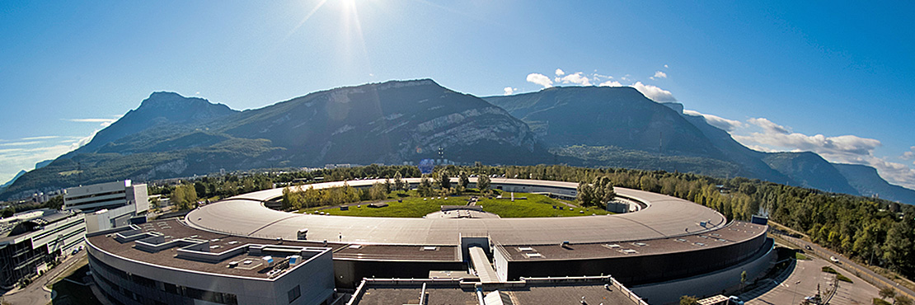
Venue
European Synchrotron Radiation Facility ESRF, Grenoble
https://www.sbfi.admin.ch/sbfi/fr/home/recherche-et-innovation/cooperation-internationale-r-et-i/organisations-internationales-de-recherche/
esrf/_jcr_content/par/image/image.imagespooler.jpg/1474613374641/esrf.jpg

Slide 3
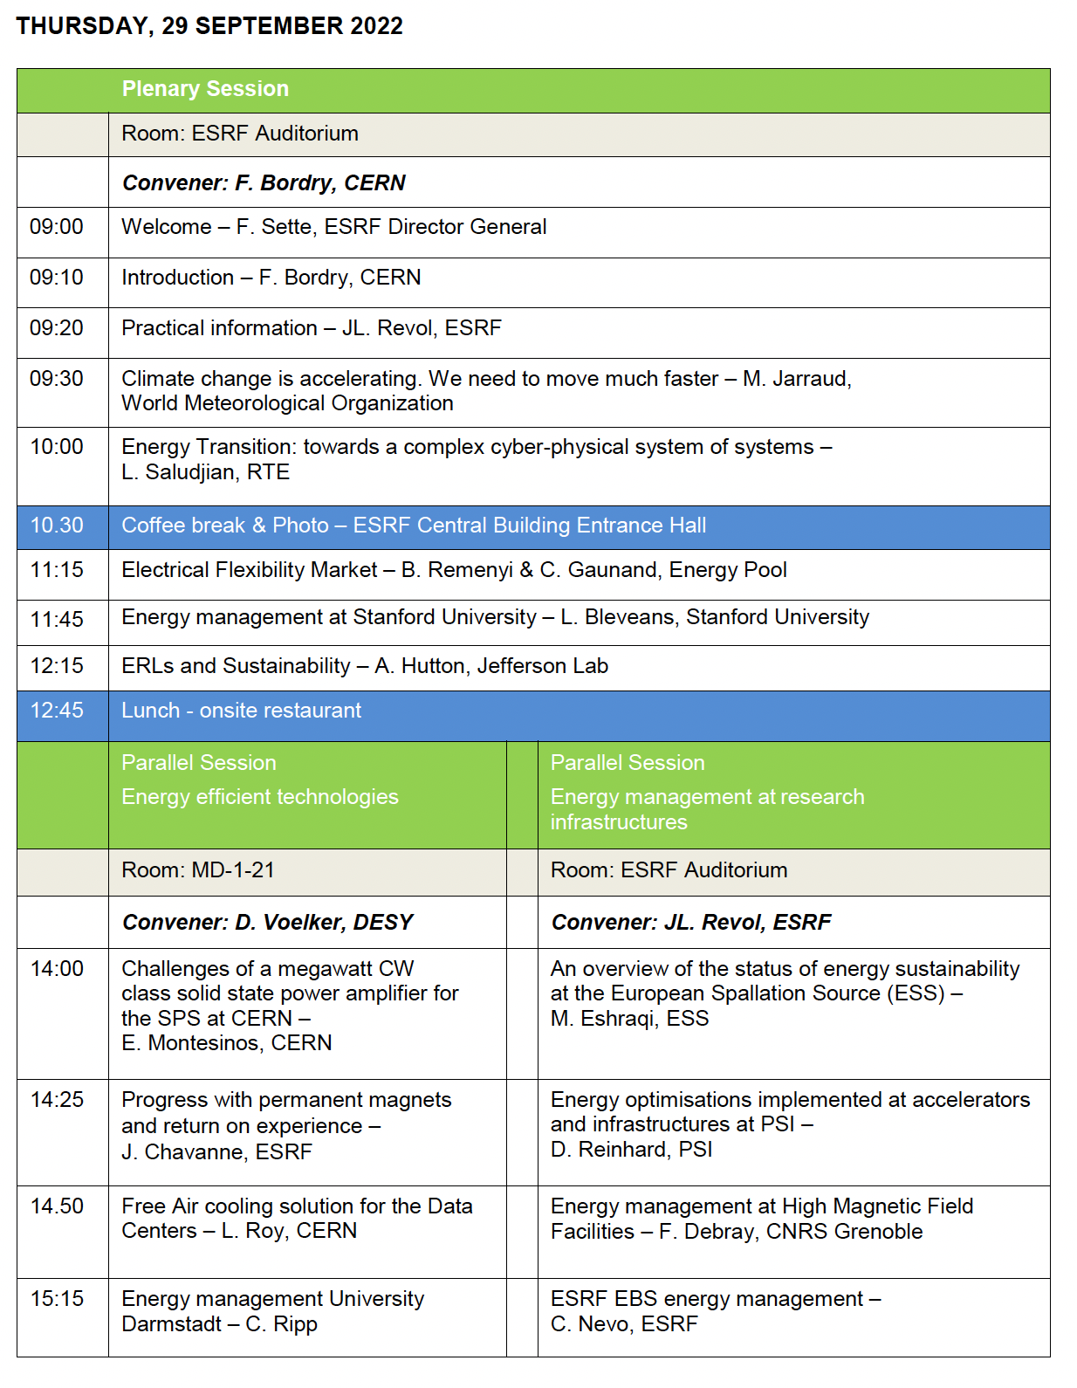
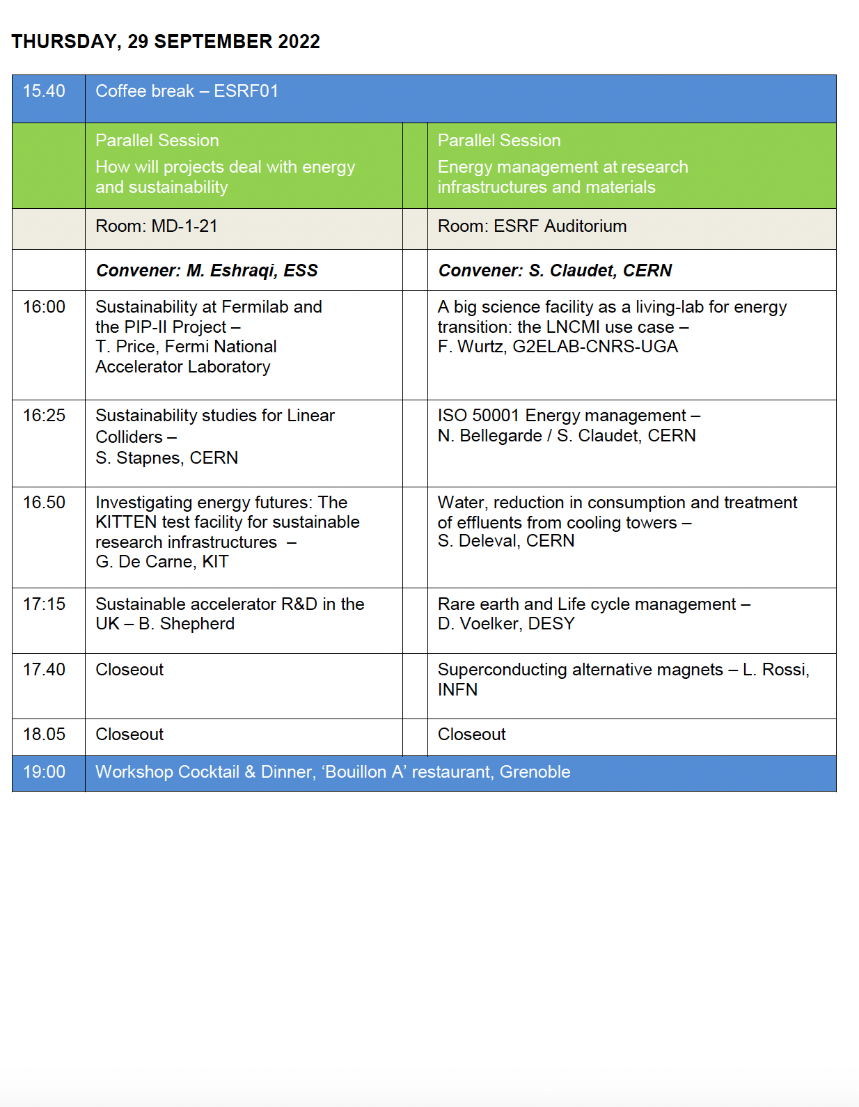
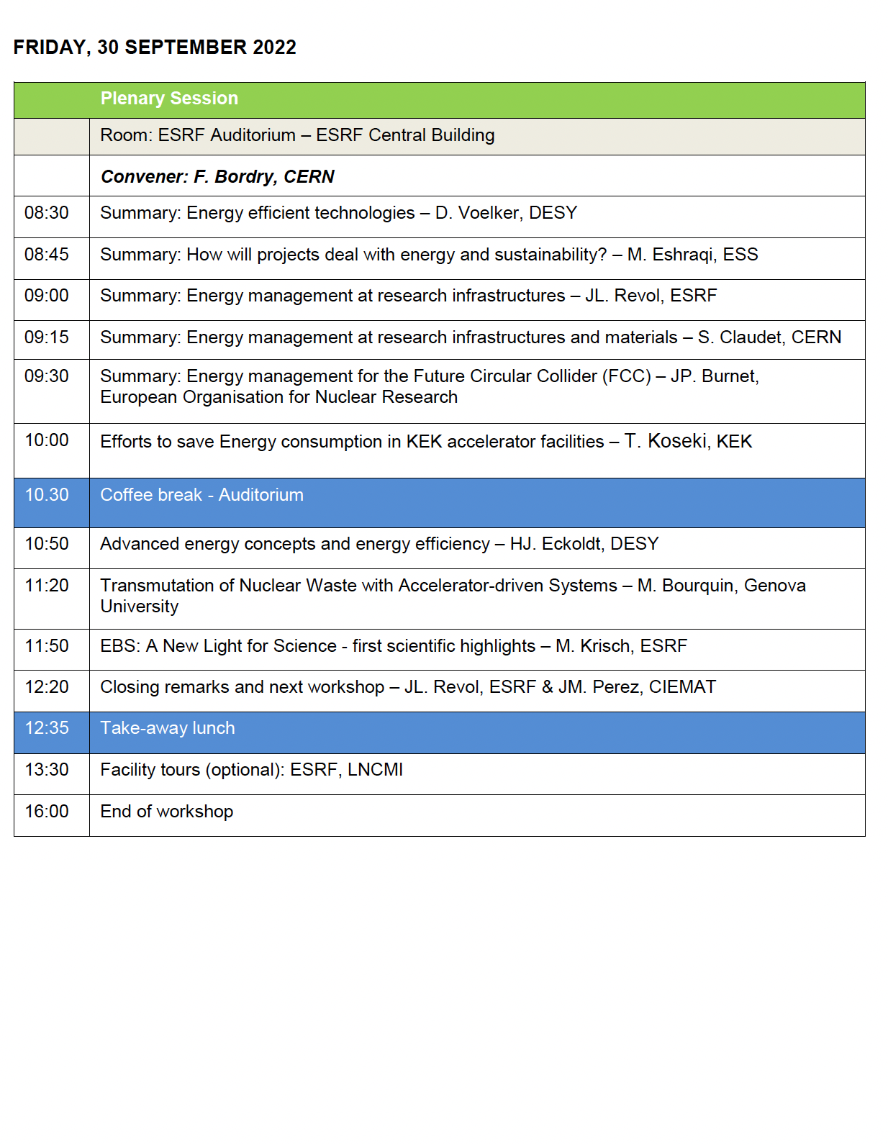
Agenda
6th workshop of the series
101 participants

Slide 4

Highlights
Lots of facts and figures
Look at the slides!
https://indico.esrf.fr/event/2/contributions/92/

Slide 5
Public Electricity Power and Grid Stability

Slide 6
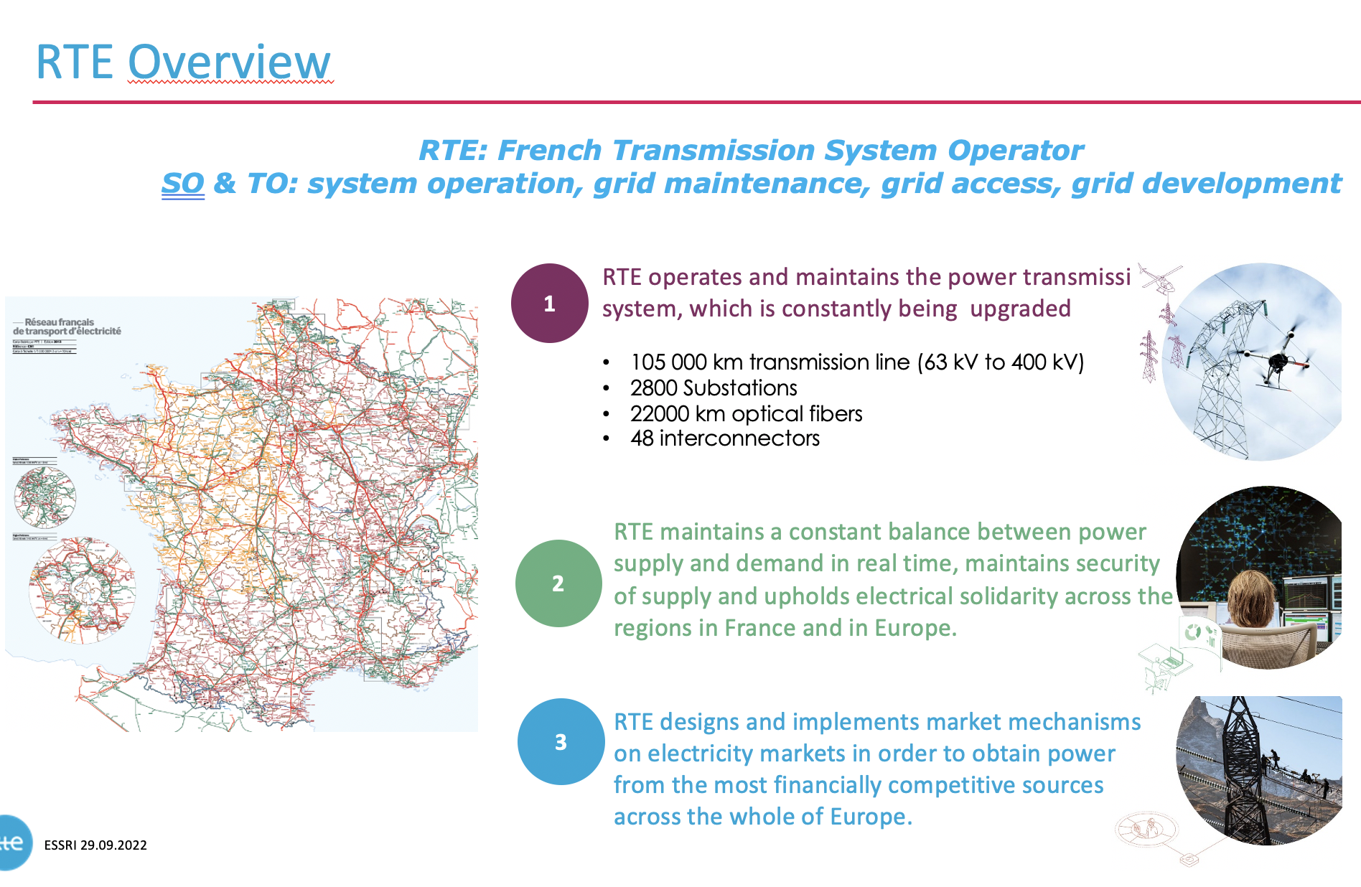
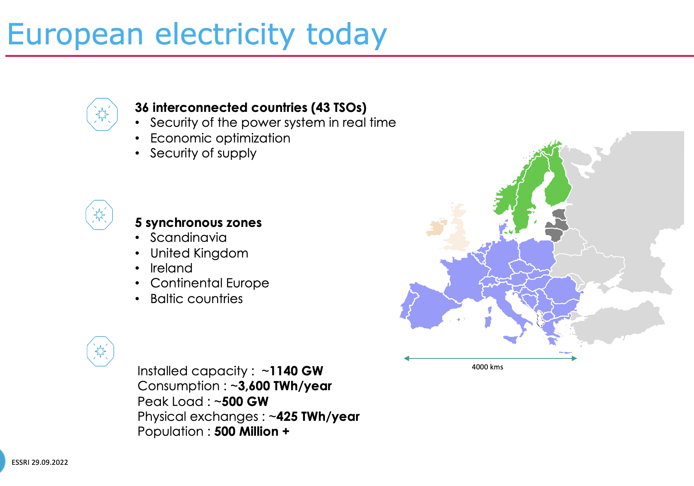
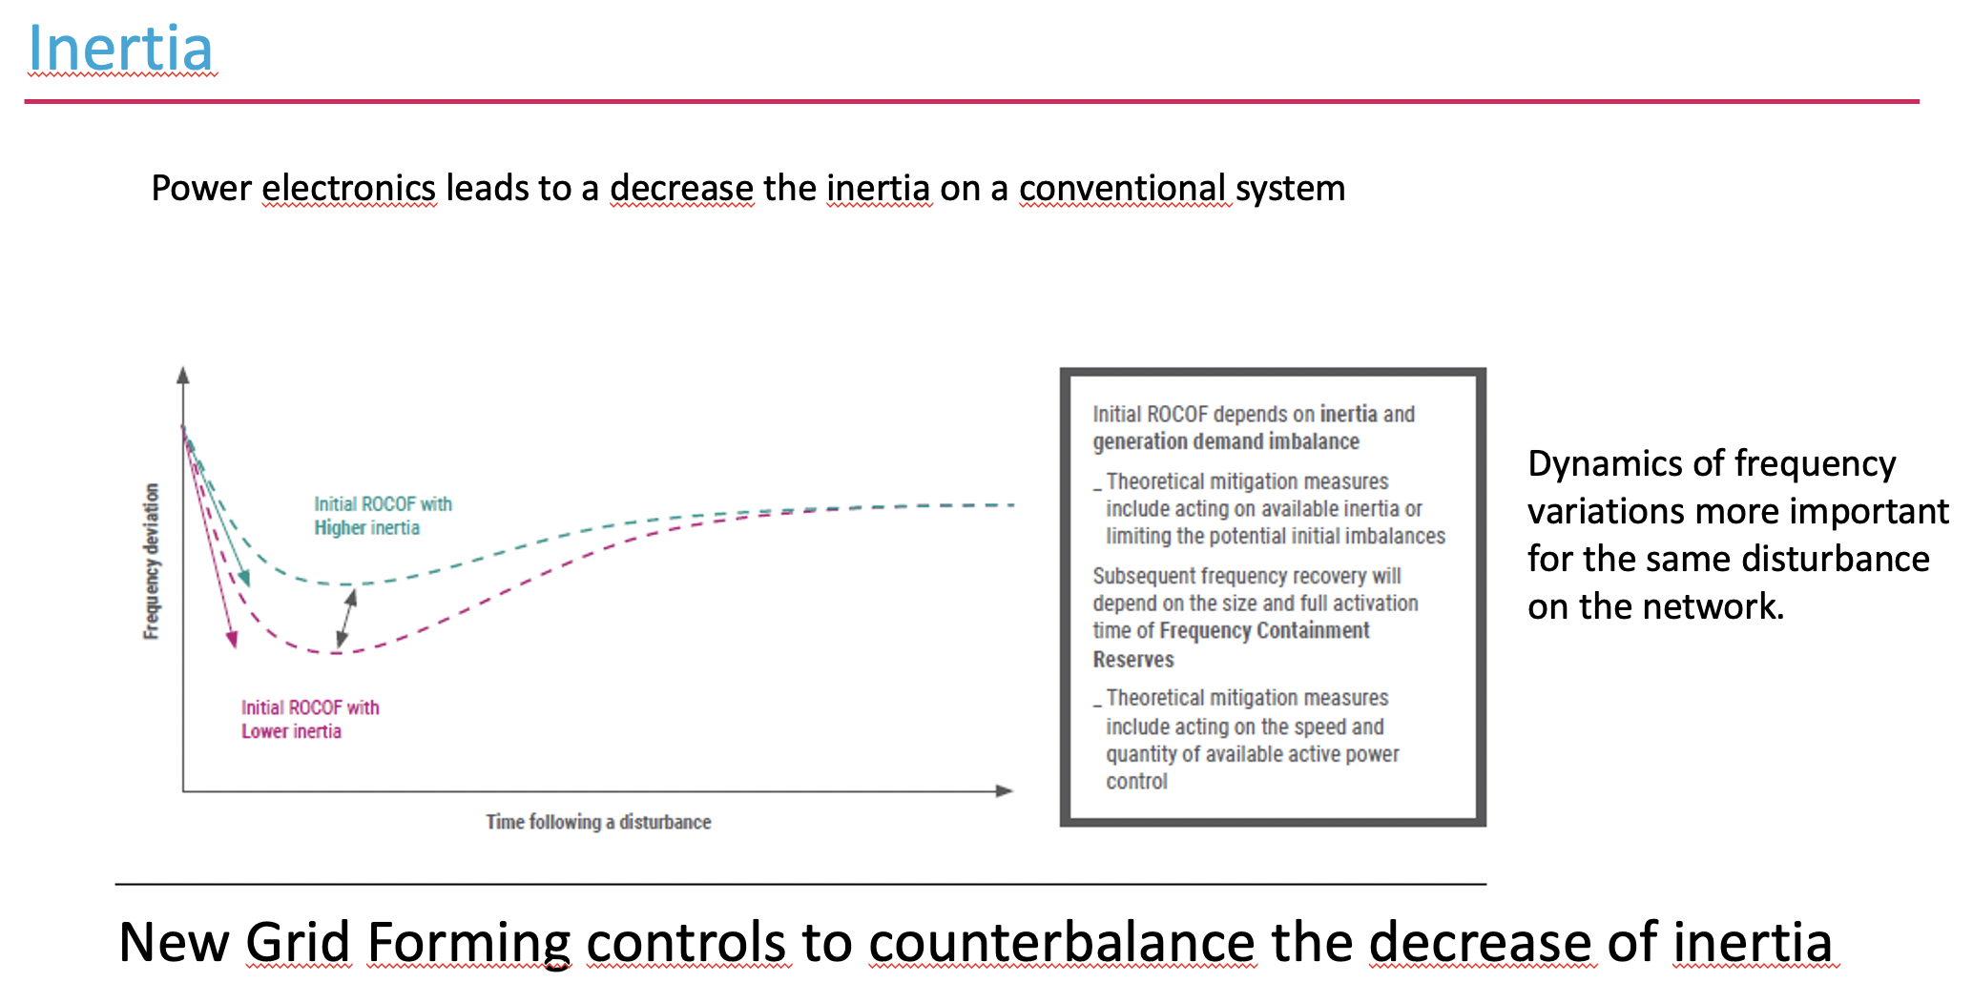
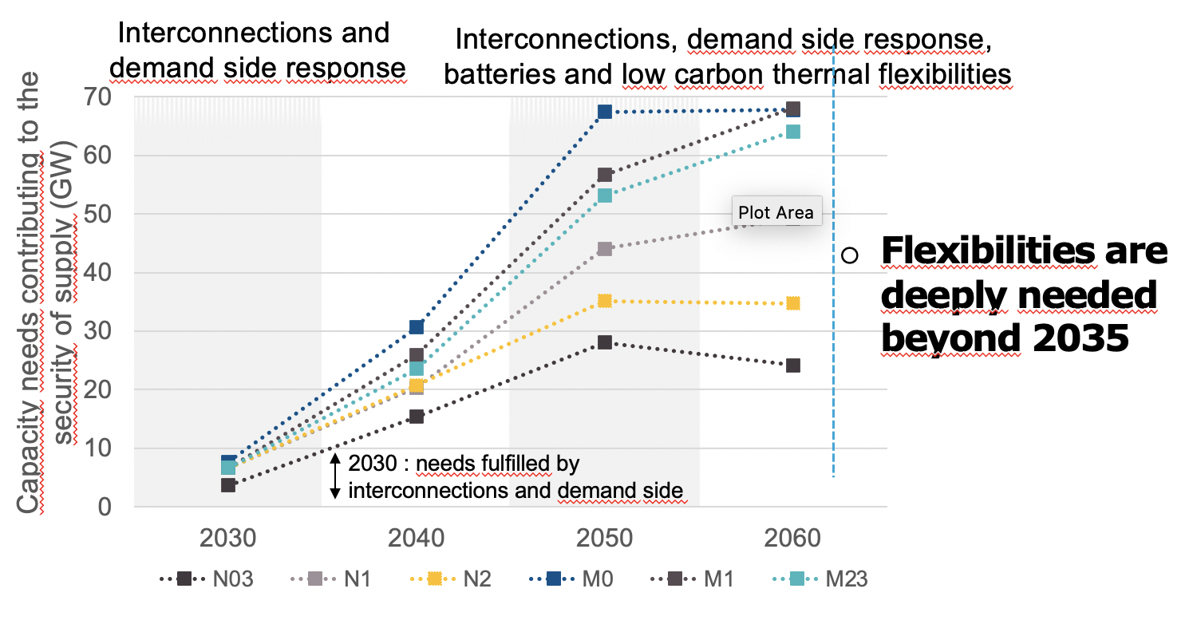
L. Saludjian:
(R)evolution of the electrical system and its challenges
https://indico.esrf.fr/event/2/contributions/93/

Slide 7
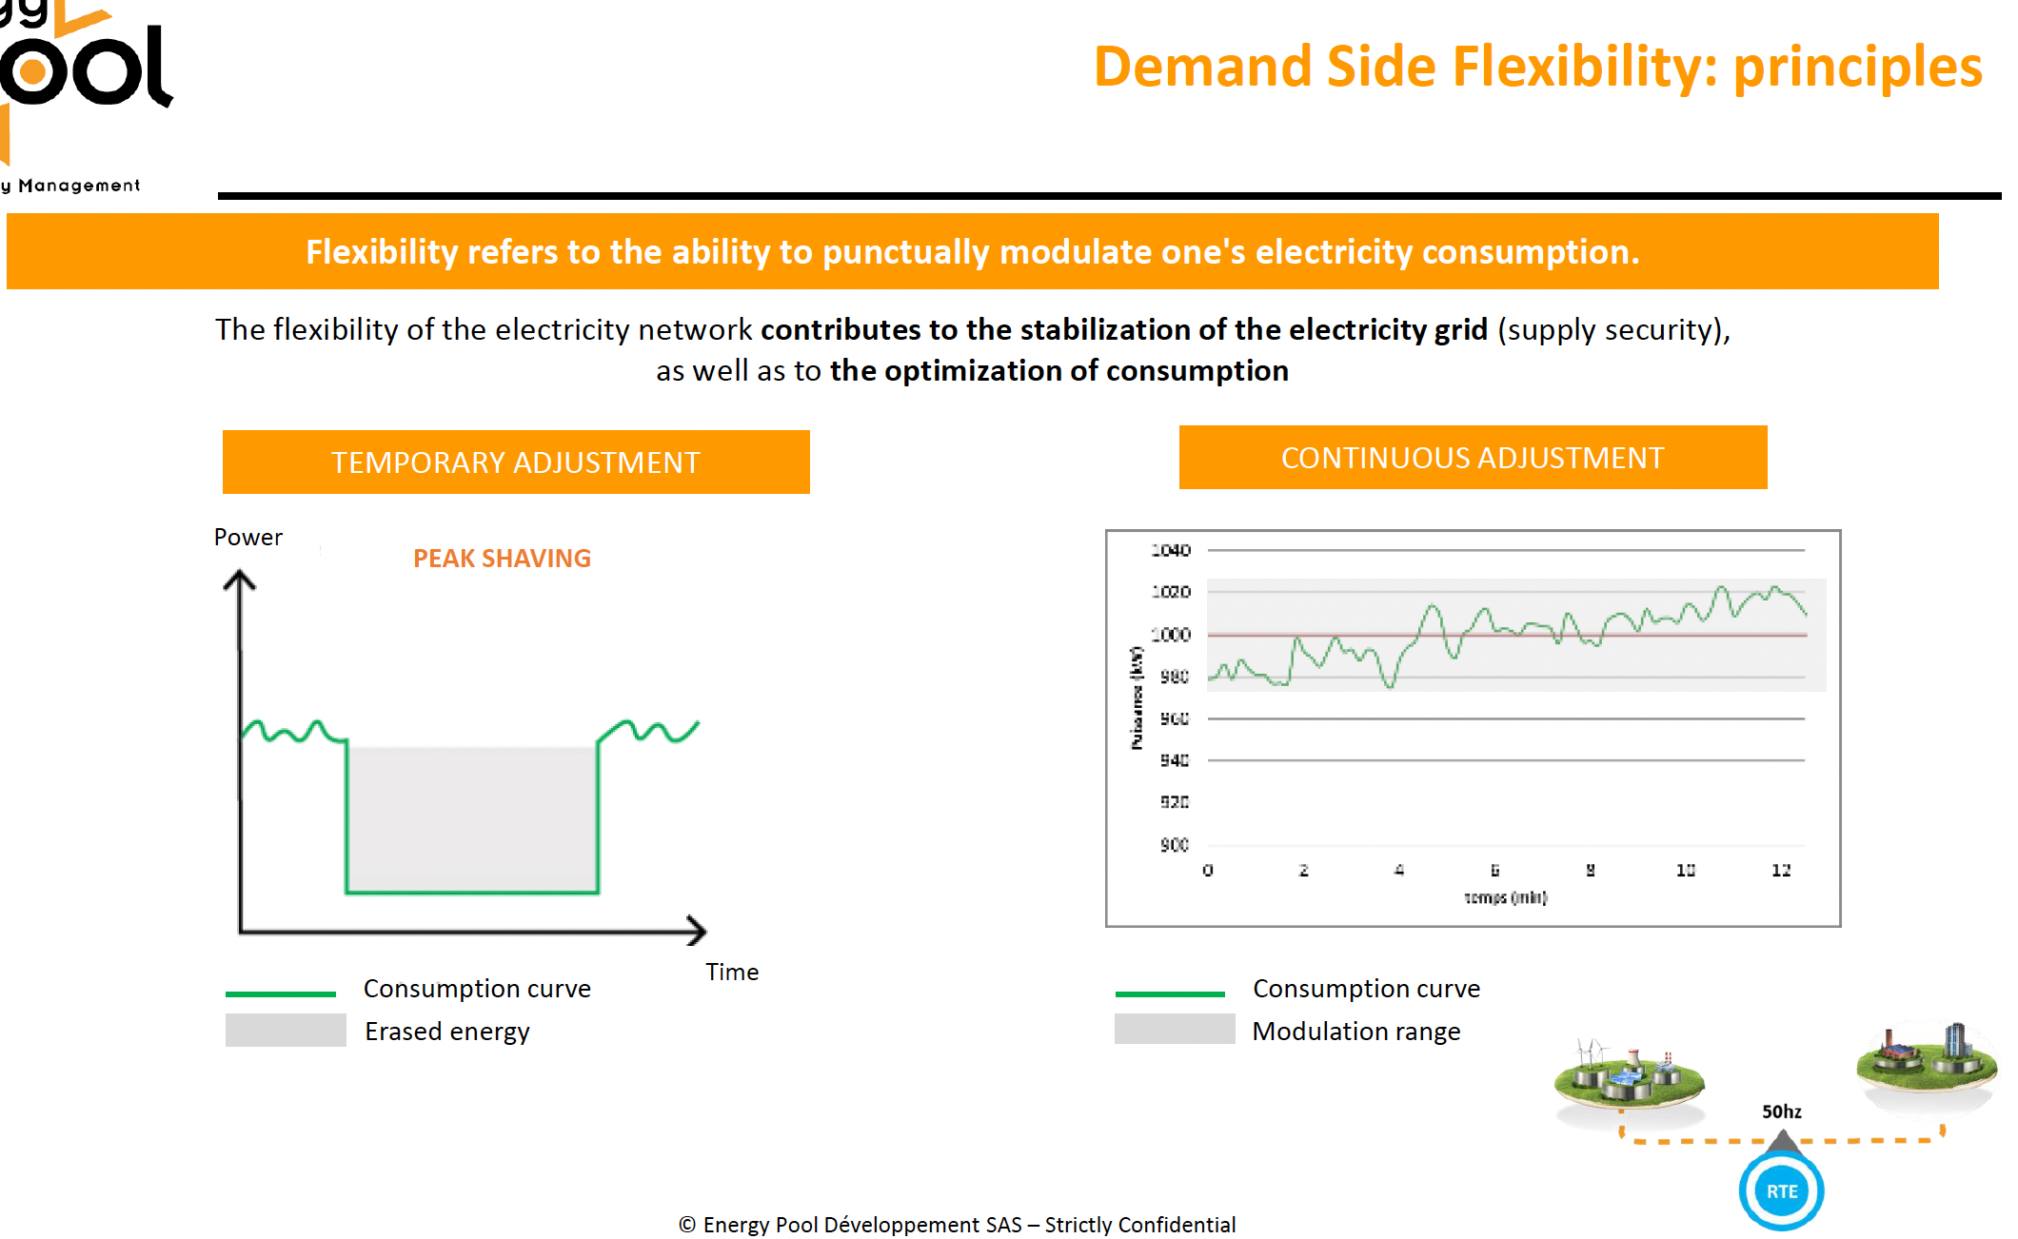
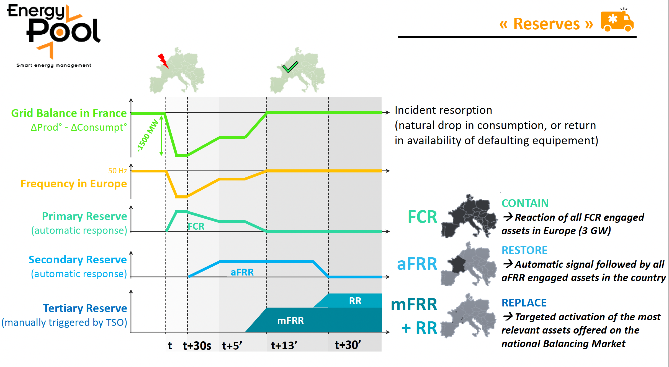
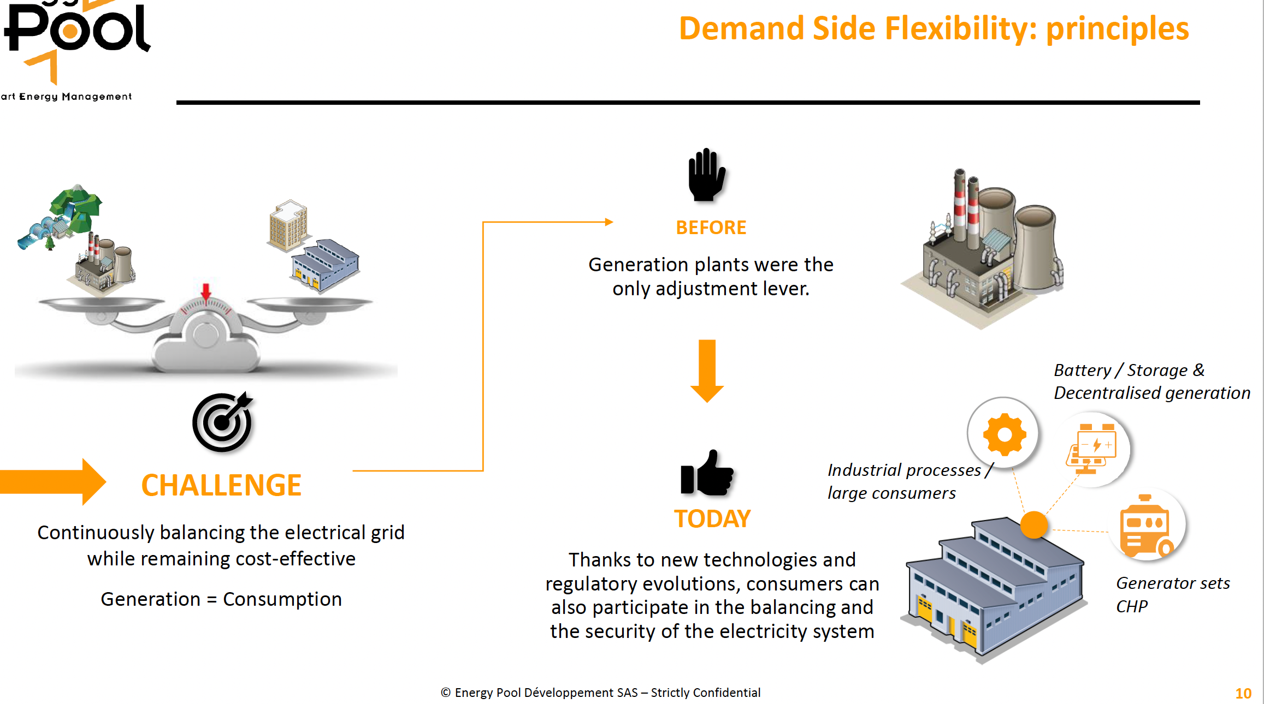
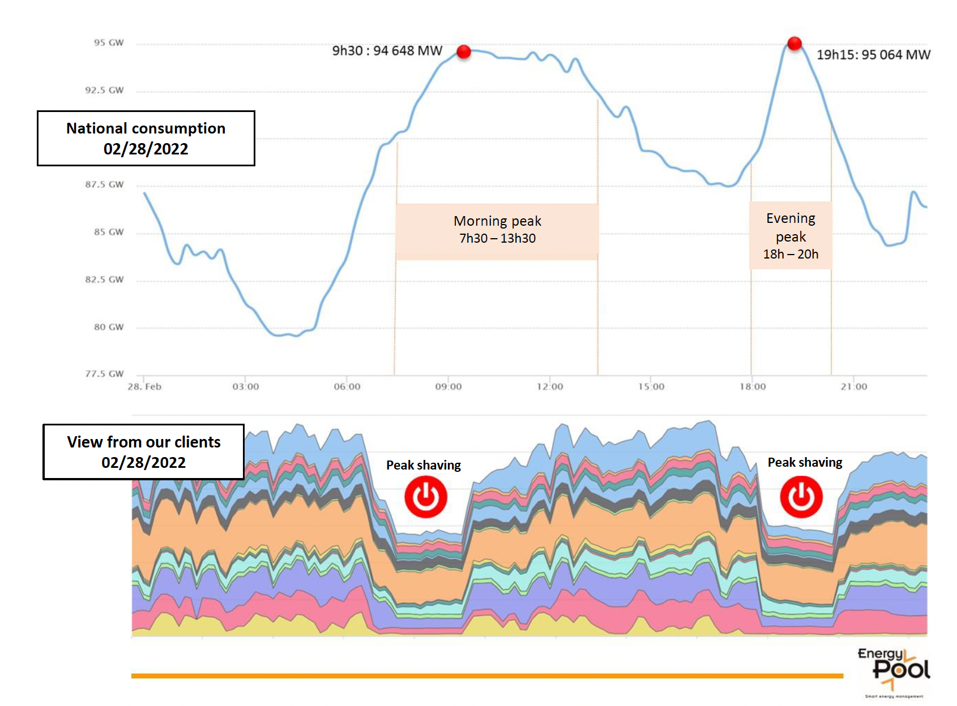
C. Gaunand & B. Remenyi:
Introduction to Demand Side Flexibility
https://indico.esrf.fr/event/2/contributions/94/

Slide 8
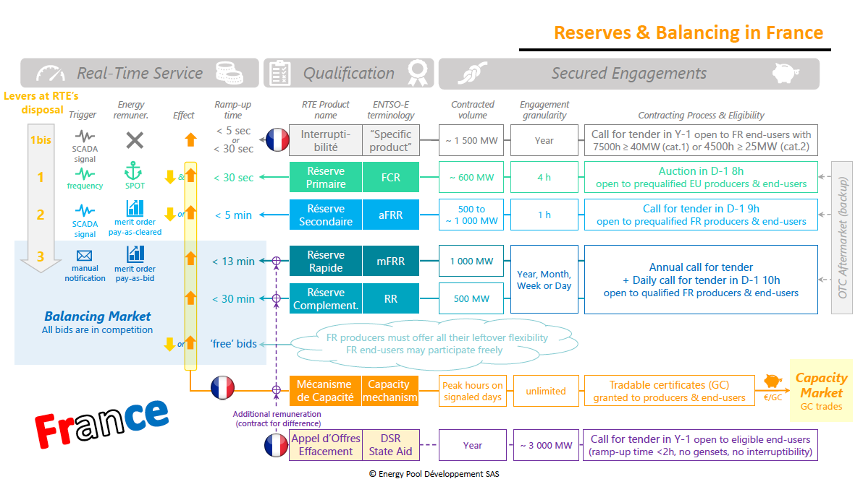

Slide 9
Electricity market and grid stability
Electric grid relies on synchronous mechanical generators (turbines)
  Disturbances lead to drop in voltage and frequency
  Synchronous generators react to frequency shift with highly variable output -> stabilize the system
New power sources (PV, wind) and consumers don’t react to disturbances
  -> provide no inertia
  -> no stabilization of the system
  System becomes unstable
Grid stabilization requires consumers that react to signals from grid:
Demand Side Flexibility
  Peak shaving: reduce load (planned)
  Continuous adjustment (within predefined power trange)
  Load shedding in emergency
  Cost as incentive for participation
In the future:
  Static / inflexible load is bad
  Dynamic / flexible load is good
  -> stabilizes grid
  -> saves cost (rebates / premiums)

Slide 10
My Conclusions for Linear Accelerators
Linear Accelerator is ideal for grid stabilization
  No stored beam -> fast recovery time
  Continuous rep-rate modulation
Accelerator labs: make transition from passive to active electricity consumer
  Passive: reduce load during times of high spot market prices
  currently: long term contracts with stable prices -> little / no incentive to do that
  -> this is changing!
  Active: Cooperate with grid operator (TSO) to modulate load for grid stabilisation:
  Demand Side Flexibility
Linear accelerator:
RF power (~30-40%) directly proportional to rep-rate
Other systems (cryogenics, HVAC, Damping Ring RF) follow partially / with delay
Design all systems (if possible) for high flexibility: maximise dynamic load fraction
Energy buffers: decouple electric load from performance on a short term basis
Develop as unique selling point for linear accelerators
-> Define new Performance Indicators for quantification

Slide 11
Live Cycle Assessments

Slide 12
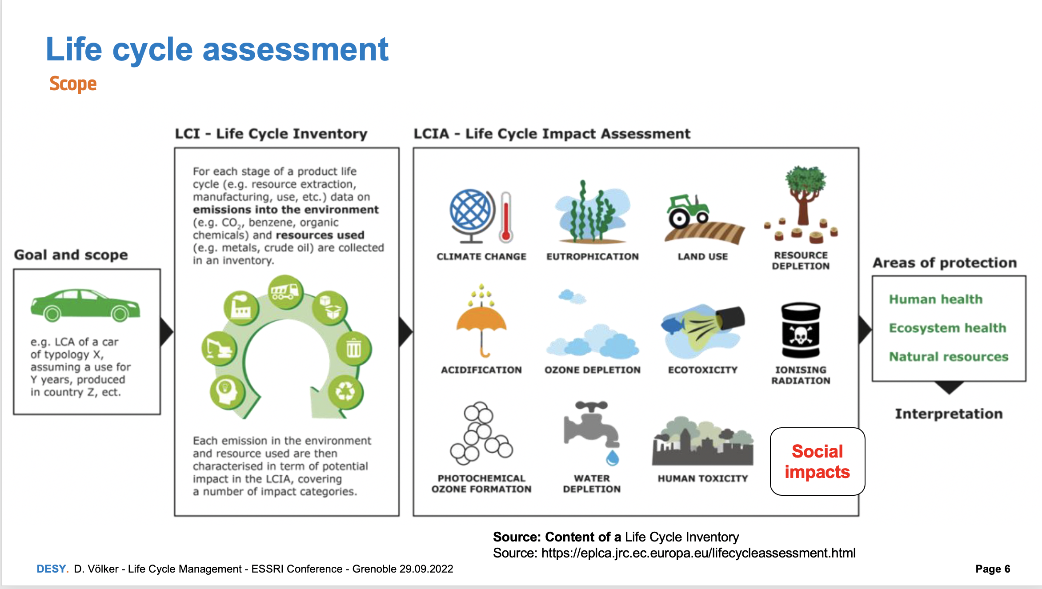
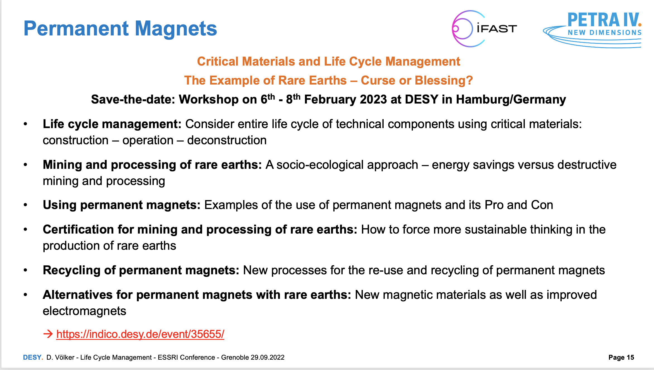

D. Völker: Rare Earth and Life Cycle Management
https://indico.esrf.fr/event/2/contributions/113/

Slide 13
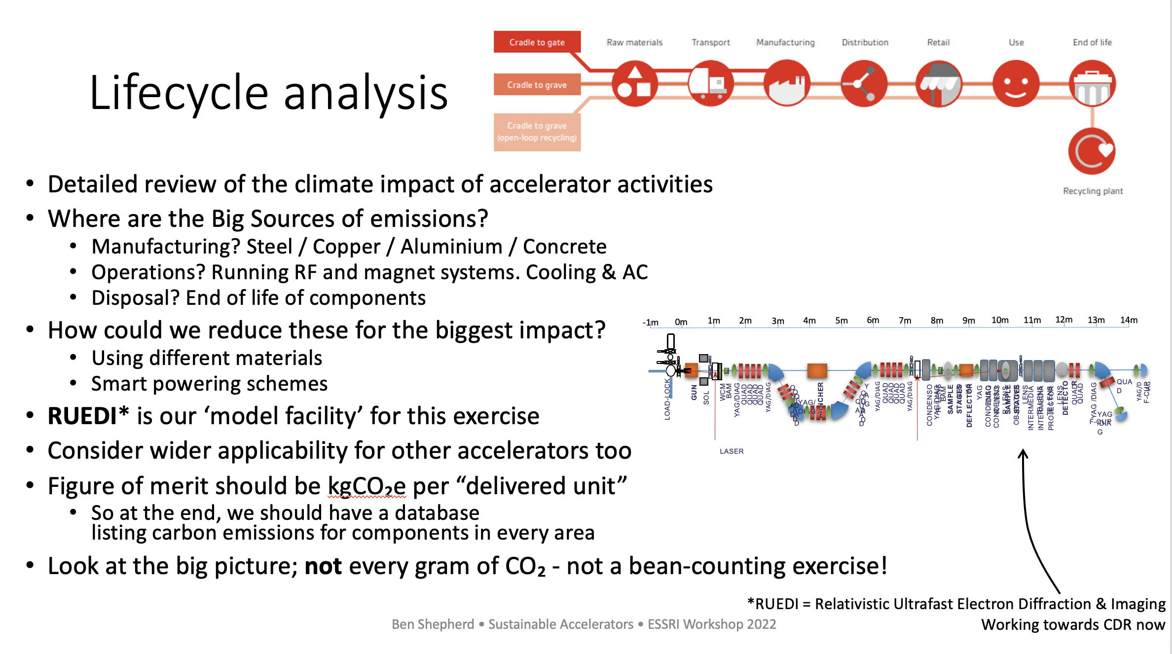
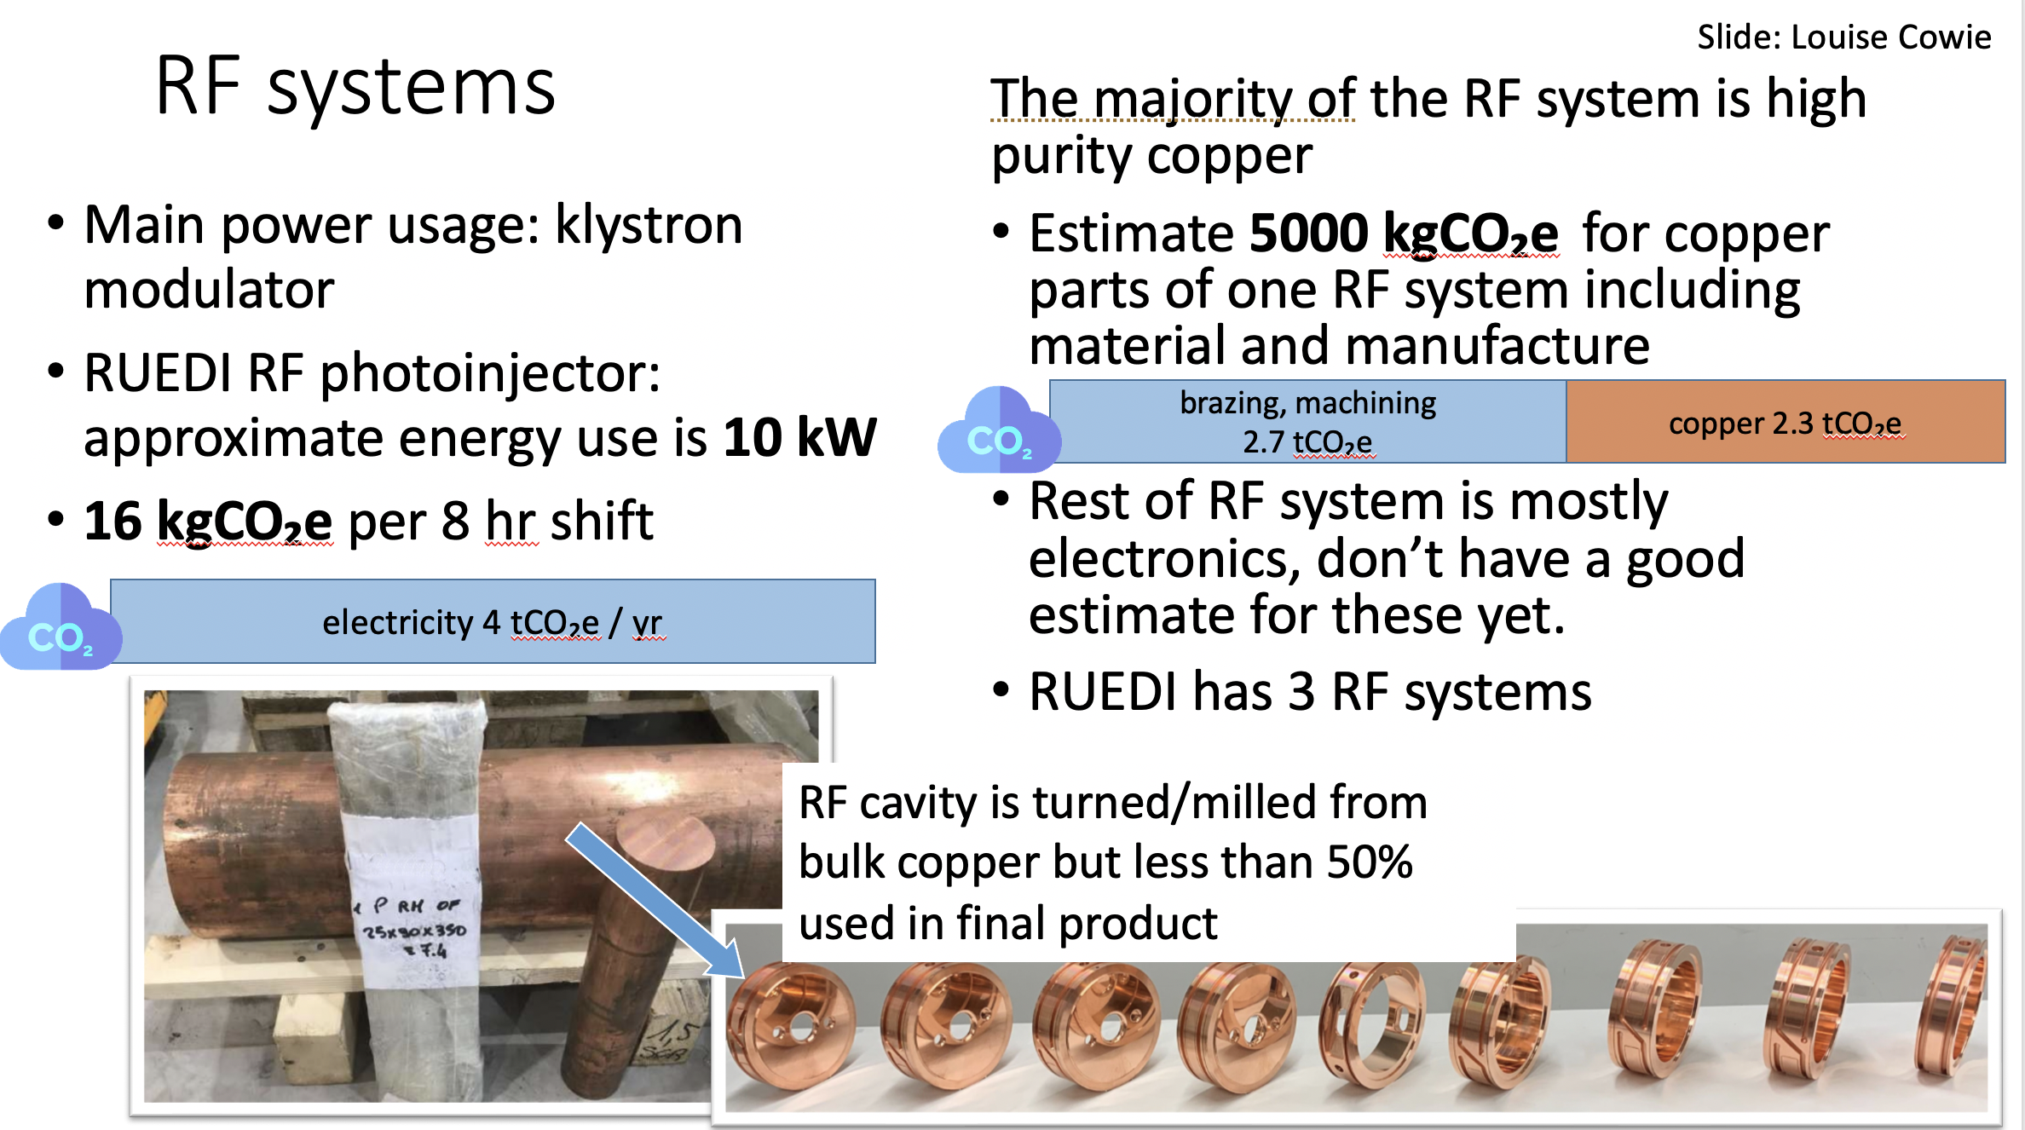
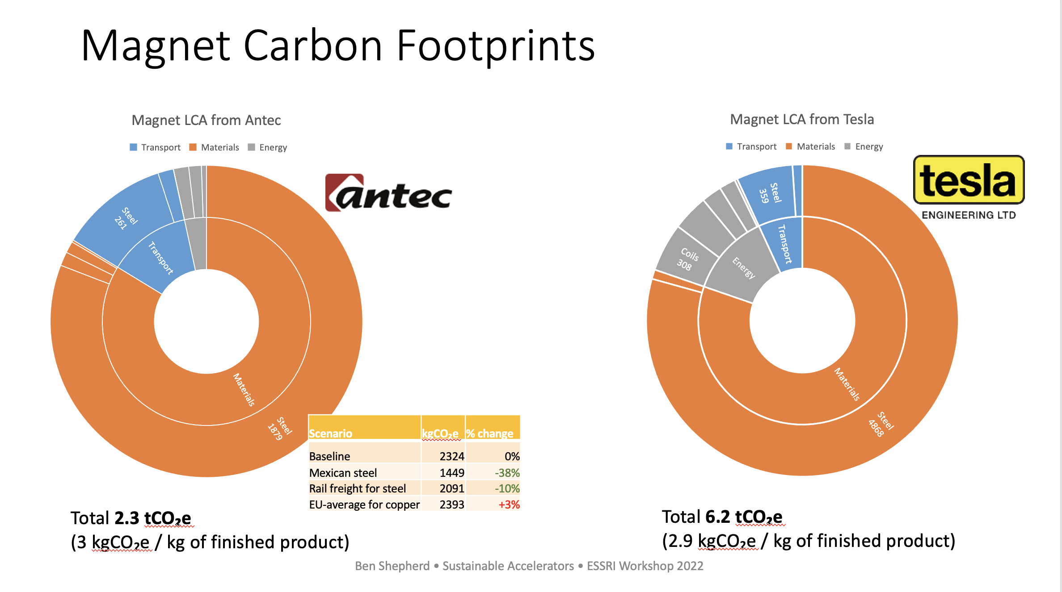
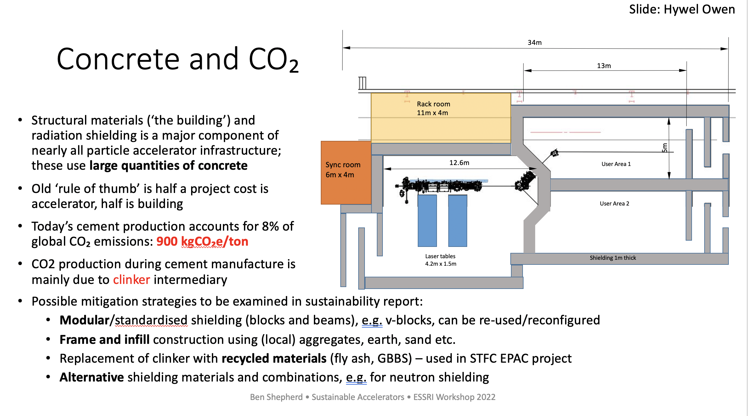
B. Sheperd: Sustainable Accelerator R&D

Slide 14
Digital Twins

Slide 15
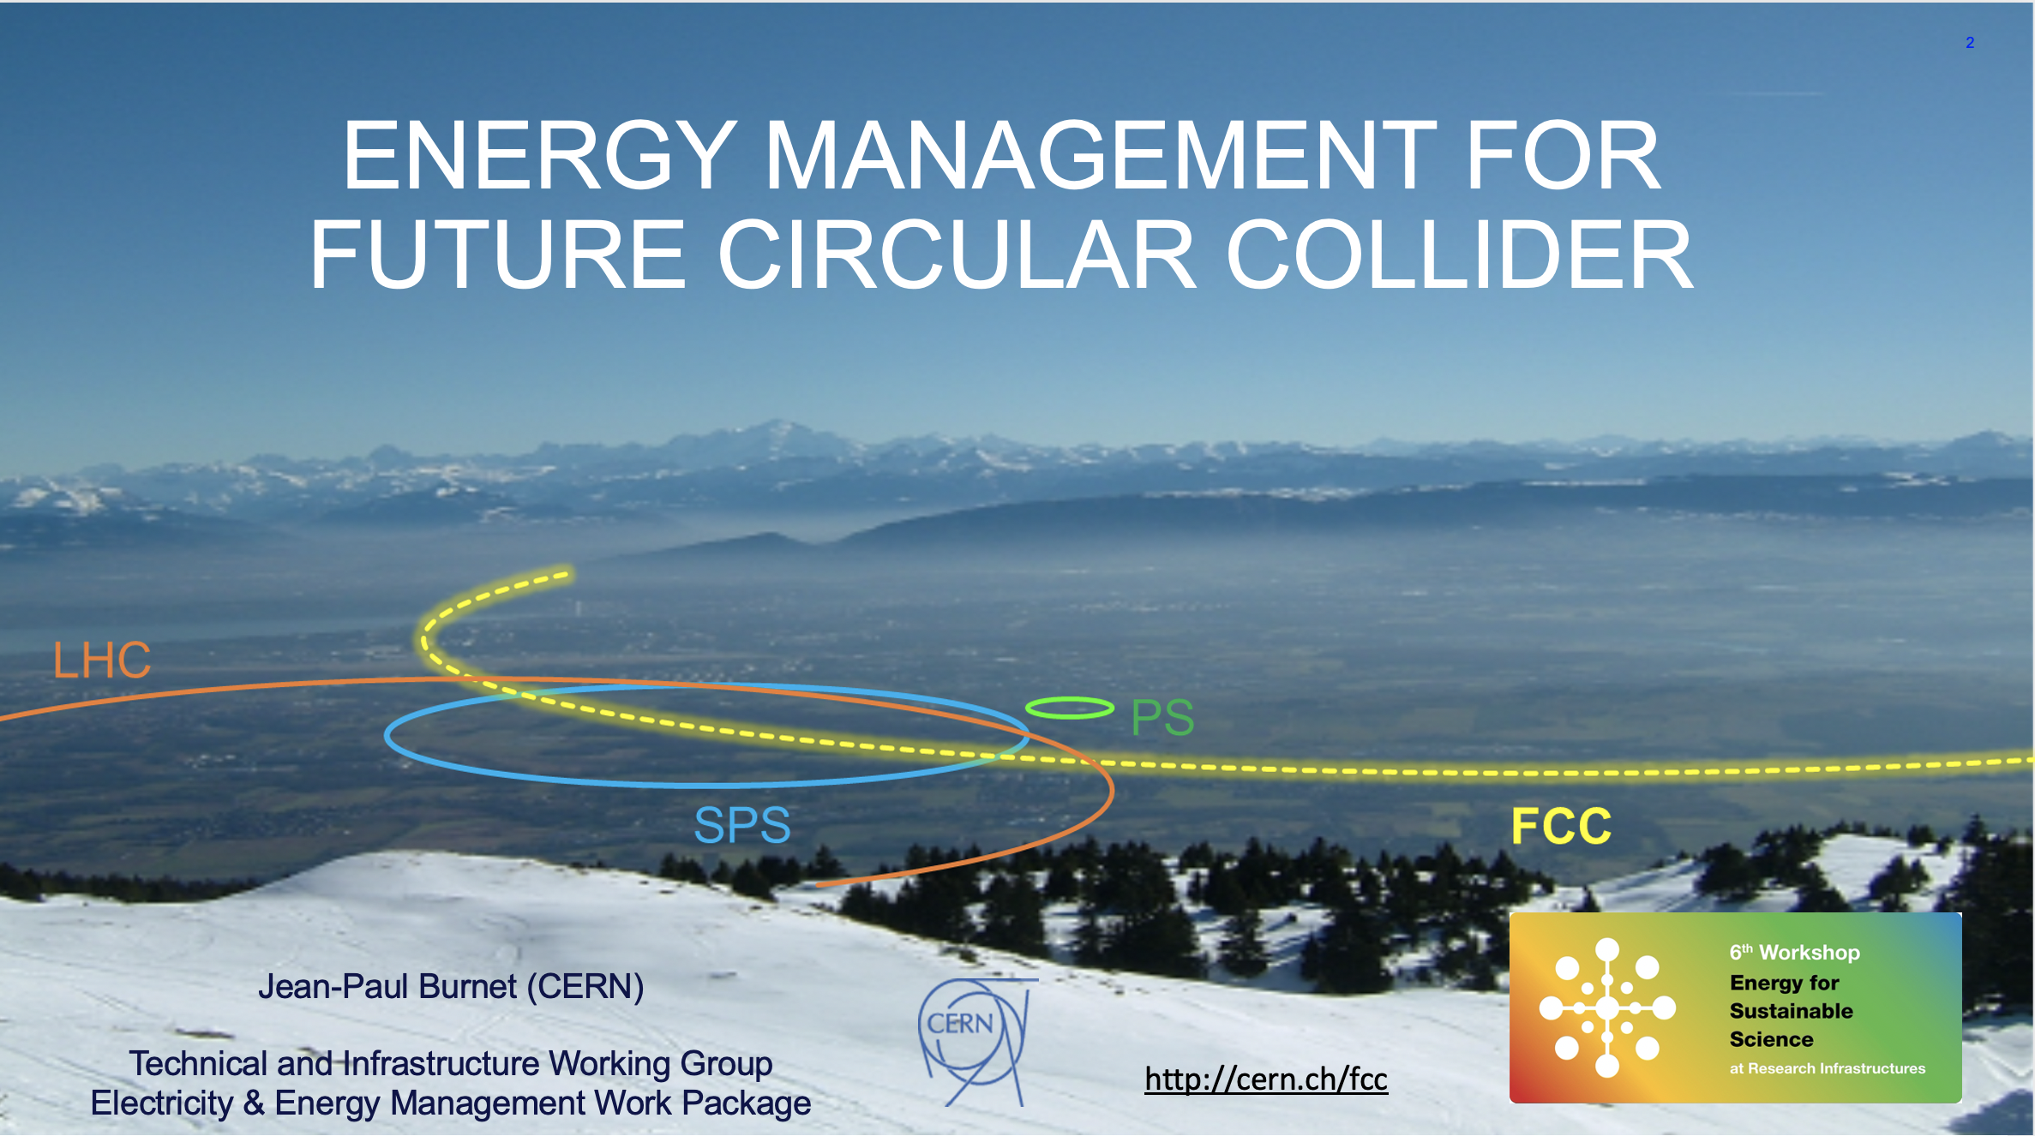
FCC
https://indico.esrf.fr/event/2/contributions/119/

Slide 16
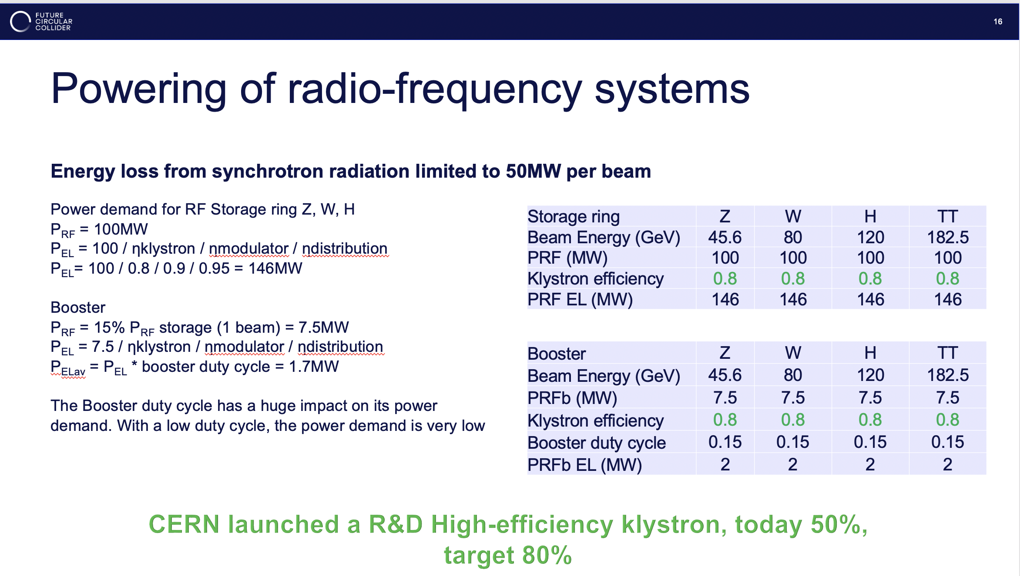
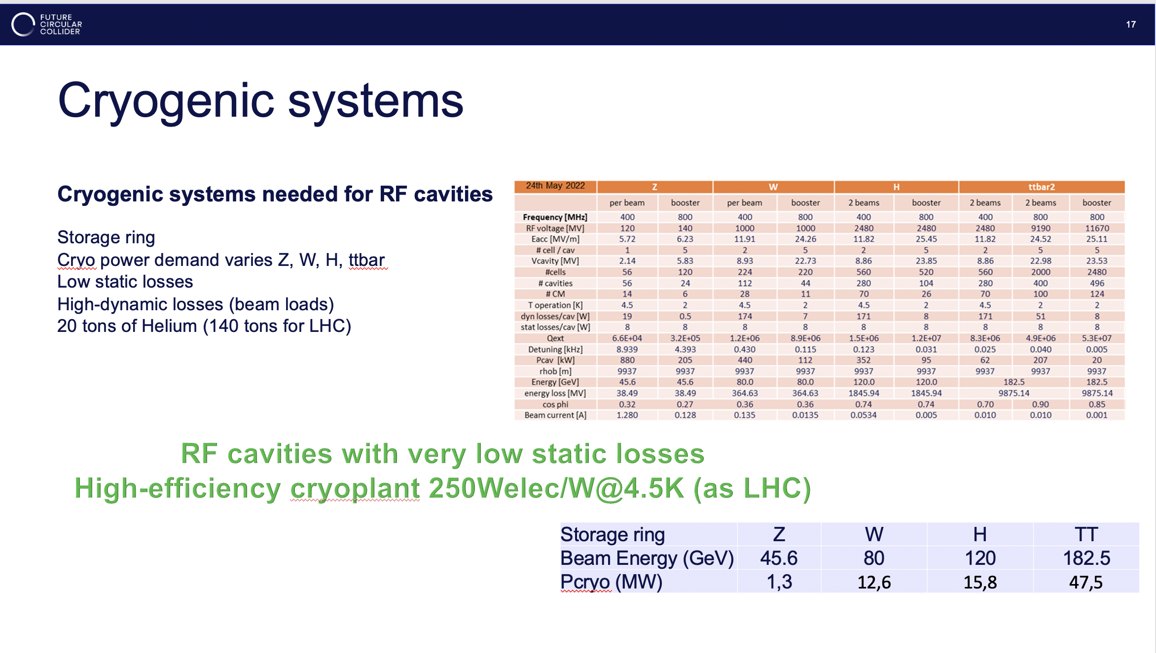
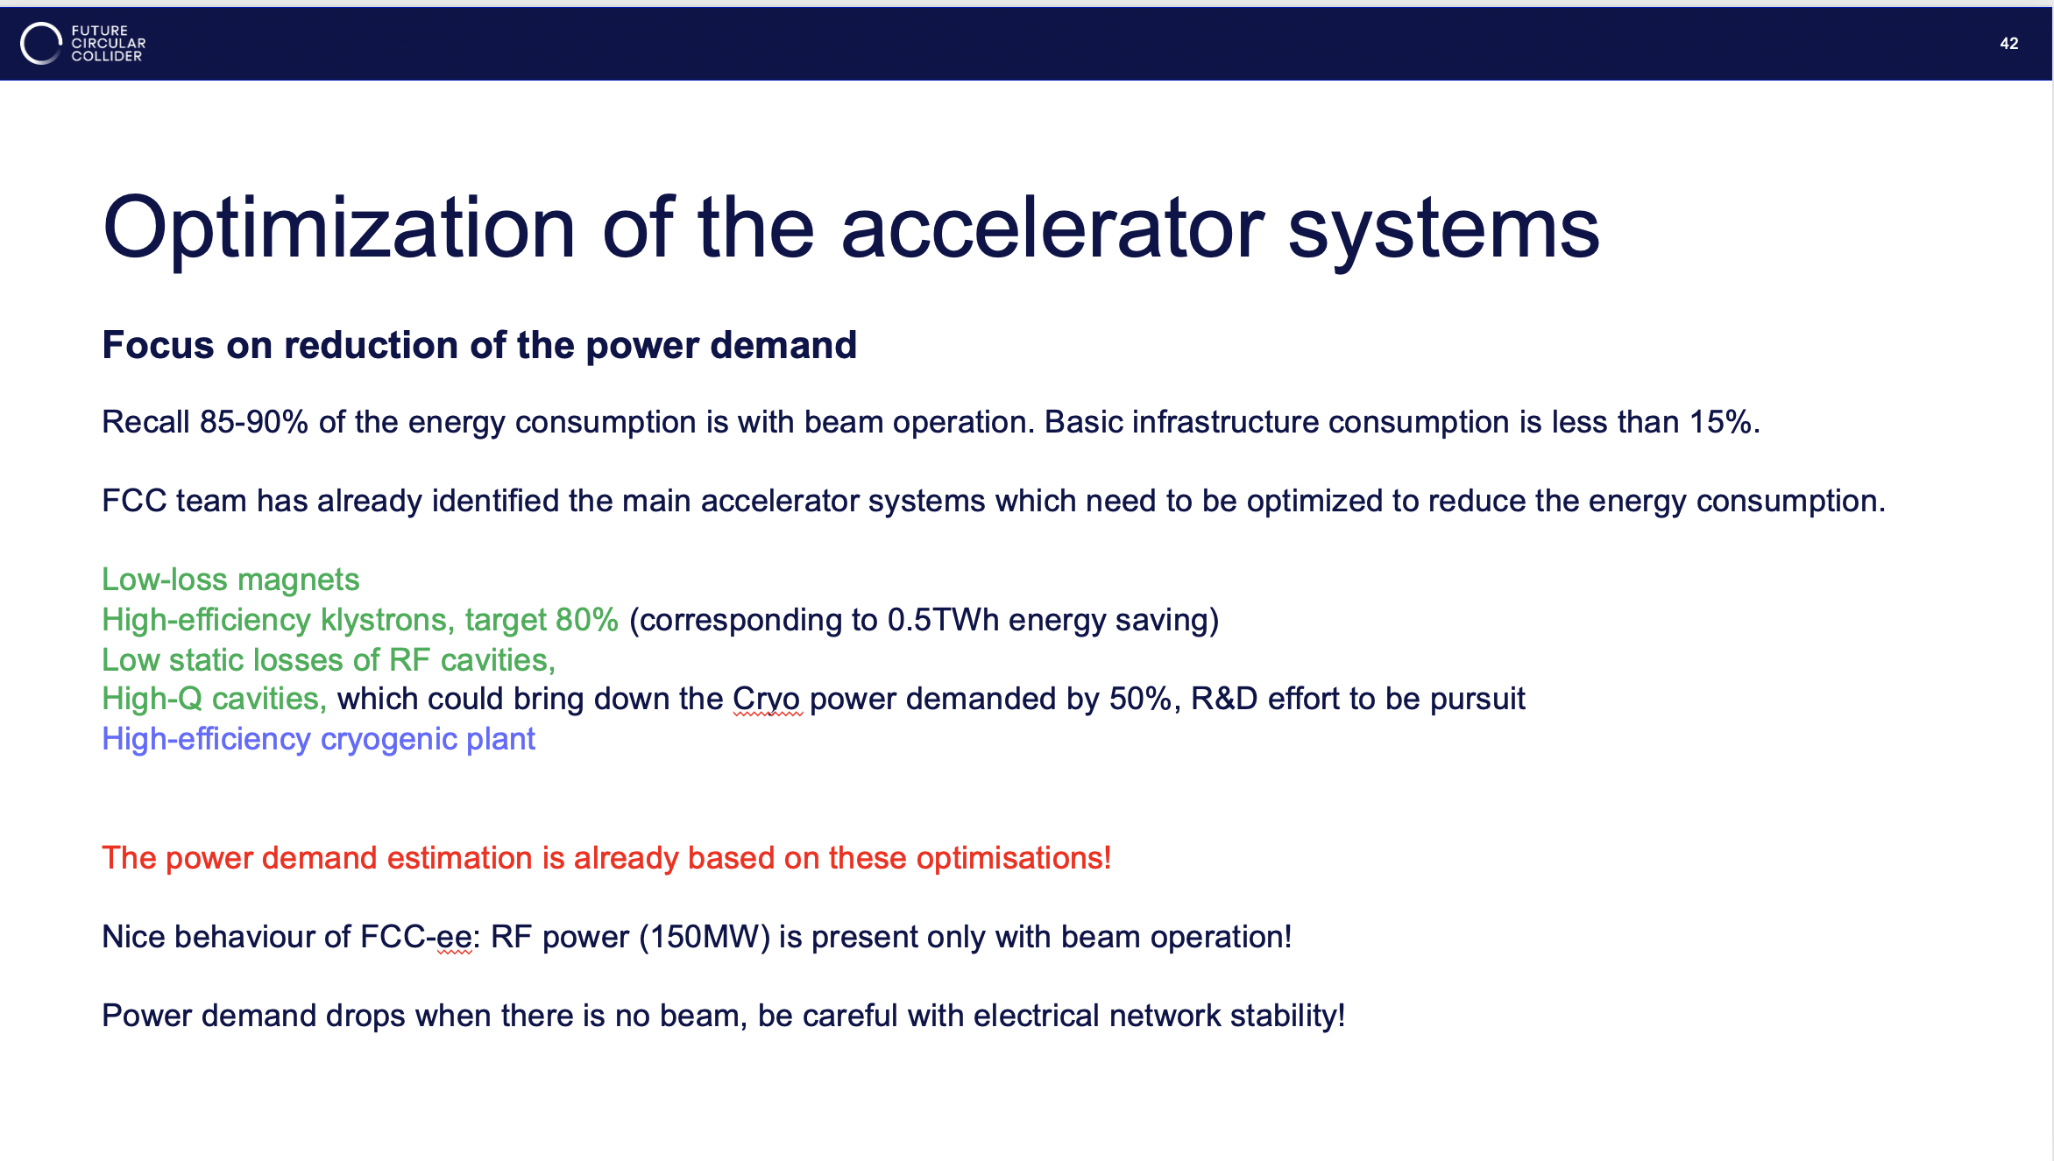
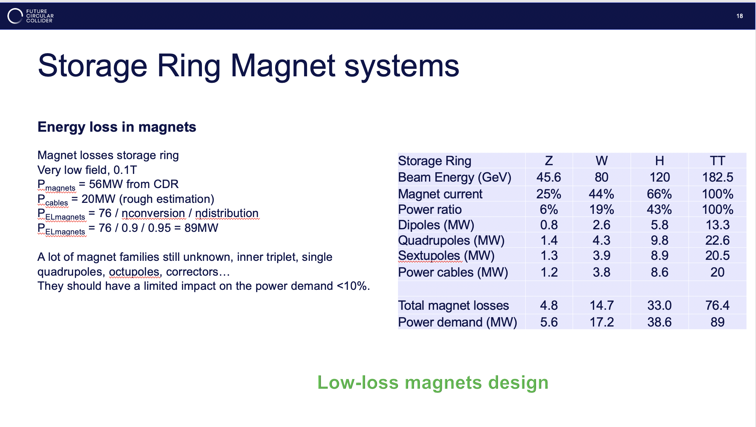
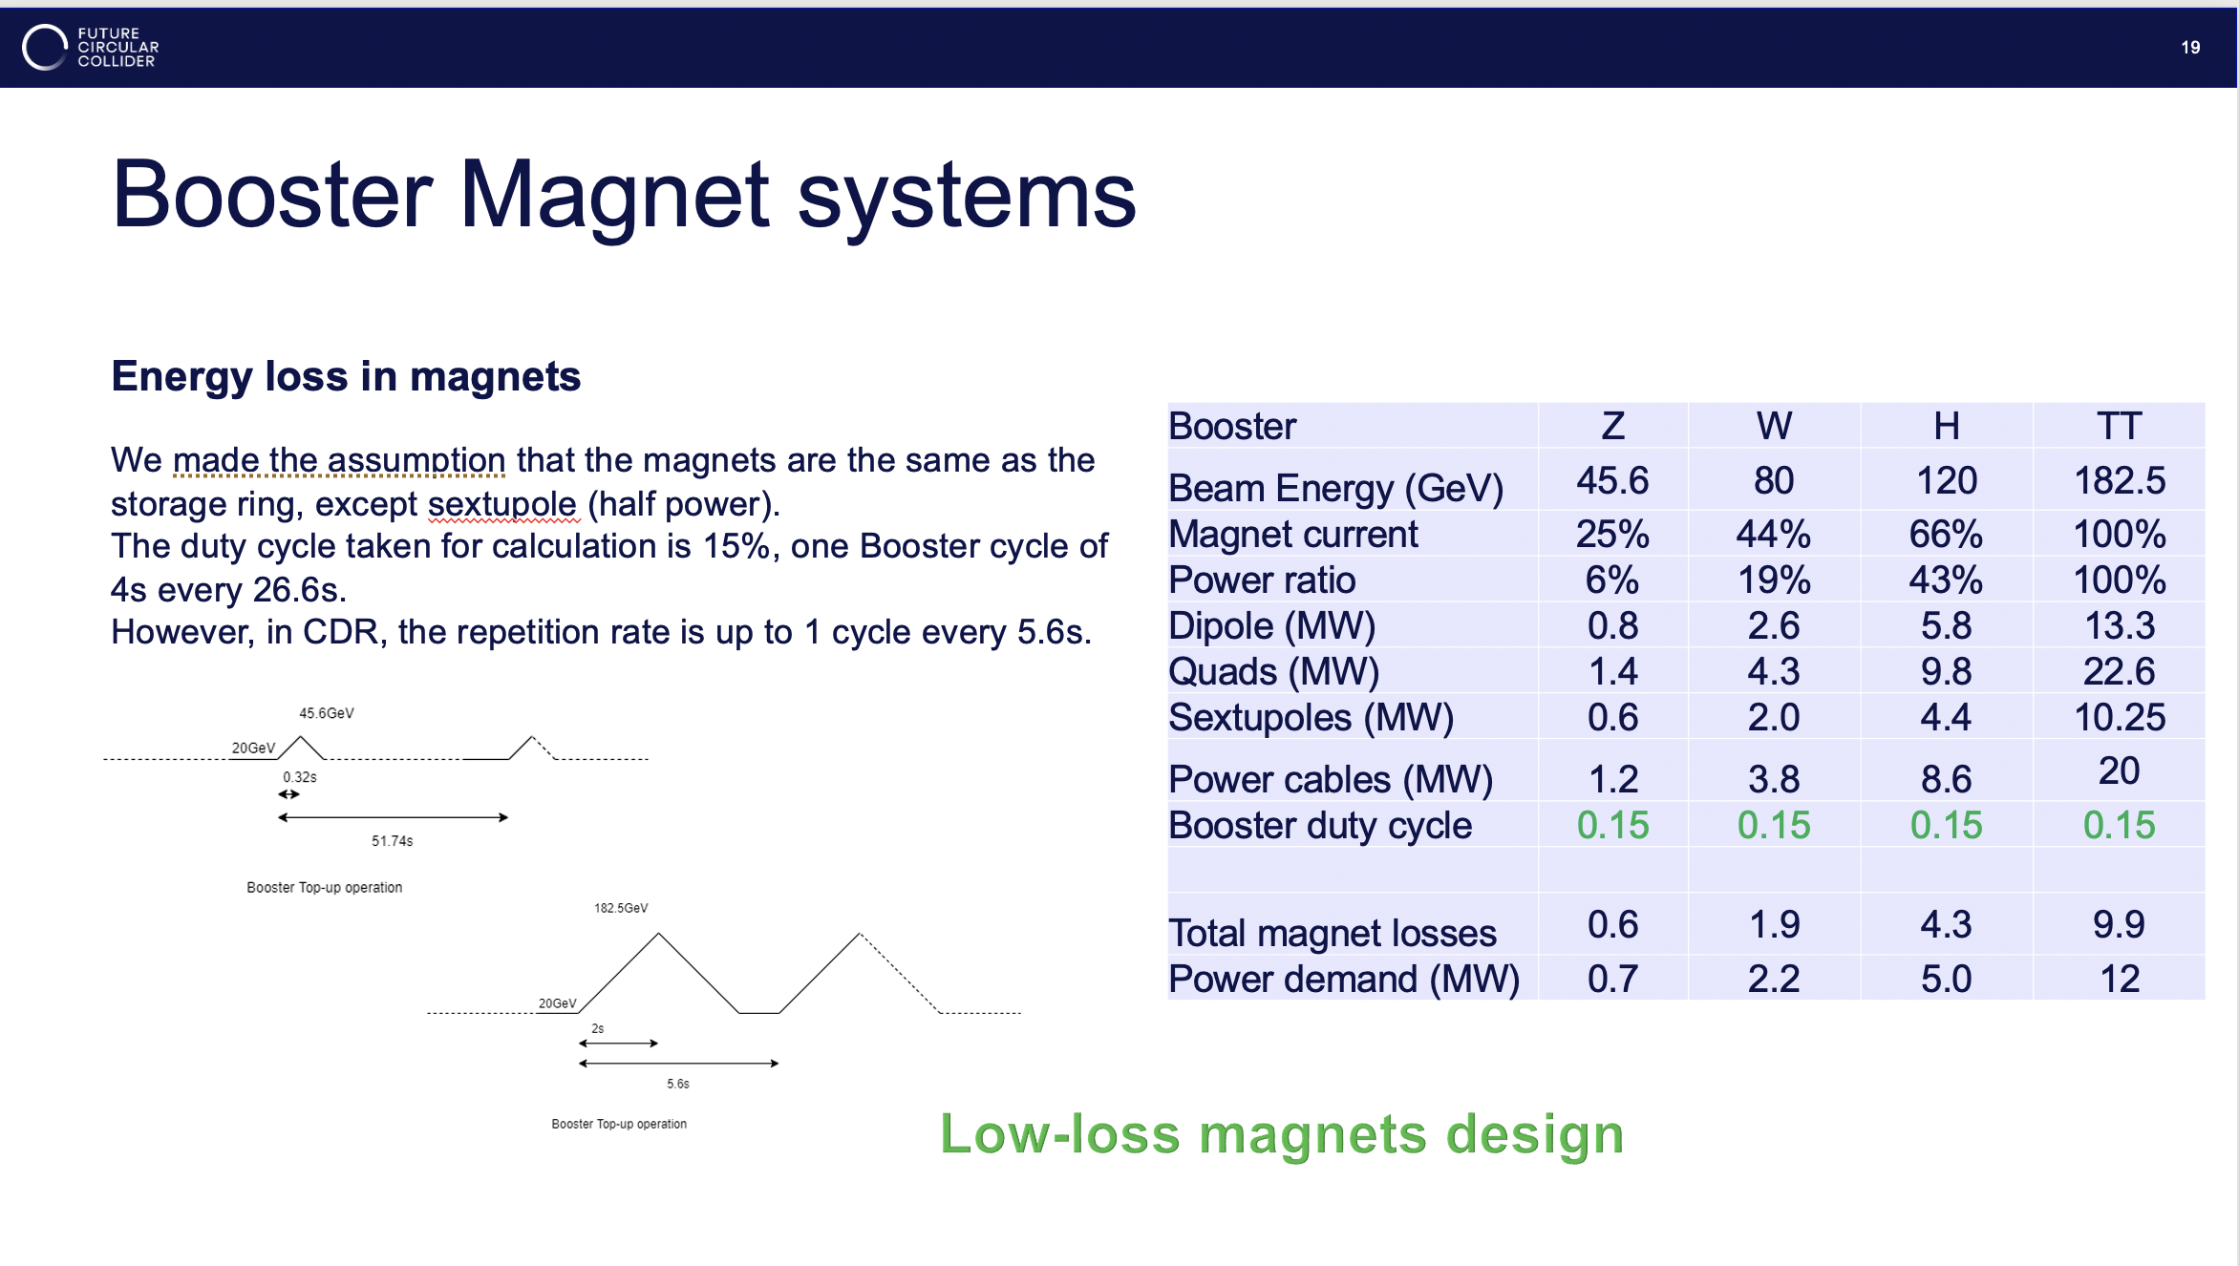
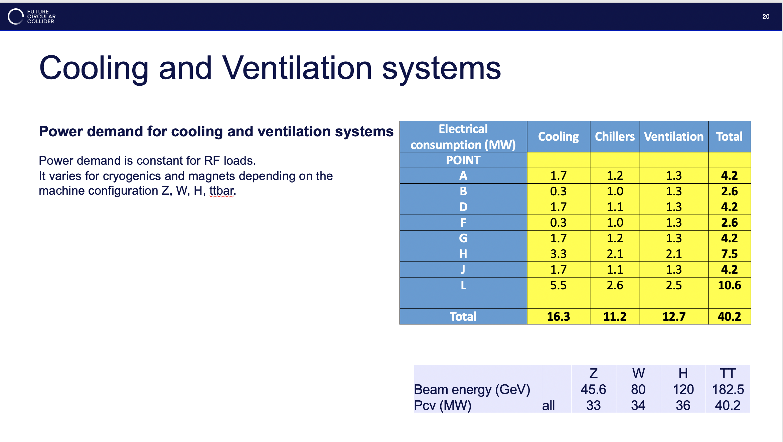
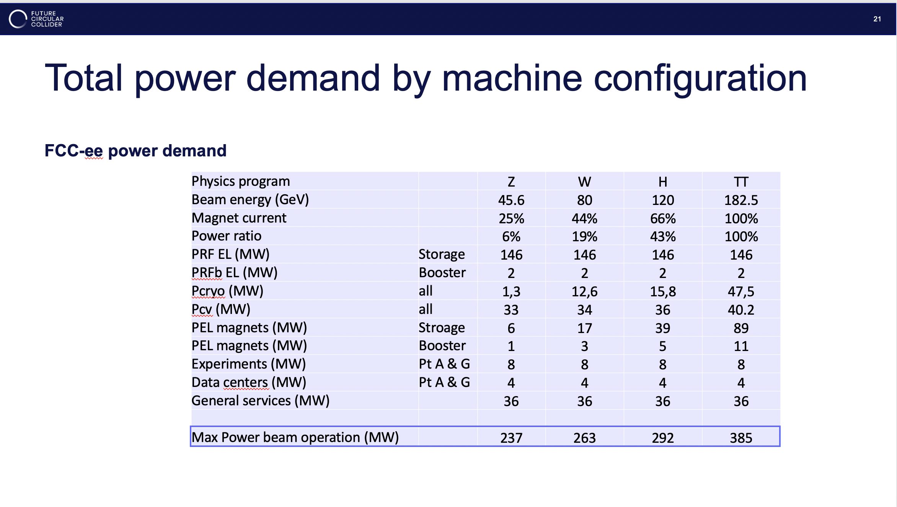
Power Estimate
Comprehensive power estimate for FCC
Relies on a number of future technology
improvements

Slide 17
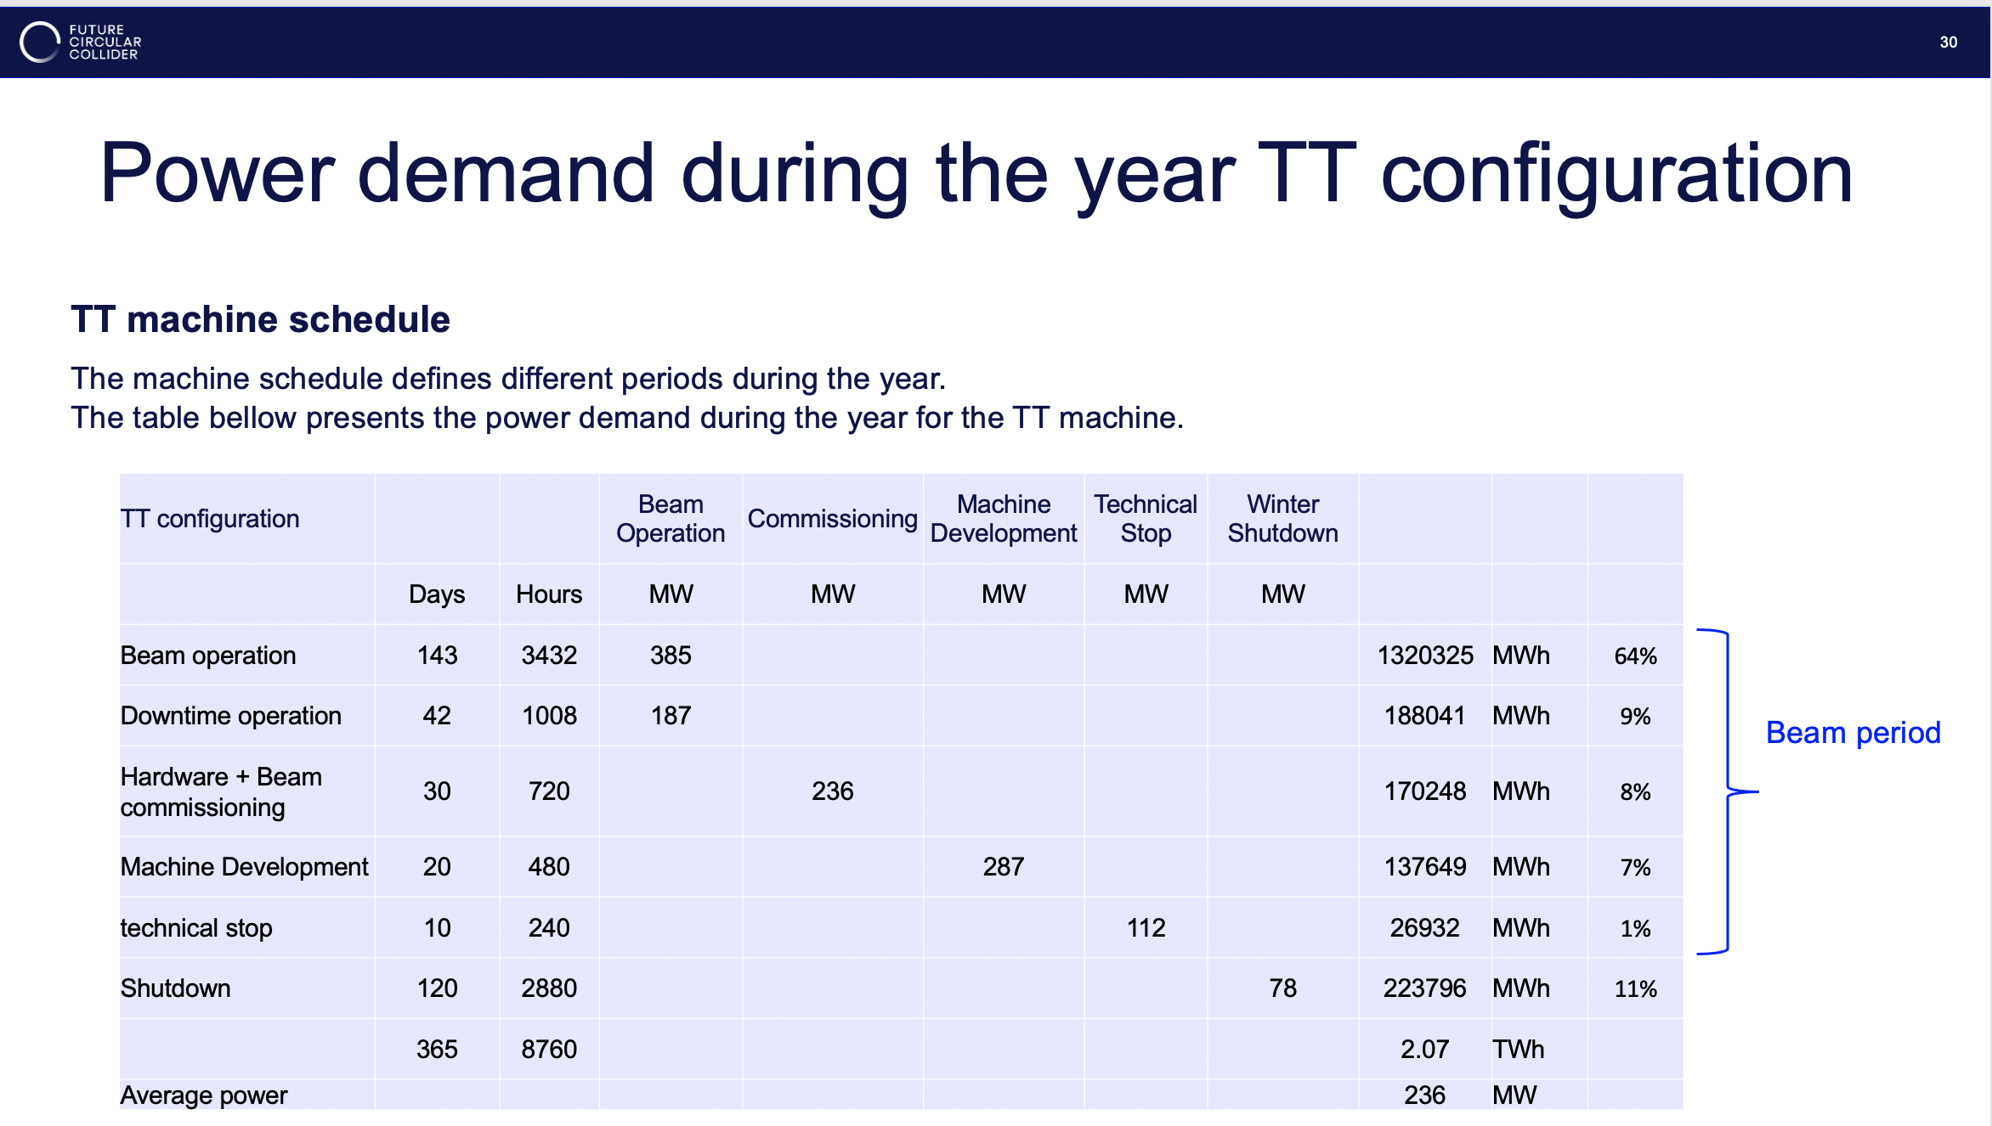
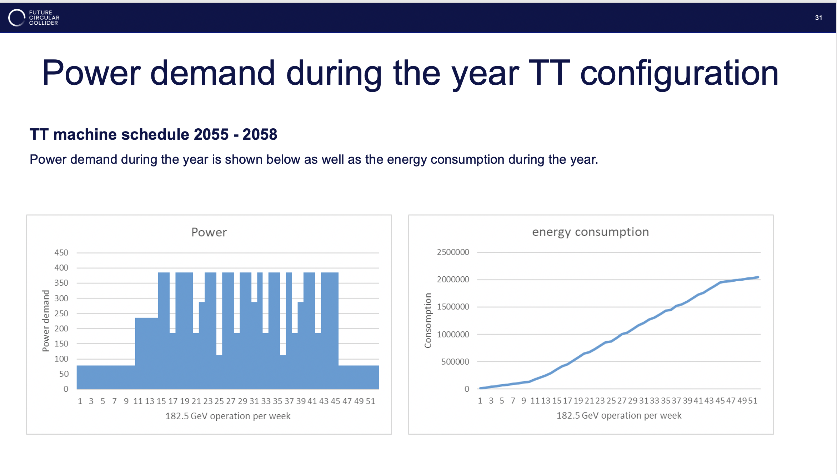
Energy Consumption
307 MW

Slide 18
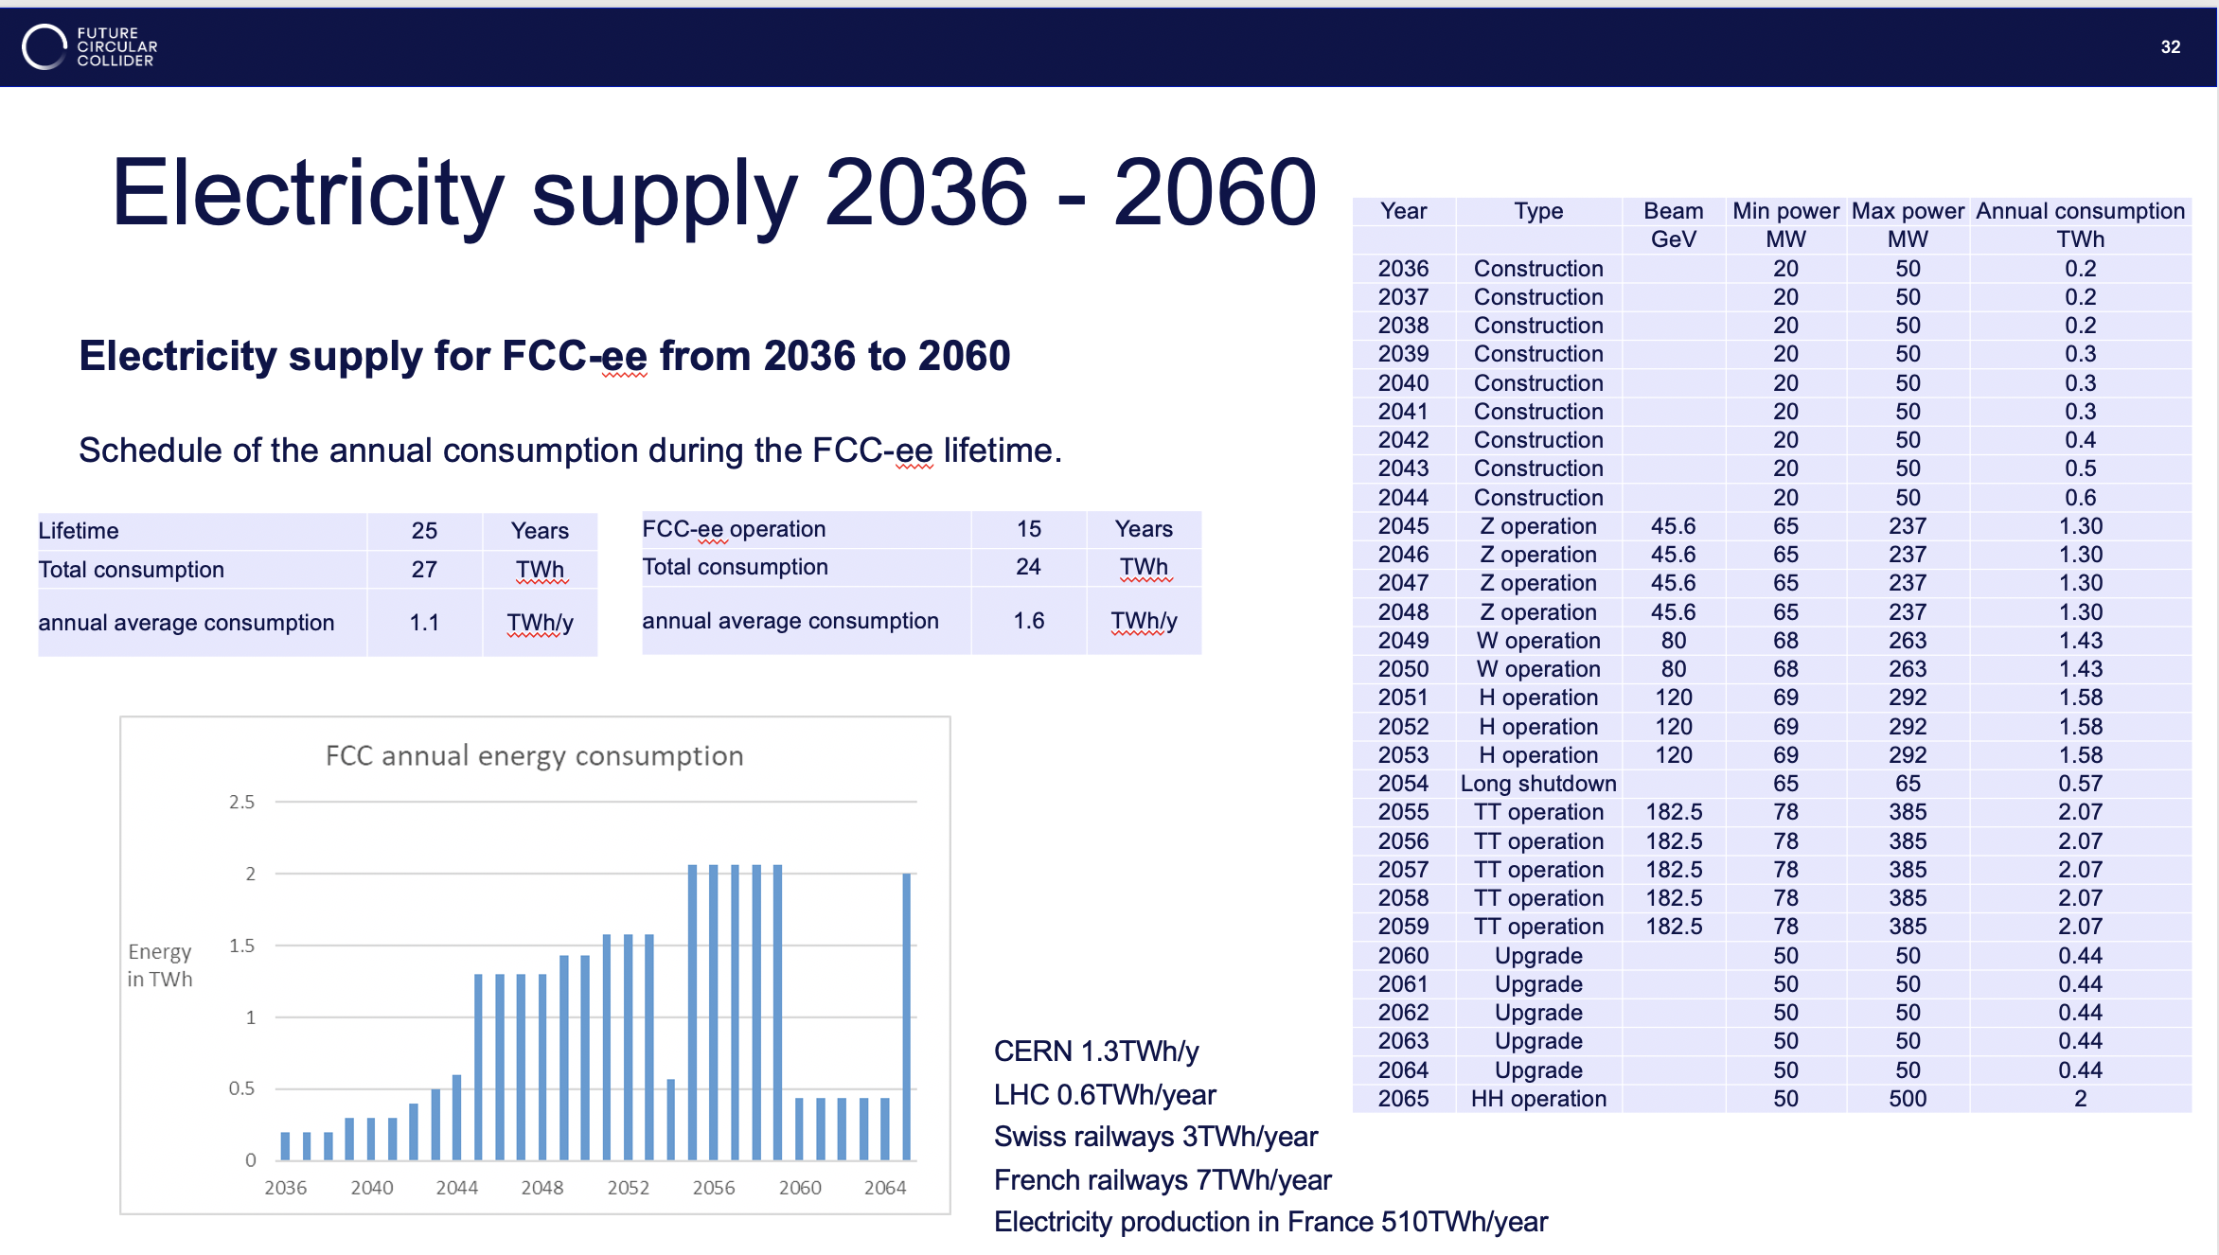
2 TWh

Slide 20

Next Workshop

