Slide 1
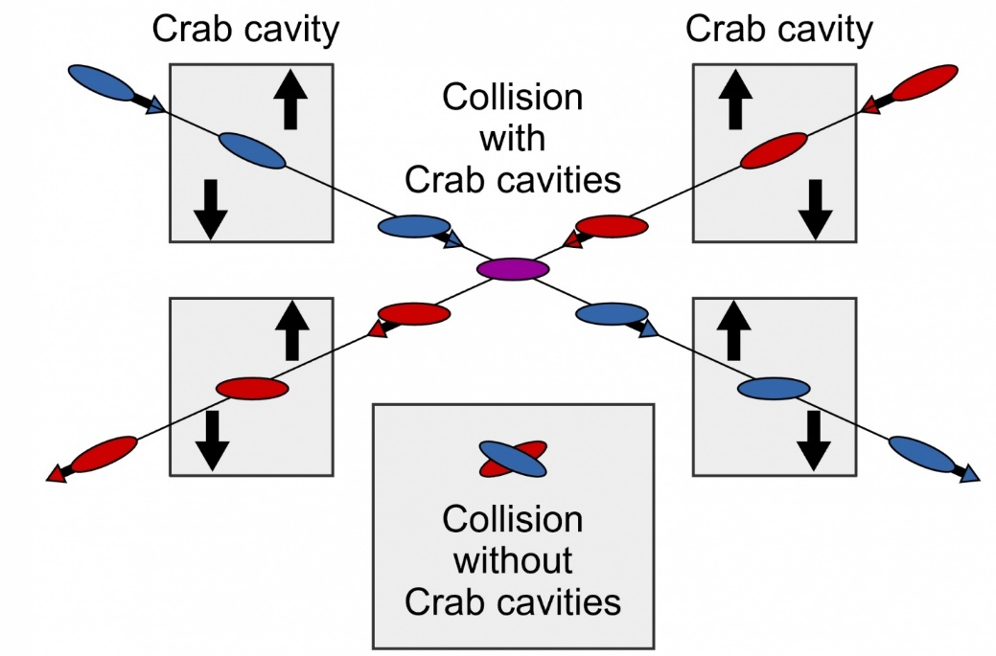

WG2 SRF: WP3 Crab Cavities
Design Review Workshop #3 – 21/10/22
Peter McIntosh
UKRI-STFC Daresbury Laboratory
1st November 2022

Slide 2
Agenda for WP3 Design Review #3 (GMT)
Friday 21st October 2022 | Friday 21st October 2022
13:30 | Introduction and Remit for the Workshop | Peter McIntosh (STFC) | 5 min
13:35 | Specification Review | Peter McIntosh (STFC) | 15 min
Cavity Design Updates
13:50 | Elliptical/Racetrack | Graeme Burt (Lancaster University) | 15 + 5 min
14:10 | RF Dipole (RFD) | Suba De Silva/Jean Delayen (ODU/JLab) | 15 + 5 min
14:30 | Double Quarter Wave (DQW) | Silvia Verdu Andres (CERN) | 15 + 5 min
14:50 | Wide Open Waveguide (WOW) | Binping Xiao (BNL) | 15 + 5 min
15:10 | Quasi-waveguide Multicell Resonator (QMiR) | Andrei Lunin (FNAL) | 15 + 5 min
15:30 | Next Stage CC Preparations | Peter McIntosh (STFC)/K Yamamoto (KEK)/A Yamamoto (KEK) | 30 min
16:00 | Meeting close

Slide 3
Scope Design Review #3
Assess and compare CC EM designs, not likely finally optimised:
  Cavity,
  HOMs,
  Couplers,
  Multipacting,
  Tuning.
Clarifying next steps to ‘head towards’ a down-selection process:
  All EM design aspects complete, including pressure stability and fabrication assessment.
  Down-select 2 optimum CC designs for future prototype development (external review).
Final CC down-selection, post-prototype validation at ~18-months later.
As proposed at Design Review #1 – Dec 21

Slide 4
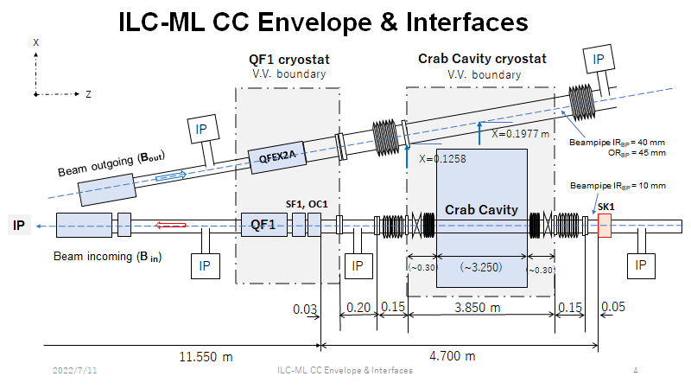
Specifications Update (v14)
A Yamamoto/T Okugi – 19/7
Further clarify longitudinal impedance specification – Both Short/Long-range

Slide 5
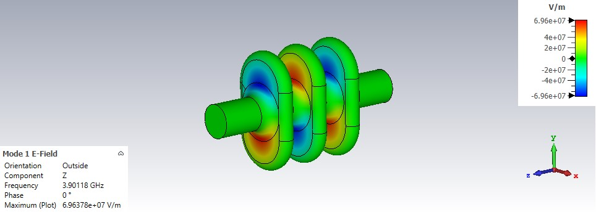
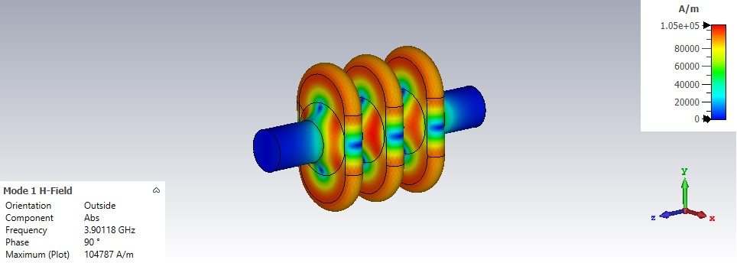
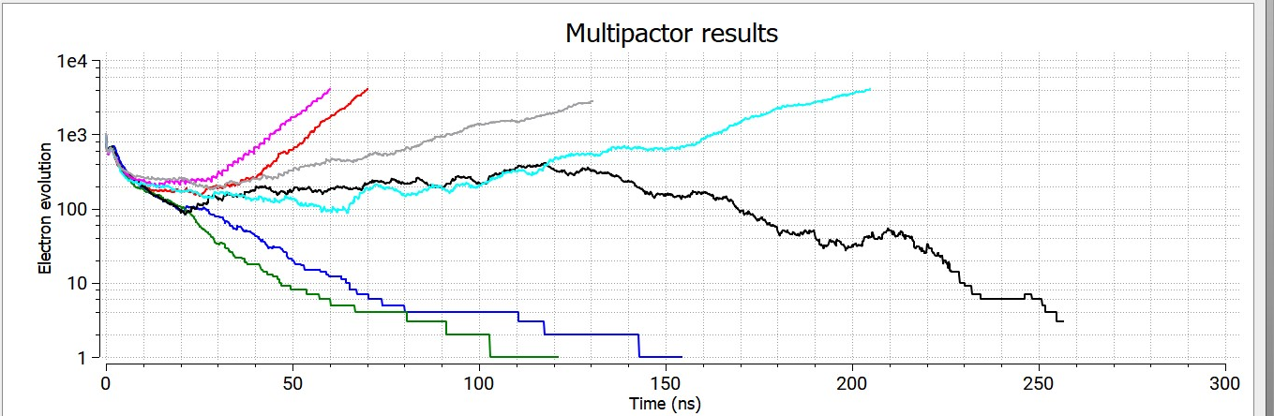
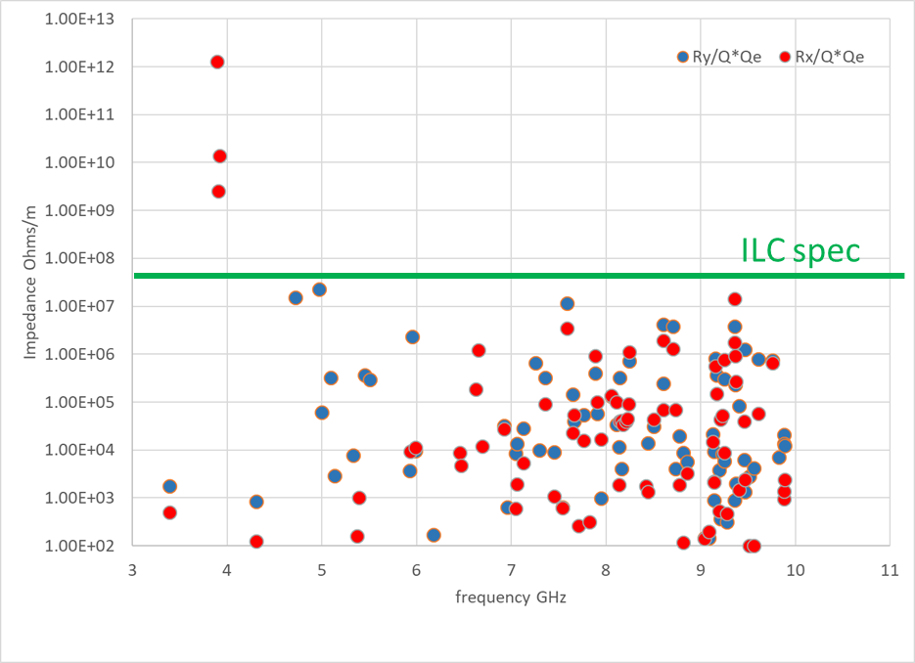
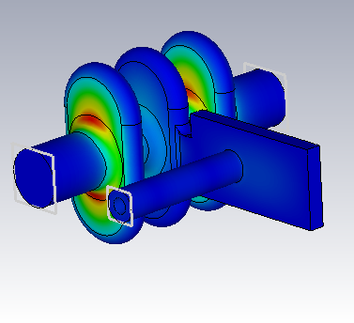
Elliptical/Racetrack 3.9 GHz
G Burt (Lancaster U)
Multipactor limit identified @ 7.15 MV/m (narrowband) on minor axis iris.
25 mm central beam-pipe, with 30 mm for end-cells to aid HOM damping.
Expect to achieve 9.7 MV/m at 80 mT with R_{t}/Q=132 Ohms.
250 GeV ILC requires 1 x 3-cell cavity @ 5 MV/m to achieve 0.615 MV.
1 TeV ILC requires 4 x 3 cells @ 5.5 MV/m to achieve 2.5 MV.
Transverse Impedance
Trapped Mode extraction using on-cell waveguide extraction

Slide 6
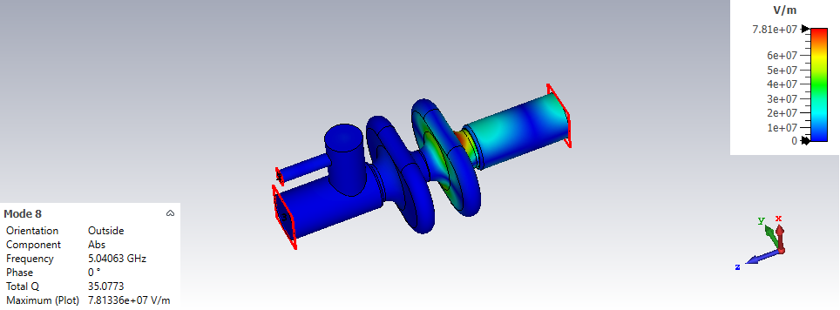
Elliptical/Racetrack 3.9 GHz
G Burt (Lancaster U)
A 2-cell cavity has no trapped modes - on-cell damping is therefore not required – simpler to manufacture:
  Expect an increase in both LOM and SOM Qe.
Would change the ILC application expectations:
  250 GeV – 2 x 2-cell cavities @ 4.2 MV/m
  1 TeV – 5 x 2-cell cavities @ 6.5 MV/m

Slide 7
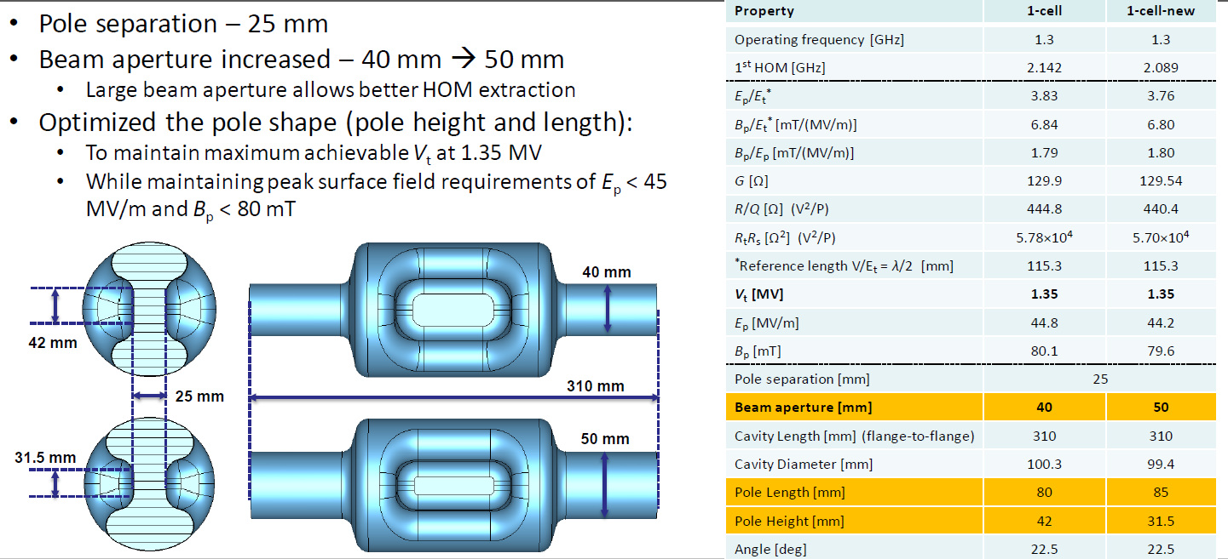
RF Dipole 1.3 GHz
S De Silva/J Delayen (Jlab/ODU)
Machined from Nb ingots, 2.5 mm thick walls - ~ 40 kg Nb material

Slide 8
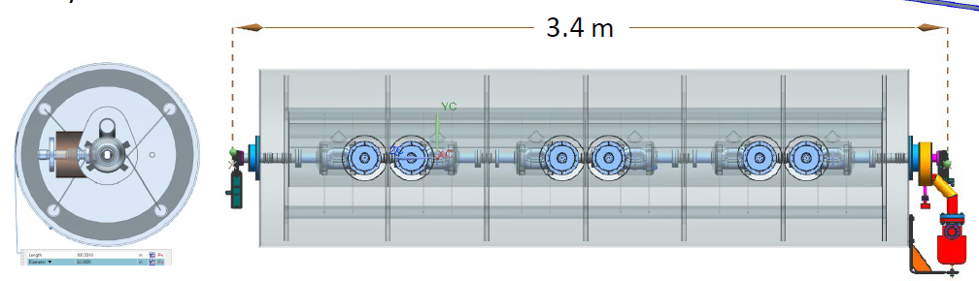
RF Dipole 1.3 GHz
S De Silva/J Delayen (Jlab/ODU)
Impedance threshold/cavity:
Zx= 8.13 MΩ/m & Zy= 10.28 MΩ/m (6 cav).
Well damped HOMs (with margin).
For 1 TeV – cryomodule to fit within 3.8 m:
6 cavities for single CM.
Incl 2nd exhaust 20 mm beam pipe.
Total achievable – 8.1 MV (1.24 MV Vt per cavity).
~10% extra margin
Design concept follows JLab C100 cryomodule.

Slide 9
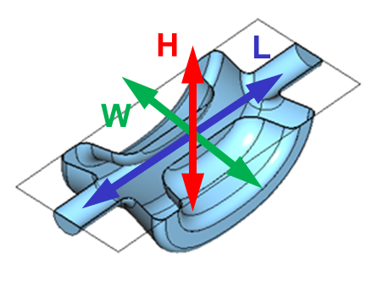
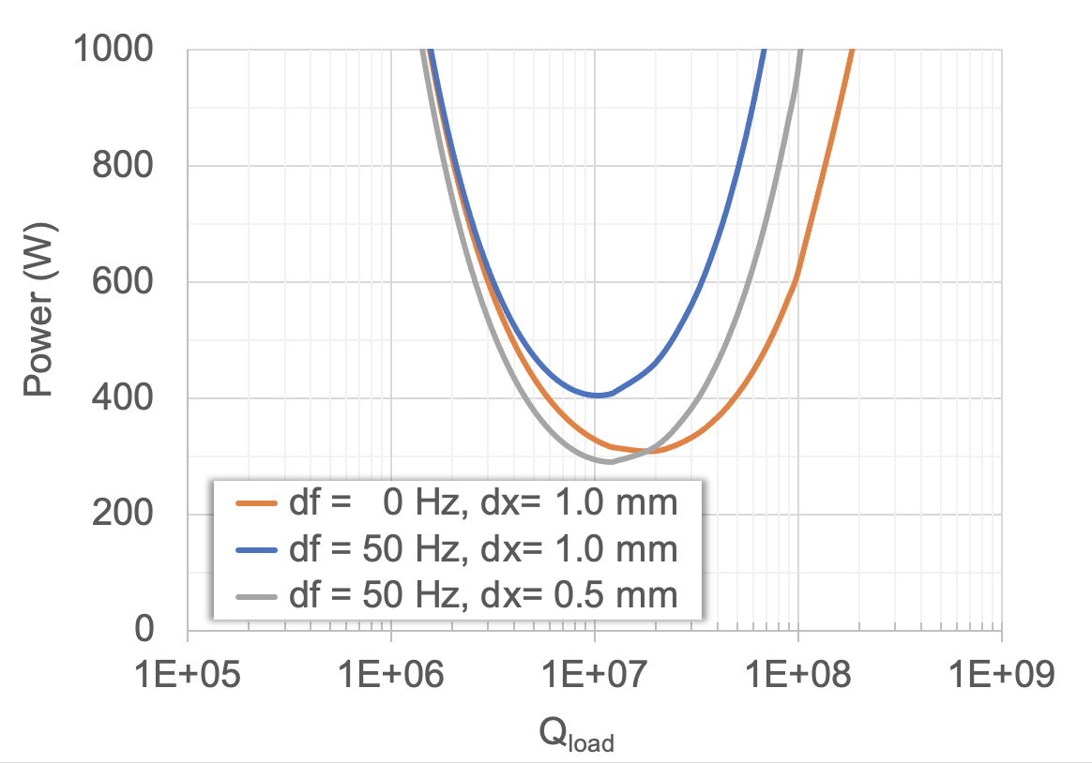
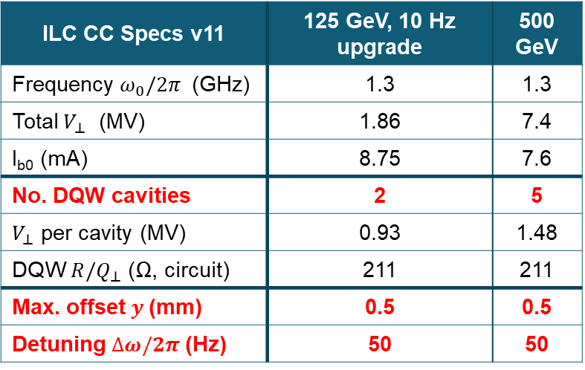
Double Quarter Wave 1.3 GHz
S Andres Verdu (BNL)
25 mm pole-separation, with 40 mm beam-pipe.
Both Tesla-type and waveguide HOM couplers being explored.
Qe = 1e7, with 130 Hz bandwidth and 300 W power requirement.
Various FPC options under study: Hook, Coax (cone and profiled).
ILC CC Specs v11 | 125 GeV, 10 Hz upgrade | 500 GeV
Frequency $ω_{0}/2π$ (GHz) | 1.3 | 1.3
Total $V_{⊥}$ (MV) | 1.86 | 7.4
I_{b0} (mA) | 8.75 | 7.6
No. DQW cavities | 2 | 5
$V_{⊥}$ per cavity (MV) | 0.93 | 1.48
DQW ${R/Q}_{⊥}$ (Ω, circuit) | 211 | 211
Max. offset $y$(mm) | 0.5 | 0.5
Detuning $∆ω/2π$(Hz) | 50 | 50

Slide 10
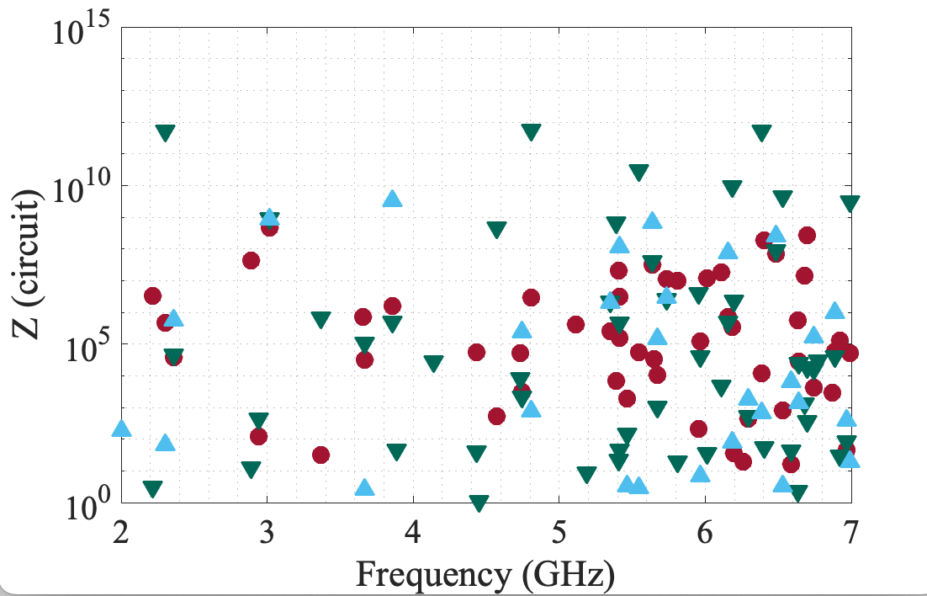
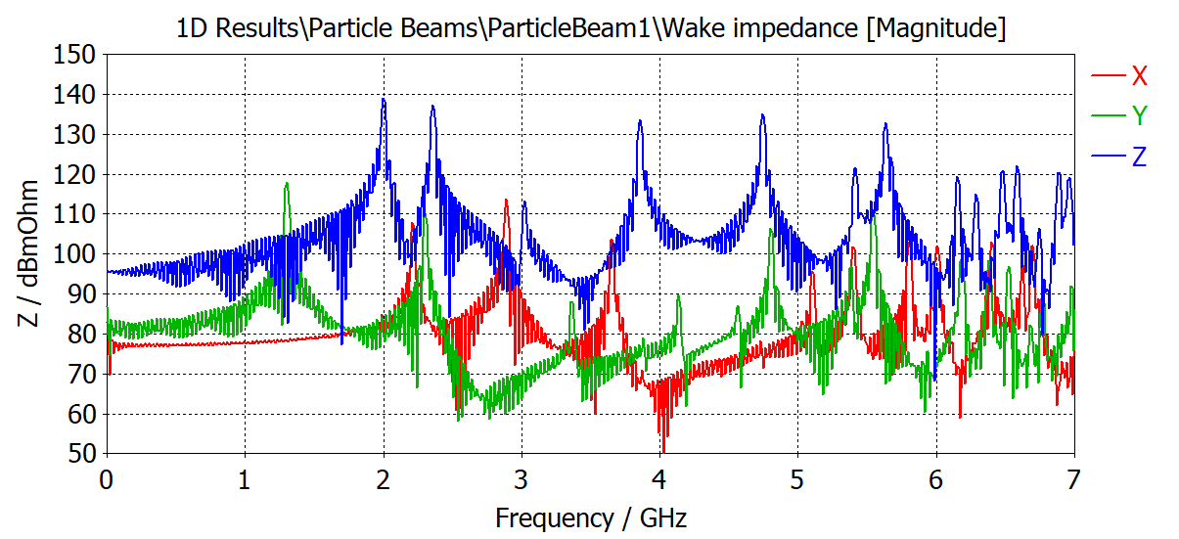
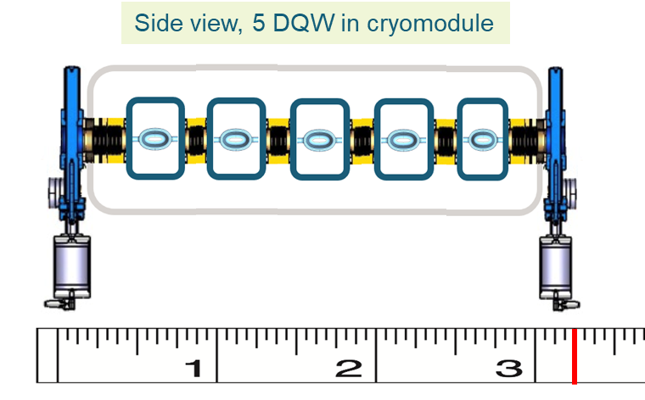
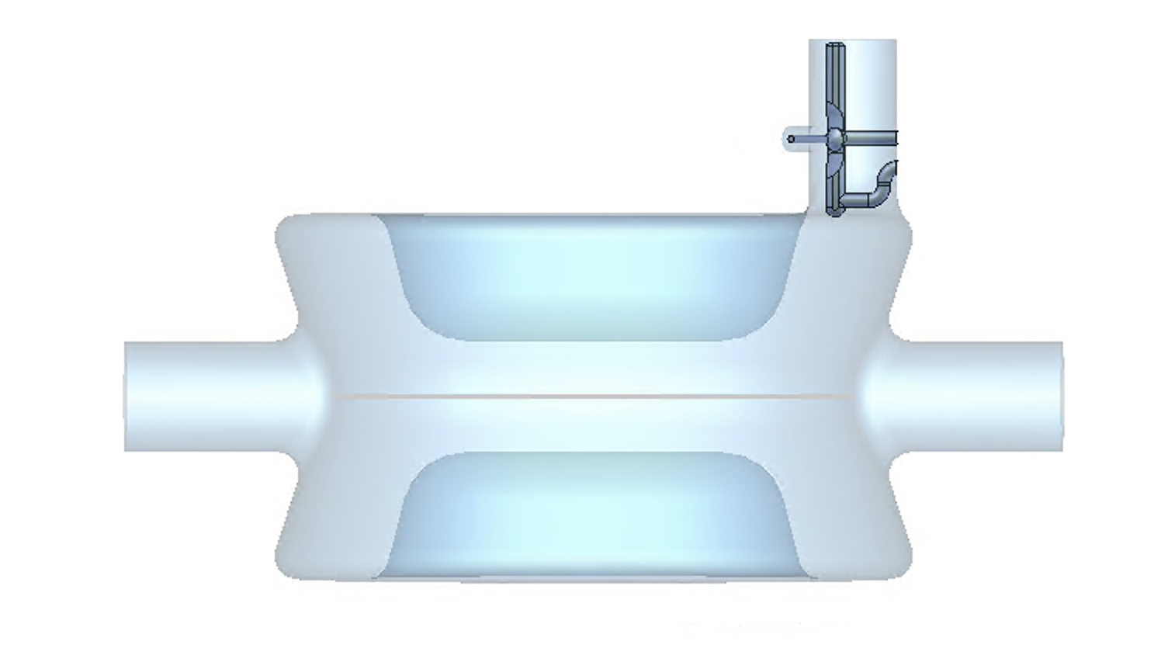
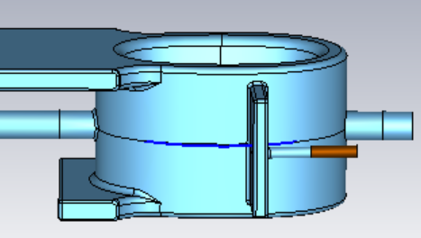
Double Quarter Wave 1.3 GHz
S Andres Verdu (BNL)
Promising results using single Tesla-type coupler.
CM easily fits within 3.8 m envelope.
~3 orders magnitude HOM damping required.
Combination of both hook and waveguide HOM dampers anticipated.
Freq TE11 cutoff (25 mm diameter) = 7 GHz
Zx, Zy
THRESHOLD
X=hor.
Y=vert.

Slide 11
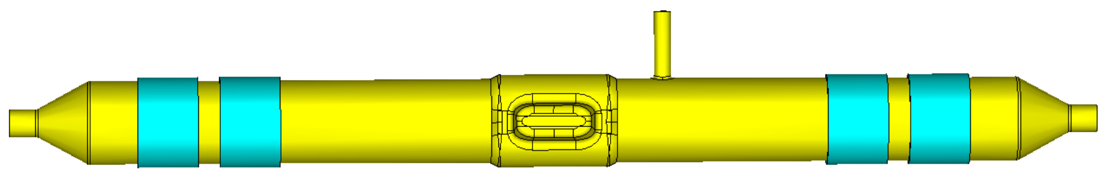
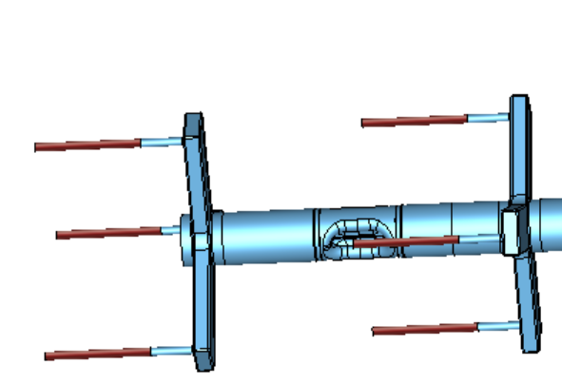
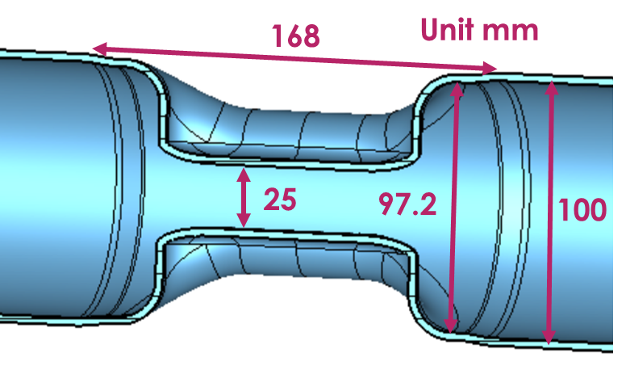
Wide Open Waveguide 1.3 GHz
B Xiao (BNL)
25 mm pole-separation, with 100 mm beam-pipe.
HOM waveguides preferred to Beam Line Absorber – shorter structure.
SOM can also attenuate in waveguides.
First transverse HOM at ~1.8GHz, first longitudinal HOM at ~2.3GHz.
Property | Value
Operating frequency [GHz] | 1.300
1st longitudinal HOM [GHz] | 2.299
1st transverse HOM [GHz] | 1.765
E_{p}/E_{t} with E_{t}=V_{t}/(λ/2) | 3.24
B_{p}/E_{t} [mT/(MV/m)] | 5.75
B_{p}/E_{p} [mT/(MV/m)] | 1.77
G [Ω] | 130.9
R/Q [Ω] | 454.3
R_{t}R_{s} [Ω²] | 59446

Slide 12
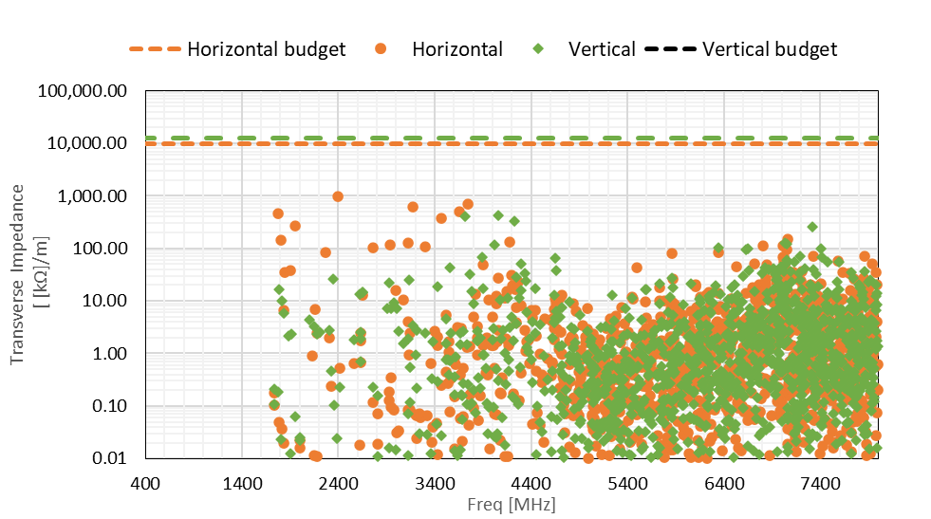
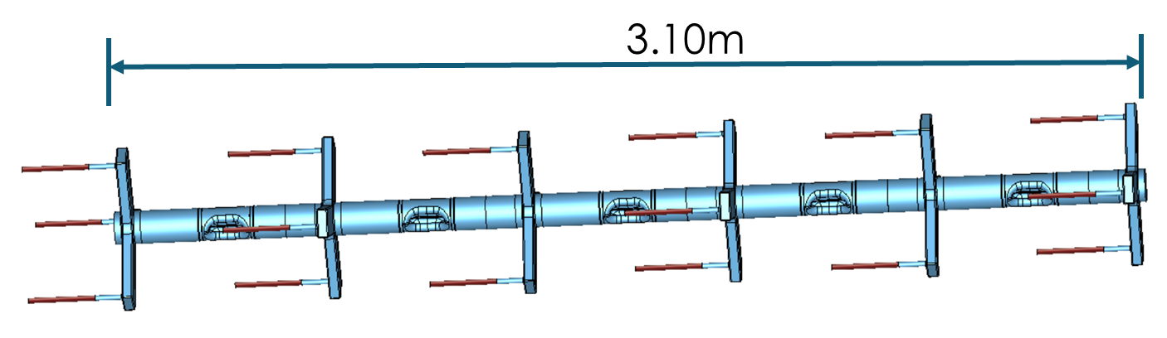
Wide Open Waveguide 1.3 GHz
B Xiao (BNL)
1.845 MV for 125 GeV case and 7.4 MV for 500 GeV required.
2 cavities for 125GeV (1.48MV/cavity) or 5 cavities for 500 GeV.
Considering to electrically short 1 WG to reduce the number of coax on each circular pipe from 3 to 2 (re: Jlab ERL-FEL scheme).
FPC Qe = 3 x 10⁶, requires 850 W RF power.

Slide 13
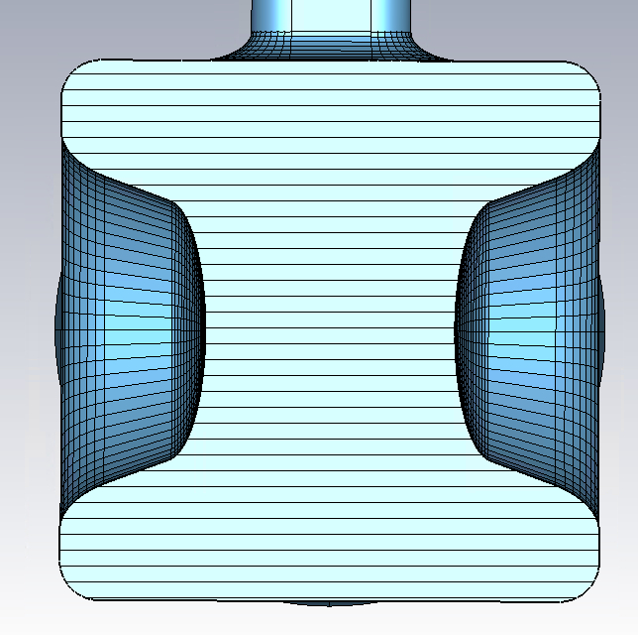
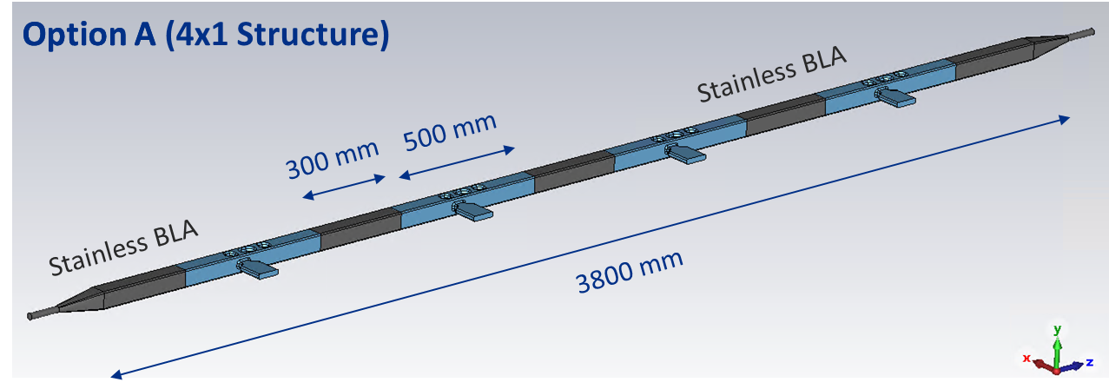
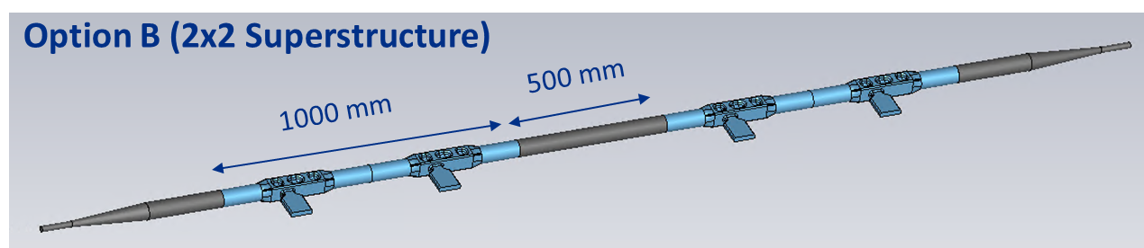
Quasi-waveguide Multicell Resonator 2.6 GHz
A Lunin/S Yakovlev (FNAL)
ILC Crab Cavity Aperture Limit: Ø25 mm
SOM strongly coupled with WG-port, Qext < 5x10³
HOM spectrum is sparse and loaded to a beam pipe
4 QMiR cavities can provide Vt ~ 4 MV for 1 TeV option
Freq | 2600 MHz
V_{kick} | 0.92 MV
(R/Q)_{t} | 225 Ω
G-factor | 130
W_{STORED} | 0.24 J
Length | < 500 mm
Ø25
□ 54 mm
HOM Transverse Impedance, Ω
Blue –horizontal, Red -vertical
Two options are considered, a chain of 1x4 and 2x2 cavities
Simple stainless-steel inserts to damp HOMs
Ceramic BLA can be a backup if needed.

Slide 14
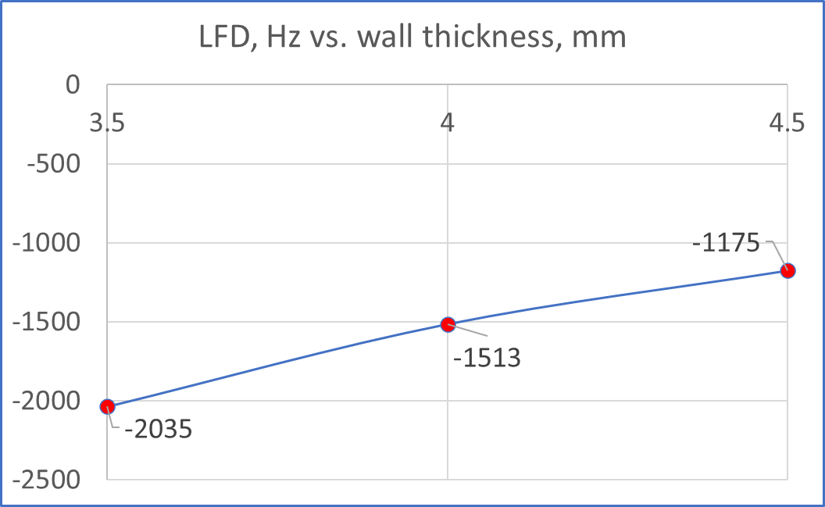
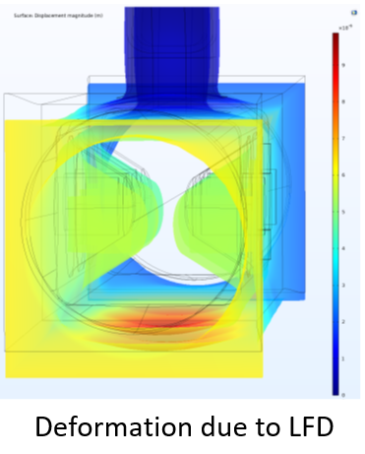
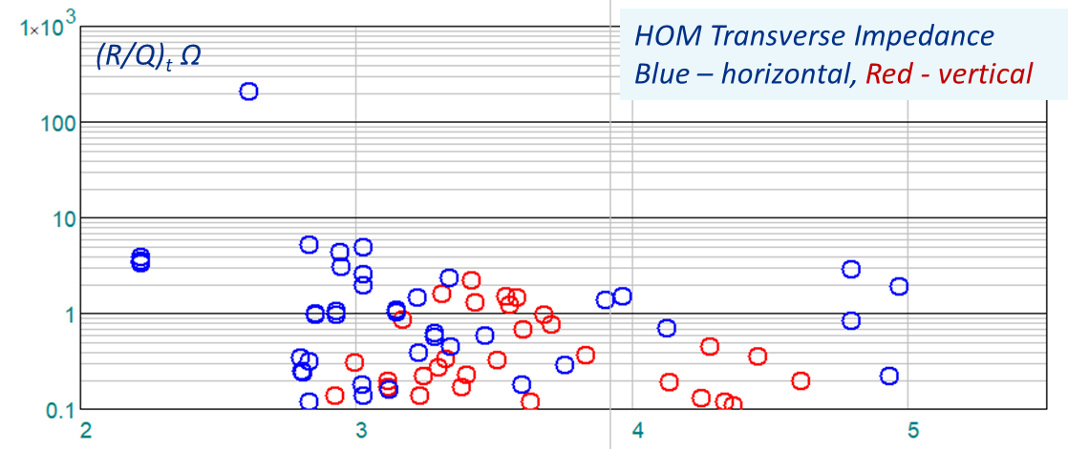
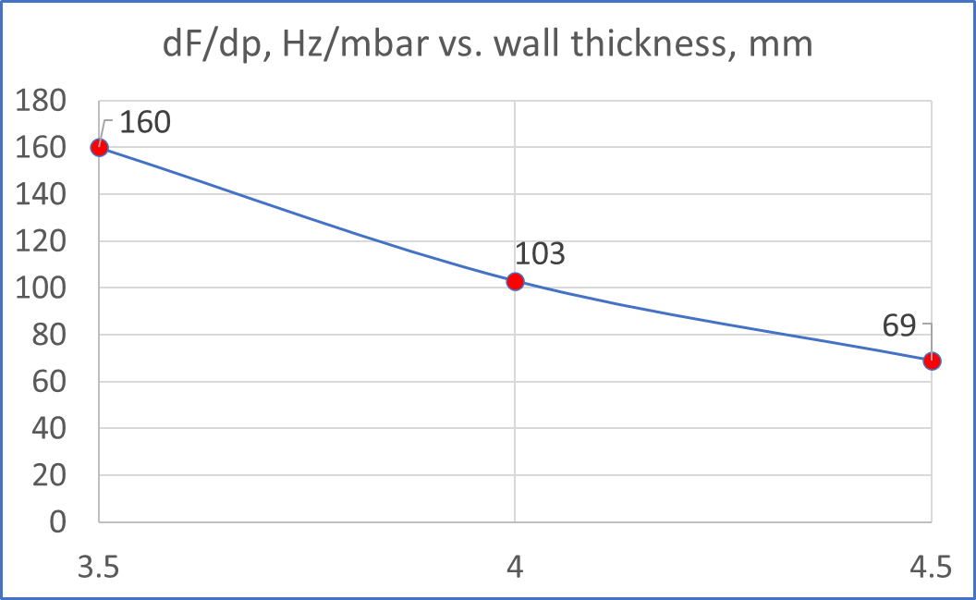
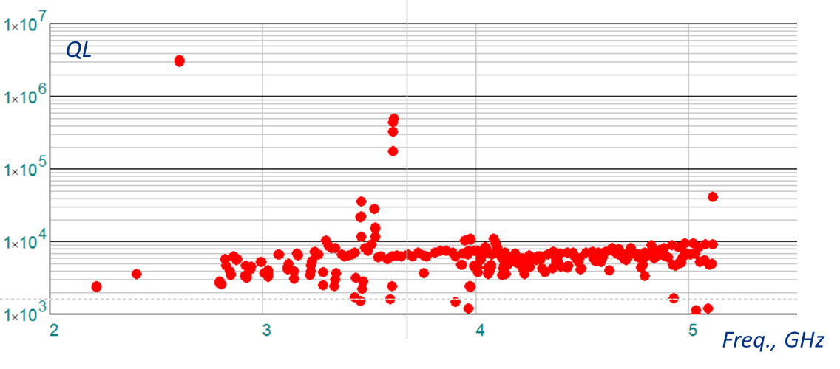
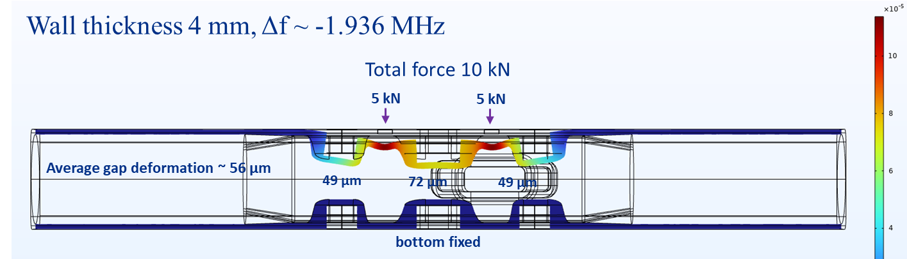
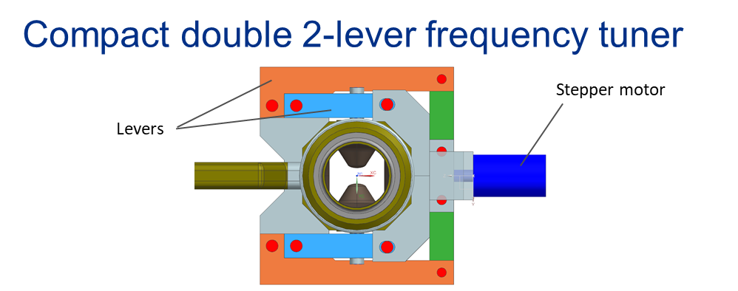
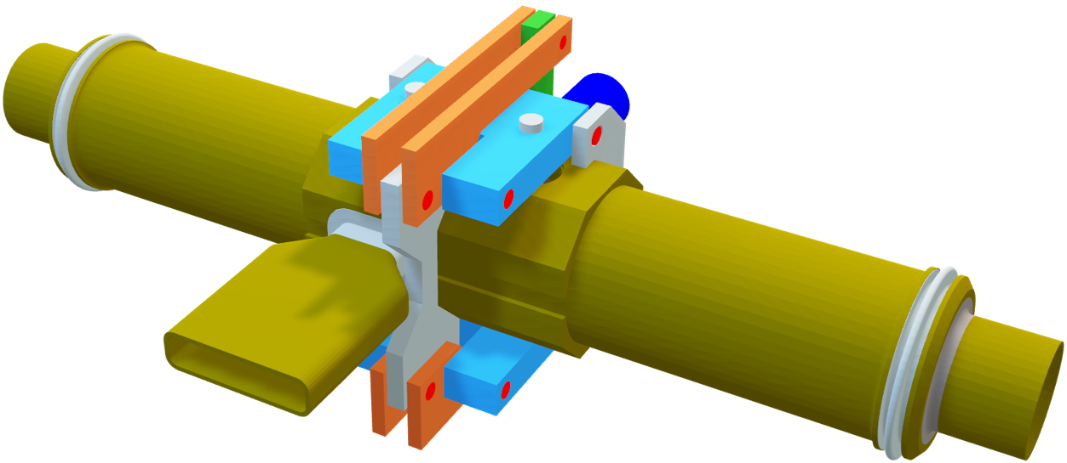
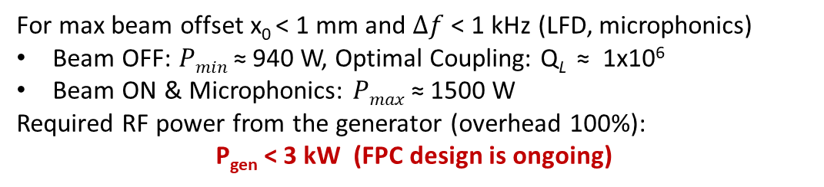
Quasi-waveguide Multicell Resonator 2.6 GHz
A Lunin/S Yakovlev (FNAL)
Option B
(R/Q)_{x} < 8 Ω
LFD < 1.5 kHz
dF/dP < 150 Hz
(R/Q)_{y} < 3 Ω
Dipole HOM
QL < 5E5
Expected frequency tuning range: ~ 2 MHz (1 MHz)
For max beam offset x₀ < 1 mm and $Δf$ < 1 kHz (LFD, microphonics)
Beam OFF: $Pmin$ ≈ 940 W, Optimal Coupling: Q_{L} ≈ 1x10⁶
Beam ON & Microphonics: $Pmax$≈ 1500 W
Required RF power from the generator (overhead 100%):
P_{gen} < 3 kW (FPC design is ongoing)

Slide 15
Crab Cavity Parameters
Design teams to converge on consistent parameters

Slide 16
Next Stage WP3 CC Preparations
For a future down-selection process:
Agree the criteria to develop for each of the CC designs:
  Cavity
  Couplers (input and HOM)
  Pressure stability and tuning
  Multipacting
  Fabrication (Sheet/Ingot/Mixed, Nb material required, readiness detail)
  Anything else (level of design detail expected (bare/dressed)
WP3 meeting proposed to review and agree criteria in Nov/Dec.
What’s left to complete for each of the design options currently?
What are the expected timescales to complete – try and agree/set today?
What alignment is needed with ILC IDT processes – timescales likely? (Spring 2023?)
Context for a proposed down-selection review:
  Terms of reference to be developed/agreed.
  Specialist membership – who defines/invites?
  IDT output anticipated and when?
(From WP3 Design Review #3 discussions)

Slide 17
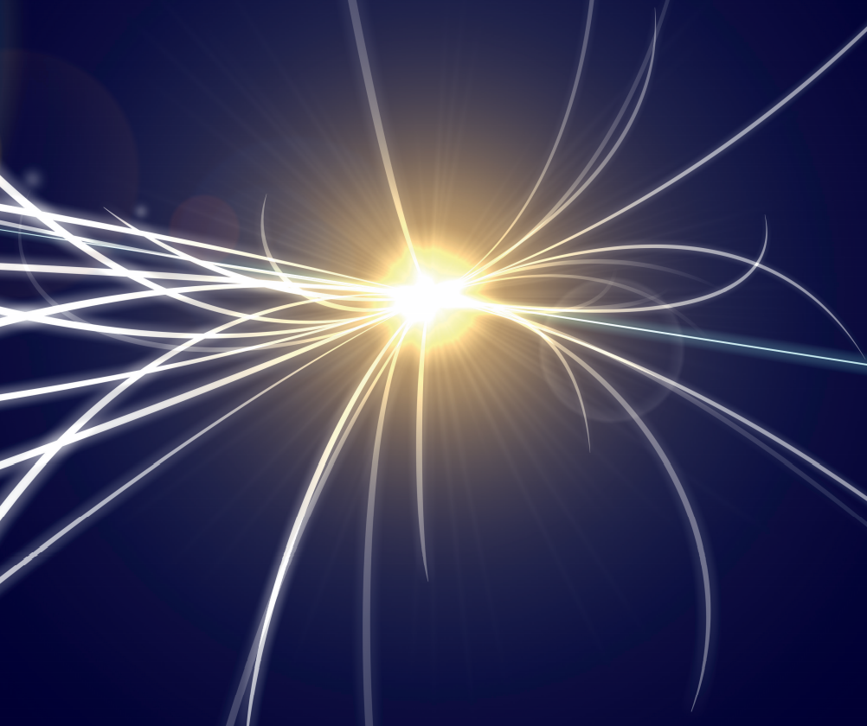

MANY THANKS
Questions?

