Slide 1
Sources Subgroup Summary
IDT-WG2, Nov.1. 2022, K. Yokoya
Oct.24 32nd Regular meeting
  Andriy Ushakov, Andy Lankford, Carlos Hernandez-Gracia, Gudi Moortgat, Hitoshi Hayano, Jenny List, Kaoru Yokoya, Peter Sievers, Phil Burrows, Reza Kazami, Sabine Riemann, Shin Michizono, Silviu Covring Dusa, Spencer Gessner, Steffen Doebert, Tsunehiko Omori, Yoshinori Enomoto,
  Indico https://agenda.linearcollider.org/event/9835/
Talk
  “Positron source for SuperKEKB”
    Y. Enomoto
      The leader of the positron group in Japan since September
      now joined in the WG2 sources group
    Uploaded as 221024-IDT-source-enomoto.pptx (.pdf)
      Big report (55 pages)
Next meeting
  Presumably on Nov.21

Slide 2
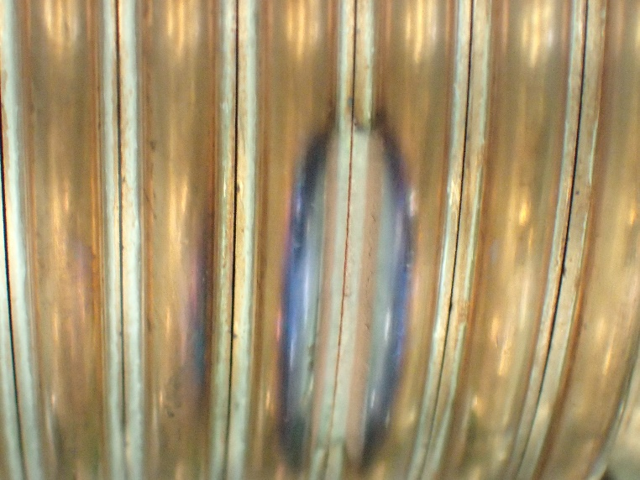
Positron source for SuperKEKB
Topics from Enomoto’s slides
From 1 nC to 3.5 nC
2016 SKEKB phase 1 started (<1nC)
2020 Major upgrade of e+ source (~ 3.5nC)
  Solve discharge problem of FC
    Change material of FC head
    External circuit to reduce voltage
  Improve beam handling
    Install steering coils inside the solenoid
Toward 4 nC and above
  Shorten distance between FC and 1st acc. Structure
Another topics
  Rotating target
  Full model simulation
  Magnetic field measurement at test bench
  Evaluation of W and W-Cu connection

Slide 3
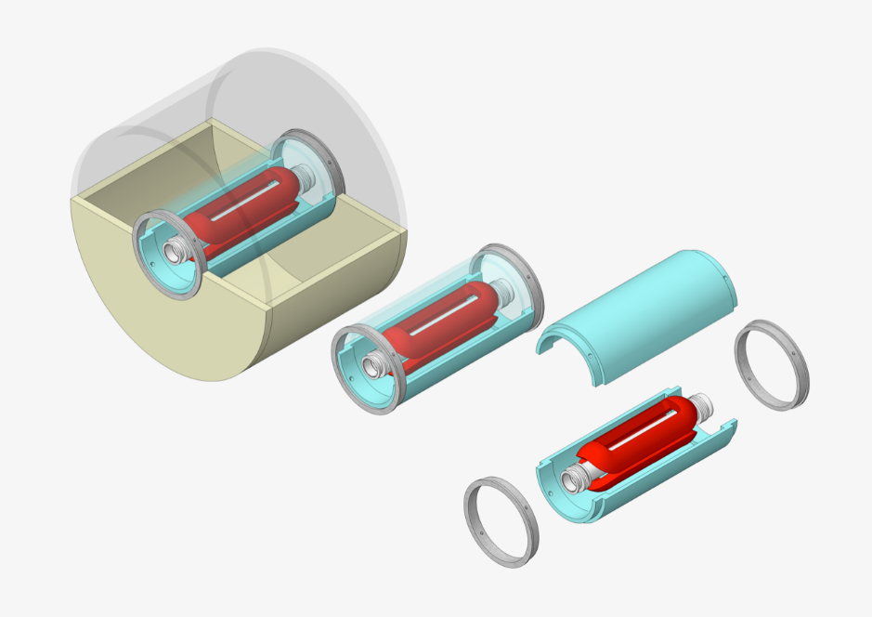
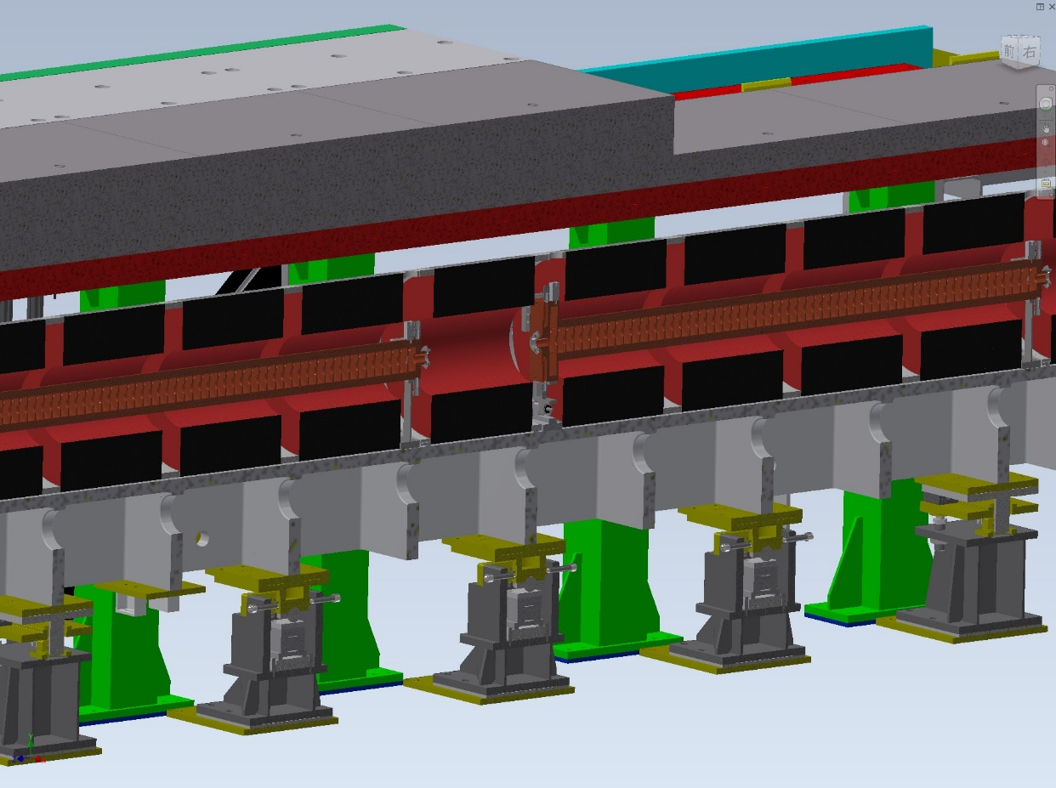
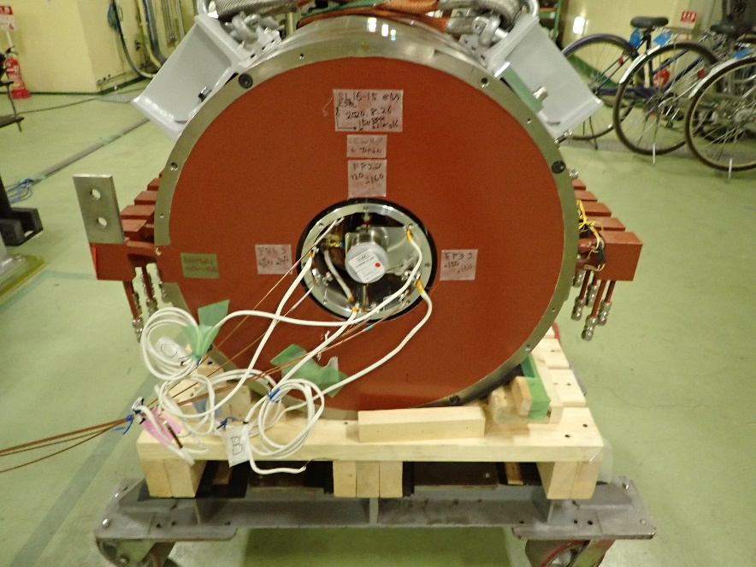
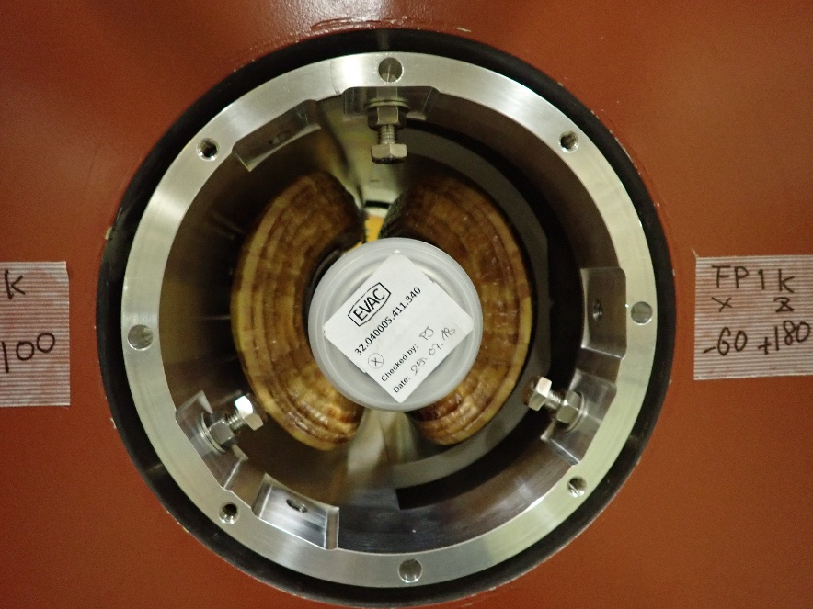
BPM and steering coils inside solenoid
There had been no BPM/steering for 22m from the target
Steering coil
support
BPM
K. Yokoyama and K. Kakihara

Slide 4
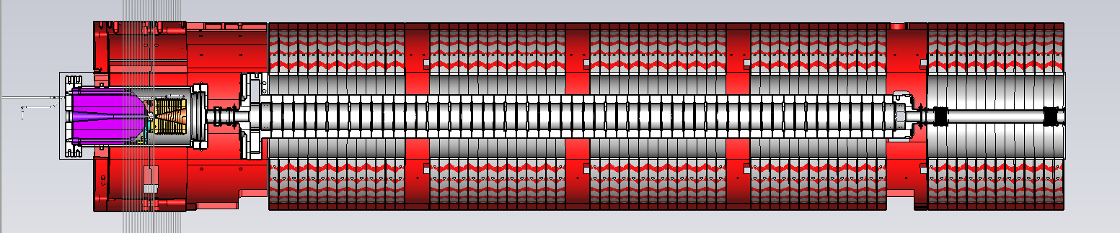
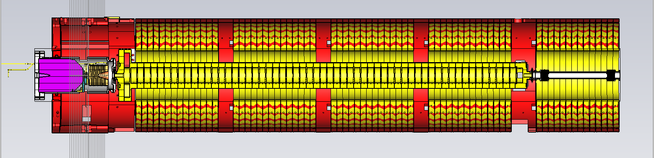
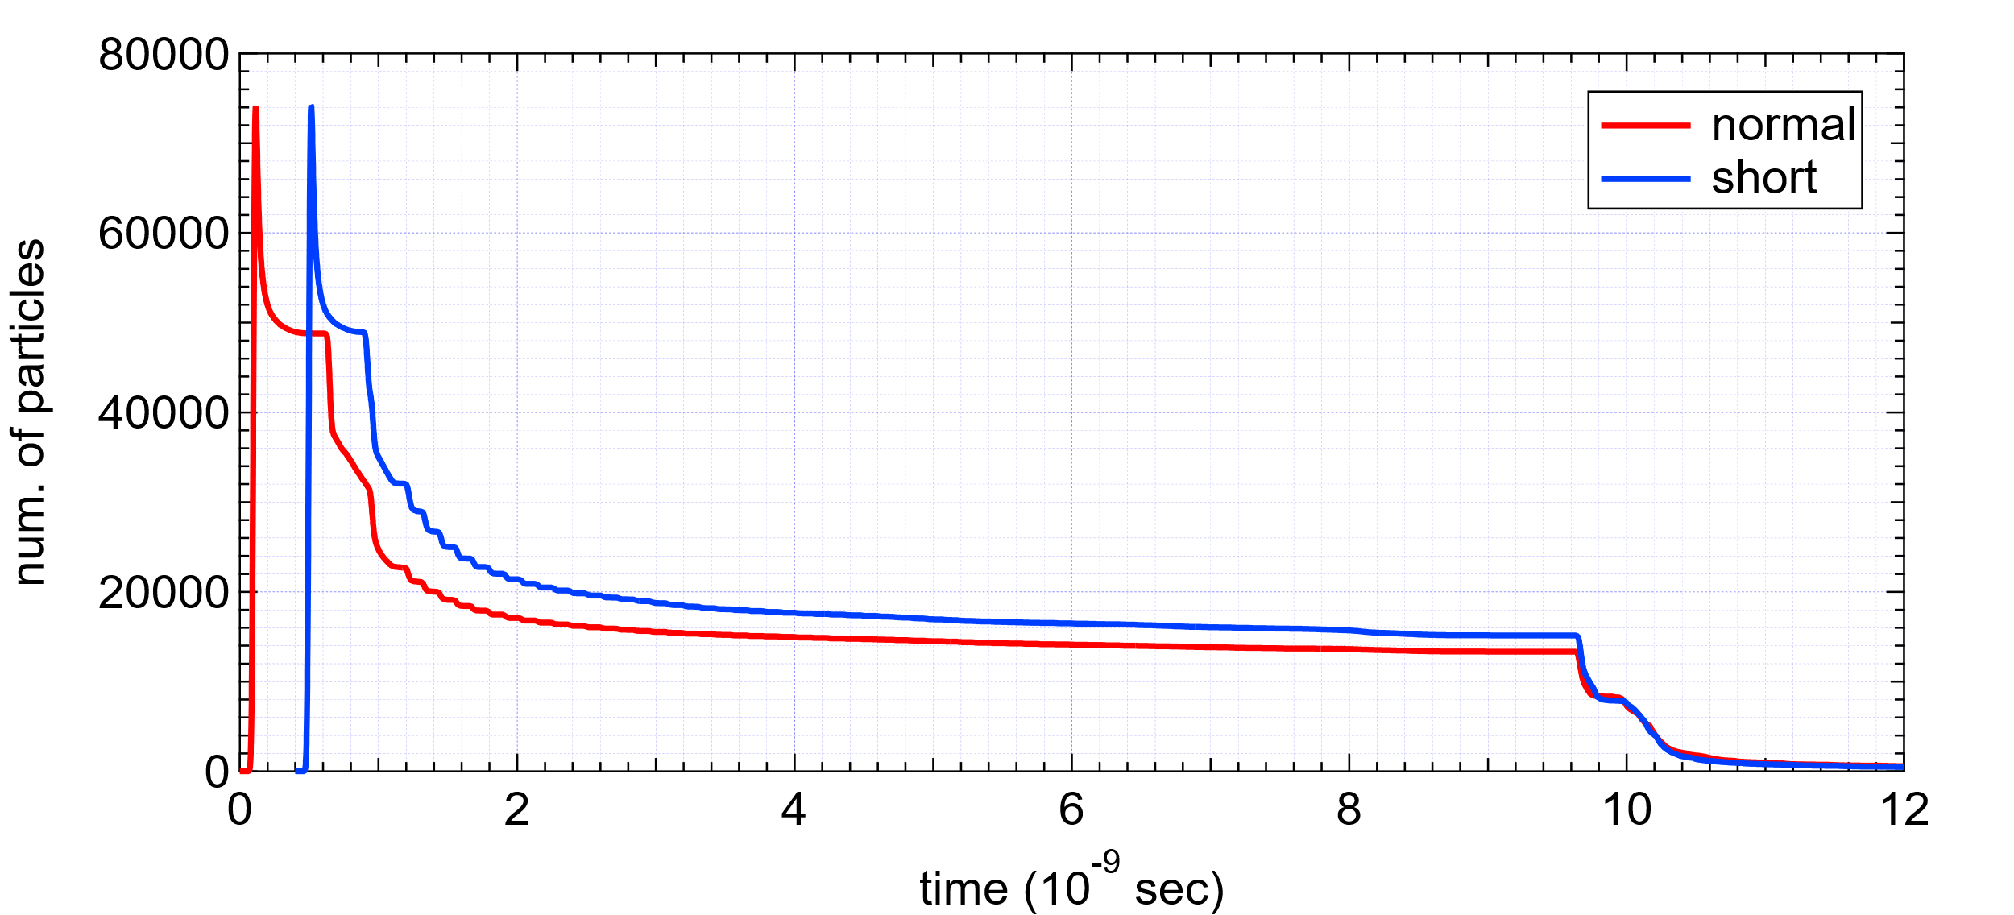
Shortended the distance from FC to cavity by ~120mm
~ 30% increase of the yield
Correspond to pC

Slide 5
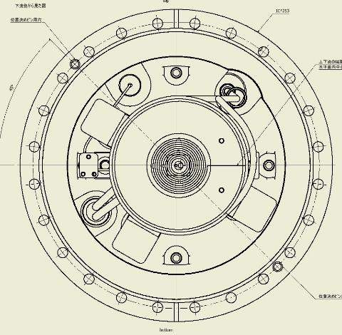
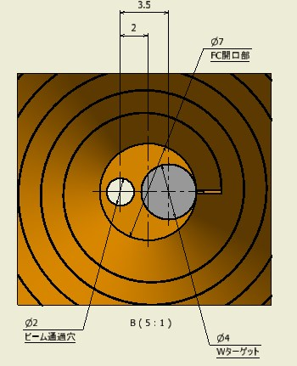
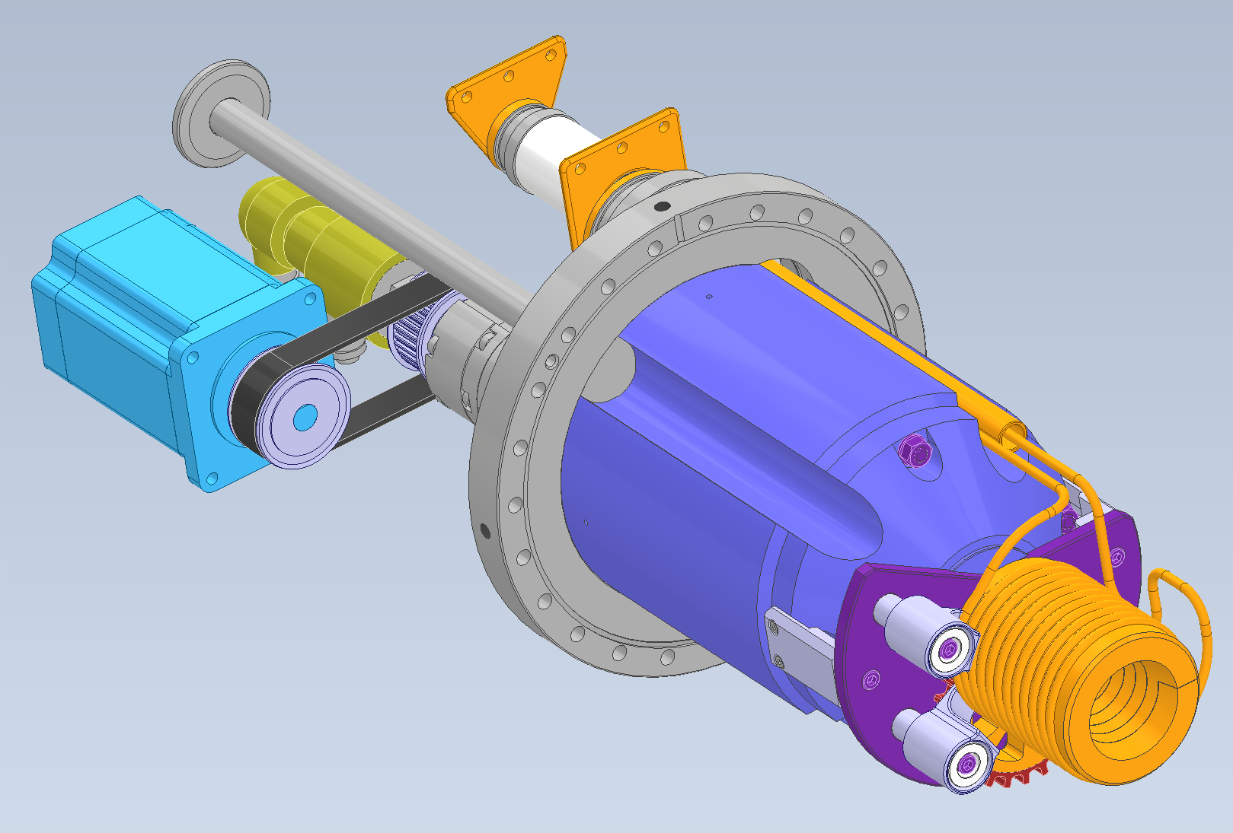
SuperKEKB positron source 3
Target material : W
Target size : Φ4 x 14
Inserted in the pule Cu block
Connected by HIP process
X = 0 hole for electron
X = 2 center of the FC
X = 3.5 center of the W target
Introduce rotating target in this asymmetric structure
X = 0
Small hole limit tuning flexibility for electron beam
Switch free space and W target within 20 ms (50 Hz)
Prototype design finished

Slide 6
From SuperKEKB to ILC
There are many common and similar tasks.
  Experience in SuperKEKB will useful for designing positron source for ILC.
  Collaboration with many other project like SuperKEKB, FCC, CLIC, CEPC etc. is important.
  Collaboration with non-accelerating institute is also important.
Target and plan for ILC positron source
Prepare for manufacturing prototype when pre-lab launched
  EDR + Drawings + mockup
    Test and develop critical components
    Simulation
    3D model

