Slide 1
ILC Racetrack Crab Design
Prof Graeme Burt, Lancaster University / Cockcroft Institute

Slide 2
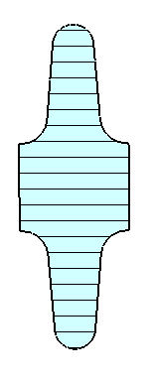
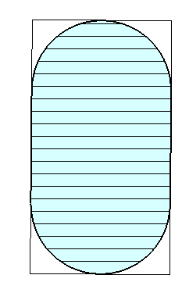
Re-optimizing the ILC crab
Minor radius
250 GeV ILC requires a 3-cell cavity @ 5 MV/m, or 2x2-cells at @4.2 MV/m
4 x 3 cells @5.5 MV/m or a 5x2 cells @6.5 MV/m at 1 TeV
Equator rounding radius
Iris rounding radius
Major radius

Slide 3
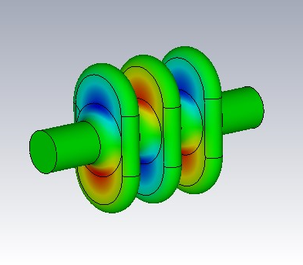
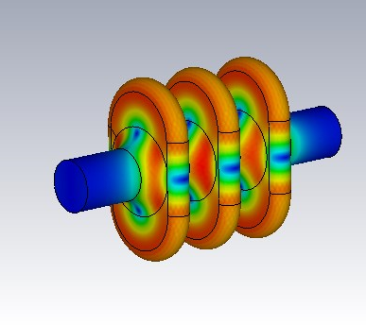
3 cell cavity
End cells initially had lower peak magnetic field
Larger beampipes were used on the end cells to aid damping (30 mm)
Slightly higher B field means that gradient is limited to 9.7 MV/m at 80 mT
R_{t}/Q=132 Ohms
E field
B field

Slide 4
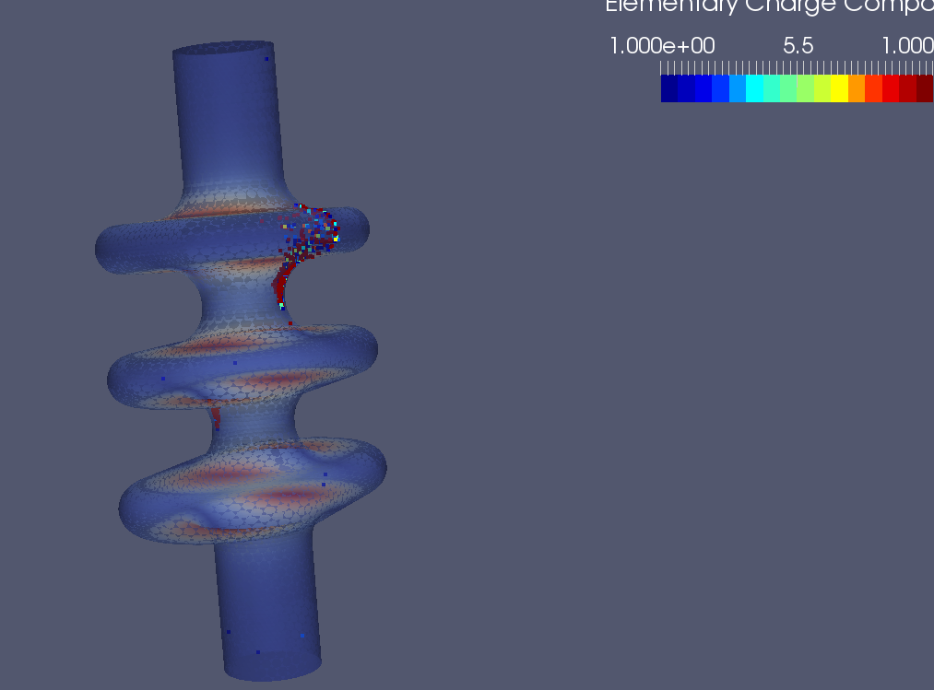
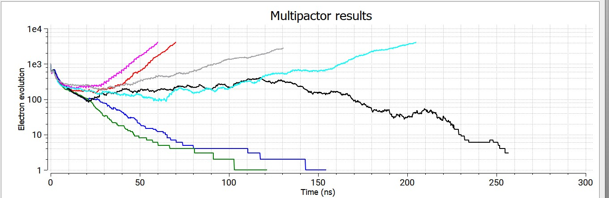
Multipactor
Multipactor band found at 7.15 MV/m on minor axis iris.
Required gradient is only 6.5 MV/m so this is acceptable
Appears very narrow band (not at 7 or 7.3 MV/m)

Slide 5
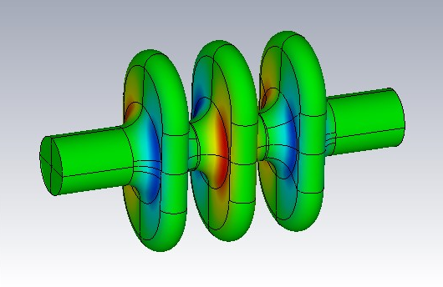
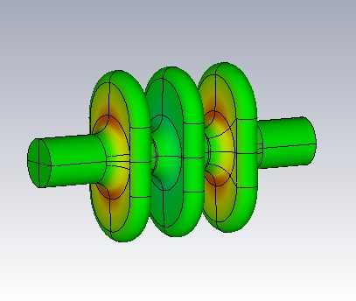
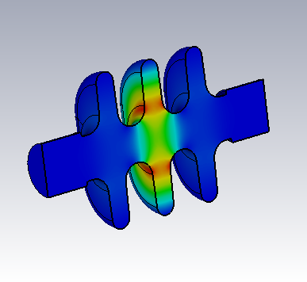
Same order and lower order modes
Highest impedance SOM is the pi mode at 5.07 GHz, Rt/Q is only 50 Ohms/m due to frequency not being synchronous.
Highest impedance LOM is the pi/2 mode at 3.32 GHz, R/Q is only 134 Ohms
Trapped mode in the centre cell may be difficult to damp so may be a larger issue

Slide 6
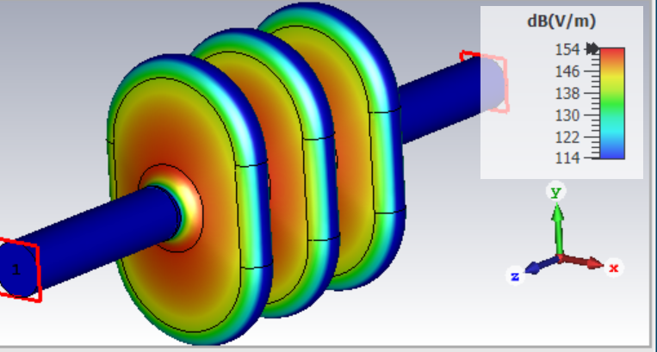
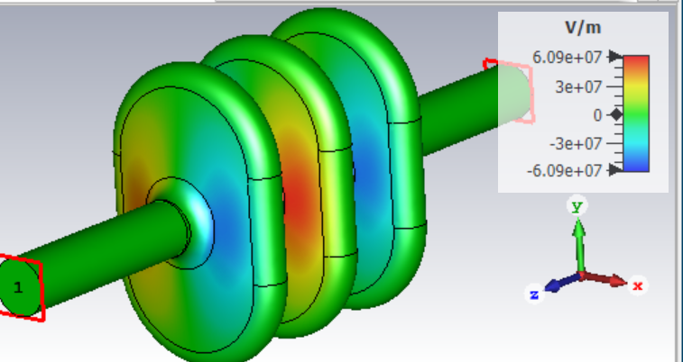
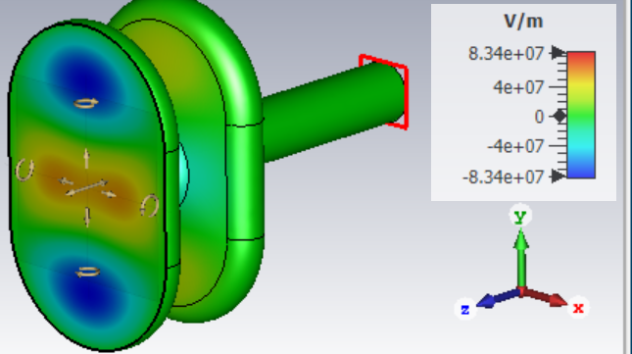
Mode spectrum

Slide 7
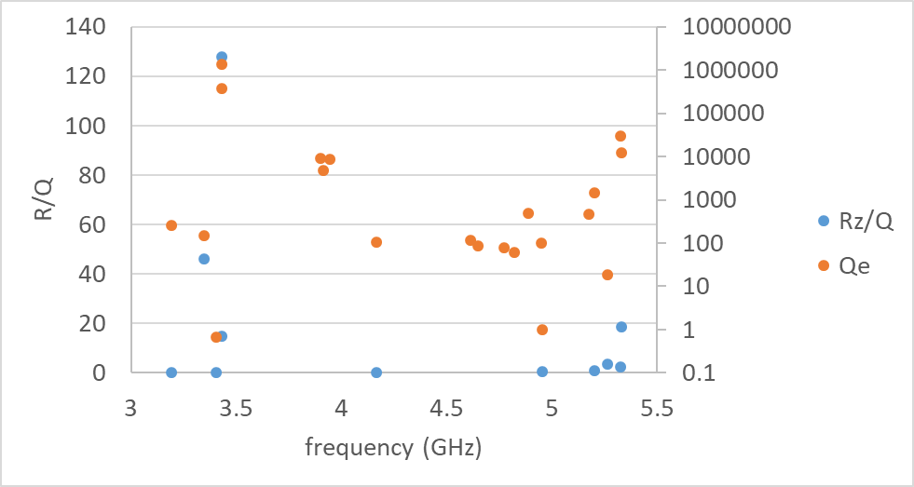
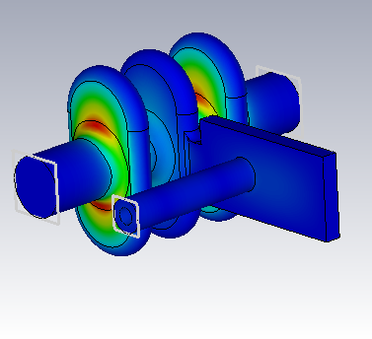
Waveguide damping
Considering a waveguide section with a coax coupled to it to minimize size and heat leak.
Coax can be positioned to prevent coupling to the crabbing mode.
Good damping overall except one mode, unfortunately the highest impedance mode.
Waveguide damper does damp the pi and 0 modes well but doesn’t damp the pi/2 modes but these will be damped strongly by a coax damper in the beampipes.

Slide 8
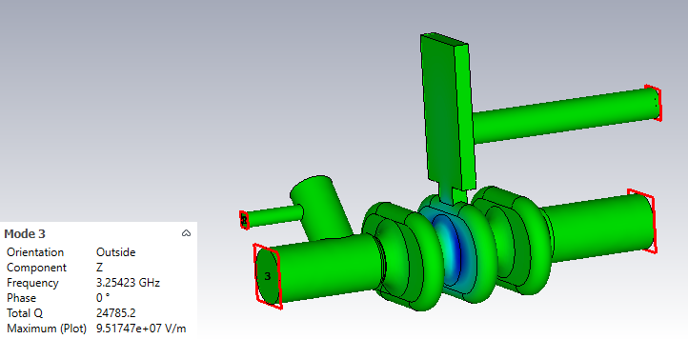
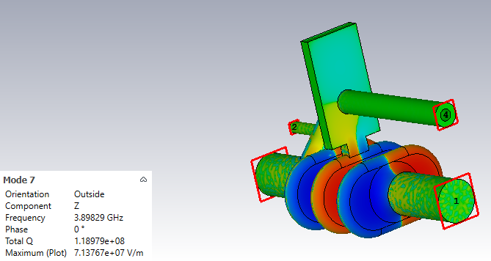
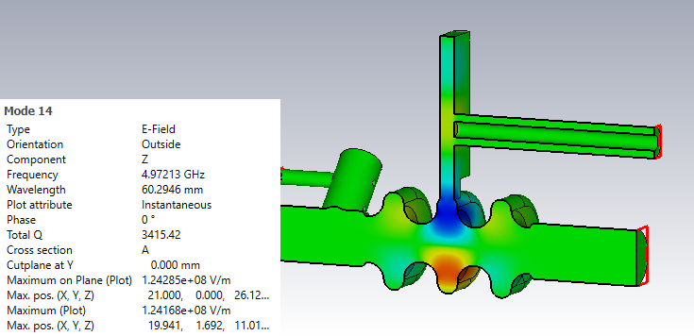
Waveguide damper with coax antenna
Waveguide has a coax antenna positioned at the field null in the waveguide at 3.9 GHz but field maxima at 3 and 5 GHz to damp LOM and SOM
LOM Q is 25,000 and SOM Q is 3,500

Slide 9
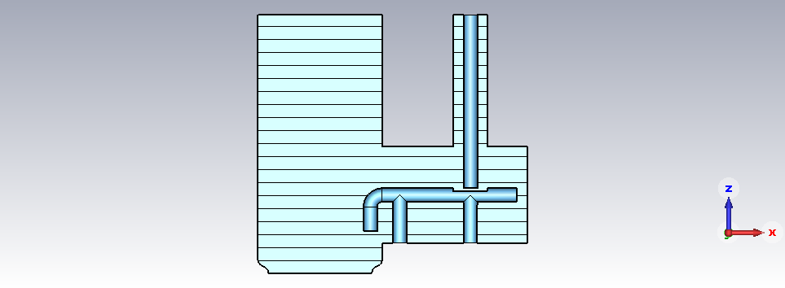
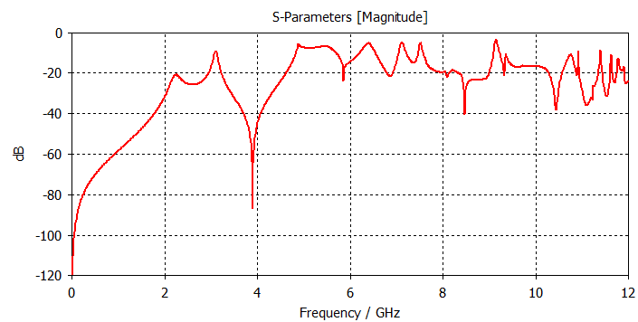
HOM coupler design
Modified version of old ILC HOM coupler, similar to ILC main linac coupler
Designed to have larger transmission at the LOM and SOM frequencies while filtering 3.9 GHz

Slide 10
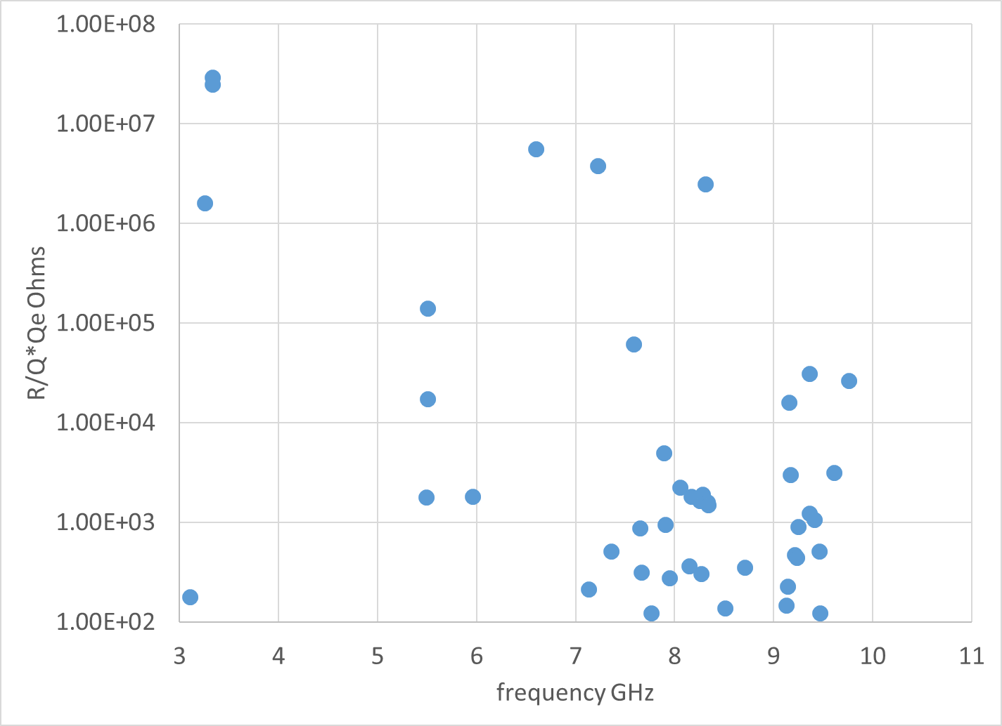
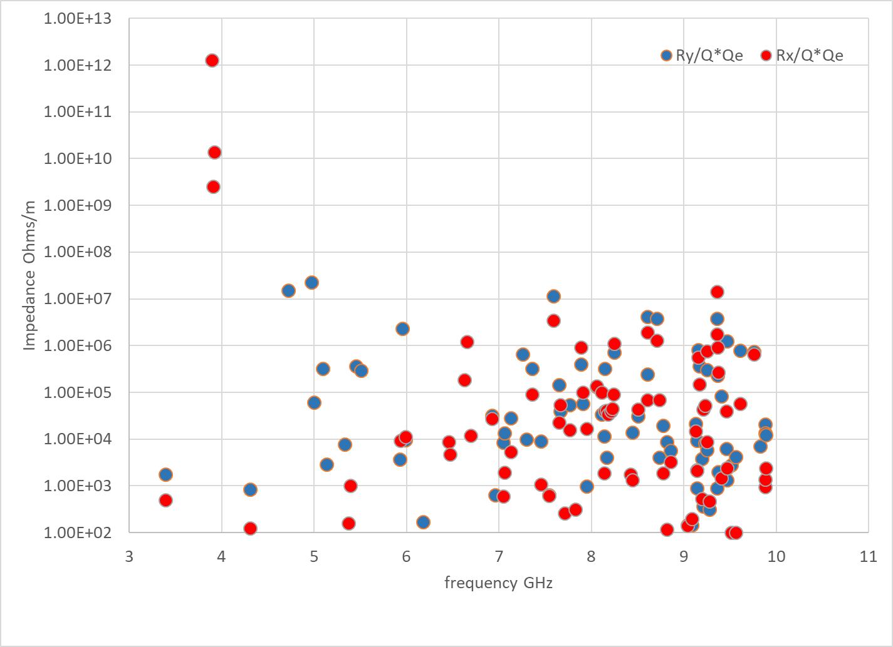
Impedance for waveguide damped 3 cell
ILC spec
The long. Impedance has no spec, the transverse impedance meets the spec except the other modes in the crabbing passband
The FPC may well damp these

Slide 11
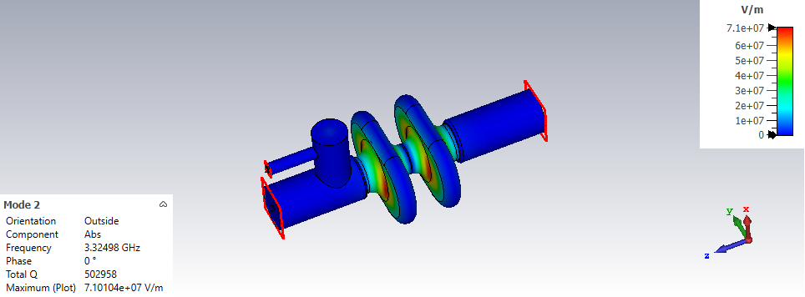
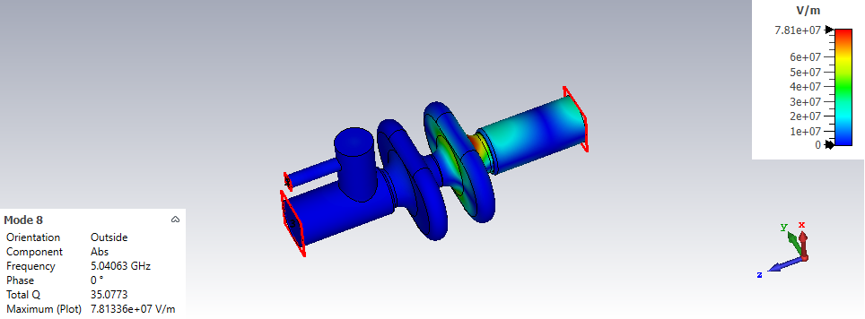
2 cell cavity
A 2 cell cavity has no trapped mode so the on-cell waveguide damper is no longer required
LOM Q factor increases to 500,000 so depends what the spec is
SOM Q is 35-100 so not an issue.

Slide 12
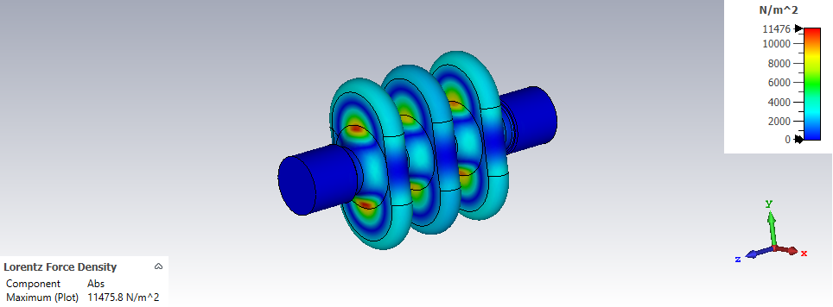
Lorentz force
Lorentz force is 4.6 kN/m^2 at 7 MV/m gradient which is fairly small
Equivalent to a 50 nm displacement
LF at 17 MV/m

Slide 13
Conclusions
Multipactor limit is 7 MV/m so we have set the cavity gradient at <6.5 MV/m
Trapped LOM in the middle cell could be an issue with a 3 cell cavity, requiring on-cell damping. A waveguide with a coax antenna provides sufficient damping while rejecting the crabbing mode
To avoid an on-cell damper a 2 cell cavity can be used
Both designs meet the ILC specification except the 0 and pi/2 crabbing modes
The modes in the crabbing passband could be damped by the FPC which needs investigation.

