Slide 1
IDT WG2 Activities
Benno List, DESY and CERN
ILC Europe Meeting
9.12.2022

Slide 2
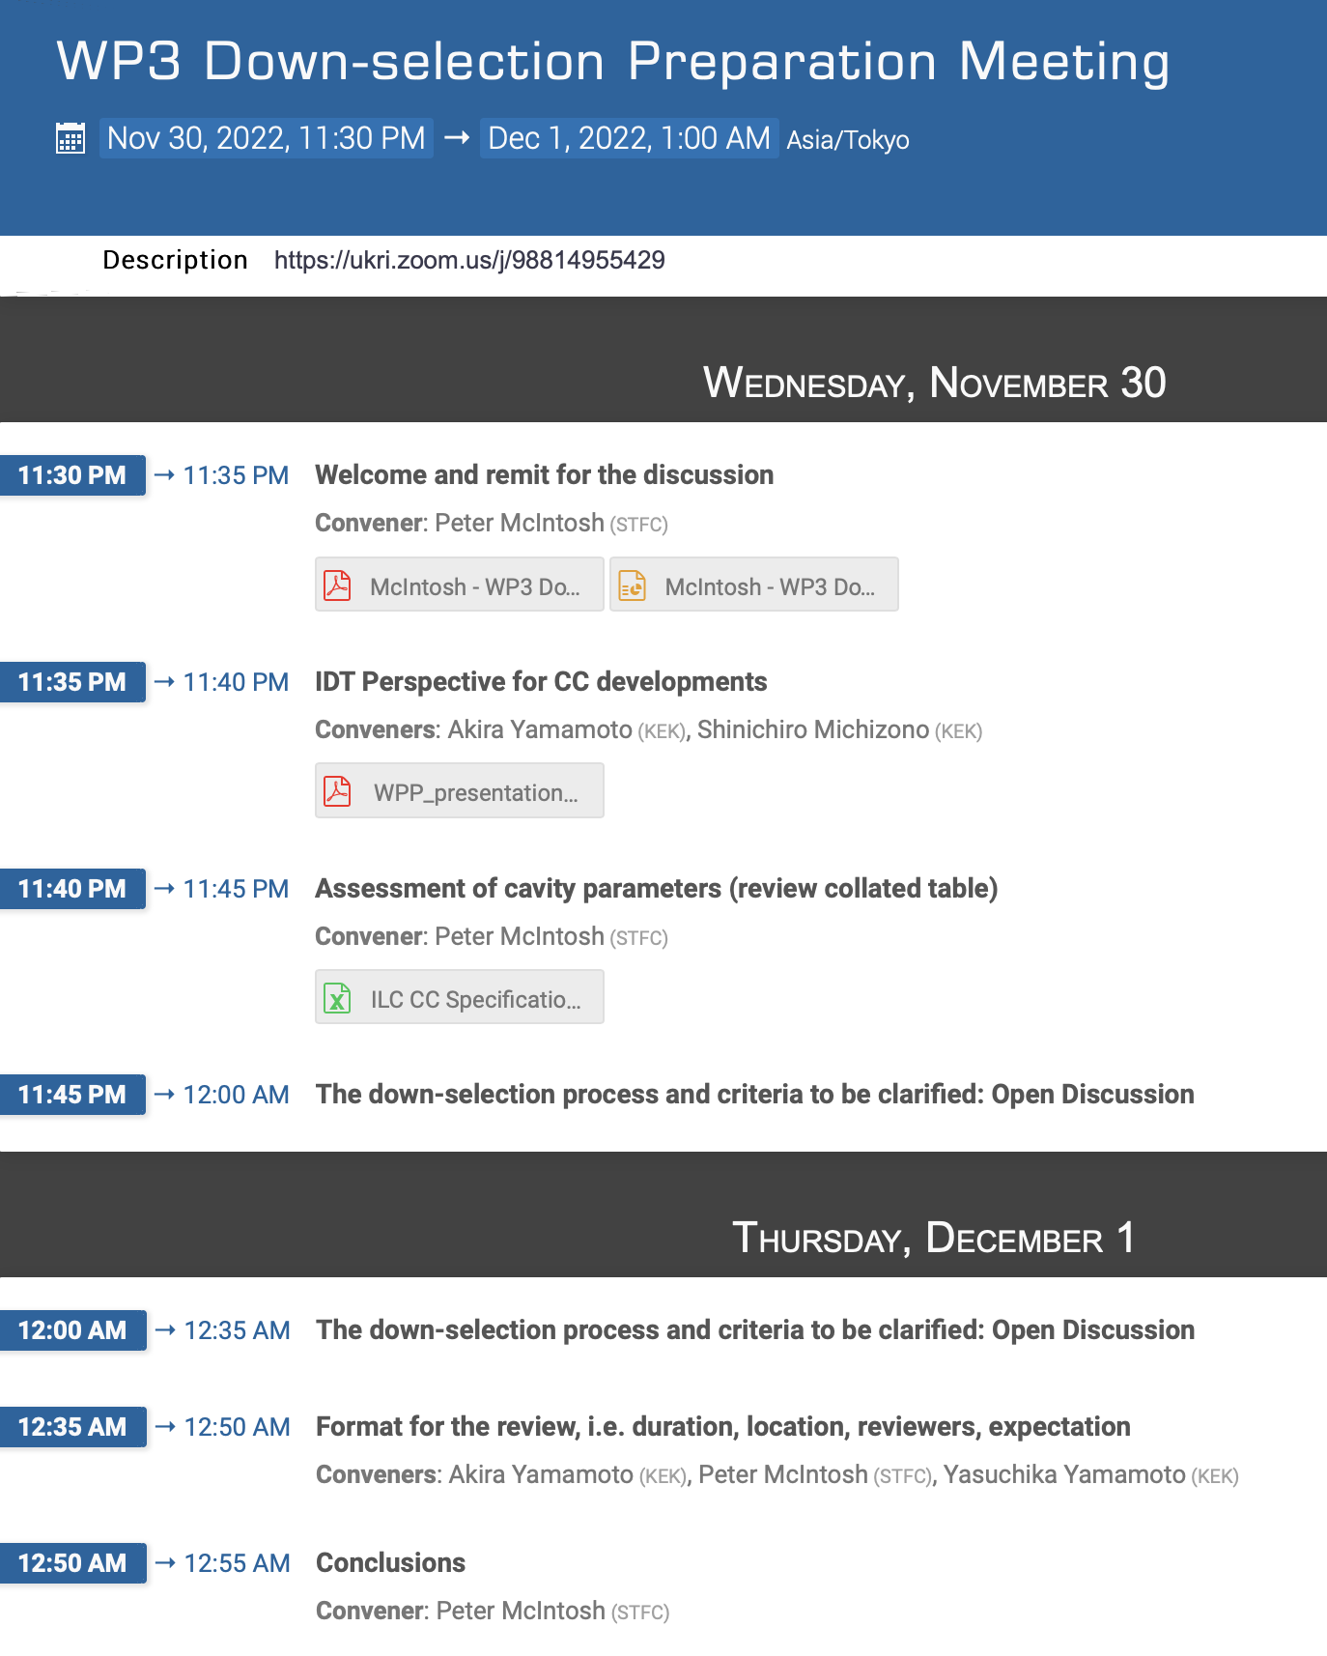
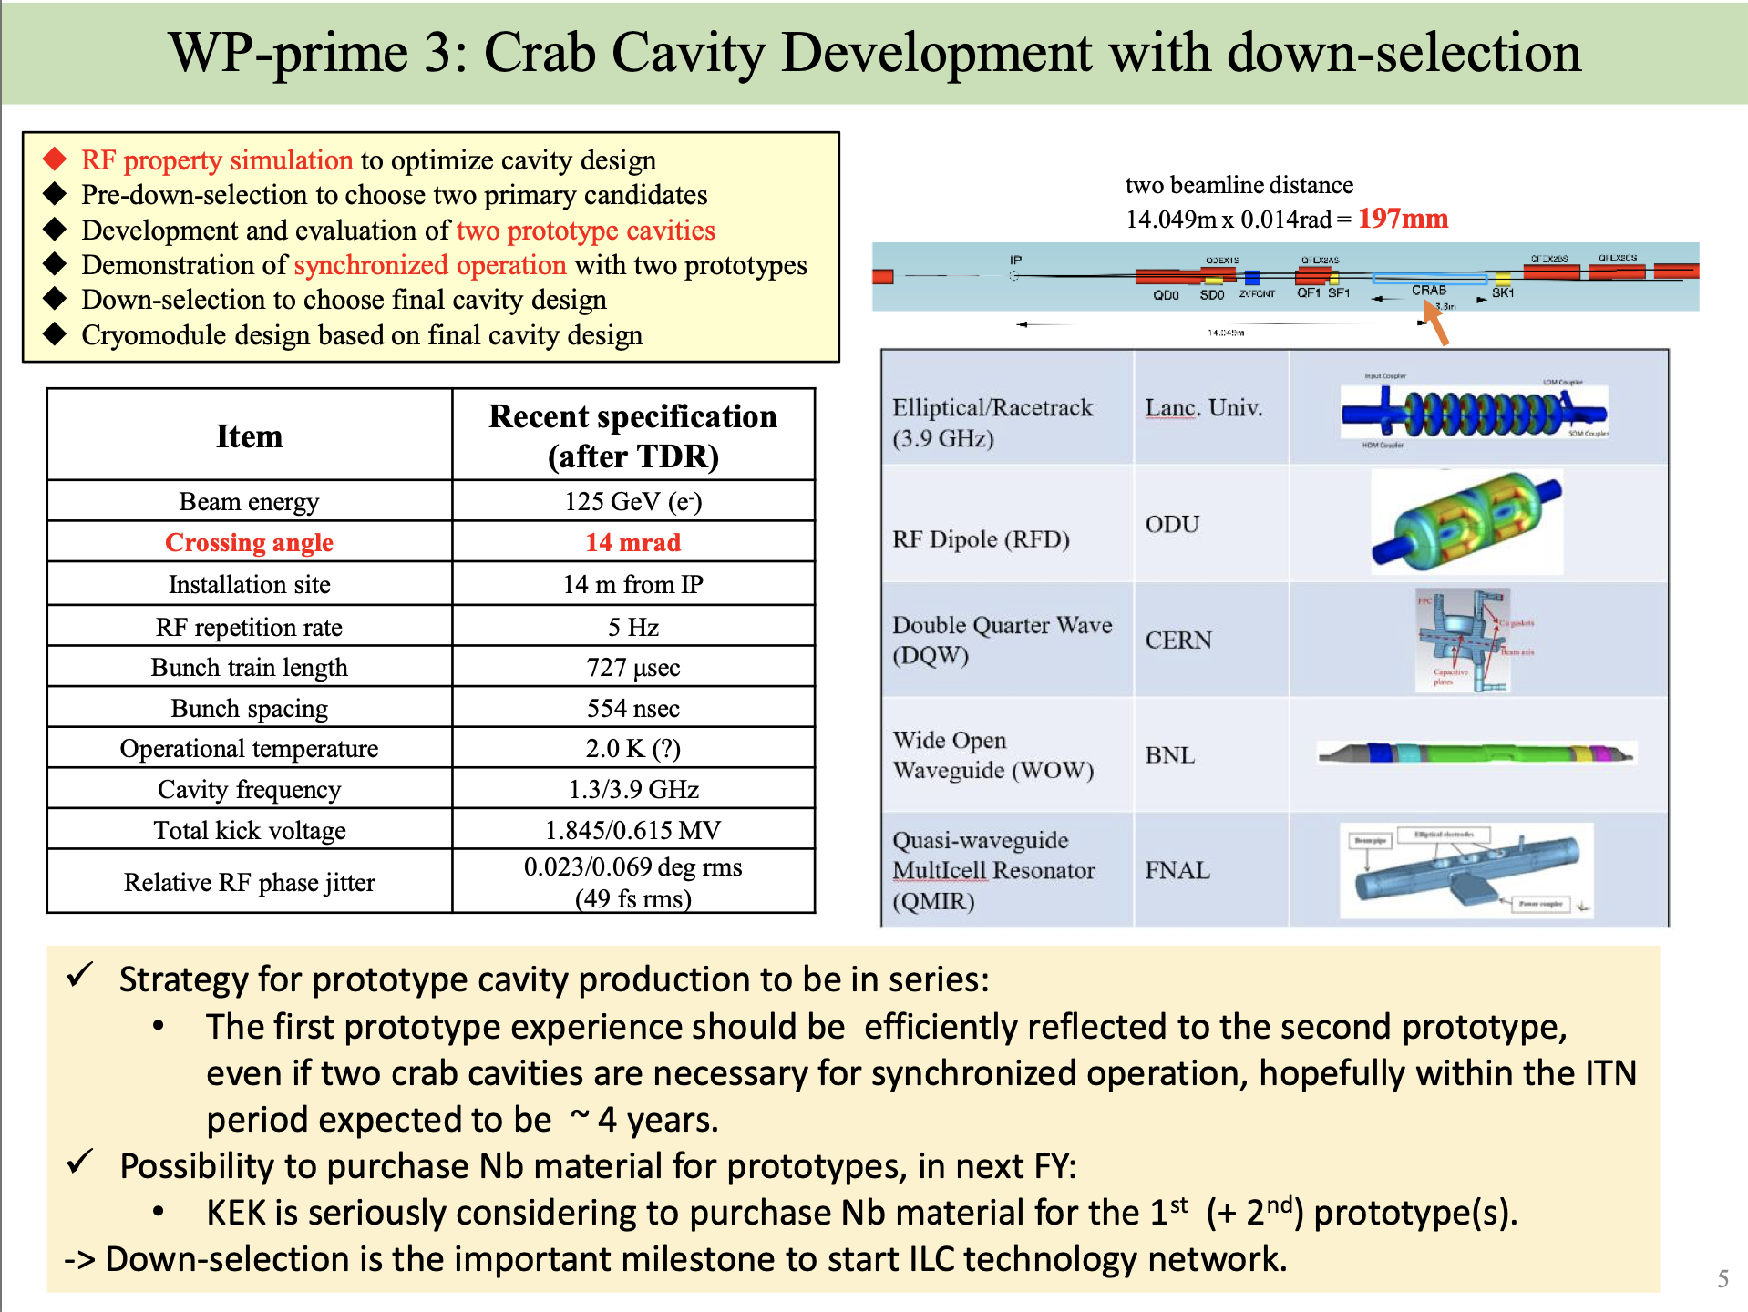
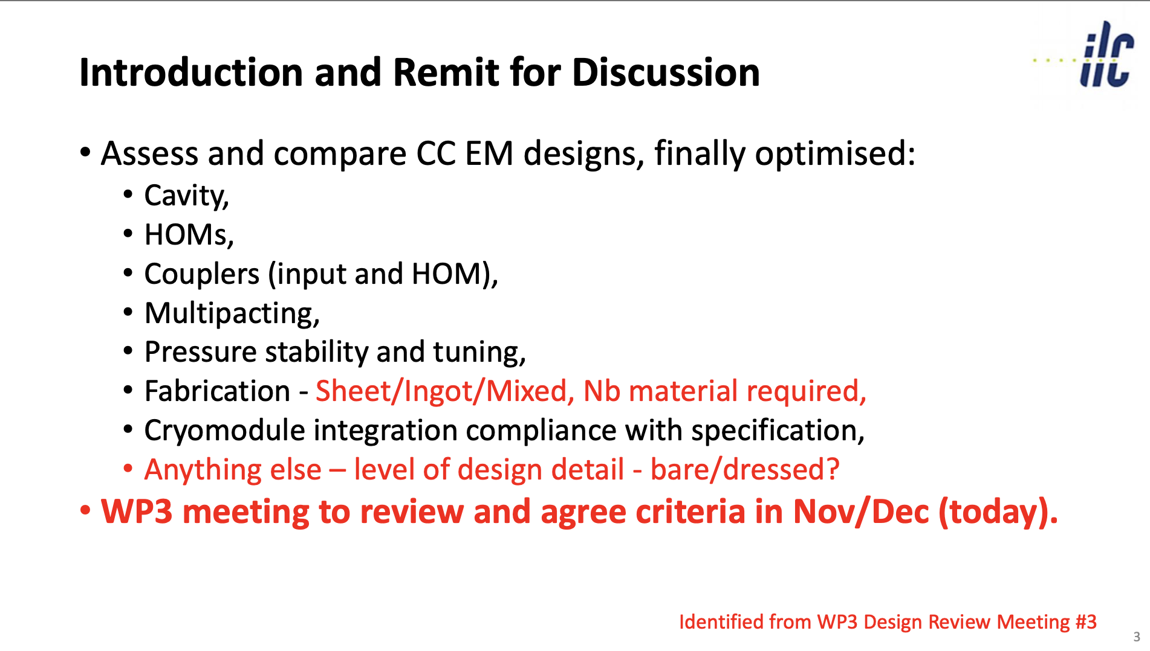
Crab Cavity: Design Downselect
30.11./1.12: crab cavity down-selection preparation meeting
https://agenda.linearcollider.org/event/9891/
Active effort with wide international participation, strong European role
S. Michizono
P. McIntosh

Slide 3
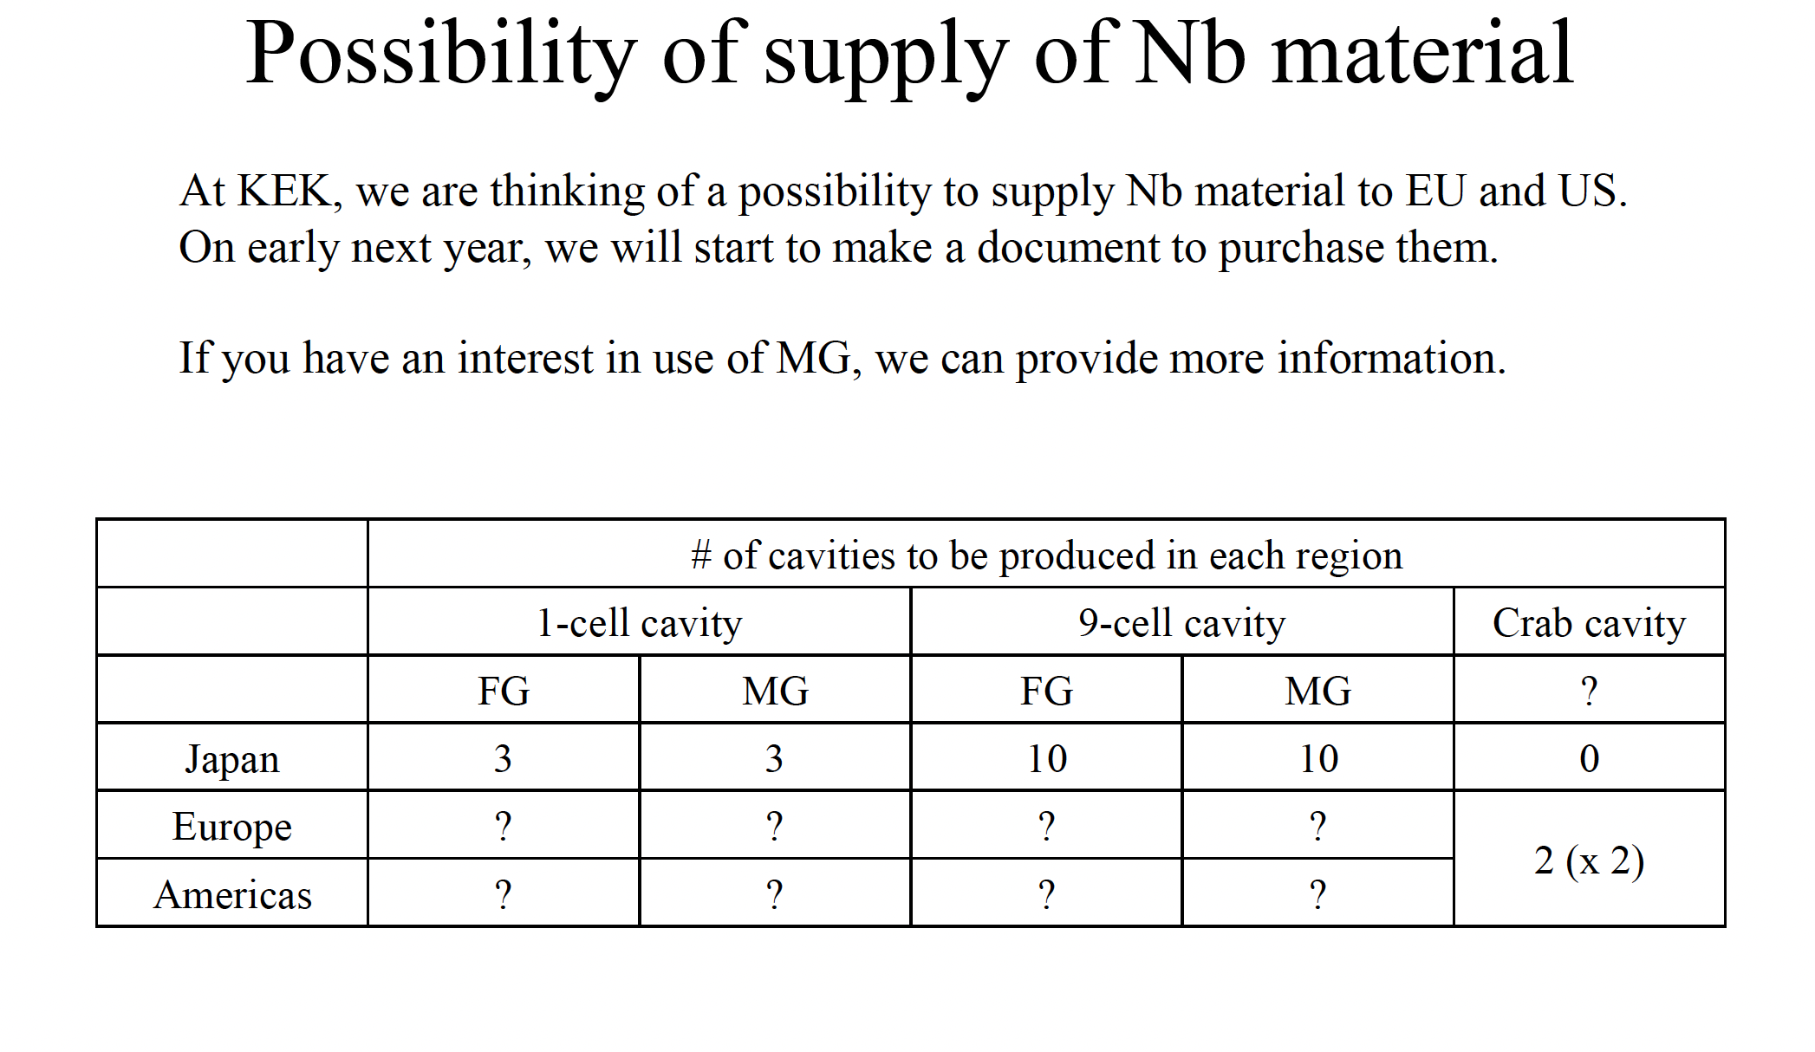
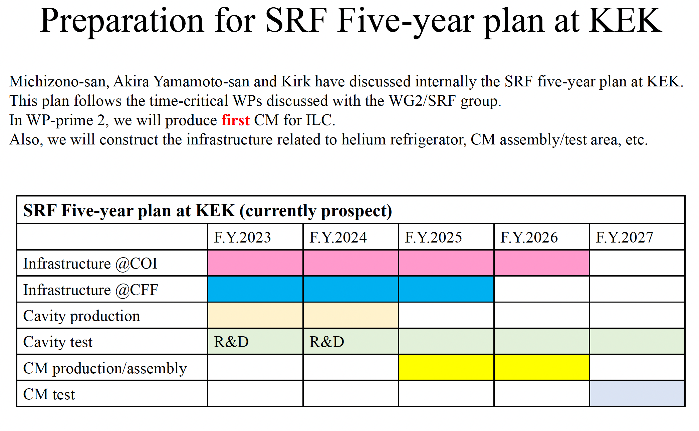
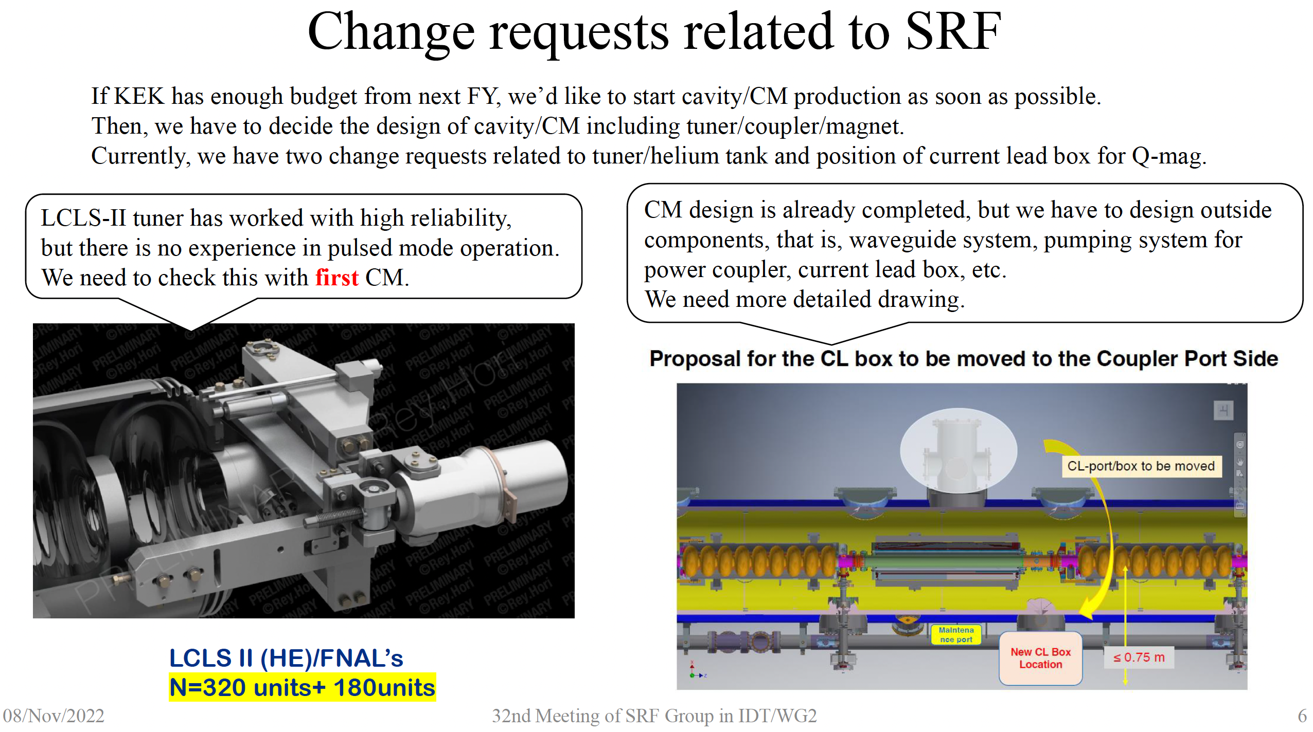
SRF Subgroup
KEK/Japan preparing for cryomodule production project starting next year
Investigating ”Medium Grain” material (sliced from ingots)
-> offer to supply material to EU and US
New ILC cryomodule design by FNAL based on LCLS-II experience: US very active
Y. Yamamoto WG2 SRF meeting 6.12.22
Y. Yamamoto WG2 meeting 8.11.22
Y. Yamamoto WG2 meeting 8.11.22

Slide 4
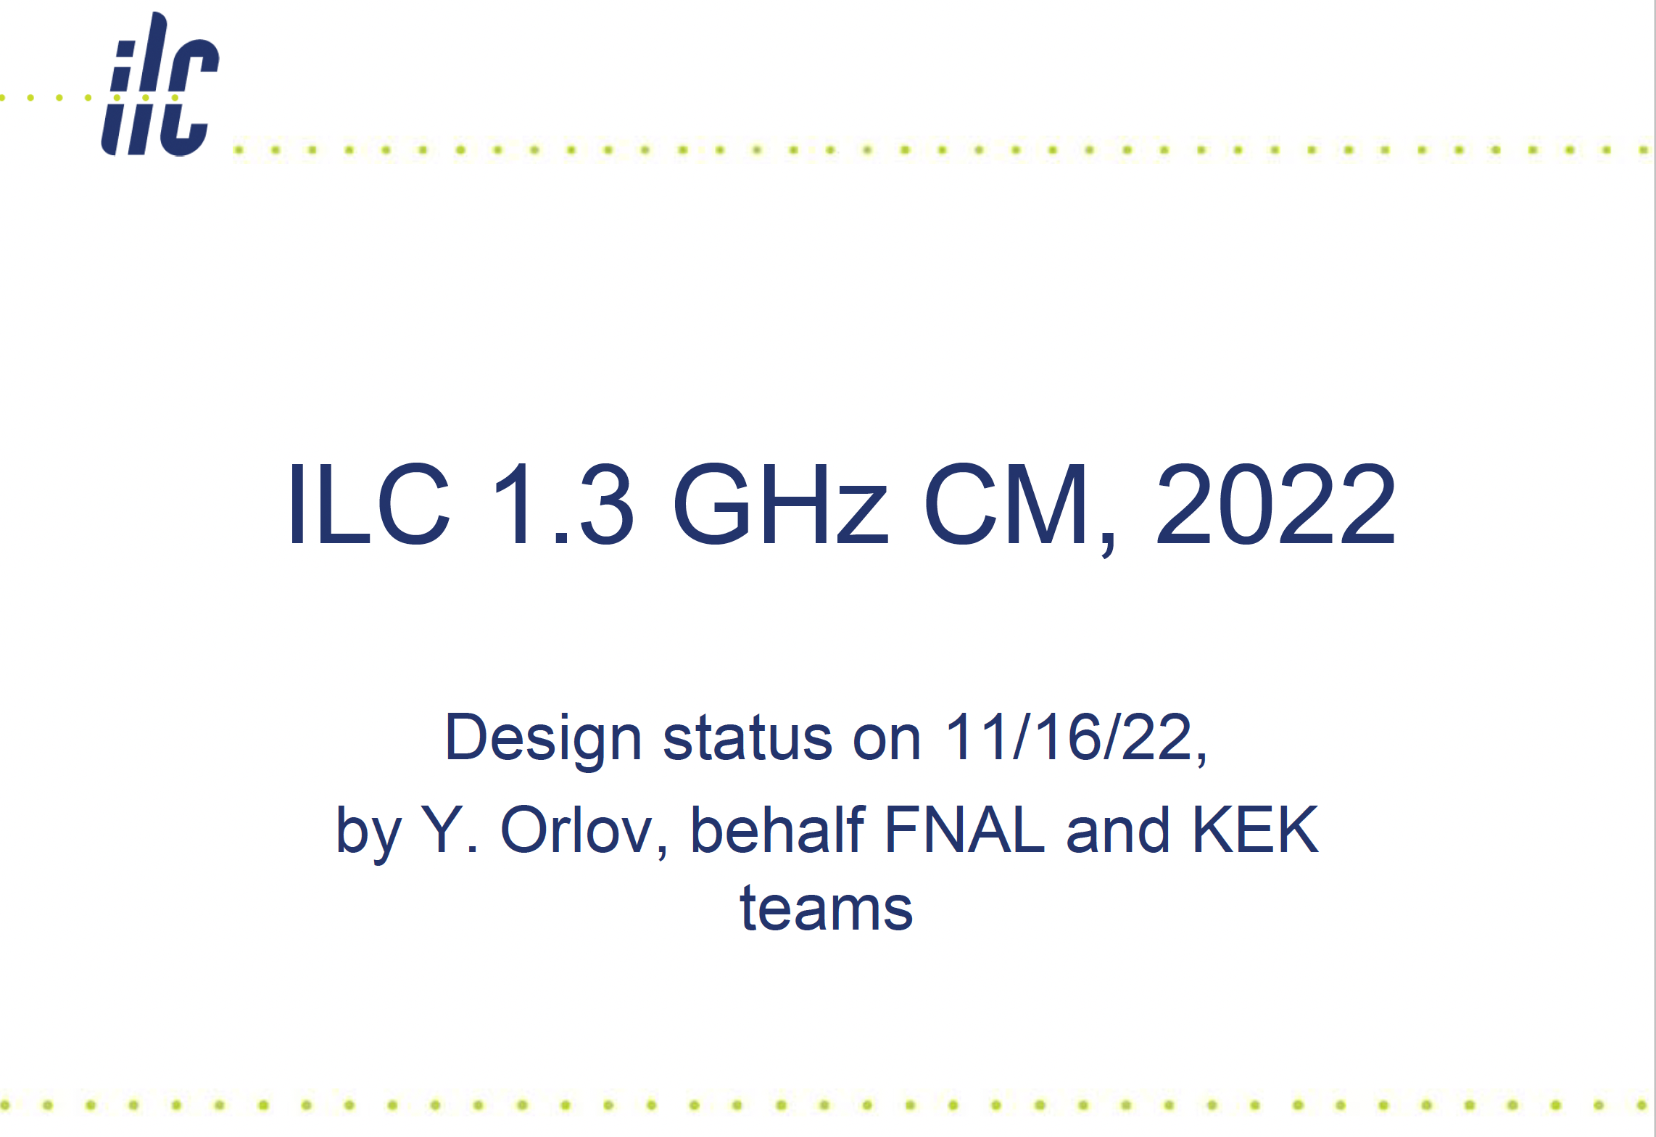
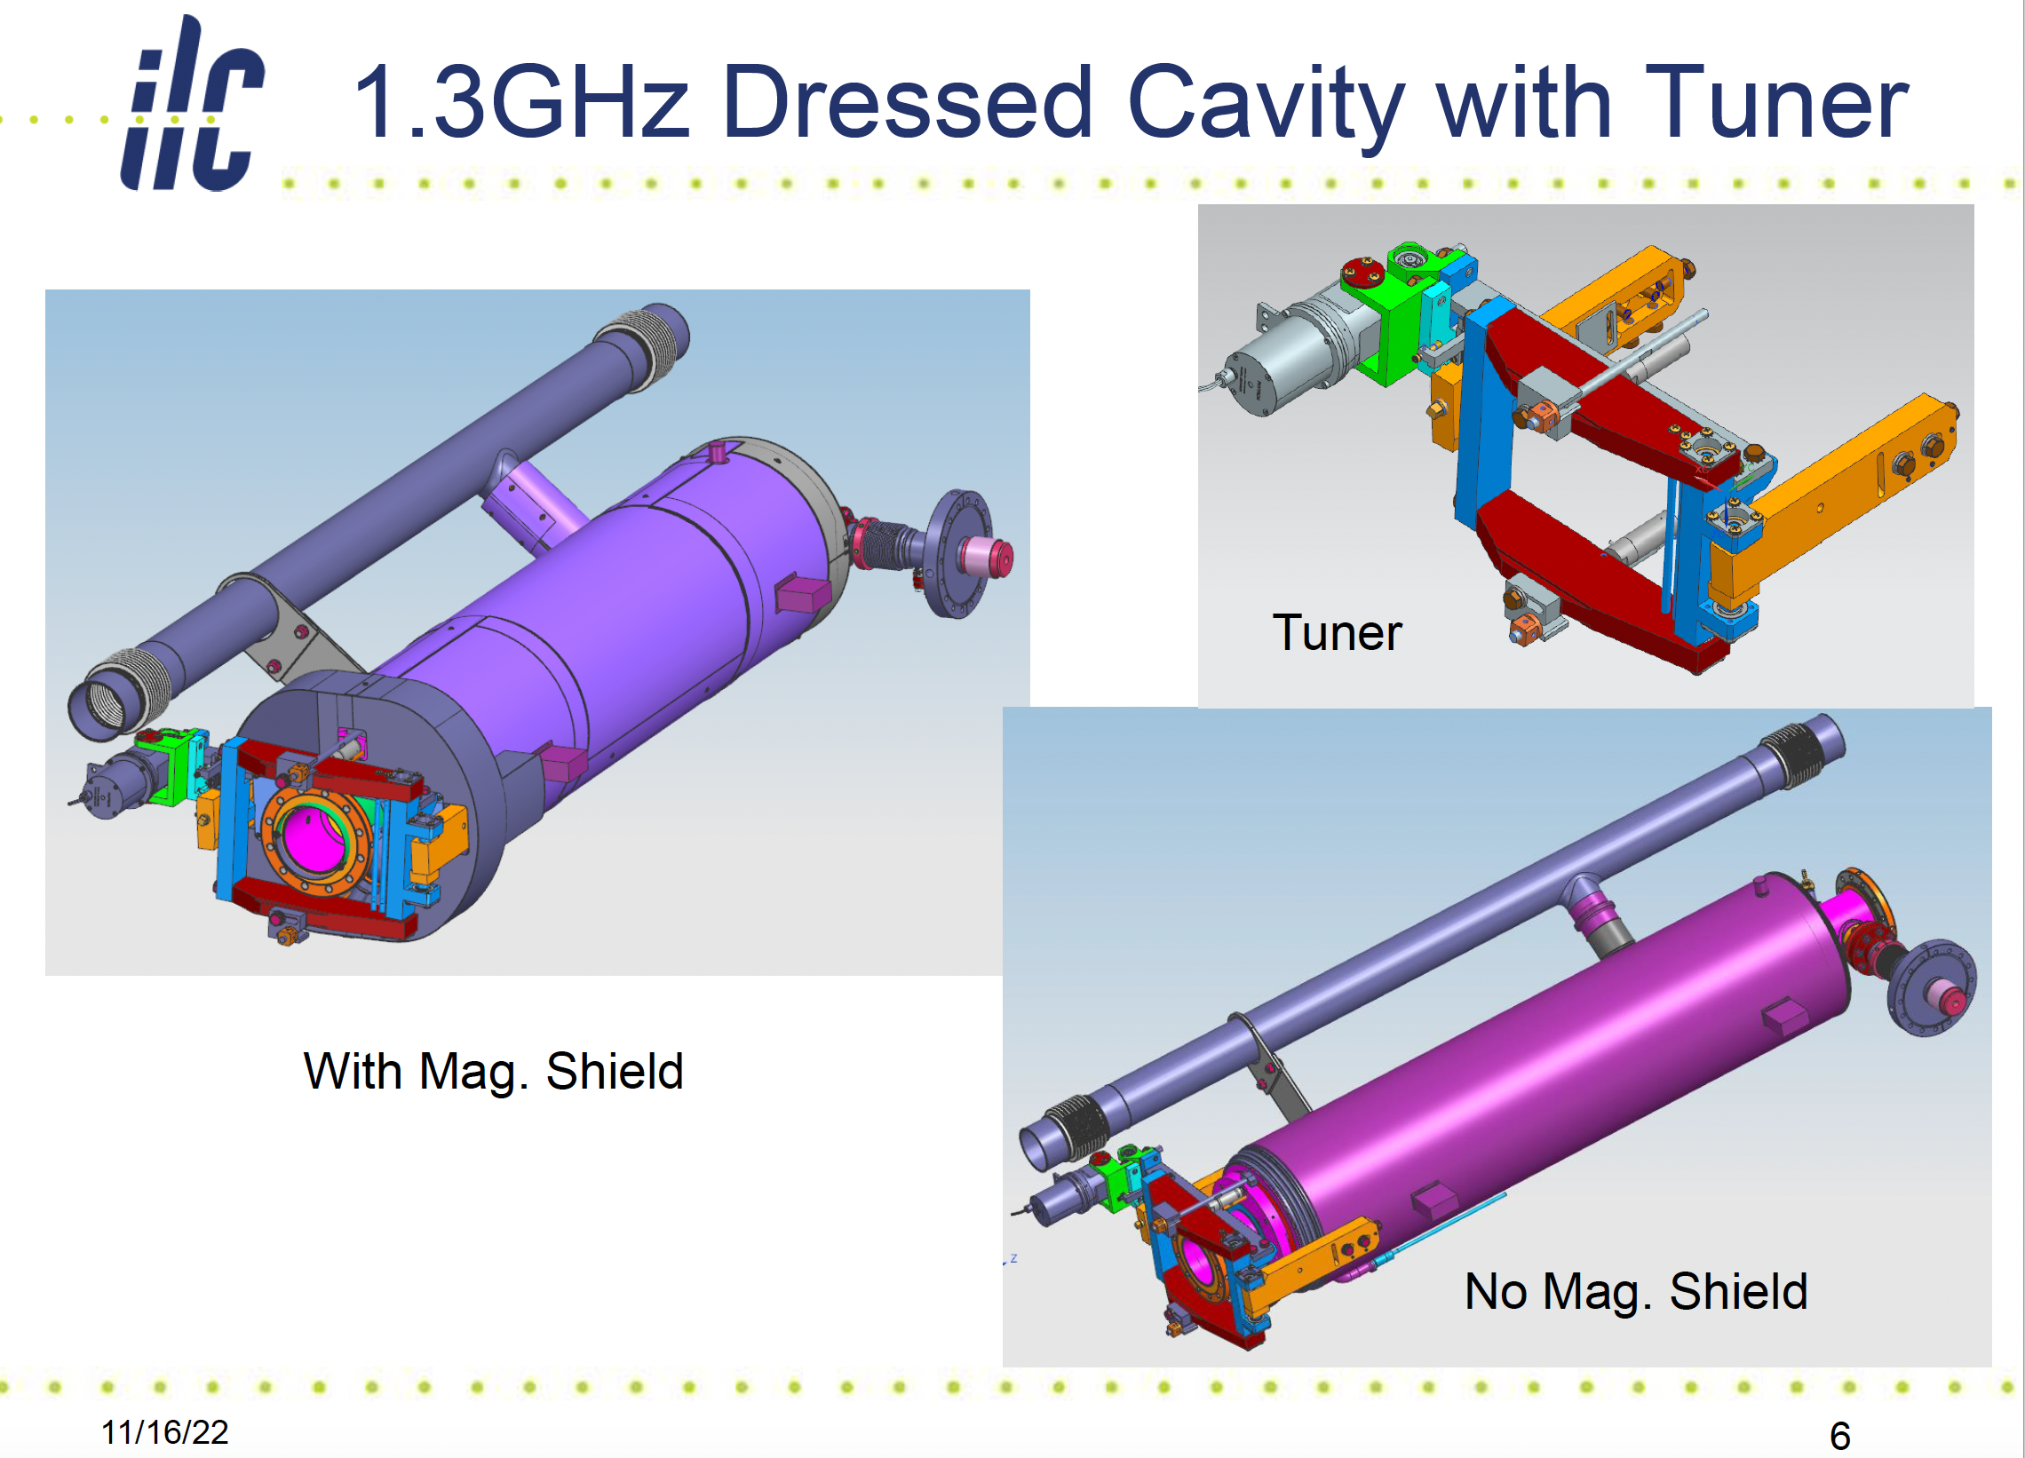
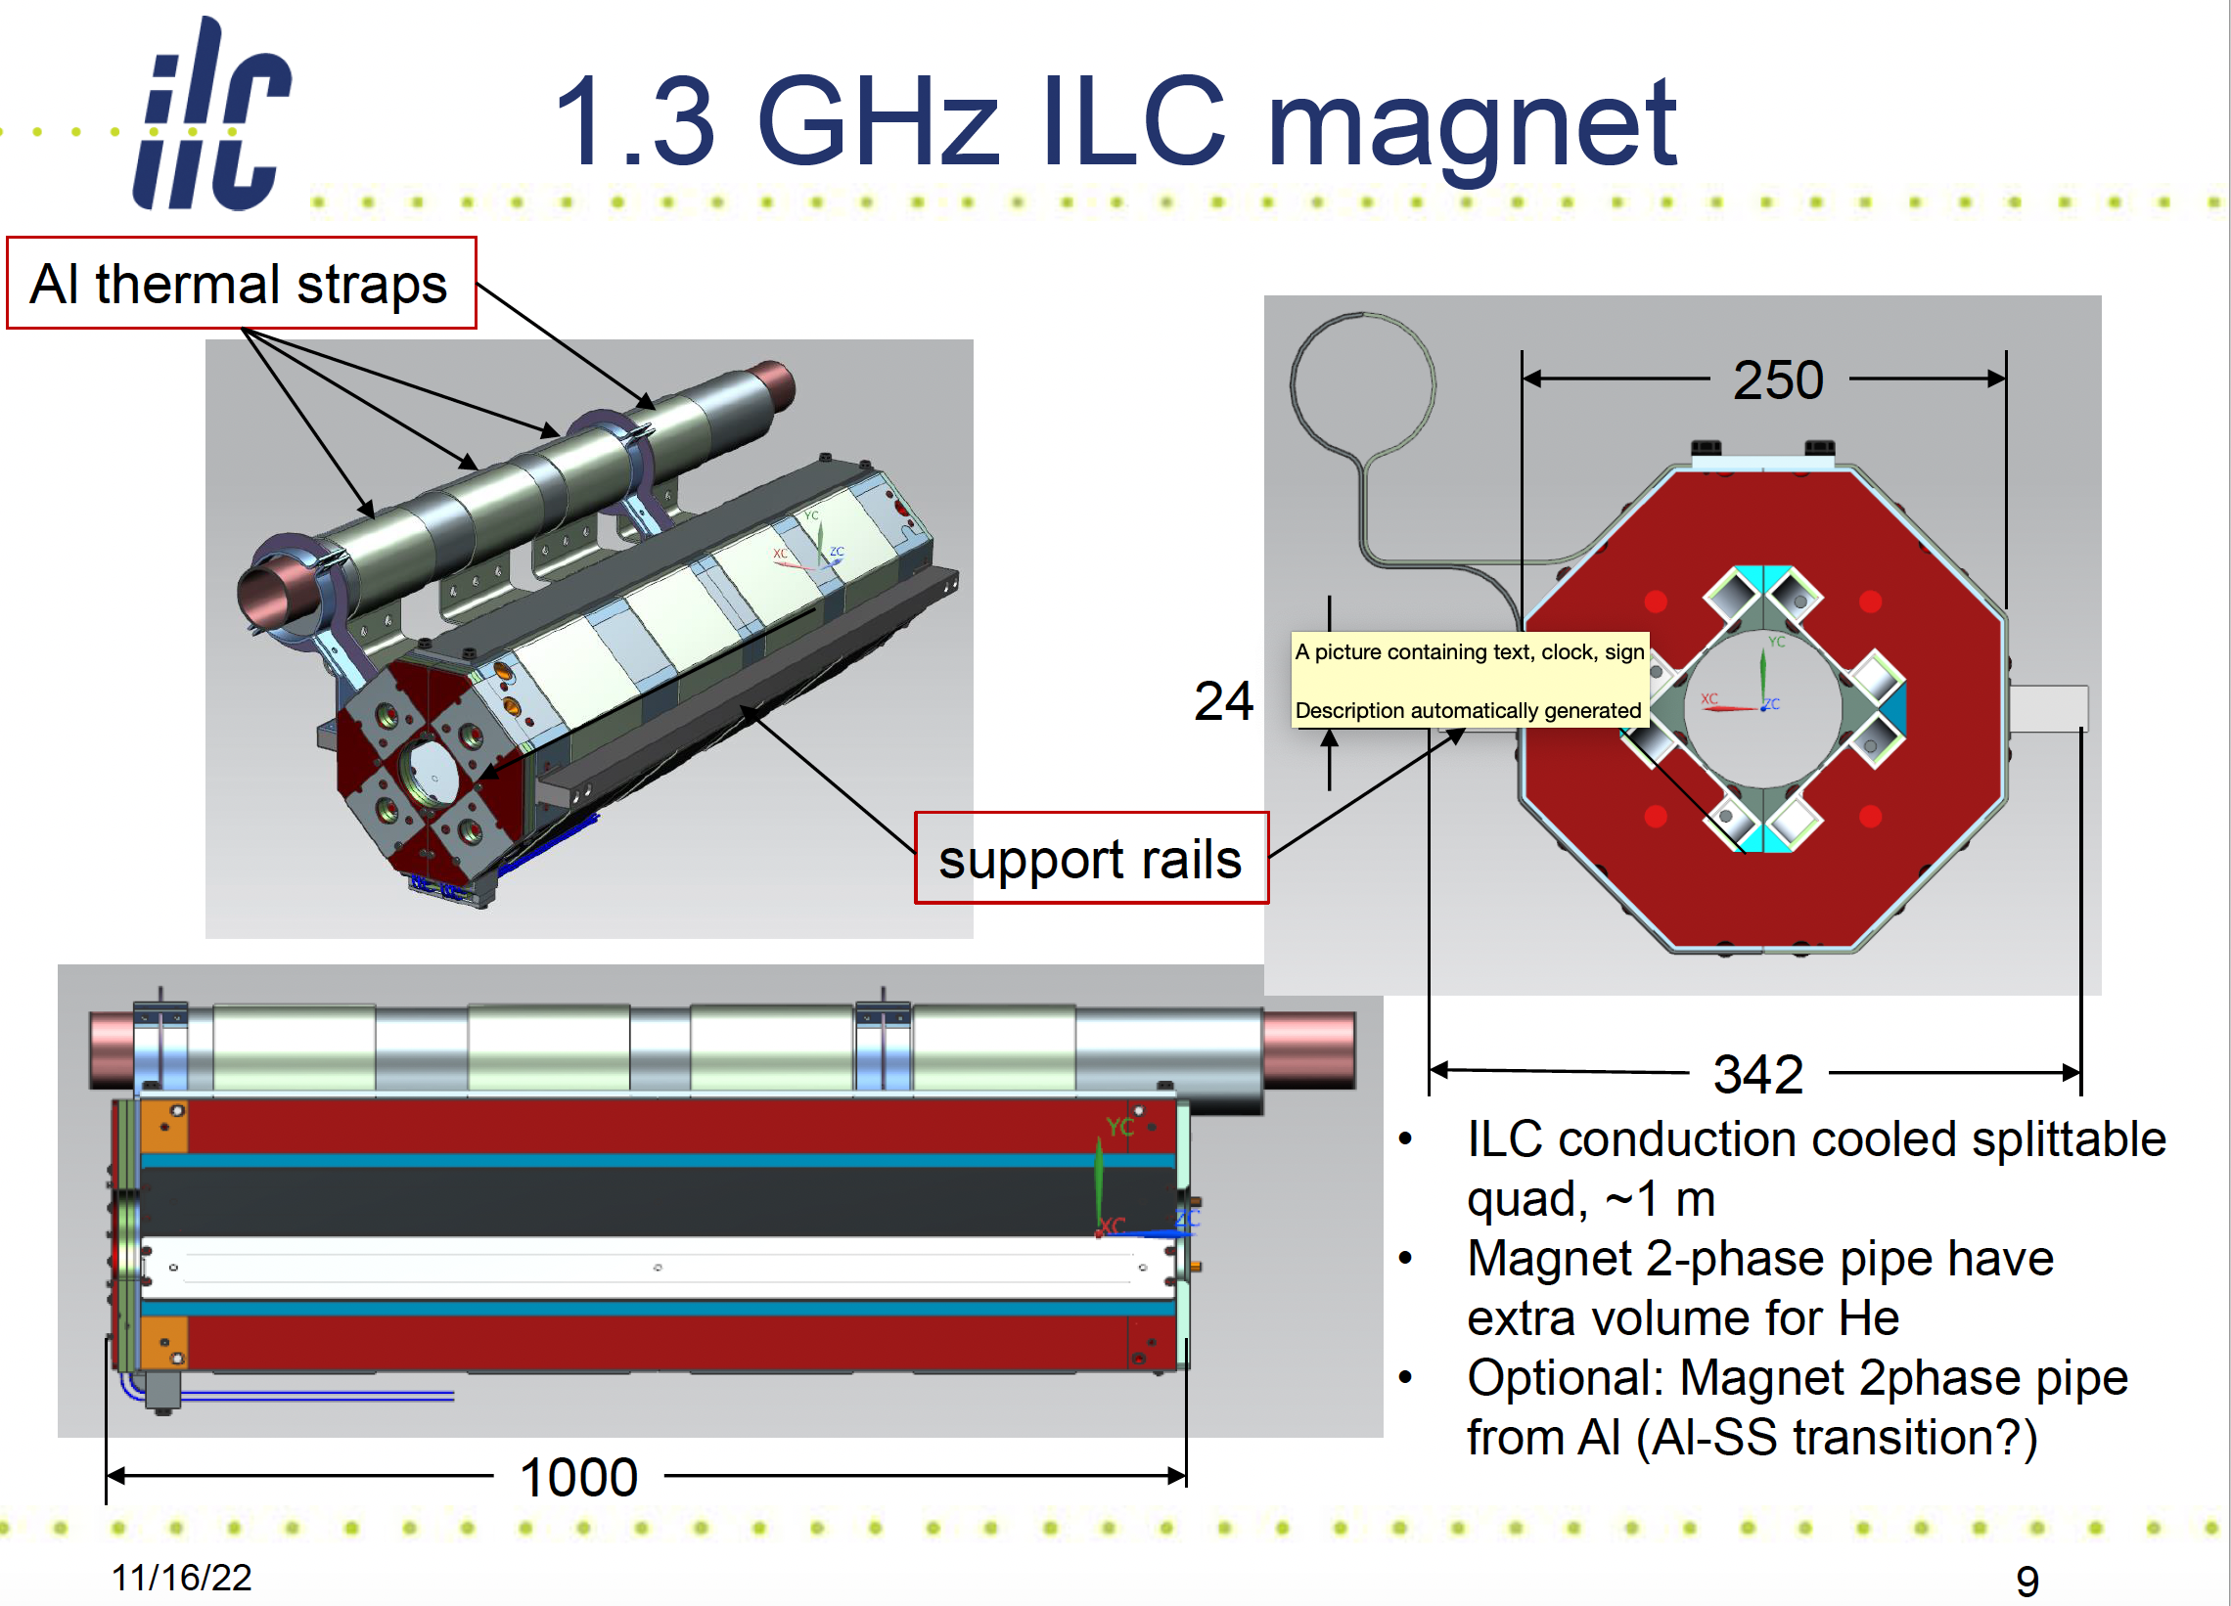
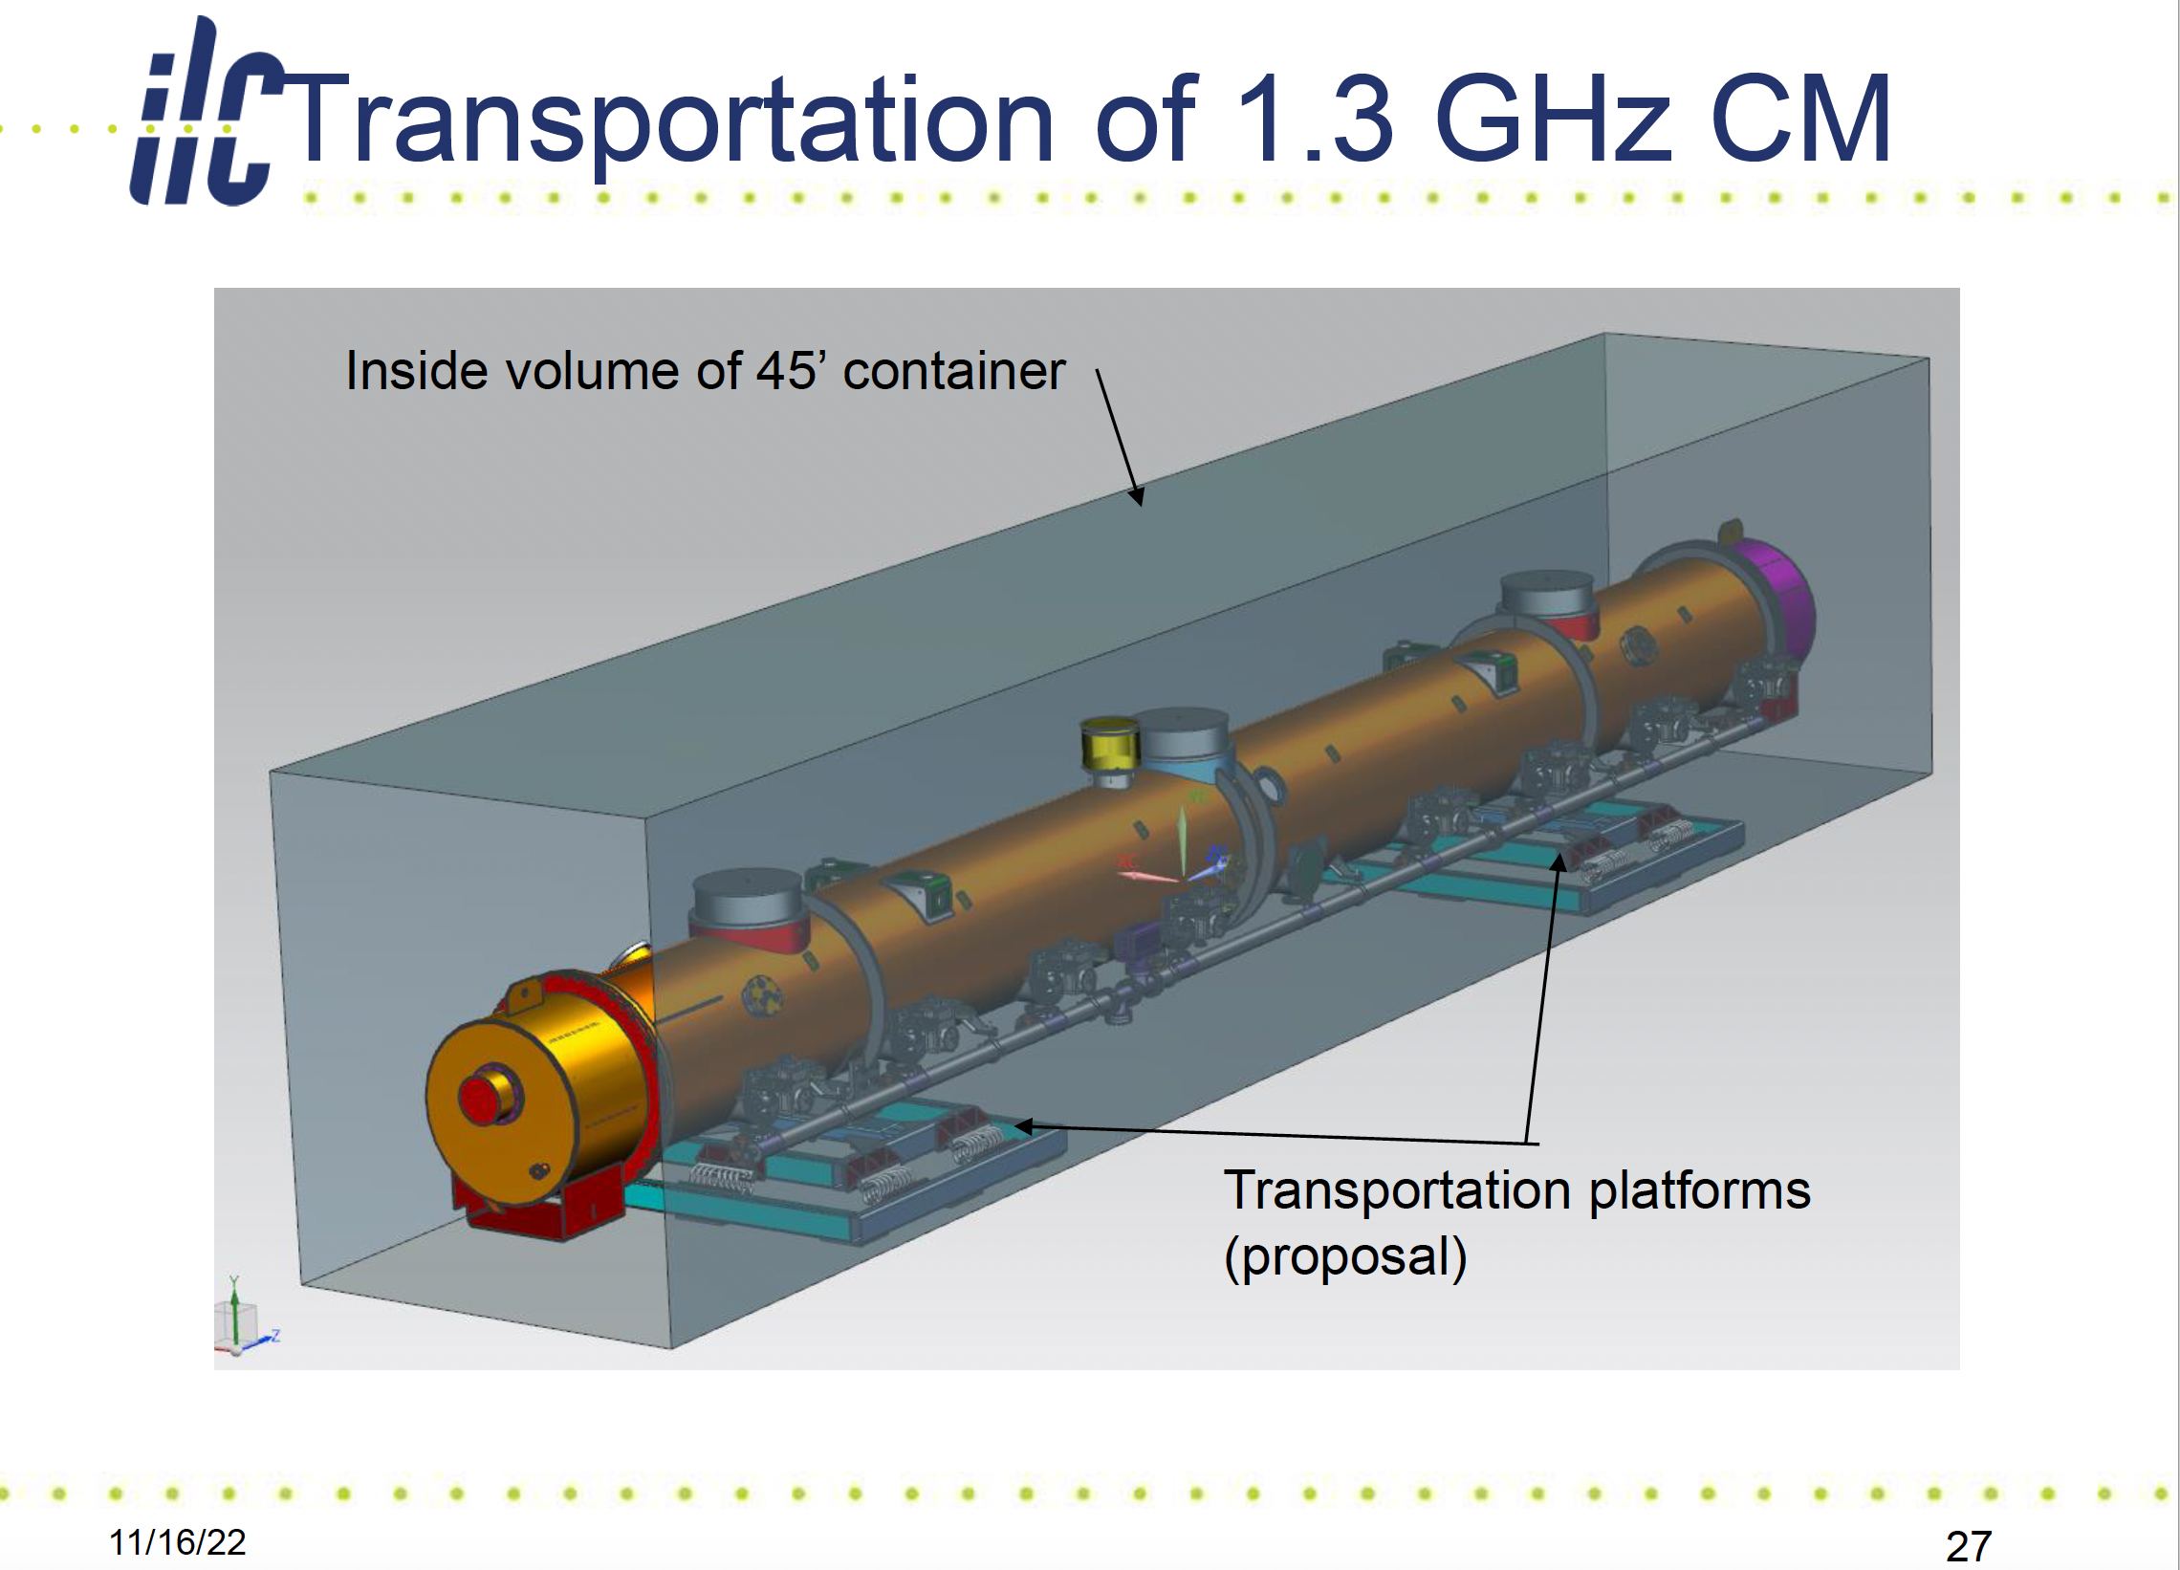
FNAL Cryomodule Design
Slides shown by K. Yamamoto SRF WG2 Meeting 6.12.2022

Slide 5
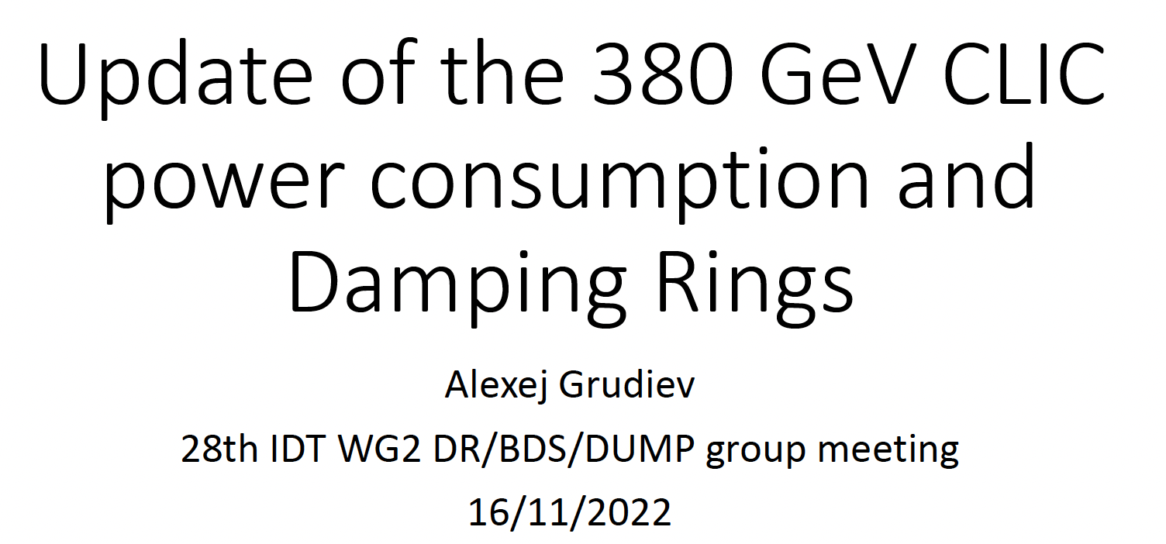
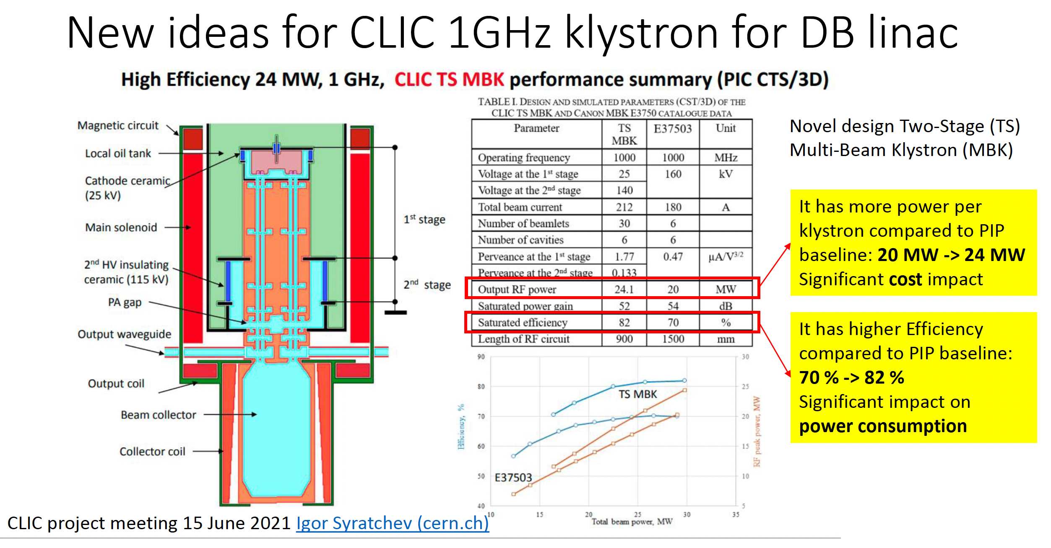
BDS/DR/Dumps Subgroup
Presentation by A. Grudiev on CLIC power optimisation
High efficiency klystrons developed for CLIC now prototyped
-> highly interesting for ILC (klystron efficiency 65% -> 85%)
Europe leading here
A. Grudiev BDS/DR/Dump subgroup meeting 16.11.22

Slide 6
