Slide 1
REPORT FROM MICROMEGAS GROUP
Paul Colas (CEA/Irfu Université Paris Saclay)
Summary of activity in 5 latest years
Synergy with other detectors
Running a TPC at circular colliders

Slide 2
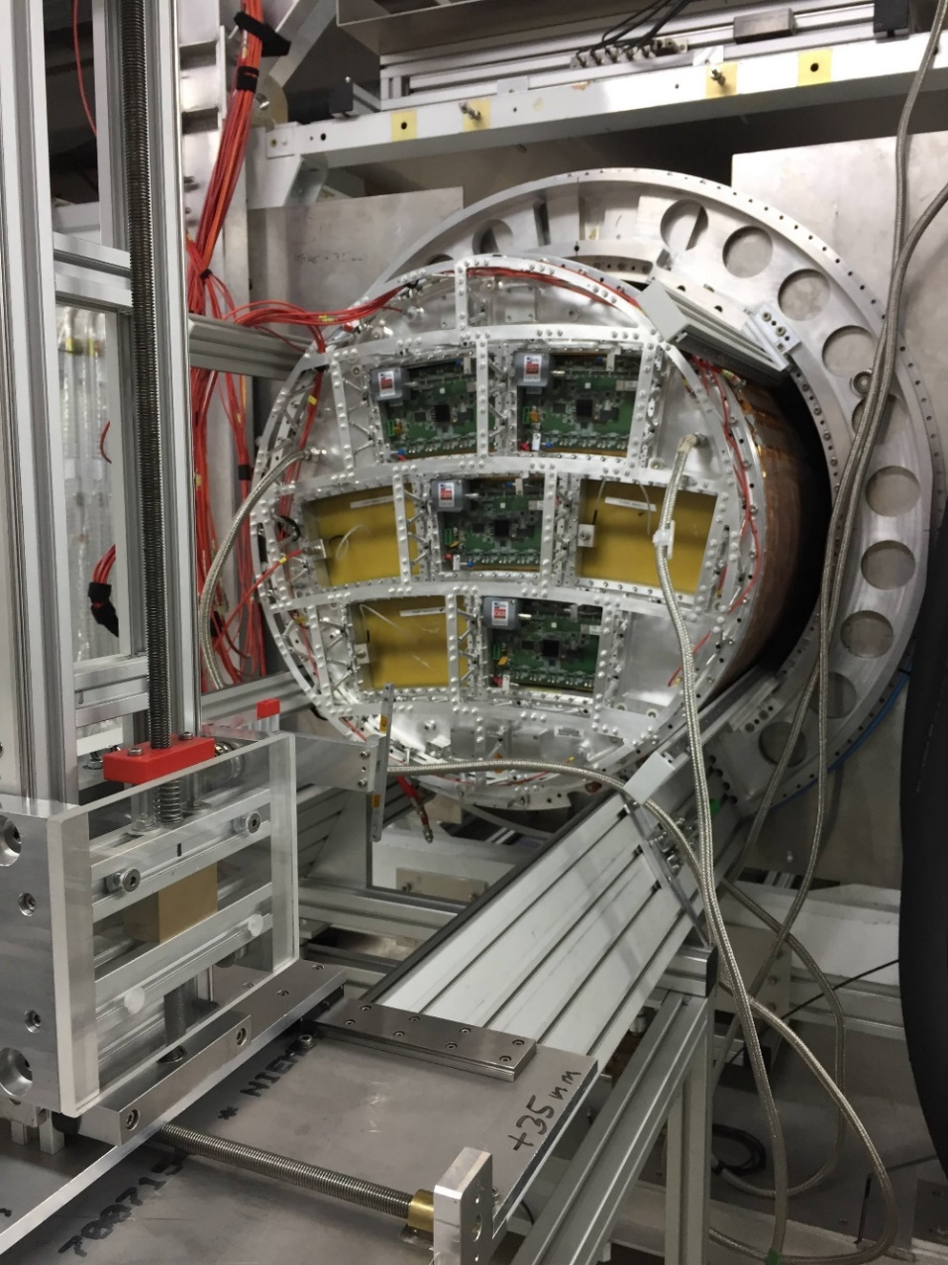
Micromegas TPC Activity in the latest 5 years
Beam test in November 2018 at DESY: 4 new ‘ERAM’ modules
Cosmic-ray test at Saclay, from January 2019 to March 2020 (interrupted by Covid and discontinued after this)
TPC costing and detailed assessment of cabling, LV power, HV distribution, etc…
Test of the cooling of one module with 2-phase CO2, with an aluminum 3D-printed cooling plate (started October 2021)
Result so far : feasibility in ILC conditions demonstrated (space and dE/dx resolution, stability, flexibility, distortion mitigation, matter budget…)
E4 E3
E1
E2

Slide 3
Still to be done : electronics and mechanics
Electronics must be compact. O(10⁶ channels) in ~10 mm² and must have low power consumption (few mW/chanel). The 65nm project SALSA would fit this (see also Zhi Deng’s talk)
Mechanical design : systematics on the sagita must be below ~20 µm. Must damp vibrations and resist to earthquakes
Needs to become an ongoing project with a defined timescale to progress further

Slide 4
Synergies with other experiments
T2K : also uses ERAM. Study charge sharing by Resistive-Capacitive anode, gain maps, RC maps (See Shivam Joshi’s talk), track and V0 reconstruction
ALICE : uses GEMs in a high track density environment. Experiences tracking with continuous data taking (important for circular e+e- colliders) and large distortions from space charge (see Jens Wiechula’s talk)

Slide 5
New questions arising
Would operation be possible at a circular collider, in particular at the Z peak at high lumi (2.10³⁶ /cm²/s per IP)?
  Would the HV supplies stand the current drawn in the endplates?
  Would the distortions due to ion space charge be moderate enough and could they be corrected?
  Would the power consumption be under control, without power pulsing?
  Would the reconstruction of data taken in triggerless mode be manageable?

Slide 6
David Rohr CHEP 2020

Slide 7
David Rohr CHEP 2020

Slide 8
Beamstrahlung photons at FCC
A. Ciarma
Enormous power radiated and copious photon production with energy of a few MeV: will produce e+e- pairs in the TPC gas if not extracted
Copious production of few-MeV photons

Slide 9
Primary ionization at the Z : maximum distortions of 330 µm for IBF=1, however stable to a few microns.
Background from incoherent pairs
Daniel Jeans used Andrea Ciarma simulated background events to estimate the ionization in the TPC : result is very large, an efficient shielding is absolutely needed (presented in SWANA meetings)
D. Jeans
PRELIMINARY

Slide 10
Running at the TeraZ with a TPC is a completely new challenge.
Will require Space Charge Distortions corrections, monitoring of the current in the TPC with some granularity to be determined, and studies of shielding against several beam-induced background sources.

Slide 11
DRD1
Transition from RD51 to DRD1 (ECFA)
M. Titov, E. Oliveiri.
Also Esther Ferrer-Ribas involved from Saclay.
Preparation of a survey. Discussion this afternoon.

