Slide 1
32nd Meeting of SRF Group in IDT/WG2
Preparation for SRF Five-year plan at KEK as Time-critical WPs (Kirk)
Others (if any)
Attendees: A. Yamamoto, K. Umemori, H. Hayano, S. Posen, L. Monaco, E. Cenni, R. Geng, R. Ruber, D. Delikaris, P. Burrows, Kirk
https://agenda.linearcollider.org/category/256/
Kirk

Slide 2
Preparation for SRF Five-year plan at KEK
Michizono-san, Akira Yamamoto-san and Kirk have discussed internally the SRF five-year plan at KEK.
This plan follows the time-critical WPs discussed with the WG2/SRF group.
In WP-prime 2, we will produce first CM for ILC.
Also, we will construct the infrastructure related to helium refrigerator, CM assembly/test area, etc.
SRF Five-year plan at KEK (currently prospect)
 | F.Y.2023 | F.Y.2024 | F.Y.2025 | F.Y.2026 | F.Y.2027
Infrastructure @COI
Infrastructure @CFF
Cavity production
Cavity test | R&D | R&D
CM production/assembly
CM test

Slide 3
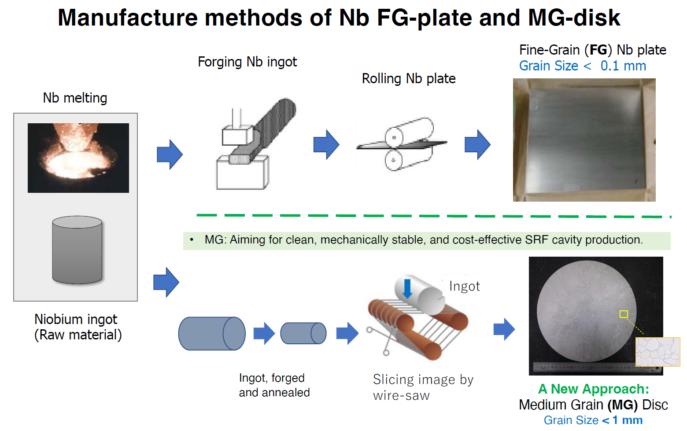


WP-prime 1: SRF Cavity
(Scoping the Industrial-Production Readiness)
Research with single-cell cavities to establish the best production process
  Advanced Nb sheet production method
  Advanced surface treatment recipe
Globally common design compatible with High Pressure Gas Safety (HPGS) regulation
24 nine-cell cavities are to be developed for industrial-production readiness
  8 cavities (4 / batch) in each region
  Production process optimized in each region encouraged
RF performance/success yield to be examined (at least including 2nd pass)
  3rd pass to be examined if effective
 | # of cavities to be produced
 | Americas | Europe | JP/Asia
single-cell | 2 | 2 | 2
nine-cell | 8 | 8 | 8 (+ 12)
Material/Sub-component
QA of Material/Sub-C
Cavity Production
Surface Process
Vertical Test =
Cavity RF Test
Production process
3

Slide 4
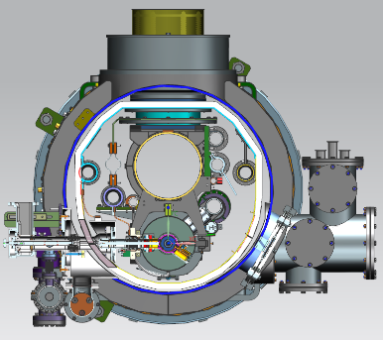
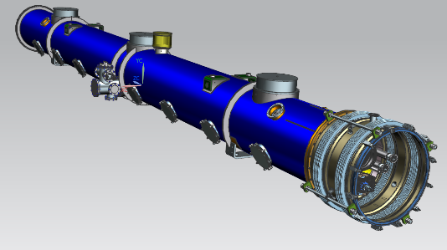
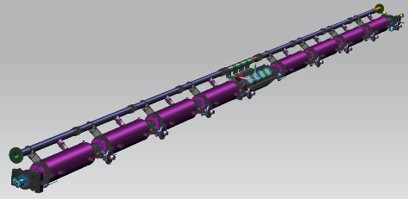
WP-prime 2: Cryomodule (CM) design
(Scoping the CM Global Transfer and Performance Assurance)
We will produce first CM!
Unify cryomodule (CM) design with ancillaries, based on globally common drawings and data-base
Establish globally compatible safety design to be approved by HPGS regulations individually authorized in each region.
Cavity string
Ancillaries:
SC mag., tuners, couplers
CM outlook with vacuum vessel
 | Americas | Europe | Japan/Asia
CM tech. design base | LELS-II | Euro-XFEL | ILC-TDR
HPGS regulation base | ASME | TÜV and EN | JP-HPGS act
ILC CM design | Common CM design globally adaptable to HPGS regulation in any regions
4

Slide 5
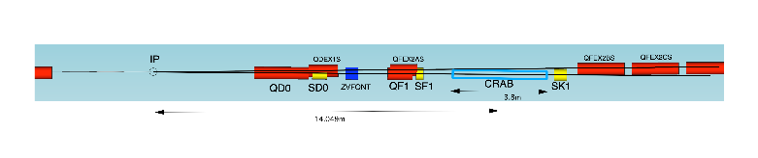
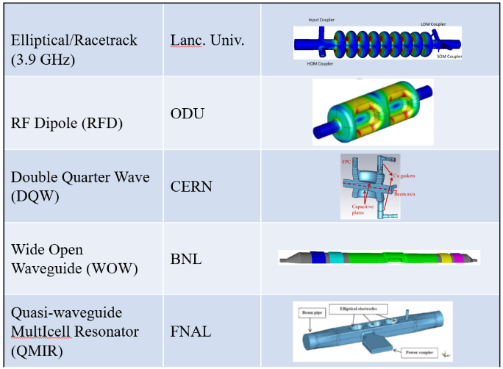
WP-prime 3: Crab Cavity Development with down-selection
RF property simulation to optimize cavity design
Pre-down-selection to choose two primary candidates
Development and evaluation of two prototype cavities
Demonstration of synchronized operation with two prototypes
Down-selection to choose final cavity design
Cryomodule design based on final cavity design
two beamline distance
14.049m x 0.014rad = 197mm
Item | Recent specification (after TDR)
Beam energy | 125 GeV (e⁻)
Crossing angle | 14 mrad
Installation site | 14 m from IP
RF repetition rate | 5 Hz
Bunch train length | 727 μsec
Bunch spacing | 554 nsec
Operational temperature | 2.0 K (?)
Cavity frequency | 1.3/3.9 GHz
Total kick voltage | 1.845/0.615 MV
Relative RF phase jitter | 0.023/0.069 deg rms (49 fs rms)
5

Slide 6
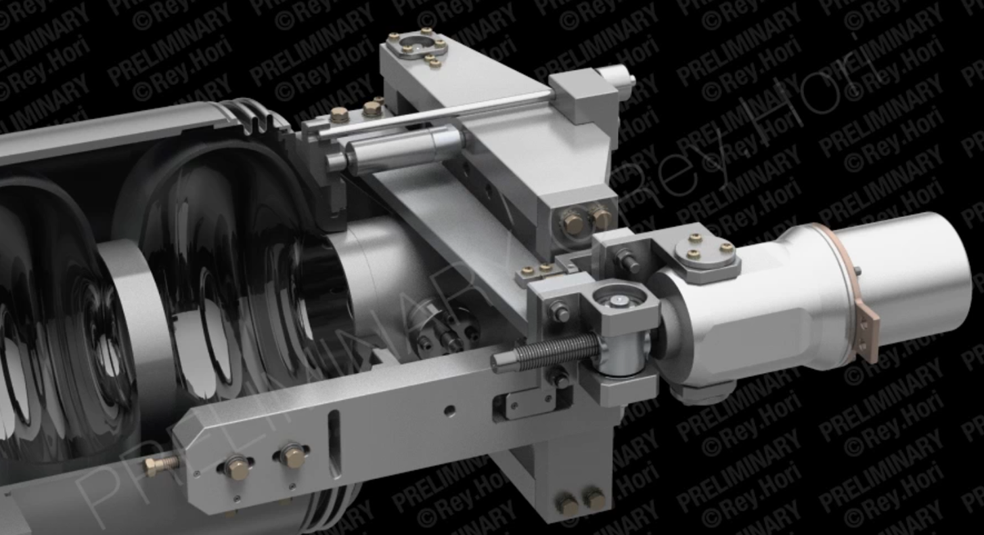
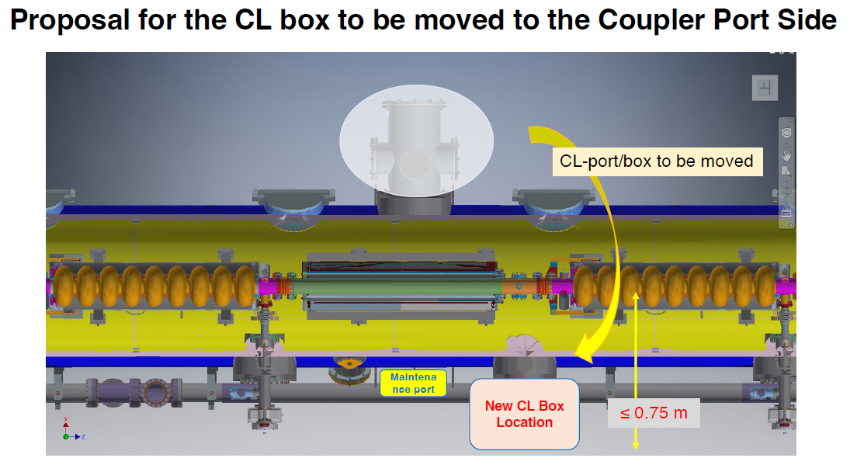
Change requests related to SRF
If KEK has enough budget from next FY, we’d like to start cavity/CM production as soon as possible.
Then, we have to decide the design of cavity/CM including tuner/coupler/magnet.
Currently, we have two change requests related to tuner/helium tank and position of current lead box for Q-mag.
LCLS-II tuner has worked with high reliability,
but there is no experience in pulsed mode operation.
We need to check this with first CM.
CM design is already completed, but we have to design outside components, that is, waveguide system, pumping system for power coupler, current lead box, etc.
We need more detailed drawing.
LCLS II (HE)/FNAL’s
N=320 units+ 180units

Slide 7
Conclusion/Suggestion
Currently, it’s difficult to submit these change requests before cavity/CM production.
After CM test and more detailed drawing completed, we will/can submit the change request.
I’d like to obtain your agreement on this policy including the cavity/CM design within this year.
If you like to check the 3D model developed by FNAL/KEK, I can provide to the SRF group.

Slide 8
Meeting schedule and recent progress
Meeting # | Date | Contents
32 | 08/Nov | Preparation for SRF Five-year plan at KEK as Time-critical WPs
33 | 22/Nov
34 | 06/Dec
35 | 20/Dec
 | End of Dec | Budget plan will be fixed
 | 15~19/May/2023 | LCWS2023 @SLAC

Slide 9
Questions/Suggestions/Comments
The tuner/piezo performance should be checked by pulsed mode operation, but there is no CM test facility to do this.
The design should be unified for first CM.
At least, one cavity from EU and US for each will/can be installed in first CM.
Actually, the SRF five-year plan will proceed through the international technology network.
It will take 1-1.5 years to evaluate the tuner performance in CM test.
After the five-year plan, we think the CM test will continue, and we may find unexpected problem to be solved.
We can put the two goals of cavity performance as the ILC specification (TDR) and as R&D (high-Q/high-G).
Magnetic shield design is different among CEA, DESY, and FNAL.
Kirk can gather some ideas from the SRF experts, then organize the topical meetings to discuss.

