Slide 1
Sources Subgroup Summary IDT-WG2, Nov.29. 2022, K. Yokoya
Nov.21 33rd Regular meeting
Joe Grames, Sabine Riemann, Spencer Gessner, Hitoshi Hayano, Andriy Ushakov, Sama Habet, Tsunehiko Omori, Yoshinori Enomoto, Amy Sy , Steffen Doebert , Mike Spata, Gudi Moortgat, Peter Sievers, Kaoru Yokoya
Indico https://agenda.linearcollider.org/event/9874/
Talk
“Novel Positron Source Development at SLAC”
Spencer Gessner,
New member of sources group
File uploaded as Positron source concepts ILC IDT.pdf
Next meeting
Presumably on Dec.12

Slide 2
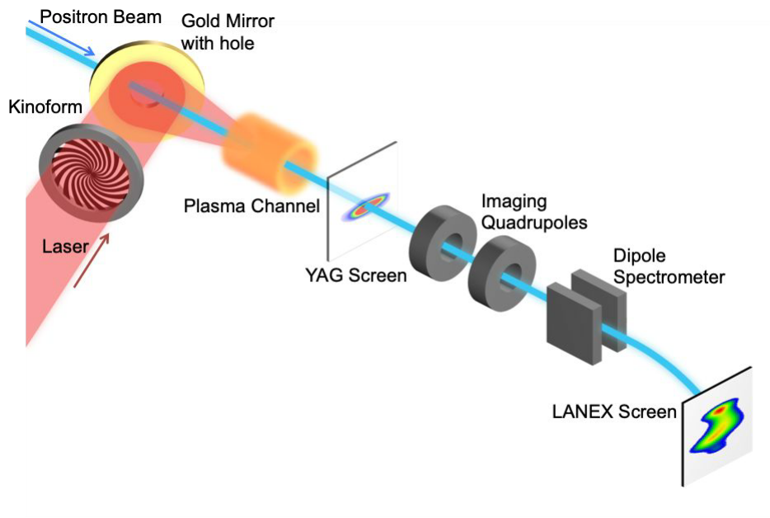
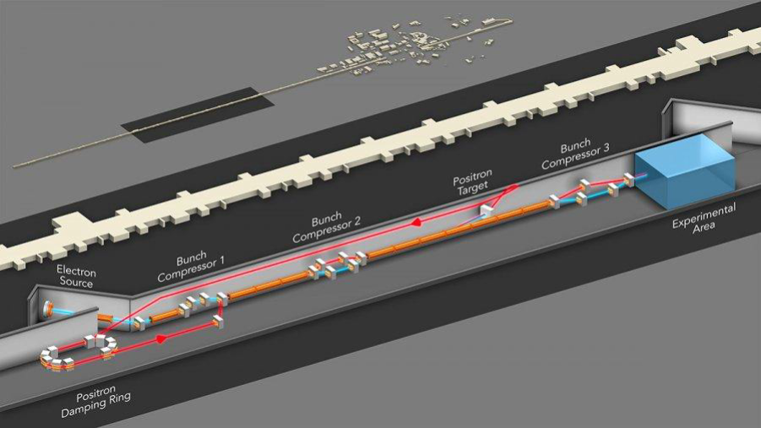
Positron PWFA
As a part of Spencer’s involvement on positron
PWFA for positron
Only a small phase area for acceleration and focusing for positron
Hollow plasma proposed to eliminate the transverse force
FACET II Positrons
Positron PWFA experiments at FACET in the past
Non-linear regime, two bunch acceleration
Hollow plasma created
SLC positron target
S. Gessner et. al. Nat. Comm. 7, 11785 (2016)

Slide 3
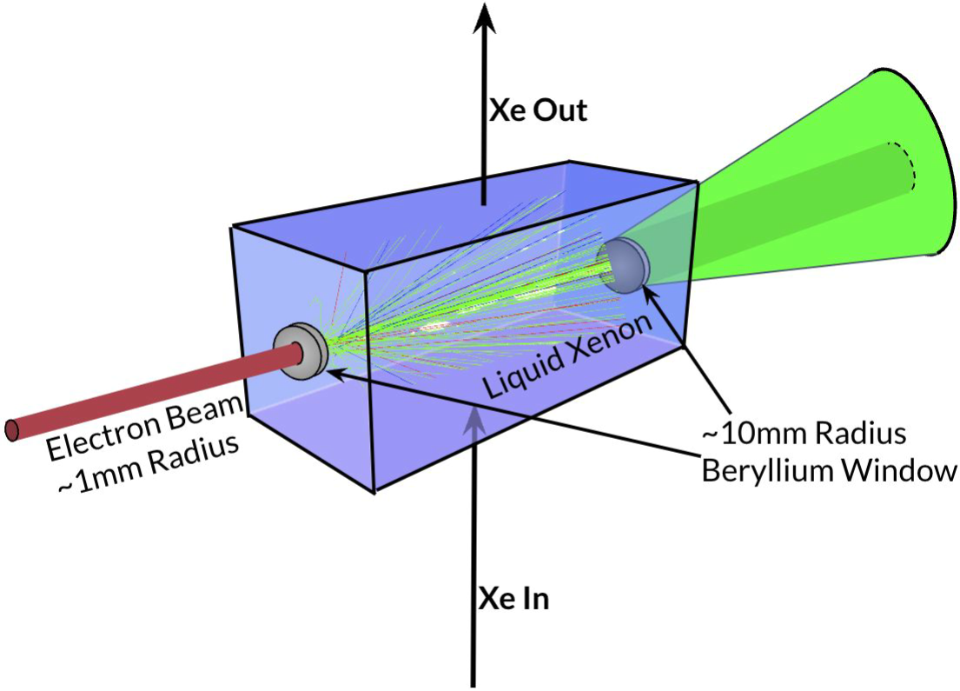
Liquid Xenon Target
Metal targets degrade over time
Liquid metal targets can be used but they are toxic (e.g., mercury)
Liquid xenon
Non-toxic, high density
Max. PEDD ~ 100 J/g (3x solid target)
LXe temperature 161 K
e+ yield cpmparable to solid target with the same radiation length
Can be used for e-driven ILC positron source
GEANT simulation: max. PEDD/train = 84 J/g
Required flow rate 0.073 L/s
Issues
Energy deposit in the beryllium at exit side
Robustness and cost effectiveness

Slide 4
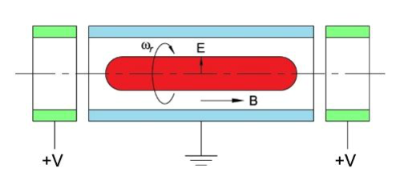
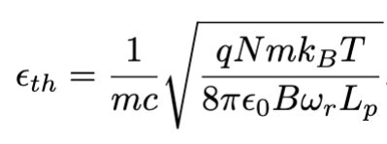
Compact Positron Source
Compact positron sources for non-HEP applications
A Penning-Malmberg trap is used to accumulate and cool positrons from a radioactive source.
The positrons are naturally polarized because they are produced by 𝛽-decays from the ²²Na source
A buffer gas to cool the positrons.
The intrinsic emittance is proportional to positron temperature in the trap.
Possible to reach 100 nm-scale emittance at room temperature.
The beam is “magnetized” because the cooling occurs in a solenoid ﬁeld.
Naturally gives ﬂat-beam emittance (Round-to-Flat Transformation, Brinkmann-Derbenev-Floettmann)
Issues
Higher intensity (only10⁷ e⁺/s from ²²Na)
Can polarized bremsstrahlung (PEPPo at JLABbe used?

