Slide 1

C3: What is to be done?
Emilio Nanni & Caterina Vernieri
IDT WG3 Update
6/8/2023

Slide 2
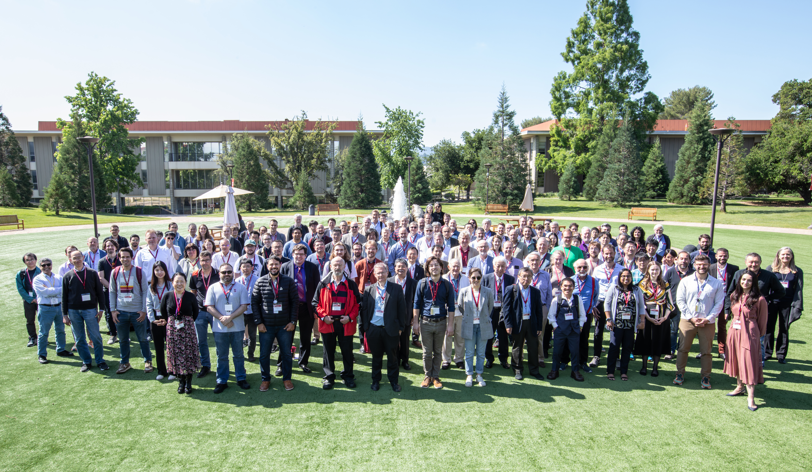
Greetings from LCWS 2023!

Slide 3
Outline
1. Brief Review of C³ Concept
2. Outstanding Technological Issues for the Accelerator
3. Demo Program
4. New Accelerator Results at LCWS
5. Comments Detectors from LCWS
7. Conclusion

Slide 4
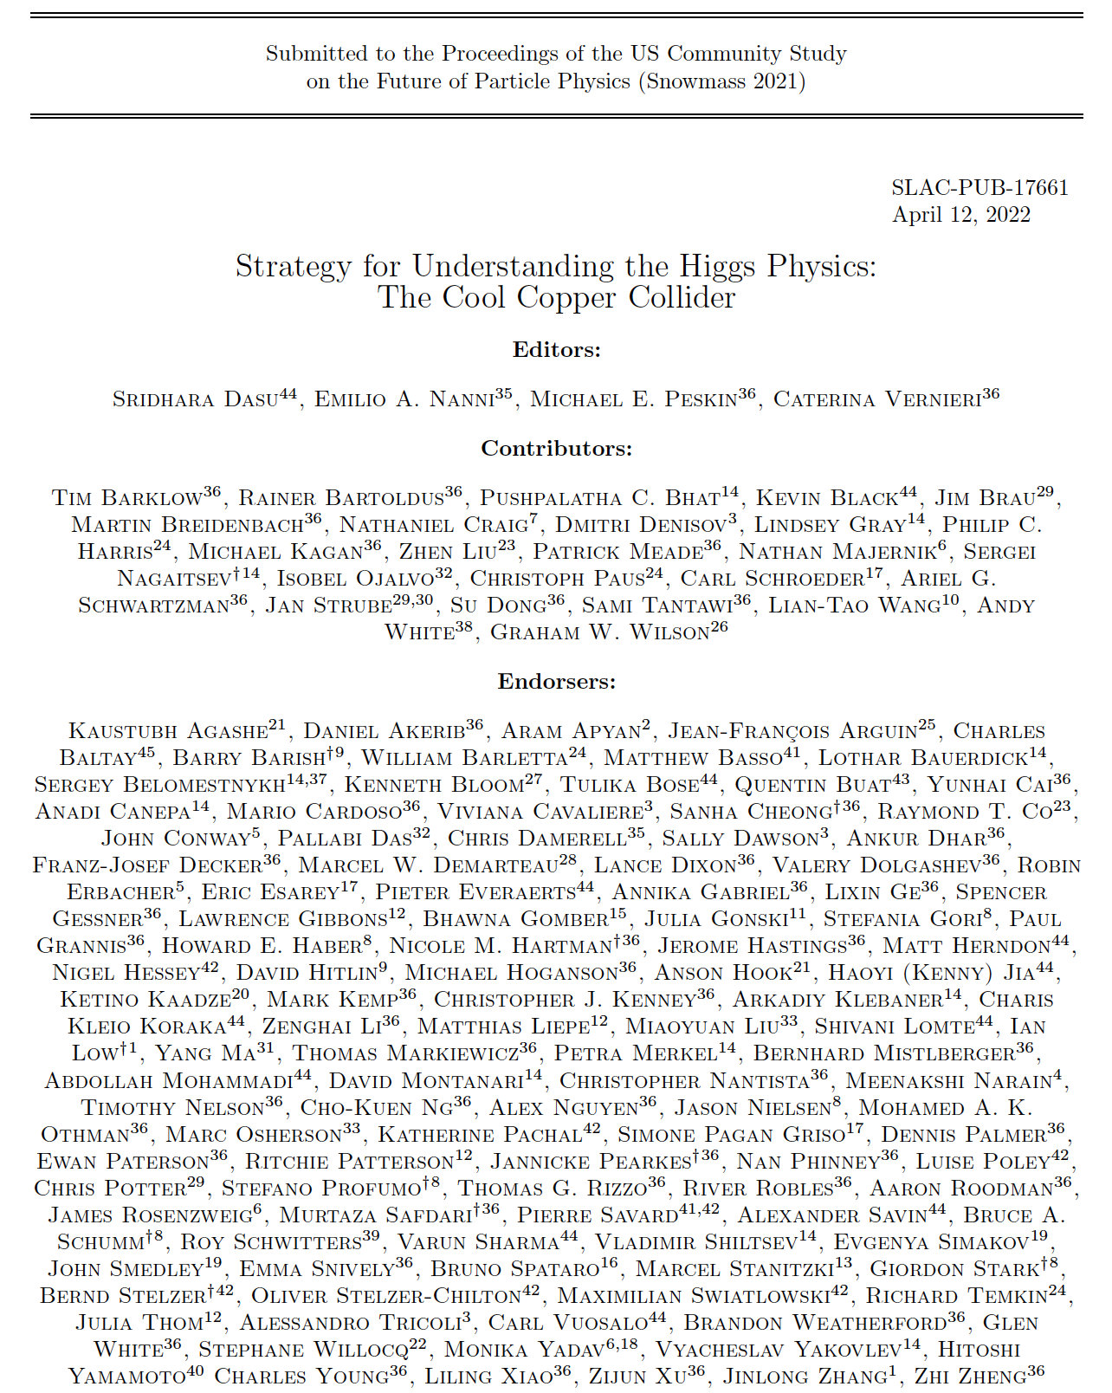
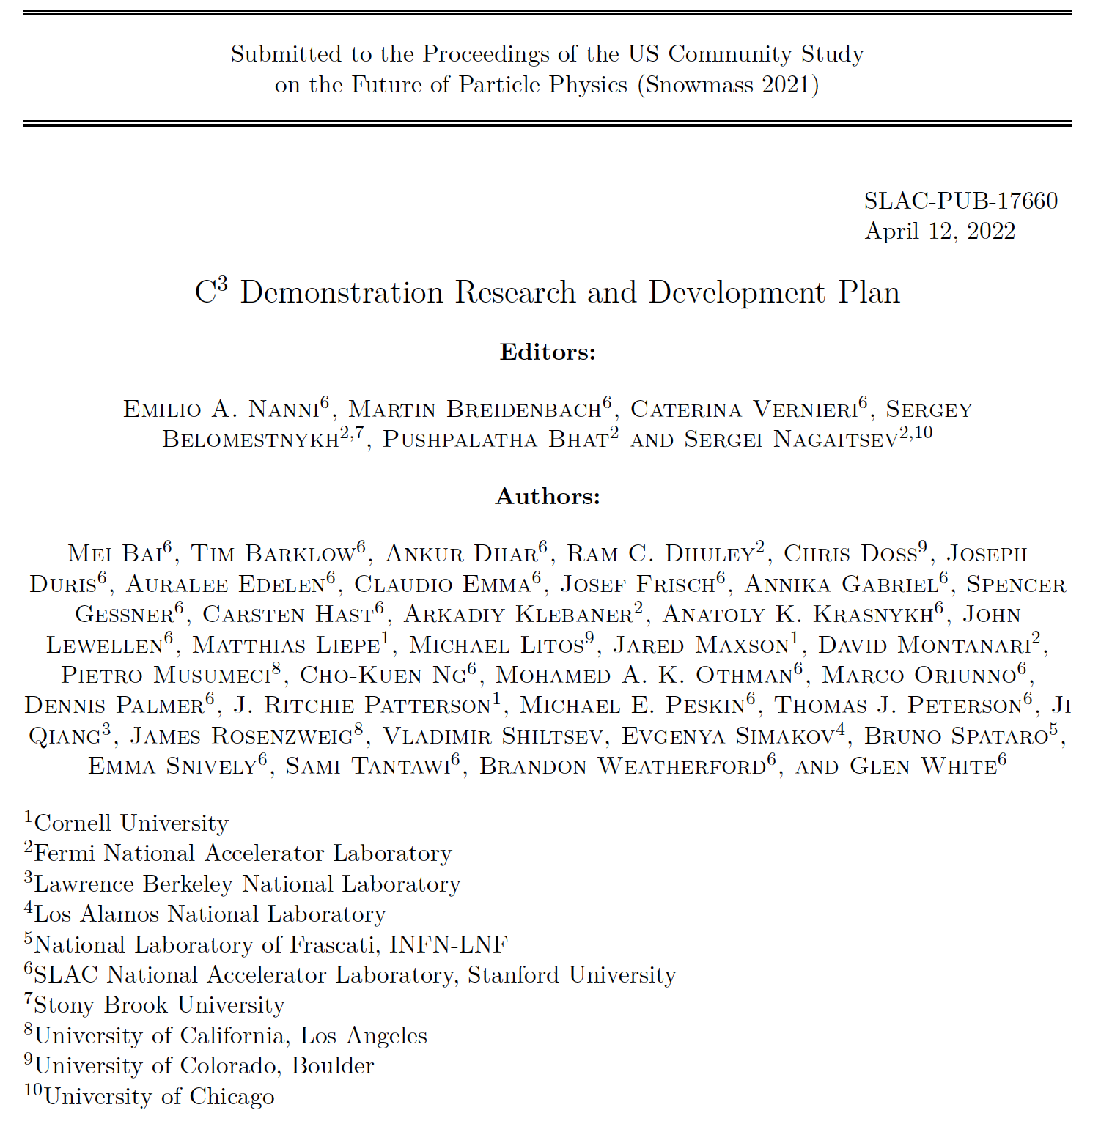
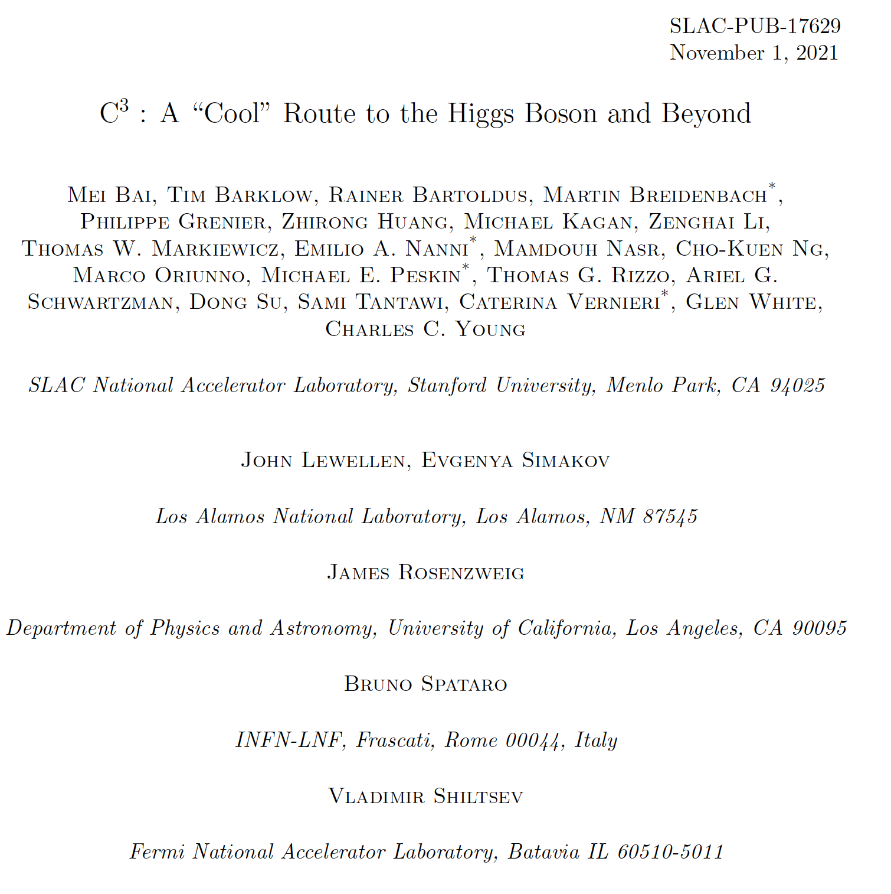
Acknowledgements
Additional Contributors
Mitchell Schneider
Charlotte Whener
Gordon Bowden
Andy Haase
Julian Merrick
Bob Conley
Radiabeam
Cici Hanna
More Details Here (Follow, Endorse, Collaborate):
https://indico.slac.stanford.edu/event/7155/
ILC Update

Slide 5

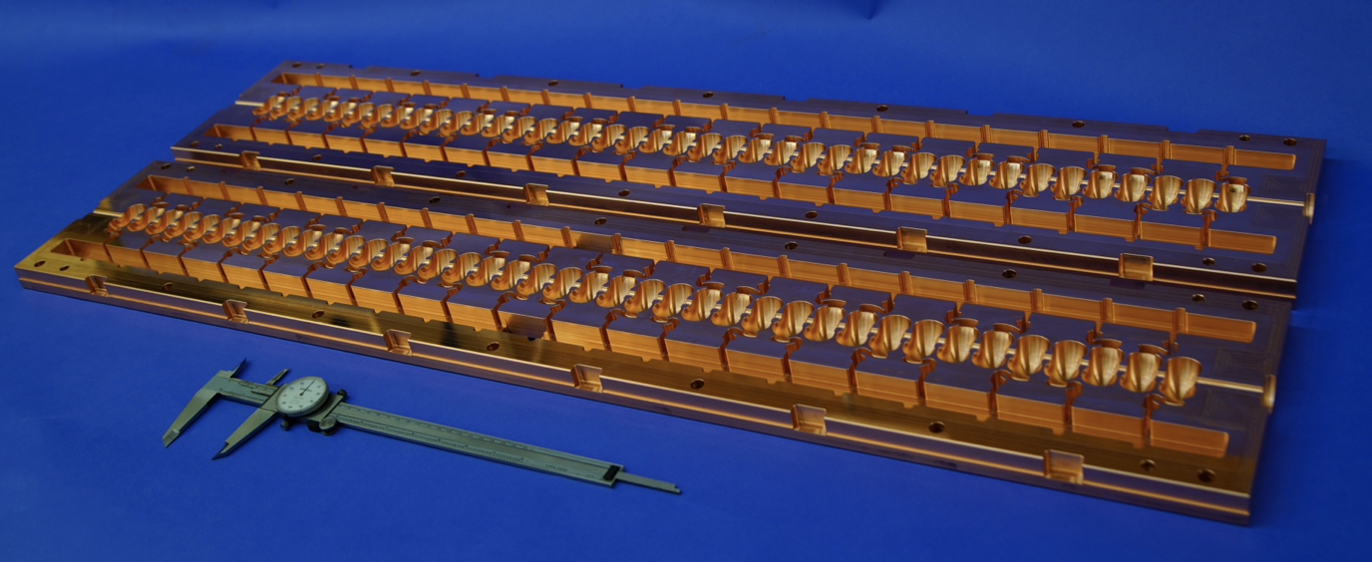
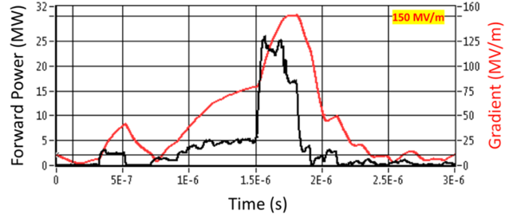
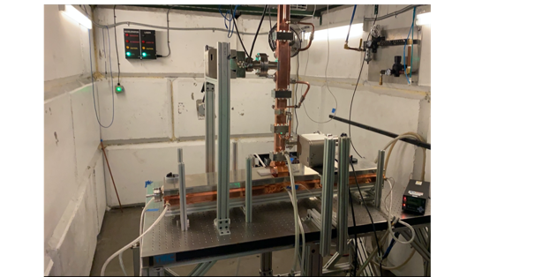
C3 Cool Copper Collider
C³ is based on a new rf technology
  Dramatically improving efficiency and breakdown rate
Distributed power to each cavity from a common RF manifold
Operation at cryogenic temperatures (LN₂ ~80-K)
Robust operations at high gradient: 120 MeV/m
Scalable to multi-TeV operation
C³ Prototype One Meter Structure
High Gradient Operation at 150 MV/m
High power Test at Radiabeam (C-band)
Cryogenic Operation at X-band
Snowmass

Slide 6
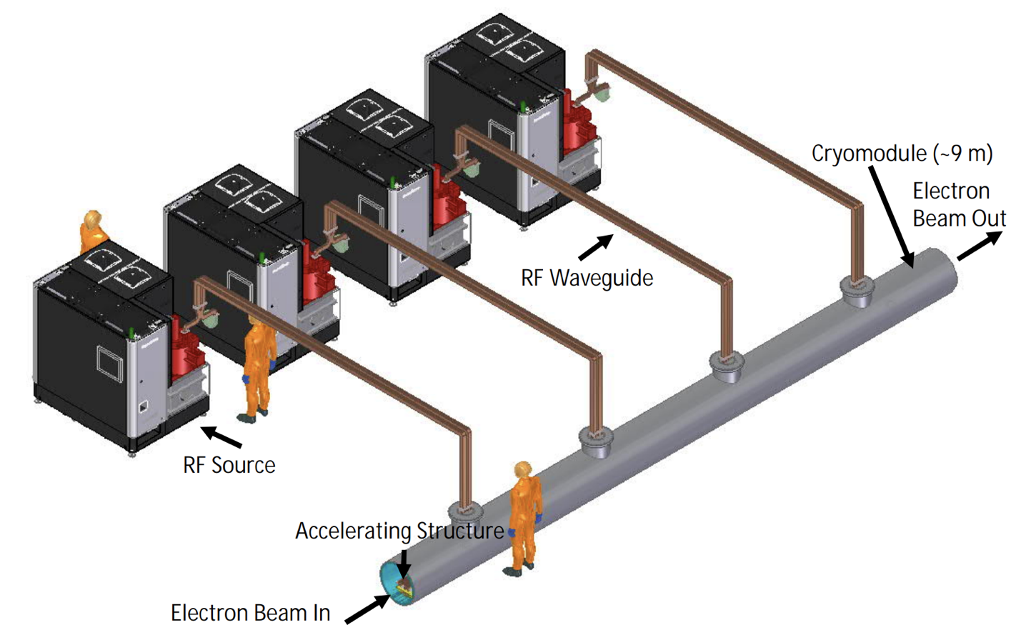
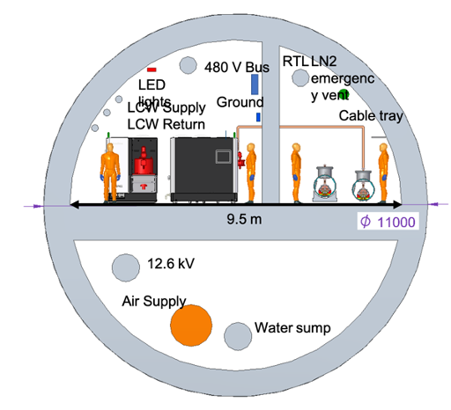
Tunnel Layout for Main Linac 250/550 GeV CoM
Need to optimize tunnel layout – first study looked at 9.5 m inner diameter in order to match ILC costing model
Must minimize diameter to reduce cost and construction time
Surface site (cut/cover) provides interesting alternative – concerns with length of site for future upgrade
Cryomodule Unit - 9 m
(630 MeV/1 GeV )
Usable Tunnel Width - 9.5 m
(Same tunnel width as ILC)
ILC Update

Slide 7
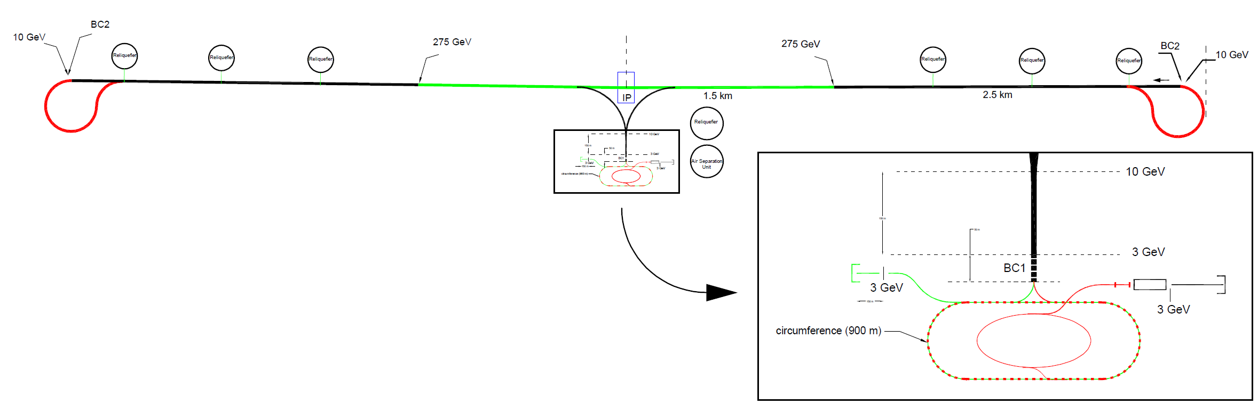
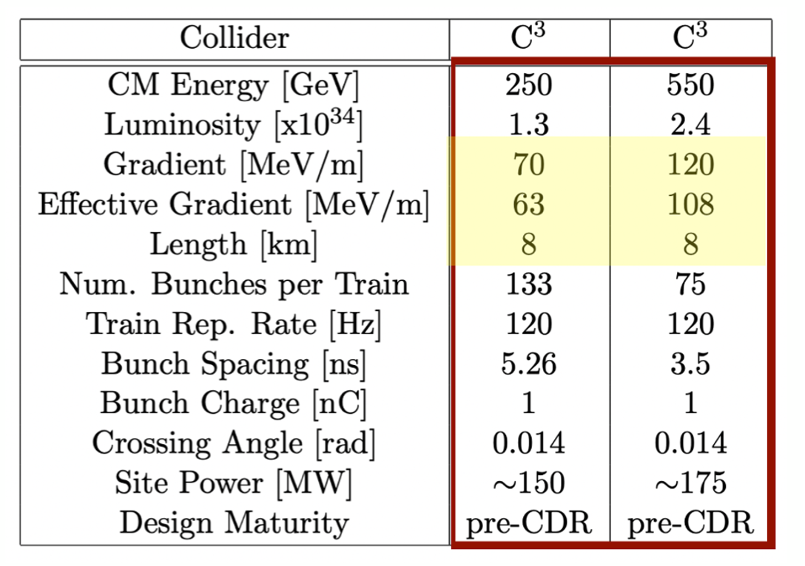
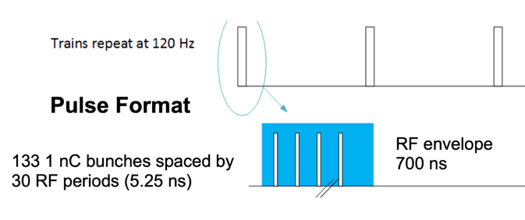
Accelerator Complex
8 km footprint for 250/550 GeV CoM ⟹ 70/120 MeV/m
7 km footprint at 155 MeV/m for 550 GeV CoM – present Fermilab site
Large portions of accelerator complex compatible between LC technologies
Beam delivery / IP modified from ILC (1.5 km for 550 GeV CoM)
Compatible w/ ILC-like detector
Damping rings and injectors to be optimized with CLIC as baseline
C³ - 8 km Footprint for 250/550 GeV
C³ Parameters
Snowmass

Slide 8
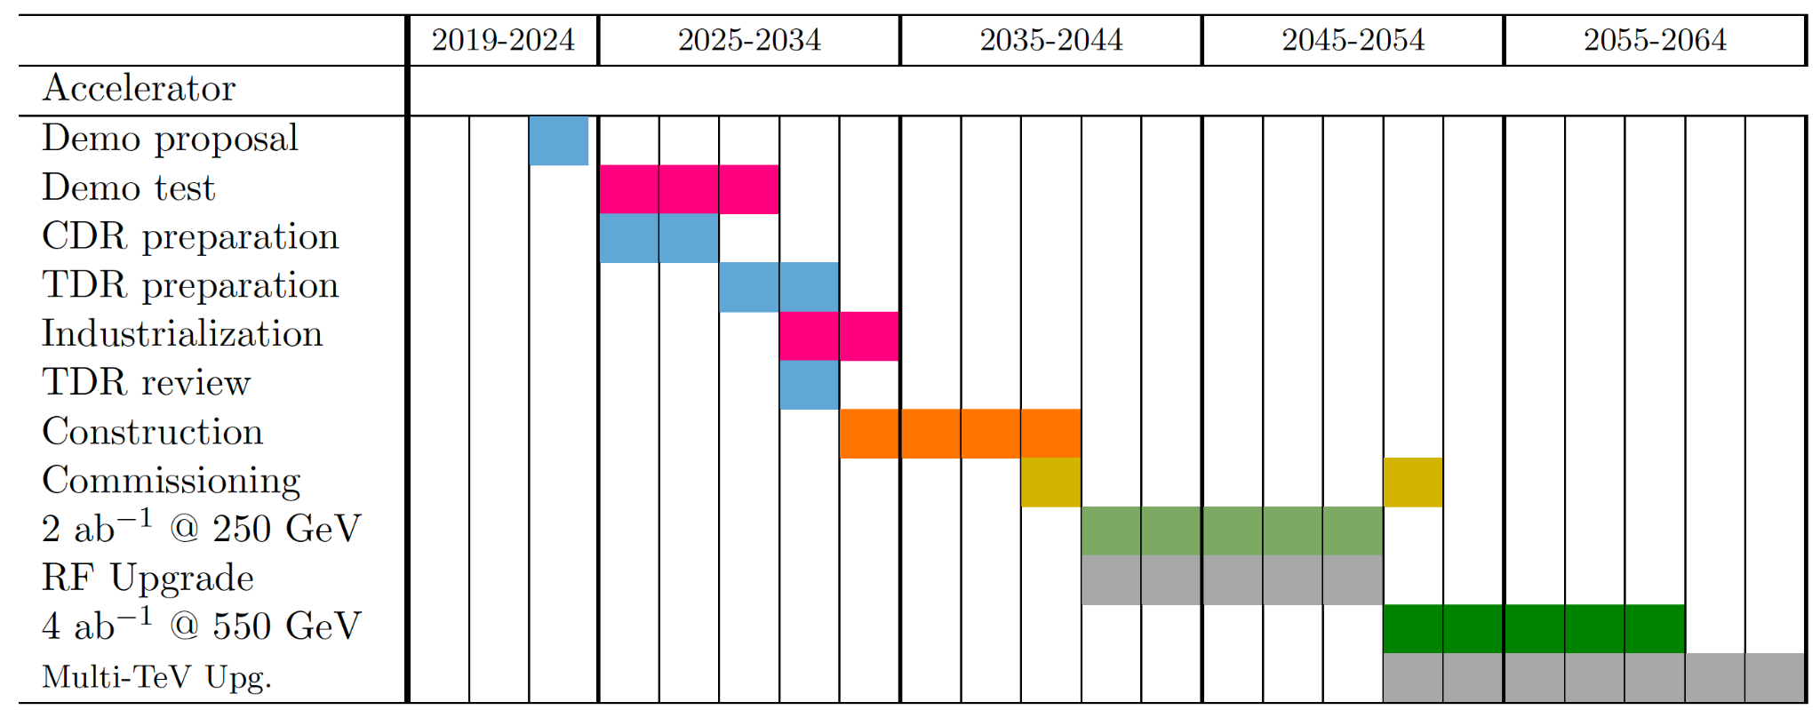
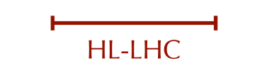
Technical Timeline for 250/550 GeV CoM
Technically limited timeline developed through the Snowmass process
Energy upgrade in parallel to operation with installation of additional RF power sources
ILC Update
Notes:
Run plan to match ILC at 250, we remain open to input -> Higher energy faster, push harder for luminosity

Slide 9
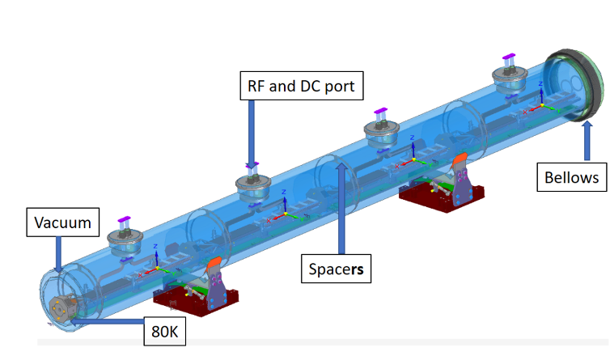
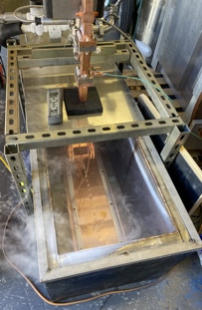
Accelerator Design and Challenges
Accelerator Design
Engineering and design of prototype cryomodule underway
Focused on challenges identified with community through Snowmass (all underway)
Gradient – Scaling up to meter scale cryogenic tests
Vibrations – Measurements with full thermal load
Alignment – Working towards raft prototype
Cryogenics – Two-phase flow simulations to full flow tests
Damping – Materials, design and simulation
Beam Loading and Stability - Thermionic beam test
Scalability – Cryomodules and integration
Cryomodule Concept
Vibration
Studies
ILC Update
Notes:
Stay a SLAC for LCWS for detailed information

Slide 10
C³ Demonstration R&D Plan
C³ demonstration R&D needed to advance technology beyond CDR level
Minimum requirement for Demonstration R&D Plan:
Demonstrate operation of fully engineered and operational cryomodule
  Simultaneous operations of min. 3 cryomodules
Demonstrate operation during cryogenic flow equivalent to main linac at full liquid/gas flow rate
Operation with a multi-bunch photo injector - high charges bunches to induce wakes, tunable delay witness bunch to measure wakes
Demonstrate full operational gradient 120 MeV/m (and higher > 155 MeV/m) w/ single bunch
  Must understand margins for 120 - targeting power for (155 + margin) 170 MeV/m
  18X 50 MW C-band sources - off the shelf units
Fully damped-detuned accelerating structure
Work with industry to develop C-band source unit optimized for installation with main linac
This demonstration directly benefits development of compact FELs, beam dynamics, high brightness guns, etc.
The other elements needed for a linear collider - the sources, damping rings, and beam delivery system – more advanced from the ILC and CLIC – need C³ specific design
Our current baseline uses these directly; will look for further cost-optimizations for of C³
ILC Update

Slide 11
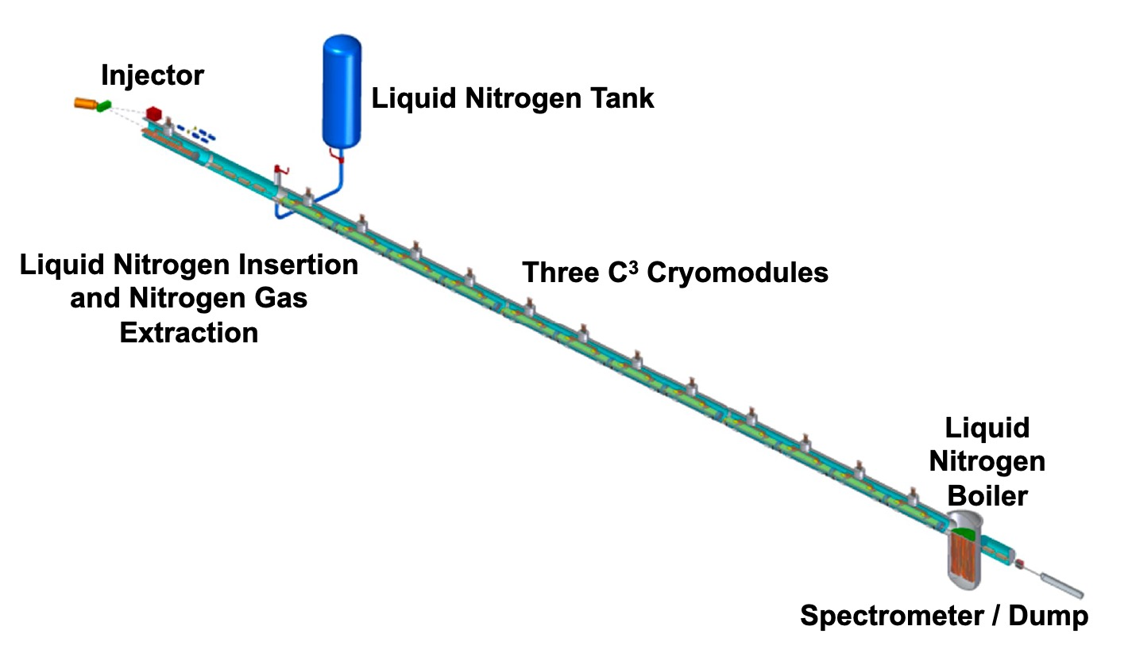
The Complete C³ Demonstrator
Demonstrate fully engineered cryomodule
~50 m scale facility
3 GeV energy reach
Answer technical questions needed for CDR
ILC Update

Slide 12
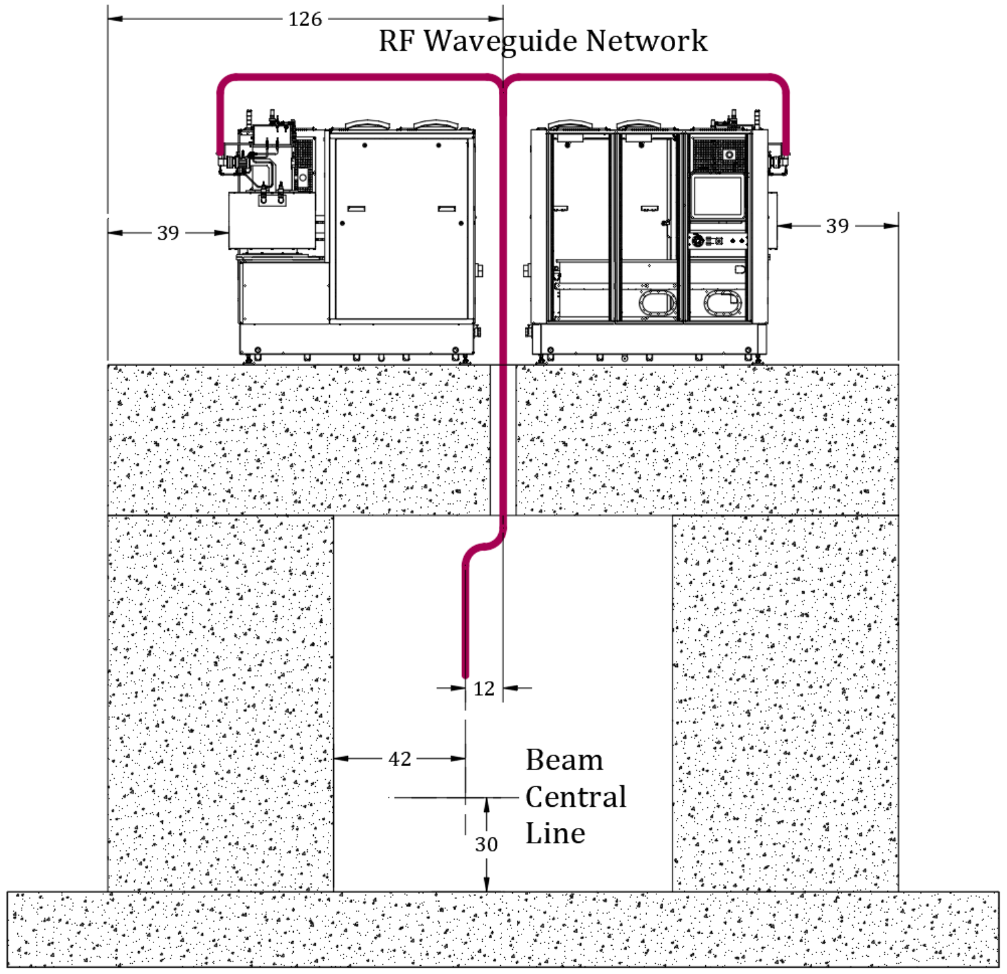
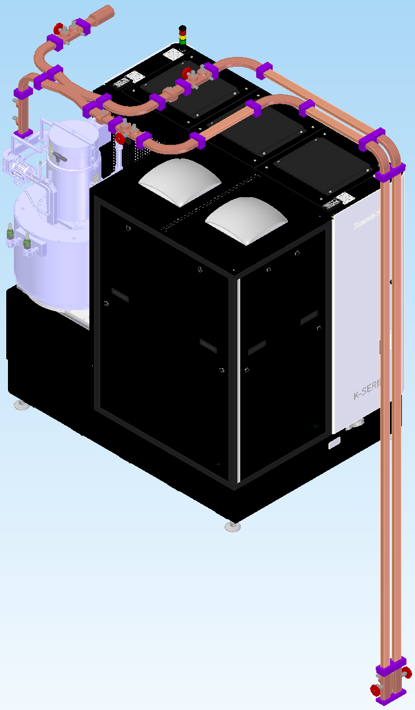
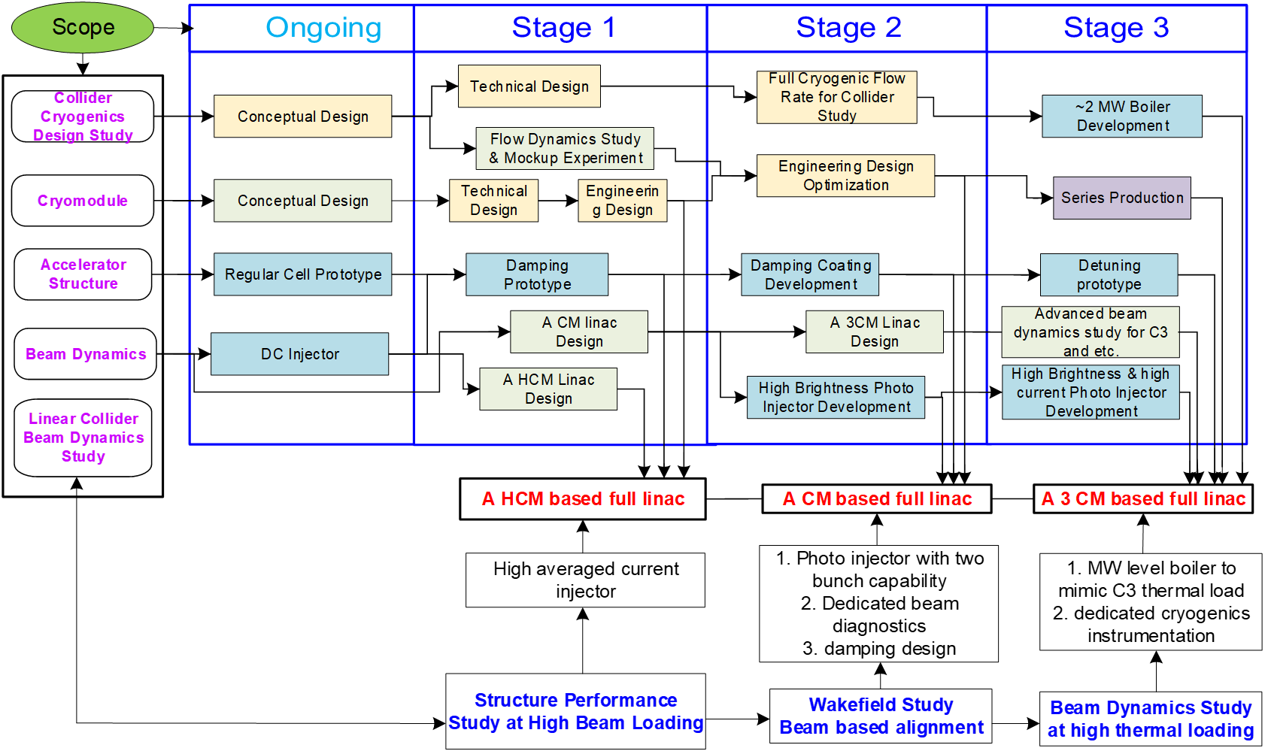
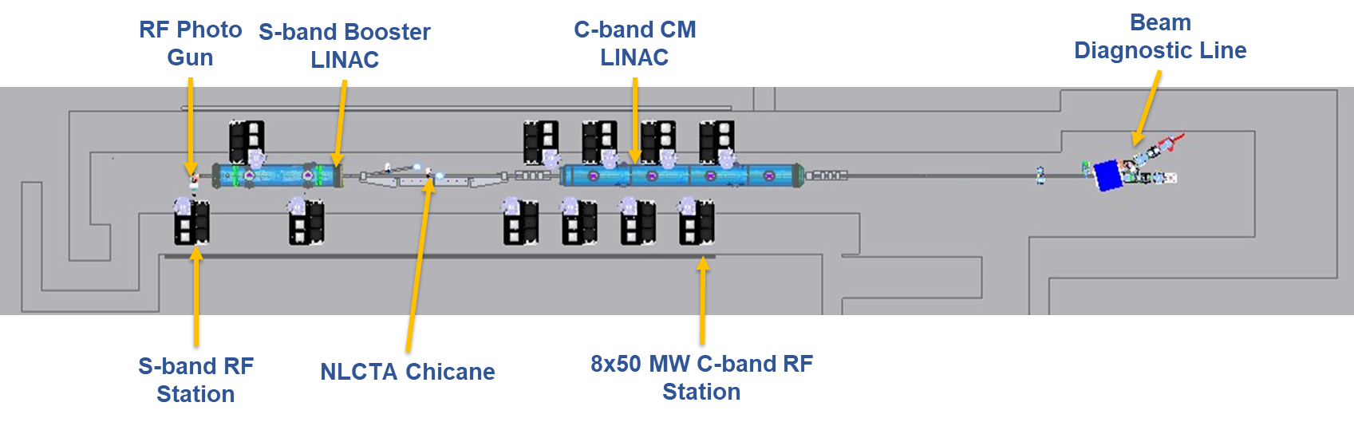
C³ Demonstration R&D Plan
High Power RF Distribution
Demo Plan
A. Krasnykh, BD W 17th May 11:20
Demo Beam Dynamics
F. Wang, NCRF W 17th May 8:30
ILC Update
J. Wu, BD Th 18th May 16:30

Slide 13
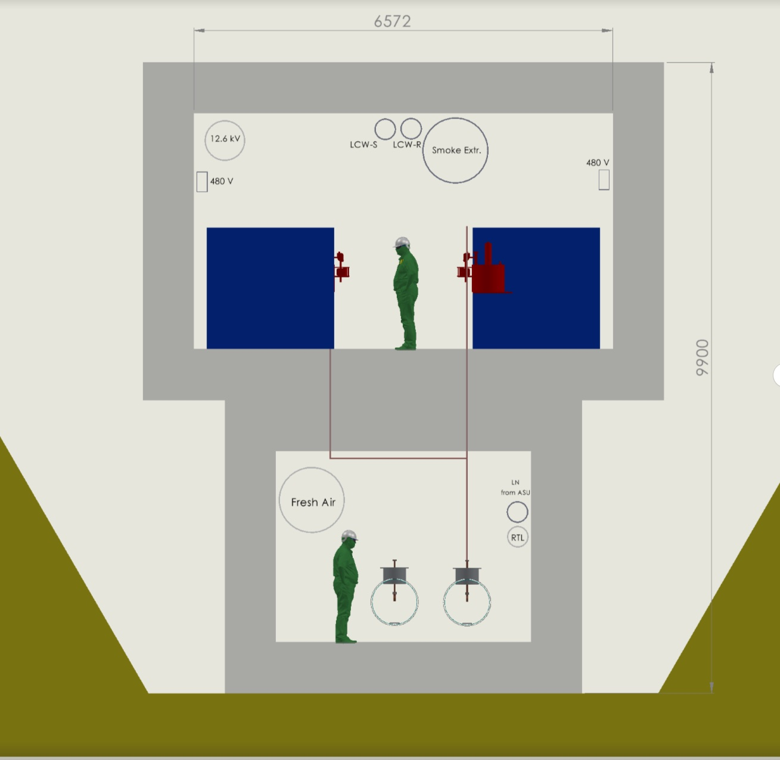
Power Consumption and Sustainability
Sustainability - construction + operations CO₂ emissions per % sensitivity on couplings
  Polarization and high energy to improve sensitivity
  Construction CO₂ emissions → minimize excavation and concrete
  Operations → limit power, decarbonization of the grid and dedicated renewable sources
B. Bullard, S&A Th 18th May 10:30
250 GeV CoM - Luminosity - 1.3x10³⁴
Parameter | Units | Value
Reliquification Plant Cost | M$/MW | 18
Single Beam Power (125 GeV linac) | MW | 2
Total Beam Power | MW | 4
Total RF Power | MW | 18
Heat Load at Cryogenic Temperature | MW | 9
Electrical Power for RF | MW | 40
Cryoplant Electrical Power | MW | 60
Accelerator Complex Power | MW | ~50
Site Power | MW | ~150
Surface Tunnel
Linac Parameters
6.6 m
Temperature (K) | 77
Beam Loading (%) | 45
Gradient (MeV/m) | 70
Flat Top Pulse Length (𝜇s) | 0.7
Cryogenic Load (MW) | 9
Main Linac Electrical Load (MW) | 100
Site Power (MW) | ~150
10 m
Notes:
Sustainability lcws talk and paper

Slide 14
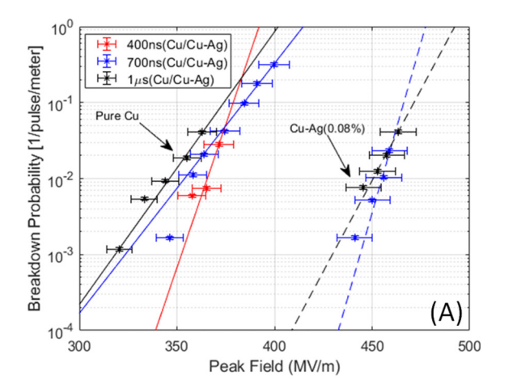
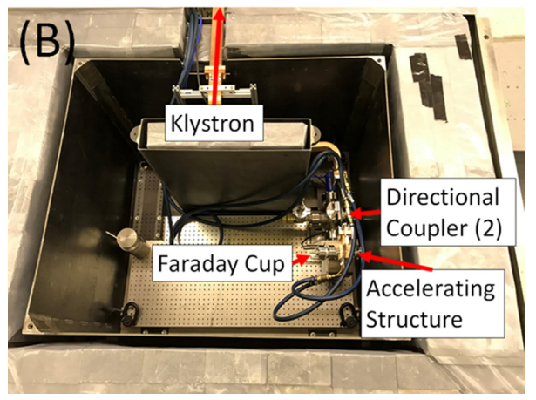
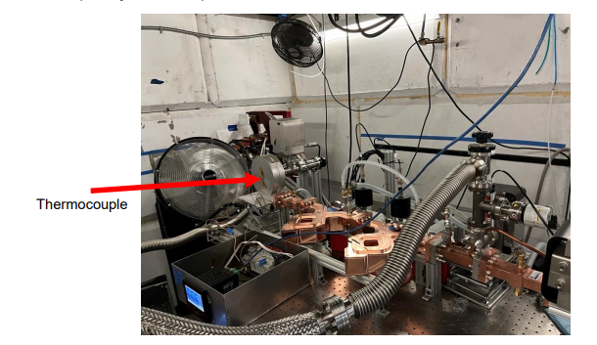
RF Design to High Gradient and High Power Testing
High gradient testing at LANL
Single cell structures
Up to 8 MW per cavity (>240 MeV/m)
High power testing at Radiabeam
Meter scale structures and components
~22 MW delivered in bunker -> 50 MW upgrade in progress
One Meter Structure
Additive Spiral Load
(Inspired by CLIC)
~190 MeV/m
Appl. Phys. Lett. 121, 254101 (2022); doi: 10.1063/5.0132706
ILC Update
Notes:
Stay a SLAC for LCWS for detailed information

Slide 15

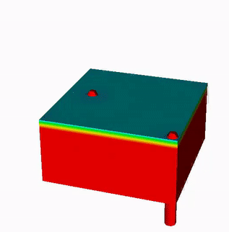
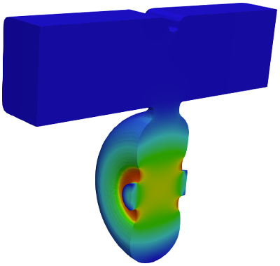
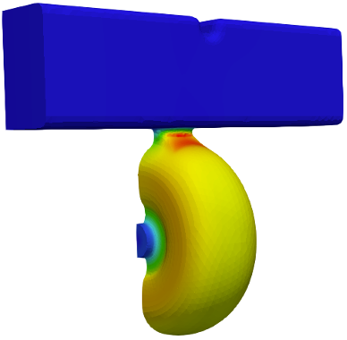
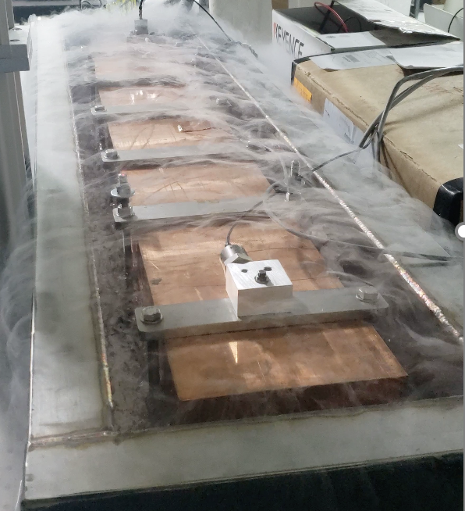
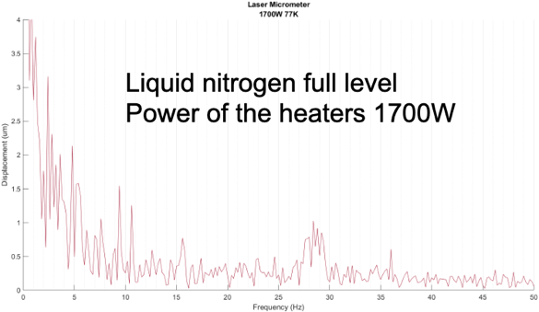
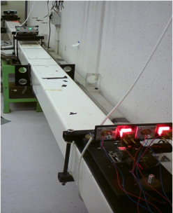

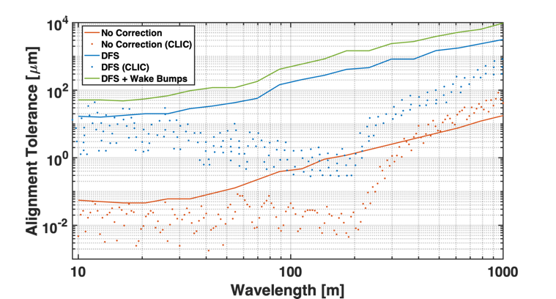
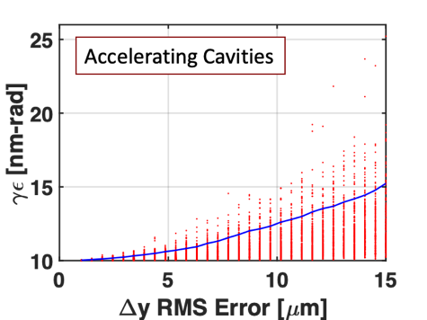
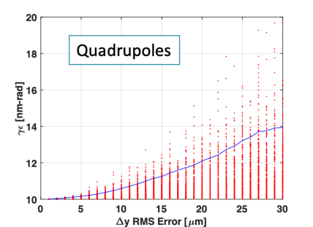
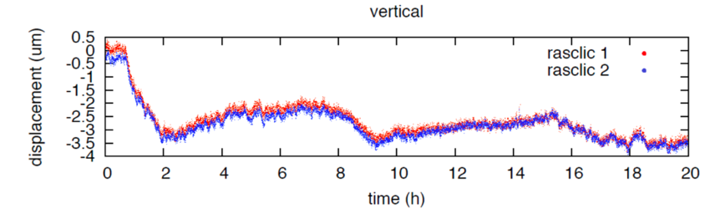
Alignment and Vibrations
Two-Phase Fluid Simulations
System level optimization essential for achieving performance
RF Structure Optimization
Vibration Analysis
3.55 mm iris radius
2.0=E_{max}/E_{acc}
1.23=H_{coup}/H_{wall}
K. Shoele
Electric Field
Precision Short and Long Range Alignment
Magnetic Field
H. Van Der Graaf
M. Shumail, Z. Li
Z. Li, NCRF W 17th May 10:30
Z. George, V. Borzenets
Main Linac Beam Dynamics
Alignment Parameters | Units | Value
Raft Components | μm | 5
Short Range (~10m) | μm | 30
Long Range (>200m) | μm | 1000
Structure Vert. Vibration | μm | 9
Quad Vert. Vibration | nm | 15
BPM Resolution | μm | 0.1
BPM-Quad Alignment | μm | 2
100 nm resolution
Approved effort to test cold
White (C³), Schulte (CLIC)
H. van der Graaf, CF W 17th May 14:30
ILC Update
G. White, Beam Dynamics W 17th May 10:30

Slide 16
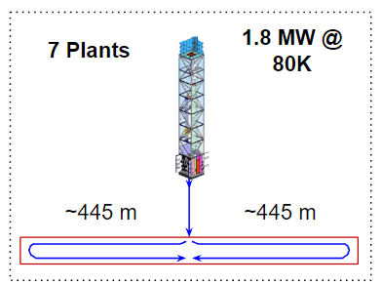
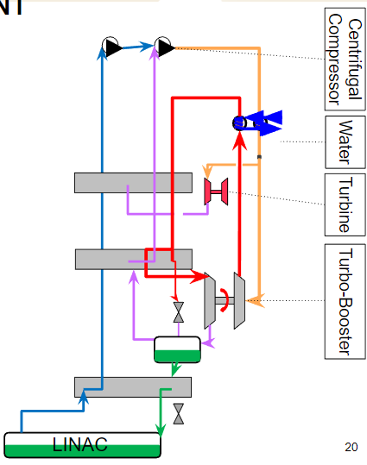
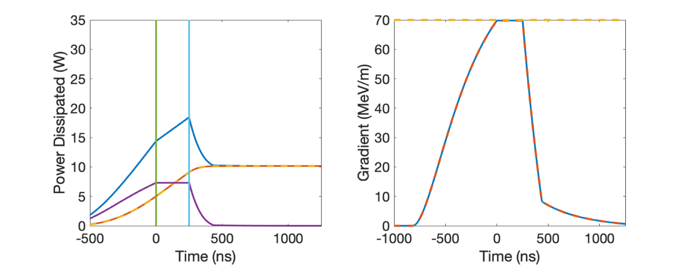
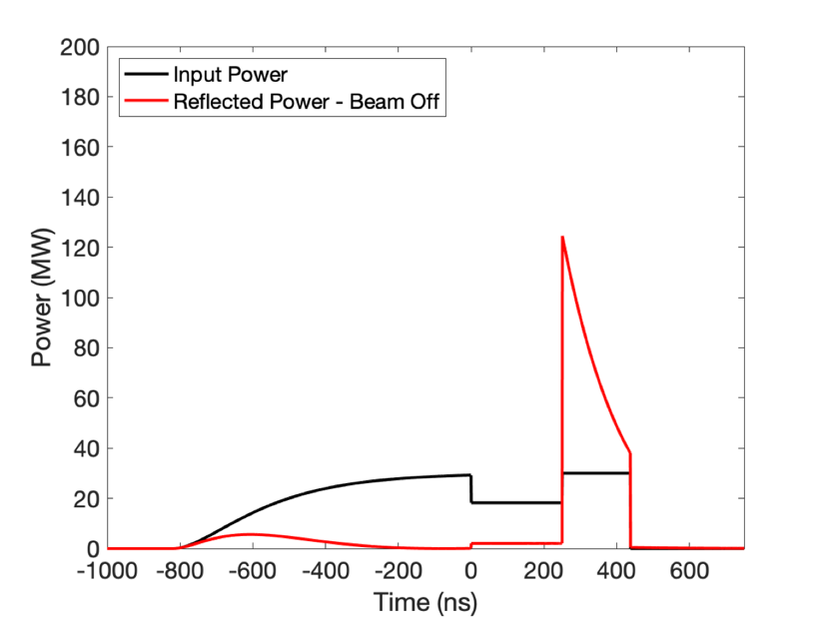
RF Power Requirements and Cryogenics
70 MeV/m 250 ns Flattop (extendible to 700 ns)
~1 microsecond rf pulse, ~30 MW/m
2.3X enhancement from cryo
No pulse compression
Ramp power to reduce reflected power
Flip phase at output to reduce thermals
<2.5 kW/m of structure for C3-250/550
15% cooling efficiency with LN
Thermals
Gradient
RF Power
M. Breidenbach, CF W 17th May 14:15
ILC Update

Slide 17
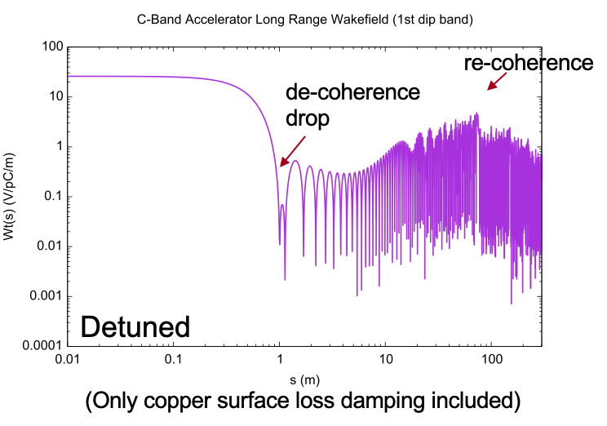
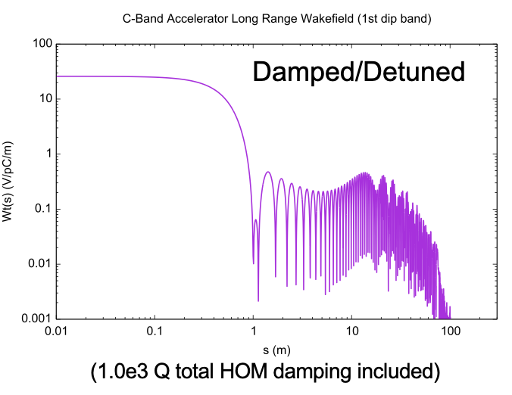
Gaussian Detuning Provides Required 1st Band Dipole Suppression for Subsequent Bunch, Damping Also Needed
Dipole mode wakefields immediate concern for bunch train
4𝜎 Gaussian detuning of 80 cells for dipole mode (1st band) at 𝑓_{𝑐}=9.5 GHz, w/ ∆𝑓/𝑓_{𝑐}=5.6%
First subsequent bunch s = 1m, full train ~75 m in length
Damping needed to suppress re-coherence
ILC Update

Slide 18
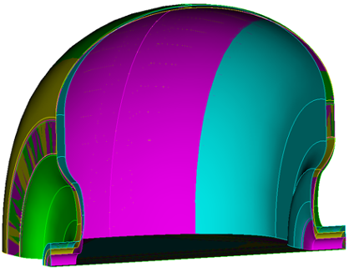
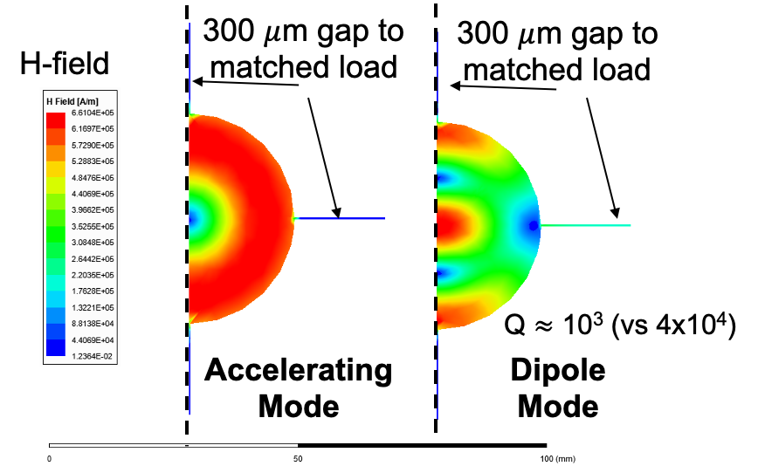
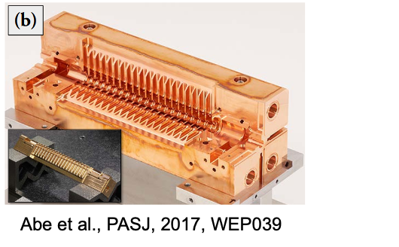
Distributed Coupling Structures Provide Natural Path to Implement Detuning and Damping of Higher Order Modes
Individual cell feeds necessitate adoption of split-block assembly
Perturbation due to joint does not couple to accelerating mode
Exploring gaps in quadrature to damp higher order mode
Detuned Cavity Designs
Quadrant Structure
ILC Update

Slide 19
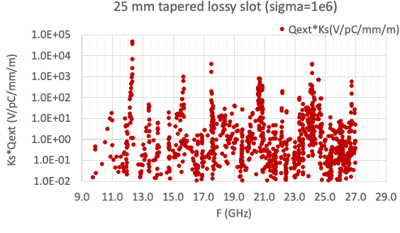
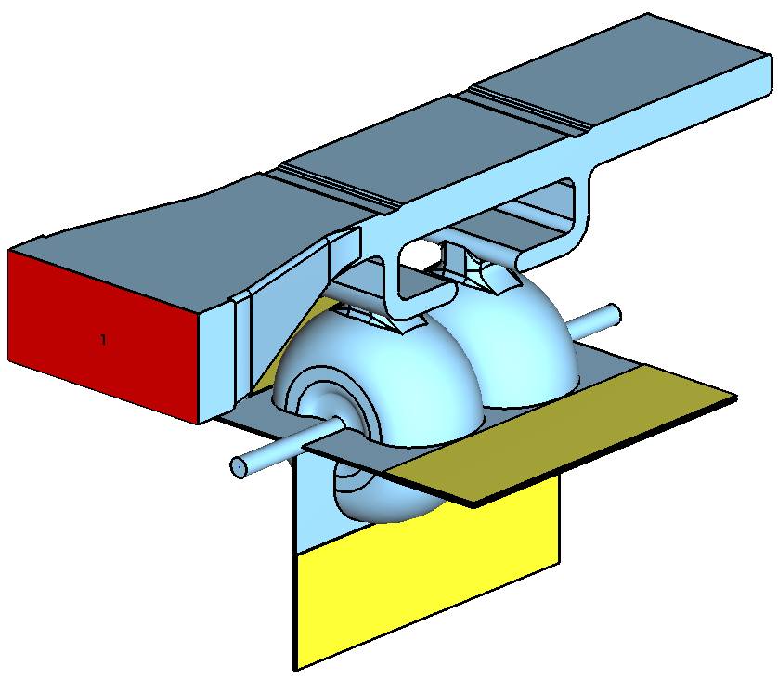
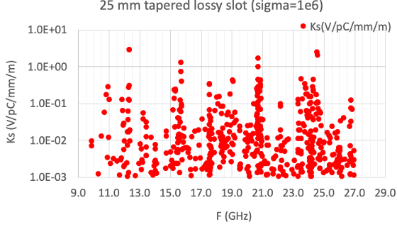
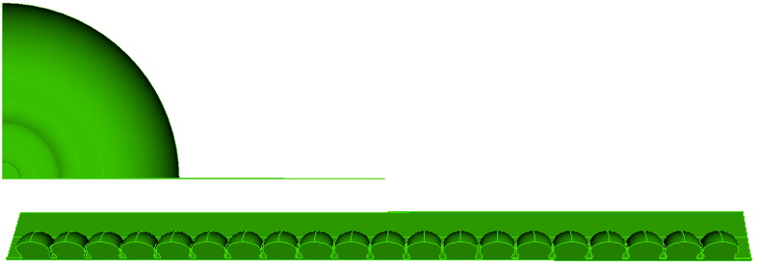
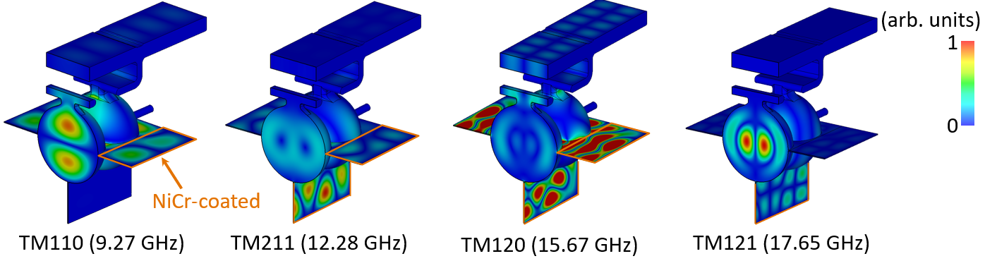
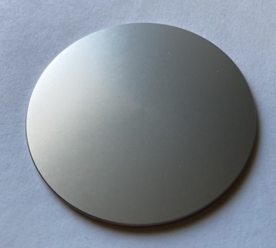
Implementation of Slot Damping
Kick Factor * Q
Need to extend to 40 GHz / Optimize coupling / Modes below 10⁴ V/pC/mm/m
NiCr coated damping slots in development
Kick Factor
Vacuum Space Model
Tapered Slot
Two Cell Prototype
H. Xu, NCRF W 17th May 13:30
NiCr Tested at 80K
ILC Update

Slide 20


Upgrade Options
Luminosity
Energy
Beam power can be increased for additional luminosity
C³ has a relatively low current for 250 GeV CoM (0.19 A) - Could we push to match CLIC at 1.66 A? (8.5X increase?)
Pulse length and rep. rate are also options
HTS Pulse Compressor
REBCO Coatings
Scalability studied to 3 TeV
Requires rf pulse compression for reasonable site power
Higher gradient option (155 MeV/m) in consideration
Cryogenics Scale to multi-TeV
Parameter | Units | Baseline | High-Lumi
Energy CoM | GeV | 250 | 250
Gradient | MeV/m | 70 | 70
Beam Current | A | 0.2 | 1.6
Beam Power | MW | 2 | 16
Luminosity | x10³⁴ | 1.3 | 10.4
Beam Loading |  | 45% | 87%
RF Power | MW/m | 30 | 125
Site Power | MW | ~150 | ~180
Qo ~ 400k
Le Sage, CERN Collaborators
arXiv:1807.10195 (2018)
G. Le Sage, S&A Th 18th May 11:30
Caution: Requires serious investigation of beam dynamics - great topic for C³ Demonstration R&D
Snowmass

Slide 21

Detector R&D topics
Some of the R&D topics emerged during LCWS
Precise timing
  For PID (10-50ps)
  For improved tracking (ns) with MAPS
  For Calorimetry PF
Highly integrated sensors MAPS for tracking and calorimetry
Different PID approaches
  i.e. gaseous compact RICH
Smart sensors/ASICs
Better and modern software frameworks
  Simulation and Reconstruction, leveraging LHC expertise

Slide 22
ILC Update Program Related to C³
ID | Title | Date | Session | Track | Presenters | Email
3 | Distributed Coupling Linac for Efficient Acceleration of High Charge Electron Bunches | 17 May 2023, 11:00 | Accelerator: Normal Conducting RF | Normal Conducting RF | Ankur Dhar | adhar@slac.stanford.edu
4 | Physics with the XFEL Compton γγ Collider (XCC) Higgs Factory | 17 May 2023, 13:30 | Physics and Detectors: Track 1 | Track 1: Physics at e+e- colliders | Timothy Barklow | timb@slac.stanford.edu
6 | C3 | 15 May 2023, 10:30 | Joint Plenary | Joint | Caterina Vernieri | caterina@slac.stanford.edu
13 | A design of the C-band RF photoinjector cavity for testing photocathodes under extreme fields | 17 May 2023, 14:40 | Accelerator: Normal Conducting RF | Normal Conducting RF | Haoran Xu | haoranxu@lanl.gov
14 | Two-cell high-gradient C-band RF accelerator cavity for high power HOM absorber testing | 17 May 2023, 11:20 | Accelerator: Normal Conducting RF | Normal Conducting RF | Haoran Xu | haoranxu@lanl.gov
20 | C3 Main Linac Beam Dynamics | 17 May 2023, 10:30 | Accelerator: Beam Dynamics | Beam Dynamics | Glen White | whitegr@slac.stanford.edu
21 | C3 demonstration plan and applications | 17 May 2023, 08:30 | Accelerator: Normal Conducting RF | Normal Conducting RF | Faya Wang | fywang@slac.stanford.edu
28 | RF sources and power distribution for the C3-demo and beyong | 17 May 2023, 13:30 | Accelerator: Normal Conducting RF | Normal Conducting RF | Anatoly Krasnykh | krasnykh@slac.stanford.edu
30 | Cryogenic Design for C3 Main Linacs | 17 May 2023, 14:15 | Accelerator: Conventional Facilities | Conventional Facilities | Martin Breidenbach | mib@slac.stanford.edu
31 | A nanosecond pulse technology for injection/extraction systems | 17 May 2023, 16:10 | Accelerator: Beam Dynamics | Normal Conducting RF | Anatoly Krasnykh | krasnykh@slac.stanford.edu
41 | C-Band Distributed Coupling Structure Design and Wakefield Damping | 17 May 2023, 10:30 | Accelerator: Normal Conducting RF | Normal Conducting RF | Zenghai Li | lizh@slac.stanford.edu
46 | Pair Production and Hadron Photoproduction Backgrounds at C3 | 18 May 2023, 13:30 | Physics and Detectors: Track 2 | Track 2: Analysis and Reconstruction | Elias Mettner | emettner@wisc.edu
47 | Muon Backgrounds from Beam Interactions with the Accelerator Structure at C3 | 18 May 2023, 13:45 | Physics and Detectors: Track 2 | Track 2: Analysis and Reconstruction | Dimitris Ntounis | dntounis@stanford.edu
51 | High Temperature Superconducting RF cavity | 18 May 2023, 11:30 | Accelerator: Sustainability & Applications | Sustainability and Applications | Gregory Le Sage | lesage@slac.stanford.edu
52 | Sustainability studies for the Cool Copper Collider | 18 May 2023, 10:30 | Accelerator: Sustainability & Applications | Sustainability and Applications | Brendon Bullard | bbullard@slac.stanford.edu
55 | Rasnik as alignment system for linac submodules | 17 May 2023, 14:30 | Accelerator: Conventional Facilities | Conventional Facilities | Harry van der Graaf | vdgraaf@nikhef.nl
88 | Cool Copper Collider Demonstrator Beam Dynamics and Diagnostics | 18 May 2023, 15:30 | Accelerator: Beam Dynamics | Beam Dynamics | Juhao Wu | jhwu@slac.stanford.edu
111 | An Integrated Simulation Tool for Dark Current Radiation Effects using ACE3P and Geant4 | 17 May 2023, 16:00 | Accelerator: Normal Conducting RF | Normal Conducting RF | Lixin Ge | lge@slac.stanford.edu
120 | Application of CrYogenic Brightness-Optimized Radiofrequency Gun (CYBGORG) for Future Collider Studies | 17 May 2023, 14:20 | Accelerator: Normal Conducting RF | Normal Conducting RF | Gerard Lawler | gelawler@protonmail.com
207 | Wakefield Damping in a Distributed Coupling Accelerating Structure for CLIC | 17 May 2023, 16:30 | Accelerator: Normal Conducting RF | Normal Conducting RF | Evan Ericson | eje344@mail.usask.ca
ILC Update

Slide 23
Conclusions
C³ provides a rapid route to precision Higgs physics with a compact 8 km footprint
  Higgs physics run by 2040
  US-hosted facility possible
C³ time structure is compatible with ILC-like detector design and optimizations ongoing
C³ upgrade to 550 GeV with only added rf sources
  Higgs self-coupling and expanded physics reach
C³ is scalable to multi-TeV
C³ Demo advances technology beyond CDR level
  5 year program, followed by completion of TDR and industrialization
  Three stages with quantitative metrics and milestones for decision points
  Direct and synergistic contributions to near-term collider concepts
More Details Here (Follow, Endorse, Collaborate):
https://indico.slac.stanford.edu/event/7155/
ILC Update

Slide 24
Questions?

Slide 25
Additional Material

Slide 26



Synergies with Future Colliders
RF Accelerator Technology Essential for All Near-Term Collider Concepts
C³ Demo is positioned to contribute synergistically or directly to all near-term collider concepts
CLIC - components, damping, fabrication techniques
ILC - options for electron driven positron source based C³ technology
Muon Collider - high gradient cryogenic copper cavities in cooling channel, alternative linac for acceleration after cooling
AAC - C³ Demo utilized for staging, C³ facility multi-TeV energy upgrade reutilizing tunnel, 𝛾𝛾 colliders
FCC-ee - common electron and positron injector linac from 6 to 20 GeV
  reduce length 3.5X OR reduce rf power 3.5X
90% seeds < 8 um-rad with lattice errors
Planned test at Argonne
Tracking with Lucretia includes longitudinal and transverse wakes, chromatic effects etc
Error study is 100 seeds, 100 μm element offsets, 300 μrad element rolls (rms)
  No corrections applied
ILC Update

Slide 27









Further Cavity Optimization Possible
Single side coupling iris induces dipole and quad fields
Coupling hole symmetrization and racetrack shape incorporated to minimize dipole and quad fields
dipole, quad calculated at 50MV/m
Dipole
Quad
✅
w/o symmetrization
Dipole
Quad
V1-simple-stub
(not ideal cancellation)
V2-symm-stub
(good cancellation)
ILC Update
with symmetrization 100X reduction
Zenghai Li

Slide 28




Global Contributions
C³ Technical Timeline Only Possible with the Exceptional Progress of ILC and CLIC
Benefit from injector complex and beam delivery concepts
Continue to benefit from technological improvement by ILC and CLIC
High Efficiency RF Sources (CLIC)
Electron Driven Positron Source
Nanobeams for IP (ATF)
https://www-atf.kek.jp/atf/
I. Sarchev, CERN
Courtesy of Y. Enomoto
Vibrant International Community for Future Colliders is Essential
ILC Update

Slide 29

Full Parameters
ILC Update

Slide 30


Cryomodule Design and Alignment
Up to 1 GeV of acceleration per 9 m cryomodule; ~90% fill factor with eight 1 m structures
Main linac will require 5 micron structure alignment
Combination of mechanical and beam based alignment
Pre-alignment warm, cold alignment by wire, followed by beam based
Mechanical motor runs warm or cold – no motion during power failure
Piezo for active alignment
Investigating support and assembly design
Cryomodule
Cryomodule Cross Section
ILC Update

Slide 31


Requirements for a High Energy e⁺e⁻ Linear Collider
Using established collider designs to inform initial parameters
Quantifying impact of wakes requires detailed studies
Most important terms – aperture, bunch charge (and their scaling with frequency)
Target initial stage design at 250 GeV CoM
2 MW single beam power
Luminosity
Machine | CLIC | NLC | C³
Freq (GHz) | 12.0 | 11.4 | 5.7
a (mm) | 2.75 | 3.9 | 2.6
Charge (nC) | 0.6 | 1.4 | 1
Spacing (𝜆) | 6 | 16 | 30/20
# of bunches | 312 | 90 | 133/75
Beam Power
https://clic-meeting.web.cern.ch/clic-meeting/clictable2010.html
NLC, ZDR Tbl. 1.3,8.3
ILC Update

Slide 32


Breakthrough in the Performance of RF Accelerators
RF power coupled to each cell – no on-axis coupling
Full system design requires modern virtual prototyping
Electric field magnitude produced when RF manifold feeds alternating cells equally
Optimization of cell for efficiency (shunt impedance)
Control peak surface electric and magnetic fields
Key to high gradient operation
ILC Update
Tantawi, Sami, et al. PRAB 23.9 (2020): 092001.

Slide 33



Cryo-Copper: Enabling Efficient High-Gradient Operation
Cryogenic temperature elevates performance in gradient
Material strength is key factor
Impact of high fields for a high brightness injector may eliminate need for one damping ring
Operation at 77 K with liquid nitrogen is simple and practical
Large-scale production, large heat capacity, simple handling
Small impact on electrical efficiency
Cryogenic temperature elevates performance in gradient
Increased material strength is key factor
Increase electrical conductivity reduces pulsed heating in the material
Cahill, A. D., et al. PRAB 21.10 (2018): 102002.
ILC Update

Slide 34



Beam Format and Detector Design Requirements
ILC timing structure: Fraction of a percent duty cycle
Power pulsing possible, significantly reduce heat load
  Factor of 50-100 power saving for FE analog power
Tracking detectors don’t need active cooling
  Significantly reduction for the material budget
Triggerless readout is the baseline
C³ time structure is compatible with ILC-like detector overall design and ongoing optimizations
ILC timing structure
C³ timing structure
1 ms long bunch trains at 5 Hz
2820 bunches per train
308ns spacing
ILC Update

Slide 35

Why 550 GeV?
We propose 250 GeV with a relatively inexpensive upgrade to 550 GeV
An orthogonal dataset at 550 GeV to cross-check a deviation from the SM predictions observed at 250 GeV
From 500 to 550 GeV a factor 2 improvement to the top-Yukawa coupling
O(20%) precision on the Higgs self-coupling would allow to exclude/demonstrate at 5𝜎 models of electroweak baryogenesis
ILC Update

Slide 36

One note on polarization
arXiv:1708.08912
arXiv:1801.02840
There are extensive comparisons between the FCC-ee plan and the C³/ILC runs that show they are rather compatible to study the Higgs Boson
When analyzing Higgs couplings with SMEFT, 2 ab⁻¹ of polarized running is essentially equivalent to 5 ab⁻¹ of unpolarized running.
  Electron polarization is essential for this. But, there is almost no difference in the expectation with and without positron polarization.
  Positron polarization allows more cross-checks of systematic errors. We may wish to add it later.
  Positron polarization brings a large advantage in multi-TeV running, where the most important cross sections are from e-_{L}e+_{R}
ILC Update

Slide 37

Implementation of Slot Damping
Kick Factor * Q
Need to extend to 40 GHz / Optimize coupling / Modes below 10⁴ V/pC/mm/m
NiCr coated damping slots in development
Kick Factor
Vacuum Space Model
Damping Slot Prototype
Tapered Slot
ILC Update

Slide 38




Accelerator Complex
8 km footprint for 250/550 GeV CoM ⟹ 70/120 MeV/m
7 km footprint at 155 MeV/m for 550 GeV CoM – present Fermilab site
Large portions of accelerator complex compatible between LC technologies
Beam delivery / IP modified from ILC (1.5 km for 550 GeV CoM)
Compatible w/ ILC-like detector
Damping rings and injectors to be optimized with CLIC as baseline
G. White, Beam Dynamics W 17th May 10:30
C³ - 8 km Footprint for 250/550 GeV
Alignment and DFS Studies
DR Kickers
ILC Update
A. Krasnykh, Beam Dynamics W 17th May 16:10

Slide 39

Table of Parameters
ILC Update

