Slide 1
Recent progress in TPC R&D
Work in progress along the lines discussed at the ECFA workshop at DESY on adapting to FCC or CEPC conditions.
K. Fujii, D. Jeans and S. Ganjour are re-visiting the distortion estimates
New background calculations at the Z are in progress
  See my presentation at the France-Italy FCC workshop in Lyon.
  Watch the next FCC workshop in January in Cracow
Particle ID is best done by combining dE/dx and time-of-flight
Synergies with other TPCs have to be exploited. ALICE GEM-TPC is about to start taking data and T2K is half-way characterizing and constructing elements. BELLE 2 experience is also worth exploiting.

Slide 2
Tracking at an EW/Higgs/top factory
At the Z pole and beyond, particle ID is an essential ingredient, for tagging and studies of Heavy Flavours (together with an excellent vertex detection)
A TPC ideally combines dE/dx measurement and low material budget, allowing a continuous measurement of the tracks. A strong magnetic field aligned with the TPC drift field limits diffusion and allows charged track momentum measurement.
Together with silicon (vertex) detectors, it allows the excellent performance in resolution needed to extract the Z recoil peak to tag Higgses in a model-independent and unbiased way
TPC is the main tracker for the ILD detector concept. At ILC, it profits from a beam time structure allowing power switching and gating. ILD is considering adapting the concept in case a circular collider is built first.

Slide 3
TPC R&D
All the R&D is carried out within the LCTPC collaboration (spokesperson Jochen Kaminski)
France is mainly involved in the Micromegas pad readout option
There are also GEM pad options (Germany and Japan) and Micromegas pixels (digital readout, Nikhef and Bonn, and formerly Saclay and Freiburg). All the options are tested at the DESY beam test facility, using a large field cage, common gas system, cosmic-ray and beam trigger, power supplies
Beside this dedicated R&D, lessons are learnt from experiments in progress, using TPCs with similar techniques issued from e+e- collider studies : ALICE at LHC (GEMs), T2K/ND280 at J-PARC (resistive Micromegas)

Slide 4
Gas choice has to be revisited
Base gas :
  Ar for largest ionization : 97 e-ion pairs in ~35-40 clusters
  He for well-separated clusters (but cannot set field to the maximum drift velocity)
Additional gases
  Isobutane : quencher, cuts UVs to avoid avalanche propagation, but sensitive to neutrons
  CF4 : increases electron drift velocity and reduces diffusion in magnetic field by a factor of ~10 at 3.5 T and ~5 at 2T.
  Low e attachment (keep O₂ and H₂O below ~10 ppm to drift over 2m) velocity)
T2K gas Ar:CF4:Isobutane 95:3:2 satisfies all requirements for a TPC, but CF4 might be forbidden in future. Recirculating should be sufficient.

Slide 5
Distortions from positive ions
Ions drifting in the gas are very slow (typically a few m/s)
Primary ions from ionization in the gas (from event track of from machine background) or secondary ions from the amplification back-flowing in the drift region, drift very slowly, producing space charge which distorts the trajectories of the electrons drifting from the tracks by creating a transverse component to the drift field
Calculated in 2011 by D. Arai and K. Fujii :
2022 : New calculation in progress, adapt to Z pole
(K. Fujii, S. Ganjour, Mingrui Zhao…)
Simulation by M. Killenberg (2009)

Slide 6
Case of FFC or CEPC at Z pole : almost continuous set of disks.
https://agenda.linearcollider.org/event/5504/contributions/24543/attachments/20144/31818/PositiveionEffects-kf.pdf

Slide 7
Daniel Jeans studied primary ion density from Z events
Presented one week ago in Software meeting
ILD detector but B=2T
Keep low-pT tracks, but only from Z (no machine background)

Slide 8
back-flowing ions (IBF=1)
D. Jeans

Slide 9
Corresponds to 1 ion drift time
Fluctuations of charge density due to curlers
K. Fujii, preliminary

Slide 11
Resulting maximum distortions at Z pole for IBF=5 :
~1200 µm (preliminary, does not include beam-induced background)
(100 µm if IBF can be fully suppressed…)
Can it be corrected for?
Only on average, or the charge must be locally measured. This is difficult, as the micro-curlers saturate the amplifiers.
Maybe only way, in Gridpix, using the segmented mesh of the chips : monitor the mesh current of each chip.

Slide 12
Pair production background
Studied with GUINEA-PIG MC (ILC, D. Schulte 2003, A. Vogel 2007) and GUINEA PIG++ (FCC, E. Perez 2019, A. Ciarma 2022)
ILC 250 GeV
B=3.5 T
FCC 91.2 GeV
B=2 T

Slide 13
Charge spreading studies in T2K
Waveforms of a pad and its neighbours are simultaneously fitted to extract RC and amplitude. This allows to determine RC maps and gain maps for each ERAM module (Encapsulated Resistive Anode Micromegas)
X-ray test bench
S. Joshi, S. Hassani, J.-F. Laporte

Slide 14
Pad size : from pixel (digital TPC) to pad
Y. Aoki et al 2022 JINST 17 P11027
Uli Einhaus
Pixel TPC
Pad TPC

Slide 15
Use of Time-of-flight for PId
10 ps resolution can be envisaged from Si envelope and could provide pi-K separation at up to 20 GeV/c.
(here plots for 50ps)
See also Bohdan Dudar (ILD software and analysis meeting, 11/2022)
Manqi Ruan
ILD meeting
10/2022

Slide 16
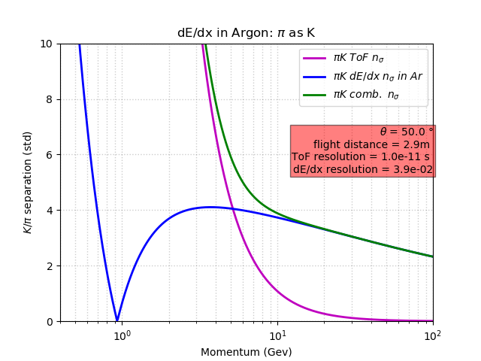
SEPARATION POWER
Combined
R. Aleksan

Slide 17
Conclusion
The use of a TPC at circular colliders requires new R&D work
  Recent and ongoing studies show that running a TPC at the Z pole and at the 2 10³⁶ cm⁻²s⁻¹ luminosity is difficult because of positive ions creating distortions.
  Real-time and localized ionization measurement might prove necessary for correcting for distortions
  Ultimate ion backflow suppression is essential
  Power consumption can be source of a problem if power pulsing not possible :cooling
  Machine background studies need to be revisited at all energies
  Gas choice has to be revisited and several options have to be considered
  Including precise timing in the tracking might be very helpful at moderate momentum
  The limitation of the magnetic field at 2T (required for high luminosity) is not good for momentum resolution (plays on sagitta and diffusion)
It is very difficult to optimize a detector both for EW-heavy flavour physics and for HZ and ttbar physics.
My personal opinion is that it is essential to recognize the complementarity between a circular collider from the Z pole to HZ and a linear collider at the higher energies : HZ to ttbar and above.

