Slide 1
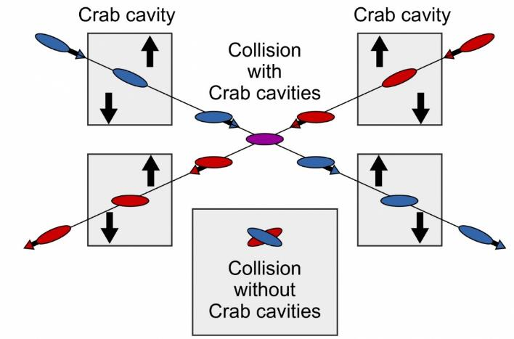

WG2 SRF: WP3 Crab Cavities Down Selection Preparation Meeting
Peter McIntosh
UKRI-STFC Daresbury Laboratory
30th November 2022

Slide 2
Agenda for WP3 Down Selection Preparation Meeting (GMT)
Friday 21st October 2022 | Friday 21st October 2022
14:30 | Introduction and Remit for the Discussion | Peter McIntosh | 5 min
14:35 | IDT Perspective for the CC Developments | Shin Michizono | 5 min
14:40 | Assessment of cavity parameters (review collated table) | Peter McIntosh | 5 min
14:45 | The down-selection process and criteria to be clarified | Open Discussion | 50 min
15:35 | Format for the review, i.e. duration, location, reviewers, expectation | Kirk Yamamoto/Peter McIntosh | 15 min
15:50 | Conclusion | Peter McIntosh | 5 min
15:55 | Meeting close

Slide 3
Introduction and Remit for Discussion
Assess and compare CC EM designs, finally optimised:
Cavity,
HOMs,
Couplers (input and HOM),
Multipacting,
Pressure stability and tuning,
Fabrication - Sheet/Ingot/Mixed, Nb material required,
Cryomodule integration compliance with specification,
Anything else – level of design detail - bare/dressed?
WP3 meeting to review and agree criteria in Nov/Dec (today).
Identified from WP3 Design Review Meeting #3

Slide 4
Next Stage WP3 CC Preparations
What alignment is needed with ILC IDT processes – timescales likely? (Spring 2023?)
Context for a proposed down-selection review:
Terms of reference to be developed/agreed.
Specialist membership – who defines/invites?
IDT output anticipated and when?
Additional Design Review #4 at end Jan 23 – review progress and provide any additional convergence required.
Down selection review ideally before end Mar 23.
(From WP3 Design Review #3 discussions)

Slide 5
IDT Perspectives for the CC Developments (Shin)

Slide 6
Cavity Parameter Review (v16)
Parameter | Elliptical/Racetrack | RFD | DQW | DQW Notes | WOW | QMIR | Units | Nomenclature
Operating frequency | 3.9 | 1.3 | 1.3 |  | 1.3 | 2.6 | GHz
SOM | 5.07 | None | N/A |  | NA | 2.217 | GHz
1st Longitudinal HOM | 3.32 | 2.396 | 2.00 |  | 1.765 | 3.46 | GHz
1st Transverse HOM | 5.07 | 2.0885 | 2.21 | Vertical | 2.299 | 2.82 | GHz
E_{p}/E_{t}* | 3.55 | 3.76 | 270 | Assume Et* = Vt/lambda/2 | 3.24 |  |  | E_{t} - clarify eqtn (JD)
B_{p}/E_{t}* | 8.3 | 6.8 | 461 | Assume Et* = Vt/lambda/2 | 5.75 |  | mT/(MV/m)
B_{p}/E_{p} | 8.3 | 1.8 | 1.71 | No ports | 1.77 |  | mT/(MV/m)
G | 164 | 129.54 | 102 |  | 130.9 | 130 | Ω
R/Q | 47.6 | 440.4 | 211 | Circuit | 454.3 acc. def. | 225 | Ω
R_{t}R_{s} | 7830 | 5.70×10⁴ |  | What is assumption for Rs? | 59446 | 13.5 | Ω² | Assumptions for Rs
V_{t} per cavity | 0.5 | 1.35 | 0.93 | Computed as total Vcc required for 125 GeV crabbing divided by number of cavities | 1.60 max 1.48 nominal | 0.92 | MV
E_{p} | 23.05 | 44.2 | 29.0 | Below 45 MV/m | 45.0 max 41.6 nominal | 40 | MV/m
B_{p} | 53.9 | 79.6 | 49.5 | Below 80 mT | 79.8 max 73.8 nominal | 75 | mT
Total V_{t} | 2.5 | 8.1 | 1.86 | This is a requirement, not a DQW parameter | 8 | 3.7 | MV
Total No. of cavities | 5 | 6 | 2 |  | 5 | 4
Active Cavity Length | 77 |  | 117 |  | 168 | 250 | mm
Flange-flange Cavity Length | 177 | 310 | TBD | Further Mech Eng needed | 514 | 500 | mm
Number of cells | 2 | 1 | 1 |  | 1 | 3
Cavity Diameter | 108.6 | 99.4 | 104 |  | 97.2 | 75 | mm
Minimum Aperture | 25 | 25 | 25 |  | 25 | 25 | mm
FPC Q_{L} |  | 1.5×10⁷ | 1.00E+07 | 0.5 mm max offset, 50 Hz detuning, Vt = 1.48 MV per cavity for 500 GeV beam crabbing | 3e6 with 0.5mm offset & 200Hz shift | 1.00E+06 |  | List assumptions used
Bandwidth |  | 0.0867 | 130 |  | 200 | 2.6 | kHz
Cavity Input Power |  | 31 | 0.3 |  | 0.85 | 1.5 | kW
Longitudinal Kick Factor k_{x} |  |  | TBD | TBD | 2.71 |  | V/pC
Horizontal Kick Factor k_{x} |  |  | TBD | TBD | 23.3 w/o 1.3GHz, 36.2 w/ | 45 | V/pC/m
Vertical Kick Factor k_{y} |  |  | TBD | TBD | 15.6 | < 0.05 | V/pC/m
Stored Energy W | 0.11 | 0.0037 | 0.0032 | Assume Q0 = 1e10 | 0.6 nominal | < 0.2 | J | Assume E_{t} 1 MV/m
HOM impedance (Longitudinal) | 29.1 |  | TBD | HOM filter and damper design optimization ongoing | 0.14 | 130 | MΩ
HOM impedance (Transverse) | 22.8 |  | TBD | HOM filter and damper design optimization ongoing | 4.87 vertical 3.65 horizontal | 150 | MΩ/m
First 3 multipole pararameters |  |  | TBD | TBD
Nb material quantity (Kg) |  | 20 | 1.79 | Further Mech Eng needed. Only hollow cavity body and beam ports, no flanges. | 50.2 | 100
Nb material sheet/ingot |  | ingot and tubes | Ingot for main body: 100 mm x 120 mm x 130 mm. Sheets or ingot for ports. | Further Mech Eng needed | sheet | ingot, Ø100

Slide 7
The down-selection process and criteria to clarify (Open)

Slide 8
Format for the review, i.e. duration, location, reviewers, expectation (Kirk/Peter)
Review terms of reference to be approved.
Reviewers to be identified and solicited (regional representation).
Review date to be confirmed (before end-Mar23).
Location to be agreed (in-person/remote).
Review output to clarified.

Slide 9


MANY THANKS Questions?

