Slide 1
33rd Meeting of SRF Group in IDT/WG2
Possibility of supply of Nb material (Kirk)
Renewed CM design to be produced (Kirk)
Others (if any)
Attendees: K. Umemori, S. Posen, L. Monaco, E. Cenni, R. Geng, S. Belomestnykh, B. Laxdal, B. List, D. Delikaris, S. Stapnes, P. Burrows, Kirk
https://agenda.linearcollider.org/category/256/
Kirk

Slide 2
Possibility of supply of Nb material
At KEK, we are thinking of a possibility to supply Nb material to EU and US.
On early next year, we will start to make a document to purchase them.
If you have an interest in use of MG, we can provide more information.
 | # of cavities to be produced in each region
 | 1-cell cavity |  | 9-cell cavity |  | Crab cavity
 | FG | MG | FG | MG | ?
Japan | 3 | 3 | 10 | 10 | 0
Europe | ? | ? | ? | ? | 2 (x 2)
Americas | ? | ? | ? | ?

Slide 3
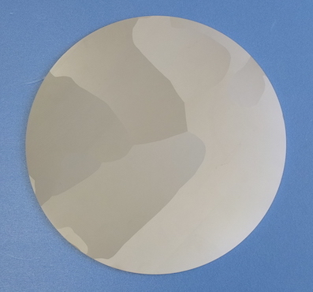
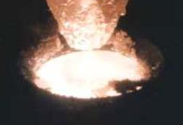
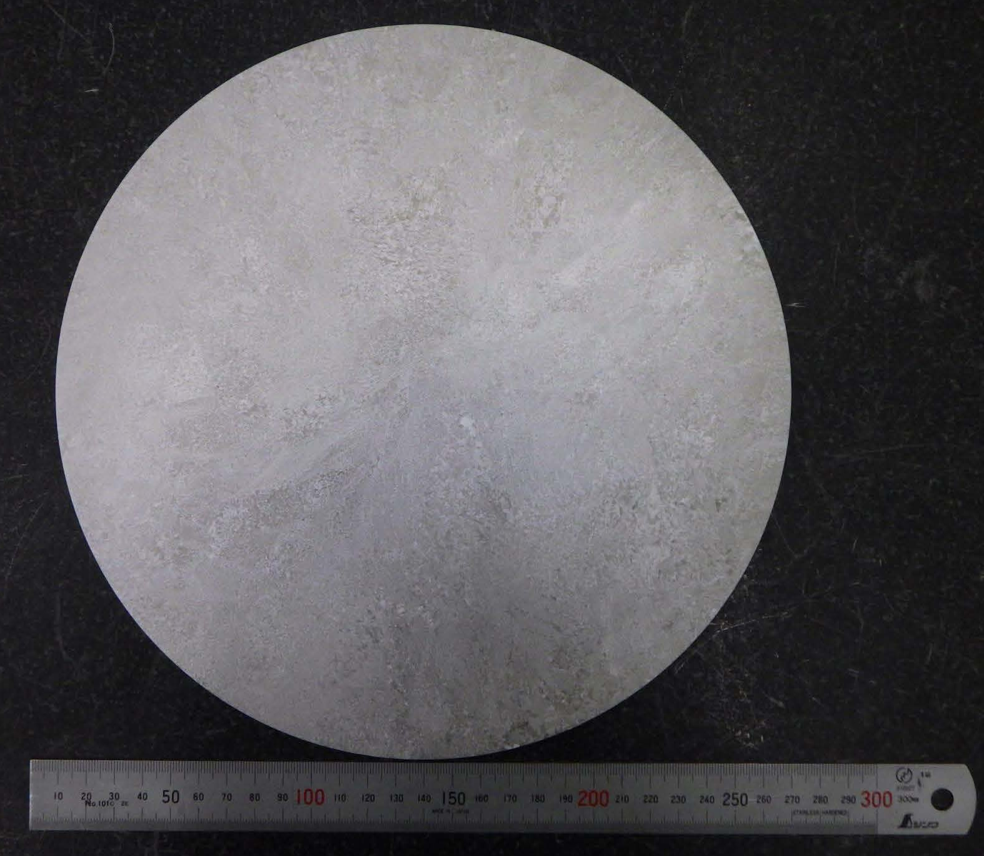
Manufacture methods of Large-Grain / Medium-Grain Nb discs
Presented by Saeki-san
Direct slice of LG ingot
Ingot
Nb melting
LG Nb
Ingot, as it is
Slicing image by wire-saw
Large Grain (LG) Disc
Grain Size >> 1 cm
Aiming for clean, mechanically stable, and cost-effective SRF cavity production.
Direct slice of MG ingot
Ingot
MG Nb
Niobium ingot
(Raw material)
Ingot, forged
and annealed
Slicing image by wire-saw
A New Approach:
Medium Grain (MG) Disc
Grain Size < 1 mm
* The “Nb forged ingot” technology originated by ATI, and SRF (GHz) cavities planned to be fabricated and RF tested by KEK and JLab, to qualify this approach, in collaboration of ATI, ODU/BSCE, JLab, and KEK.

Slide 4

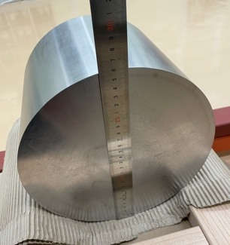
MG-Nb demonstration by
1.3 GHz SRF Cavity at KEK
Presented by Saeki-san
Courtesy: ATI
Sample location from forged ingot
“Nb RRR” Billet, annealed
MG-Nb: Good mechanical uniformity
Parameters | Nb sheet (FG) (Spec. Eu-XFEL as Reference) | Nb forged ingot (MG) Measured
RRR | R_{RT}/R_{4.2K} ≥ 300 | R_{RT}/R_{TC} 450 523
Re-crystallization | 100 % | 100 %
Grain size (ASTM) Edge, Mid., Center | 4 ~ 6 | 2 , 1, 1.5
Grain size (mm) Edge, Mid., Center | < 0.05 | 0.2, 0.25, 0.21
Y.S.-0.2% (RT) | ≥ 50 MPa | 61 MPa
T.S. (RT) | ≥ 140 MPa | 141 MPa
0.02 inch ( 50 μm)
Edge
Mid. Radius
_
260 mm φ
Grain Size: 0.2 ~ 0.3 mm
Mechanical stability
may be expected

Slide 5
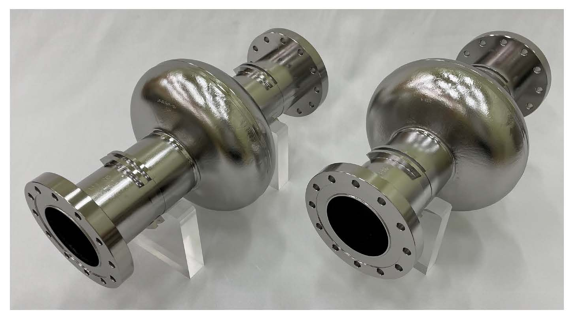
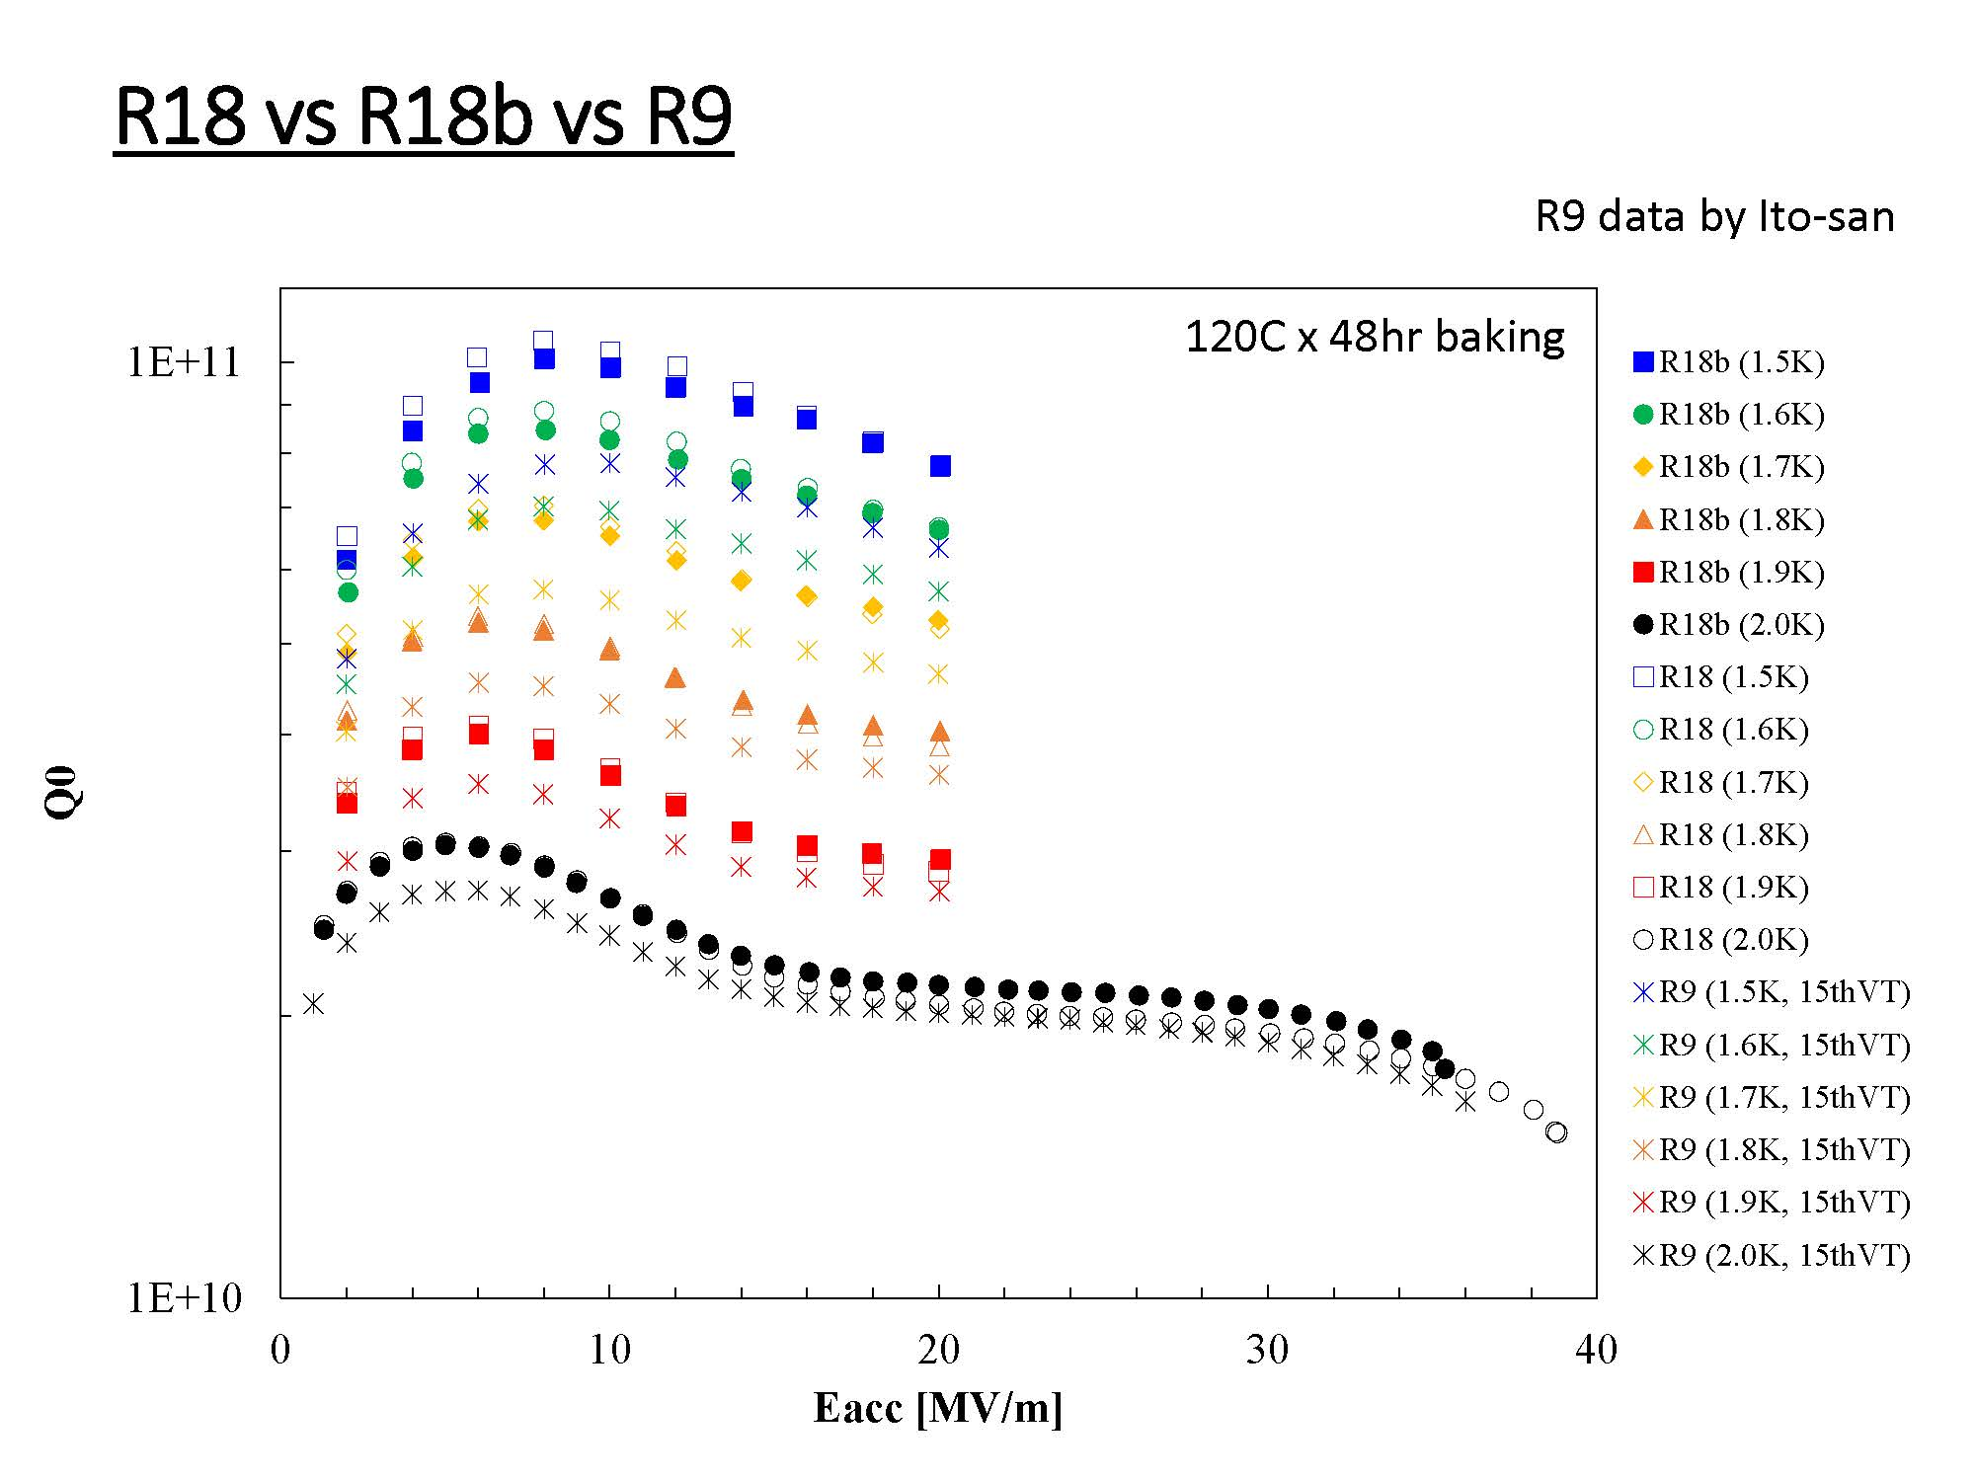
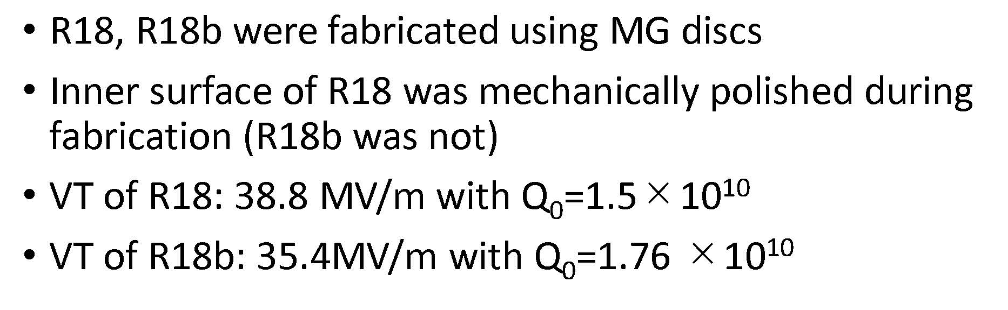
Presented by Saeki-san
MG-Nb material （High-RRR, Low-Ta）
Results of MG single-cell cavities.
R18, R18b (vs. R9 / FG single-cell cavity).
>35MV/m
Two MG-Nb single-cell cavities have reached > 35 MV/m

Slide 6
Preparation for SRF Five-year plan at KEK
Michizono-san, Akira Yamamoto-san and Kirk have discussed internally the SRF five-year plan at KEK.
This plan follows the time-critical WPs discussed with the WG2/SRF group.
In WP-prime 2, we will produce first CM for ILC.
Also, we will construct the infrastructure related to helium refrigerator, CM assembly/test area, etc.
SRF Five-year plan at KEK (currently prospect)
 | F.Y.2023 | F.Y.2024 | F.Y.2025 | F.Y.2026 | F.Y.2027
Infrastructure @COI
Infrastructure @CFF
Cavity production | Nb material | Production
Cavity test | R&D | R&D
CM production/assembly
CM test

Slide 7
Meeting schedule and recent progress
Meeting # | Date | Contents
33 | 06/Dec | Possibility of supply of Nb material, “Renewed” CM design
? | 20/Dec
 | End of Dec | Budget plan will be fixed
 | 15~19/May/2023 | LCWS2023 @SLAC
 | 25~30/Jun | SRF2023 @Grand Rapids, MI, US

Slide 8
Questions/Suggestions/Comments
MG material is available for HPGS?
  At KEK, we have done some tests related to mechanical property at low temperature. Then, we think it’s available, but we need more tests to pass our HPGS.

Slide 9
Backup slides

Slide 10
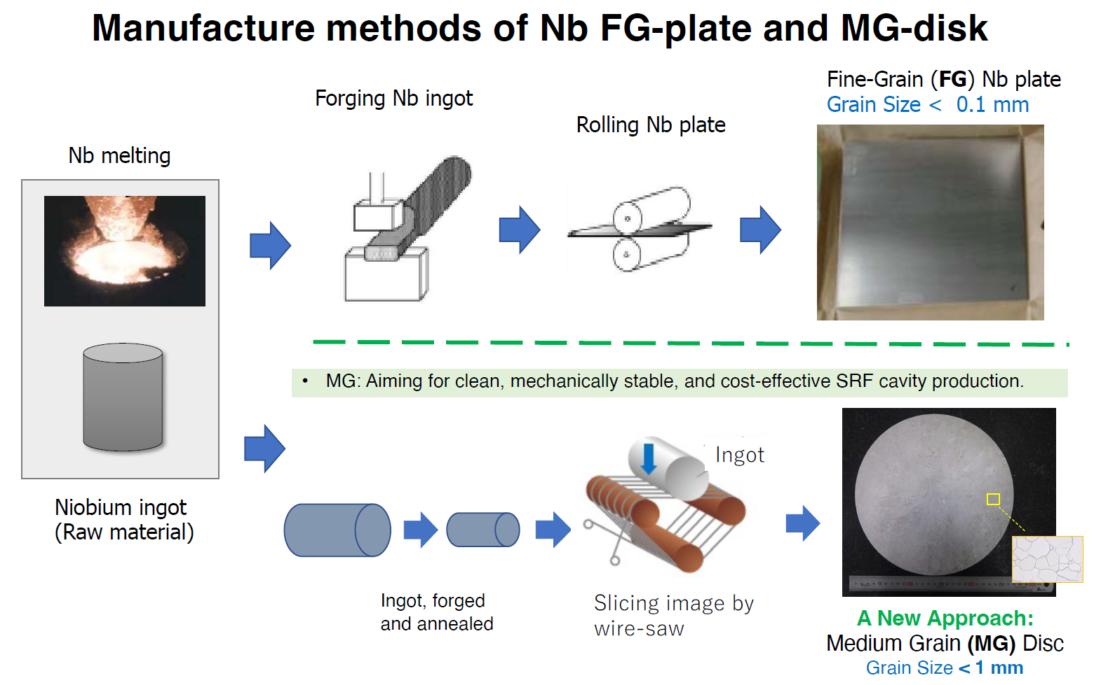


WP-prime 1: SRF Cavity
(Scoping the Industrial-Production Readiness)
Research with single-cell cavities to establish the best production process
  Advanced Nb sheet production method
  Advanced surface treatment recipe
Globally common design compatible with High Pressure Gas Safety (HPGS) regulation
24 nine-cell cavities are to be developed for industrial-production readiness
  8 cavities (4 / batch) in each region
  Production process optimized in each region encouraged
RF performance/success yield to be examined (at least including 2nd pass)
  3rd pass to be examined if effective
 | # of cavities to be produced
 | Americas | Europe | JP/Asia
single-cell | 2 | 2 | 2
nine-cell | 8 | 8 | 8 (+ 12)
Material/Sub-component
QA of Material/Sub-C
Cavity Production
Surface Process
Vertical Test =
Cavity RF Test
Production process
10

Slide 11
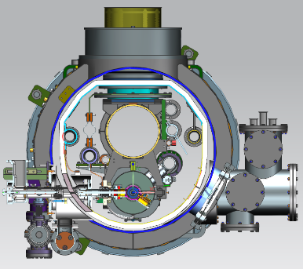
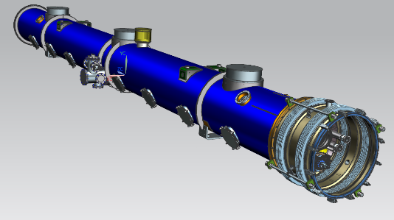
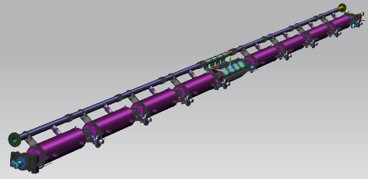
WP-prime 2: Cryomodule (CM) design
(Scoping the CM Global Transfer and Performance Assurance)
We will produce first CM!
Unify cryomodule (CM) design with ancillaries, based on globally common drawings and data-base
Establish globally compatible safety design to be approved by HPGS regulations individually authorized in each region.
Cavity string
Ancillaries:
SC mag., tuners, couplers
CM outlook with vacuum vessel
 | Americas | Europe | Japan/Asia
CM tech. design base | LELS-II | Euro-XFEL | ILC-TDR
HPGS regulation base | ASME | TÜV and EN | JP-HPGS act
ILC CM design | Common CM design globally adaptable to HPGS regulation in any regions
11

Slide 12
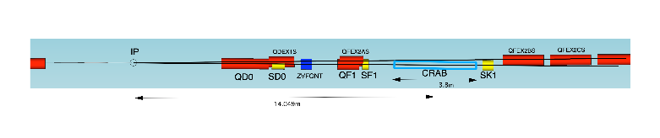
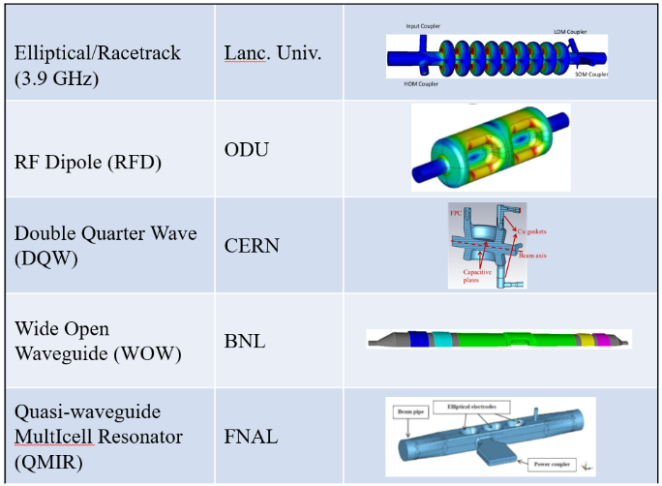
WP-prime 3: Crab Cavity Development with down-selection
RF property simulation to optimize cavity design
Pre-down-selection to choose two primary candidates
Development and evaluation of two prototype cavities
Demonstration of synchronized operation with two prototypes
Down-selection to choose final cavity design
Cryomodule design based on final cavity design
two beamline distance
14.049m x 0.014rad = 197mm
Item | Recent specification (after TDR)
Beam energy | 125 GeV (e⁻)
Crossing angle | 14 mrad
Installation site | 14 m from IP
RF repetition rate | 5 Hz
Bunch train length | 727 μsec
Bunch spacing | 554 nsec
Operational temperature | 2.0 K (?)
Cavity frequency | 1.3/3.9 GHz
Total kick voltage | 1.845/0.615 MV
Relative RF phase jitter | 0.023/0.069 deg rms (49 fs rms)
12

Slide 13
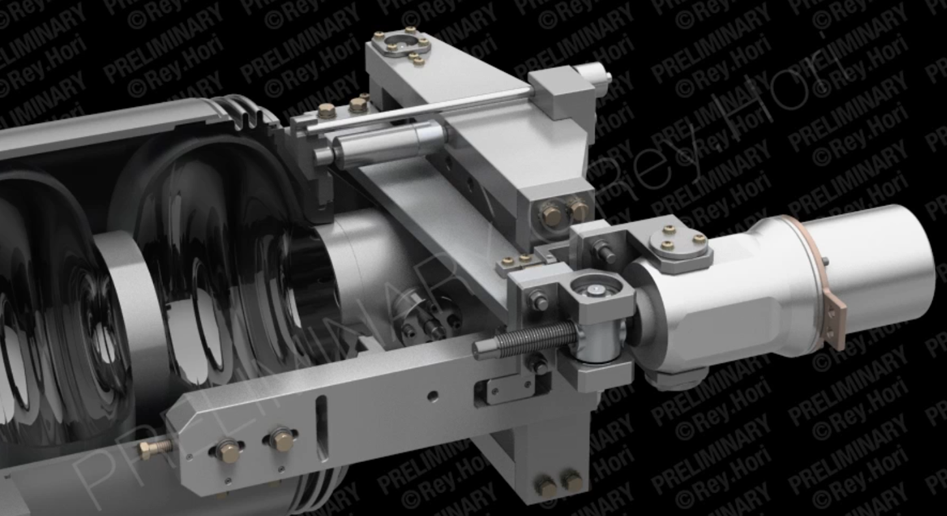
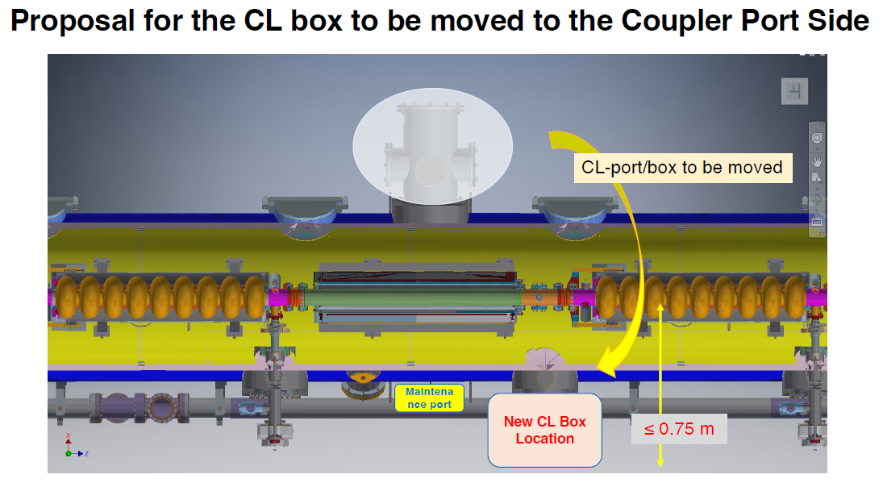
Change requests related to SRF
If KEK has enough budget from next FY, we’d like to start cavity/CM production as soon as possible.
Then, we have to decide the design of cavity/CM including tuner/coupler/magnet.
Currently, we have two change requests related to tuner/helium tank and position of current lead box for Q-mag.
LCLS-II tuner has worked with high reliability,
but there is no experience in pulsed mode operation.
We need to check this with first CM.
CM design is already completed, but we have to design outside components, that is, waveguide system, pumping system for power coupler, current lead box, etc.
We need more detailed drawing.
LCLS II (HE)/FNAL’s
N=320 units+ 180units

Slide 14
Conclusion/Suggestion
Currently, it’s difficult to submit these change requests before cavity/CM production.
After CM test and more detailed drawing completed, we will/can submit the change request.
I’d like to obtain your agreement on this policy including the cavity/CM design within this year.
If you like to check the 3D model developed by FNAL/KEK, I can provide to the SRF group.

