Slide 1

Logistic Prep Status for ILC Crab Cavity Down-selection Review
Venue:
-Blocked “Large Conference Room” in 1F, Building 2 inside KEK, Tsukuba Campus
Accommodation:
-Blocked 20 rooms(w/bathroom) in KEK Dorm, Tsukuba Campus from Apr. 3rd to 8th
-Blocked 20 rooms hotel outside of KEK: Urban Hotel https://www.urbanhotel.co.jp/guestroom/
Meals:
-Breakfast: Prior reservation needed to be served inside the Campus (or Grocery Store op 8:30)
-Lunch: KEK may prepare “Obento” JP style lunch box (Cafeteria and Cafe available)
-Dinner: Invitational dinner will be hosted by KEK for one night
Cafeteria and Cafe available inside the Campus available for other nights
Coffee Break:
-KEK will prepare beverage and snacks for the three days

Slide 2
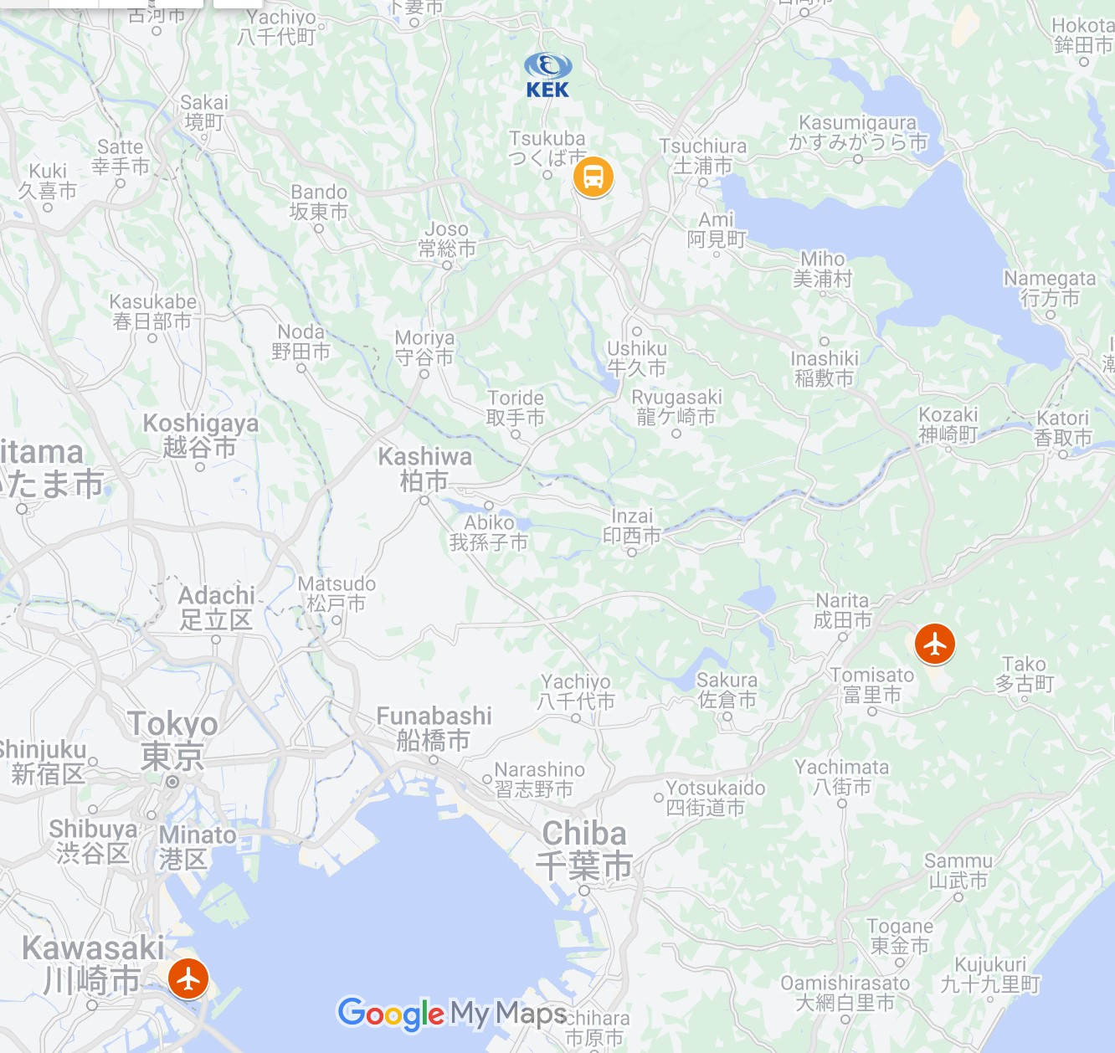
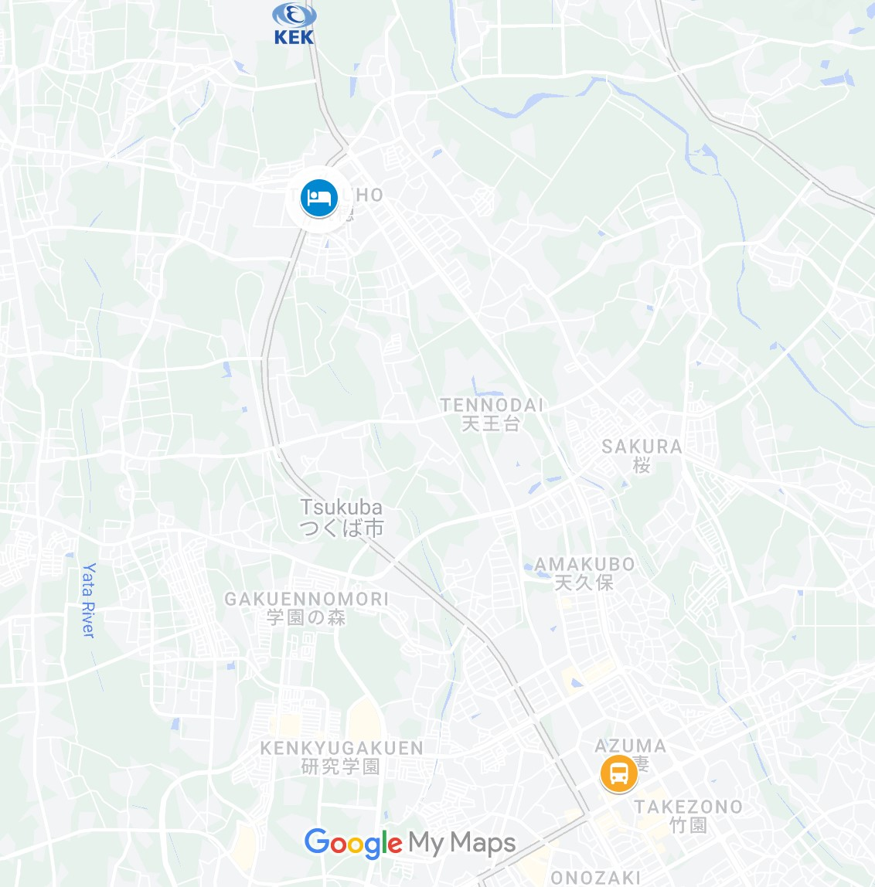
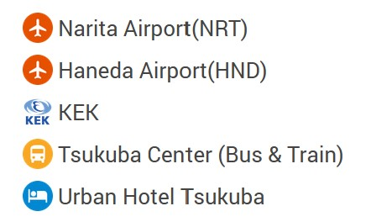
Logistic Prep Status for ILC Crab Cavity Down-selection Review
KEK
From Urban Hotel to KEK
<Walk> 25 min
Hotel Shuttle Bus & KEK Official Bus maybe available
KEK
Tsukuba Center
Urban Hotel
<Bus> 60min
Link to Timetable
<Train> 100min
Link to Google Map
<Bus> 20min
Link to Timetable
<Bus> 20min
Hotel Shuttle bus available upon reservation
NRT
<Taxi> 3,000 JPY (25 USD)
Always available at Tsukuba Center
<Bus> 110min
Link to Timetable
<Train> 110min
Link to Google Map
Tsukuba Center
HND

Slide 3
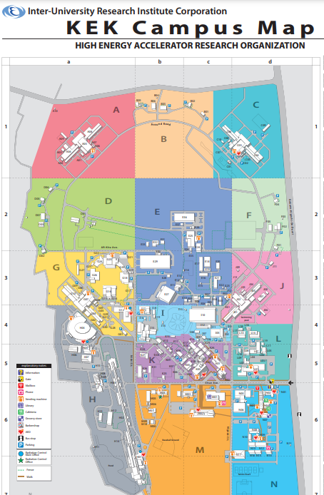
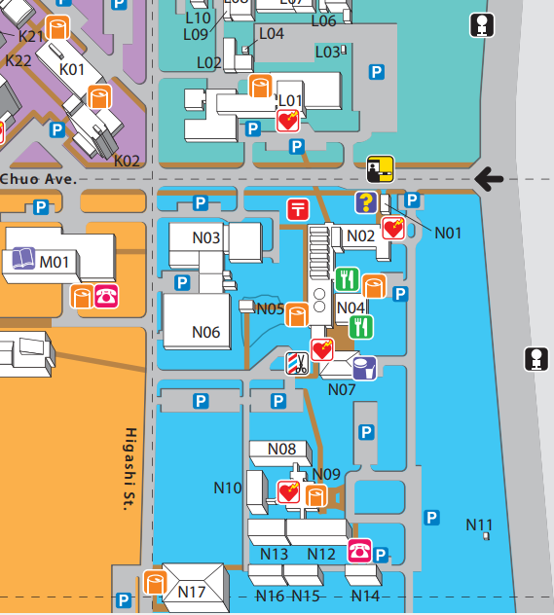
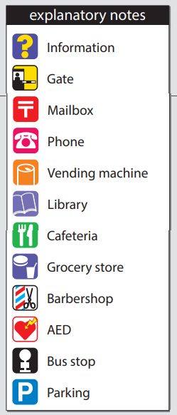
Logistic Prep Status for ILC Crab Cavity Down-selection Review
Venue: “Large Conf. Room”1F, Building 2
Cafeteria
Cafe
Grocery Store
KEK Dorm

Slide 4
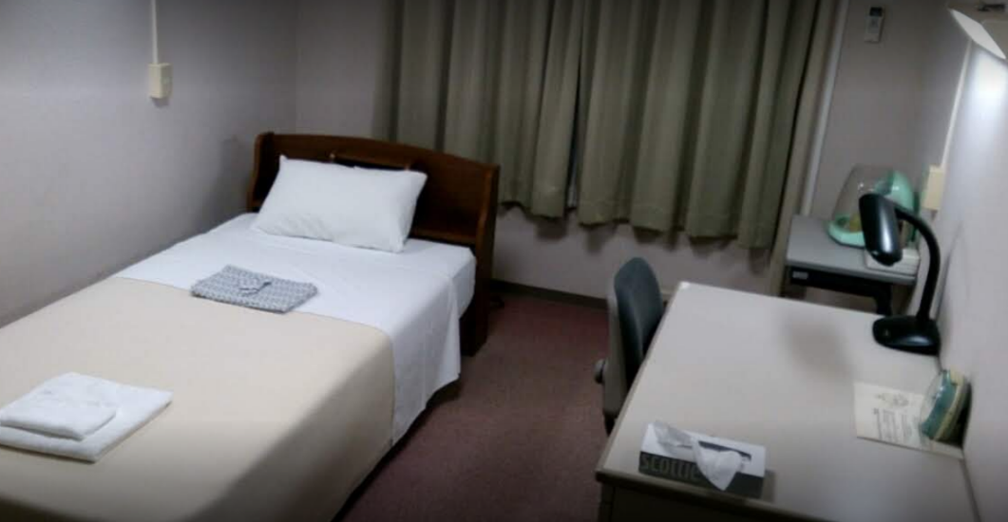
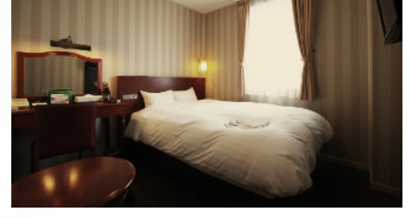
Logistic Prep Status for ILC Crab Cavity Down-selection Review
KEK Dorm
Urban Hotel
https://www2.kek.jp/uskek/eng/visiting/dormitory.html
https://www.urbanhotel.co.jp/english/
Rate: 3,000 JPY/night max
No breakfast included
->23 USD if 130 JPY/USD
Rate: 8,870 JPY/night w/ breakfast
7,900 JPY/night w/o breakfast
-> 68 - 60 USD if 130 JPY/USD

Slide 5
Logistic Prep Status for ILC Crab Cavity Down-selection Review
<Cafeteria> 【open only on weekdays】
○Lunch 11:30 to 13:30 (weekdays)
○Dinner 17:30 to 18:30
(Tue, Wed, and Thu only. Closed on Mon and Fri)
(-> closest outside restaurant is approx. 2km (approx. 20 min walk))
<Cafe> 【open only on weekdays】
〇Lunch 11:30 to 14:00
<Grocery Store> 【open only on weekdays】
〇8:30 to 18:00

Slide 6
Logistic Prep Status for ILC Crab Cavity Down-selection Review
Further actions and supports scheduled to be taken by KEK International Office:
Visa application (for those needed)
Exemption of Visa (Short-Term Stay)
https://www.mofa.go.jp/j_info/visit/visa/short/novisa.html
Airplane ticket arrangement (if requested), per diem and allowance payment (for “Reviewer”)
Reserving KEK host dinner for one night during the event
Coffee break prep.
Conference room prep.

Slide 7
Logistic Prep Status for ILC Crab Cavity Down-selection Review
Matters to be confirmed for kicking-off:
Number of participants outside of KEK -> around 15
(10 from Design Team and 5 Reviewer)
Accommodation preference -> Keep both KEK Dorm
and Urban Hotel
Participant’s travel fee that KEK will cover -> Reviewer

Slide 8
Logistic Prep Status for ILC Crab Cavity Down-selection Review
Point-of-Contact:
Scientific inquiry
Yasuchika Kirk Yamamoto
yasuchika.yamamoto@kek.jp
Logistic inquiry
KEK International Promotion Office
i-promo@ml.post.kek.jp

