Slide 1
European activities
Recent progress:
A subset of the technical activities of the full ILC preparation phase programme have been identified as critical. Moving forward with these is being supported by the MEXT (ministry) providing increased funding.
European ILC studies, distributed on five main activity areas, is foreseen to concentrate (for the accelerator part) on these technical activities :
A1 with three SC RF related tasks
SRF: Cavities, Module, Crab-cavities
A2 Sources
Concentrate on undulator positron scheme – fast pulses magnet, consult on conventual one (used by CLIC and FCC-ee)
A3 Damping Ring including kickers
Low Emittance Ring community, and also kicker work in CLIC and FCC
A4 ATF activities for final focus and nanobeams
Many European groups active in ATF, more support for its operation expected using the fresh funding
A5 Implementation including Project Office
Dump, CE, Cryo, Sustainability, MDI, others (many of these are continuations of on-going collaborative activities)
Personnel with interest and skills in European labs/Univ., local infrastructure
Material funds as estimated (major/core part from KEK), in some cases complemented by local funding
EAJADE, MC exchange project supporting Higgs factory personnel exchange to Japan and the US
CERN LC, project office (~within existing LC resources at CERN)
EAJADE: Information at LINK

Slide 2
European Organisation of programme
CERN plays coordinating role
KEK contribution to the material cost is essential
Main contract for flow of funds between CERN and KEK*
  CERN-KEK ILC IDT agreement already extended by 2 years
  Amendments/modifications would be needed for ITN, most practical is new Agreement (next slide)
Subsequent contracts* – similar to what is done for other studies for future colliders – between CERN and European Labs in the cases where money flow is needed (limited number)
Establish a distributed Project Office, administratively anchored to CERN, to follow up the work.
Aim to involve CERN personnel, fellows, PJAS within the current LC resource planning at CERN (in many cases using long term collaborative links and common studies between CLIC and ILC)
*Additional collaboration agreements between KEK and FA/countries might be very beneficially, where these activities are recognised directly
CERN
KEK
Lab/Univ/FA n
Lab/Univ/FA 1
Notes:
Please comment

Slide 3
Resource estimate (core)
Estimated material funds 4 MCHF over 4 years
Top-down estimate of technical personnel purely for ITN deliverables ~30 FTY year
This rests of basis of technical expertise, infrastructure and technology in the European labs/Universities/Industries which are not included in this resource overview, plus the scientific community, including students, involved in ILC related studies.

Slide 6
Recent updates - I
Overall concept in more practical terms:
Implemented the ITN activity in Europe is that CERN act as a “hub", receives core funding from KEK and distribute activities and funds to European partners.
We therefore need an agreement which allow transfer of funds from KEK to CERN, covering up to 4 MCHF over 4-5 years (i.e. extendable up to this level), with flexibility in the amounts to be transferred and for the time-profile (i.e - amounts and exact use (deliverables) of the funding received are specified in the actual invoices generated along the way).
I would expect that we in 2023 could receive XXXX CHF.
A key goal of an agreement is to move step by step up to the maximum years and funds mentioned above, so that Europe, CERN and KEK can be confident at every step that we deliver as expected for the right amounts. And that we also can adjust and/or stop in a controlled way.
Concept discussed in meeting between CERN and KEK DGs in January, next - start to prepare new agreement
Presentation requested in the CERN SPC and Council 20.3 and 22.3

Slide 7
Recent updates – II
Activities:
Discussion between CERN (Steinar), KEK (Akira, Shin), CEA (Enrico and IRFU management), INFN (Laura in contact with INFN management) on cavities: material, single cell cavities, testing, placing contracts ..
Discussion between CERN and UoH about pulsed magnet
ATF3 kick off 8-9.3
Sustainability study submitted for tunnel (and IPAC presentation approved) – need to get back into dump, cryo etc. EAJADE kick off end March, project start 1.3.
Also very active work on crab cavities but currently not “European specific”, also DR work to be planned
Contact points for WPs (Enrico, Laura. Peter, Gudi, DR to be decided, Angeles and Phil ATF2/3, Benno/Maxim for sustainability
Ideally identify main technical contact at CERN, and complement list above with 2-3 more names to take overall follow up responsibilities, including pursuing complementary funding and resources
CERN MTP text will reflect developments, CERN funds will accommodate some operational support
CERN – KEK office being refinances for 2023-24
Need also to report back to LDG

Slide 8
Goal | The International Linear Collider (ILC) studies are progressing lead by an International Development Team (IDT) where CERN participates. The CERN linear collider studies support this effort through combined activities with CLIC, co-operation with KEK for specific technology developments where CERN has expertise, and studies using ATF2 facility. The future of the ILC focussed part of linear collider activities will depend on the progress of the ILC project in Japan, building on the commonalities between CLIC and ILC, common R&D interests between CERN and KEK, and extensive European activities and capabilities related to ILC studies and technologies, inside and outside CERN.
Organisation | The International Linear Collider (ILC) studies are led by an International Development Team (IDT) where CERN participates. The CERN team also plays an important role in organising and facilitating European planning for the ILC preparation phase.
2023 targets | Participate in relevant working groups for ILC and organize collaborative R&D efforts with KEK for ILC and CLIC; Continue to play a coordinating and facilitating role for European planning and contributions to the ILC as the project evolves.

Slide 10
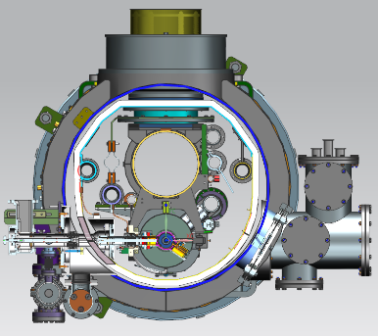


A1: SRF Cavities and Cryomodule design
(Global Industrial Production Readiness)
Research with single-cell cavities to establish the best production process
  Advanced Nb sheet production method
  Advanced surface treatment recipe
Globally common design compatible with High Pressure Gas Safety (HPGS) regulation
24 nine-cell cavities are to be developed for industrial-production readiness
  8 cavities (4 / batch) in each region
  Production process optimized in each region encouraged
RF performance/success yield to be examined (at least including 2nd pass)
  3rd pass to be examined if effective
Production process
Unify cryomodule (CM) design with ancillaries, based on globally common drawings and data-base, and
Establish globally compatible safety design base to be approved by HPGS regulations individually authorized in each region, most likely referring ASME guidelines.
 | # of cavities to be produced
 | Americas | Europe | JP/Asia
single-cell | 2 | 2 | 2
nine-cell | 8 | 8 | 8 (+ 12)
Material/Sub-component
QA of Material/Sub-C
Cavity Production
Surface Process
Vertical Test =
Cavity RF Test
Group involved on European side in discussions
of the programme:
CEA, INFN Milano primarily
Also potentially: IJClab, DESY, STFC/Daresbury+Lancaster, CERN, Uppsala, ....
CIEMAT (for SC magnet)
SCRF (Grad, Q) is a priority for most future high energy accelerators, and also beyond HEP

Slide 11
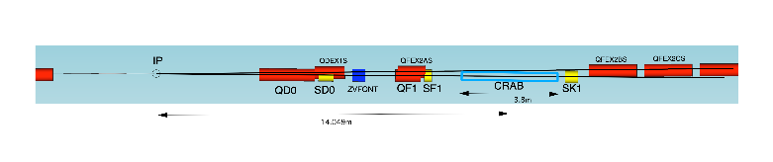
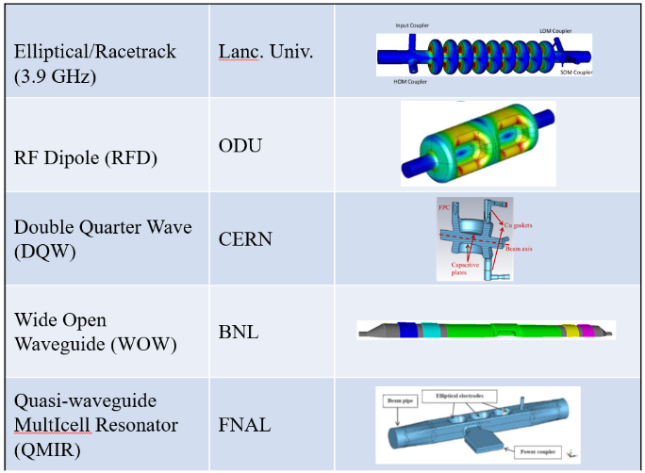
A1: Crab Cavity Development with down-selection
:
RF property simulation to optimize cavity design
Pre-down-selection to choose two primary candidates
Development and evaluation of two prototype cavities
Demonstration of synchronized operation with two prototypes
Down-selection to choose final cavity design
Cryomodule design based on final cavity design
two beamline distance
14.049m x 0.014rad = 197mm
Item | Recent specification (after TDR)
Beam energy | 125 GeV (e⁻)
Crossing angle | 14 mrad
Installation site | 14 m from IP
RF repetition rate | 5 Hz
Bunch train length | 727 μsec
Bunch spacing | 554 nsec
Operational temperature | 2.0 K (?)
Cavity frequency | 1.3/2.6/3.9 GHz
Total kick voltage | 1.845/0.923/0.615 MV
Relative RF phase jitter | 0.069 deg rms (49 fs rms)
Group involved on European side in discussions
of the programme: STFC/Daresbury and Lancaster Univ, and CERN
Links to general studies of crab cavity solutions:
(among others for HL-LHC, EIC and Elettra2.0)

Slide 12
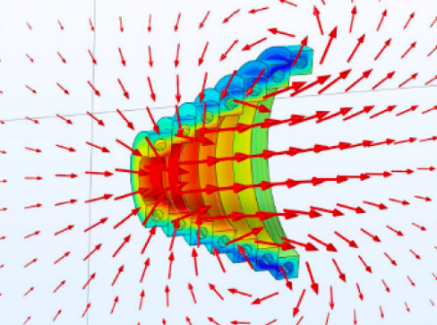
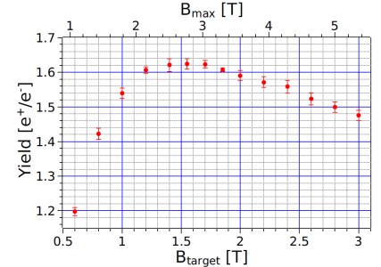
A2: Positron Source - Rotating Target and Focusing System for Undulator Scheme
Target specification
  Titanium alloy, 7mm thick (0.2 X₀), diameter 1m
  Rotating at 2000 rpm (≙ ~33 Hz) in vacuum
  Photon power ~60 kW, deposited power in target about 2 kW,
  efficient power/e+
  Radiation cooling
  Magnetic bearings, widely used for Fermi choppers (ESS etc.), vacuum pumps and fast rotating masses
R&D to be done as WP-prime
  Detailed simulations in close contact with OMD design on-going
  Design finalization, laboratory test of mock-up design (in the first 2 years)
  Magnetic bearings: technical speciﬁcations done, ready for feasibility study, engineering design, test (in the remaining years)
A priority item for the undulator scheme is the magnetic focusing system (OMD) right after the target
The mature candidate is a pulsed solenoid (PS)
R&D items to be done as WP-prime
  Detailed simulations (almost finished)
  Ready for engineering design for a prototype PS
  Field measurements with 1kA (pulsed and DC) and with 50kA both in a single pulse mode and finally in a 5ms pulsed mode at 5 Hz
  Prototype of plasma lens as OMD (funded study on-going), example for application of new technology for the ILC
Undulators are very popular photon sources, possible synergies
Yield versus field on the target
1
Group involved on European side in discussions of the programme:
Univ. of Hamburg, CERN, DESY, HZ Dresden-Rossendorf, SKF Jülich and possibly ESS-Bilbao.
For polarized positrons, providing physics advantages, linking also to FEL/undulators studies.

Slide 13
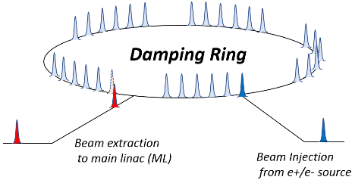
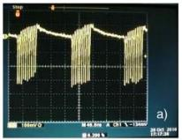
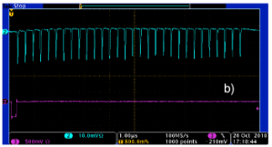
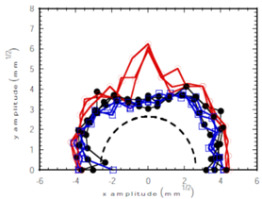
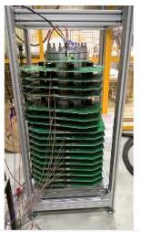
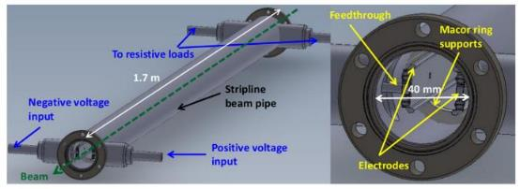
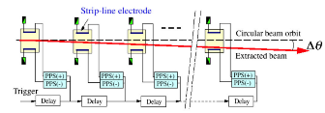
A3: Damping Ring optimization and injection/extraction
The ILC damping ring (DR) is required to satisfy the low emittance and the large dynamic aperture simultaneously.
The ILC DR will be further improved by incorporating the findings of the latest light source design. Increasing the dynamic aperture is also important in the design of DR.
By quantitatively evaluating the effect of fringe field to the dynamic aperture of magnets in ILC DR, the method for evaluating fringe field to the dynamic aperture in accelerator design will be established and the design of ILC DR will be optimized.
A fast kicker system using a semiconductor pulse power supply with nanosecond response was confirmed as proof of principle at KEK's ATF about 10 years ago.
Semiconductor technology has been evolving, and it is now possible to advance nanosecond response beam injection/excitation systems using the recent semiconductor technology.
The technical evaluation of the fast kicker power supply using the recent semiconductor technologies.
The evaluation of fast pulsed power supply technology will contribute not only to the fast kicker system but also to the performance and reliability of nanosecond-scale beam control technology and its application to a wide range of accelerator systems.
Beam extraction test at KEK ATF
ILC fast injection/extraction system
Stored beam in DR
Extracted beam from DR
Beam injection/extraction system
for CLIC damping ring
13
Many group can find this interesting and have capabilities to do it, there is a large and well organised low emittance ring community in Europe – and many also experience with similar studies for CLIC and FCC-ee.

Slide 14
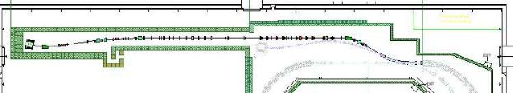
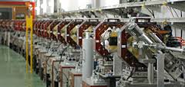
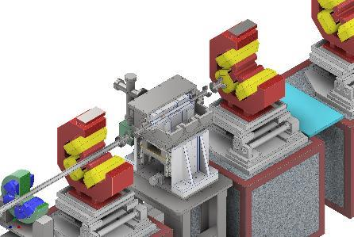
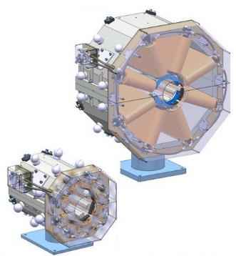
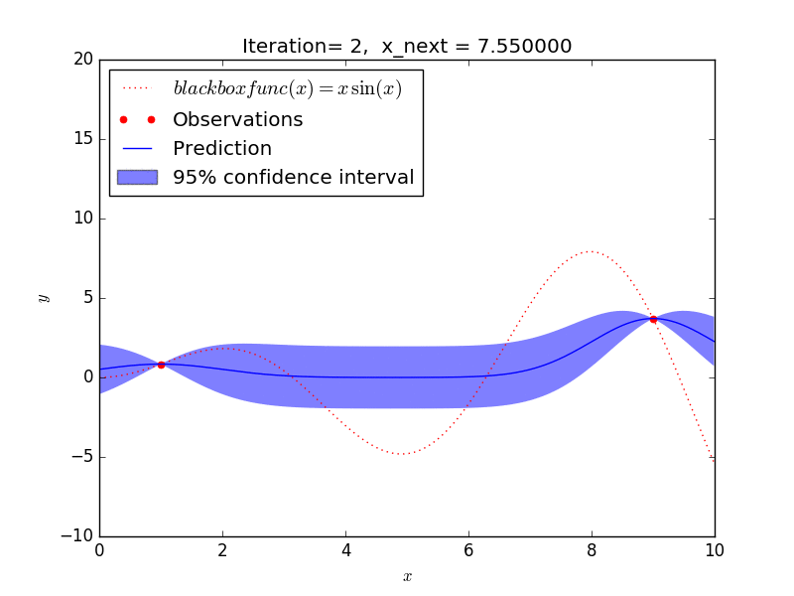
A4: ATF3 programme (final focus, nanobeams)
ATF2 beamline is the only existing test accelerator in the world to test the final focus system (FFS) of linear colliders.
The following 3 research topics are important topics to be pursued at the ATF.
  wakefield mitigation
  correction of higher-order aberration
  training for ILC beam tuning
The technical research at ATF2 beamline has proceeded, and should continue to be based on the ATF international collaboration, or its extension (welcome to new collaborators).
ATF2 beamline
Wakefield test station
Octupole magnets
for higher-order
aberration
Very relevant studies for any linac and Higgs factory closely related to low emittances and nano beams, e.g. alignment, stabilisation, instrumentation, beam-dynamics, etc.
Strong European leadership with several group from France, UK, Spain, Germany and also CERN, also extensively used for PhD training
A future ATF3 programme has been defined and reviewed internationally, supported also by MC researcher exchange programmes as EJADE and EAJADE (LINK)
Maximum search algorithms
to be applied to beam tuning
( Machine Learning )

Slide 15
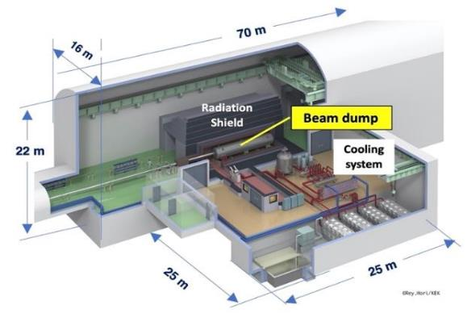
A5: Implementation studies
Project Office to follow this effort, admin base CERN but can/should be distributed
  Linking to EAJADE and communication efforts, and the KEK-CERN offices
Continue existing collaborative efforts on CE and Cryo (CERN, DESY, KEK)
Common studies CLIC/ILC on sustainability issue (ongoing), e.g. power, energy and running models, CO2 (sustainability is also an EAJADE WP).
  the four activities above are all addressing optimisation of lum. to power, and/or power consumption directly for ILC
  will also connect to green ILC studies in Tohoku within EAJADE (e.g. facility integration in local environment and infrastructure, carbon emission goals, power availability and sources)
Connecting to ILC physics and detector developments, in particular MDI (also a focus of EAJADE)
One of the ITN studies also belong to this activity:
Finalize the engineering design of the main beam dump system
  Vortex water flow in the dump vessel
  Cooling water circulation and heat exchange
  Remote exchange of the beam window
  Countermeasure for failures / safety system
Involved: CERN, EAJADE community, ESS Bilbao for dumps. Many of these topics are
related to exploiting communalities between EXFEL, HL-LHC or CLIC and ILC
Notes:
B

