Slide 1
34th Meeting of SRF Group in IDT/WG2
Recent status of crab cavity including down selection review (Kirk)
Others (if any)
Attendees: A. Yamamoto, E. Cenni, S. Belomestnykh, R. Ruber, S. Stapnes, P. Burrows, Kirk
https://agenda.linearcollider.org/category/256/
Kirk

Slide 2
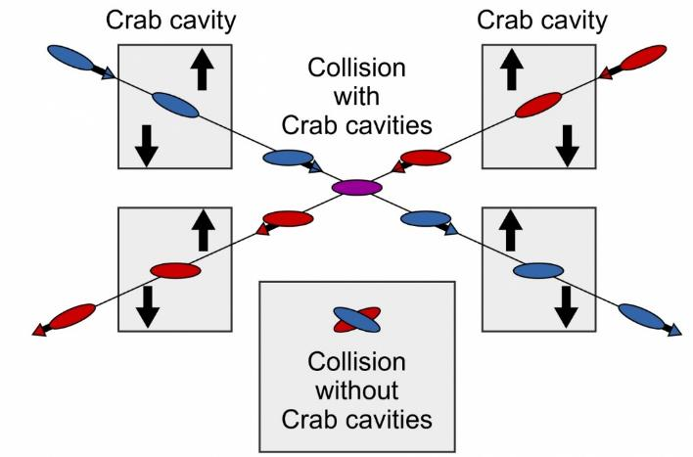

WG2 SRF: WP3 Crab Cavities
Design Review Workshop #4
Peter McIntosh
UKRI-STFC Daresbury Laboratory
27th January 2023

Slide 3
Agenda for WP3 Design Review #4 (GMT)
Friday 27th January 2023 | Friday 21st October 2022
13:30 | Introduction and Remit for the Workshop | P McIntosh (STFC) | 5 min
13:35 | Specification and Cavity Parameter Review | P McIntosh (STFC) | 10 min
13:45 | Down-selection review update | P McIntosh (STFC)/K Yamamoto (KEK) | 20 min
14:05 | Nb material procurement preparation and HPG safety constraints | A Yamamoto (KEK) | 30 min
Cavity Design Updates
14:35 | Elliptical/Racetrack | Graeme Burt (Lancaster University) | 15 + 5 min
14:55 | RF Dipole (RFD) | Suba De Silva/Jean Delayen (ODU/JLab) | 15 + 5 min
15:15 | Double Quarter Wave (DQW) | Silvia Verdu Andres (CERN) | 15 + 5 min
15:35 | Wide Open Waveguide (WOW) | Binping Xiao (BNL) | 15 + 5 min
15:55 | Quasi-waveguide Multicell Resonator (QMiR) | Andrei Lunin (FNAL) | 15 + 5 min
16:30 | Meeting close
https://agenda.linearcollider.org/event/9944/

Slide 4
Scope Design Review #4
Assess and compare CC EM designs, not likely finally optimised:
  Cavity,
  HOMs,
  Couplers,
  Multipacting,
  Tuning.
  Fabrication (Sheet/Ingot/Mixed, Nb material required, readiness detail)
Clarifying next steps to ‘head towards’ a down-selection process:
  All EM design aspects complete, including pressure stability and fabrication assessment.
  Down-select 2 optimum CC designs for future prototype development (external review)*.
Down selection review now set for April 4 – 6 2023, in-person at KEK.
Final CC down-selection, post-prototype validation at ~18-months later*.
*As proposed at Design Review #1 – Dec 21

Slide 5
Down-selection Review Update
Review to be held at KEK Tsukuba:
  305-0801 Ibaraki Prefecture Tsukuba City Oho 1-1
3-day in-person review:
  Tuesday 4th April – Thursday 6th April, synchronised at JST time-zone
A ‘Neutral’ international review panel being appointed:
  2 x SRF experts from each region, plus Toshiyuki Okugi (KEK) ILC-BDS
  5 out of 6 panel members appointed, awaiting final response.
KEK to assist participants with local logistics arrangements.

Slide 6
Proposed Review Panel Charge
Review the crab cavity (CC) designs proposed, to assess their predicted compliance against the functional Specifications for the ILC-250, extended capability for the ILC-500, and the feasibility for higher energy.
Review the status of the design of these CC solutions and identify their risk in comparison to other comparable systems presently in operations or in development elsewhere in the world.
Review the proposed CC solutions for their choices of materials, fabrication processes, fast and slow tuning systems, power coupler, HOM couplers, SRF performance, etc.
Review the plan for the prototype development including possible cooperation (or consortium effort) with other laboratories and companies/industry.
Provide appropriate advice and feedback for the criteria and further processes to be scoped for the final CC down-selection, based on the prototype development and subsequent high-power tests.

Slide 7
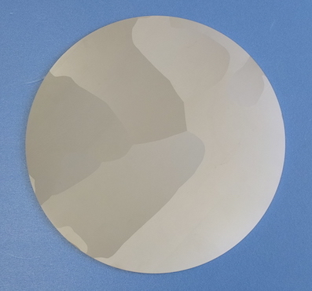
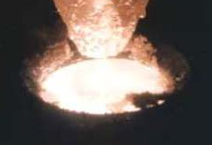
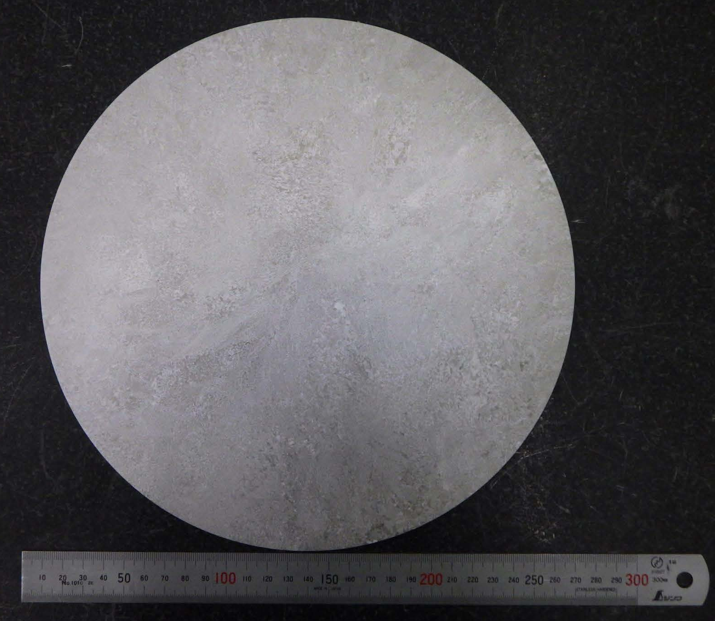
Manufacture methods of Large-Grain / Medium-Grain Nb discs
Presented by Saeki-san
Direct slice of LG ingot
Ingot
Nb melting
LG Nb
Ingot, as it is
Slicing image by wire-saw
Large Grain (LG) Disc
Grain Size >> 1 cm
Aiming for clean, mechanically stable, and cost-effective SRF cavity production.
Direct slice of MG ingot
Ingot
MG Nb
Niobium ingot
(Raw material)
Ingot, forged
and annealed
Slicing image by wire-saw
A New Approach:
Medium Grain (MG) Disc
Grain Size < 1 mm
* The “Nb forged ingot” technology originated by ATI, and SRF (GHz) cavities planned to be fabricated and RF tested by KEK and JLab, to qualify this approach, in collaboration of ATI, ODU/BSCE, JLab, and KEK.

Slide 8

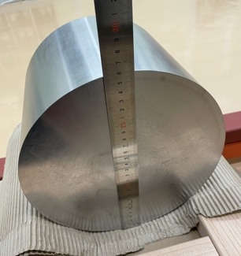
MG-Nb demonstration by
1.3 GHz SRF Cavity at KEK
Presented by Saeki-san
Courtesy: ATI
Sample location from forged ingot
“Nb RRR” Billet, annealed
MG-Nb: Good mechanical uniformity
Parameters | Nb sheet (FG) (Spec. Eu-XFEL as Reference) | Nb forged ingot (MG) Measured
RRR | R_{RT}/R_{4.2K} ≥ 300 | R_{RT}/R_{TC} 450 523
Re-crystallization | 100 % | 100 %
Grain size (ASTM) Edge, Mid., Center | 4 ~ 6 | 2 , 1, 1.5
Grain size (mm) Edge, Mid., Center | < 0.05 | 0.2, 0.25, 0.21
Y.S.-0.2% (RT) | ≥ 50 MPa | 61 MPa
T.S. (RT) | ≥ 140 MPa | 141 MPa
0.02 inch ( 50 μm)
Edge
Mid. Radius
_
260 mm φ
Grain Size: 0.2 ~ 0.3 mm
Mechanical stability
may be expected

Slide 9
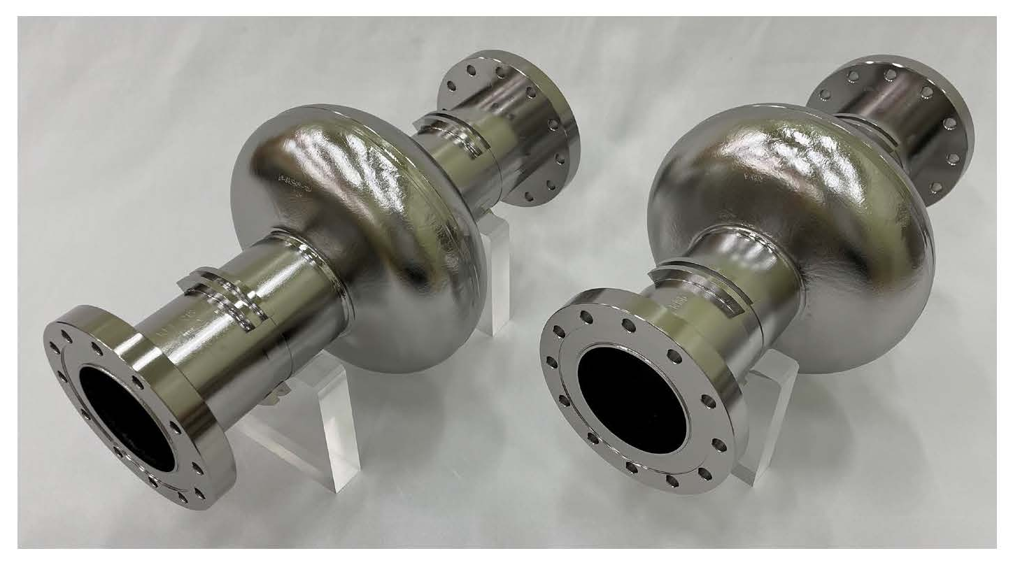
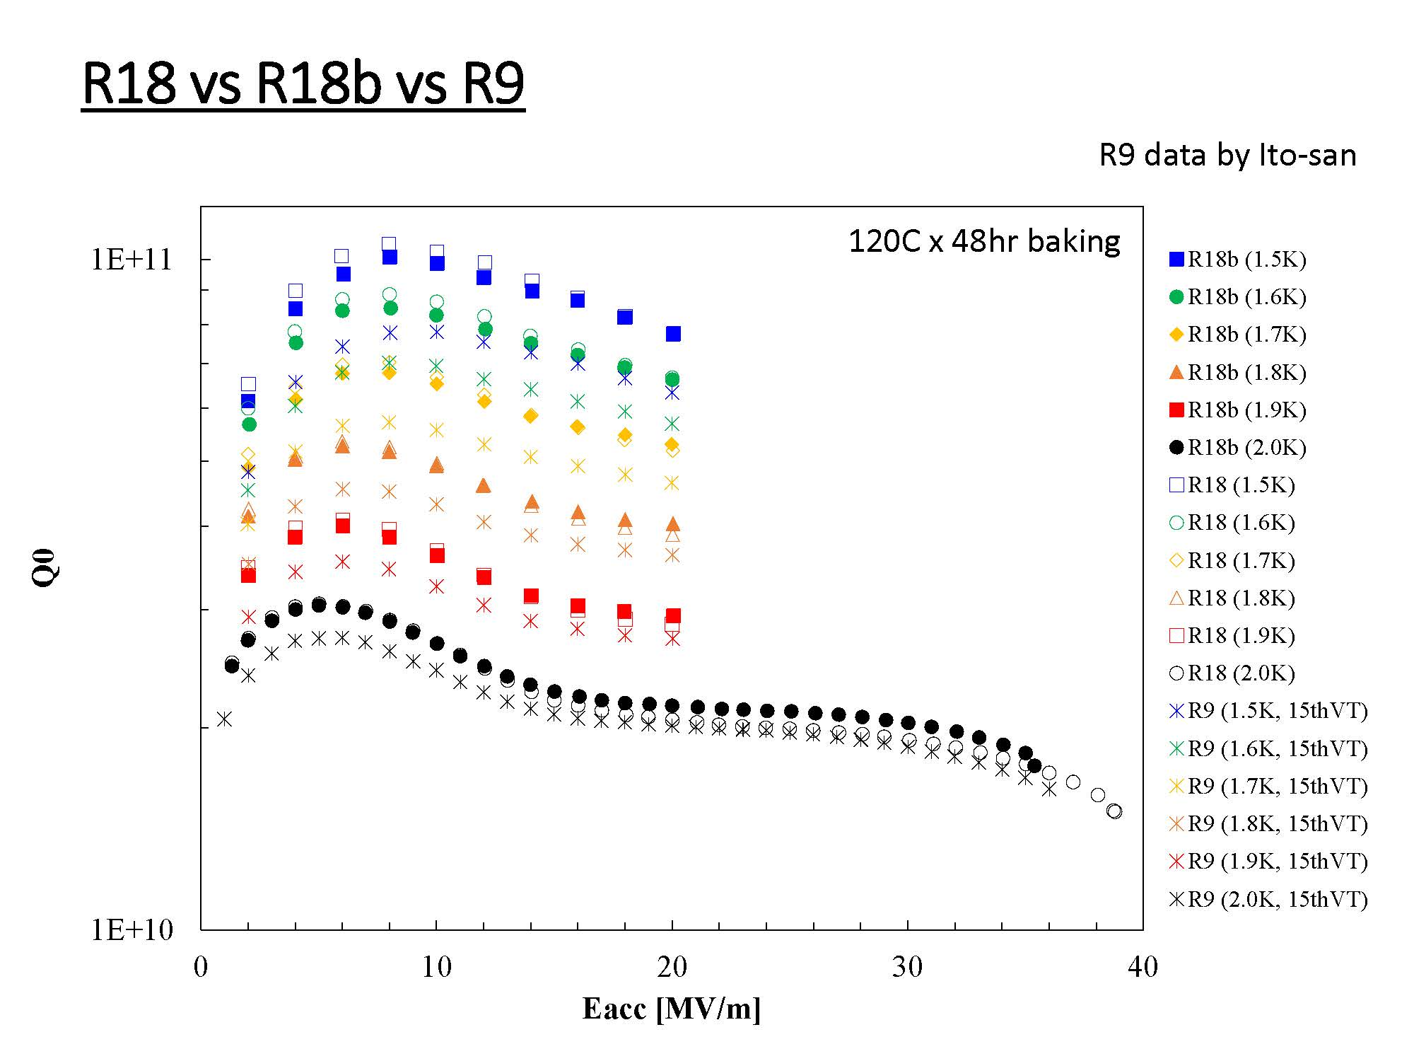
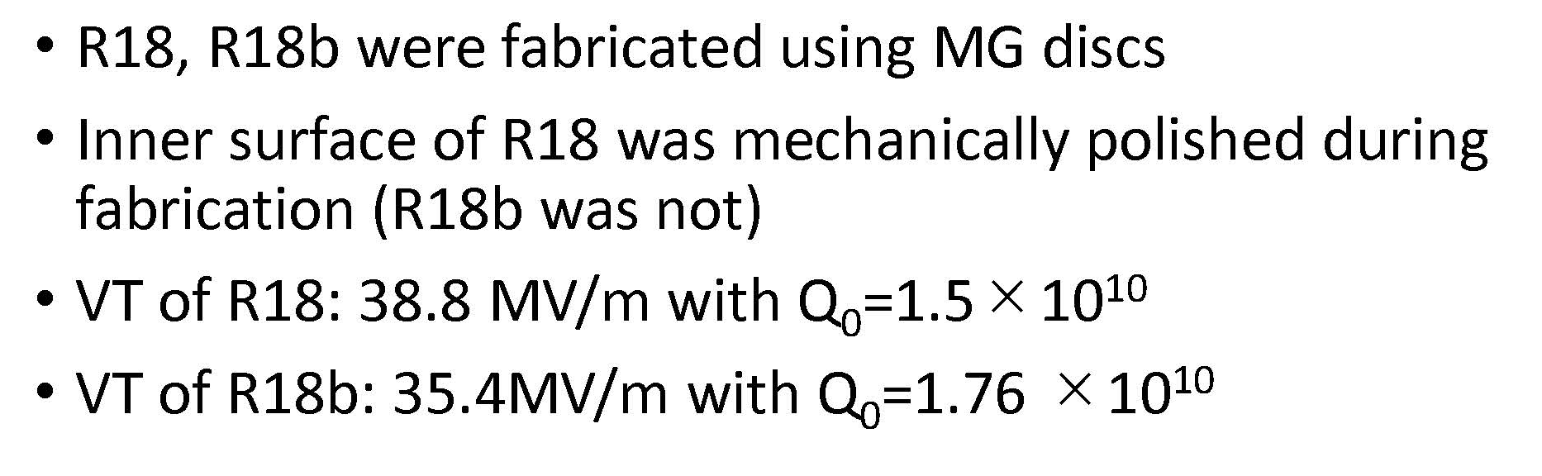
Presented by Saeki-san
MG-Nb material （High-RRR, Low-Ta）
Results of MG single-cell cavities.
R18, R18b (vs. R9 / FG single-cell cavity).
>35MV/m
Two MG-Nb single-cell cavities have reached > 35 MV/m

Slide 10

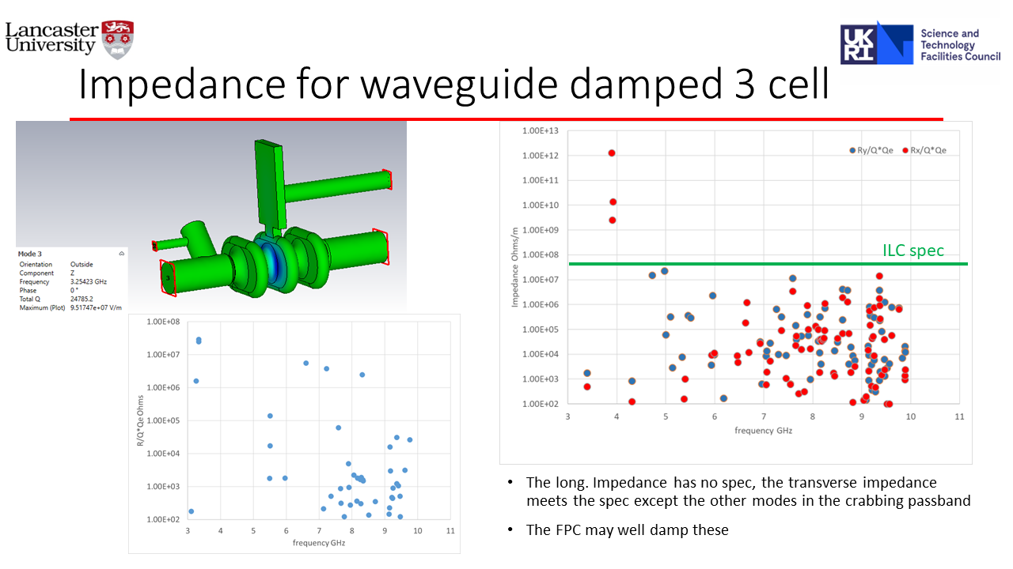
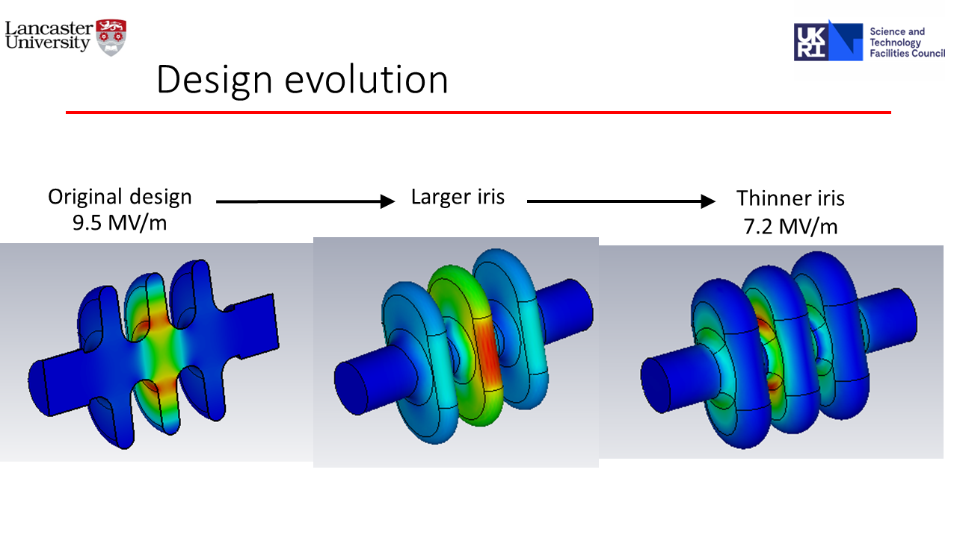
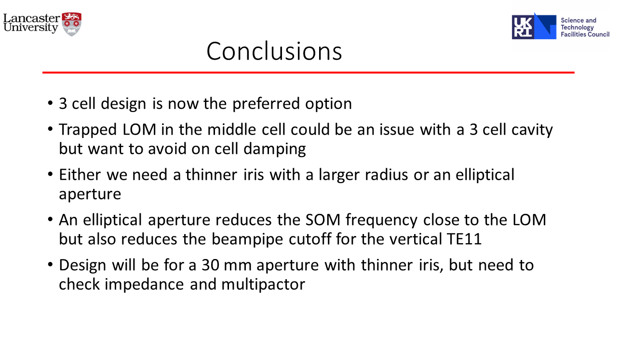

Slide 11
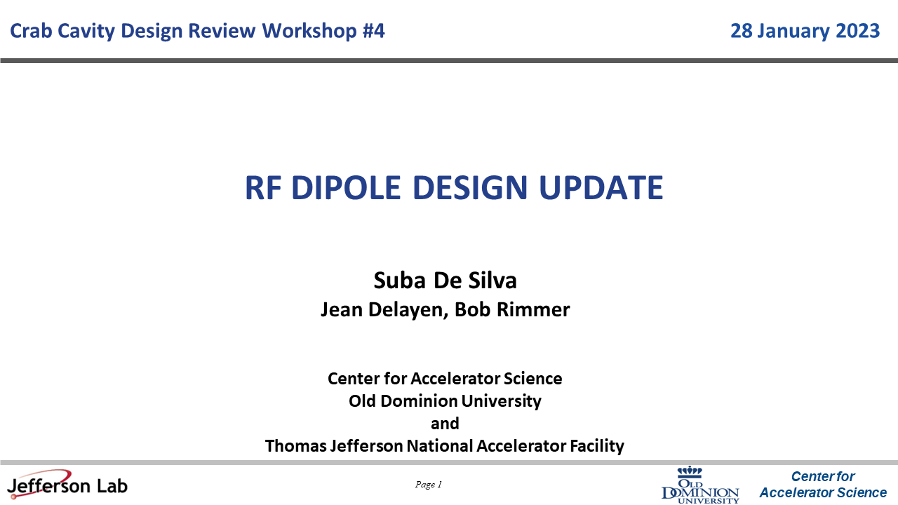
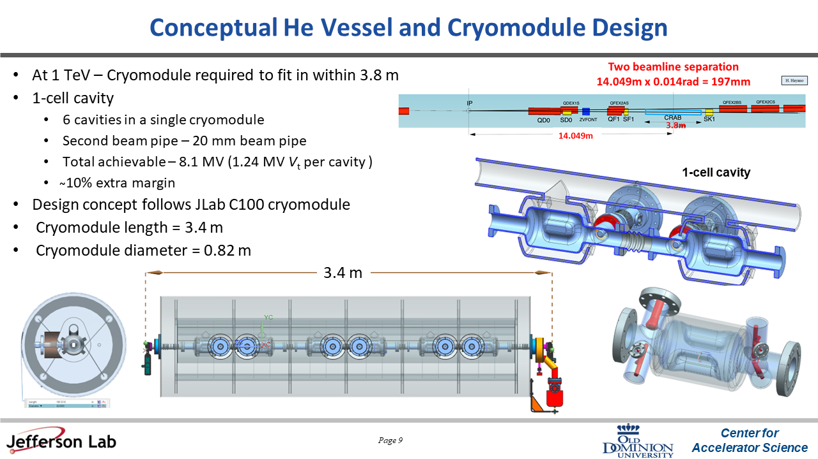
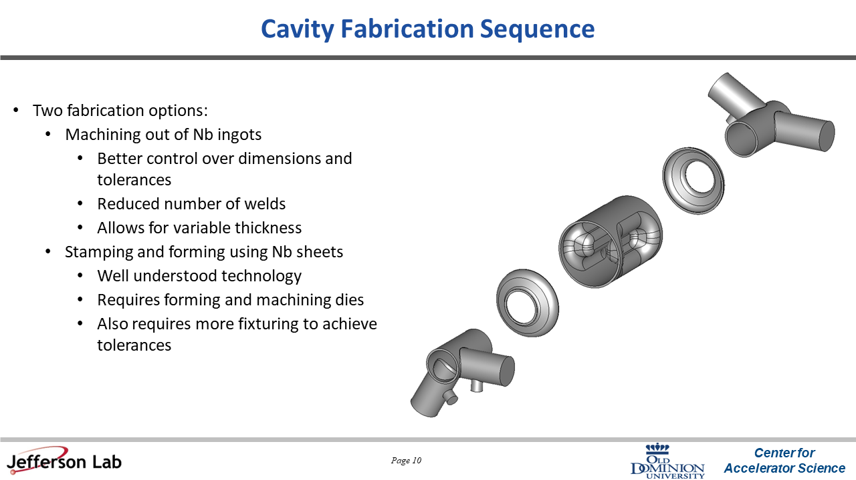
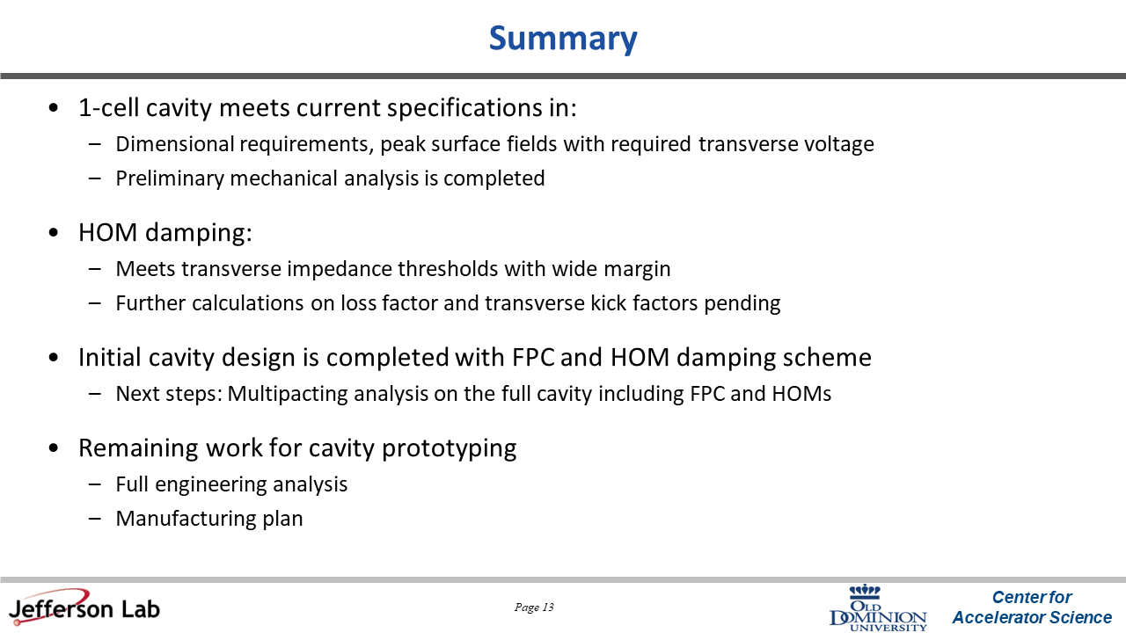

Slide 12
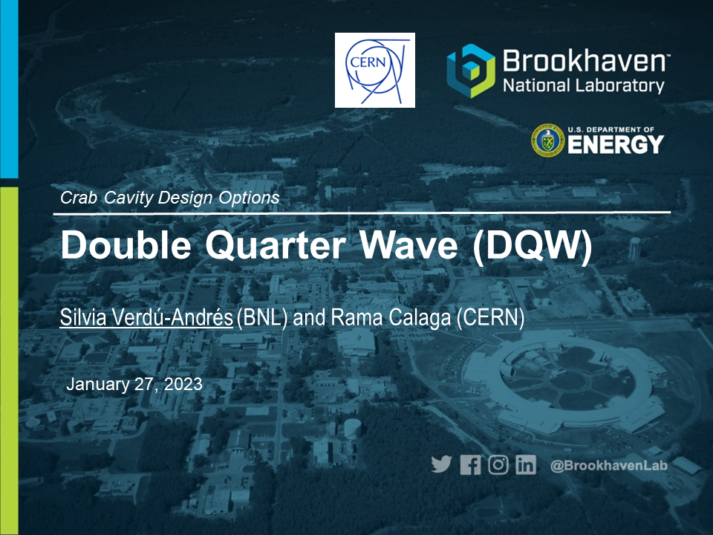
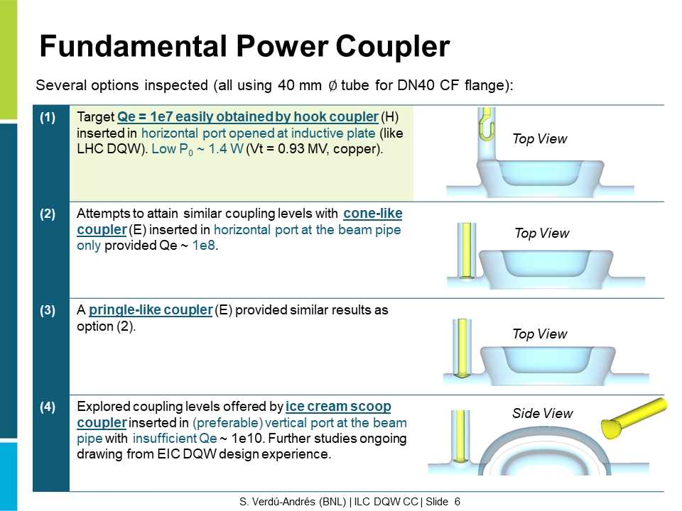
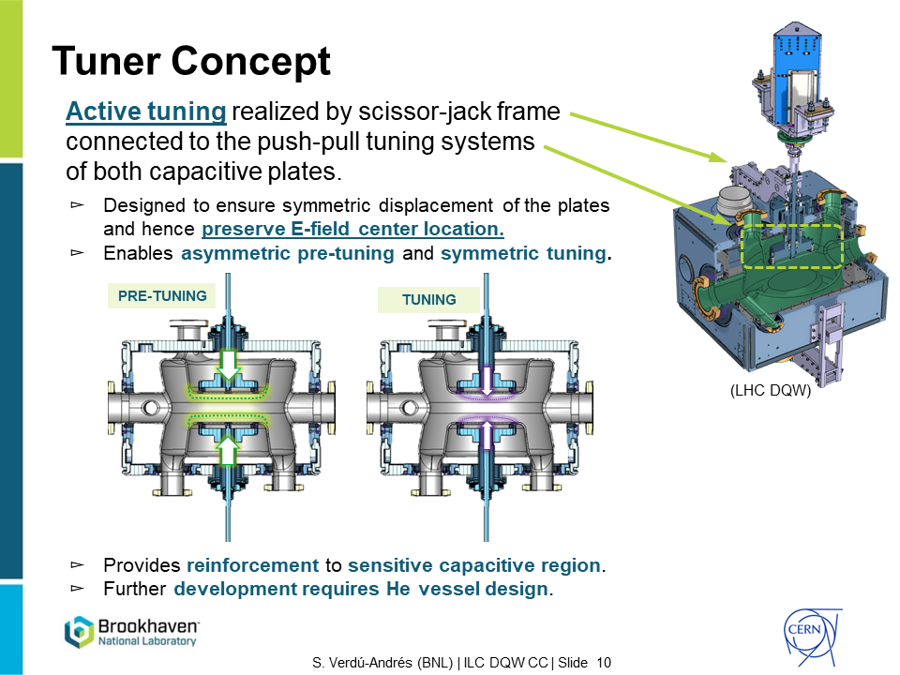
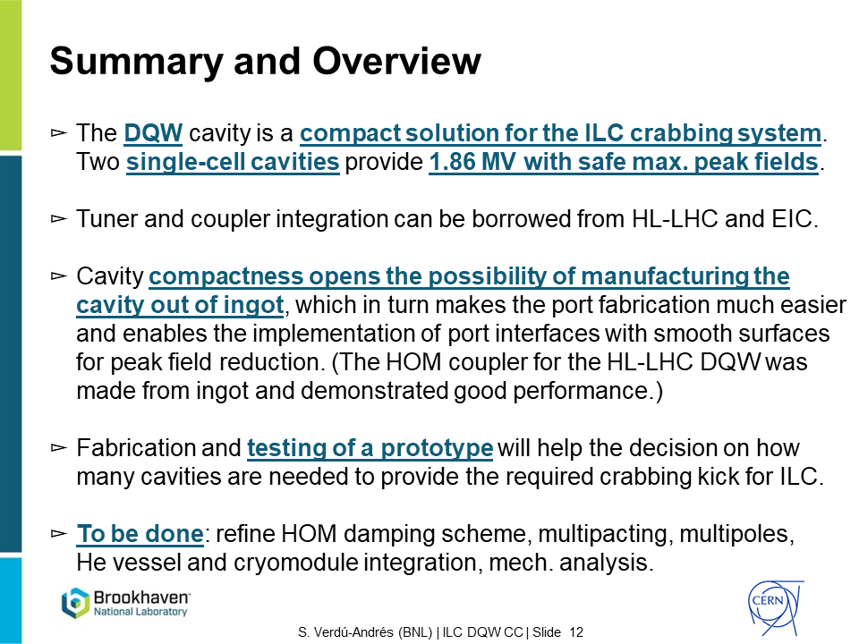

Slide 13
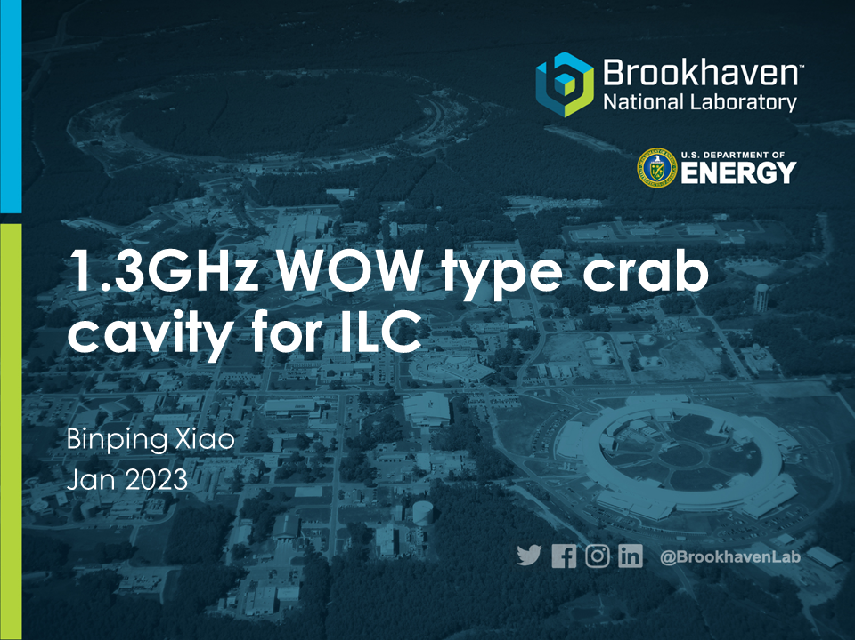
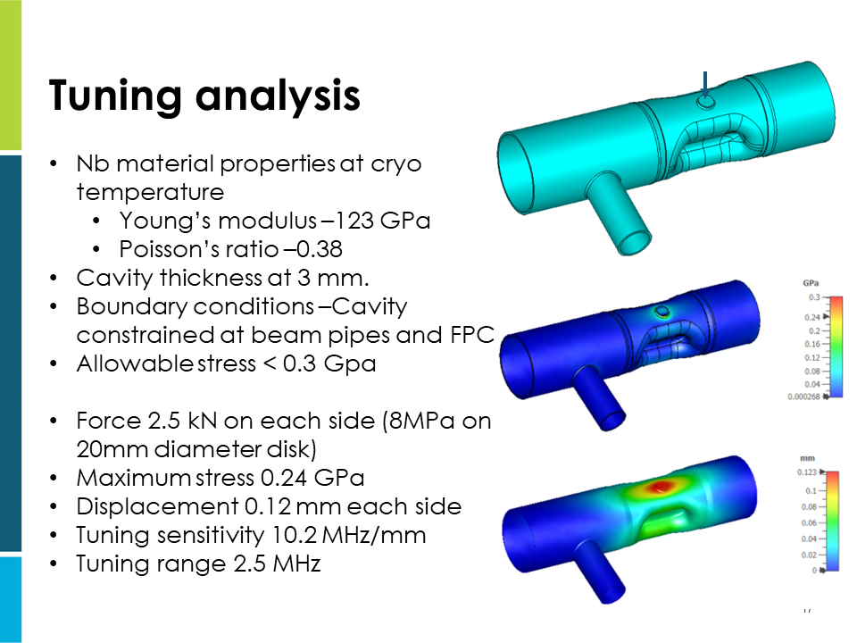
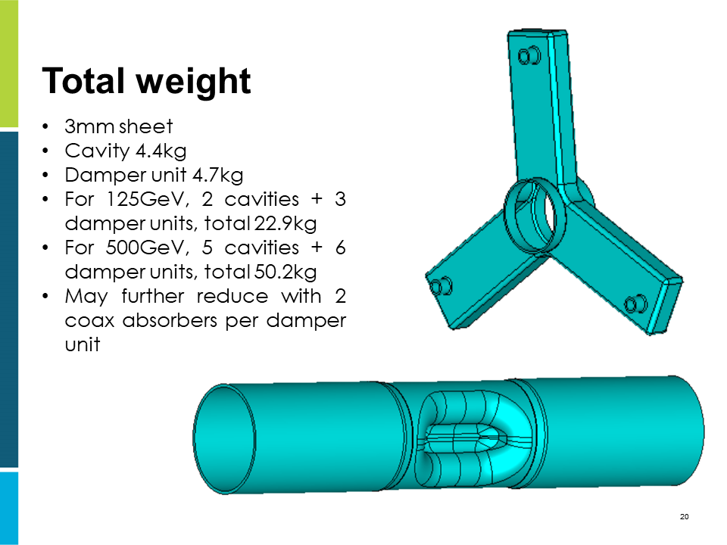
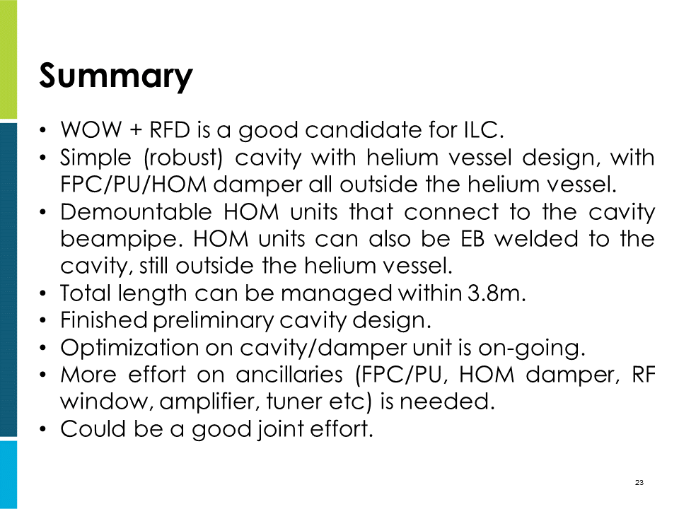

Slide 14
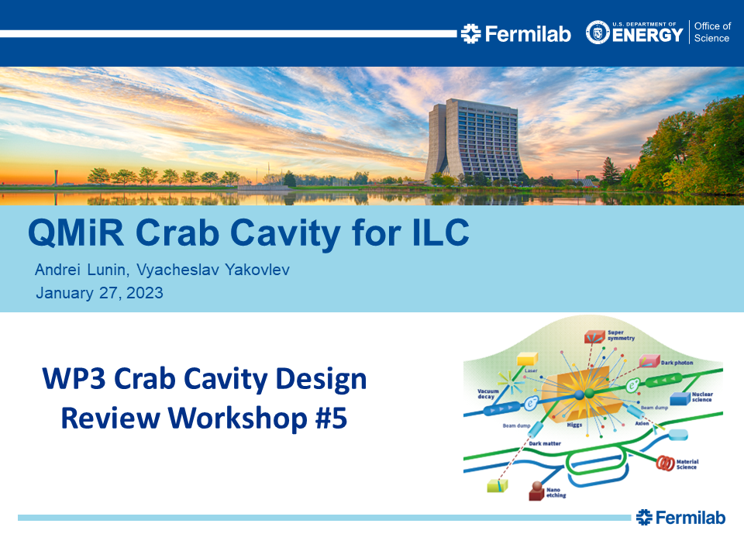
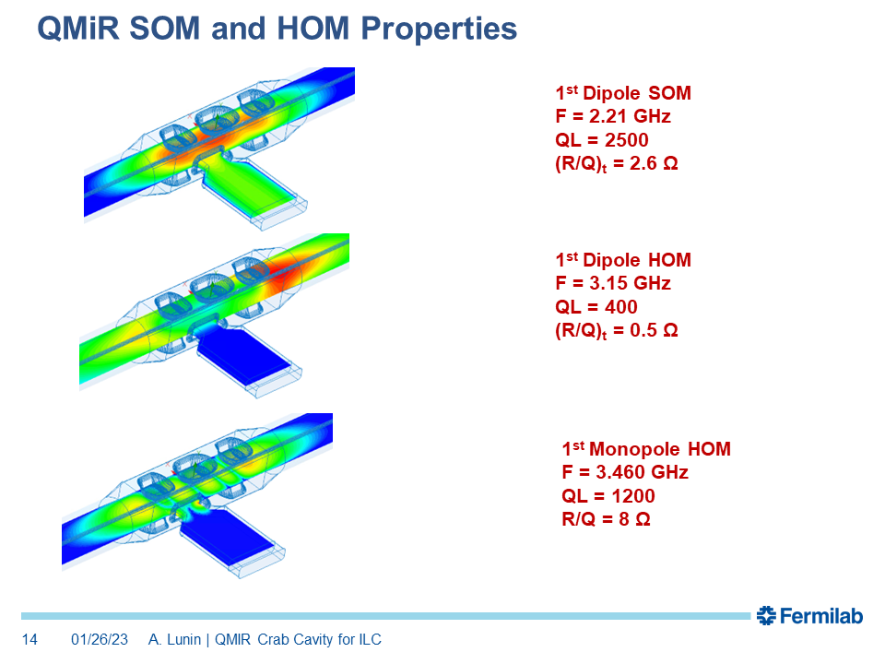
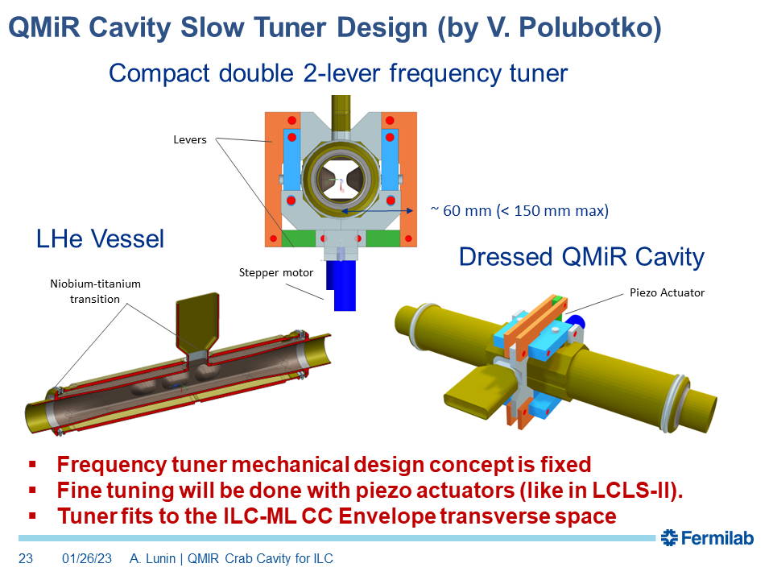
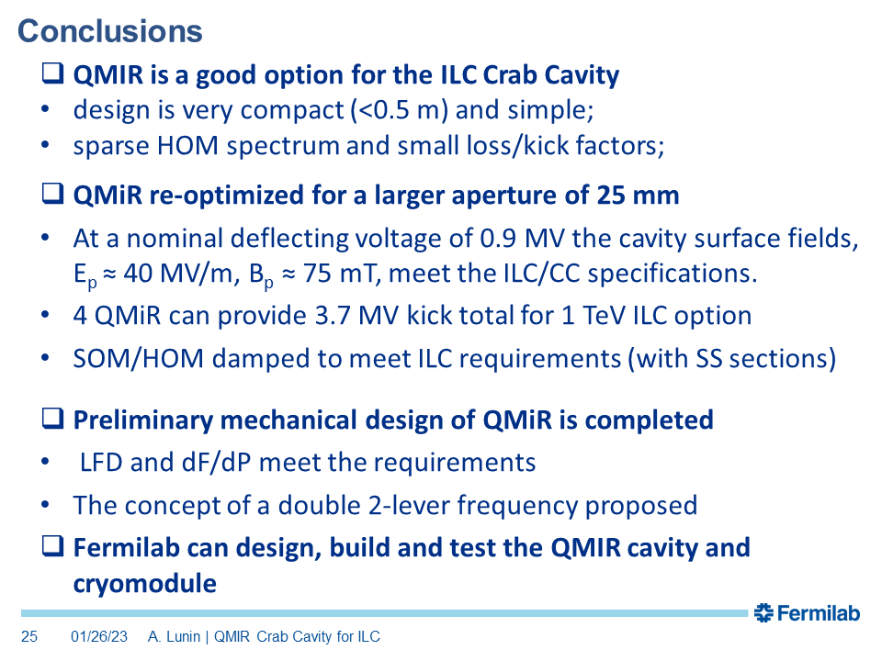

Slide 15

Meeting schedule and recent progress
Meeting # | Date | Contents
34 | 7/Feb | Down-selection review of crab cavity
 | 15~19/May/2023 | LCWS2023 @SLAC
 | 25~30/Jun | SRF2023 @Grand Rapids, MI, US
https://indico.slac.stanford.edu/event/7467/overview

Slide 16
Questions/Suggestions/Comments
Which Nb material (FG or MG) is better will be discussed at the down selection review. It depends on part of CC, such as cavity, beampipe, coupler port.
Plenary talks at LCWS2023 will be fixed soon.

Slide 17
Backup slides

Slide 18
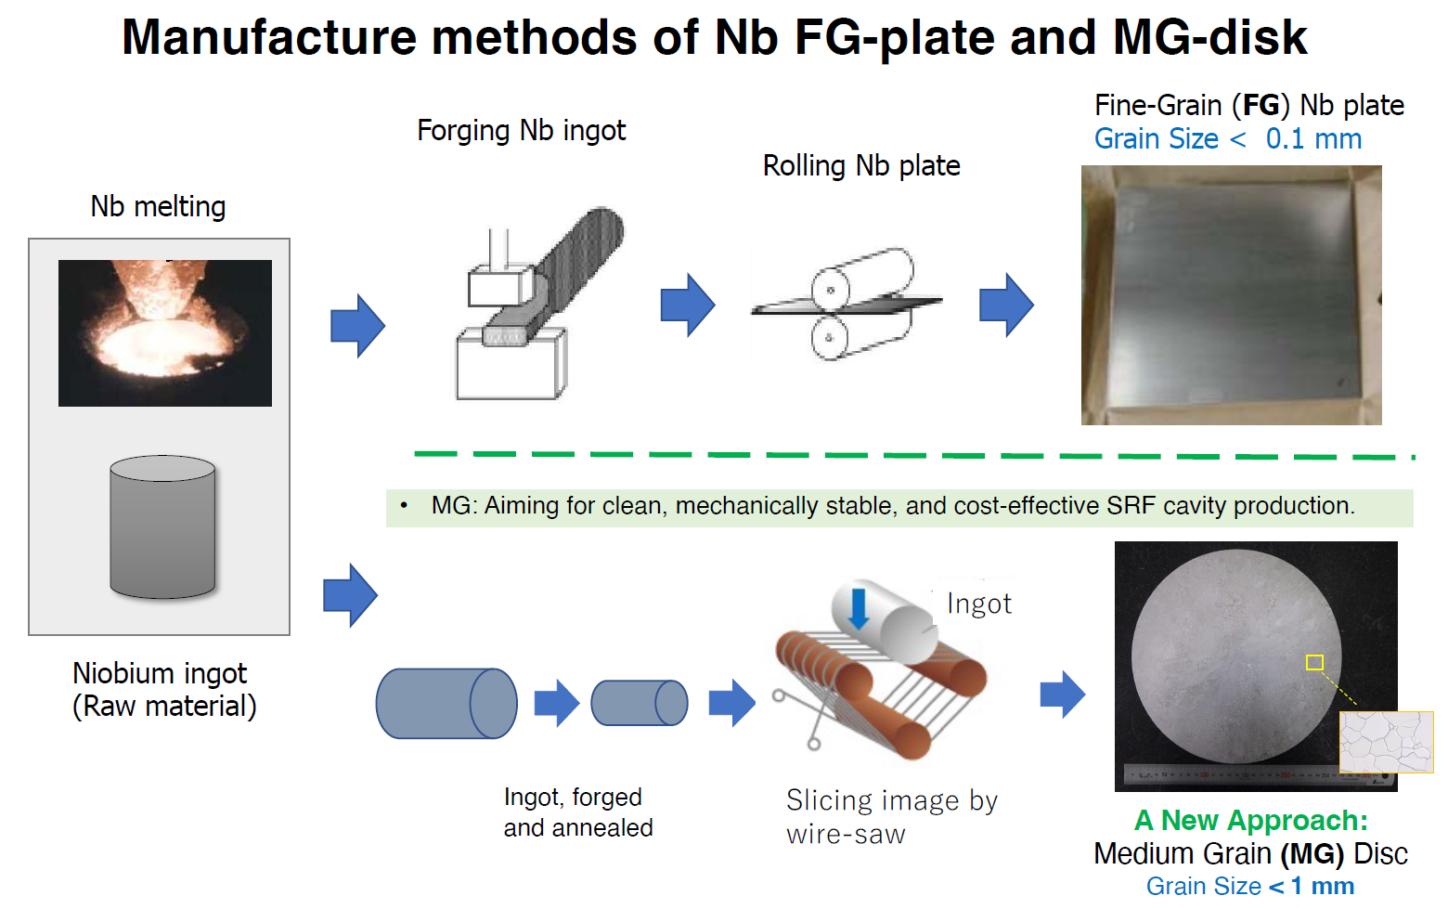


WP-prime 1: SRF Cavity
(Scoping the Industrial-Production Readiness)
Research with single-cell cavities to establish the best production process
  Advanced Nb sheet production method
  Advanced surface treatment recipe
Globally common design compatible with High Pressure Gas Safety (HPGS) regulation
24 nine-cell cavities are to be developed for industrial-production readiness
  8 cavities (4 / batch) in each region
  Production process optimized in each region encouraged
RF performance/success yield to be examined (at least including 2nd pass)
  3rd pass to be examined if effective
 | # of cavities to be produced
 | Americas | Europe | JP/Asia
single-cell | 2 | 2 | 2
nine-cell | 8 | 8 | 8 (+ 12)
Material/Sub-component
QA of Material/Sub-C
Cavity Production
Surface Process
Vertical Test =
Cavity RF Test
Production process
18

Slide 19
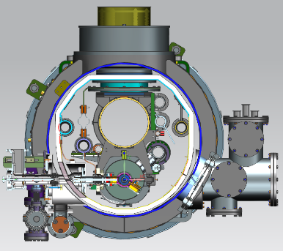
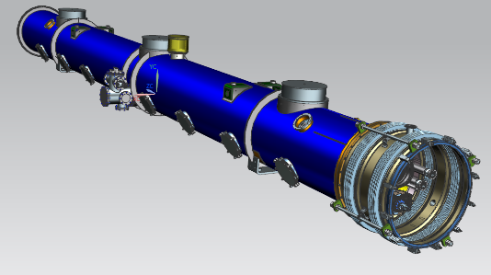
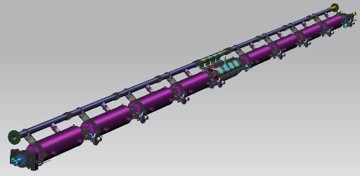
WP-prime 2: Cryomodule (CM) design
(Scoping the CM Global Transfer and Performance Assurance)
We will produce first CM!
Unify cryomodule (CM) design with ancillaries, based on globally common drawings and data-base
Establish globally compatible safety design to be approved by HPGS regulations individually authorized in each region.
Cavity string
Ancillaries:
SC mag., tuners, couplers
CM outlook with vacuum vessel
 | Americas | Europe | Japan/Asia
CM tech. design base | LELS-II | Euro-XFEL | ILC-TDR
HPGS regulation base | ASME | TÜV and EN | JP-HPGS act
ILC CM design | Common CM design globally adaptable to HPGS regulation in any regions
19

Slide 20
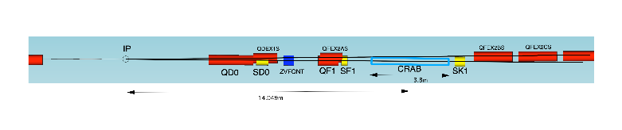
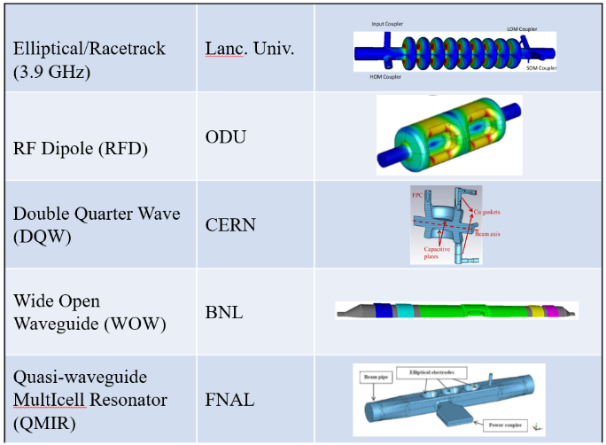
WP-prime 3: Crab Cavity Development with down-selection
RF property simulation to optimize cavity design
Pre-down-selection to choose two primary candidates
Development and evaluation of two prototype cavities
Demonstration of synchronized operation with two prototypes
Down-selection to choose final cavity design
Cryomodule design based on final cavity design
two beamline distance
14.049m x 0.014rad = 197mm
Item | Recent specification (after TDR)
Beam energy | 125 GeV (e⁻)
Crossing angle | 14 mrad
Installation site | 14 m from IP
RF repetition rate | 5 Hz
Bunch train length | 727 μsec
Bunch spacing | 554 nsec
Operational temperature | 2.0 K (?)
Cavity frequency | 1.3/3.9 GHz
Total kick voltage | 1.845/0.615 MV
Relative RF phase jitter | 0.023/0.069 deg rms (49 fs rms)
20

Slide 21
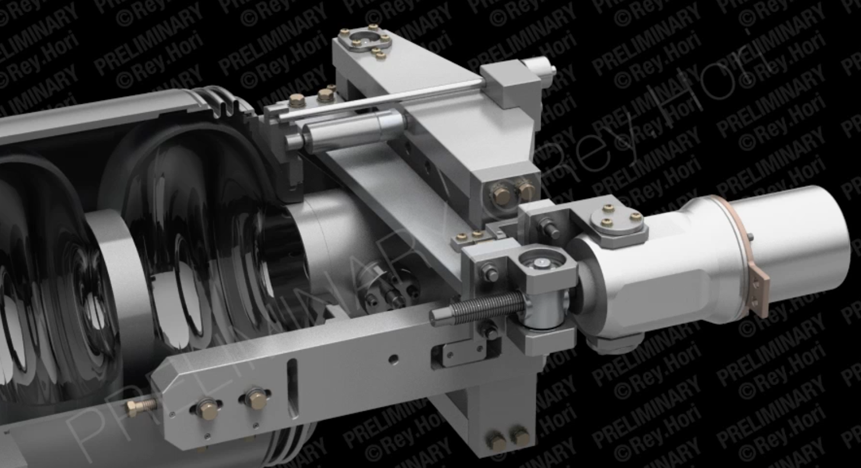
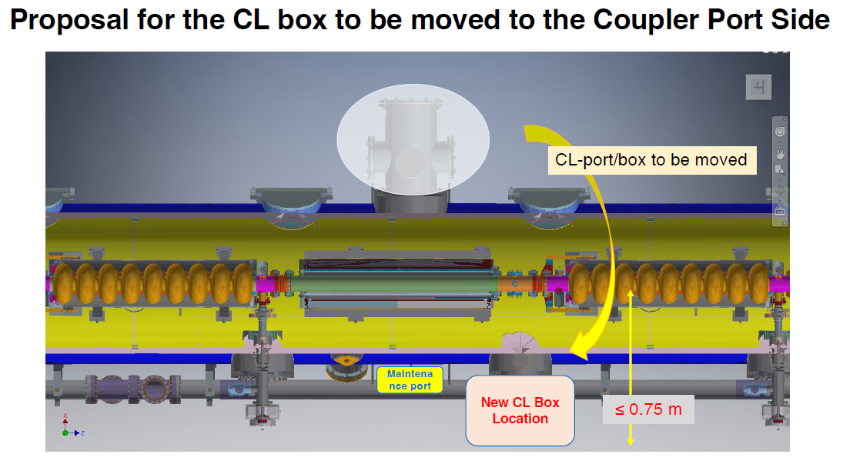
Change requests related to SRF
If KEK has enough budget from next FY, we’d like to start cavity/CM production as soon as possible.
Then, we have to decide the design of cavity/CM including tuner/coupler/magnet.
Currently, we have two change requests related to tuner/helium tank and position of current lead box for Q-mag.
LCLS-II tuner has worked with high reliability,
but there is no experience in pulsed mode operation.
We need to check this with first CM.
CM design is already completed, but we have to design outside components, that is, waveguide system, pumping system for power coupler, current lead box, etc.
We need more detailed drawing.
LCLS II (HE)/FNAL’s
N=320 units+ 180units

Slide 22
Conclusion/Suggestion
Currently, it’s difficult to submit these change requests before cavity/CM production.
After CM test and more detailed drawing completed, we will/can submit the change request.
I’d like to obtain your agreement on this policy including the cavity/CM design within this year.
If you like to check the 3D model developed by FNAL/KEK, I can provide to the SRF group.

