Slide 1
Japanese funding for ILC R&D and CERN’s role
Steinar Stapnes
CERN Council session 23.03.2023

Slide 2
The ILC IDT organization – following the ICFA meeting at SLAC February 2020
2020: The IDT – created by ICFA and hosted by KEK – prepared the ILC Preparation Phase plan (“Pre-lab”), which would over a ~4 year period, lead to a complete Engineering Design as needed to start construction of the ILC.
Late 2020 - early 2021: The plan was reviewed by a MEXT appointed panel and deemed premature, referring to that the prospects for an international cost sharing for ILC were not clear. However increased support for technical developments and accelerator R&D was recommended.
During 2021- early 2022: Within the IDT a subset of the technical activities of the full preparation phase programme has been identified as priorities, to be addressed with an international effort. The required resources are at ~1/3 level of the original plans. The activities planned are foreseen to take 2-4 years.
Second half of 2022: These plans were included MEXT budget request and has been approved by the Finance Ministry. The funding can become available in May 2023 (DIET approval needed). It will double the KEK resourced available for ILC preparation, and in particular provides important new funding for ILC relevant hardware developments.
Some parts of this funding can be used to foster international collaboration and efforts.
The budget needs to be approved yearly, but the programme is set up for five years.
We call the “project” the ILC Technology Network (ITN), and this presentation (briefly) summarized the work foreseen, focusing on the European efforts.

Slide 3
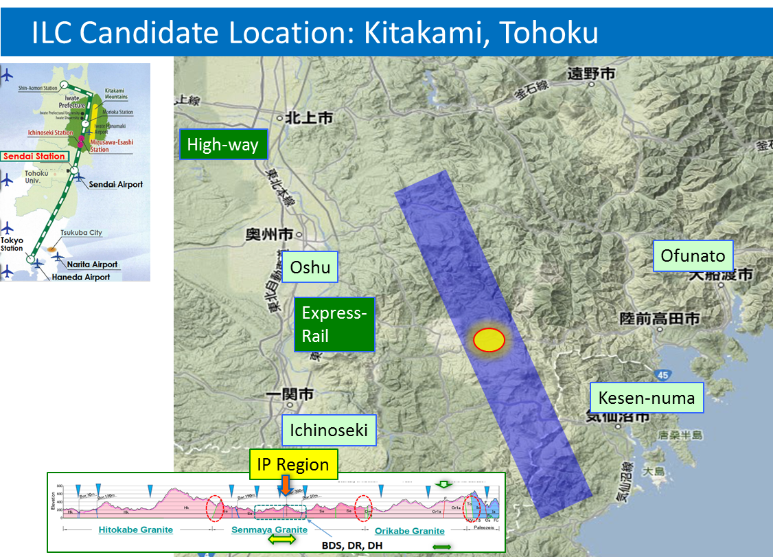
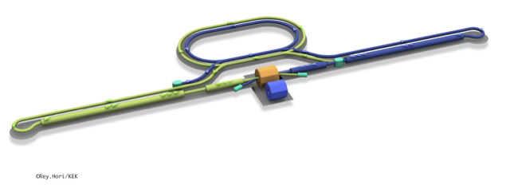
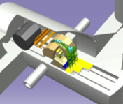
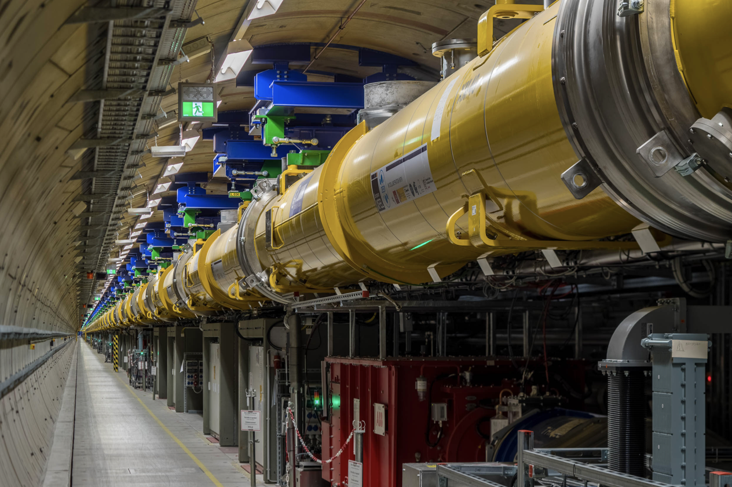
The ILC250 accelerator facility
ITN focus areas
Interaction point
Damping Ring
e+ Source
Item | Parameters
C.M. Energy | 250 GeV
Length | 20km
Luminosity | 1.35 x10³⁴ cm⁻²s⁻¹
Repetition | 5 Hz
Beam Pulse Period | 0.73 ms
Beam Current | 5.8 mA (in pulse)
Beam size (y) at FF | 7.7 nm＠250GeV
SRF Cavity G. Q₀ | 31.5 MV/m (35 MV/m) Q₀ = 1x10 ¹⁰
e- Source
e- Main Linac
Beam dump
Physics Detectors
e+ Main Linac
Bunches of ~10¹⁰ e+/e-
Undulator positron source
Creating particles Sources
  polarized electrons/positrons
High quality beam Damping ring
  low emittance beams
Acceleration Main linac
  superconducting radio frequency (SRF)
Collide them Final focus
  nano-meter beams
Go to Beam dumps

Slide 4
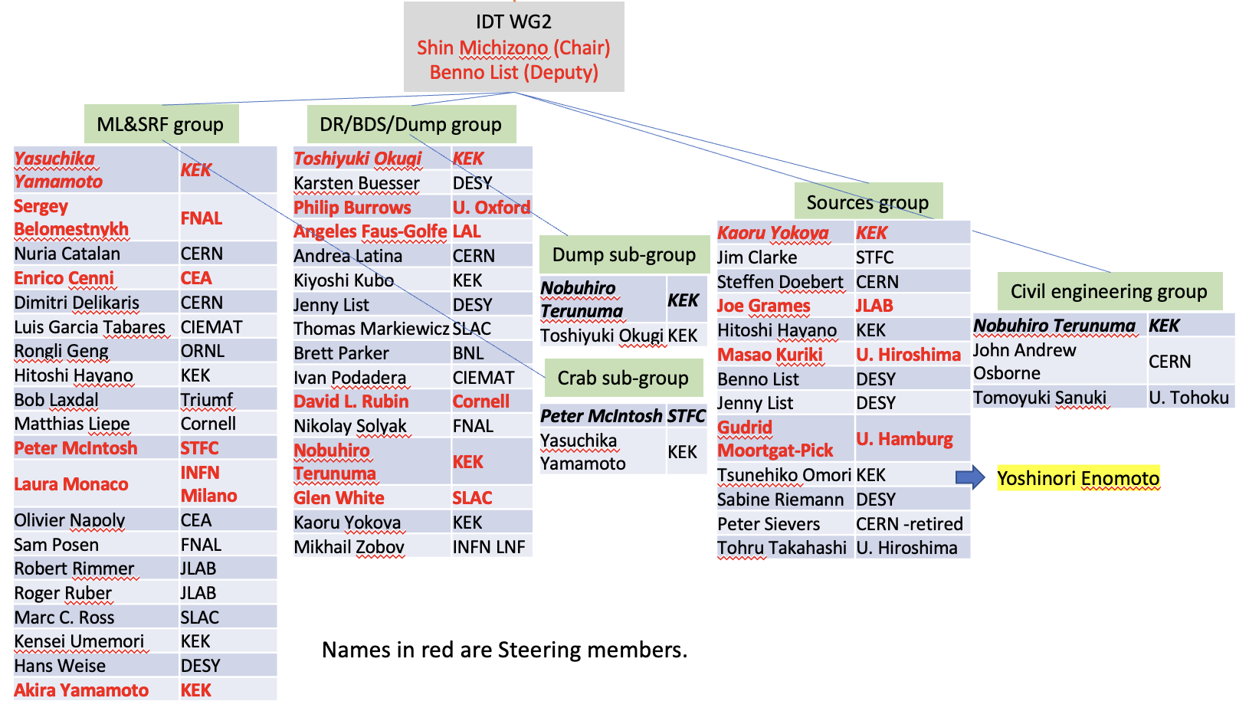
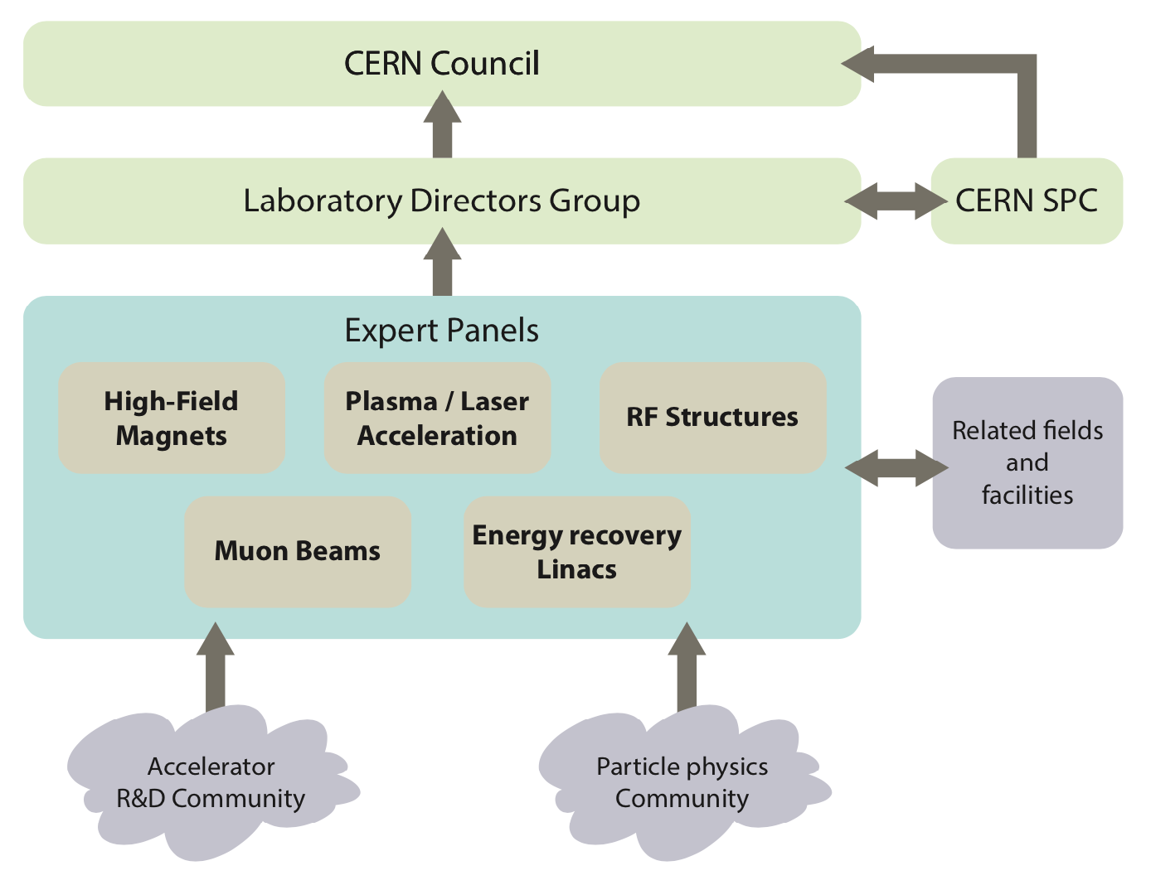
Within IDT, 2020 -> today:
Established European Representation and contribution to all WGs making sure lab and university capabilities and interests were reflected in the planning.
CERN-KEK ICA appendix covering CERNs role in the IDT, also its role in European coordination, communication and planning. This is organized as part of the Linear Collider Study at CERN, as also described in the recent MTPs.
Focus on Europe
The initial plan for the ILC preparation phase activities (“Pre-lab”), and the priorities currently emphasised in the ITN, have been worked out by the IDT-WG2.
The WG2 group has important European involvement in the ITN planning.
European Preparation for the ITN (2023 ->):
A model for European participation discussed in a series of ILC Europe meetings (covering all aspects of European ILC activities) – see the following slides. The model has also been discussed with KEK and in the ILC IDT.
In parallel discussions took place between CERN (Fabiola Gianotti), KEK (Masanori Yamauchi), Mike Lamont (CERN-ATS), Tatsuya Nakada (IDT chair) and myself on a resource contribution to Europe by KEK, how to implement it and to start the European activities.
Information about the ITN status sent by e-mails to the laboratory managements most concerned mid 2022, and presented to the full LDG in November 2022
Reminder: ITN is not only relevant for ILC, it is also relevant for our R&D planning and technology expertise and interests of many European labs and industries (and also other projects related to the technologies pursued).
Notes:
Split in two slides?

Slide 5
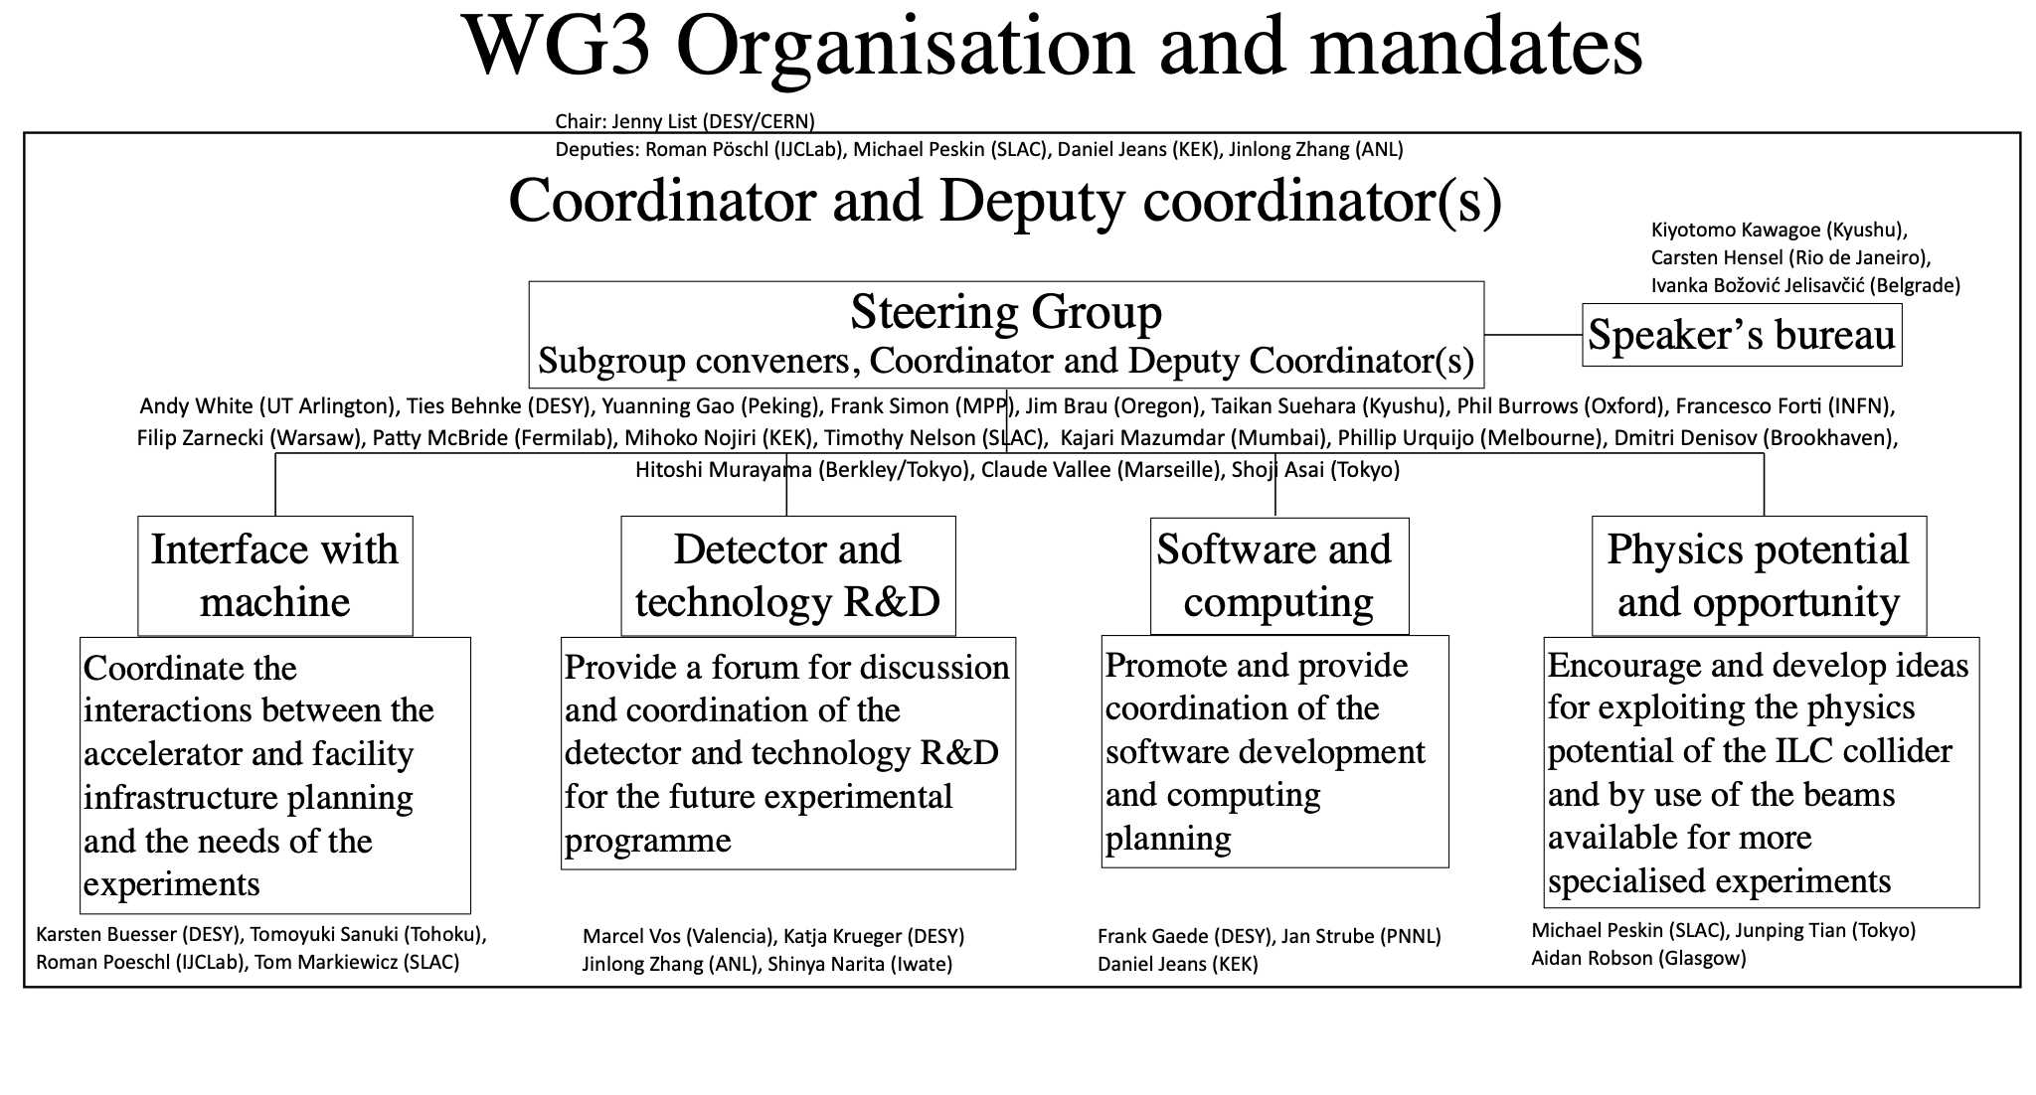

Slide 6
European Organisation of the ITN programme
CERN plays coordinating and facilitating role
KEK contributes to the material costs
Main contract for flow of funds between CERN and KEK*
  CERN-KEK ILC IDT agreement already extended by 2 years
  New agreement being prepared for ITN, describing the European programme, allowing funds to be transferred
Subsequent contracts* – similar to what is done for other studies for future colliders – between CERN and European Labs in the cases where money flow is needed (limited number)
Establish a light distributed Project Office, administratively anchored to CERN, to follow up the work.
Aim to involve CERN personnel, fellows, PJAS within the current LC resource planning at CERN (in many cases using long term collaborative links and common studies between CLIC and ILC). This is possible without perturbing the overall LC study resource allocation.
*Additional collaboration agreements between KEK and FA/countries might be very beneficially, where these activities are recognised directly
CERN
KEK
Lab/Univ/FA n
Lab/Univ/FA 1
Notes:
Please comment

Slide 7
The European activities, and resources
Personnel with interest and skills in European labs/Univ., local infrastructure
Material funds as estimated (major/core part from KEK), in some cases complemented by local funding
EAJADE, MC exchange project supporting Higgs factory personnel exchange to Japan and the US
CERN LC, project office (within existing LC resources at CERN)
European presentation of ILC studies, distributed on five main activity areas (see more details in slides below):
A1 with three SC RF related tasks
SRF: Cavities, Module, Crab-cavities
A2 Sources
Concentrate on undulator positron scheme, consult on conventual one (as used by CLIC and FCC-ee)
A3 Damping Ring including kickers
Low Emittance Ring community (many studies in CLIC and FCC-ee)
A4 ATF activities for final focus and nanobeams
Many European groups active in ATF
A5 Implementation including Project Office
Dump, CE, Cryo, Sustainability, MDI, others (many of these are continuations of on-going collaborative activities)
EAJADE: Information at LINK
Notes:
Shorten text on left ?

Slide 8
Resource estimate (core) for Europe
Estimated material funds 4 MCHF over 4 years
Top-down estimate of technical personnel purely for ITN deliverables ~30 FTY-years
This rests of basis of technical expertise, infrastructure and technology in the European labs/Universities/Industries which are not included in this resource overview, plus the scientific community, including students, involved in ILC related studies .

Slide 9


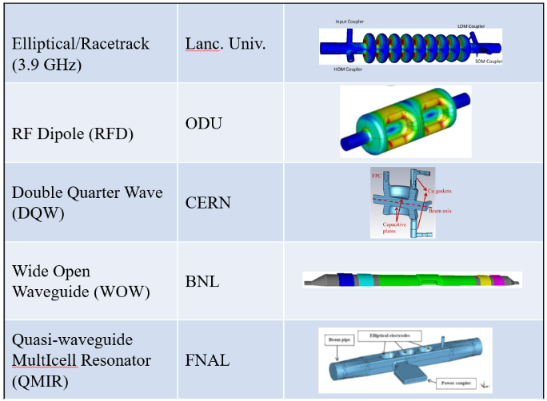
A1: SRF Cavities, Cryomodule design, Crab cavities
Crab cavity down-selection, including developments of evaluation to choose final cavity design
Cryomodule design based on final cavity design
Unify cryomodule (CM) design with ancillaries, based on globally common drawings and data-bases.
Group involved on European side in discussions
of the programme: CEA, INFN Milano primarily
Also potentially: DESY, IJClab, STFC/Daresbury+Lancaster, Uppsala, ....
Also CIEMAT and IFIC (main linac SC magnets and instrumentation)
SCRF (Grad, Q) is a priority for most future high energy accelerators, also beyond HEP
Group involved on European side in discussions
of the programme: STFC/Daresbury and Lancaster Univ, and CERN
Links to general studies of crab cavity solutions:
(among others for HL-LHC, EIC and Elettra2.0)

Slide 10
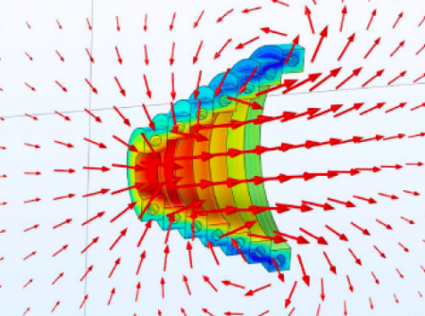
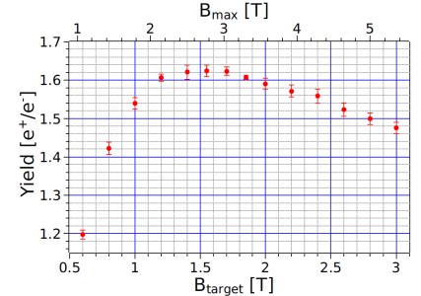
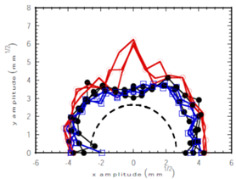
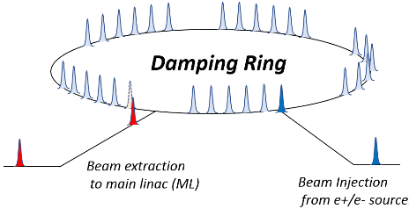
A2: Positron Source
A3: Damping Ring optimization and injection/extraction
A priority item for the undulator scheme is the magnetic focusing system (OMD) right after the target
The main candidate is a pulsed solenoid (PS), design and prototyping
The ILC damping ring (DR) is required to satisfy the low emittance and the large dynamic aperture simultaneously.
The ILC DR will be further improved by incorporating the findings of the latest light source design. Increasing the dynamic aperture is also important in the design of DR.
The technical evaluation of the fast kicker power supply.
Yield versus field on the target
ILC fast injection/extraction system
1
Group involved on European side in discussions of the programme:
Univ. of Hamburg, DESY, HZ Dresden-Rossendorf, SKF Jülich and possibly others.
For polarized positrons, providing physics advantages, linking also to FEL/undulators studies.
Many group can find this interesting and have capabilities to do it, there is a large and well organised low emittance ring community in Europe – and many also with experience from similar studies and prototyping for CLIC and FCC-ee.

Slide 11
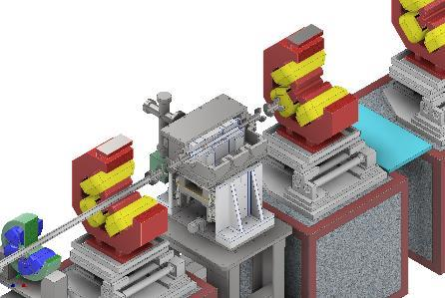
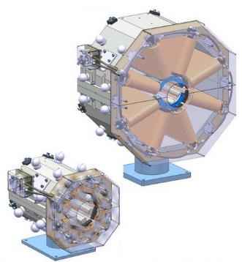
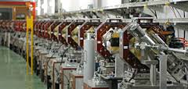
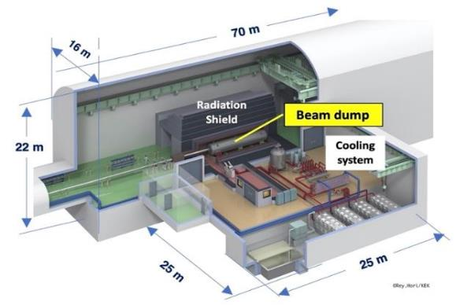
A4: ATF3 (final focus, nanobeams)
A5: Implementation studies
ATF2 beamline at KEK is the only existing test accelerator in the world to test the final focus system (FFS) of linear colliders.
The following 3 research topics are important topics to be pursued at the ATF; wakefield mitigation, correction of higher-order aberration, ILC beam tuning studies
ITN integration activities – in Europe and within international effort, and interfaces to other ILC activities and related R&D studies
Project Office to follow the effort, base@CERN but distributed, liaison with EAJADE, communication, and the KEK-CERN offices
Link to existing collaborative efforts on CE and Cryo (CERN, DESY, KEK)
Common studies CLIC/ILC on sustainability issue (ongoing), e.g. power, energy and running models, CO2 (sustainability is also an EAJADE WP), beam-dump engineering studies.
  the four activities above are all addressing optimisation of lum. to power, and/or power consumption directly for ILC
  will also connect to green ILC studies in Tohoku within EAJADE (e.g. facility integration in local environment and infrastructure, carbon emission goals, power availability and sources)
Connecting to ILC physics and detector developments, in particular MDI (also a focus of EAJADE)
Wakefield test station
Octupole magnets
for higher-order
aberration
ATF2 beamline
Very relevant studies for any linac and Higgs factory closely related to low emittances and nano beams, e.g. alignment, stabilisation, instrumentation, beam-dynamics, etc.
Strong European leadership with several group from France, UK, Spain, Germany and also CERN, also extensively used for PhD training
Supported also by MC researcher exchange programme and EAJADE (LINK)
Involved: CERN, EAJADE community, distributed project office, A1-A4 responsible.
Many of these topics are related to exploiting communalities between EXFEL, HL-LHC or CLIC and ILC and are continuations of collaborate work.

Slide 12
Concluding words and next steps
Initial planning in Europe for ITN well underway
  Agreement draft CERN - KEK mid April
  Contribution to the material cost from KEK starting ~mid 2023
  Converge on European planning such that draft research contracts CERN and European partners can be drawn up on this timescale (initially for SCRF cavities and pulsed magnet)
  LC planning at CERN in agreement (requires some adjustments 2023-25), helped by EAJADE (EU funds).
The programme is very well aligned with European accelerator R&D priorities (for Higgs-factories and LDG roadmap), and builds on existing expertise, industrial capabilities and infrastructure – and a long history of technology developments for SC linacs and ILC in Europe
  SC cavities (word-wide) are predominantly produced by European industry (RI and Zanon)
Important extension of accelerator R&D collaboration between Japan and Europe (and similarly Japan – US)
Concerning the LDG accelerator roadmap, the primary – but not only – link is to RF. The work also has R&D elements related to plasma, energy recovery, magnets and muons.

